Slide 1
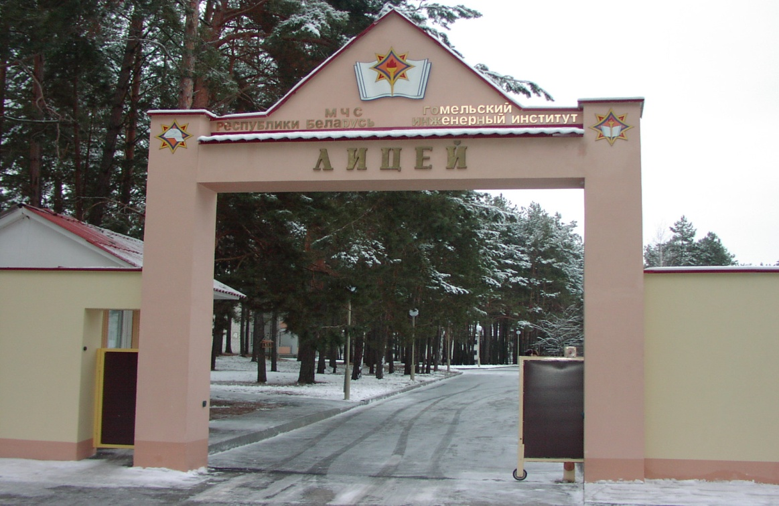
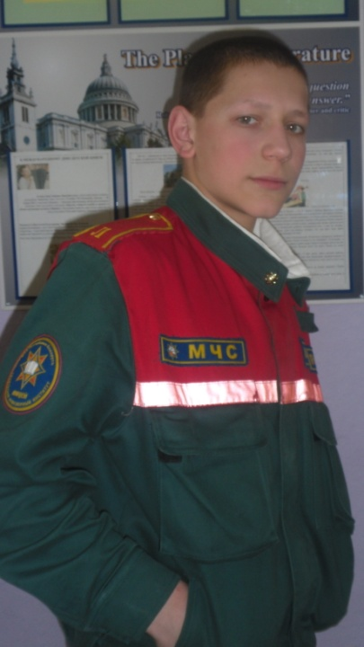
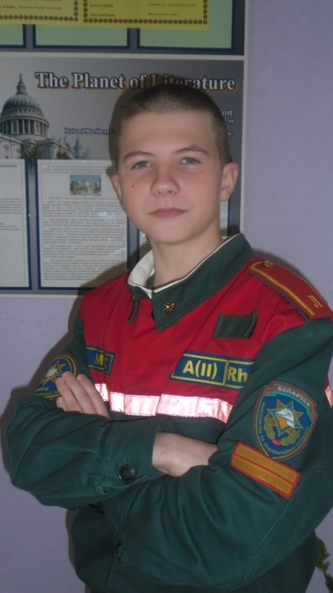
Dear friends,
Our names are Ilia Maksimov and Semyon Kastritskiy,
we are 2nd course students of the Lyceum of Ministry of
Emergency Situations of the Republic of Belarus,
and we`ve written this article about
the environmental issues of Gomel.

Slide 2
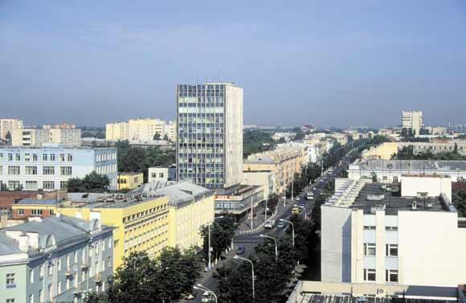
The Environmental Issues of Gomel, Belarus:
Chernobyl Catastrophe and the Present
We live Gomel. It is a beautiful city in the southern-eastern part of Belarus.

Slide 3
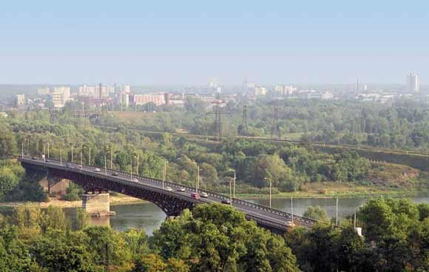
Gomel stands on the river Sozh, has long wide streets, nice parks and squares, and the landscape near it is very picturesque.

Slide 4
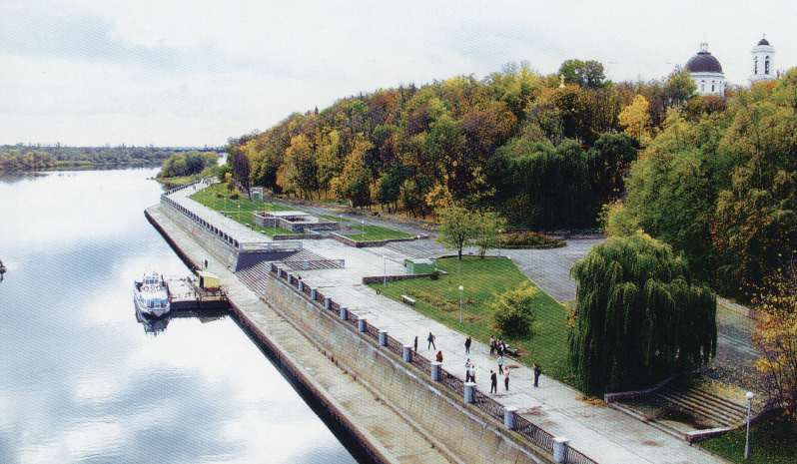
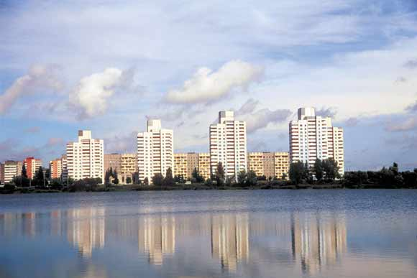

Slide 5
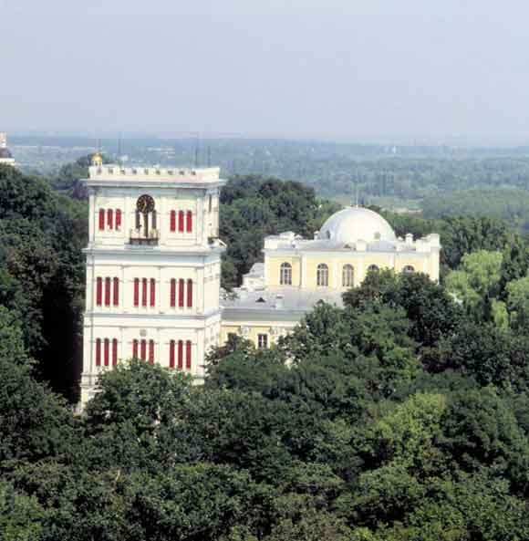
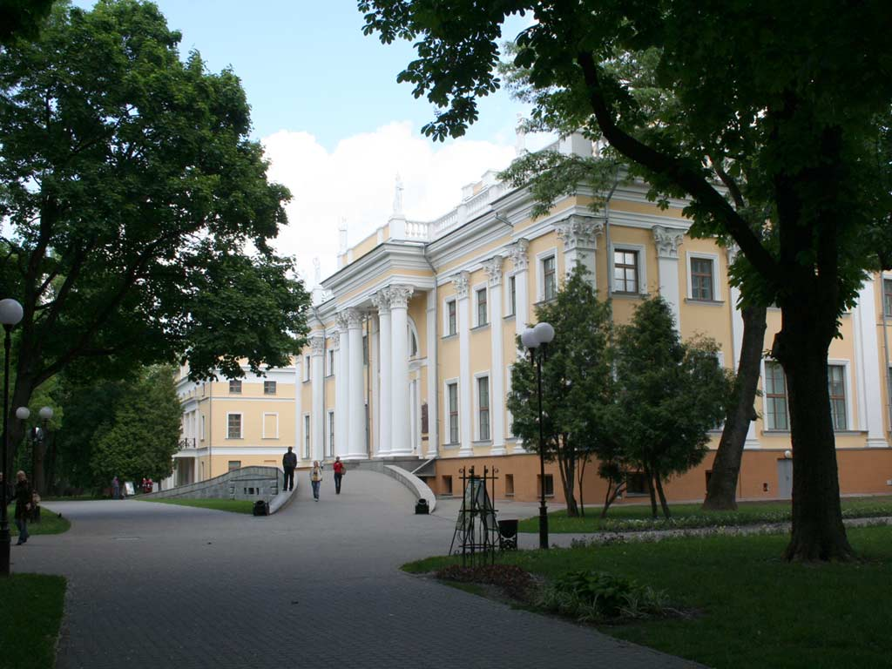
There are a lot of landmarks both in Gomel and in Gomel region, and many tourists
come to see them.

Slide 6
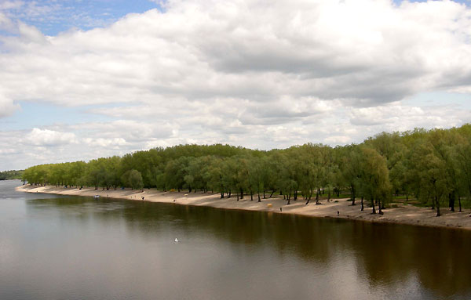
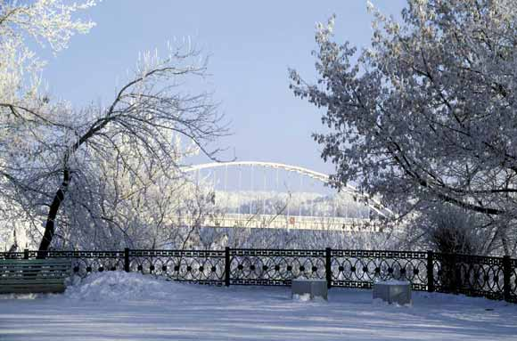

Slide 7
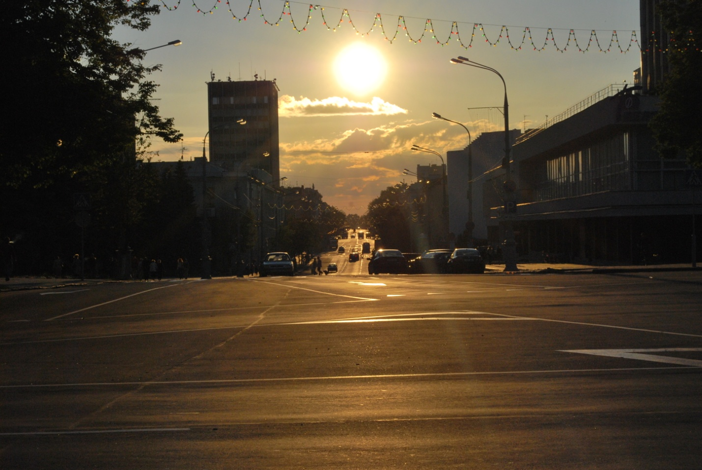

Slide 8
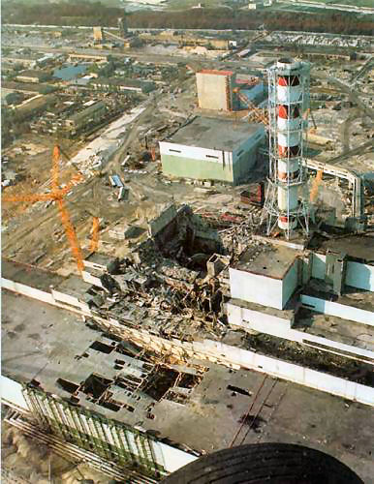
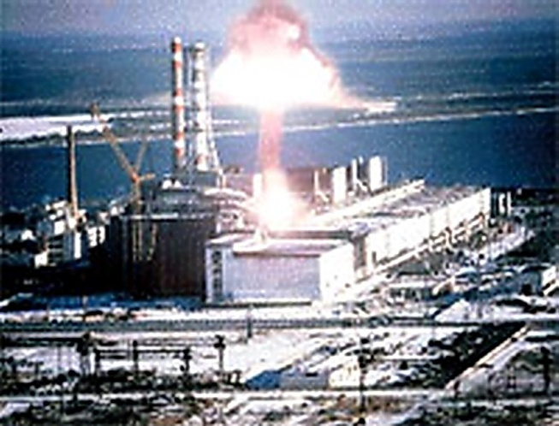
What environmental issues does our city face and how severe are these issues?
Gomel and Gomel region face the consequences after Chernobyl catastrophe.
A lot of harmful elements got into the air after the explosion at the atomic power station in Chernobyl, so the air and the ground got very contaminated.

Slide 9
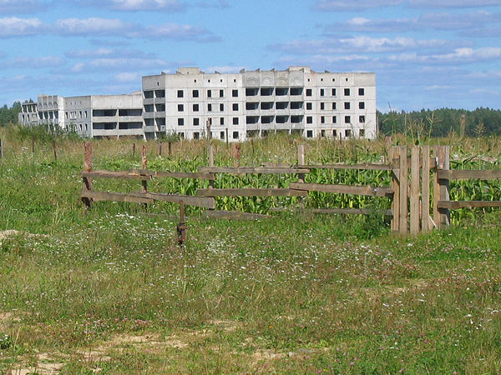
There are a lot of contaminated areas in Gomel region that are not fit for living.

Slide 10
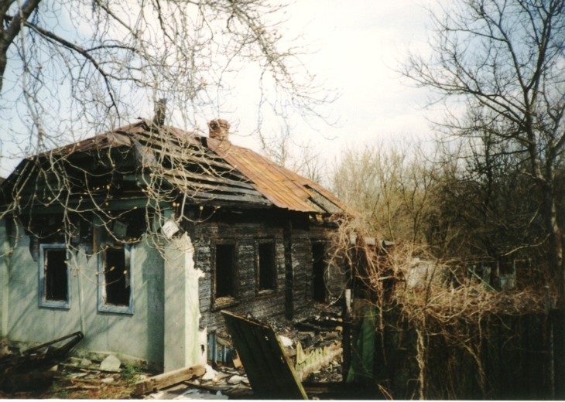
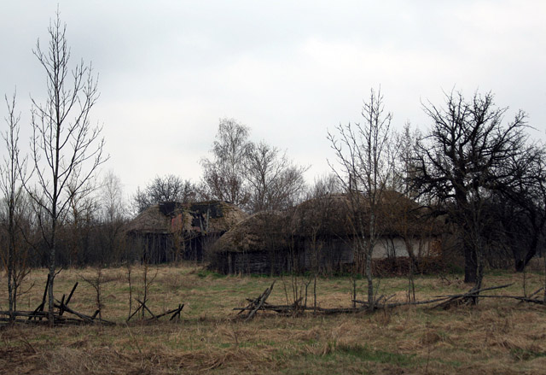
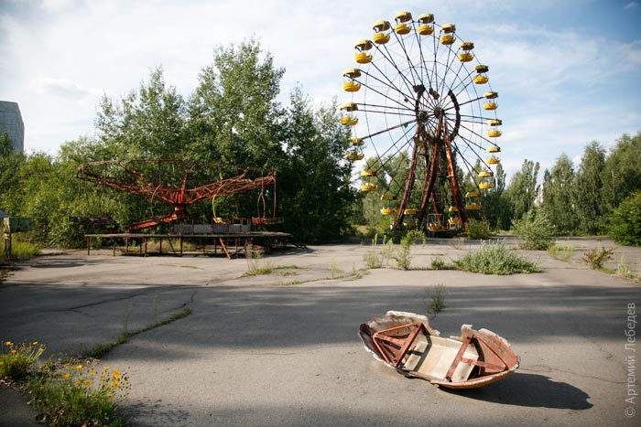
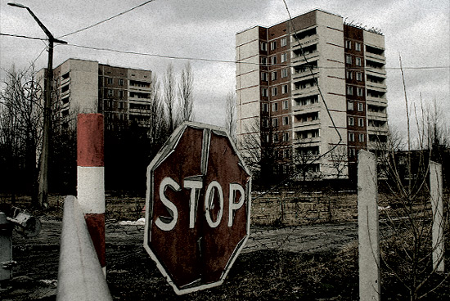

Slide 11
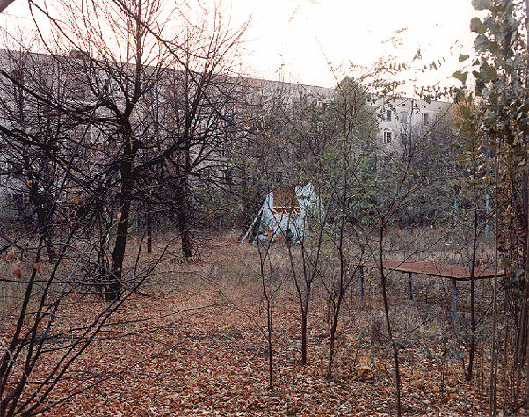
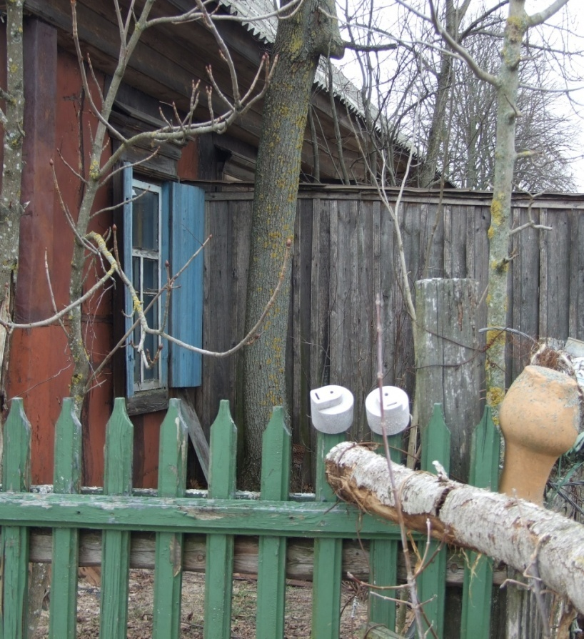
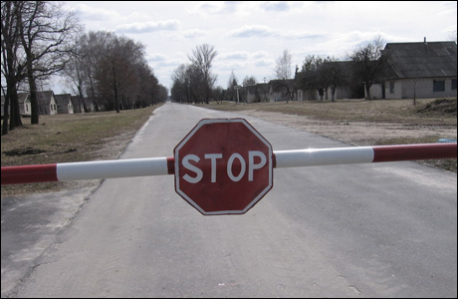

Slide 12
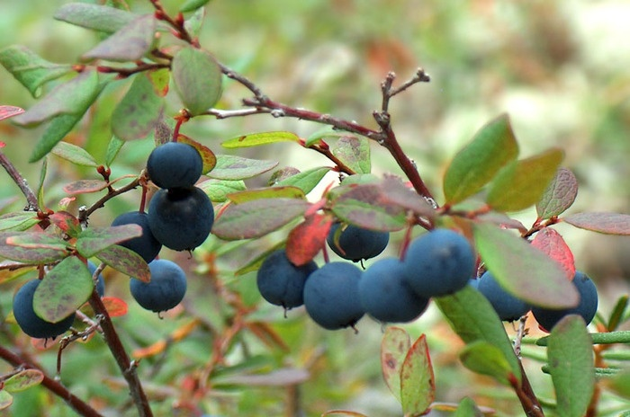
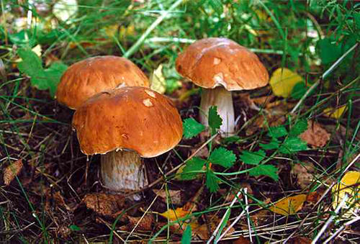
What are the consequences of
Chernobyl catastrophe?
The aftermath will last long as some chemical elements that got into the ground with the acid rain need a great period of decay. So, it is not recommended to eat mushrooms and berries picked up in forests.

Slide 13
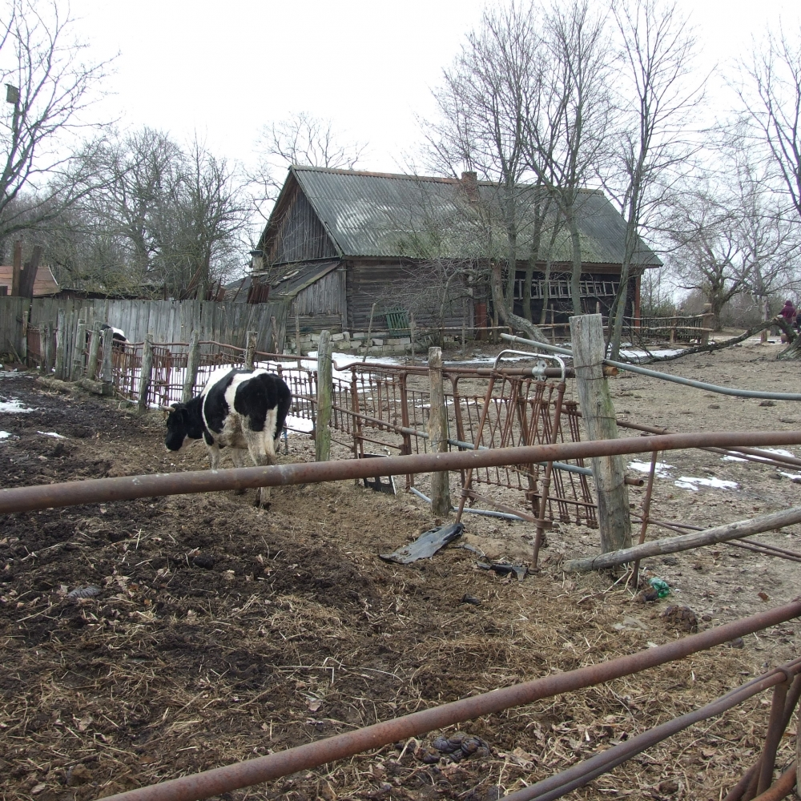
Milk from village cows is also considered dangerous as they eat grass that grows on the contaminated ground.

Slide 14
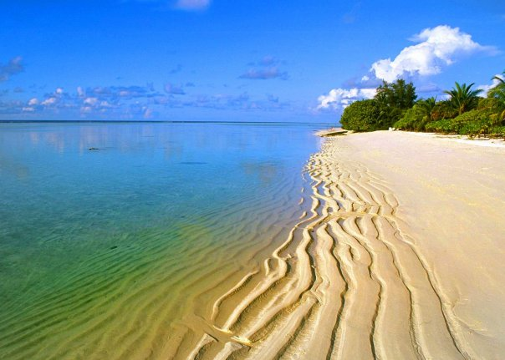
But the greatest issue
connected with Chernobyl catastrophe is
numerous health problems.
Cases with cancer have increased,
more people have heart problems,
and more babies are born with different disorders.
What can be done?
One of the solutions
to health problems
is to go regularly
to the seaside to breathe
the sea air full of iodine,
and also to take necessary vitamins.

Slide 15
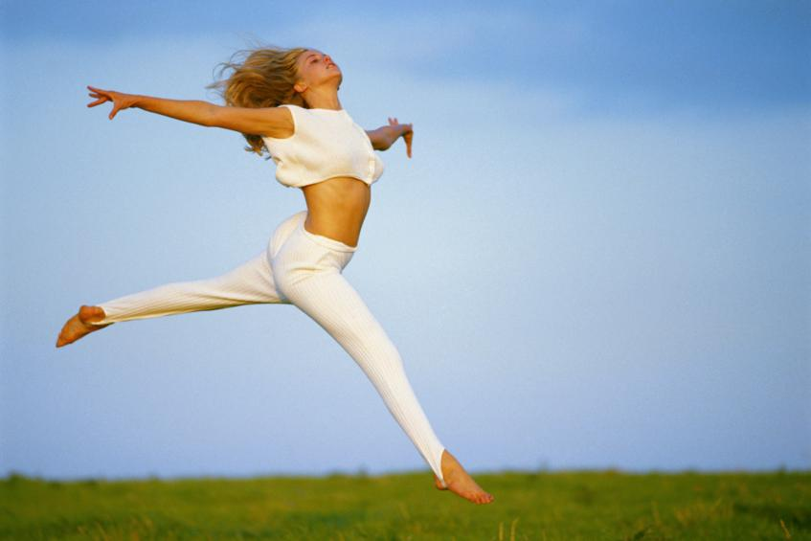
The consequences after Chernobyl catastrophe can be neither denied nor avoided, we have to live with them.
But young people CAN and NEED
take care of their health
to leave after them
a healthy generation.

Slide 16
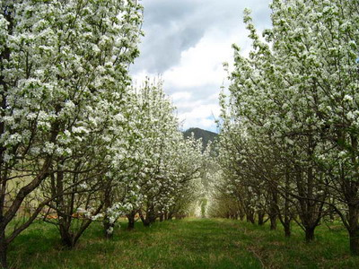
Also, we can popularize environmental protection in the form of
planting trees,
cleaning the surrounding area and
holding Clean-up Your Town activities.

Slide 17
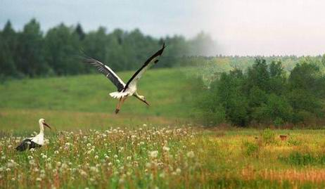
Together we can make a difference in the environmental protection and save our country clean and beautiful.

