Slide 1
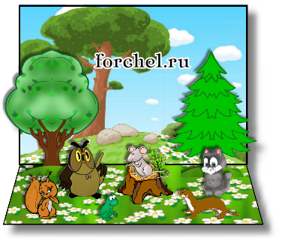






FOREST ENCYCLOPEDIA
“WONDERS OF THE FOREST”

Slide 2

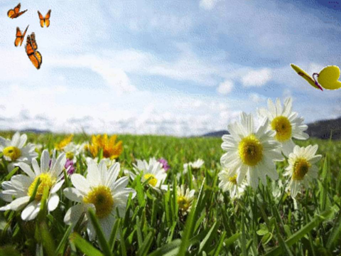





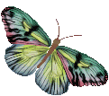
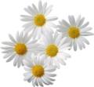

Sponsored by
the students of 5 grades
Slonim gymnasium 1
Belarus
Teacher – Irina Volynets

Slide 3
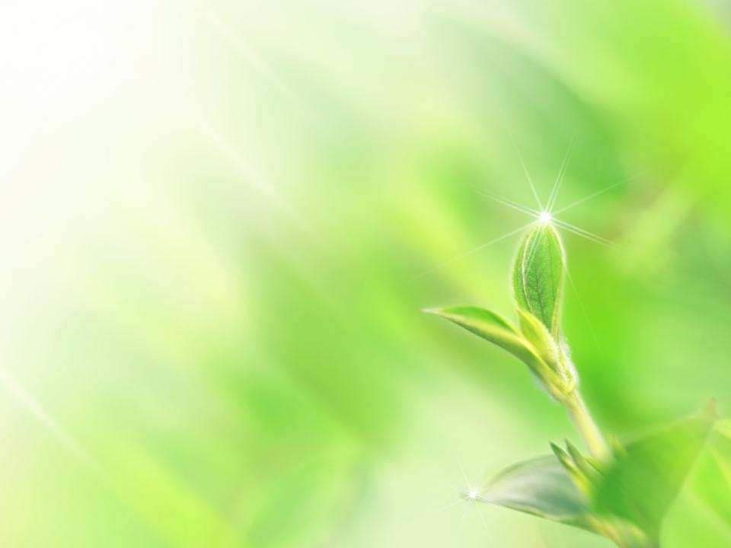

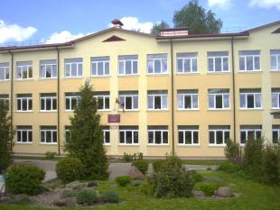

CREATORS
Tanya Benko
Kate Dyatlova
Kate Sinitsa
Kate Risunova
Ksenya Sosnovskaya
Artem Golubets
Denis Vorotynets
Dasha Belevich
Diana Alisevich
Karolina Danilchik
Kate Skobeiko
Slava Tsydik
Maxim Moroz
Vanya Volynets

Slide 4
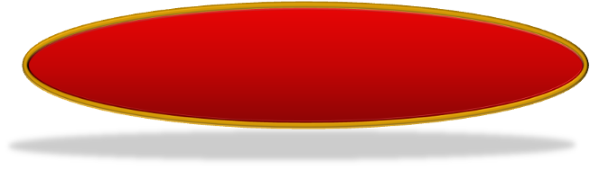

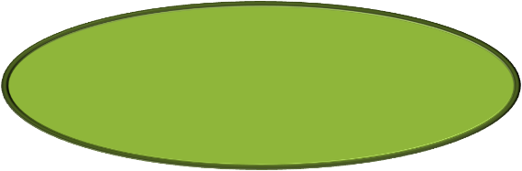

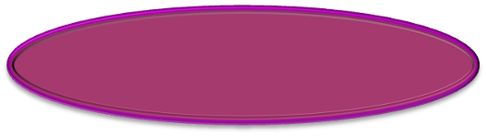

Special gratitude to
Students of
Secondary School 2 Educational Centre
Kinel-Cherkassy Samara Region, Russia
8th graders
Starye Dorogy gymnasium, Belarus
6 graders
Campbellton middle school,
Canada
TEACHERS: Natasha Belozorovich, Inna Inkina,
Ranatee Fournier

Slide 5
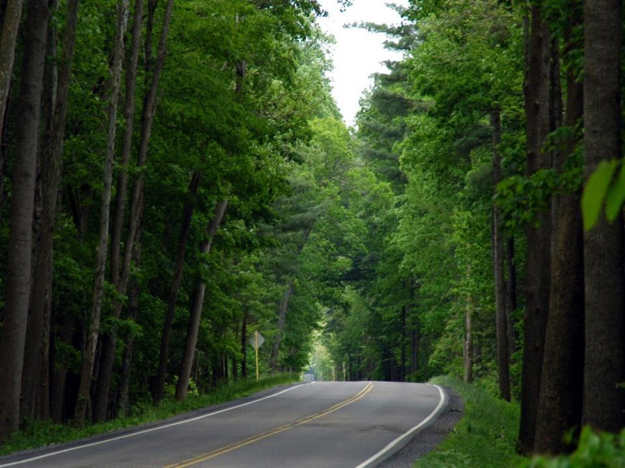
A forest is a large area of land covered with trees.
But a forest is much more than just trees. It also
includes smaller plants, such as mosses, shrubs,
and wild flowers. In addition, many kinds of birds,
insects, and other animals make their home in the
forest. Millions upon millions of living things that
can only be seen under a microscope also live in the
forest.

Slide 6
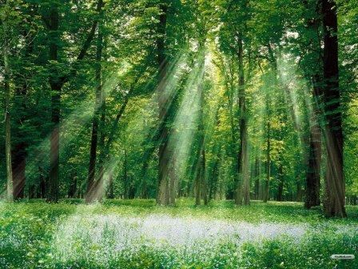
Forests in Belarus

Slide 7

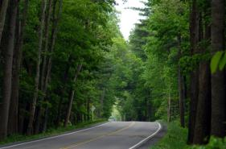
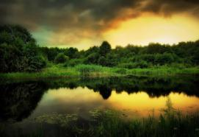
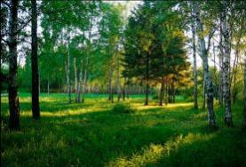



One third of Belarus is covered with forests

Slide 8
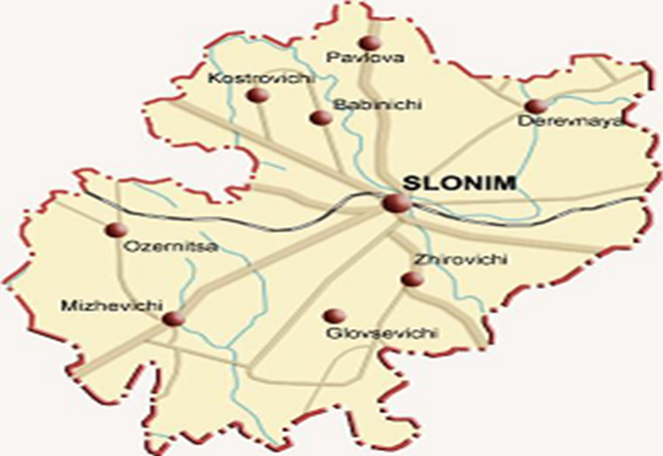
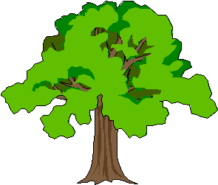
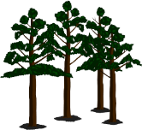
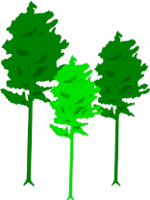
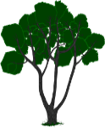
62673 ha

Slide 9
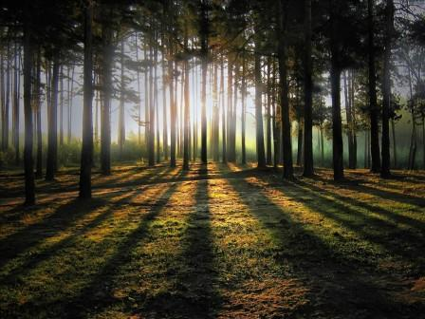
A Belarusian forest is great and mysterious. It can never be dull or monotonous. Each path leading deep in the woods brings you to a green temple full of wonders, rain-washed and sun-heated, smelling of conifers, flowers and herbs – to a fascinating world of mysteries, wonders and new discoveries.
LET'S VISIT A BELARUSIAN FOREST!

Slide 10
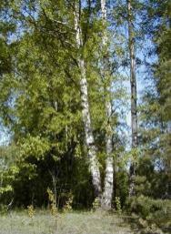
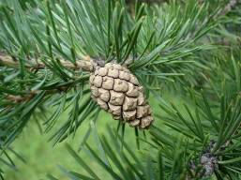
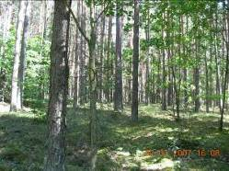


Forest ecosystems are characterized by exclusive
high biodiversity. The flora consists of around 111
different types of trees. About twelve thousand species
of plants and mushrooms can be found in these forests.
Mainly fir and pine wood trees form these dense forests.
There are thirteen types of pine woods and 12 types of fir
woods available here. In Belarus forests, 28 types of
trees as well as around 70 types of shrubberies can be
found.

Slide 11
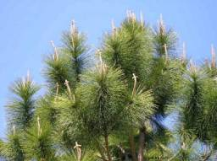
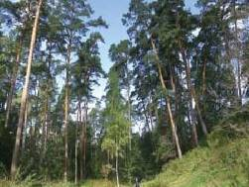
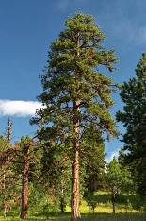
THE PINE
A pine is any of a large group of evergreen trees that have needlike leaves and bear cones. Pines are found in a wide range of environments, but they most often grow in sandy or rocky soils. Some pines reach heights of about 60 meters. Others are small and shrublike.
Pines belong to a group of plants called conifers. Nearly all pines have needles that grow in bundles of two, three, or five each.
Pine rank as the world’s most important source of timber. Most pines grow rapidly and form straight, tall trunks that are ideal for timber. Some pines produce resin, a substance used to make such products as turpentine, paint, and soap. The wood of many pine species makes excellent pulp for the manufacture of paper. Pines are also grown as shade trees. Some people use sometimes pines as Christmas trees.

Slide 12

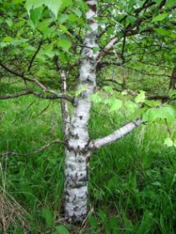
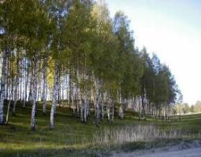
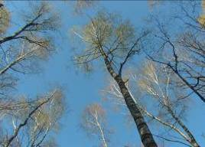
THE BIRCH
Birch is the name of a group of about 40 slender trees and shrubs that grow in parts of Europe, northern Asia and North America. They have a thin bark that peels in horizontal layers. Some birches have bark that separates into sheets almost like paper. Birches produce long catkins (scaly spikes), which contain tiny flowers.
Their leaves grow alternately on the twig, and are generally bright green, turning yellow in autumn. The birch is a tall, graceful tree with delicate branches. The slender trunk of the birch has thin peeling bark.
Silver birch grows in the country where I live. Silver birch is a graceful Old World species. It is easily recognized by its papery, peeling, black-and-white bark and the ragged base to the trunk. The brunches of the silver birch usually droop at the tips Silver birch grows mainly on sandy and gravelly soils. In Belarus the sap from a variety of silver birch called weeping birch is used in spring to make syrup.

Slide 13
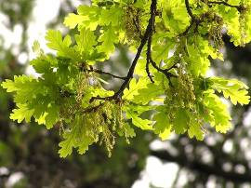
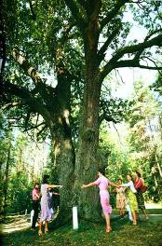
THE OAK
The oak is any of a large variety of trees or shrubs that bear acorns. There are more than 600 species of oaks. Nearly all of them grow naturally in the Northern Hemisphere only.
Oaks vary in size and the way they grow. Some oaks never become taller than shrubs. Other reach height of more than 30 metres.
Oaks grow slowly and usually do not bear acorns until they are about 20 years old. But these trees live a long time. Most oaks live for 200 to 400 years.
Oaks are an important source of timber. Oak wood is heavy, hard and strong and it has a beautiful grain. Manufactures use it for furniture, barrels, boats, and railway sleepers. Many of the once extensive oak woods of Europe were destroyed long ago to provide timber for boat building and house construction. Cork comes from the bark of some oak species. Acorns are an important source of food for wildlife. In some countries pigs and poultry are fed on acorns.
Several kinds of oaks are used to provide fannin for curing leather and for making blue-black ink. Tannin is found in the bark of oak trees but it is also concentrated in galls. Cortex Quercus is used as medicine for diarrhoea, pulmonary tuberculosis, women’ s diseases, and eczema, for strengthening teeth and gaggling a throat.

Slide 14
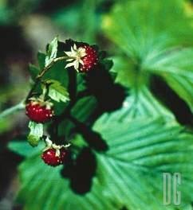
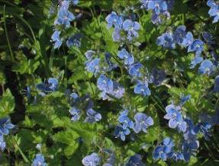
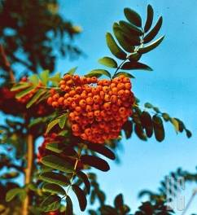
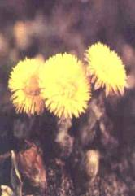
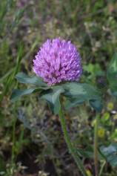
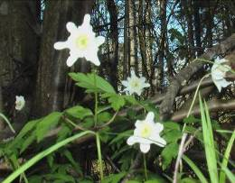
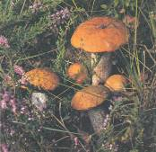
Forests offer a diverse set of habitats for different plants – mushrooms, flowers, berries, herbs and bushes

Slide 15
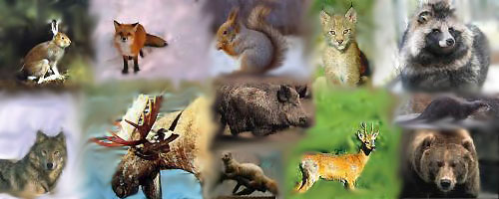
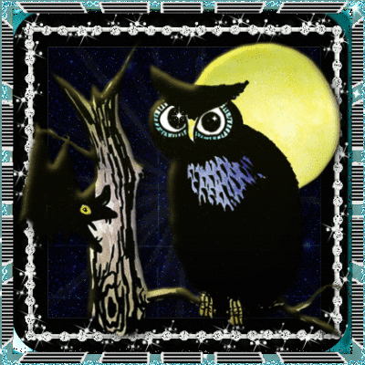

The Fauna of Belarus is noted for its diversity. Around 464 species of invertebrates and more than thirty thousand vertebrates make the fauna of Belarus. About 60 species of fish and 305 species of birds are present here. About six classes of mammals represent the mammal family in Belarus. Elks, wild boars, deer, roe deer, wolves, hares, beavers, and wolves are mostly found in the country

Slide 16
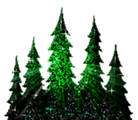
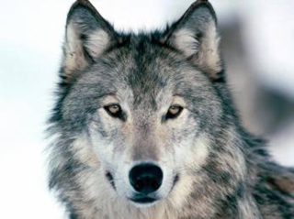
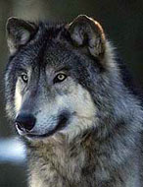
THE WOLF
The wolf is one of the largest members of the dog family . Wolves are expert hunters and prey chiefly on large hoofed animals, such as caribou, deer, elk and moose. Many people are afraid of wolves. They believe wolves attack human beings, and the animal’s eerie howl frightens them. But wolves avoid people as much as possible.
Wolves look much like German shepherd dogs. But a wolf has longer legs, bigger feet, a wider head, and a long bushy tail. Most adult male wolves weigh from 35 to 55 kilograms. They measure from 1.5 to 2 meters long, including the tail, and are about 75 centimeters tall at the shoulder. Female wolves are smaller.
A wolf has excellent vision, a keen sense of smell, and fine hearing.
Wolves eat almost any animal they can catch. Many of animals they hunt, such as caribou and elk are faster and stronger then wolves.

Slide 17
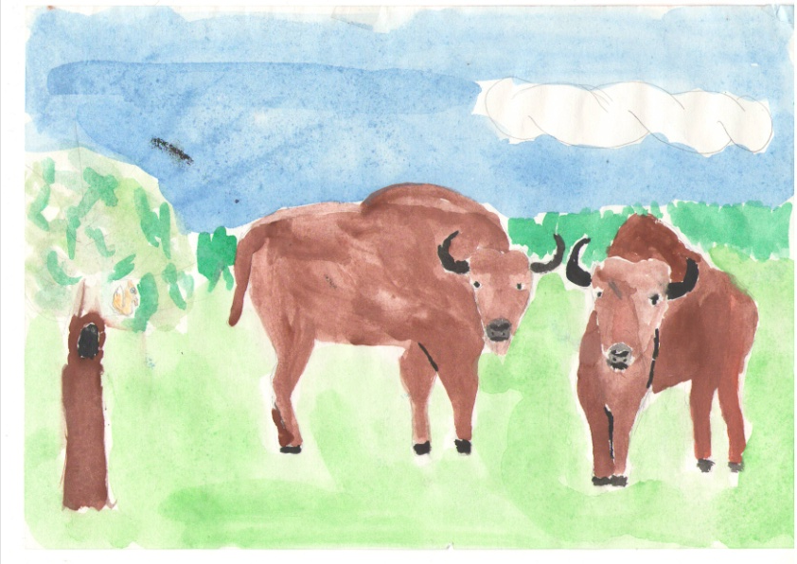
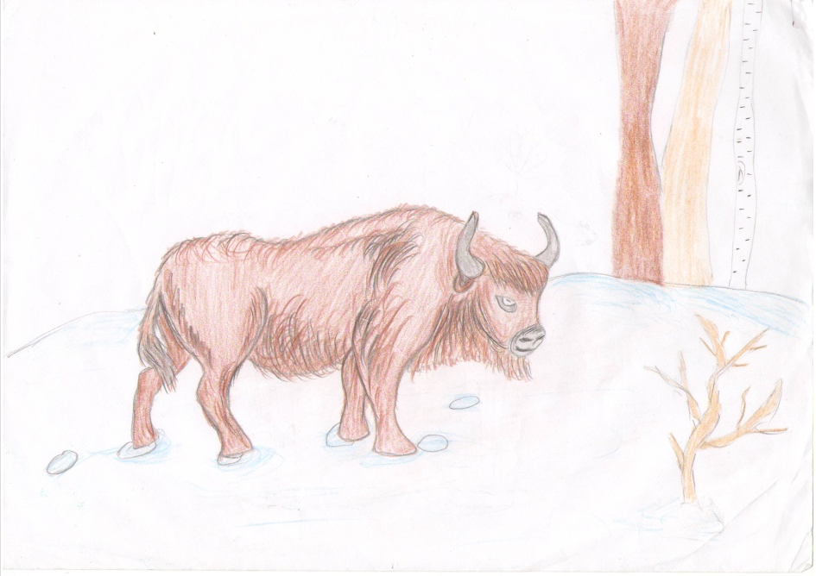
THE BISON
The European bison lives in a protected forest between Poland and Belarus. It is brownish-black, except on the hind part of the body, which is brown. Long, coarse hair covers the head, neck, and hump. The hair forms a beard on the throat and chin. The head has a pair of horns like those of domestic cattle. Some pairs of horns spread about 90 centimetres
apart at their widest point. A fully grown bull measures from 3 to 3.8 metres long, from the tip of its nose to the end of its short, tufted tail. Its height at the shoulders measures about 1,8 metres. Bulls usually weigh between about 700 and 900 kilograms. Extremely large ones may weigh as much as 1,400 kilograms. Cows are much smaller than bulls and rarely weigh more than about 400 kilograms.

Slide 18
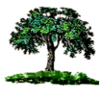
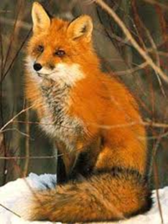
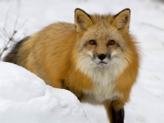
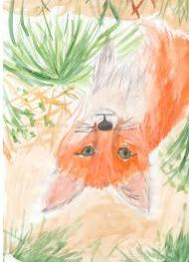
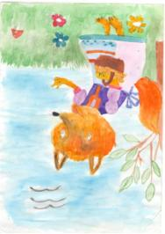

THE FOX
Fox is a common name for many species of omnivorous mammals belonging to the Canidae family. Foxes are small to medium-sized canids (slightly smaller than the medium-sized domestic dog), characterized by possessing a long narrow snout, and a bushy tail (or brush).
In the wild, foxes can live for up to 10 years, but most foxes only live for 2 to 3 years due to hunting, road accidents and diseases. Foxes are generally smaller than other members of the family Canidae such as wolves, jackals, and domestic dogs. Reynards (male foxes) weigh, on average, around 5.9 kilograms and vixens (female foxes) weigh less, at around 5.2 kilograms. Foxes are omnivores. They eat small mammals, reptiles, (such as snakes), amphibians, scorpions, grasses, berries, fruit, fish, birds, eggs, dung beetles, insects and all other kinds of small animals.

Slide 19






THE LYNX
The Lynx is a mammal that has a short tail, furry ruffs, and special paws that are so big the helps it stay on top of the snow and swim. It weighs about 80-90 pounds and is twice the size of a bobcat. Its fur is usually brown and has a lot of dark brown spots.
The lynx doesn’t build its home. It mostly lives inside evergreen forests and sleeps on rock ledges or in trees. They hunt on the ground, but they can climb trees and can swim swiftly, catching fish. The lynx will eat whenever they get a chance, but they very much prefer meat. It helps that they have very sharp teeth and long legs. That helps it catch and hold its prey tightly.
People have killed many lynx and now this animal is included in our Red Book. Hunting lynx is forbidden.

Slide 20




THE ROE DEER
The Roe deer is the smallest and the most widespread from all European deer. It is widespread in Western Europe, from the
Mediterranean to Scandinavia, and from the British Isles to the Caucasus.
It is relatively small, reddish and grey-brown, and well-adapted to cold environments. The weight of a big male is about 27 kg. It has rather short, erect antlers and a reddish body with a grey face. Its hide is golden red in summer, darkening to brown or even black in winter, with lighter undersides and a white rump patch; the tail is very short and barely visible.
The Roe Deer is primarily crepuscular, or primarily active during the twilight, very quick and graceful, lives in woods although it may venture into grasslands and sparse forests. It feeds mainly on grass, leaves, berries and young shoots.
It particularly likes very young, tender grass with a high moisture content, i.e., grass that has received rain the day before.

Slide 21




The beaver is a primarily nocturnal, large, semi-aquatic rodent. Beavers are known for building dams, canals, and lodges (homes). They are the second-largest rodent in the world (after the capybara). Their colonies create one or more dams to provide still, deep water to protect against predators, and to float food and building material.
They are known for their alarm signal: when startled or frightened, a swimming beaver will rapidly dive while forcefully slapping the water with its broad tail, audible over great distances above and below water. This serves as a warning to beavers in the area. Once a beaver has sounded the alarm, nearby beavers will dive and may not reemerge for some time. Beavers are slow on land, but are good swimmers, and can stay under water for as long as 15 minutes.
Beavers are herbivores, and prefer the wood of
quaking aspen, cottonwood, willow,
alder, birch, maple and cherry trees.
They also eat sedges, pondweed,
and water lilies.
THE BEAVER

Slide 22






Different insects and micro-organisms live in the forest.

Slide 23







Endangered species
The Belarus Red Book was created to protect rare and vanishing species of plants and animals. Currently protected and recorded within the Red Book are: 17 mammal species, 72 bird species, 4 amphibian species, 10 types of fish, 72 types of insects

Slide 24


Forests are in danger nowadays.
Every 45 minutes a hectare of the world’s forests is destroyed forever.

Slide 25


ACT NOW –
FOREST MATTERS

Slide 26



BELARUSian LANDSCAPE
Belarus is a very green country. Natural vegetation covers 93.1% of the land, and 1/3 of all green landscape is forest. In Belarus forest, 28 types of trees as well as around 70 types of shrubberies can be found. They include:
Birch (across the country)
Pine (across the country)
Conifers (northern areas)
Oak ( southern areas)

Slide 27


BELARUSian WILDLIFE
Belarus is home to huge array of wild animals and birds, many of them rare species.
Around 76 species of animals have been recorded in Belarus, including:
                elks
                deer
                wild bear
                beavers
                wolves
                bisons
There are also around 300 species of birds in Belarus.

Slide 28





Slide 29

National parks
There are five National Parks in Belarus, protected by the State. Their work has been recognised and supported by UNESCO.

Slide 30

Belavezhskaya Pushcha
Belavezhskaya Pushcha park is in the Brest region, 340km to the southwest of Minsk.
Belavezhskaya Pushcha park is home to many ancient oak trees dating back More than 500 years, as well as venerable ash, pine and fir trees.

Slide 31

Braslavskiye ozera national park
This park was established in 1995 among the beautiful lakes of the Vitebsk region in the north-west of Belarus.

Slide 32

Narachansky national park
Narachansky National Park in the Minsk region of Belarus was established in 1999.

Slide 33

Pripyatsky national park
This park lies in the Gomel region in the south of the country, 250km from Minsk.

Slide 34

BEREZENSKYI NATIONAL PARK
This park is situated in the north of Belarus. 120km from Minsk. It was created to protect rare animals.

Slide 35

Created by Liza Senkovskaya
8th form
Gymnasia #1
Starye Dorogi
Belarus

Slide 36
Forestry in Canada
What kind of forests are in New Brunswick?

Slide 37






White pine
Cedar
Maple

Slide 38



Red spruce
Northern white cedar
Eastern
hemlock

Slide 39




What species of animals
live in New Brunswick?
White-tailed deer
wolf
moose
black bear

Slide 40





bird
fish
raccoon
owl

Slide 41



mouse
snake
skunk

Slide 42







Do you know what species of plants
grow in New Brunswick?
apple trees
hazel nuts
potatoes
tomatoes
rose bush

Slide 43




ENDANGERED ANIMALS
Gulf Sturgeon
Yellow Lamp
mussel
Eastern gray
squirrel
Dwarf Wedge
mussel

Slide 44


What can we do
to save the forests?
Stop cutting down trees
and stop polluting.

Slide 45


Forests in Samara Region
Secondary School 2 Educational Centre
Kinel-Cherkassy Samara Region Russia
Made by Julia Avdonina

Slide 46


Contents
1) General Information.
2) Coniferous forests.
3) Buzuluk forest
4) Deciduous forests.
5) Oak forest
6) Floodplain forests
7) Ravined forest.
8)Conclusion

Slide 47

General Information
According to various experts from 1,500 to 1,800 species of vascular plants grows in Samara region . Two hundred and twenty six plants of Samara region are of particular scientific value. These include plants such as Astragalus Tsinger, lady'sslipper, dwarf iris, beautiful feather, Hedysarum macranthon, Zhigulevskyspurge, wormwood solyankovidnaya, Cephalanthera red grouse Russian, Koeleriasclerophyllous, the rank of Litvinov and sharovitsa speckled, which are included in the Red Data book of the Russian Federation and Samara region.

Slide 48


Coniferous forests
In the forests of Samara region there are the most valuable conifers, formed by Scots pine.They occupy 12% of the total forested area of ​​the region. These forests belong to the Eastern European regional group, subzonal type of forest-steppe and steppe, and is defined as "pine and broad-leaved pine, herb-grass, steppe."

Slide 49


Buzuluk forest
Buzuluksky boron is an interesting and unique natural object, which was described in more than 300 books.
On the territory of Buzuluk boron there are three categories of areas that differ in the mode of moisture and forest conditions. The first is the high dunes and the southern slopes of a deep level of standing water surface, as most dry location. The second category is the gentle hillocks and plateaus between the dunes with the same level of standing water surface. The third category consists of hollows and depressions between the dunes with the level of ground water available for plant roots.

Slide 50

Deciduous forests
Deciduous tree plantations, which play a major role, are trees with leaves as plates.We call an oak, a maple, a linden, a birch, an elm, a poplar, an alder, a willow and others the deciduous species.
The basis of the forest of Samara region are deciduous forests, which belong to the "Eastern European Volga-Zavolzhskii deciduous oak-linden forests without the ash."

Slide 51

Oak forests
Oak forests are composed of a variety of Samara Region communities. Among them are the most common oak-bereskletovo landyshevaya, orlyakovo-landyshevaya and motley.In more humid areas oak-bereskletovo of oak, and of oak-landyshevaya of oak grow. Often, the tree layer, along with oak part lime, forming a grove of oak with lime,yasmennikovo-zvezdchatkovuyu and others. Sometimes a part of the tree layer includes maple platanovidny.

Slide 52

Floodplain forests
Floodplain forests are the most common in river valleys, the Sok, the Kondurcha, the Great Kinel, the Samarka, the Big Irgiz and other rivers. Near the river bed, on the sandy sediments of the floodplain, flooded for a long time with water, forming willow. They are composed of willow wood floor white, triandra, and basket.

Slide 53


Ravined forest
Ravined forest. In the steppe zone of Samara region, the conditions for forest life is very unfavorable. Woody vegetation is going to the watershed in a secure place beams and ravines (gullies), where the ground water are shallow and moisture conditions are better.Such forests are called ravined. Developing on the border of the spread of woody vegetation due to adverse climatic conditions, the forests in these areas are characterized by poor growth, poor quality of the stand and the almost complete absence of seed regeneration.

Slide 54


Conclusion
Thank you for your attention!

