Slide 1

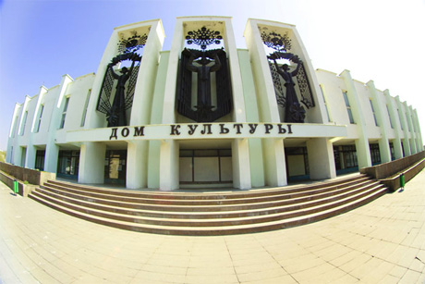
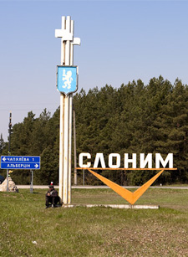
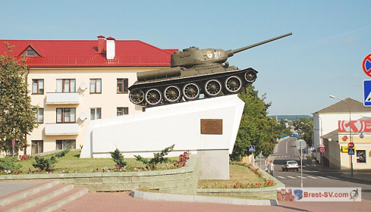
Slonim

Slide 2
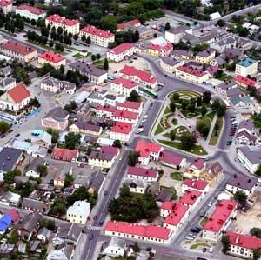
Slonim was founded in the 11th century in a picturesque place where the river Issa flows into the river Shchara. This is one of the most ancient and beautiful towns of Belarus. The Slonim region is located in the south of Grodno oblast. eters. As of January 2011, there were 72,000 people living in the region (of them 55,400 in the town of Slonim).

Slide 3
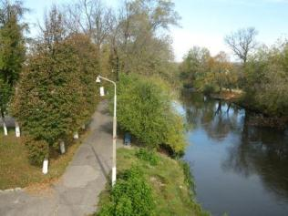

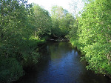
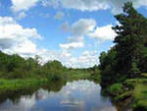
this town is situated
in a picturesque place
on the banks of two rivers: the Shchara
and the isa.

Slide 4


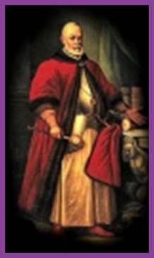

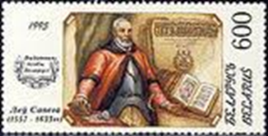
Slonim was first
Mentioned in chronicles
in 1252. It has a long history.
It played an important role
in the history of Belarus.
Lev Sapega

Slide 5

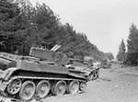



Slonim suffered a lot in the World War II.

Slide 6
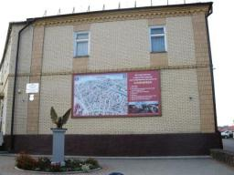
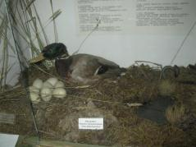
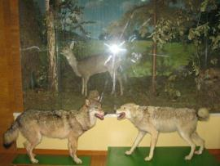
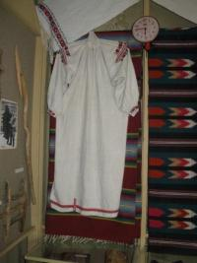
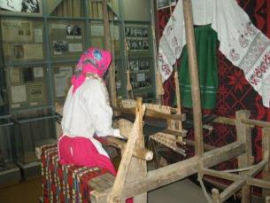
The towns history is reflected in the exhibits of the Museum of local lore named after I.Stabrovsky. It is one of the oldest museums in Slonim. The museum was opened on September 20 , 1929. There are 5000 exhibits. Nowadays it’s situated in Lenin Square, 1. There are two sections: a natural section and a historical section.

Slide 7
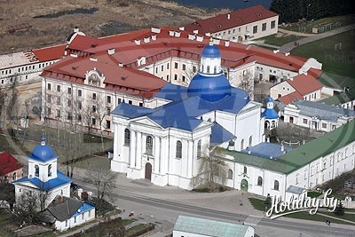
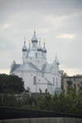
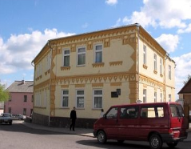
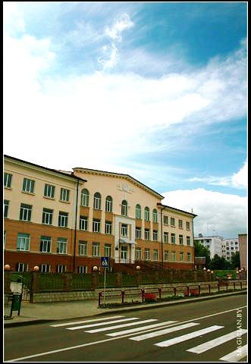
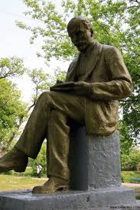
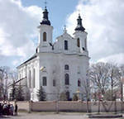
There are a lot of factories and plants, schools and monuments, exhibition centres and parks in Slonim.

Slide 8
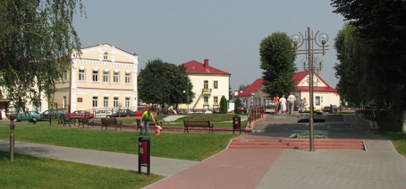
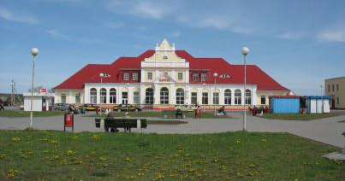
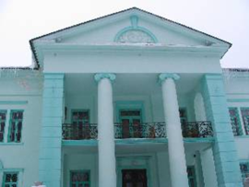
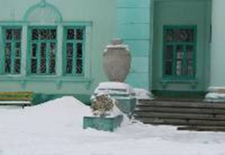
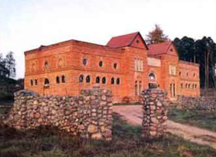
Slonim is a very beautiful town!!!
"Slonim is a very beautiful town. The town has a considerable number of architectural monuments and a rich historic and cultural heritage. There are a lot of cultural and historical monuments here. The main sights of modern Slonim are churches. The oldest building in Slonim is Puslovsky’s castle.

Slide 9
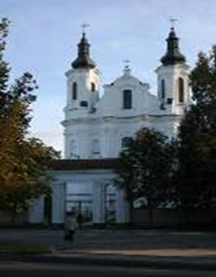
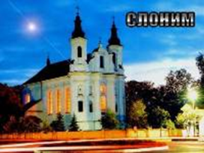
St. Andrew’s church
The present brick church was built in the 18th century in the late baroque style. It has a splendid facade emphasized by the moldings and pilasters, two small towers express the building’s fantasy and lightness.

Slide 10
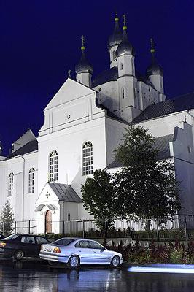
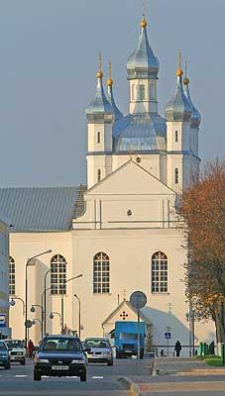
Don’t miss the chance to visit the highest cathedral in Slonim. It is Svyato-Uspensky cathedral.

Slide 11
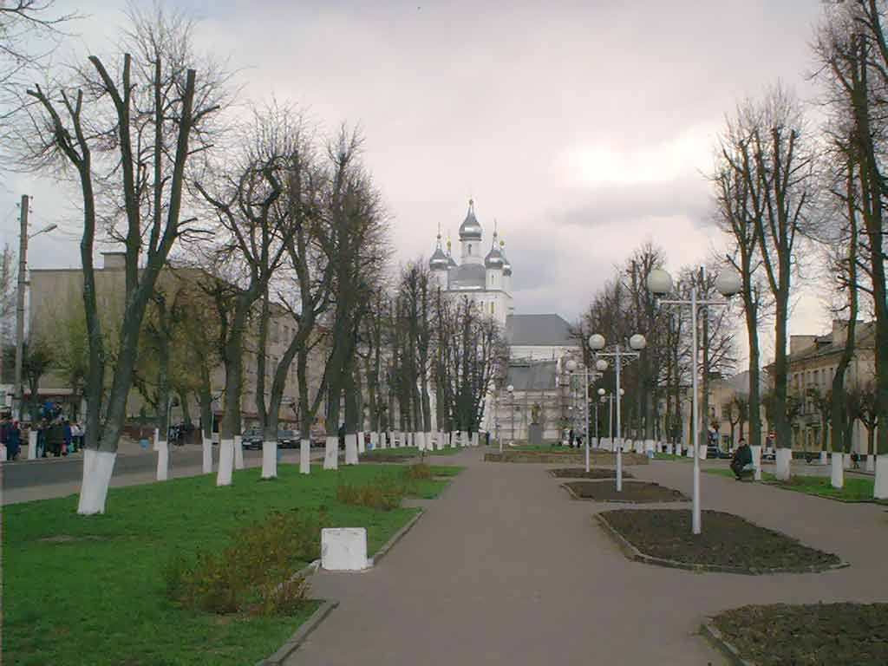
Go down the streets of Slonim and feel the atmosphere of this city - the jewel in the crown of Belarus.

Slide 12
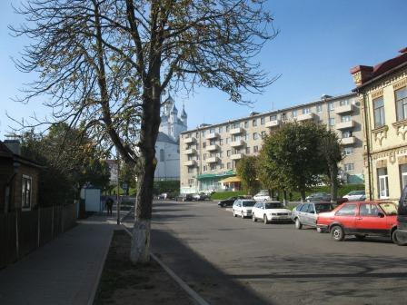
Go down the streets of Slonim
and feel the atmosphere of this city- the jewel in the crown of Belarus.

Slide 13
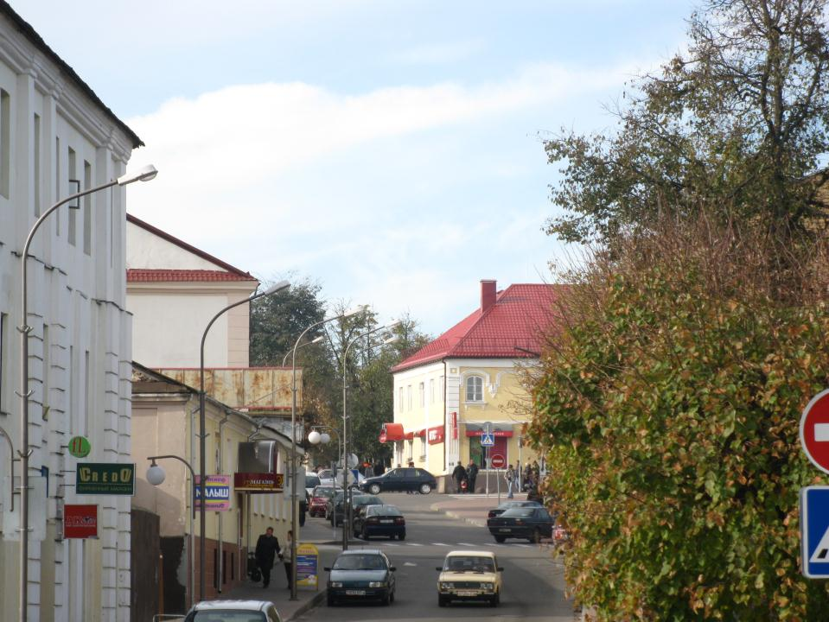
Go down the streets of Slonim
and feel the atmosphere of this city - the jewel in the crown of Belarus.

Slide 14
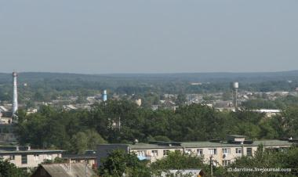
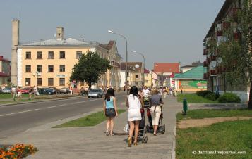
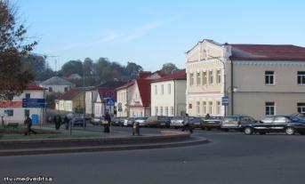

Slide 15
Thank you for attention!!!
Created by Kate Dyatlova and Kate Sinitsa
Grade 5
Slonim gymnasium 1
Belarus

