Slide 1
Music we love

Slide 2
Favourite genres of music
pop-music - 50%
hip-hop - 20%
techno - 5%
rock - 5%
rap - 20%

Slide 3
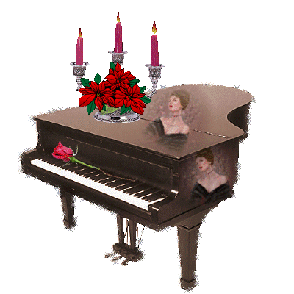
Favourite musical instruments
piano
guitar
drums
violin

Slide 4
Favourite singers
Our favorite singers are Miley Cyrus, Dima Bilan, Dima Koldun, Britney Spears, Denis Maidan, Nyusha, 5sta family, DJ Smash, Leralera, Nastya Kamensky, Potap and Guf

Slide 5
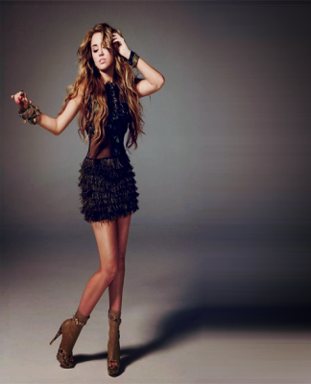
Miley Cyrus
Fact file
Birth name: Destiny Hope Cyrus
Born: November 23, 1992
Nashville, Tennessee, U.S.
Genres: Pop, country pop, dance, electropop, teen pop
Occupations: actress, musician
Instruments: vocals, guitar, piano
Years active 2001–present
Labels: Walt Disney, Hollywood
Associated acts: Hannah Montana, Billy Ray Cyrus, Demi Lovato
Website: MileyCyrus.com
Miley Ray Cyrus is an American actress and pop singer-songwriter. She achieved wide fame for her role as Miley Stewart/Hannah Montana on the Disney Channel sitcom Hannah Montana. Cyrus ranked number thirteen on Forbes' 2010 Celebrity 100. For the 2011 Guinness World Records, she was named the “Most Charted Teenager” following her 29th US Billboard Hot 100 chart entry on November 7, 2009 with “Party in the USA”.

Slide 6
Dima Bilan
Fact file
Birth name: Viktor Nikolaevich Belan
Born: December 1981 (age 30)
Origin: Ust-Dzheguta, Karachay–Cherkessia, Russian SFSR, Soviet Union
Genres: pop, R&B, soul
Instruments: vocal, accordion, piano
Labels Universal (2008-present), Gala Records (2003-2007), EMI (2006, 2008), Мистерия Звука (2008)
Associated acts: Nelly Furtado, Rudy Perez, Jim Beanz, Ryan Tedder, Trudy Bellinger, Edvin Marton, Evgeni Plushenko, Larisa Dolina, J.R. Rotem, Anastacia
Website: http://www.bilandima.com/

Slide 7
Dima bilan
Díma Bilán (is a Russian actor and pop singer . He represented Russia at the Eurovision Song Contest 2006 with "Never Let You Go", finishing second, and he won the contest in 2008 in Belgrade, with the song "Believe". He has had several Russian no. 1 hits.
When Dima was two years old, his family moved to his grandmother’s place in the city of Naberezhnye Chelny in Tatarstan and he also lived in Greece for 3 years in an island named "Santorini". When he was six years old, his family moved to Kabardino-Balkaria where he went to school with his sister. He took part in morning performances, recited poems and sang songs.
Bilan graduated from Gnesins Musical College as a classical vocal performer. He made his debut when he reached fourth place at the Russian/Latvian festival "New Wave" in 2002. In 2003, Bilan released his debut album titled Nochnoy Huligan (Night Hooligan).
In 2008, Bilan won two awards from Muz TV: "Best male artist" and "Best ringtone" for the song "Nevozmozhnoe vozmozno". Dima also won the Best Russian Act award at MTV Europe Music Awards.

Slide 8
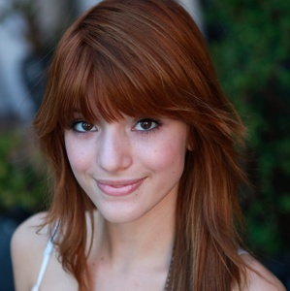
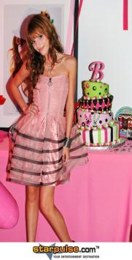
Bella Thorne
Fact file
Birth name: Annabella Avery Thorne
Born: October 8, 1997
Pembroke Pines, Florida, U.S.
Genres: dance-pop, electropop
Occupations: actress, singer, model, dancer
Instruments: vocals
Years active 2003–present (actress)
2011–present (singer)
Labels : Walt Disney
Associated acts: Zendaya
Website:http://bellathorneofficial.com
Annabella Avery "Bella" Thorne is an American teen actress, dancer, singer, and model. She is a child model and actor with appearances in more than 20 films and television series and more than 60 commercials, she is best known for her role as the aspiring young dancer CeCe Jones on the Disney Channel original series Shake It Up!.

Slide 9
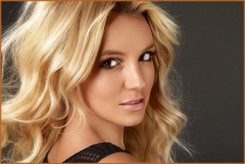
Britney Spears
Fact file
Birth name: Britney Jean Spears
Born: December 2, 1981 (age 30)
McComb, Mississippi, U.S.
Genres: pop, dance
Occupations: singer, songwriter, dancer, actress, record producer, author, fashion designer, video director
Instruments: vocals, piano
Years active 1992–present
Labels: Jive, RCA
Associated acts: The New Mickey Mouse Club
Website: britneyspears.com
britney.com
Britney Jean Spears is an American recording artist and entertainer. Spears began performing as a child, landing acting roles in stage productions and television shows. She signed with Jive Records in 1997 and released her debut album ...Baby One More Time in 1999. During her first decade in the music industry, she became a prominent figure in mainstream popular music and popular culture. Her first two albums established her as a pop icon and broke sales records, while title tracks "...Baby One More Time" and "Oops!... I Did It Again" became international number-one hits. Spears has sold over 100 million albums worldwide. Spears is recognized as the best-selling artist of the first decade of the 21st century. She was ranked the 8th Artist of the 2000s by Billboard.

Slide 10
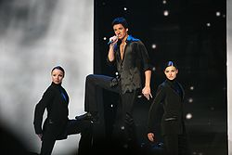
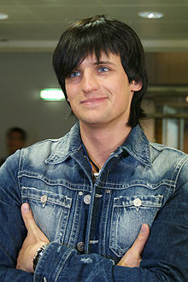
Dima Koldun
Fact file
Birth name: Dmitry Aleksandrovich Koldun
Born: 11 June 1985 (age 26)
Origin: Minsk, Belarus
Genres: pop, pop rock, synthpop
Occupations: singer
Years active 2004–present
Labels: Lizard
Website: www.koldun.name
Dima Koldun is a pop singer from Minsk, Belarus. He participated in the Eurovision Song Contest 2007 and has been the most successful entrant from Belarus to date. His song "Work Your Magic" was the first Belarusian song to enter the Eurovision final which later achieved 6th place and top chart positions in Eastern Europe.

Slide 11
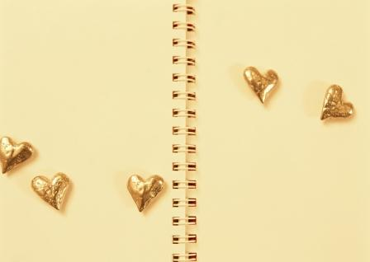
Created by
Kate Skobeiko
Karolina Danilchik
Grade 5
Slonim gymnasium 1
Belarus
ppm1

