Slide 1
Clothing: past and present
Made by:
School No. 10
Bobruisk
Belarus

Slide 2
Clothes Quotes
Any man may be in good spirits and good temper when he's well dressed. ~Charles Dickens
Funny that a pair of really nice shoes make us feel good in our heads - at the extreme opposite end of our bodies. ~Levende Waters
Our clothes are too much a part of us for most of us ever to be entirely indifferent to their condition: it is as though the fabric were indeed a natural extension of the body, or even of the soul. ~Quentin Bell
One should either be a work of art, or wear a work of art. ~Oscar Wilde
If I were a cat, what would make me purr? A pair of really comfortable blue jeans, and massages. ~Cinnamon Stomberger
Fashion can be bought. Style one must possess. ~Edna Woolman Chase
Carelessness in dressing is moral suicide. ~Honoré de Balzac
Clothes are never a frivolity: they always mean something. ~James Laver
The truly fashionable are beyond fashion. ~Cecil Beaton
Never wear anything that panics the cat. ~P.J. O'Rourke

Slide 3
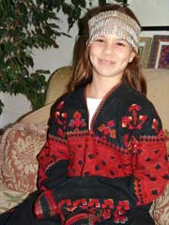
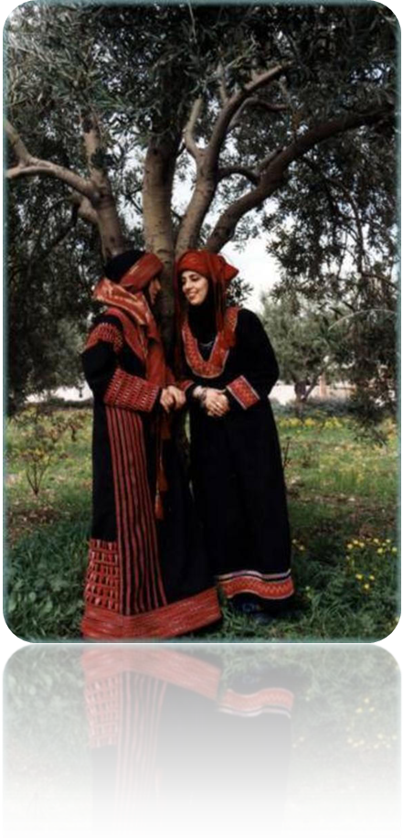
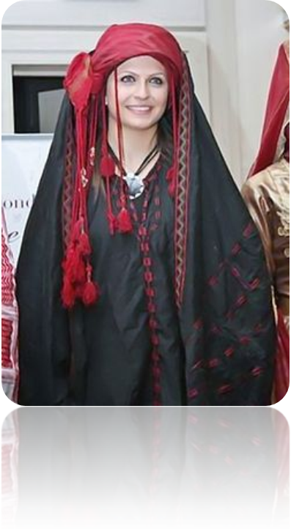
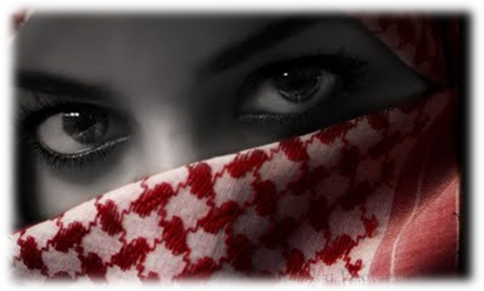
Folk Clothes Jordan

Slide 4
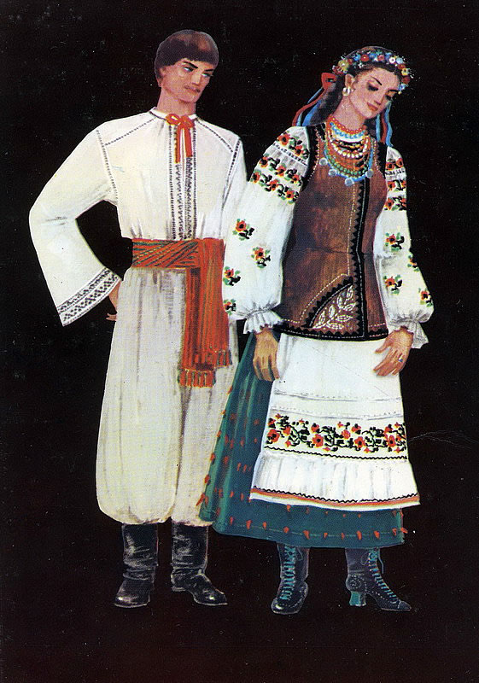
Folk Clothes Ukraine
Typically, the female costume consists of a shirt or Vyshyvanka( which is a colloquial name of the traditional Ukrainian embroidered shirt), long skirts, vests, and national footwear. Red necklace is usually put on the neck , and head is decorated with a handmade wreath of flowers. The overclothes repeat the shape of vests. Male costume consists of a shirt which is also embroidered, pants or trousers with a belt, and hats. Traditional Ukrainian clothing may be worn for festivals, special occasions, or holidays.

Slide 5
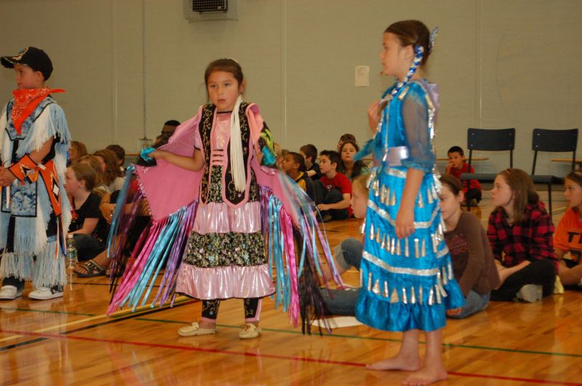
Folk Clothes Canada
Canada is a multicultural nation, so we don’t have our own national clothing.
Our native American culture would be the closest thing to our national clothes.
This is two Mik Maq girls wearing traditional dance costumes.

Slide 6
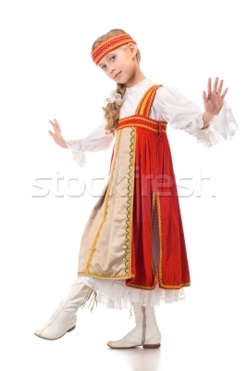
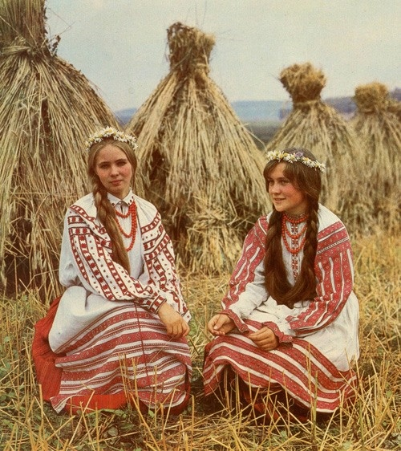
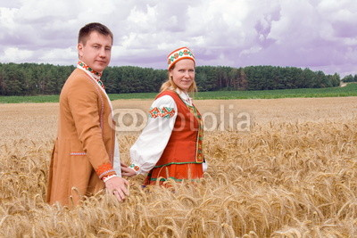
Folk Clothes Belarus

Slide 7
Youth style from Ukraine
Teenagers in Ukraine like in any other country wear different clothes. That usually depends on taste of each particular individual because that is one of the things which resembles ourselves. And here one can find different styles varying from smart casual clothes to sophisticated dresses. It is normal that each teenager wants to be dressed in fashionable clothes but not everyone can afford it because of the lack of money. In my opinion, it is necessary to wear comfortable clothes so that nothing will disturb you. And besides, even from the simplest things, be it even jeans and sweater or jacket or anything else, one can create quite stylish look which would resemble one's personality drawing people's attention (in good sense of it).

Slide 8
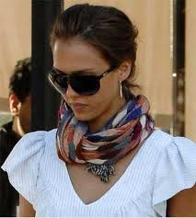
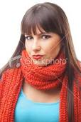
Youth style from Canada

Slide 9
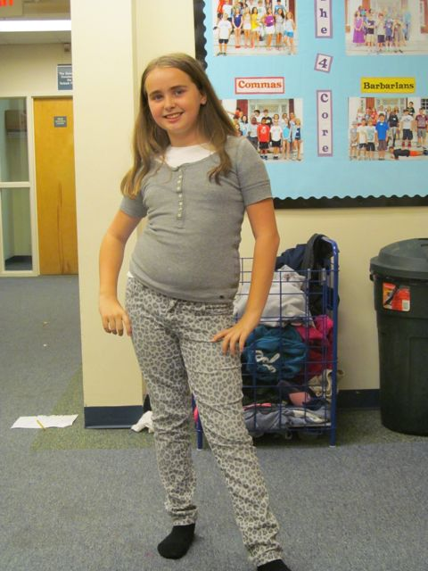
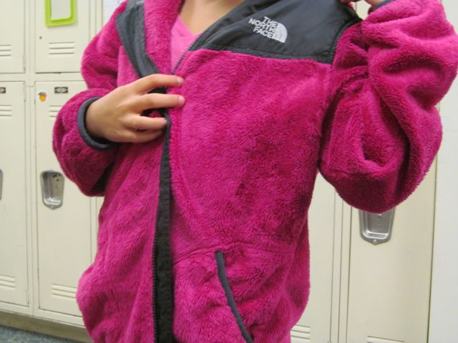
Youth style from the USA
Faith is wearing a typical outfit that a girl would wear to school—a matching shirt and pants.

Slide 10
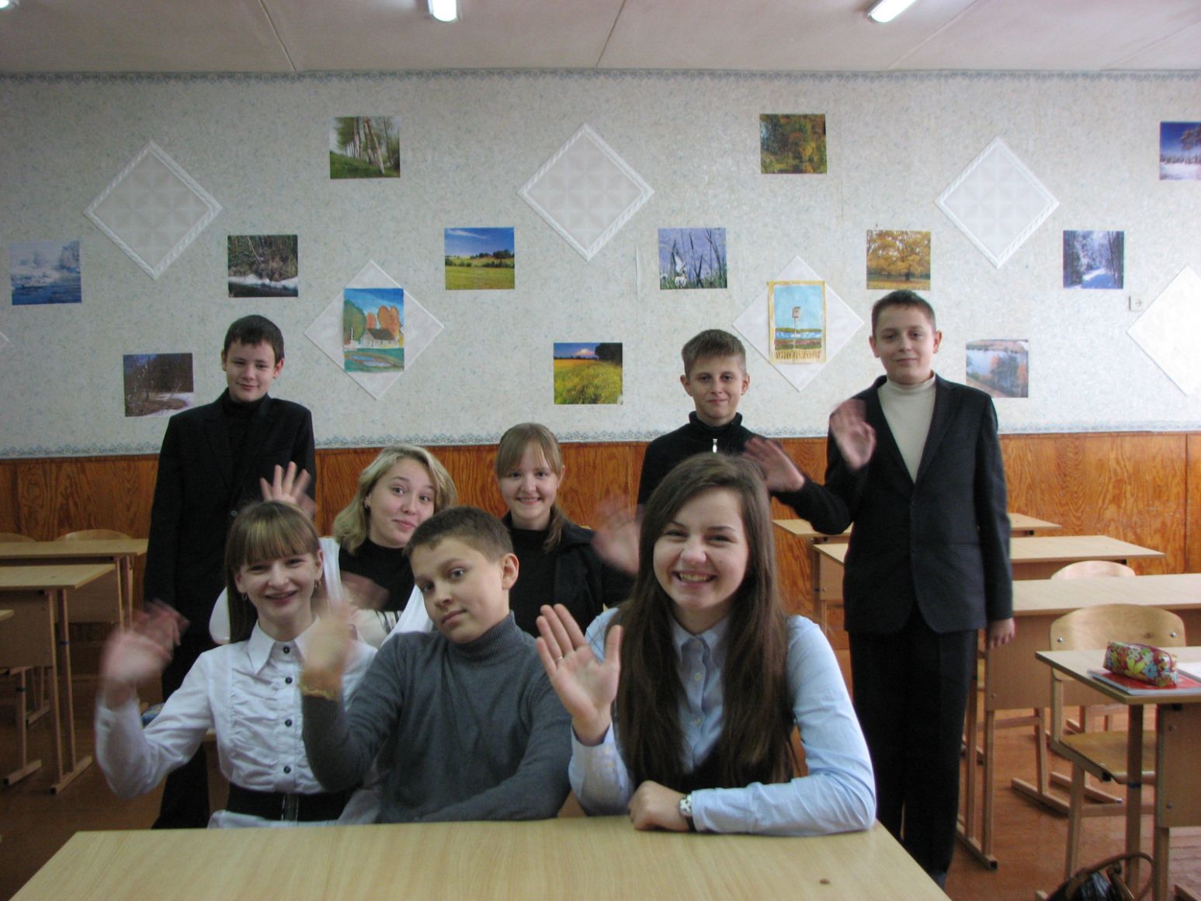
School outfit in Belarus
In general we wear clothes of formal style to school: suits for boys, dark trousers (rarely skirts) and blouses for girls.

Slide 11
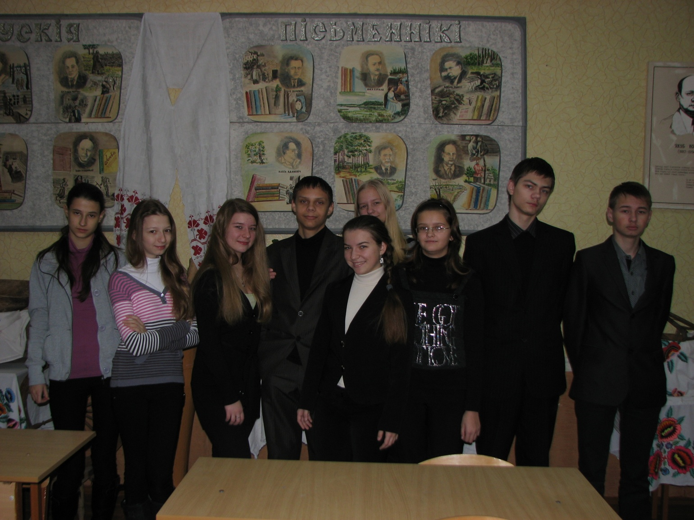
School outfit in Belarus
We don’t really like formal style, we prefer jeans and sweatshirts.

Slide 12
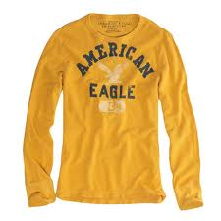
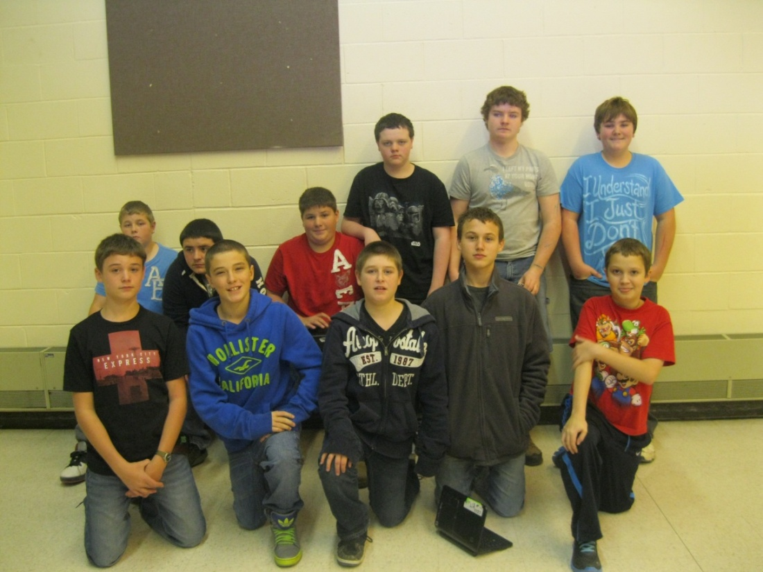
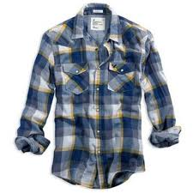
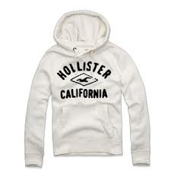
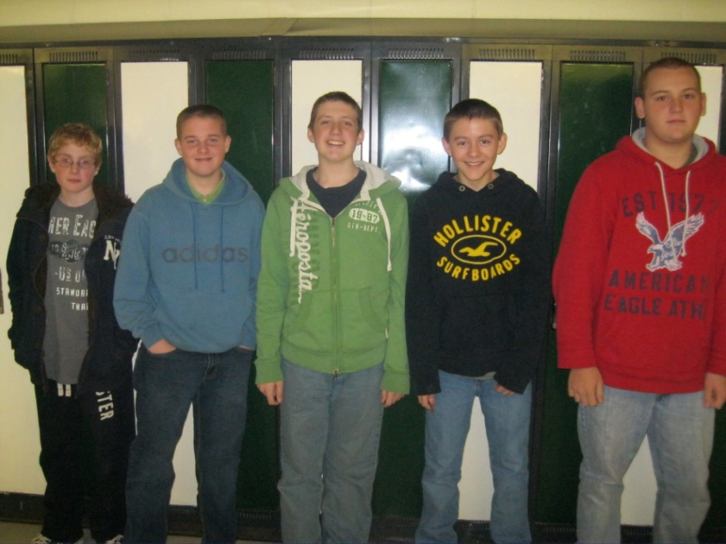
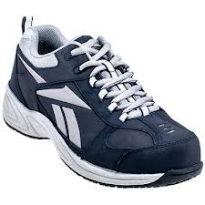
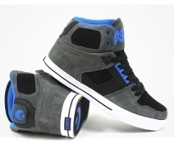
School outfit in Canada
Guys in our school mostly wear name brand t-shirts and hoodies. Such as Hollister, American Eagle and Areopostale. Some guys also wear Plaid shirts, however that isn’t as popular.
For shoes, guys usually wear just simple Sneakers, such as Nike, or Reebok. Some guys also may wear Osiris Sneakers.

Slide 13
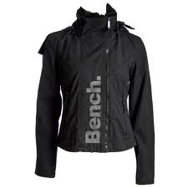
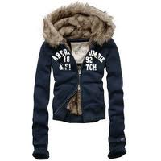
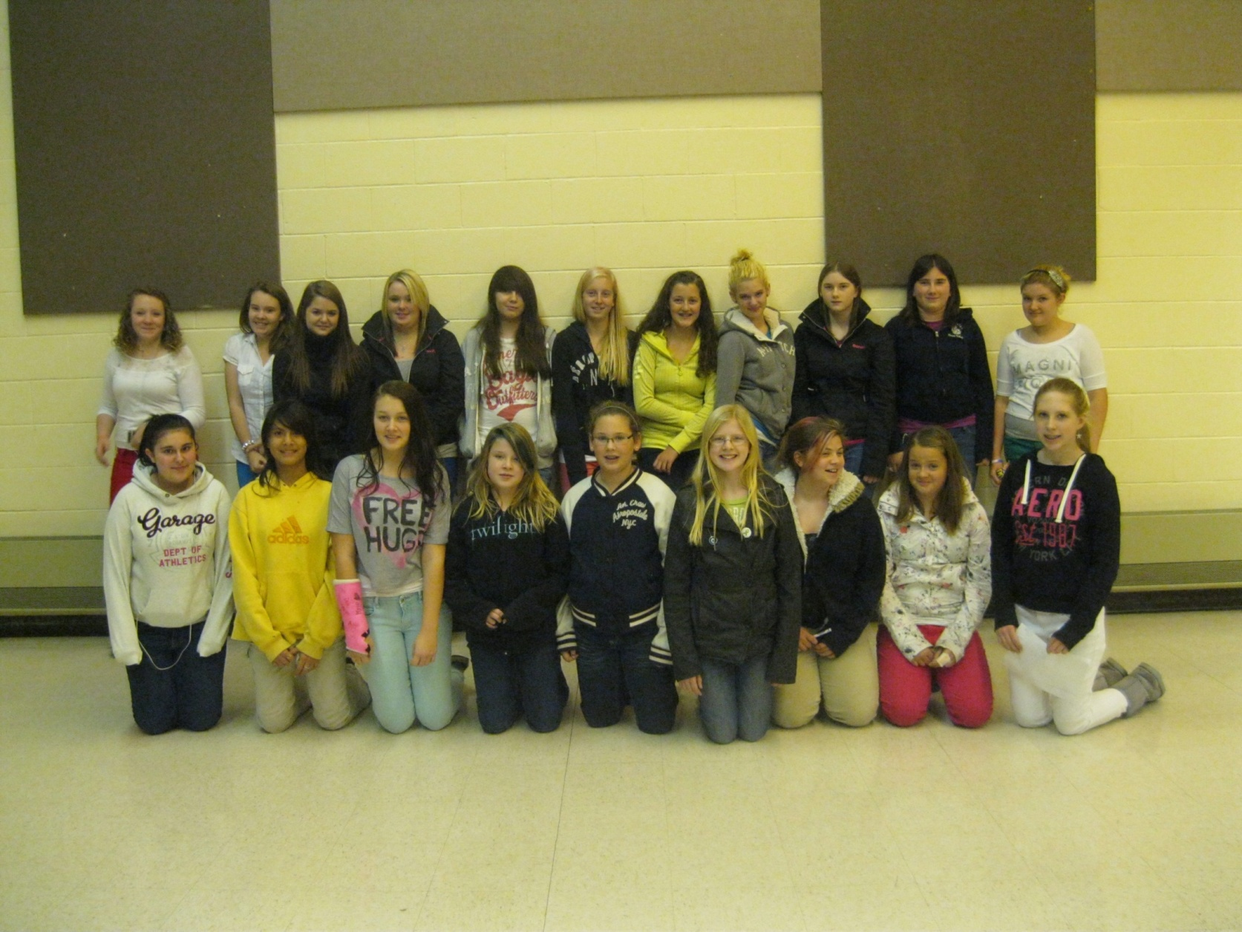
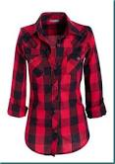
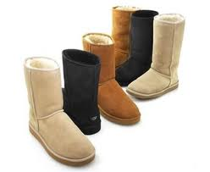
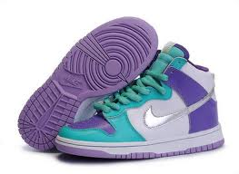
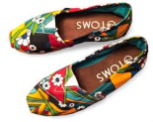
School outfit in Canada
For girls clothing, they mostly wear what’s in style which is usually more formal, than casual. What’s in this year is colored skinny jeans, plaid shirts, scarfs. We also wear name brand hoodies such as, Bench, Lulu Lemon, Hollister, American Eagle and so on.
For shoes, girls wear mostly Ugg Boots, Clogs, Dressy Boots, Birkenstocks, High-top Sneakers, and Tom shoes.

Slide 14
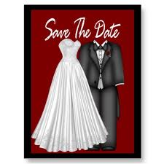
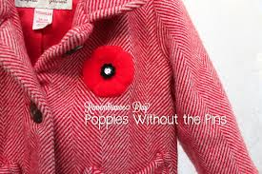
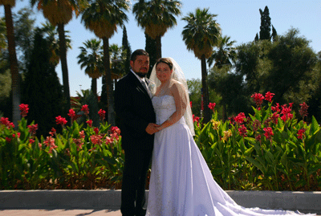
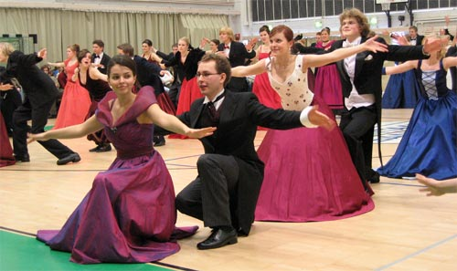
Special occasions
In Canada the traditional clothing for a wedding is a white dress and tux.
On remembrance day in Canada, it’s traditional to wear something red, and a poppy.
Today’s bride in Belarus may choose to wear a white wedding dress (the color of joy) or she may choose to wear a more colorful dress. The groom wears a suit.
School leaving parties are always unbelievably colorful in Belarus.

Slide 15
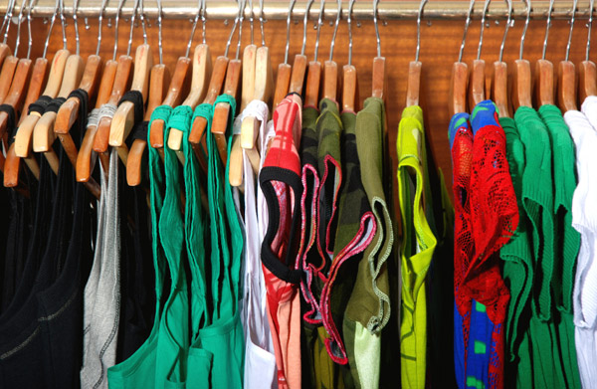
Are we alike or different?
Questionary results.

Slide 16
What style do you prefer?
Canada
Belarus

Slide 17
What is your favourite colour?
Canada
Belarus

Slide 18
What is your favourite item of clothes?
Canada
Belarus

Slide 19
Who chooses clothes for you?
Canada
Belarus

Slide 20
What is your opinion about school uniform?
Canada
Belarus

Slide 21
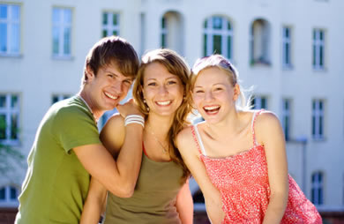
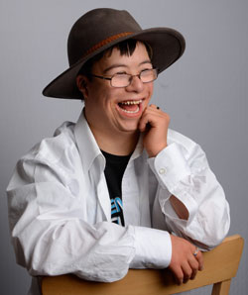
Wear clothes that make you happy!

