Slide 1
LOCAL LEGENDS

Slide 2
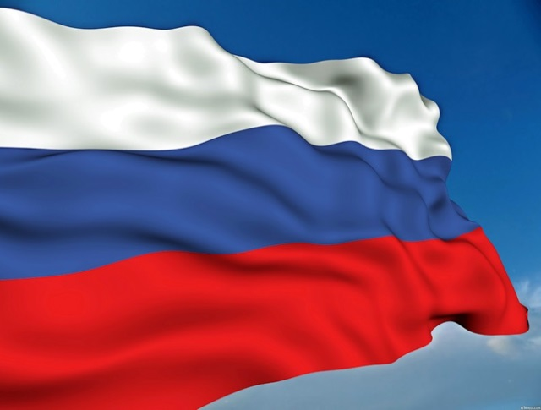
Countries-participants

Slide 3
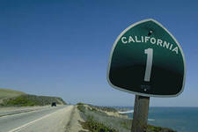
Сalifornia is a state located on the West Coast of the United States. It is the most populous U.S. state.

Slide 8
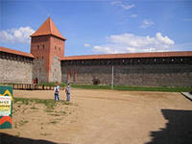
Lida is a city in western Belarus in Hrodna Voblast, situated 160 km west of Minsk.

Slide 15
Starye Dorogi, Belarus

Slide 17
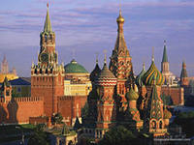
Moscow is the capital city and the most populous federal subject of Russia. The city is a major political, economic, cultural and scientific center in Russia and in Europe.

Slide 22
Legend from Grodno, Belarus
A famous legend says, there is an underground passage in the centre of town with many trapdoors from a lot of houses in it. It goes from the Cathedral of St. Francis Xavier under Neman and comes out on the other riverside, in the Franciscan church.

Slide 23
Legends from Seattle

Slide 26
Thank you for your work Friends!!!

