Slide 1
Jobs Around the World
Class 6B
School “Dan Barbilian”
Constanta
Romania

Slide 2
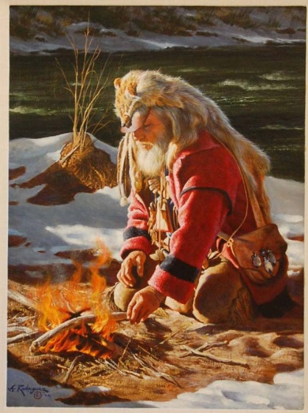
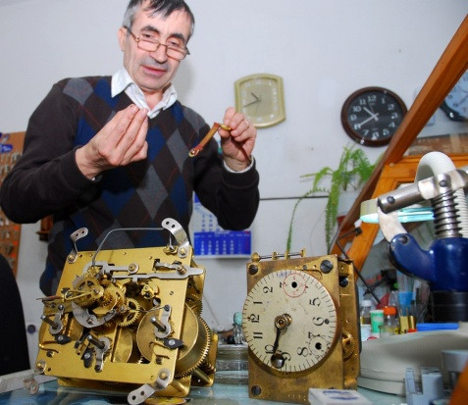
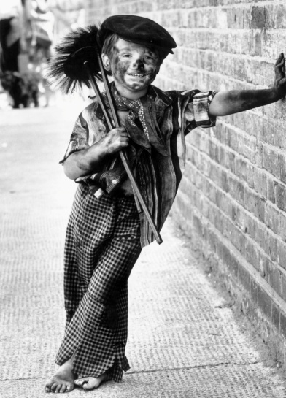
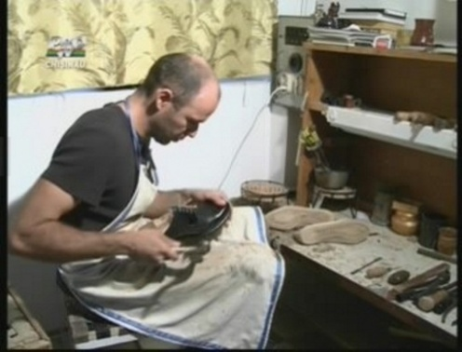
The Oldest Jobs
Students from different countries told us that among the oldest jobs in their region are:
craftsmen, manufacturers, builders, potters, shoe-makers, farmers, gold seekers, tailors, chimney sweeps, watch makers.
Romanian students were impressed by the stories about gold seekers in America and the talent and patience involved in such jobs as watch makers or jewellers.

Slide 3
The Most Modern Jobs
There are lots of modern jobs, both in our region and in other countries. The ones which have the strongest impact on the modern society are jobs in the IT field, but also the ones related to research, business, entertainment and media.

Slide 4
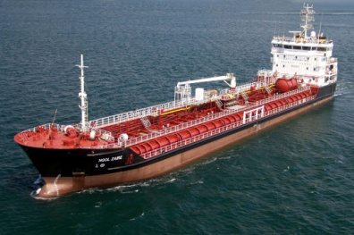
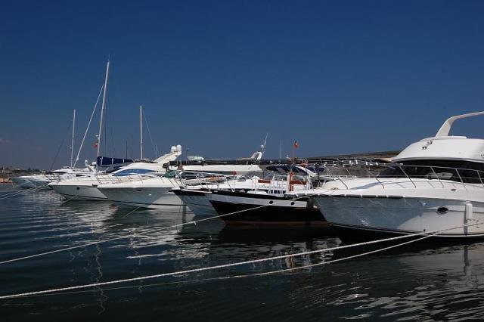
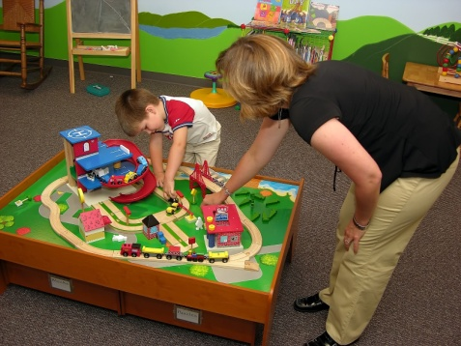
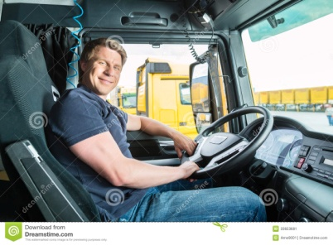
What people in our region do for a living
Most students involved in our project referred to their parents’ jobs or the jobs of people around them. Thus, they mentioned such jobs as:
teachers
doctors and nurses
architects
seamen and army officers
shop assistants
librarians
electricians and mechanics
drivers
In our city, for example, lots of men work as seamen because Constanta is situated on the Black Sea Coast.

Slide 5
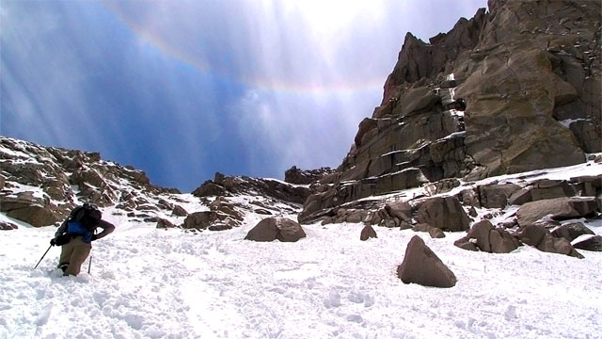
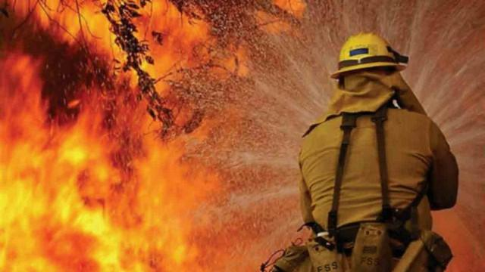
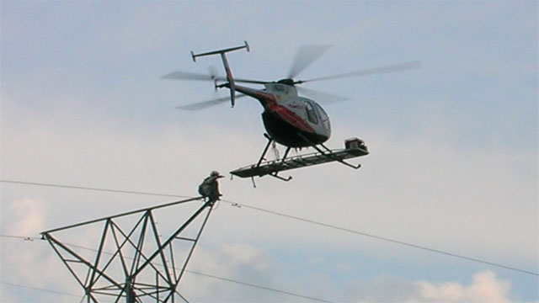
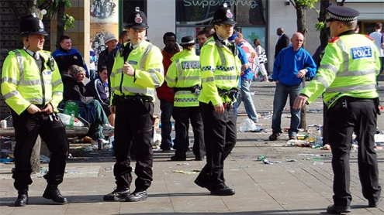
Hardest and easiest jobs
In our project, there’s been a lot of discussion on this topic, as there are hard jobs in all fields, but they seem easy if you are dedicated and hard-working. Also, certain jobs can be considered easy, but if you take a closer look, you’ll see they need much effort and long hours. In the end, we agreed that it needs a lot of courage and determination to have such dangerous jobs as: mountain guides, stunt men, alligator wrestlers, lineman & power workers, firefighters, roofers, pilots or police officers.

Slide 6
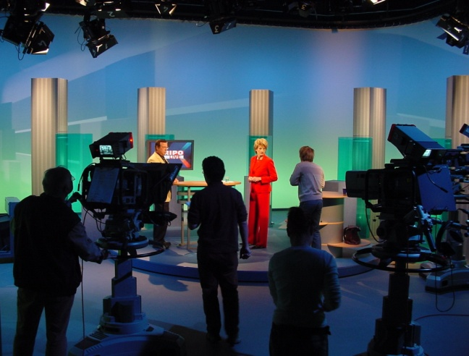
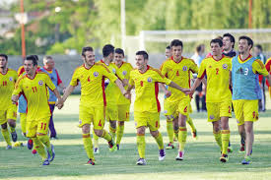
Best-paid versus Worst-paid Jobs
We think the best-paid jobs are in television, IT , entertainment and showbiz, sport and business.
On the other hand, the worst-paid are probably the easy ones, which don’t need a lot of preparation and learning and don’t take long hours.

Slide 7
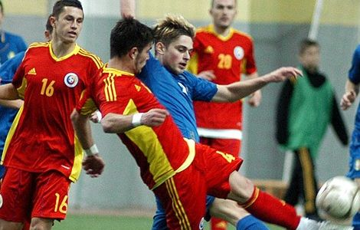
If I could choose my job right now, I would like to be a…
Well, it isn’t easy for us, children or teenagers to answer such a question, but …boys would like to become IT specialists, football players, police officers or work in the army, while girls want to be famous singers, actresses, fashion designers, business women, doctors or teachers! Wish them luck!

Slide 8
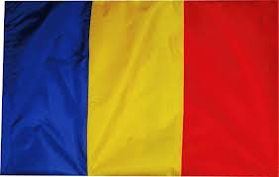
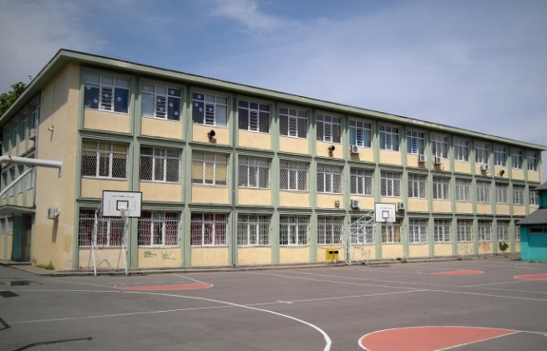
Thanks a lot for your collaboration!
It has been very interesting and useful for us to find out about jobs from different parts of the world!
Good luck at school and in your future career!
Students in 6B, “Dan Barbilian” School
English teacher, Mirela Munteanu

