Slide 1
CULTURAL ASPECTS OF OUR LIVES
iEARN -Learning Circles
May, 2014
a project developed by students in classes 5B and 6C from “Ion Creanga” School, Cluj-Napoca, Romania, teacher Dana Muntean;
Thank you to our partners from:
Vine Middle School, Knoxville, TN, USA
Dan Barbilian School, Constanta, Romania
University Prep, Seattle, WA, USA
Negoreloe School №1, Energetic, Belarus
Moscow, Russia for their great contributions!

Slide 2
CULTURAL ASPECTS OF OUR LIVES
Why culture? Because by looking at the culture of a community you understand that community better!
Culture is the name for what people are interested in, their thoughts, their models, the books they read and the speeches they hear, their table-talk, gossip, controversies, historical sense and scientific training, the values they appreciate, the quality of life they admire. All communities have a culture. It is the climate of their civilization. Walter Lippmann

Slide 3
What we chose to look at:
Representative cultural institutions in the partner cities
Historical aspects to understand the past
Fairs and festivals to understand the present
Traditions
Art
Religion
… and dreams!

Slide 4
Which are the most representative cultural institutions in your towns?
We got some interesting information. Our partners mentioned most often: universities, museums and monuments.
Our class voted our favorites from each partner:
In Knoxville- Knoxville Museum of Art
In Constanta- The Casino Building
In Seattle- The Space Needle
In Energetic- the museum of nature and the war museum in Stankovo
In Cluj-Napoca- Babes Bolyai University
In Moscow - Kremlin

Slide 5
Thanks to our partners for
these great pictures.
ENJOY! ☺

Slide 6
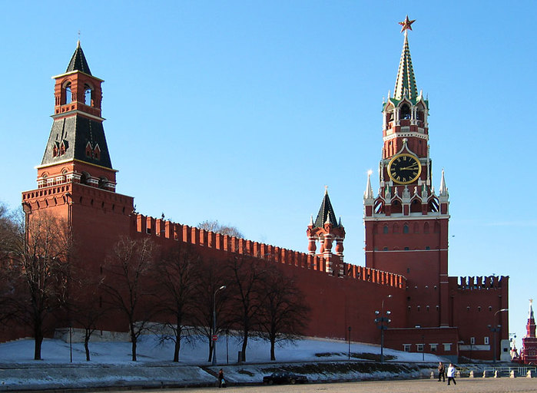
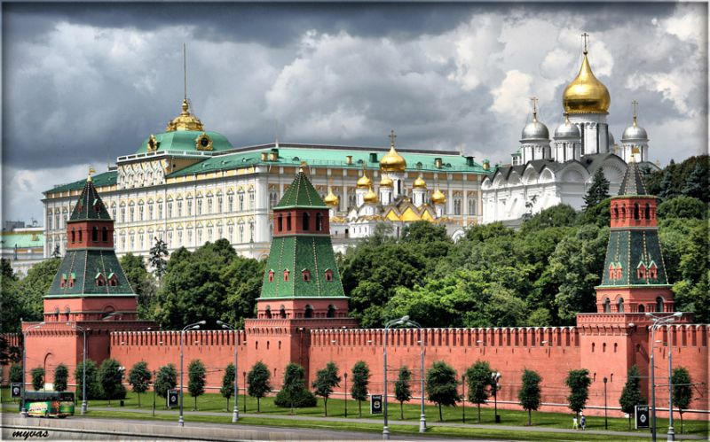
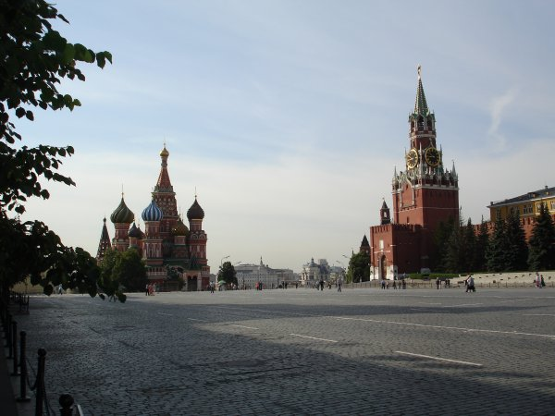
Kremlin
Moscow

Slide 7
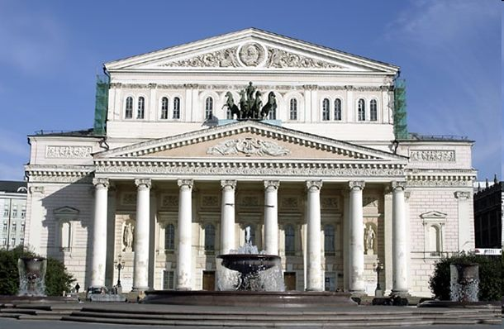
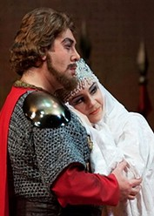
Bolshoy theatre
Moscow
Prince Igor

Slide 8
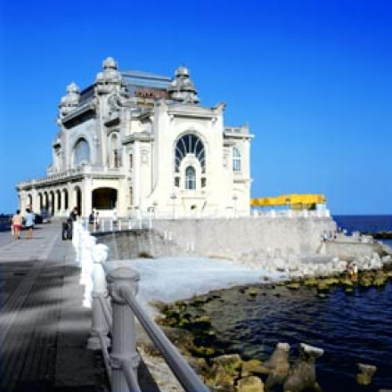
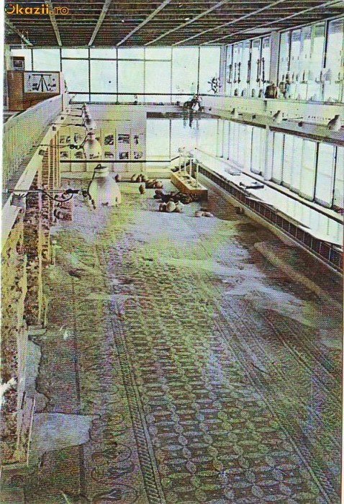
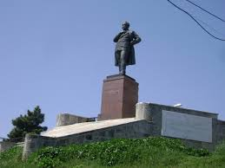
Constanta
The Roman Mosaic Ediffice
The Statue of our great Romanian poet, Mihai Eminescu
The Casino Building

Slide 9
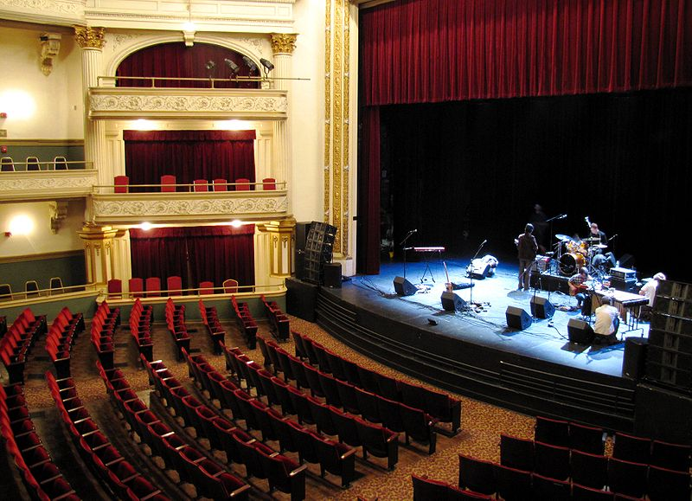
Bijou Theatre
Knoxville

Slide 10
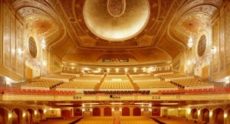
There are more than 100 theaters in Seattle. The theater pictured below is called the Paramount Theater.
Wow!!

Slide 11
Church
Knoxville

Slide 12
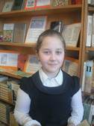
There is only a town club in our Energetic. We`ve got a library there. We also have a library in our school

Slide 13
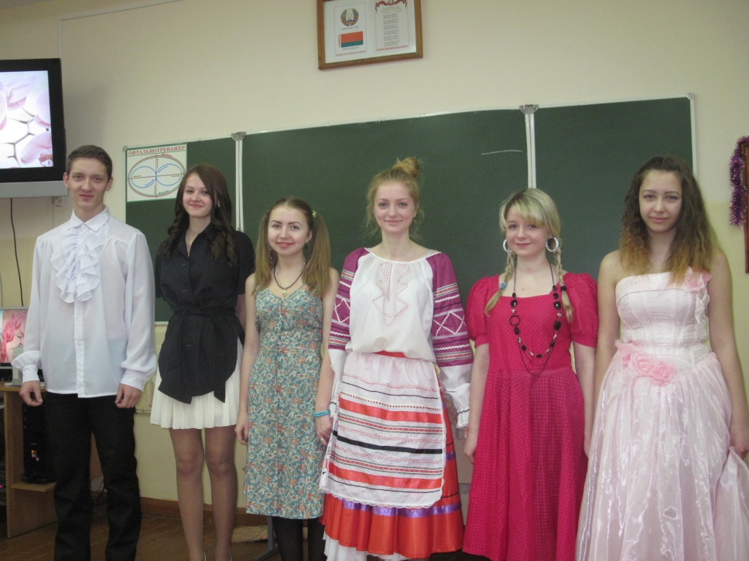
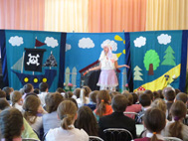
ENERGETIC: We haven`t got any theatres in our town. We can only dream of them. Some of our teachers and students try to do dramatizations or theatre troupes from our capital come to our school.

Slide 14
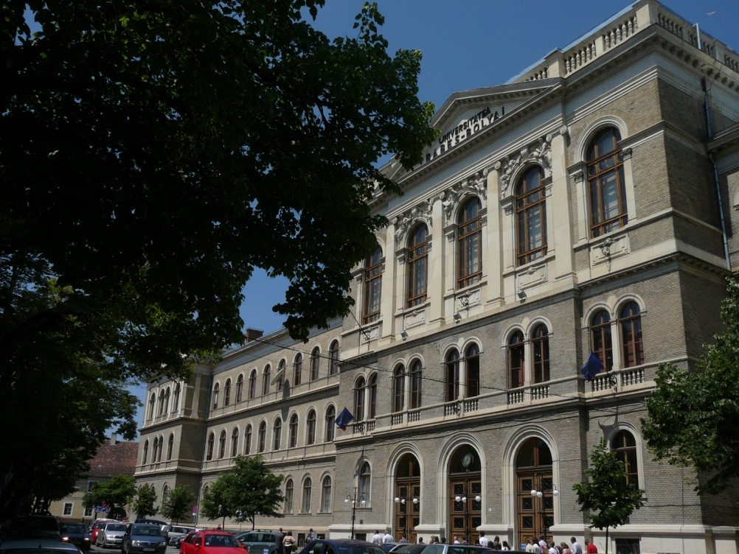
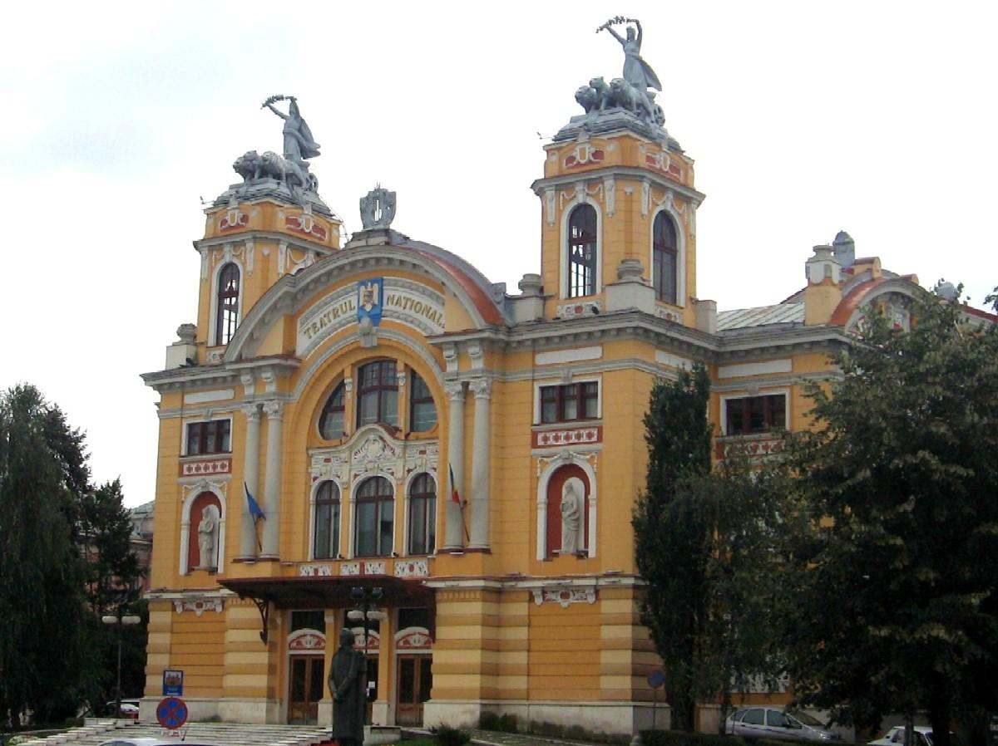
In Cluj, the most important cultural institutions are:
- Babes –Bolyai University
-Romanian National Opera
-Transylvania State Philharmonic

Slide 15
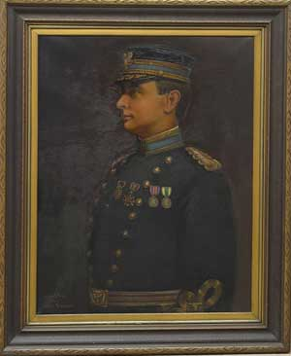
The most relevant museum in our city
Museum of East Tennessee History
Knoxville

Slide 16
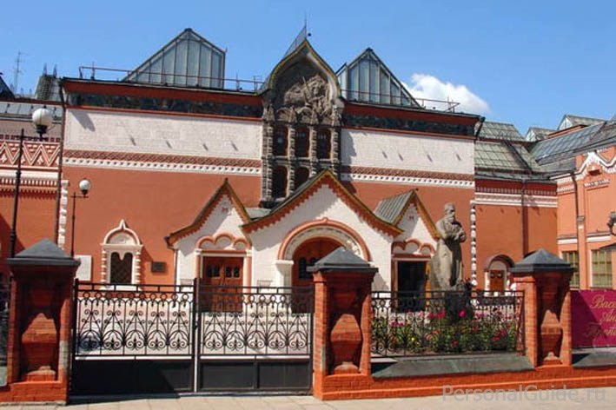
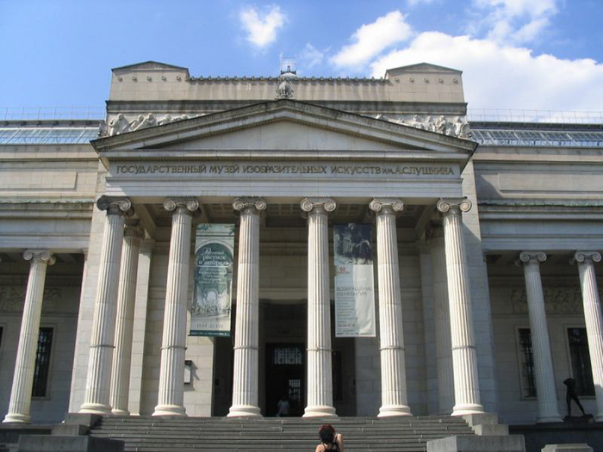
Pushkin Museum
Tretyakov Gallery
Moscow

Slide 17
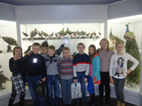
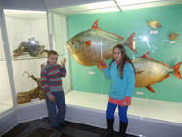
There is a small museum in our school, a museum of nature in a village next to our town and «war» museum in Stankovo village. School children visit these museums every year. It`s very interesting to know the history and culture of our country
Energetic

Slide 18
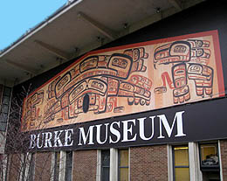
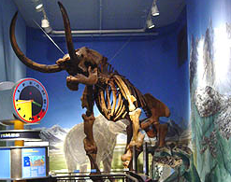
What is the most important cultural institution in your town?
The Burke Museum because it shows us Native American history from where we live. Native Americans used to live in Seattle.
Seattle

Slide 19
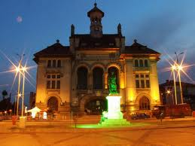
The most visited and relevant museum in our city
The National History and Archaeology Museum, with the statue of Ovid
Constanta

Slide 20
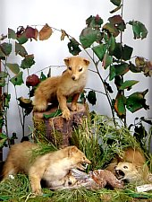
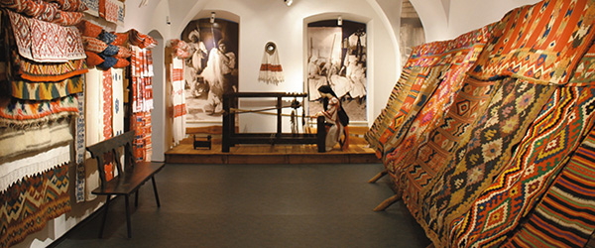
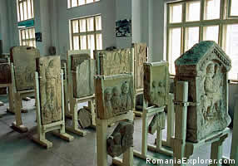
Which is the most visited/relevant/interesting museum in your town?
The most visited museum from Cluj is the Zoological museum. It’s big and at least once a year , there comes an exhibition of interesting live animals.
The most relevant museum from my town is the Etnographical museum.
The most interesting museum in my town is the History museum. In it , there are a lot of things that speak about our history.
Cluj

Slide 21
FAIRS & FESTIVALS
WE WANTED TO SEE WHAT PEOPLE LIKE TO DO IN DIFFERENT PARTS OF THE WORLD, WHAT KIND OF THINGS THEY APPRECIATE AND CELEBRATE
Fairs are organised in Cluj very often, for example only in Autumn are 20 important festivals. Fairs are many kinds: pop music, folk music, books, gifts, folk traditions ... I think that the Gift Festival ( Targul de iarna ) and Transylvanian Rippers are the most appreciated by a part of my classmates fans of extreme sports. (Adi S., 5B, Ion Creanga School, Cluj)

Slide 22
Fairs And Festivals
Our favourite ideas for festivals/fairs from each partner:
In Knoxville- The Biscuit Festival
In Constanta- The Christmas Fair
In Seattle-The torchlight parade
In Moscow-Spasskaya tower- a super military show!
In Cluj- The Gift Festival
Now, some slides from our partners. ENJOY!!!

Slide 23
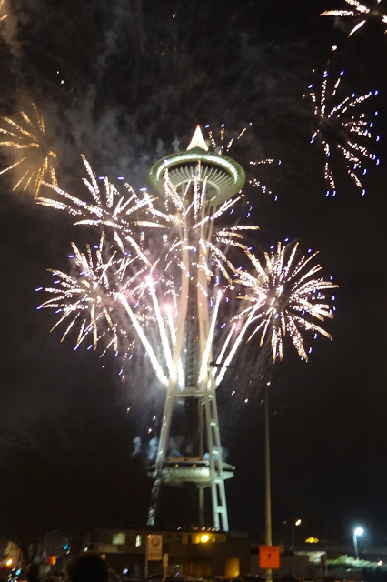
New year's eve at the space needle is one of the most popular festivals.
there are around 60 major festivals taking place this year.
What is one festival that takes place in your town?

Slide 24
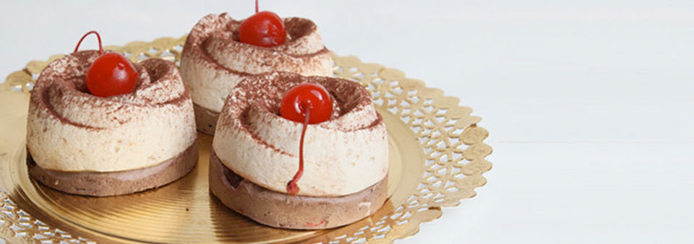
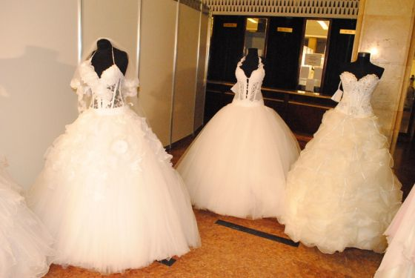
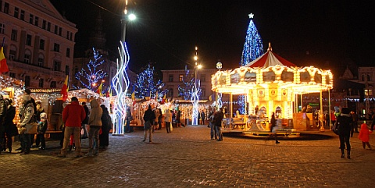
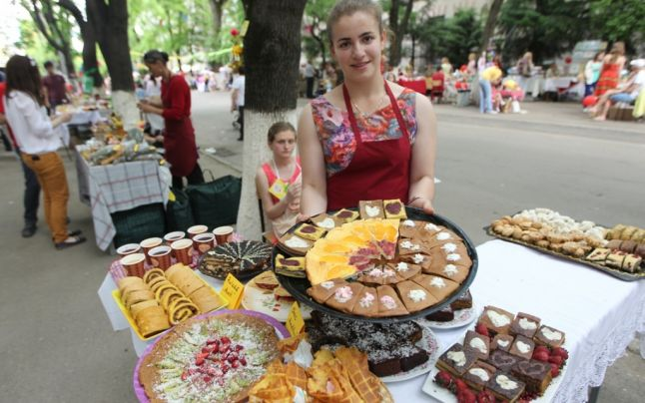
Fairs
“The sweets fair” is a typical fair for my town . There are a lot of stands. They sell a lot of various sweets : cotton candy, jellies , chocolate and more. I love this fair because I love sweets.” (Irina , 5B)
Cluj-Napoca

Slide 25
Festivals and Events
Knoxville impressed us with the variety of ferstivals and fairs
Dogwood Arts Festival
Dragon Boat Festival
East Tennesssee History Fair
Cherokee Heritage Festival
Rossini Festival Italian Street Fair
The International Biscuit festival
A farm-life festival

Slide 26
The torchlight parade is our favorite.
There are three major fairs in our town.
Seattle

Slide 27
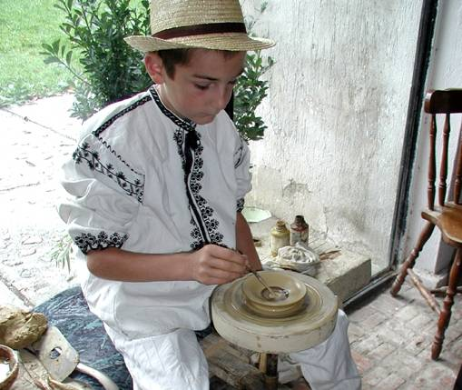
Fairs
Constanta
The Christmas Fair – December
The Easter Fair – April
The Folk Traditions Fair – June/July

Slide 28
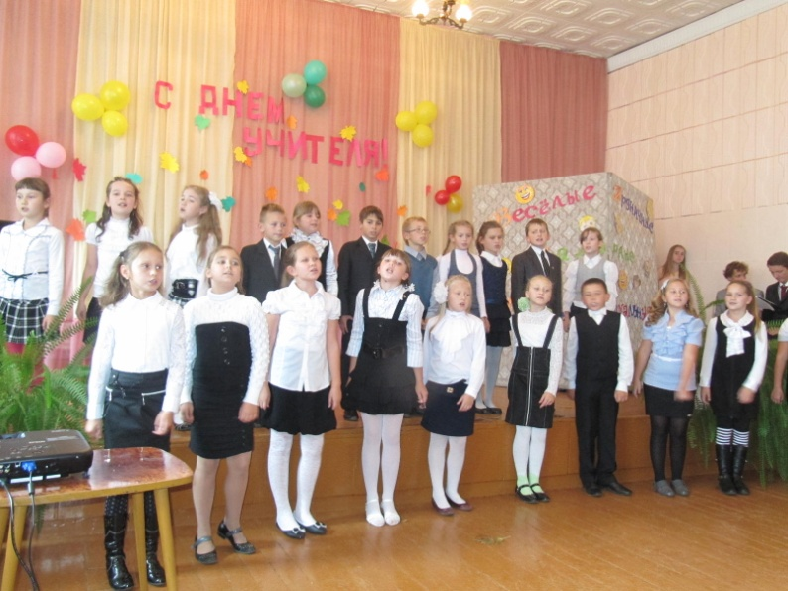
We do our life ourselves here in Energetic. The festivals are not held in our town, only concerts. They are held in honor of different events ( especially holidays)
Energetic

Slide 29
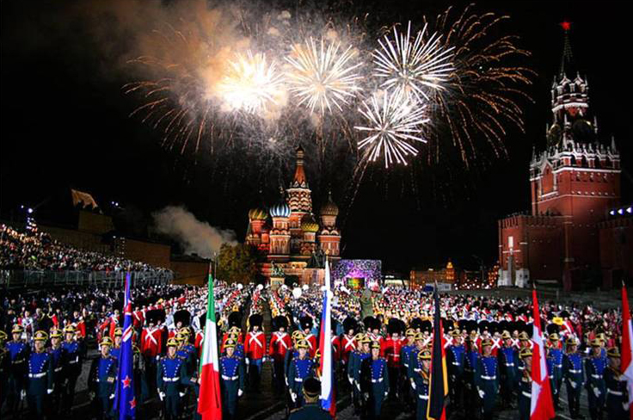
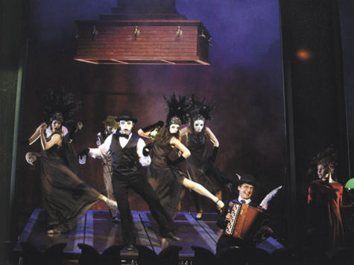
We have many festivals in our town.
Moscow
Spasskaya tower
Chekhov festival

Slide 31
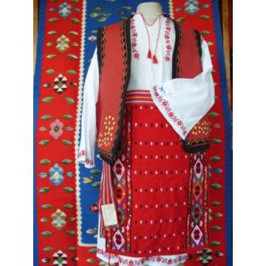
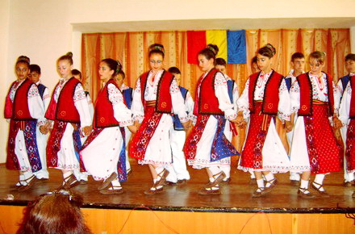
Folk Traditions
CONSTANTA: National folk costumes from our region, Dobrogea

Slide 32
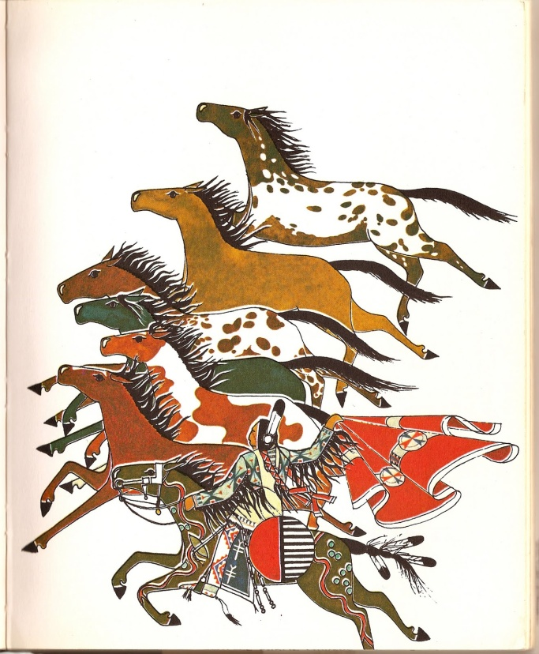
The John t. Williams project is important to Seattle because most native people don't live in the heart of the city and this organization has programs to bring native people together.
What folk traditions are important in your town?
Seattle

Slide 33
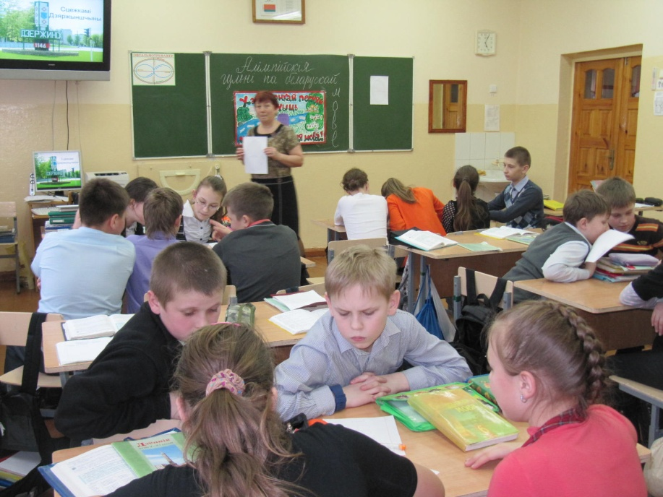
ENERGETIC: We all appreciate our history and culture. Every year we spend mother language day . We also act some plays in our native costumes.

Slide 34
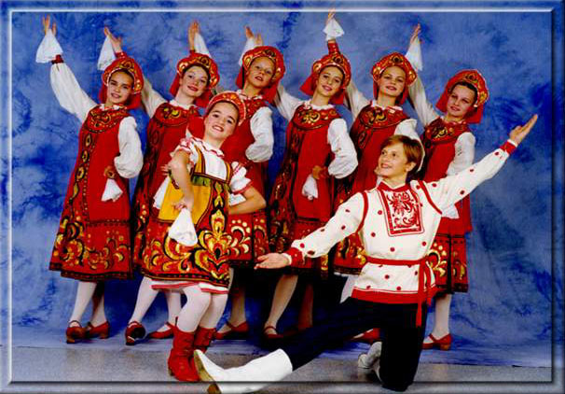
Moscow- Folk Costumes

Slide 35
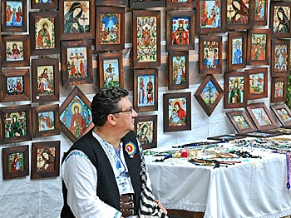
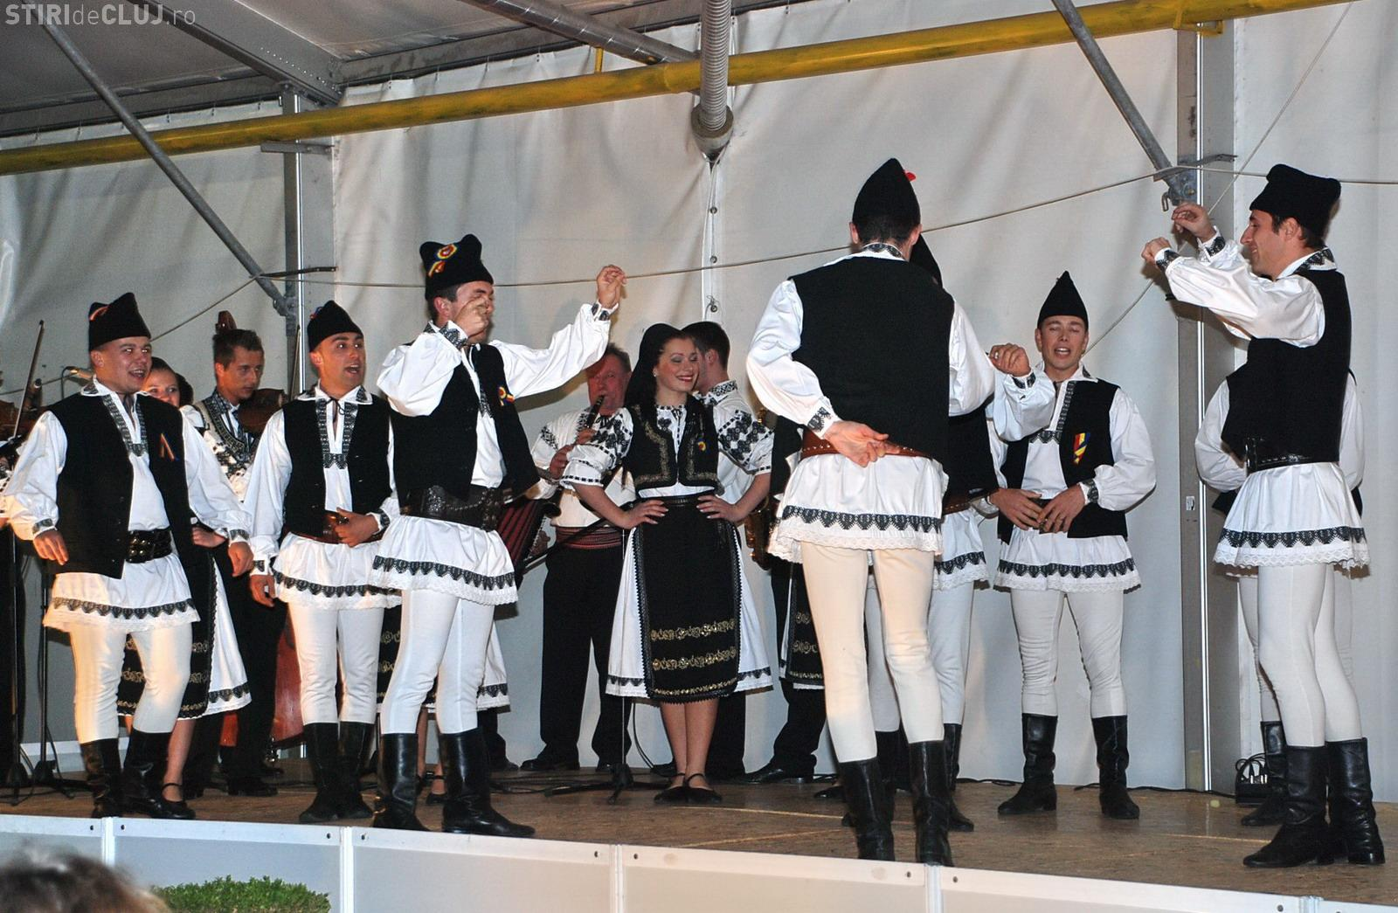
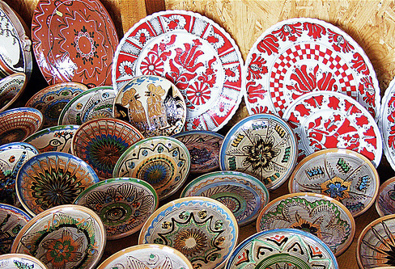
Folk Traditions Cluj

Slide 36
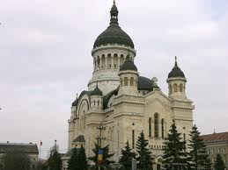
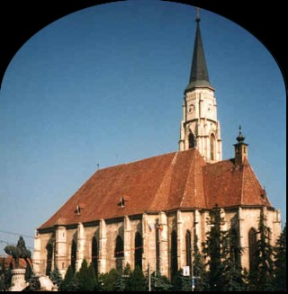
RELIGION
Cluj
YES,RELIGION IS IMPORTANT FOR PEOPLE . They go to church because they believe in God, they need comfort and they want to keep the tradition. In Cluj there are a lot of churches and many new ones are being built. Most of them are Orthodox , and Greek or Roman Catholic but there are also Protestant, Baptists, Pentecostal and some others, too. We study Religion in school.
Tudor Pop, 5B, Ion Creanga School, Cluj
The Ortodox
cathedral
The Catholic cathedral

Slide 37
WHAT WE noticed FROM OUR PARTNERS’ presentations
People are not so religious everywhere. For example only 31% of the population of Seattle go to church regularly.
The percentage of religions is different: in Romania and Russia there are a lot of Orthodox people; in the USA most people are Baptists.

Slide 38
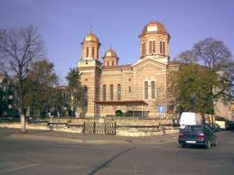
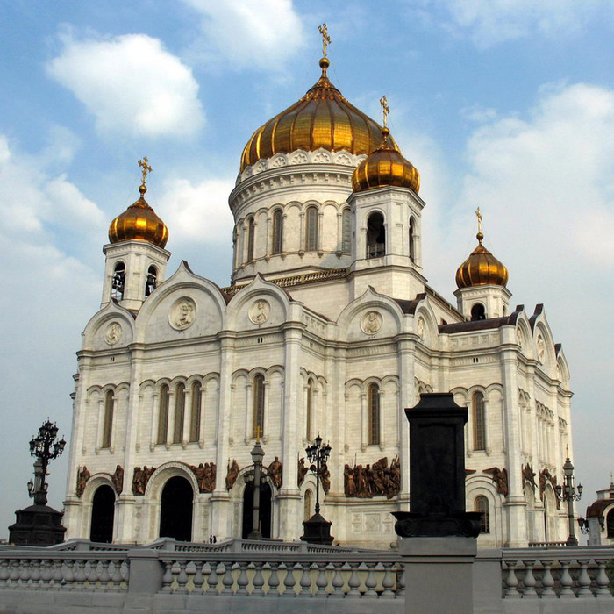
The orthodox churches in Romania and Russia are very similar and they keep a traditional look.
Moscow, Russia
Constanta, Romania

Slide 39
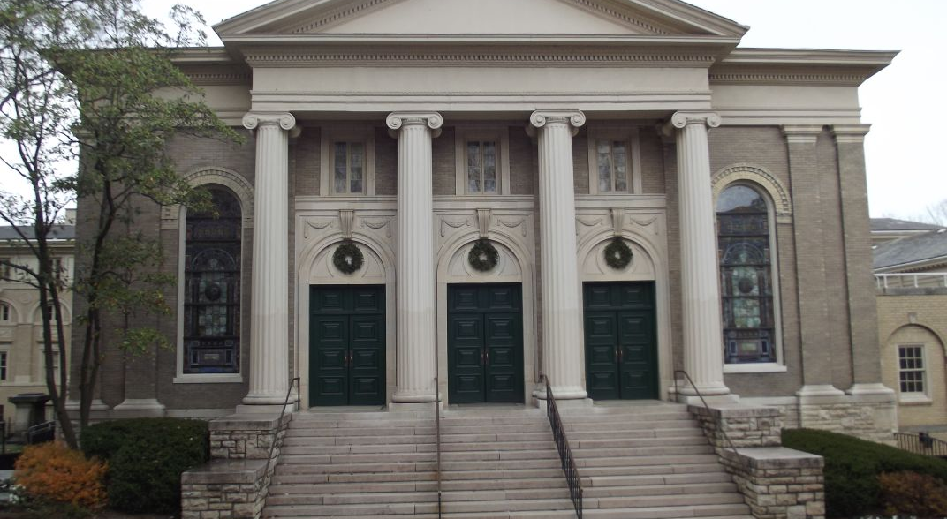
… but the churches in Knoxville are a little bit different (Tudor first thought that it was the City Hall ☺).

Slide 40
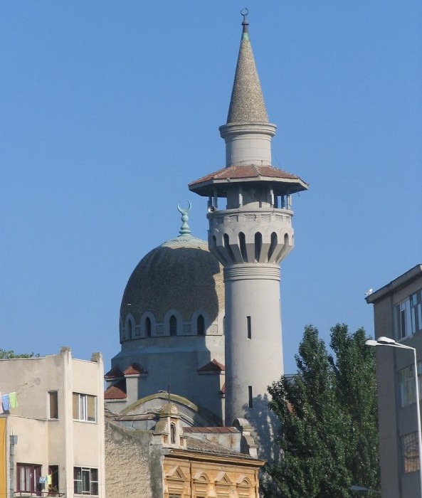
Constanta
Yes, religion is a very important aspect for the people in our city. There are churches and mosques in Constanta.

Slide 41
MONUMENTS AND WHAT THEY TELL US…

Slide 42
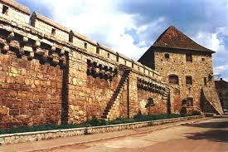
MONUMENTS AND WHAT THEY TELL US…
Cluj grew in medieval times. Each Guild was responsible with defending a corner of the citadel. This tower was the Tailors’.

Slide 43
ENERGETIC: We have monuments next to our town not in it. Everything we do is take care of them ( clean, paint, lay flowers).

Slide 44
Pushkin monument
Moscow
Monument to the first Peter

Slide 45
SEATTLE
The Space Needle, made for when the 1962 World's Fair was hosted in Seattle.

Slide 47
MODERN ART
at the Art Museum of Cluj
http://sabinnemes.wordpress.com/2011/01/23/muzeul-national-de-arta-cluj/

Slide 48
Seattle
Waiting for the Interurban
The Seattle Sculpture Park

Slide 49
If you had all the power in the world, what cultural institution would you build in your town? Why?

Slide 50
Knoxville : we would build statues to remind us of important people
Seattle: We would build a Seattle history museum that would have both art and historical examples of how Seattle was before we lived here. We would build this because it would better show people how others lived before us and the extraordinary history of our city.

Slide 51
Constanta- we would build a huge Circus and a Toy Museum in our city!

Slide 52
We would like to have different cultural institutions in our town but understand it`s not impossible to have them all. That is why we would like to have a modern cinema center and hope we`ll have it in future.
ENERGETIC:

Slide 53
Moscow:
As about our cultural center it can be a huge building with many cultural institutions in it.
The first floor – Music halls, music classes, workshops and studio
The second floor – Art halls, photo exhibitions, workshops and museum of art
The third floor- Theaters and cinemas, workshops, studios
The forth floor – dancing, studio, workshops
The fifth floor – libraries, workshops, studios

Slide 54
Cluj:
I WOULD BUILD A THEATRE
- On its scene would play the most famous Romanian and foreign artists: theatre, ballet on ice, contemporary dance and Opera. (Georgia R., 5B, “Ion Creanga” School, Cluj, Romania)

Slide 55
We decided that we would like to build
A MUSEUM OF THE FUTURE.
….A theme park will be included!☺
It will have 4 sections.
1.On the 1st floor there will be the cinema.
2. On the 2nd floor there will be some big temples.
3. On the 3rd floor there will be an exhibition of dummies in realistic clothes: VIPs, celebrities etc.
4. On the 4th floor will be….. THE ROOM OF THE PAST. There you can put a helmet on your head and you can sit down…..and
YOU CAN WATCH THE WHOLE HISTORY!!!!!!
(Bogdan R., 5B, Ion Creanga School, Cluj, Romania)
Cluj:

Slide 56
CLUJ-NAPOCA 2021
Cluj wants to be the European Capital of Culture in 2021 and the European Youth Capital in 2015
These are projects of the European Union. Cities develop cultural projects for one year, which are based on values such as: Participation ,Interculturalism, Responsibility , Respect for diversity, Non-discrimination, tolerance, Tradition, Innovation, European Dimension
The slogan: CULTURE CHANGES THE CITY - is so true!
VOTE for CLUJ!!!! ☺

Slide 57
THANK YOU!
Irina, Georgia, Daria, Tudor, Bogdan, Adi, Cristi, Robi

