Slide 1
Guidebook of Leisure Activities
Guidebook of Leisure Activities
Negoreloe School №1
Energetic 2014

Slide 2
We try to answer the questions:
What do you do in your free time if there is no place to go?( imagine this situation if it is unreal)
What are the most popular leisure activities with your friends?( ask your friends, please)
List leisure activities that make your city\ country special ( if possible).
How do you spend your weekends? Do you agree with a saying? « Weekends are a bit like rainbows; they look good from a distance, but disappear when you get close to them».

Slide 3
We all look forward to the weekend, whether to spend time with family or see friends. But one thing `s for sure, weekends never seem to last long enough!
Pupils from Cluj(Romania)`ve mentioned that today's teenagers seem to have more time and less responsibility and supervision than the last generation's. It's quite common to see teens "hanging out" at shopping centers, fast food restaurants or where ever they can get together to socialize. Usually, they just have fun and enjoy themselves, but sometimes problems occur.

Slide 4
But what to do If there is no place to go ? Here are the decisions
1. Play video games, get on facebook
2. Go to sleep
3. Watch televsion
4. Go outside, go walking, hang out with friends
5. Play basketball, go biking
Play with Legos

Slide 5
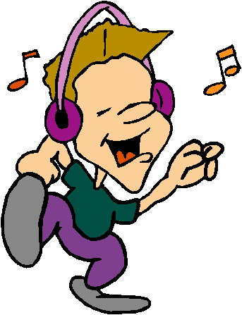
The most popular leisure activities are: Seattle Jump on trampolines , play MTG ( Magic The Gathering ) ,play video games, listen to music , go to stores and malls, go to football field, go skiing, go to Starbucks

Slide 6
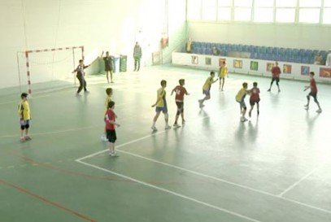
Constanta
do sports
go to the Mall or to the cinema
watch films at home and sometimes read books

Slide 7
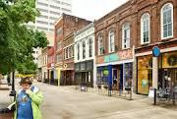
Knoxville
Walk around
Go to the mall
Go to Gatlinburg, TN (Smokey Mountains)
Go to Market Square (shopping & art area)
Talk with friends
Text

Slide 8
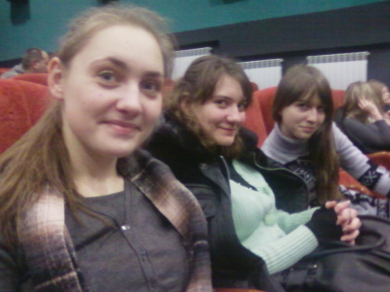
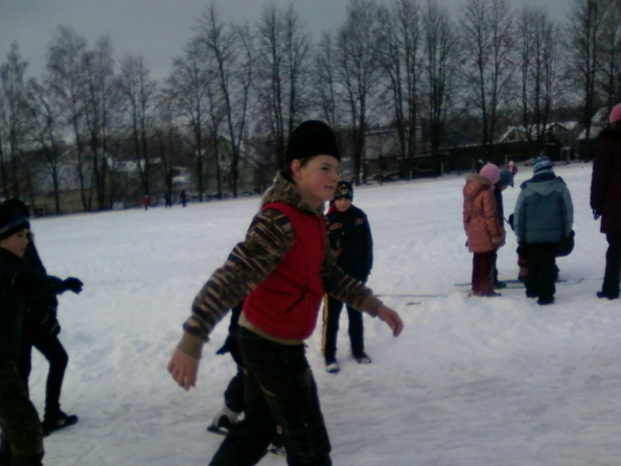
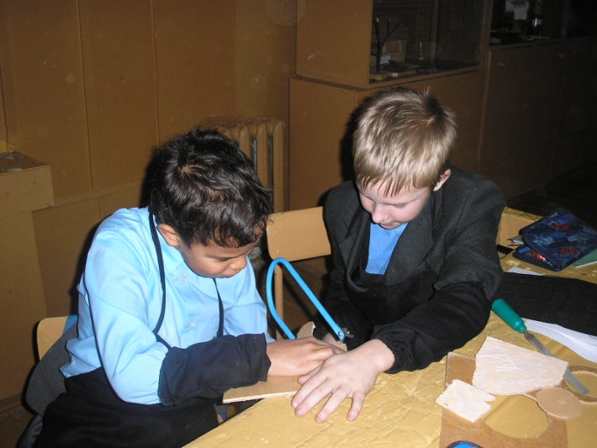
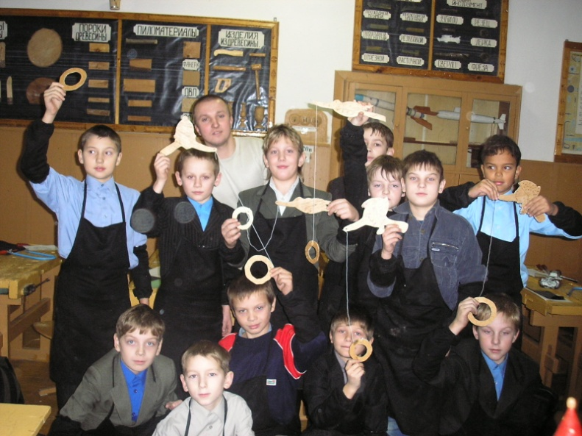
Energetic
Doing sports
Watching TV or going to the cinema, reading, doing crafts

Slide 9
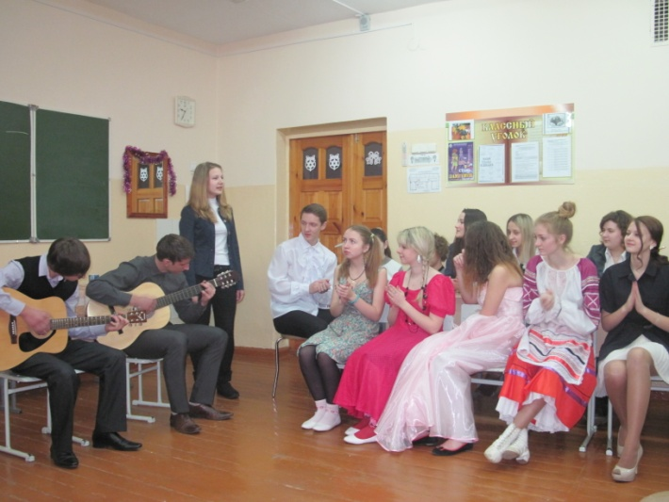
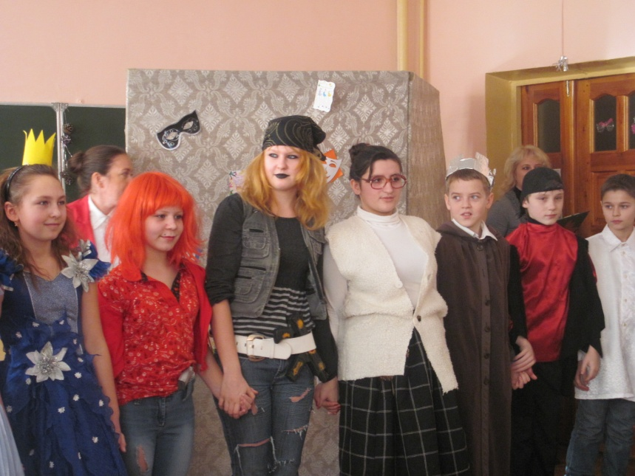
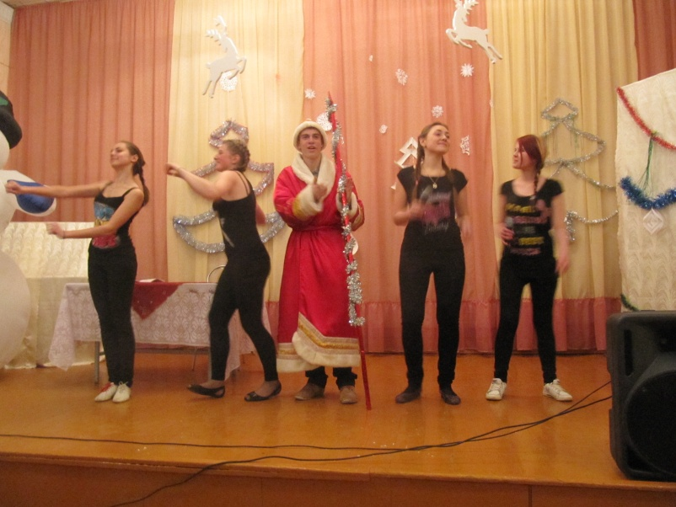
Playing musical instruments, singing and dancing, going for picnics with families and friends.

Slide 10
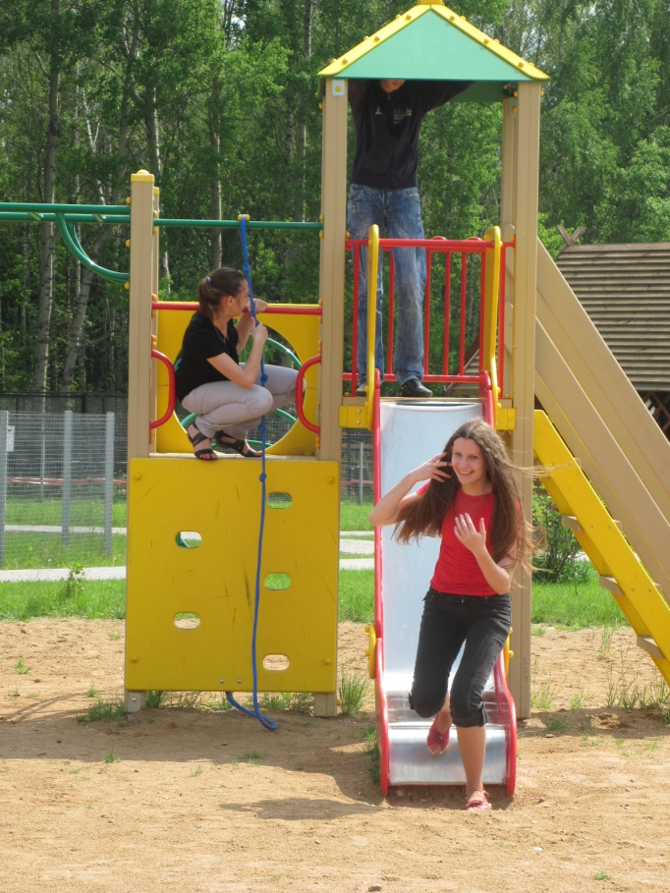

Slide 11
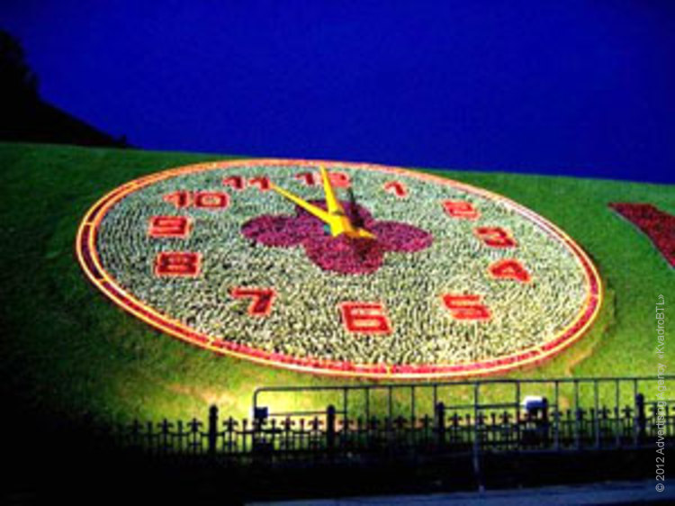
But there are so many beautiful and interesting places to visit! Thank you dear friends for showing them.
The parks of Moscow. We liked them very much. You are lucky to have them around.
«Patriarchal park» and Poklonnaya Hill

Slide 12
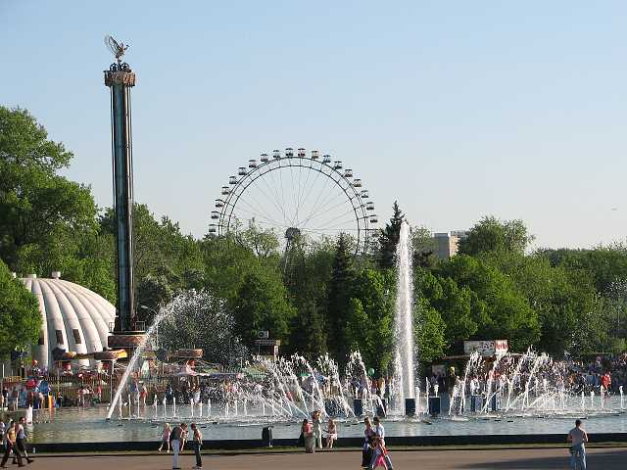
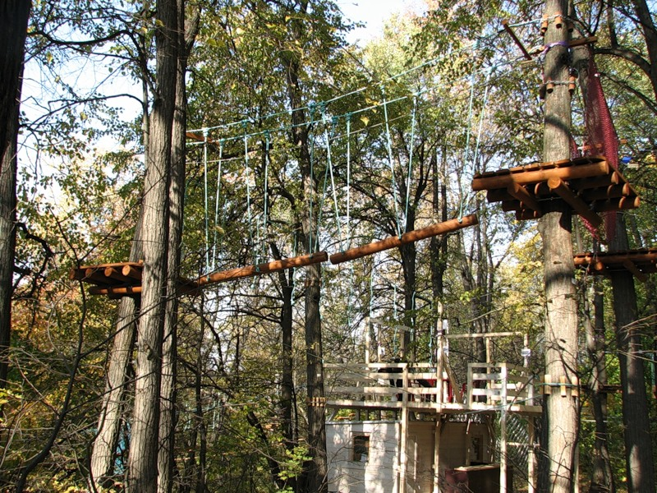
Sokolniki Park
panda-park

Slide 13
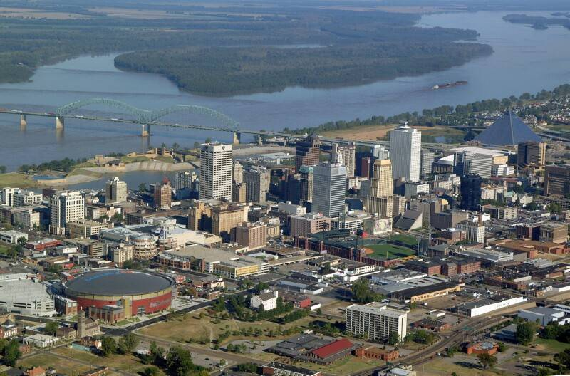
Great Smoky Mountains National Park in Knoxville
Nashville, TN
Dollywood
Gatlinburg, TN
Memphis, TN and
Atlanta, Georgia near Knoxville

Slide 14
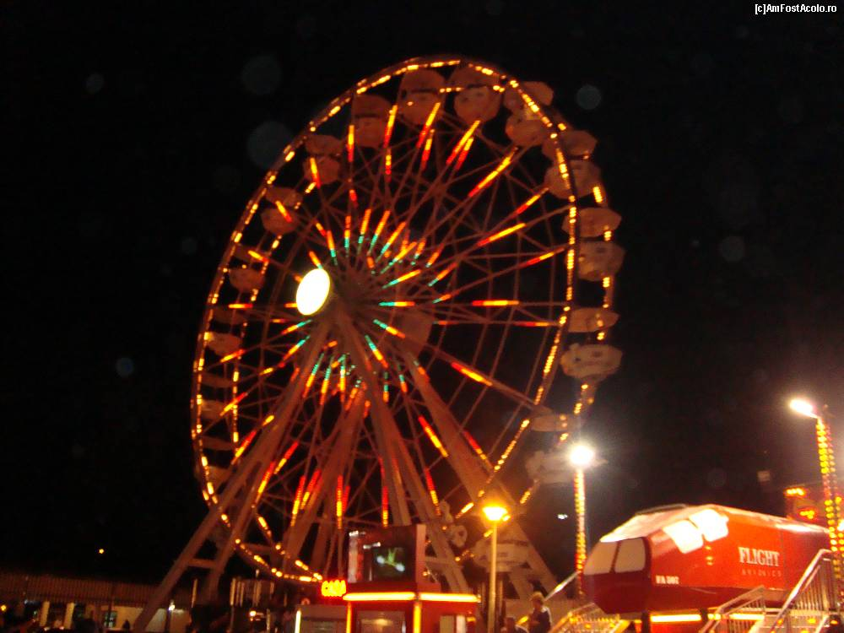
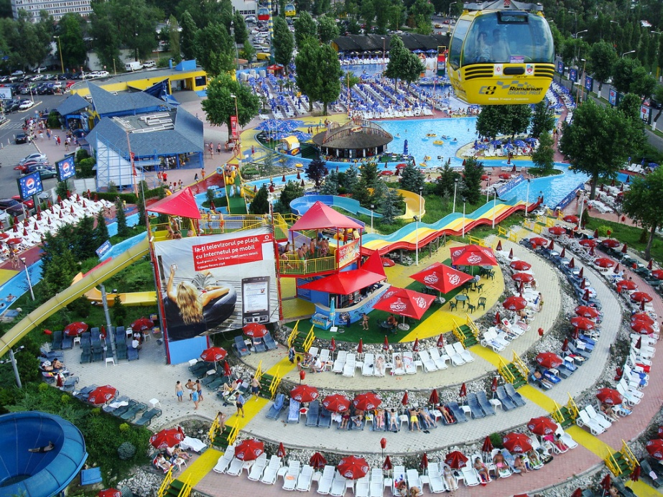
Amusement parks and places in Constanta
Dolphinarium and Planetarium Aqua Magic, Holiday Village in Mamaia Tomis Harbour Beaches in Mamaia Resort, on the Black Sea Coast Micro-reservation (zoo)

Slide 15
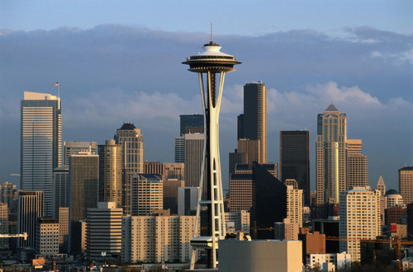
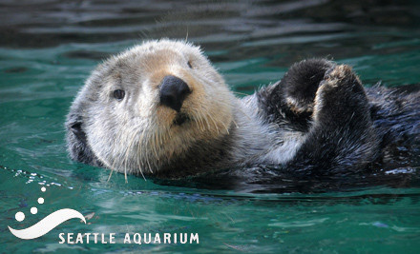
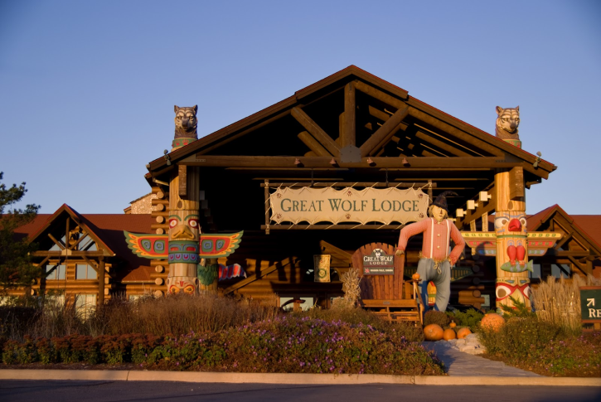
Seattle
Seattle Space Needle
Ferris wheel
Seattle Aquarium
Woodland Park Zoo
Great Wolf Lodge
Museums
Pike Place Market

Slide 16
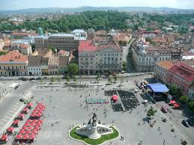
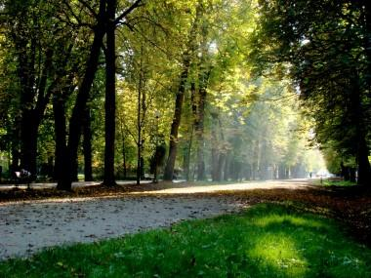
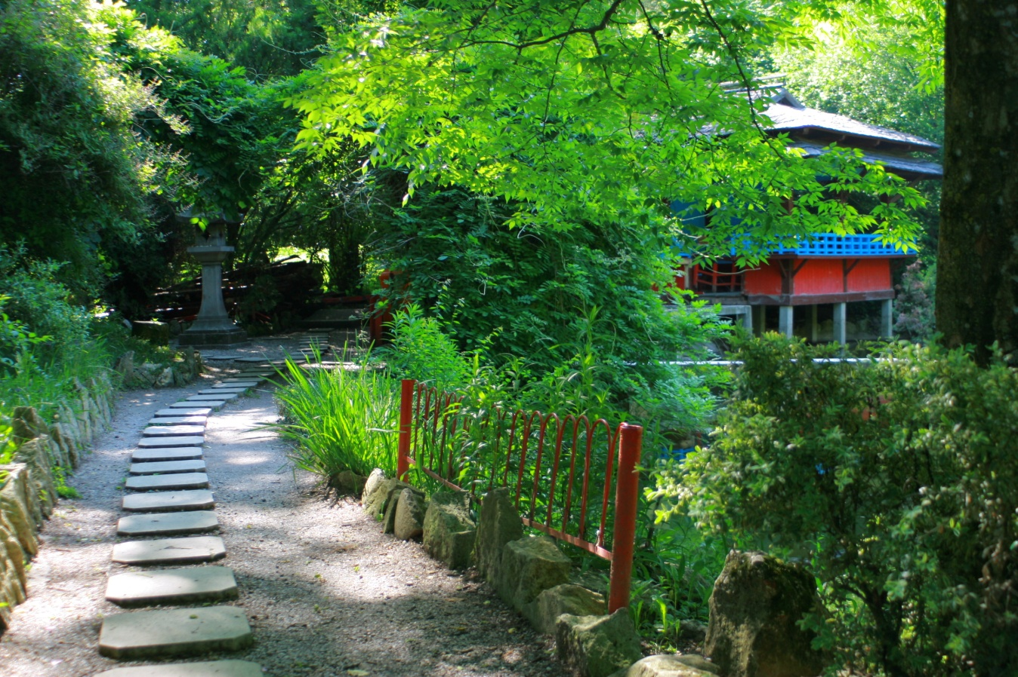
Cluj
the Rozelor Park
the Unirii Square
the Botanical garden

Slide 17
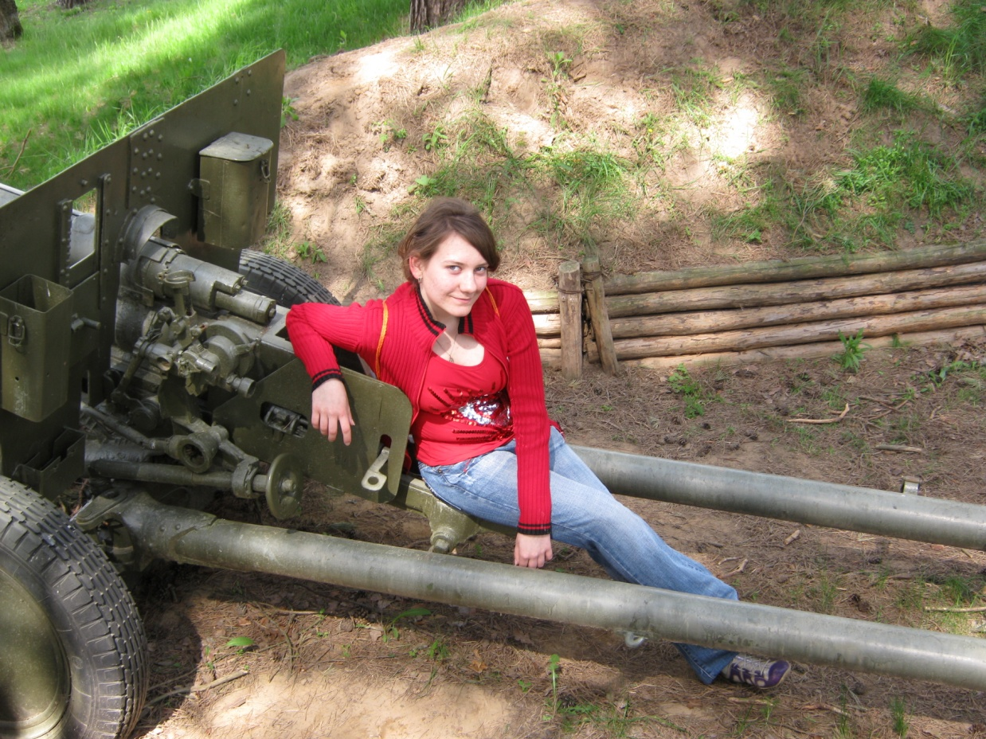
We visit parks and gardens next to our town. War museum and park with old oaks in Stankovo village

Slide 18
Sport is great!
Professional Sports Teams in Seattle are:
Seahawks (they won the Super Bowl!) American football
Sounders: a pro soccer team
Mariners: A professional baseball team
Rainmakers: A professional ultimate team

Slide 19
The new Cluj Arena Stadium is the largest in Cluj-Napoca (capacity 30,201), and is ranked as an UEFA Elite stadium.

Slide 20
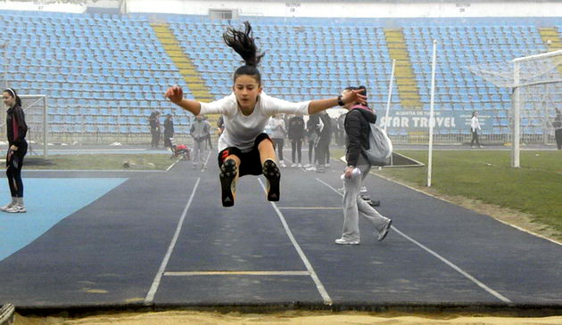
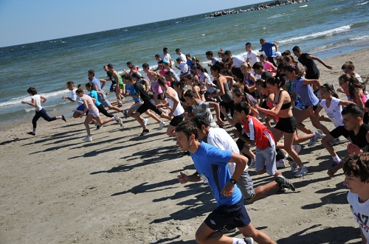
Sport in Constanta
In our city, teenagers like sports and they take part in a lot of competitions, such as: athletics, basketball, football and handball.

Slide 21
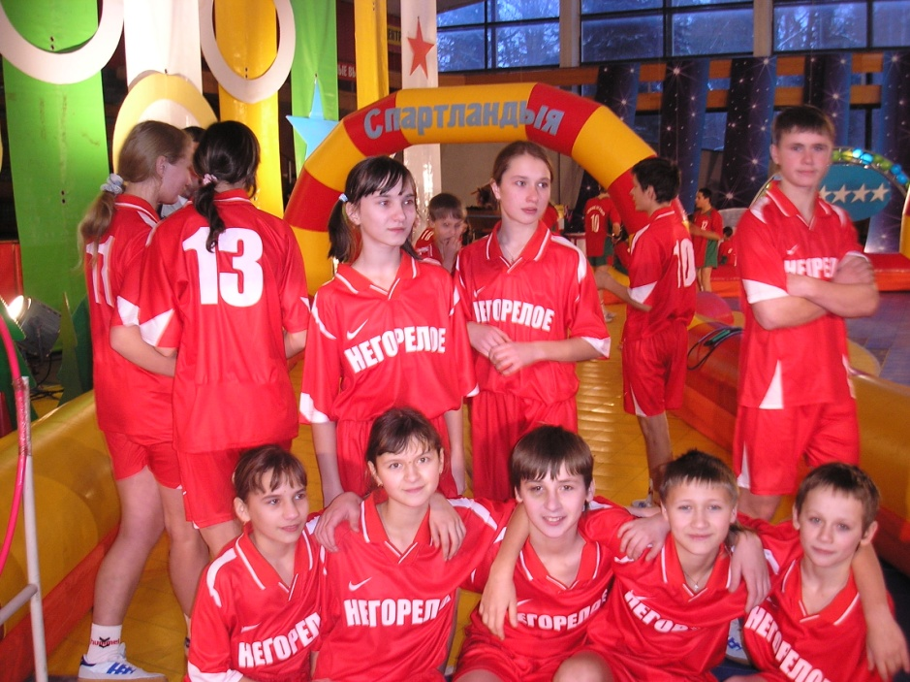
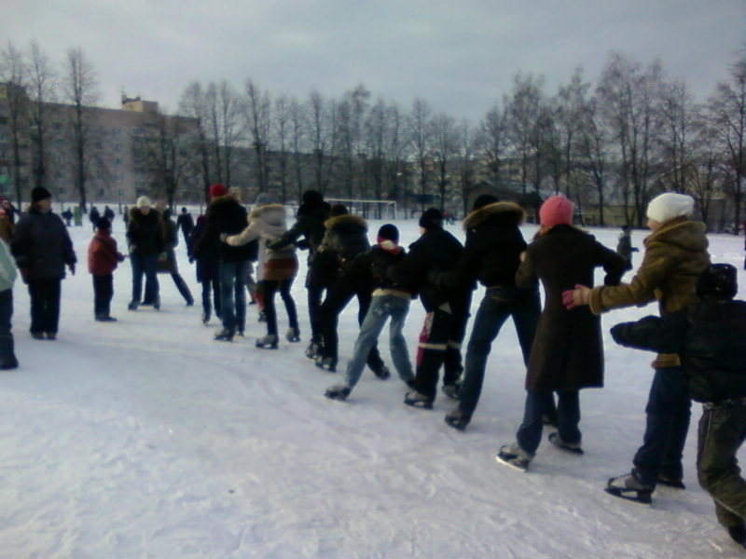
We also like doing sport!
There are different sport competitions in our school. Every second Saturday of a month Health Day is at school.

Slide 22
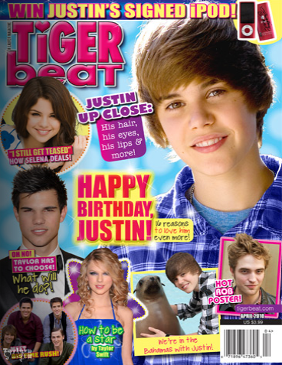
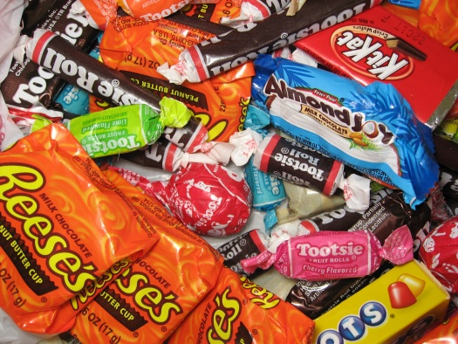
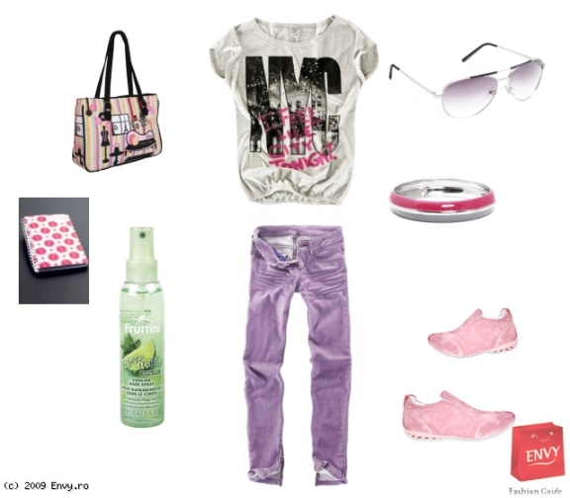
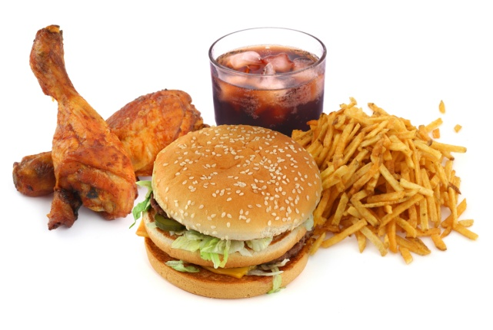
Oh shopping!
spending money on:
Candy
Clothes
Earrings
Food
Shoe
Magazines
MTG cards ( Magic The Gathering )
Music

Slide 23
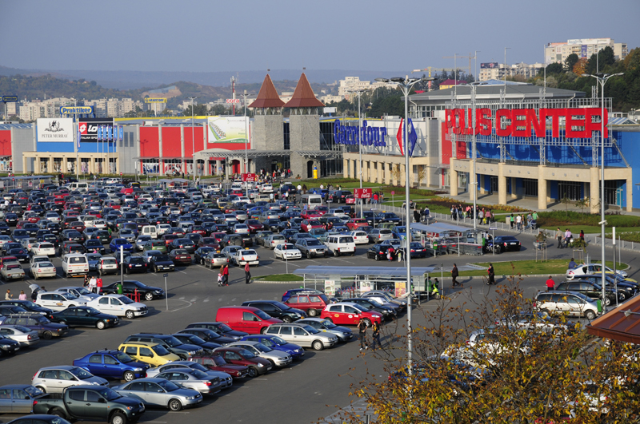
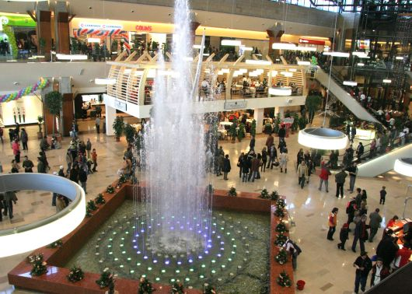
Polus Center Cluj
It was the first shopping mall in Cluj-Napoca. Among the finds was the tomb of a Gepid princess and a 3300-year-old tomb of a pair of lovers.
Iulius Mall

Slide 24
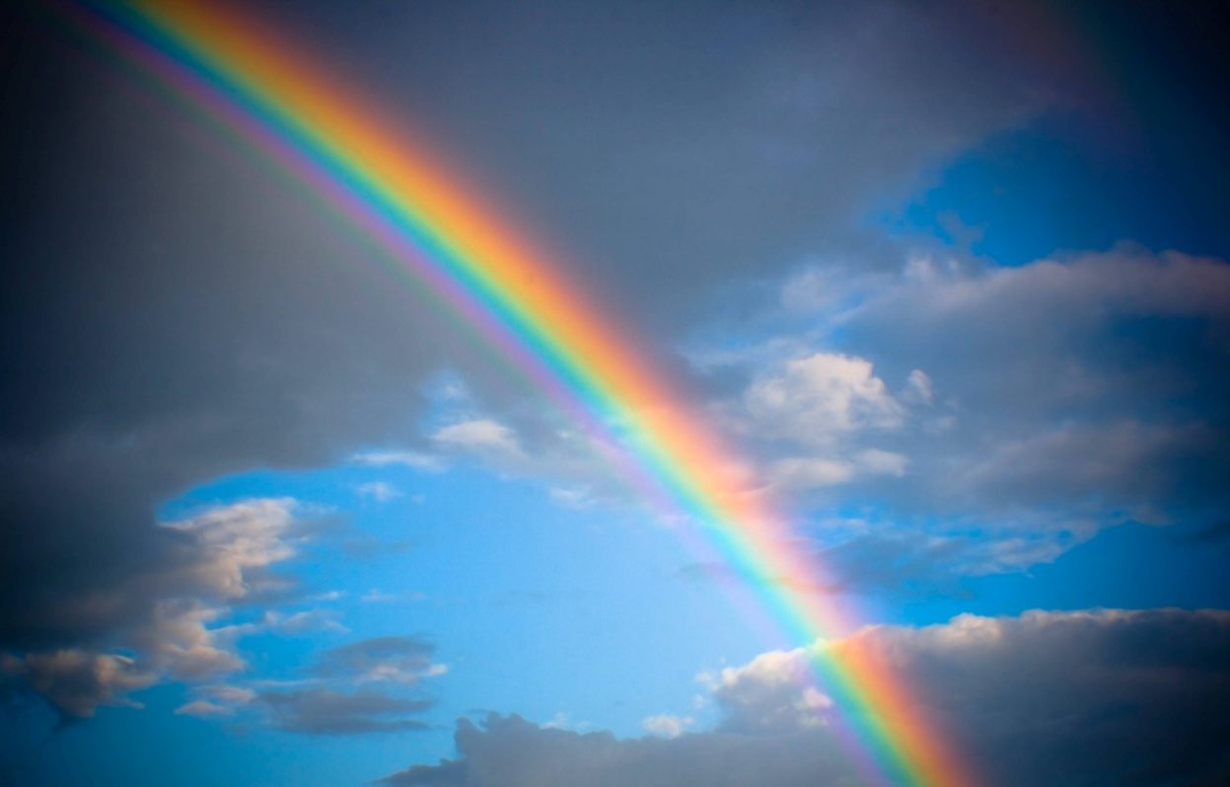
“Weekends are a bit like rainbows, they look good from a distance, but disappear when you get close to them.”
weekends are too short, like the image of a rainbow in the sky!
they are good until we are in them!
they don’t last like rainbows don’t last…

Slide 25
Thank you very much!!!

