Slide 1
Shopping in Lattakia
For many years, shopping has been the easiest way of communication between an individual and a city.
Because when you arrive as a tourist at any city in the world, the first thing you will do is to roam around on its streets looking for things that you don’t see in your hometown, and buying stuff to take with you as a souvenir.

Slide 2
- So by shopping you can easily communicate with any place on the planet.
- Now come with me on a brief tour in my own hometown to show you the places where you can shop…

Slide 3
-Street Vendors:
Well, here in Lattakia we have a lot of street vendors, and they sell many different stuff, like rosaries and necklaces…

Slide 4
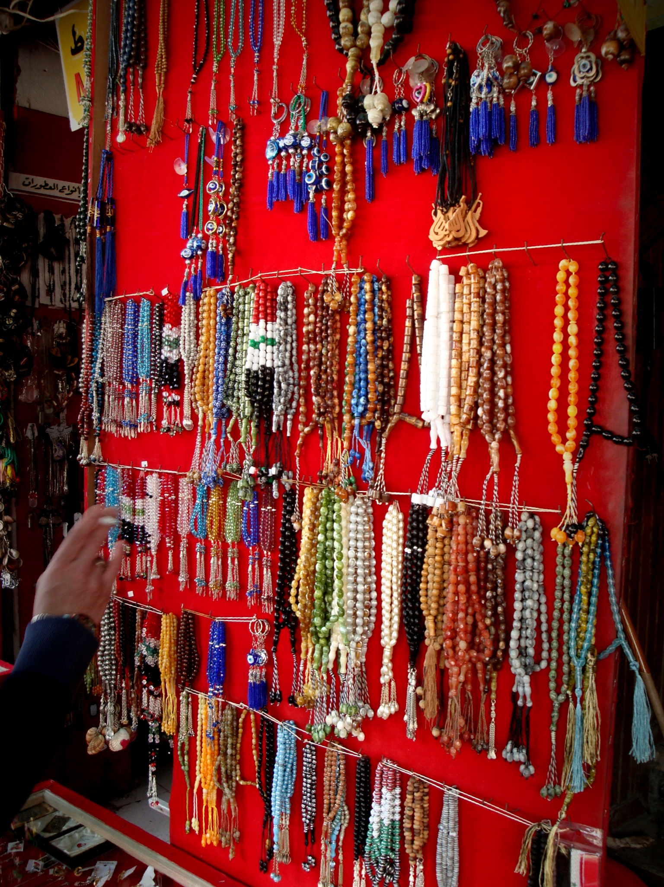
Notes:
The photo speaks for itself

Slide 5
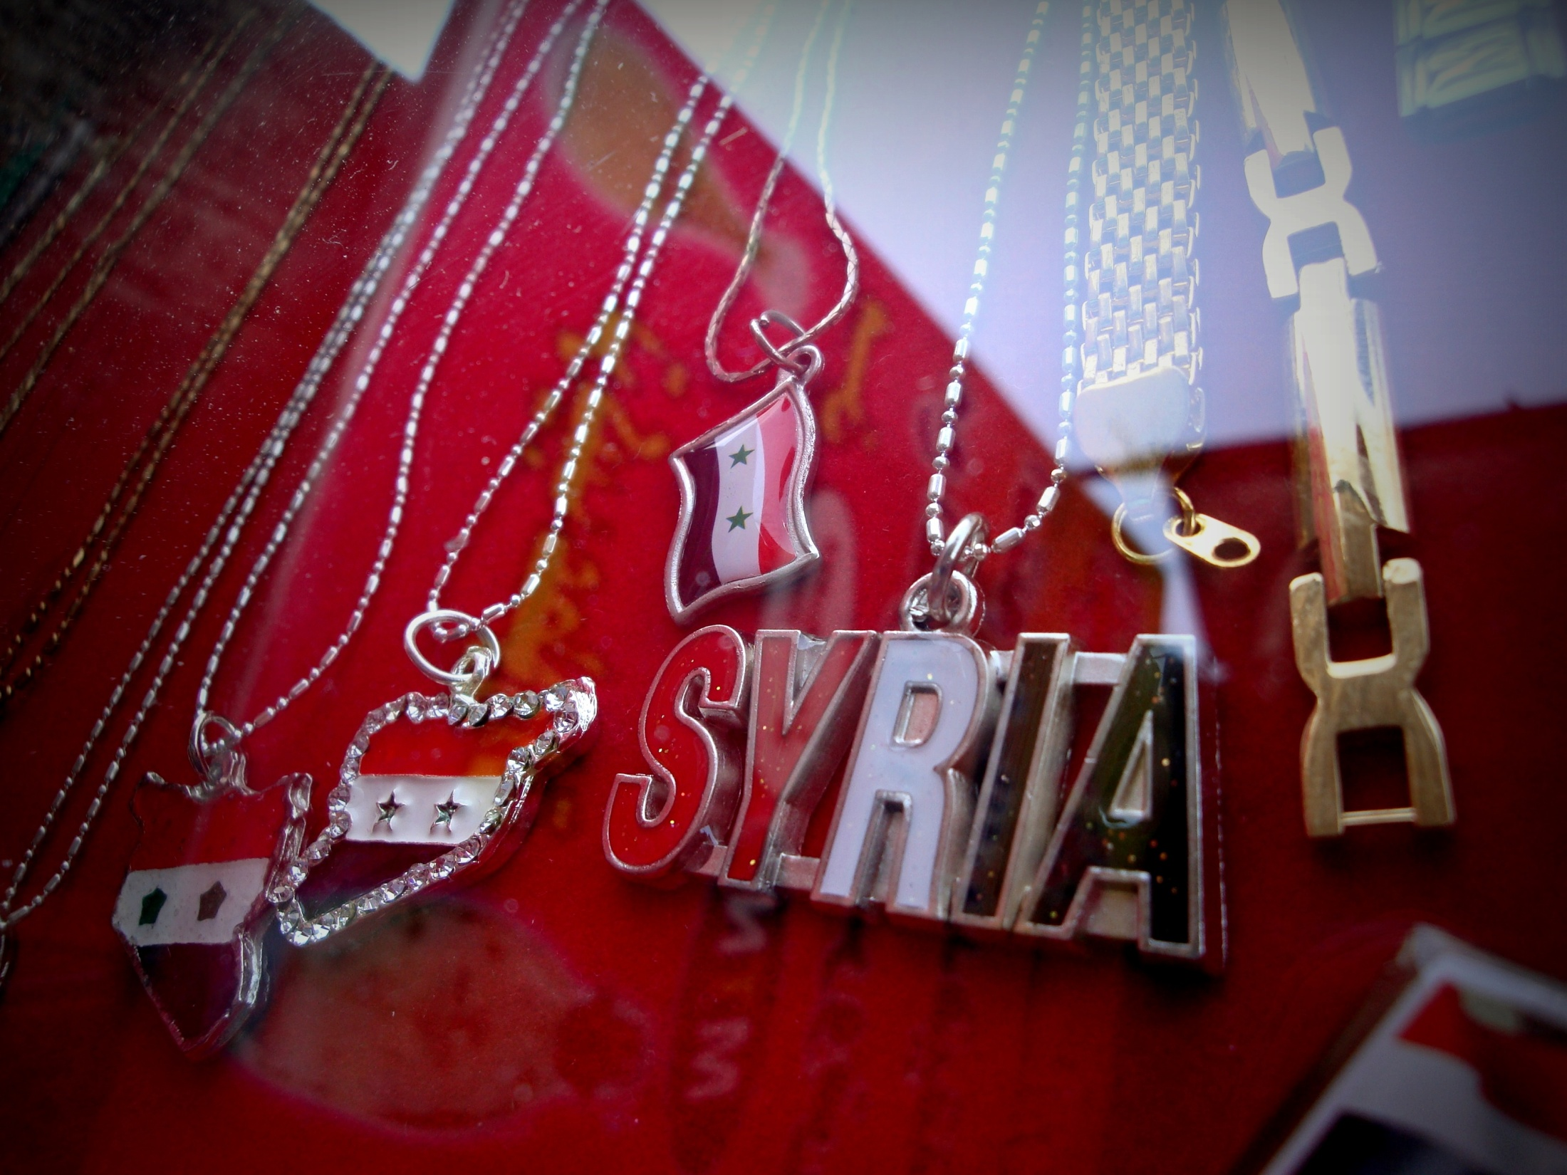

Slide 6
-Malls:
Malls are new to our culture, so people mostly prefer to shop at souks.
But, in time, people are getting more used to shopping at malls…

Slide 7
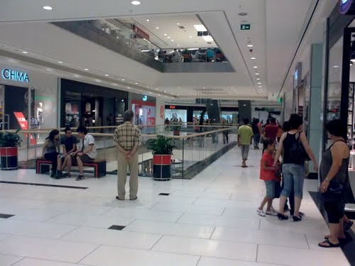
ORANGE MALL – LATTAKIA.

Slide 8
- Spices and Dried Beans:
They are used a lot in our cooking, so spices and dried beans take a big place in our souks.

Slide 9
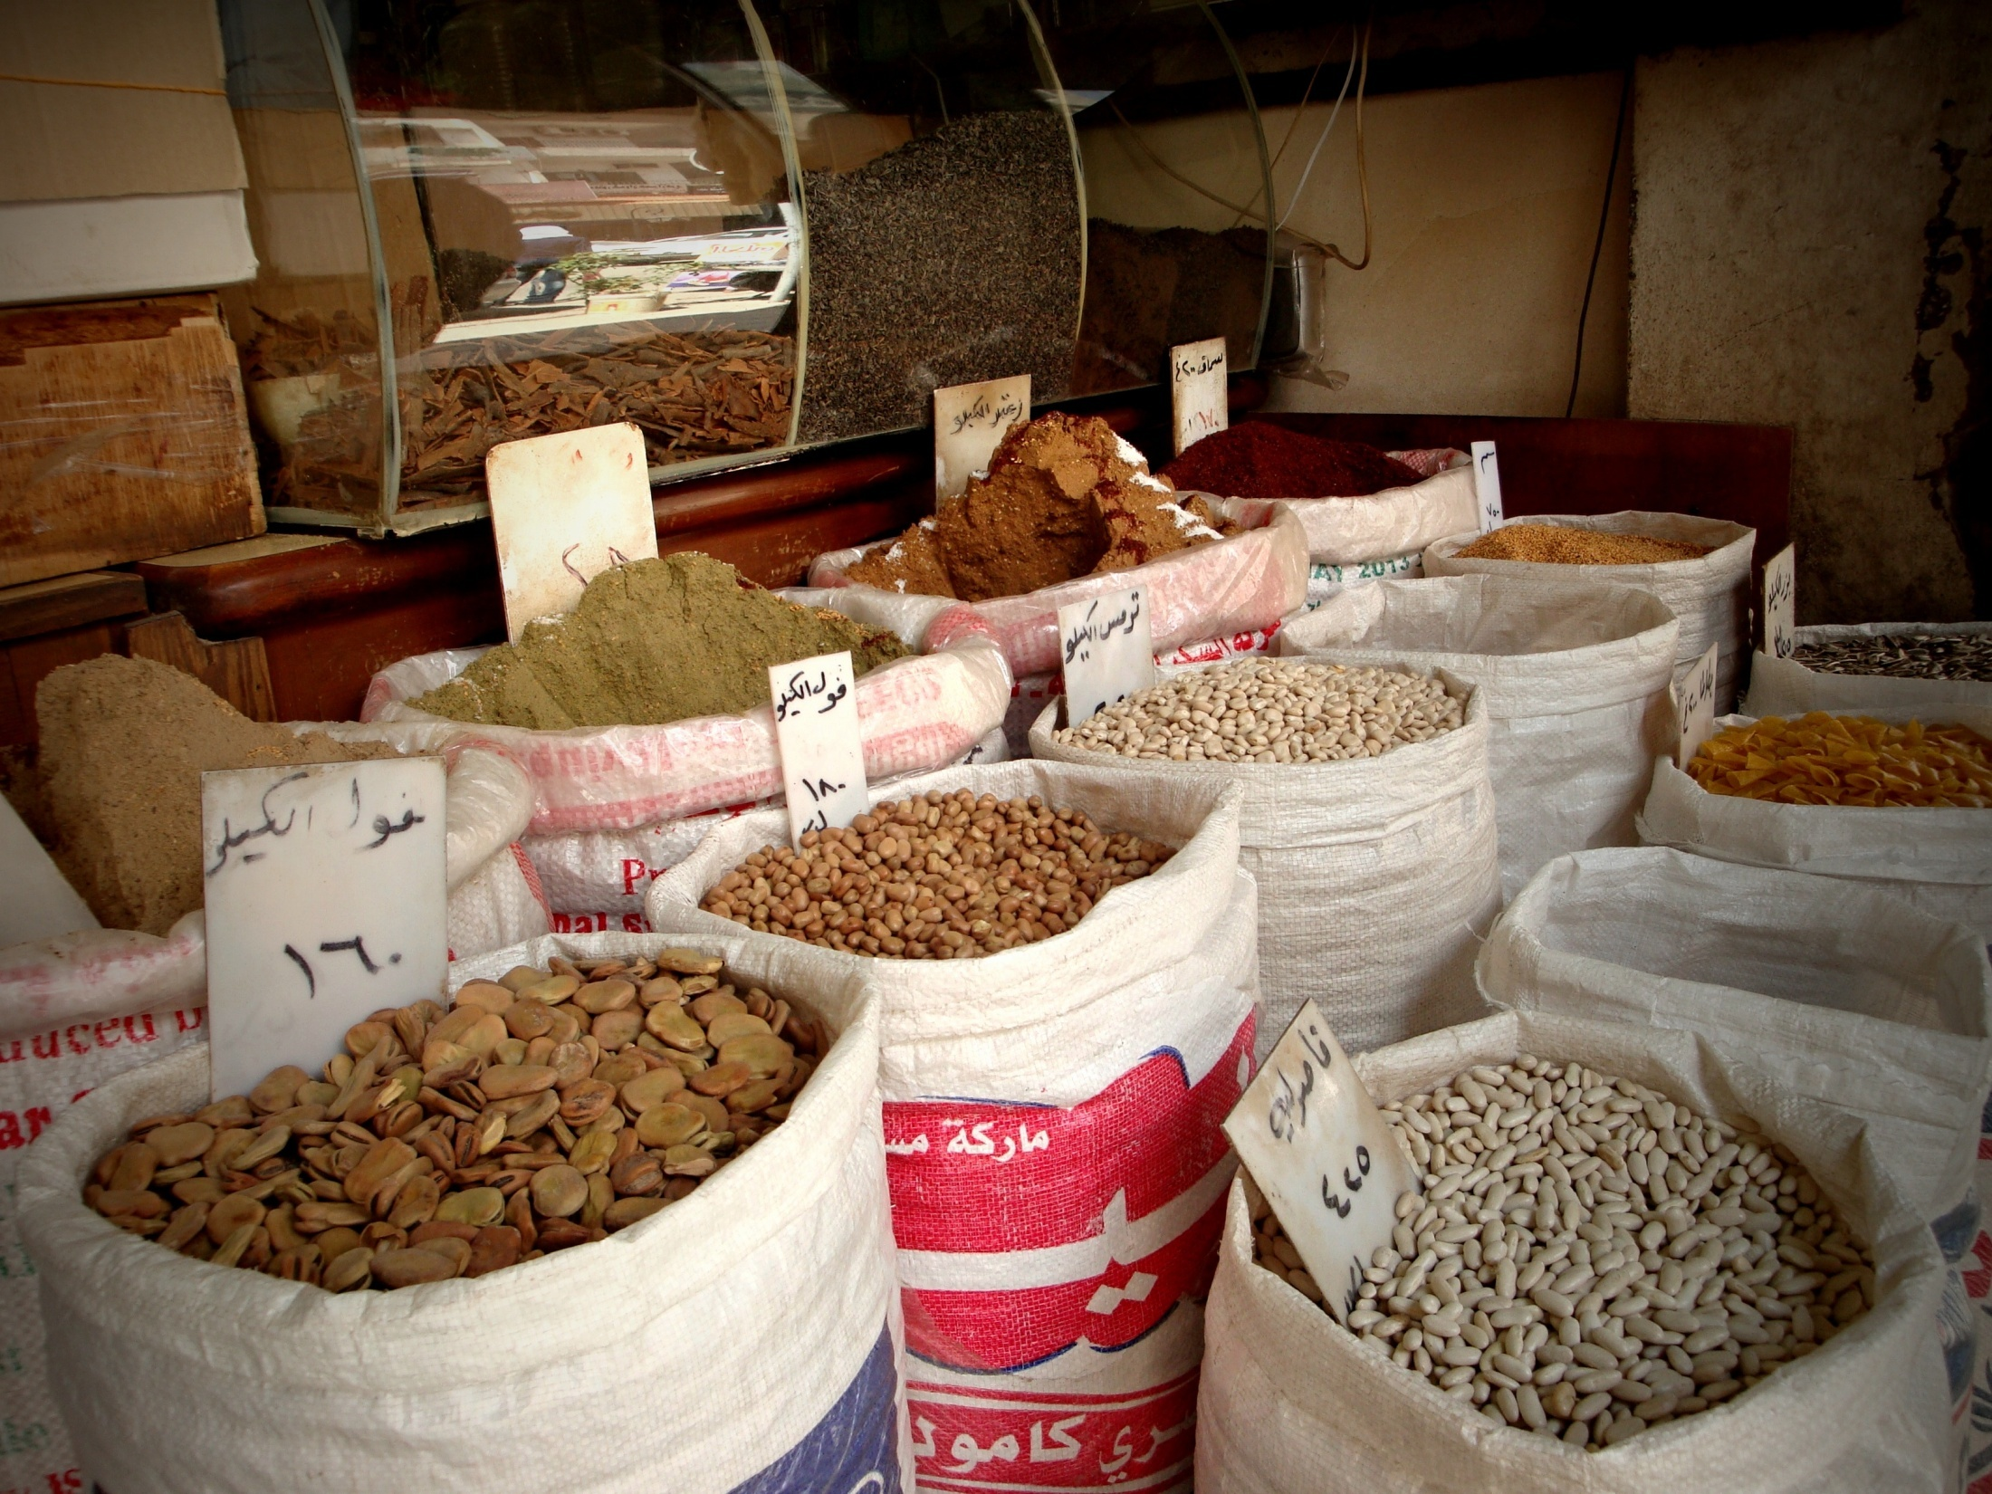

Slide 10
- Gifts Shops:
Gifts Shops are very popular here in Lattakia..
These shops are very huge, and they have all the gifts that you might need for any anniversary.

Slide 11
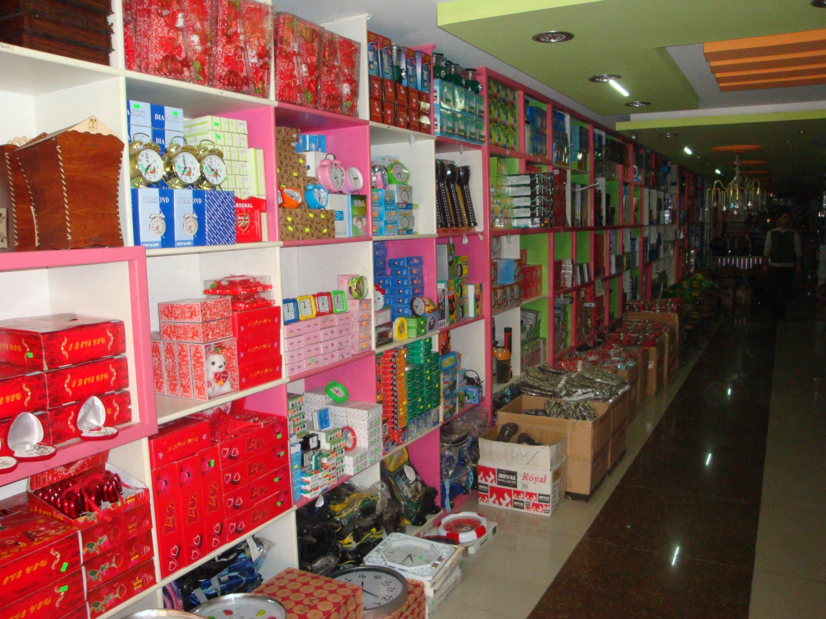

Slide 12
- Thrift Shops for Used Clothes:
There you can find a lot of awesome clothes for a very low price!

Slide 13
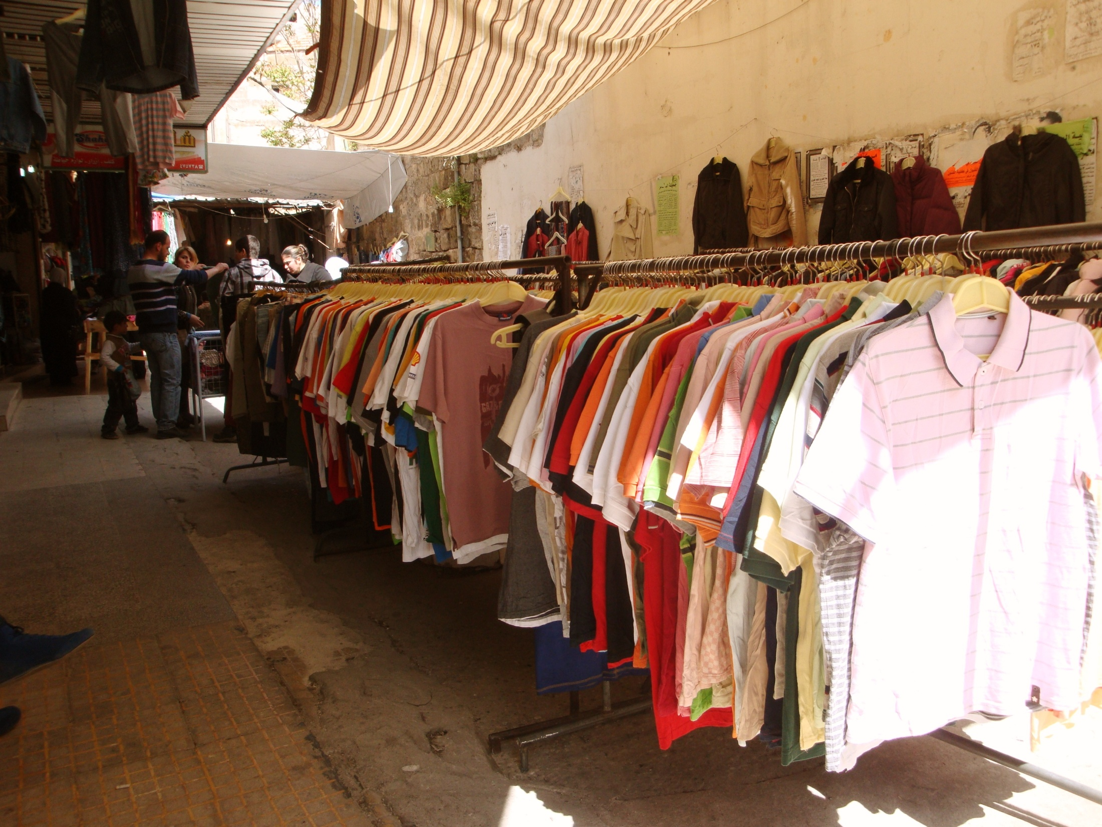

Slide 14
Now I’ll just leave you with some photos from our souks..
I hope you enjoyed this little tour with me..
And thank you..

Slide 15
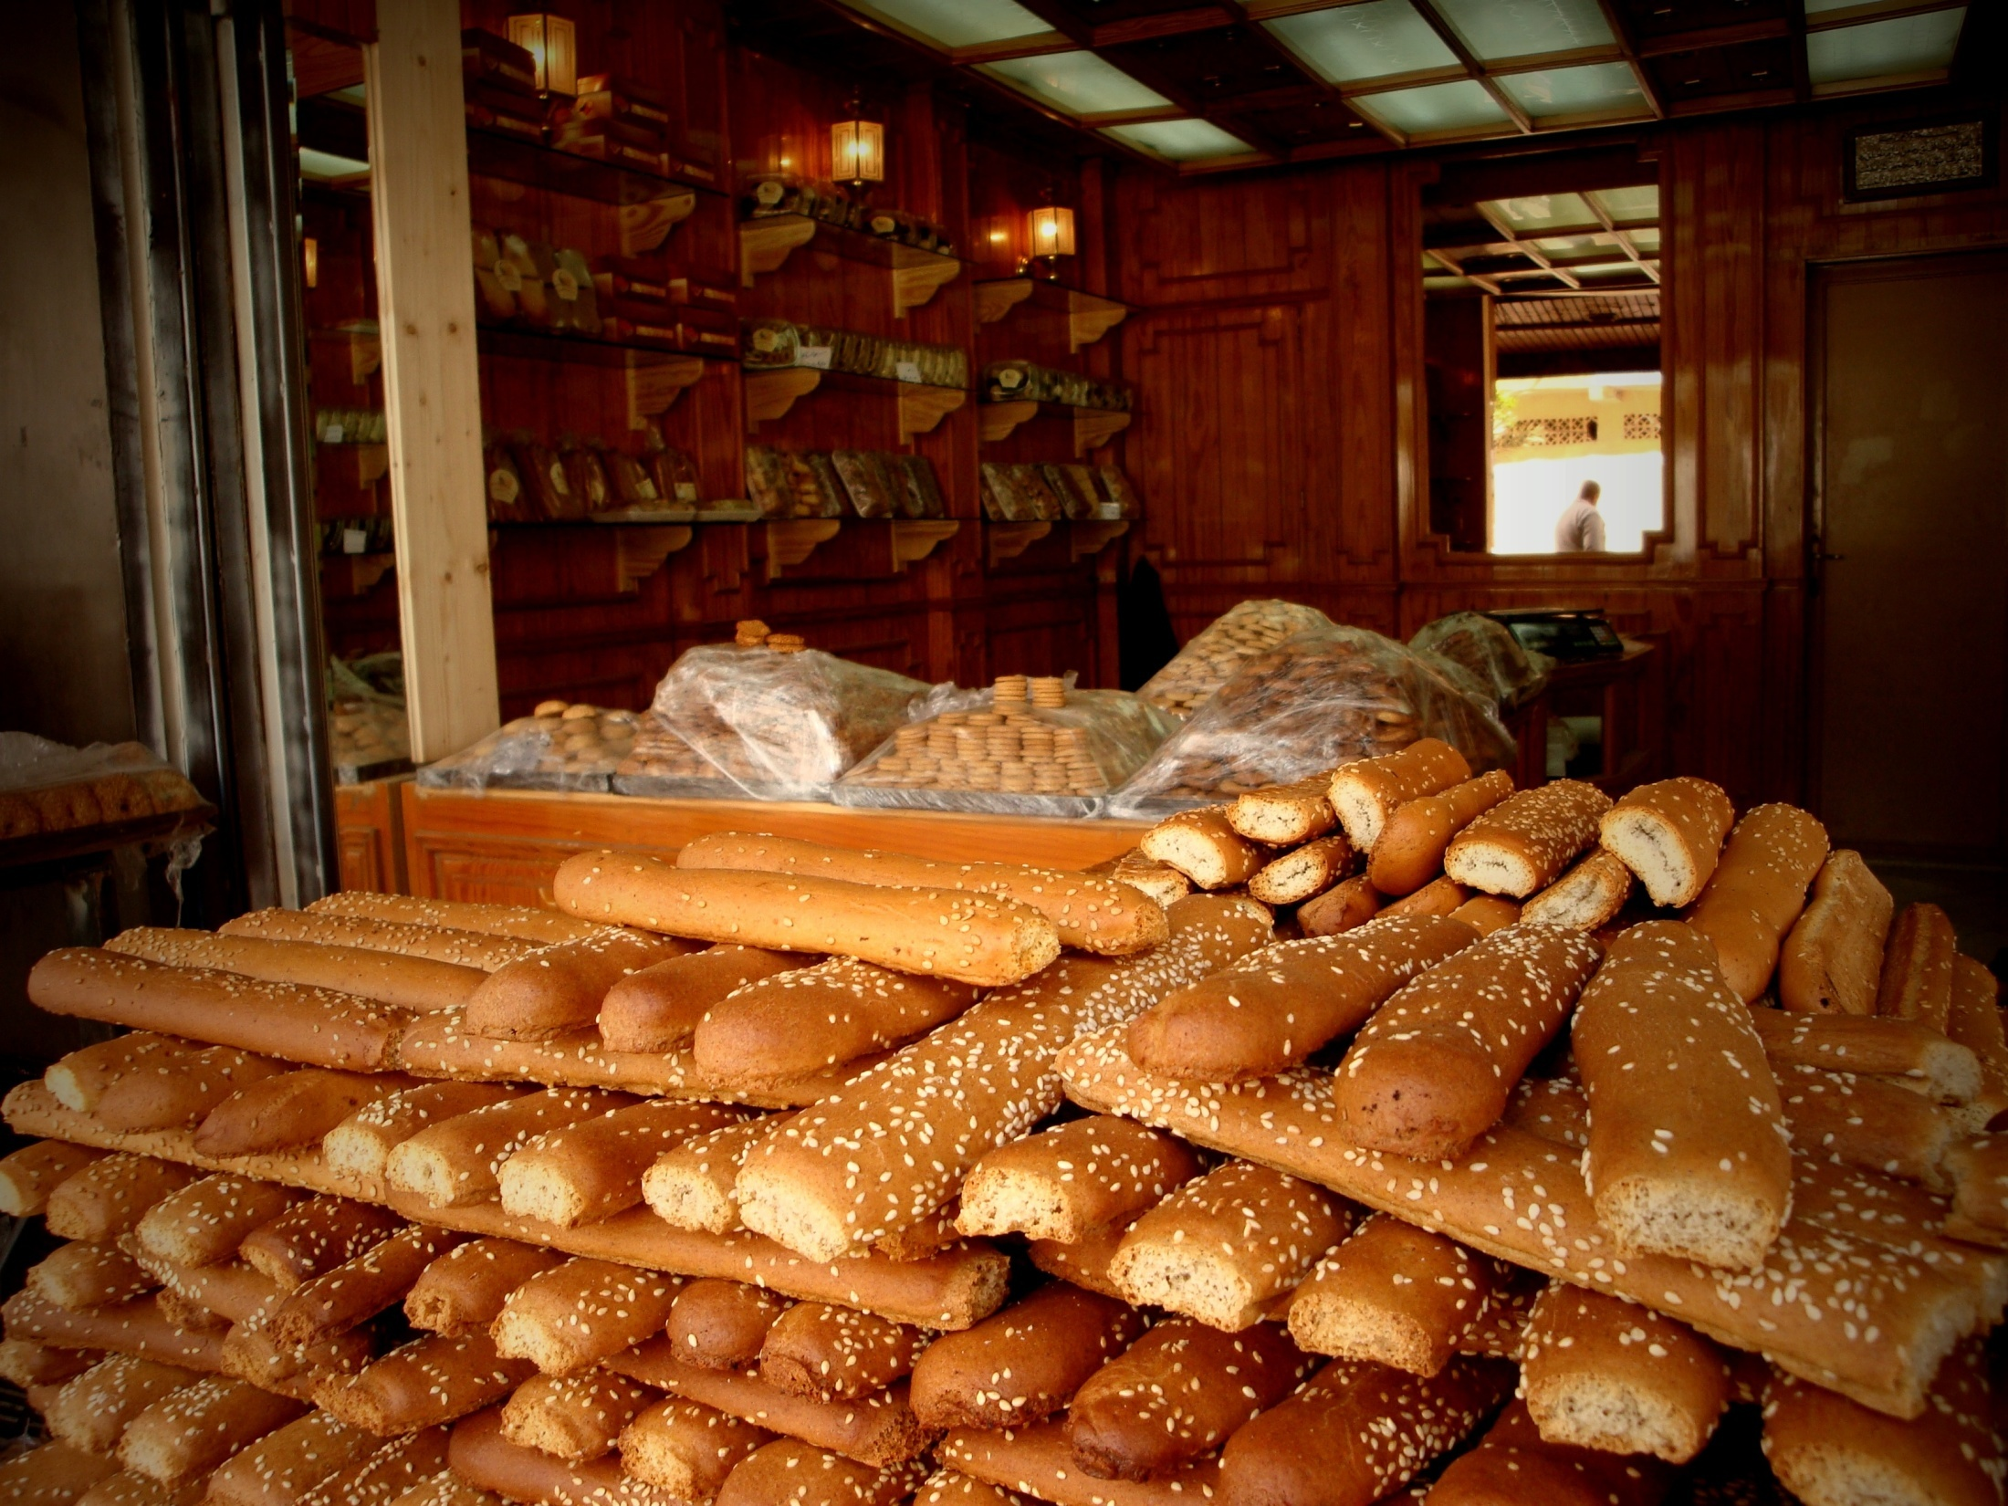
Notes:
Bakeries are everywhere

Slide 16
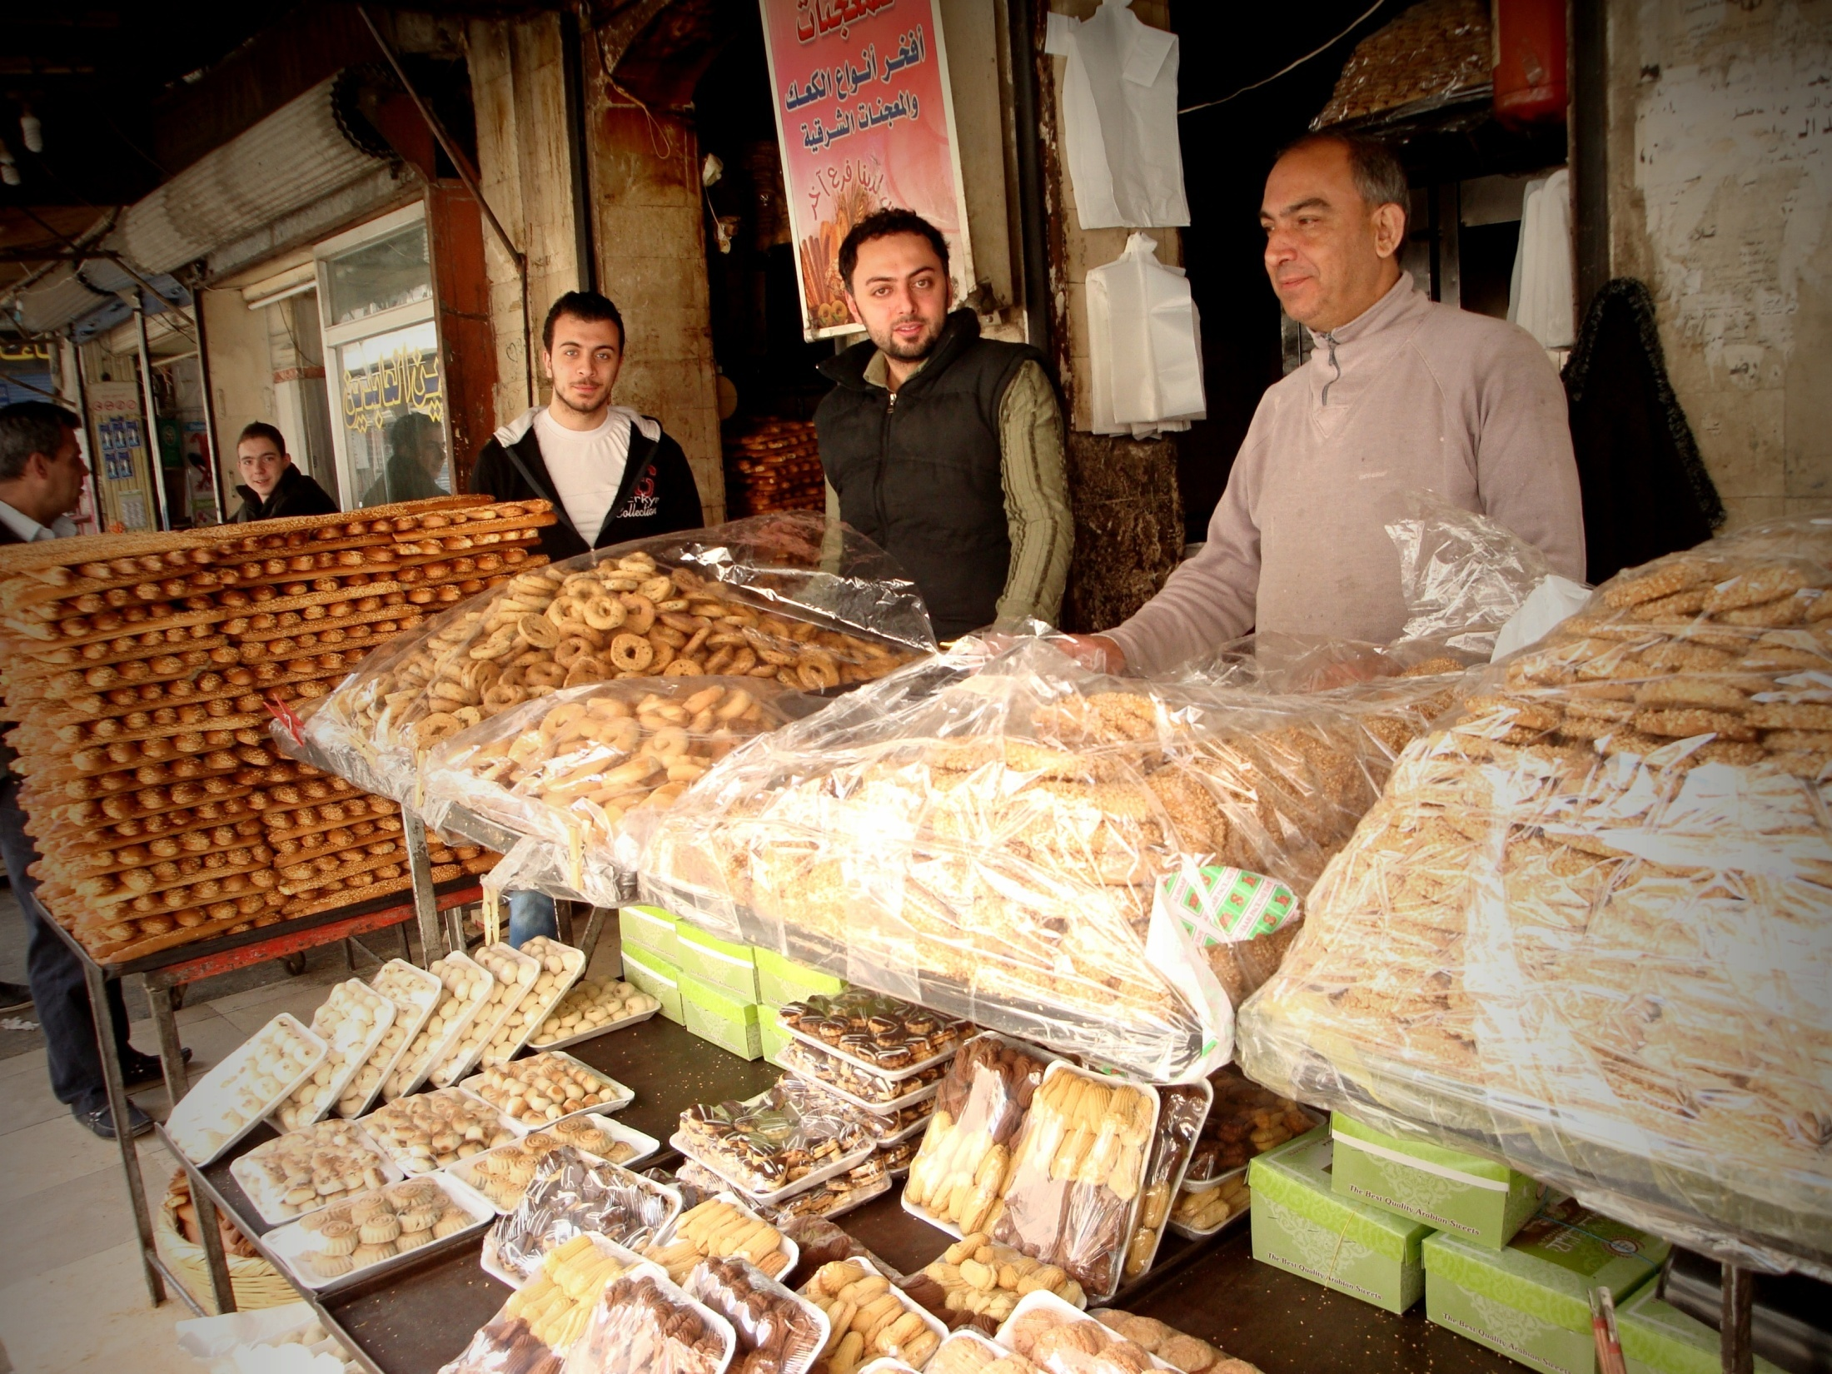
Notes:
Cookies with smiles

Slide 17
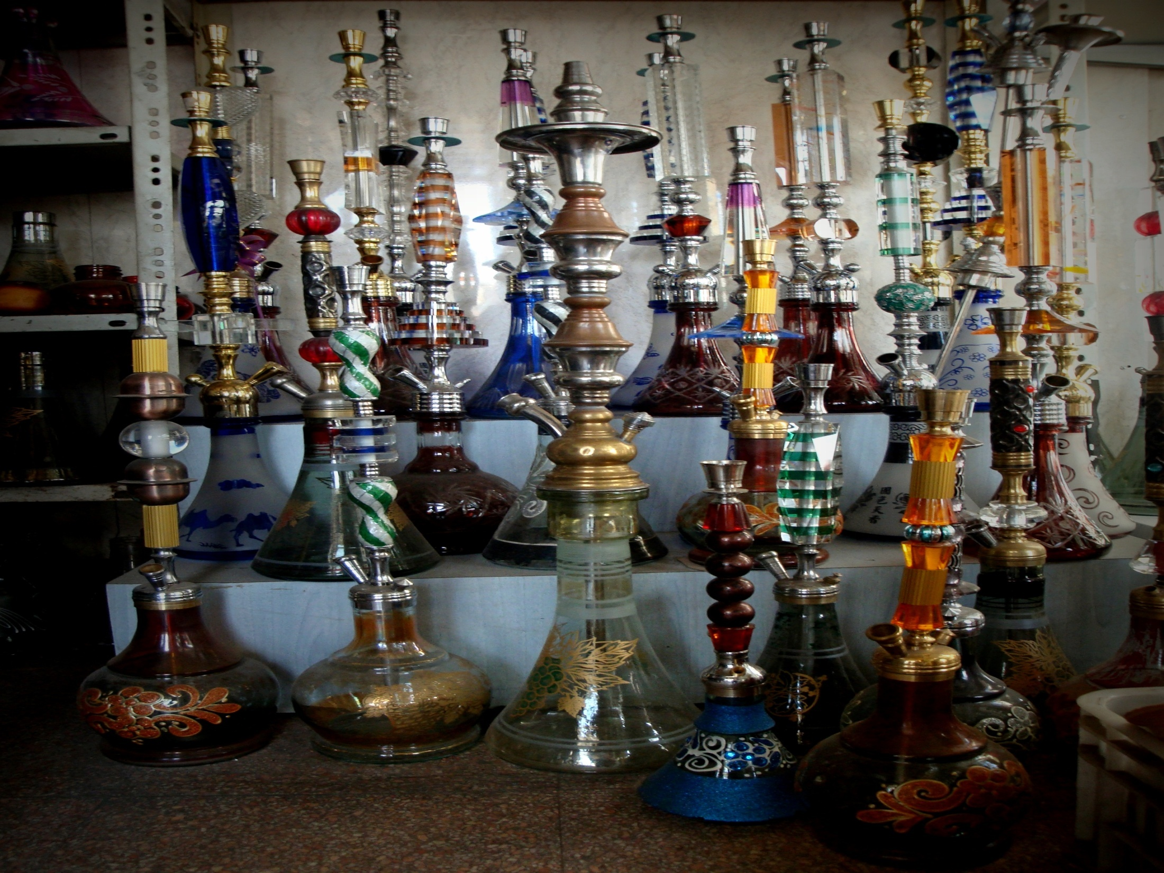
Notes:
Shesha shops too, unfortunately!!!

Slide 18
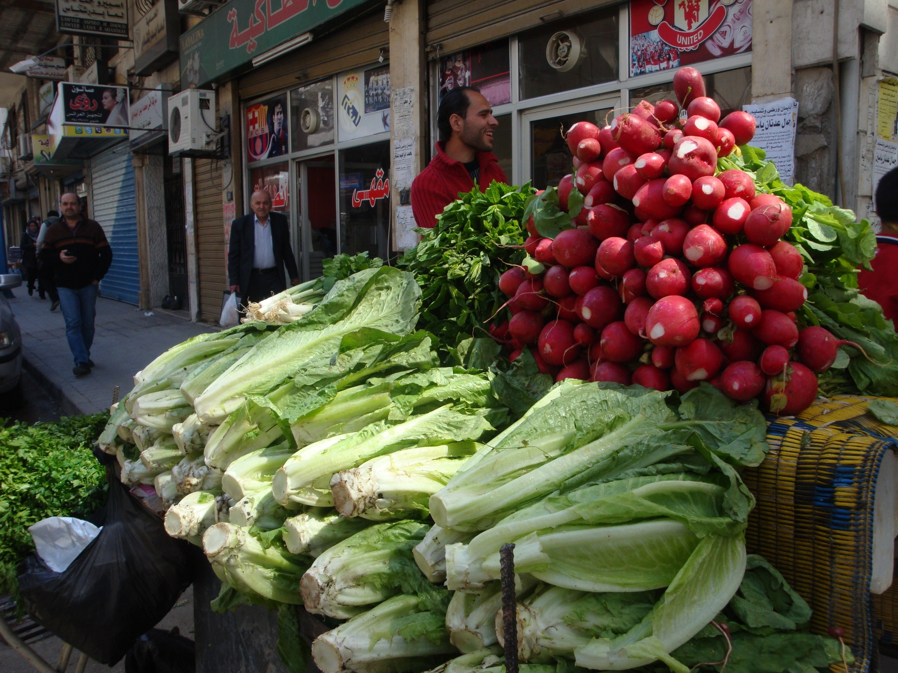
Notes:
Fresh vegetables everywhere…home grown vegetables…

Slide 19
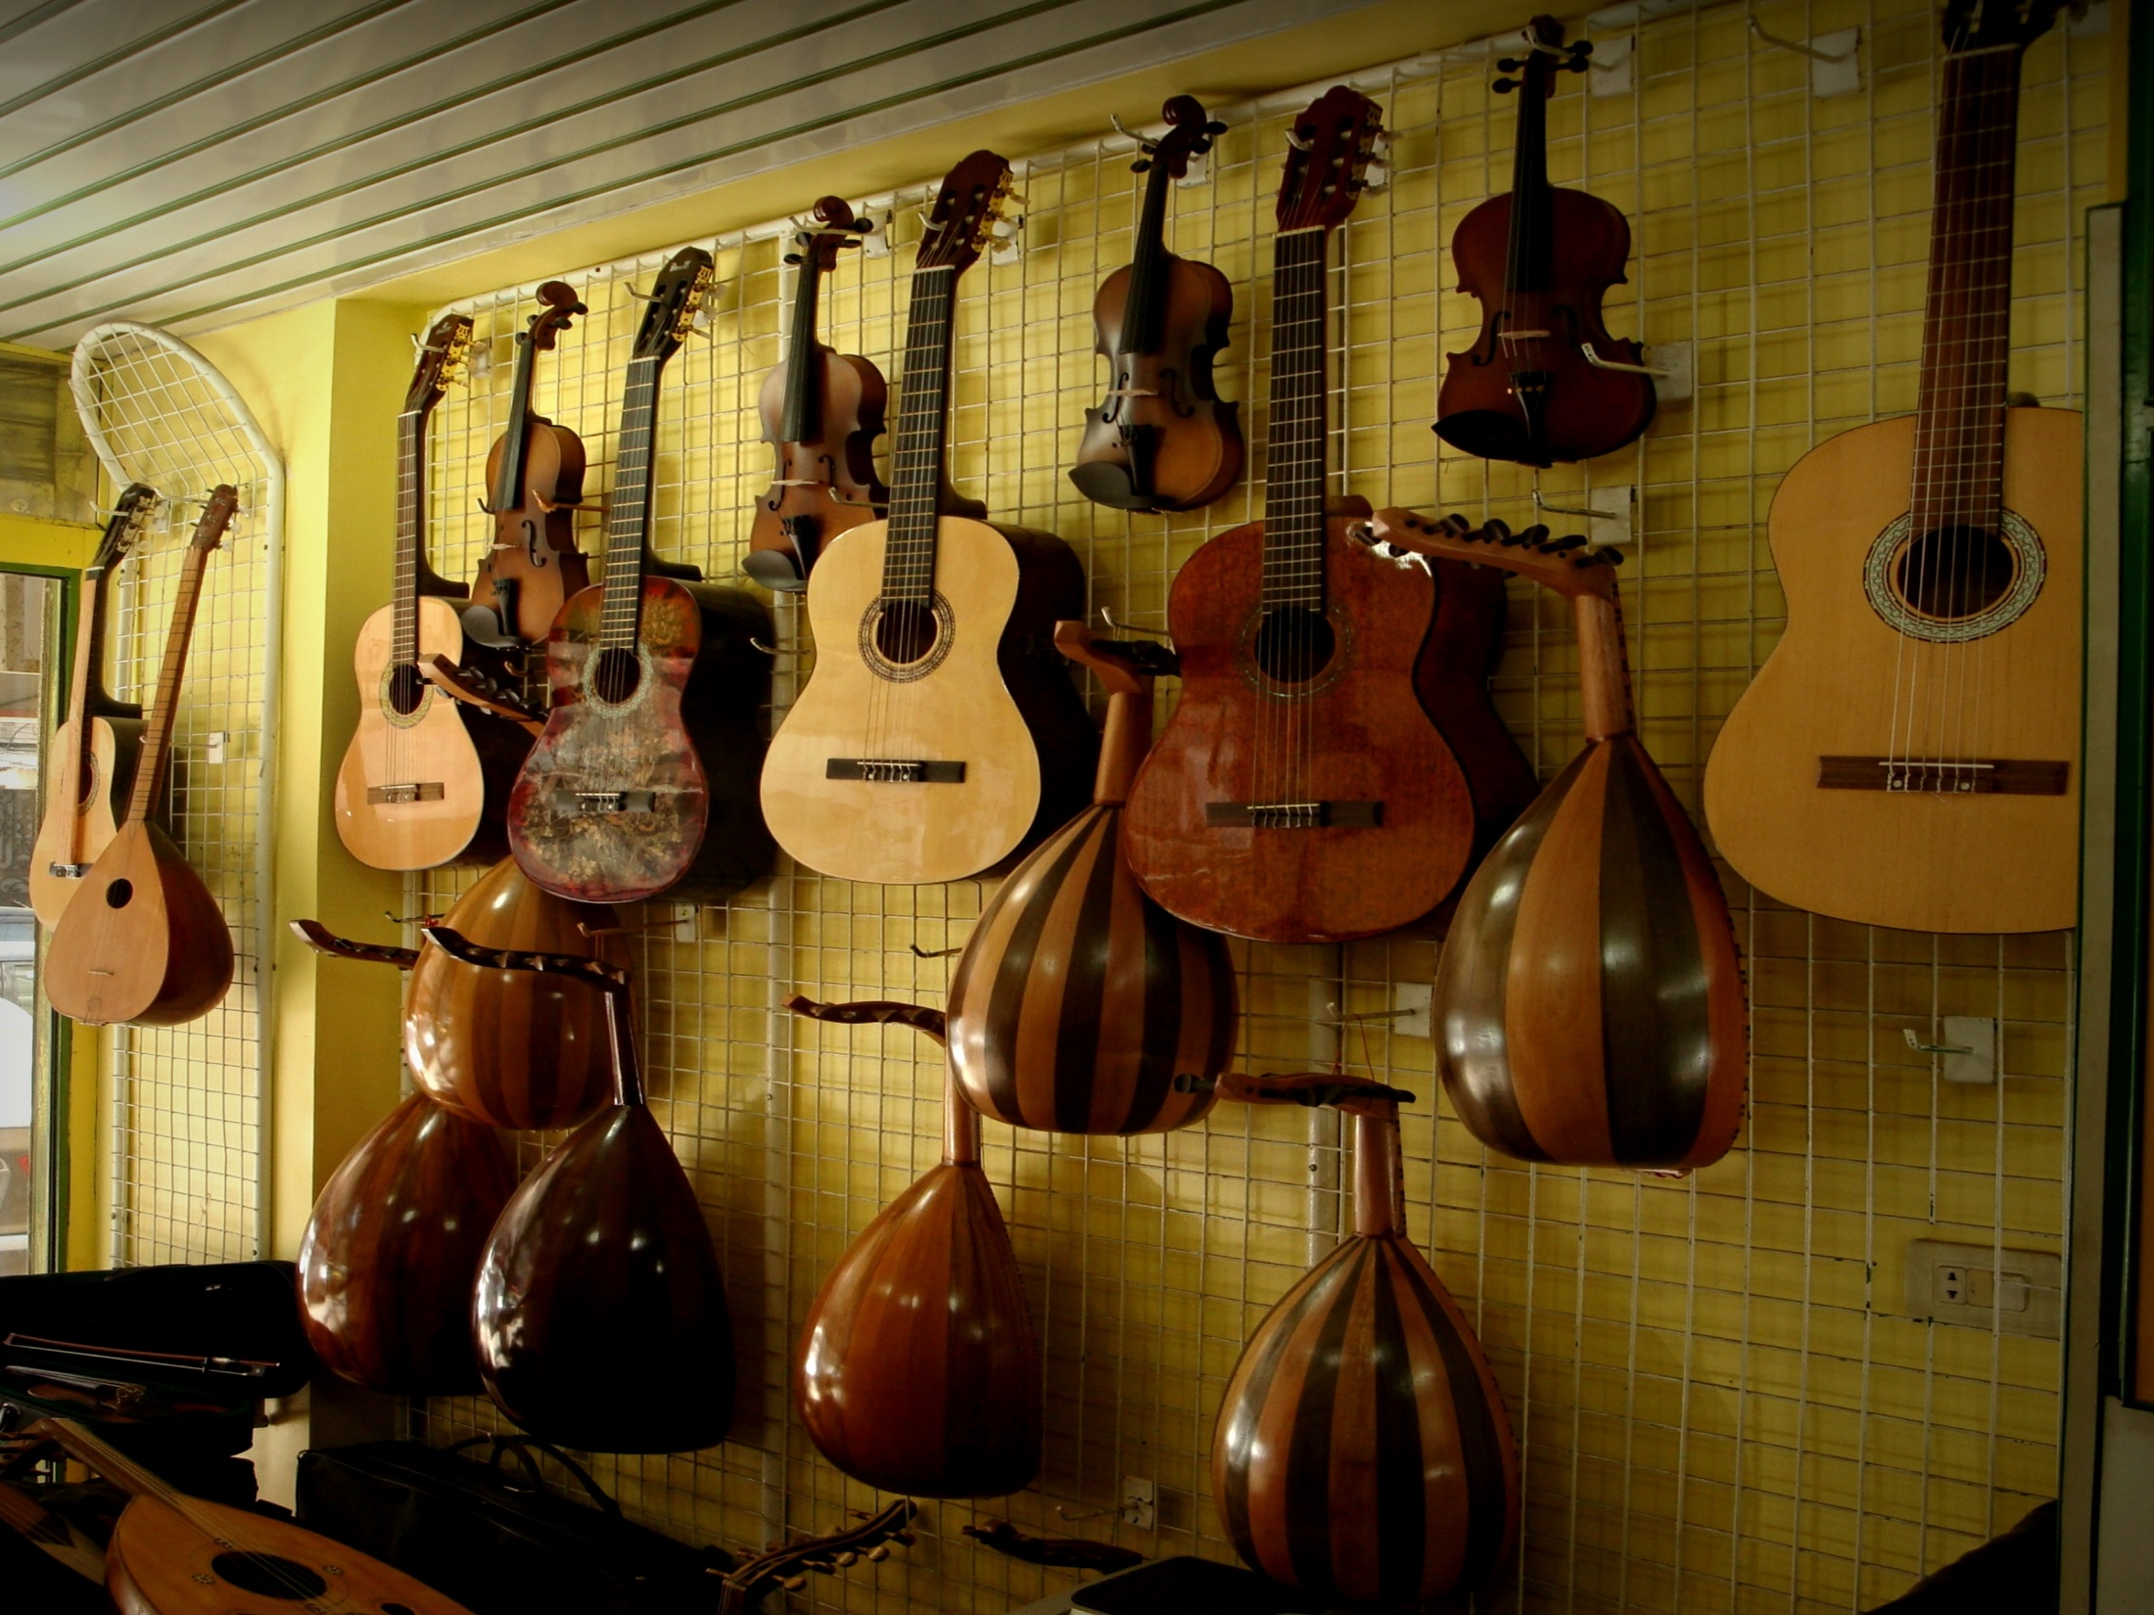
Notes:
There are shops for musical instruments…

Slide 20
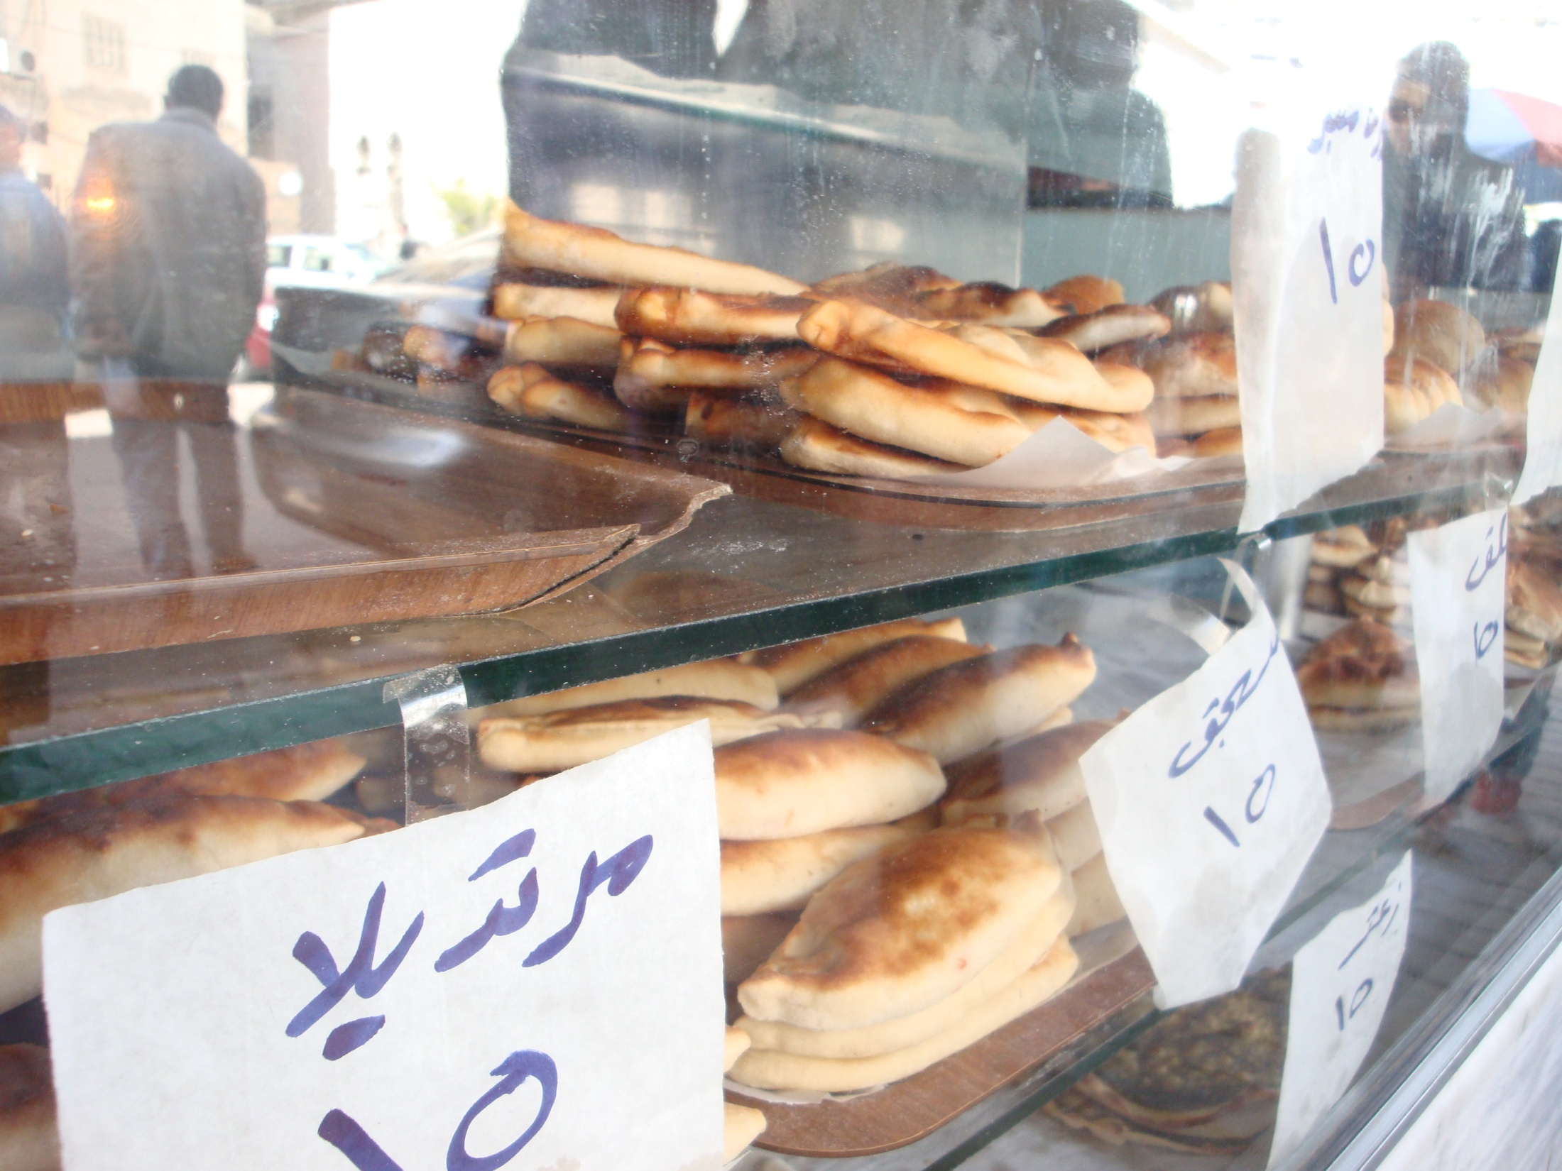
Notes:
Syrian Pies Corner shops with different tops: cheese, thyme, Syrian cheese, green olives, flavored meat, red pepper…and the like…Hot, handy and tastsy.

Slide 21
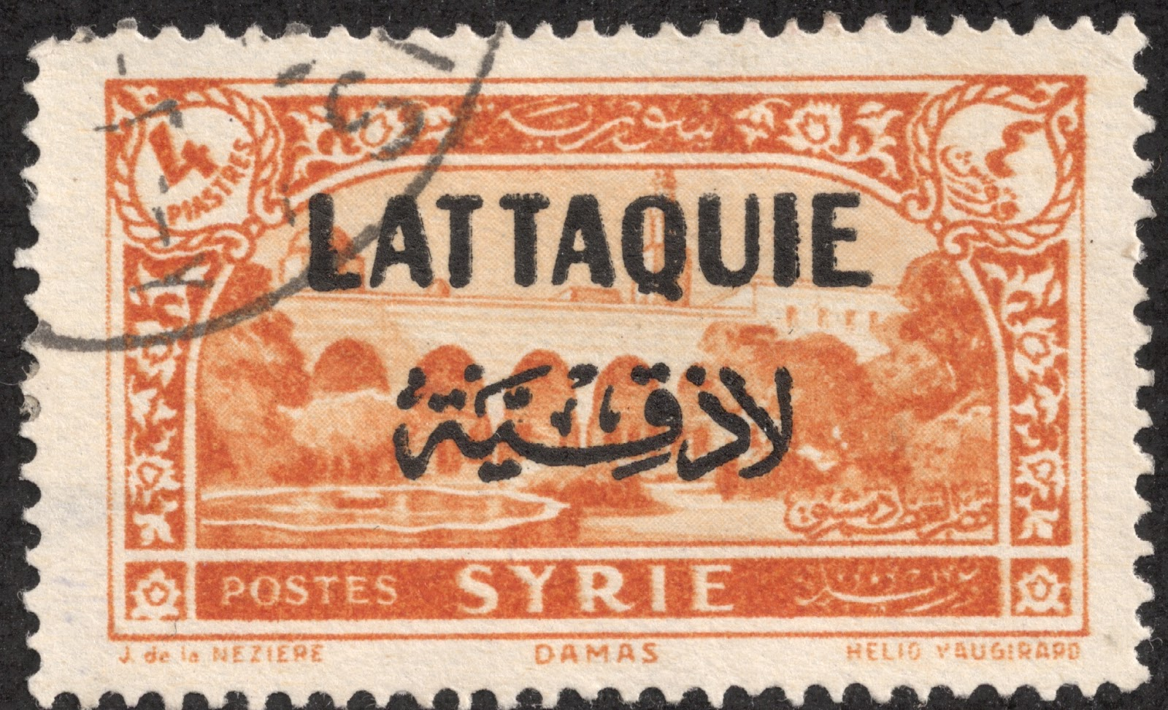

Slide 22
Created by:
Dirar Hasan.
Dirar.hasan77@yahoo.com

Slide 23

Places & Prespective Learning Circle – High School 2014
iEARN Syria
lattakia2222@gmail.com

