Slide 1
They did it!
ACCESS-Orhei Teacher: Ilie Efros

Slide 2
Goal of the project:
We led a research and find out personalities from medieval age who
very important for our country.

Slide 3
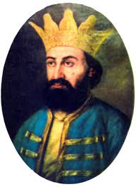
Bogdan the 3rd
King of Moldova between 1504-1517
Born on 1479 and died on 1517.

Slide 4
Importance
Solve national problems with the help of Polish army.
Implemented reforms in agriculture and fought against Tatars.
Implemented the money reform which lead to the manufacture of first Moldovian coins

Slide 5
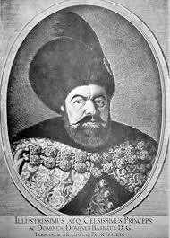
Vasile Lupu
Born on 1595 and died on 1661
King of Moldova between 1653-1653

Slide 6
Importance
He built many churches and the most beautiful one is called ,, Trei Ierahi’’ from Iasi, Romania.
Established a typography in Chisinau.

Slide 7
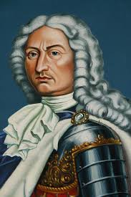
Dmitrie Cantemir
Born on 1673 and died on 1723
King of Moldova between 1693-1710

Slide 8
Importance
Was the most distinguished cultural personality of medieval age.
He wrote books containing historical, geographical, philosophical, theological themes.

Slide 9
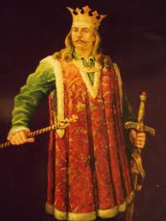
Stefan cel Mare( Stefan the Great)
King of Moldova between 1453-1504.
He was the greatest Moldovan king during medieval age.

Slide 10
Importance
His reign was a period of economic prosperity and one of strengthening state institutions.
On international level he achieved successes in relations with neighbour countries. He managed to establish itself as an outstanding strategist and diplomat.

