Slide 1
Money History Wunshan Senior High School
Members: Sheng_Xun Huang & Wei_Hong Dai

Slide 2
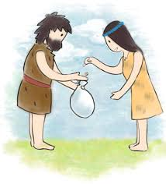
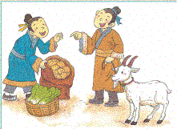
Long time ago…

Slide 3
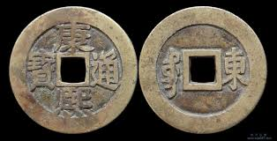
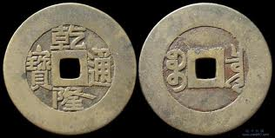
Qing Dynasty
Emperor Kang Xi
Emperor Qian Long

Slide 4
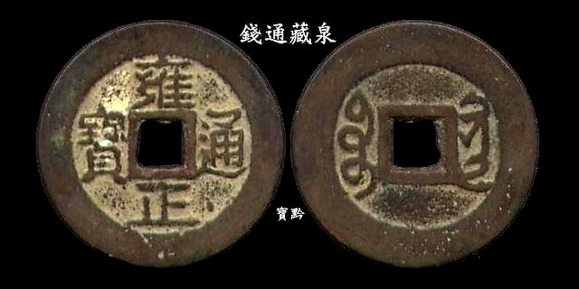
Emperor Emperor Yong Zheng Jia Qing

Slide 5
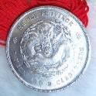
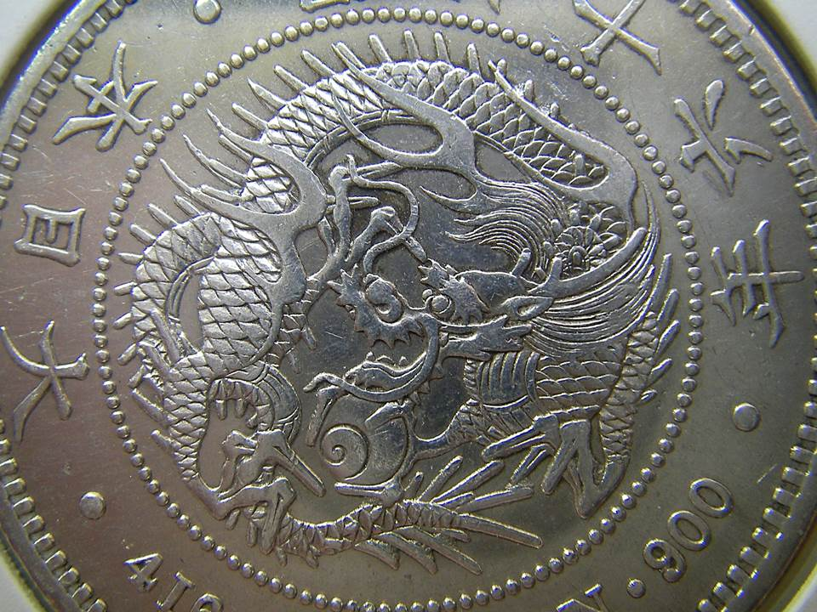
Japan Colonization
Dragon Silver Coins

Slide 6
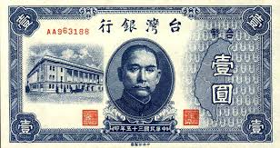
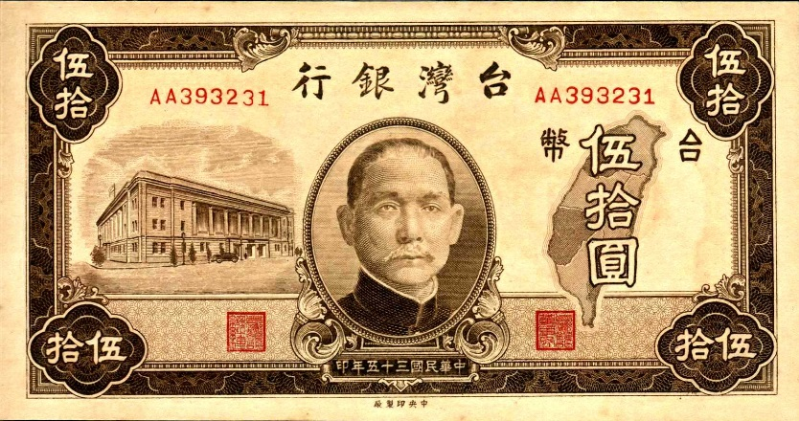
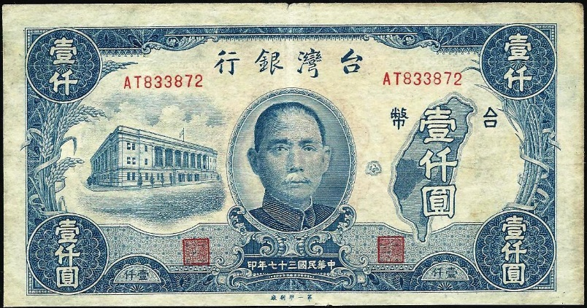
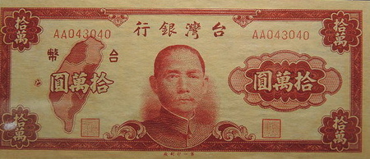
Old Taiwan Dollars
OTD 1
OTD 50
OTD 1000
OTD 100000

Slide 7
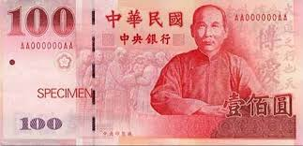
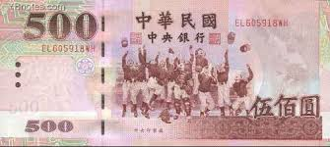
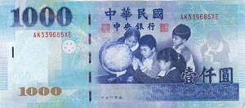
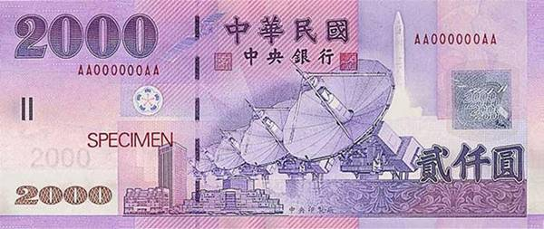
New Taiwan Dollars
NTD 100
NTD500
NTD 1000
NTD 2000

Slide 8
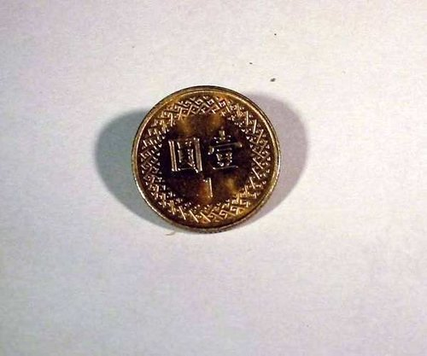
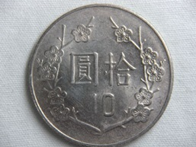
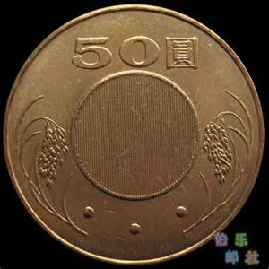
Coins
NTD 1
NTD 10
NTD 50

Slide 9
Thank You!

