Slide 1
Final Project “Music and Places”
Mishatkina Elena
Places and Perspectives Learning Circle 1
Class 8B
Lyceum #6
Tambov, Russia

Slide 2
Goal Of The Project
To exchange information on music of the communities (samples of traditional music, most popular music, famous musicians of the place and their works)

Slide 3
Questions
1. Where in your city can music be heard?
2. Place – type of music: What type of music is more often played in each place? How is it performed? (It can be presented on a slide: a photo of the place – some words about music and a piece of recorded music if possible)
3. Place – famous musicians: Are there any famous people connected with places of your town? (Any famous musicians born in your city and some short pieces of information about these musicians like vital statistics and most famous/ favourite works)
4. Place – events: are any musical events held in your community? (It can be a short article describing one – two events)
5. Your class and music: how many people in your class play any musical instruments or sing or compose music? What instruments do you play? Have you got a school orchestra or band? Do you take part in concerts? Do you organize any concerts for charity? (It can be a diagram showing the results of the survey and some slides)

Slide 4
Tambov (Russia) and Seattle (the USA) Where in your city can music be heard?
Tambov
Seattle
Concert Hall
Drama Theatre
University of Culture
Musical Institute and schools
City park
Open stages
Key Arena
Zoo
Seattle Center
Benaroya Hall
EMP – Experience Music Project

Slide 5
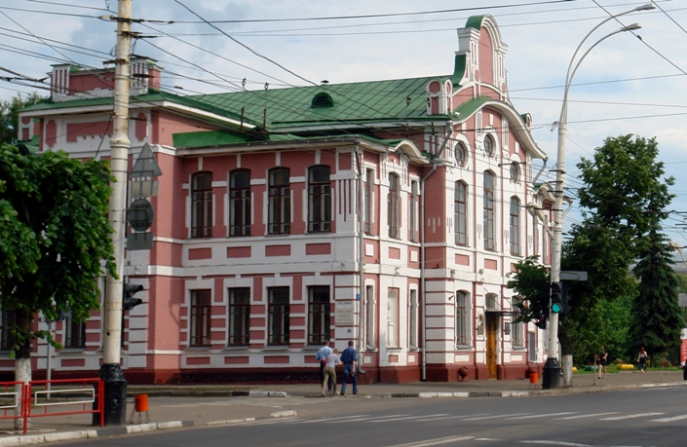
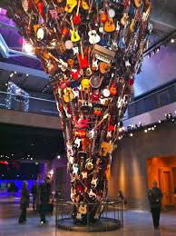
. Place – type of music: What type of music is more often played in each place? How is it performed?
In both places:
Classical melodies
-Jazz
-Rock
-Pop
-Dance
-Street Music
-Rap
Guitar Sculpture in the EMP , Seattle
Musical Institute named after Rakhmaninov, Tambov

Slide 6
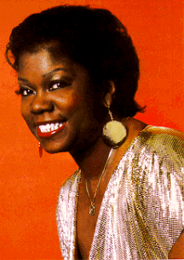
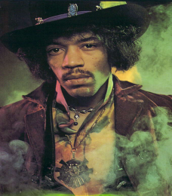
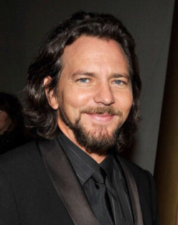
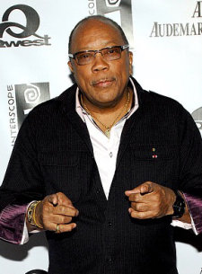
3. Place – famous musicians: Are there any famous people connected with places of your town?
Ernestine Anderson Jazz Great – Singer
Macklemore and Ryan Lewis
Jimi Hendrix
Quincy jones
Eddie Vedder

Slide 7
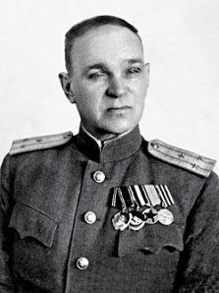
Sergey Rakhmaninov, a classical music composer
Vasiliy Agapkin who wrote a patriotic marsh called Farewell of Slavianka
Roman Bazhilin

Slide 8
4. Place – events: are any musical events held in your community?
Religious Holidays and traditional Celebrations such as Shrovetide
Rakhmaninov Festival
Festival of Brass Bands
City Day
Folk Music Festival
Bumbershoot (an annual international music and arts festival held in Seattle, Washington).
FOLKLIFE FESTIVAL
Vera Project
Pike Place

Slide 9
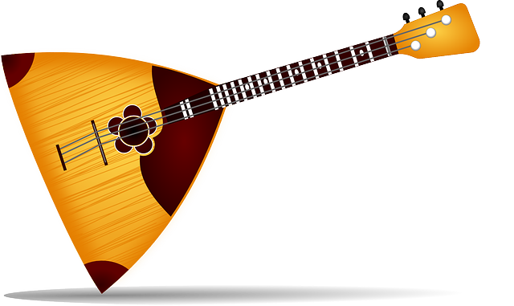
Your class and music: how many people in your class play any musical instruments or sing or compose music? What instruments do you play? Have you got a school orchestra or band? Do you take part in concerts? Do you organize any concerts for charity? )
Musicians in my class (Written by Dmitry Zimarin, Tambov, Russia
When I conducted a survey, I was surprised by result. 8/13 of my class are musicians or singers. I think that’s impressive.
There are different types of Instruments which they are playing like: guitar, violin and even ancient Russian instrument balalaika.
I finished musical school and have a diploma. I’m playing the classic guitar and the balalaika.
Some students and teachers organise charity concerts , 3-4 times per a school year

Slide 10
References
"Bumbershoot." Wikipedia. Wikipedia, n.d. Web. 28 Apr. 2015. <http://en.m.wikipedia.org/wiki/Bumbershoot>.
"Experience Music Project." Journeys in the Light. Journeys in the Light, 19 Jan. 2013. Web. 28 Apr. 2015. <http%3A%2F%2Fwww.journeysinlightphotoblog.net%2F2013%2F01%2F19%2Fexperience-music-project%2F>.
Keuler, Morgan. Bumbershoot Performance. Digital image. Bassnectar. Bassnectar, 3 Sept. 2013. Web. 28 Apr. 2015. <http://www.bassnectar.net/2013/09/bumbershoot-2013-family-photo/>.
Nelson, Christopher. Bumbershoot. Digital image. Fest 300. Fest 300, 27 June 2004. Web. 27 Apr. 2015. <https://www.fest300.com/magazine/the-zombies-festimonial-60s-psychedelia-is-reborn-at-festivals>.
"At The Museum." EMP Museum. EMP, n.d. Web. 28 Apr. 2015. <http://www.empmuseum.org/>.
http://upload.wikimedia.org/wikipedia/commons/9/99/Vera_Project_12.jpg
http://static1.squarespace.com/static/52ec29bfe4b01e0476cb9944/531e3457e4b04c1bc67c32e5/531e3458e4b04c1bc67c32e6/1394488408560/il_fullxfull.378991576_k9vx.jpg
http://upload.wikimedia.org/wikipedia/commons/0/09/EMPPano11.jpg
http://www.empmuseum.org/media/2955/emp_museum_private_event.jpg
http://seattle.findwell.com/wp-content/uploads/2013/10/5th-theatre_interior_low.jpg
https://cbsseattle.files.wordpress.com/2011/03/picture-004.jpg
http://cojovo.com/wp-content/uploads/2014/12/5063961496_908f5e7806_z.jpg
Barrister, Lllegitamate. "Amp Guitar." Guitar World. N.p., 25 Apr. 2015. Web. 28 Apr. 2015. <http://www.killmatriarch.com/acoustic-guitar/amp-guitar>.
Early, Gerald. "The Story of an American Musician." PBS. PBS, 22 June 2005. Web. 29 Apr. 2015. <http://www.pbs.org/wnet/americanmasters/.../quincy-jones/the.../636/-pbs.or>.
Early, Gerald. "The Story of an American Musician." PBS. PBS, 22 June 2005. Web. 29 Apr. 2015. <http://www.pbs.org/wnet/americanmasters/.../quincy-jones/the.../636/-pbs.org>.
Usweeklystaff. "Celebrity News, Celebrity Gossip and Pictures from UsMagazine.com - Us Weekly." Latest News. Ananimos, n.d. Web. 28 Apr. 2015. <http://www.usmagazine.com/>.
EMP. 2009. EMP, Seattle, WA. http://upload.wikimedia.org/wikipedia/commons/0/09/EMPPano11.jpg
Key Arena. 2013. We Day, Seattle. http://keyarena.s3.amazonaws.com/img/Vito_Amati_We_Day_Seattle_2013_2216.jpg
Opera House. 2013. Seattle Opera House, Seattle. https://portlandtheatrescene.files.wordpress.com/2013/08/2013-08-25-seattle-2135.jpg
Seattle sympony, Seattle Symphony. Personal photograph by author. 2014.
Seattle Space Needle. 2014. Space Needle, Seattle, WA. http://images.fineartamerica.com/images-medium-large-5/seattle-space-needle-emmanuel-panagiotakis.jpg photograph

Slide 11
References
Valliere, Kevin. Macklemore. Digital image. Occasional and Spectacular Faliures. Occasional and Spectacular Faliures, 4 Apr. 2013. Web. 29 Apr. 2015. <https://kevalliere.wordpress.com/2013/04/04/if-i-can-be-an-example-macklemore-and-the-search-for-real-male-role-models/>.
Debord, Jason. Guitar. Digital image. Rock Subculture Journal Jason DeBords Rock Pop Concert Review and Music Resource. Rock Subculture, 01 Dec. 2013. Web. 29 Apr. 2015. <http://rocksubculture.com/2013/12/01/rock-subcultures-top-101-list-of-alternative-christmas-songs-the-best-rock-pop-indie-punk-rb-new-wave-modern-rock-from-the-70s-80s-90s-00s-and-beyond/>.
Saxophone. Digital image. Jazz in America. Jazz America, n.d. Web. 29 Apr. 2015. <http://www.jazzinamerica.org/LessonPlan/5/3/228>.
Ariana Grande. Digital image. Diva Devotee. Diva Devotee, 3 Sept. 2012. Web. 29 Apr. 2015. <http://www.divadevotee.com/2012/09/Vocal-Range-Ariana-Grande-Soprano-Music-3octaves.html>.
Drums. Digital image. Yamaha. Yamaha, 2015. Web. 29 Apr. 2015. <http://usa.yamaha.com/products/musical-instruments/drums/ac-drumsets/rock_tour_color_variaion/>.

Slide 12
References
https://www.google.ru/url?sa=i&rct=j&q=&esrc=s&source=images&cd=&cad=rja&uact=8&ved=0CAcQjRw&url=http%3A%2F%2Fturtmb.ru%2Fsubmenu%2Foffer%2Ftraipse%2Fs%2Fs_1163.html&ei=qpciVeHHJcO2sQH2t4DgBg&bvm=bv.89947451,d.bGg&psig=AFQjCNFc65JFd9-P0L6iimJie5I9O909HA&ust=1428416803972412
https://www.google.ru/url?sa=i&rct=j&q=&esrc=s&source=images&cd=&cad=rja&uact=8&ved=0CAcQjRw&url=http%3A%2F%2Ftraveltipz.ru%2Ftrips%2Frestaurants-rating%2Ftambov-russia-741&ei=ZpciVczTIoONsAHjioBI&bvm=bv.89947451,d.bGg&psig=AFQjCNGr1aLbgCeY9SU7X5_3iNsi5pIVZg&ust=1428416703649418
https://vk.com/photo-41918330_307602468
https://vk.com/photo-85493761_352054443
https://vk.com/photo-32987137_28648583
7
https://vk.com/photo-40926371_354114835
http://www.listnerd.com/list/most-famous-composers-from-russia- фото Рахманинова на слайде с музыкой
http://vk.com/wall-40330725_1205?reply=1207- фото Рахманинова на 1 слайде
http://www.zapoved.net/index.php/%D0%9A%D0%B0%D1%82%D0%B0%D0%BB%D0%BE%D0%B3/%D0%98%D0%B7%D0%BE%D0%B1%D1%80%D0%B0%D0%B6%D0%B5%D0%BD%D0%B8%D0%B5/3589 дом- музей Рахманинова
http://5mp3.ru/audio/99997343/-13333245/Rahmaninov_Sergey_Vasilevich__-Vokaliz(5mp3.ru).mp3
http://www.audiopoisk.com/artist/sergei-rahmaninov/ музыка Рахманинова
https://ru.wikipedia.org/wiki/%D0%E0%F5%EC%E0%ED%E8%ED%EE%E2,_%D1%E5%F0%E3%E5%E9_%C2%E0%F1%E8%EB%FC%E5%E2%E8%F7
https://vk.com/photo-40926371_354114835
http://www.vestitambov.ru/index.php?new_id=26419 http://www.taminfo.ru/tambov_novosti/culture/31320-marsh-proschanie-slavyanki-pretenduet-na-zvanie-glavnoy-pesni-pobedy.html http://cult.tmbreg.ru/foto/19486/19565.html http://www.vestitambov.ru/index.php?new_id=25343
https://www.google.ru/url?sa=i&rct=j&q=&esrc=s&source=images&cd=&cad=rja&uact=8&ved=0CAcQjRw&url=http%3A%2F%2Fwww.msktambov.ru%2Ftag%2Frzhd%2F&ei=Y0sdVZfcHcOfsAHfmoPQAg&bvm=bv.89744112,d.bGg&psig=AFQjCNEFcNKCE8nCuJSuHcXFbT-2HmbsJw&ust=1428069589207740
https://yandex.ru/images/search?img_url=http%3A%2F%2Fi.ytimg.com%2Fvi%2F03vwMrZXdus%2F0.jpg&uinfo=sw-1280-sh-1024-ww-1263-wh-879-pd-1-wp-5x4_1280x1024&text=%D0%A0%D0%BE%D0%BC%D0%B0%D0%BD%20%D0%B1%D0%B0%D0%B6%D0%B8%D0%BB%D0%B8%D0%BD&redircnt=1427983552.1&noreask=1&pos=5&rpt=simage&lr=13&pin=1
http://www.chumakoff.ru/photogallery/vystuplenija/tambov_den_goroda_ts…
http://www.msktambov.ru/tag/rashodovanie-byudzheta/page/2/
http://vk.com/wall-50207175_1458
http://vtambove.ru/news/freetime/82475/Фото: Илья Демин
http://www.gimnasia7.ru/%D0%B8%D1%81%D1%82%D0%BE%D1%80%D0%B8%D1%8F-%D0%B3%D0%B8%D0%BC%D0%BD%D0%B0%D0%B7%D0%B8%D0%B8/
http://www.msktambov.ru/wp-content/uploads/taisia/2014/08/rio-tambov.jpg
http://uploads.likengo.ru/uploads/promos/6e/68/f1cfc4233aa161ec750bd0e612ad.jpg
http://uploads.likengo.ru/uploads/albums/53/ec/a096ce0fce898bbd0c4e7d138smr-750x500.jpg
http://img-fotki.yandex.ru/get/5808/pavlenko68.0/0_616aa_5a49e63a_XXL.jpg
Photos taken by Class 8B

Slide 13
Автор шаблона – Коровина Ирина Николаевна, учитель начальных классов МБОУ «СОШ №9» г.Сафоново Смоленской области
Фон - http://afisha.altune.ru/fony-dlya-prezentacii-powerpoint-detskie.html

