Slide 1
Learning Circles September 2015 to January 2016
Topic: FOOD
Group Facilitators
Barry Kramer Olga Timofeeva
USA Russia

Slide 2
Participating Teachers/Countries
Craciun Victoria
Institution:
Gymnasium nr.99 Gh.V.Madan"
St.cel Maare nr.1
Kishinev, Truseni
Moldova 3733
Natasha Belozorovich Institution: Gymnasium #1, Starye Dorogi Krivosheina str., 24 Starye Dorogy, Misnk Region Belarus
Elena Bogoeva Institution: Petru Movila Lyceum Botanica Veche st., 11A Chisinau, Moldova 2060
Margarita Astakhova Institution: Secondary School 8a-3-12 Korolev, Moscow region Russia
Tariq Mehmood Coordinators: Ms. Samina, Ms. Rushda Institution: The Trust High School Green Town Lahore, Punjab Pakistan

Slide 3
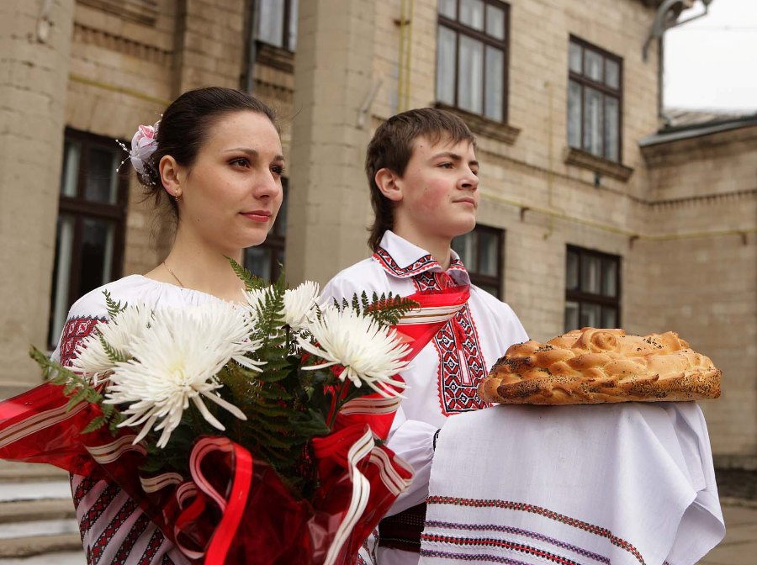
Moldavian Traditional Cuisine

Slide 4
Soup
Soups are also very popular in Moldova cuisine. Some say a meal is not complete without soup. Two of the most common soups are zama, a kind of chicken noodle soup, and ciorba, served with meat or beans. Both zama and ciorba tend to be slightly sour. There are also many other soups, such as borsh and solyanka.

Slide 5
Mamaliga
Perhaps the best known Moldovan dish is mamaliga or polenta (a cornmeal mush or porridge). This is a staple food on the Moldovan table, served as an accompaniment to meat dishes and frequently garnished with brinza, sour cream, and sometimes fried or scrambled eggs. Mamaliga is a local favorite, often served in restaurants throughout the country.

Slide 6
Traditional holiday dishes
Moldovan holiday cuisine is especially tasty. Traditional holiday dishes include cabbage leaves stuffed with minced meat (sarmale), meat jelly, and noodles with chicken. The holiday table is usually decorated with baked items, such as pastries, cakes, rolls, buns with a variety of fillings (cheese, fruit, vegetables, walnuts, etc.).

Slide 7
Easter Dishes
During Easter holidays special dishes are prepared for the occasion. Pasca is traditional Easter bread, central to the holiday, made from leavened dough and filled with cheese. The loaves often resemble braided wreaths and are ornately decorated, commonly with images of the cross. Cozonac is traditional sweet bread made with milk, sugar, eggs, butter and raisins. It is similar to the Italian Pannettone. Traditional savory Easter dishes include unsalted cheese, spring greens, various meat preparations of lamb,, or poultry, racitura (meat jelly), cabbage, and painted Easter eggs, which according to tradition, people bump together to see whose egg is strongest.

Slide 8
Thanks for watching!!!
Submitted by :
Cimpoi Nicoleta ,
the 8th form pupil

Slide 9
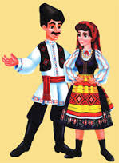
Moldovan Cuisine
Bobrova Alina
Coltsova Diana
8-B class

Slide 10
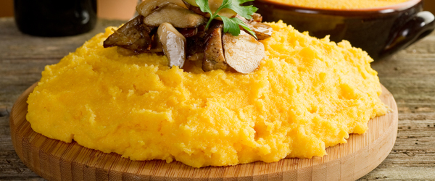
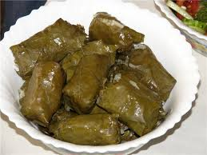
1. What is traditional food in your country?
Is it healthy? What is its nutritional value?
Our traditional food is ,,Mamaliga’’ with ,,Brinza’’ and meat. ,,Mamaliga’’ is corn smash. It’s really healthy because it has vitamins. The nutritional value of ,,Mamaliga’’ is 344 kcals.
Of course, taste “Sarmale” which are made of rice, meat and vegetables rolled in vine leaves. The nutritional value of “Sarmale” is 121 kcal.

Slide 11
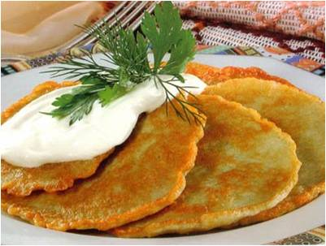
Belarusian traditional food

Slide 12
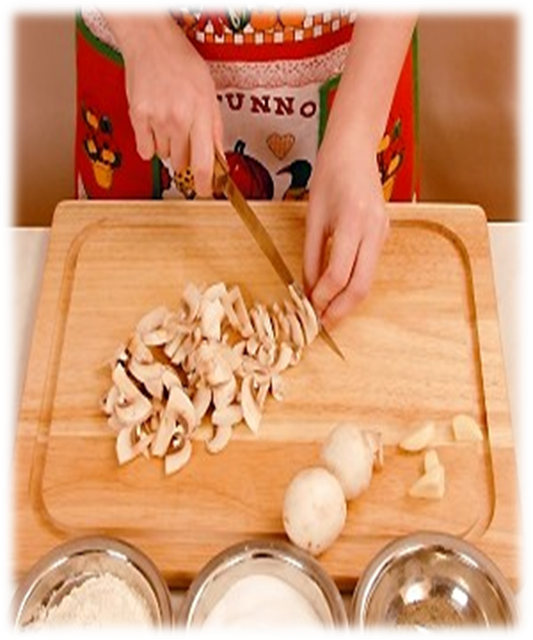
Traditional soup - is Mushroom soup.
To make a mushroom soup you need: 1) 200gr. fresh mushrooms 2) 3 table spoons of margarine 3) 1 table spoon of a flour 4) 1 litre of water 5) 1 glass of sour cream 6) salt 7) pepper 8) greens

Slide 13
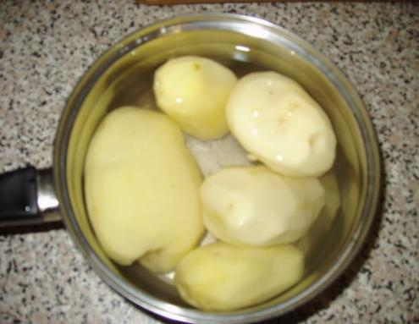
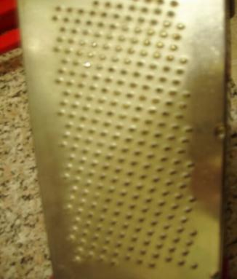
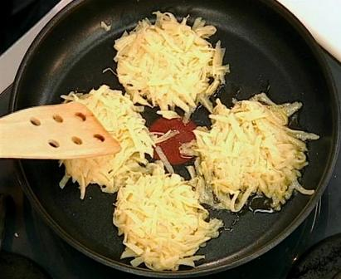
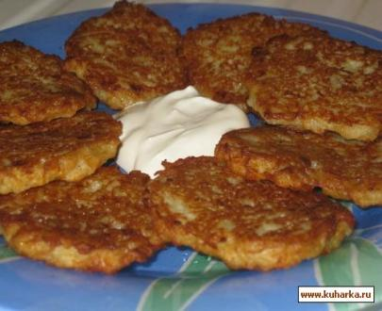
Peel potato and rub it on a grater. Add salt, flour and mix everything.
Fry on heat oil. Eat with sour cream.

Slide 14
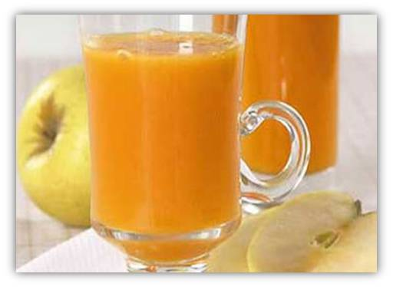
Traditional desert- Apple kisel.
You need: 1) 1 kg of apples 2) one and a half
glass of sugar 3) 3 table spoons
of potato starch.

Slide 15
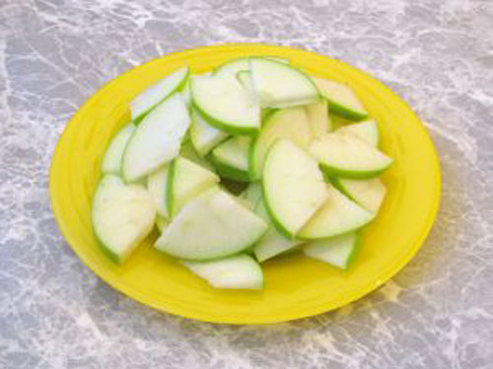
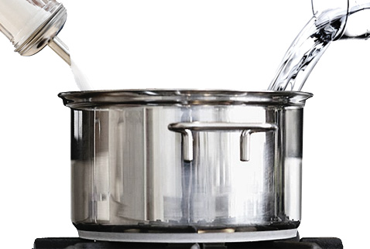
Wash apples and cut them into thin slices. Put them into the pan and add 4 glasses of water.
Cook apples while they become soft.
Cast away then on a sieve.
Wipe and mix with broth. Add sugar and boil. Add starch.
Bon
Appetit!

Slide 16
Traditional food in Belarus
Dima Davydenko
Ivan Gudkovskiy

Slide 17
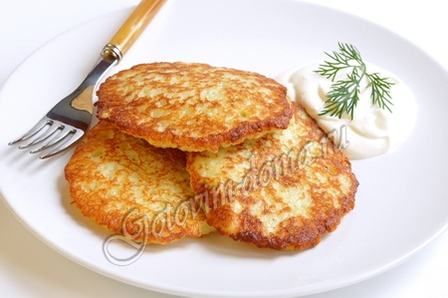
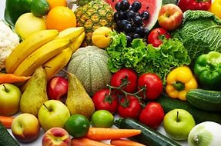
Traditional food in our country is draniki (potato pancakes) and kolduny (potato pankaces with meat).
In our country people like to eat healthy food such as fruits and vegetables.

Slide 18
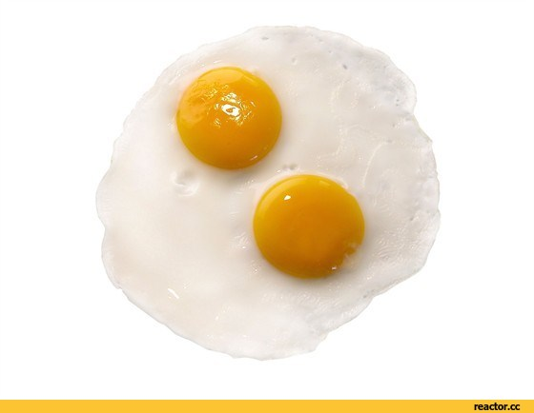
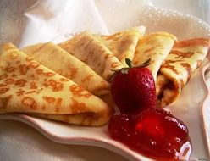
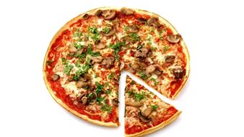
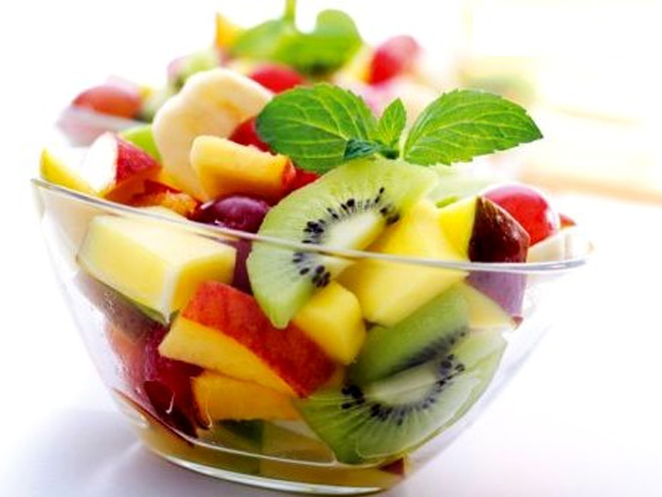
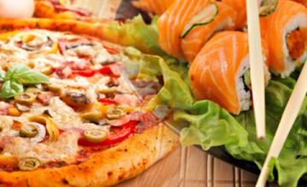
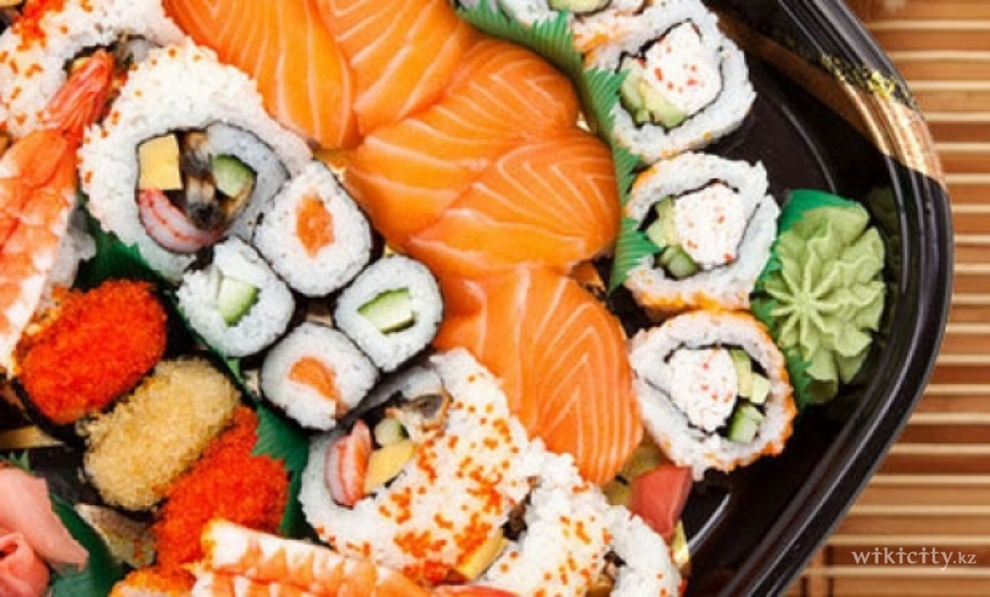
Our favorite food is pancakes, pizza, scrambled eggs, fruit salad.
Our favorite cuisines are Japanese and Italian.

Slide 19
We don’t have special eating habits.
END

Slide 20
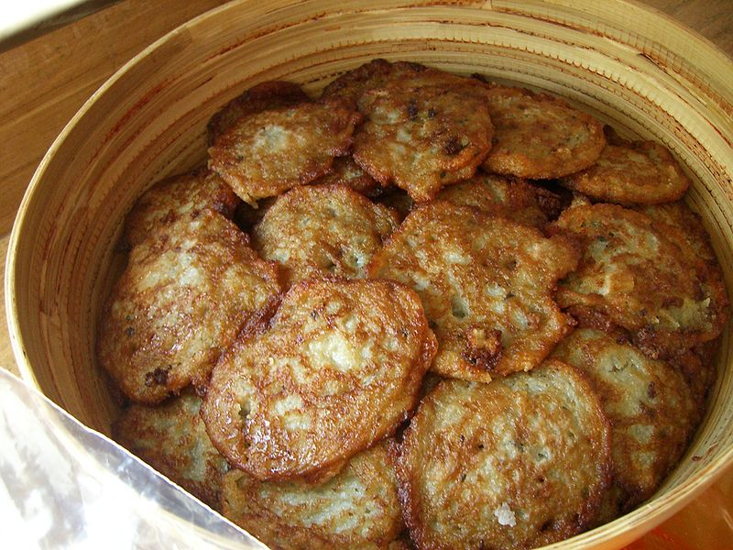
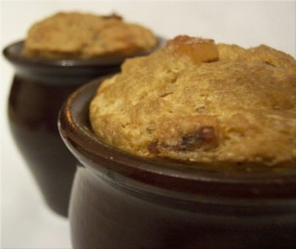
Basis of the national belarusian cuisine
are dishes from potato
,
kolduny (potatoes pancakes with meat), potato pies (babka)

Slide 21
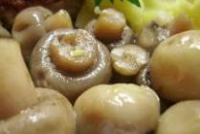
Potatoes are also often used in the preparation of salads. The natural conditions of Belarus determined the presence in Belarusian cuisine mushrooms, berries, fish, vegetables.
.
Among meat dishes biguse is popular - meat, stewed with cabbage, zeppelins (sorcerers) - meat baked in a potatoes. Also popular zrazy, sirloin, saltison, mochanka, cracklings.
Among season dishes is popular grated holodnik.

Slide 22
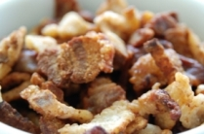
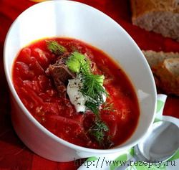
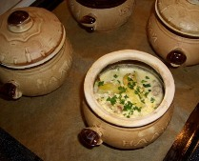

Slide 23
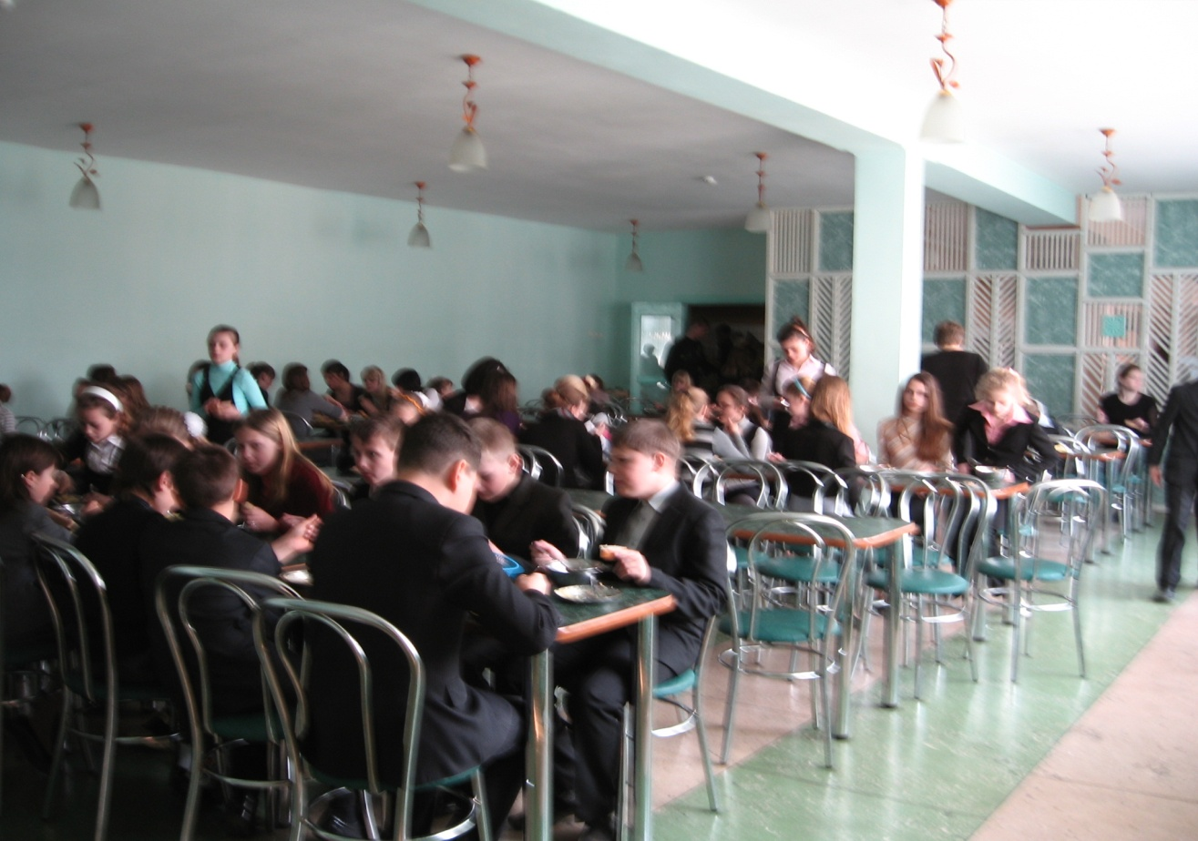
• The DINING room IN GYMNASIA № 1
"

Slide 24
You need:
Onions
Carrots
Potatoes
Tomato ketchup
Salt
Pepper
Spices
Dill
Oil
Meat broth or water
* Meat cut into pieces, fry lightly in butter.
* Add finely chopped onion and carrot. To Fry.
* Add finely chopped tomatoes, fresh or canned in their own juice.
* Add your favorite spices. Extinguish 10 minutes.
* Potatoes cleaned, cut into large cubes. Pour over meat.
* Pour the broth, many, but not to lay the potatoes.
* Salt, sprinkle with dill (can be green onions add).
* Cover, bring to a boil (do not mix!).
* At the slow-fire bake until cooked potatoes. You can to a large fire, will be faster, but so tasty not work.
* For 5 - 10 minutes prior to readiness to mix.
* BON APPETIT !!!
• stewed potatoes with meat

Slide 25
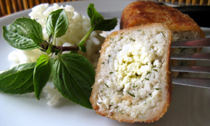
• Cutlet "Tenderness"

Slide 26
Products of prescription | The Quantity (on prescription, g) | Special comments
Dill | 10 | to taste
Salt | 5 | to taste
Black pepper | 2 | to taste
Chicken egg | 120
Butter unsalted | 70
Groats semolina | 50
Wheat bread from a flour of the premium | 200
Minced Meat | 500 | fish
Fine bread crumbs | 200
Flour of the highest grade | 30

Slide 27
What you need:
Minced fish - 500 g
White bread - 1 piece
Semolina - 2 tbsp.
2 boiled eggs
Butter- 70 g
Fresh herbs (dill)
Salt
Ground black pepper
Egg
Flour
Fine bread crumbs

Slide 28
What to do:
1. Put and leave in the milk white bread. Add in forcemeat a decoy, part of the chopped dill, pressed white bread, salt, a good stir and leave.
2. For stuffing to rub on a large grater hard-boiled eggs, chilled butter, balances chopped dill, a little bit of salt. Divide the stuffing on equal parts
3. Spread the stuffing on the palm of your hand, put in the middle of the filling and give chops an oblong shape
4. Beat eggs with milk (which is left after the soaking bread), a little salt...
5. Bread cutlet first in flour, then in mixture of eggs and milk and bread again. As a result of these simple manipulations we have obtained this is such a lovely chops...Fry the main way to norm.

Slide 29
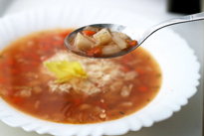
Bean soup with celery

Slide 30
Products of prescription | The Quantity (on prescription, g) | Special comments
Parsley | 5 | to taste
Vegetable oil (sunflower refined, crude) | 75
Black pepper | 2 | to taste
Tomato paste | 75
Carrot | 70
Onion | 60
Salt | 3 | to taste
Potatoes | 300
Beans | 200
Celery (root) | 100
Garlic (Allium sativum) | 4
Bay leaf | 1

Slide 31
What you need:
▪ Potatoes
▪ Beans
▪ Onion
▪ Garlic
▪ Celery root
▪ Carrots
▪ Tomato paste 3-4 tbsp.
▪ Salt
▪ Black pepper
▪ Dried or fresh chopped parsley
▪ Bay leaf
▪ 3-4 st.l. vegetable oil

Slide 32
What to do:
1. The beans to boil in the added some salt boiling water for 40 minutes, then add the chopped potatoes, celery, carrots. Continue to cook for another 30 minutes.
2. Fry the chopped onion and the crushed garlic cloves. Garlic need to fry no more than a few minutes and immediately remove from the frying pan, that he has to give its fragrance oil, and has not had time to start bitter. And bow to continue to fry until golden color.
3. Before removing from the heat, for a few minutes to add the water roasted onions, spices and tomato paste.

Slide 33
Created by
Ivan Kovalev
Alexandr Potachits
7th grade
Gymnasia #1
Starye Dorogi
Belarus

Slide 34
Pakistani Traditional Food/Drinks
Prepared By
Students of The Trust School Lahore Pakistan

Slide 35
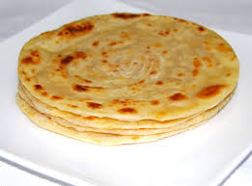
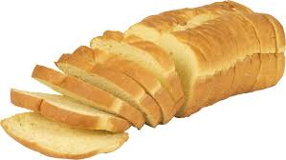
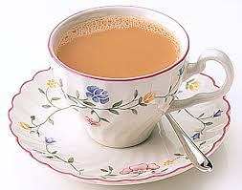
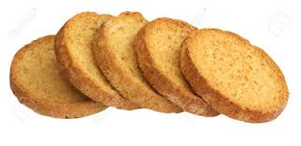
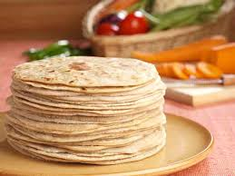
A Typical Pakistani Meal
BREAKFAST: WHAT DOES A PAKISTANI EAT?
Paratha
49%
Tea only
9%
Roti with curry
18%
Bread
10%
Rusk
7%
No Breakfast
2%
No Response
5%
Source: Gallup & Gilani / National Survey, 2009
Comparative Data
2006 2008 2009

Slide 36
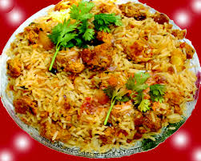
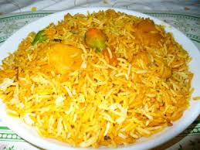
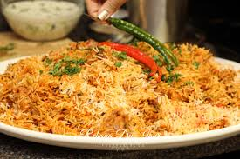
Buryani
Method:
Soak the rice in warm water, then wash in cold until the water runs clear. Heat butter in a saucepan and cook the onions with the bay leaf and other whole spices for 10 mins. Sprinkle in the turmeric, then add chicken and curry paste and cook until aromatic.
Stir the rice into the pan with the raisins, then pour over the stock. Place a tight-fitting lid on the pan and bring to a hard boil, then lower the heat to a minimum and cook the rice for another 5 mins. Turn off the heat and leave for 10 mins. Stir well, mixing through half the coriander. To serve, scatter over the rest of the coriander and the almonds.

Slide 37
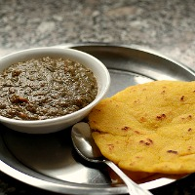
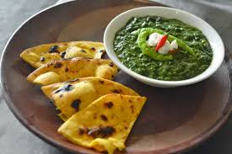
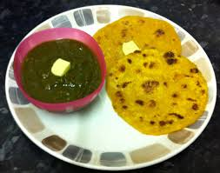
Sarson da Saag and Makki di Roti
Saron da saag and Makki di RotiSarson ka Saag and Makki di Roti is the traditional dish of Punjab Pakistan. It is the most popular winter dish of Punjabis. It is a highly nutritious because mustard leaves contain a lot of iron and protein.
But at the same time it can be little high on calories if it is served traditionally with lots of ghee or butter. Along with mustard leaves, spinach is also added which further enhances the nutritional value and taste of saag.
Ingredients:
A bunch of spinach and mustard leaves each
One chopped onion and one chopped tomato
2 chopped green chillies
½ teaspoon grated ginger and garlic each
Salt to taste
Ghee, oil
2 tablespoon maize flour
½ teaspoon garam masala
Method:
Wash and chop spinach and mustard leaves.
Add one teaspoon oil, all greens, ginger, garlic and green chillies in a pressure cooker.
Add few pinches of salt and 1 cup water.
Cook till it has done 2 whistles.
Let it cool. Grind it into a smooth paste.
Heat ghee in a saucepan, add onion and tomatoes. Sauté till cooked.
Add above mixture to the cooker. Add maize flour, lemon and garam masala.
Let it simmer until oil separates out.
Serve hot with makki ki roti. (Punjabi bread made of maize flour)

Slide 38
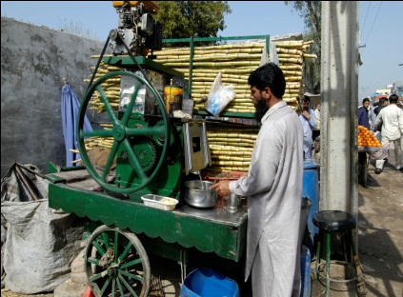
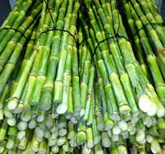
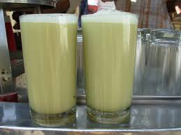
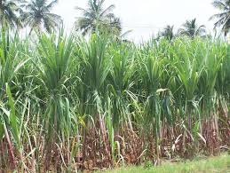
Sugarcane juice is the juice extracted from pressed sugarcane. It is consumed as a beverage in Pakistan.
National beverage of Pakistan is sugarcane juice.

Slide 39
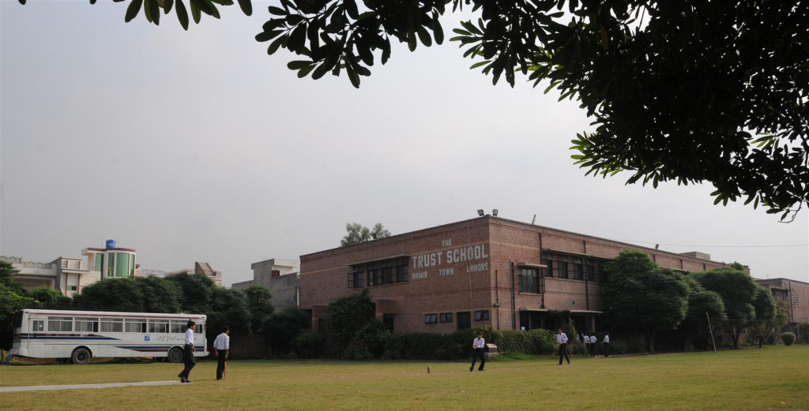
http://thetrustschool.edu.pk

