Slide 1
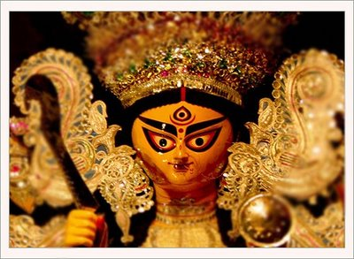
Created by Taha banswarwala Class 6, Mount Litera Zee School, Howrah, India Durga Pujo/ Navaratri- The predominant Hindu festival

Slide 2
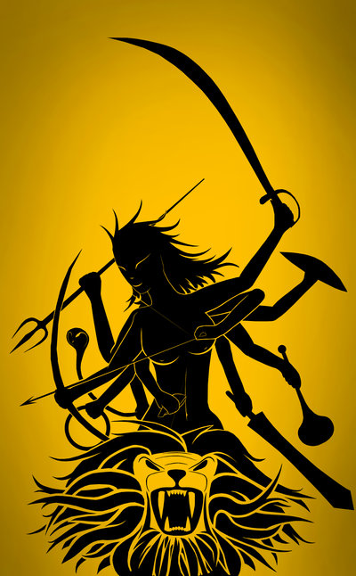
Revered Mother She has been worshiped from about 400 AD, but probably earlier, to the present. Her literary references are chiefly the Ramayana and Mahabharata, epic and Puranic texts, and she is mentioned by name in Vedic literature. In general, Durga is regarded in northern India as the gentle bride epitomizing family unity while in southern India she is revered more in her warrior aspect.

Slide 3
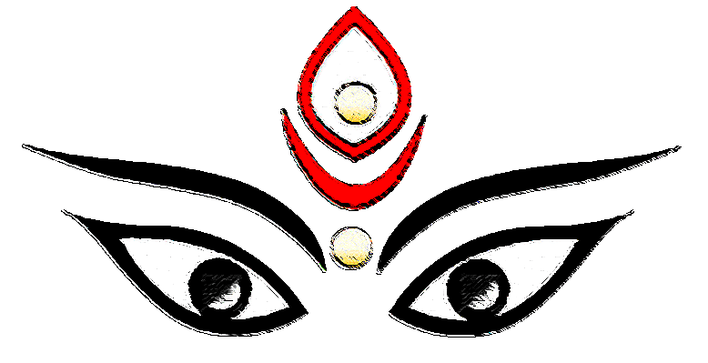
Origin/ Historyof Durga- Why it is celebrated?
Durga, a beautiful warrior seated upon a tiger, was the first appearance of the great goddess. The circumstance of her miraculous arrival was the tyranny of the demon Mahishasur, who through terrific austerities had acquired invincible strength. The gods were afraid of this water-buffalo bull because neither Vishnu nor Shiva could prevail against him. It seemed that the joint energy of Shakti was only capable of vanquishing Mahisha, and so it was the ten-armed Durga who went out to do battle.

Slide 4
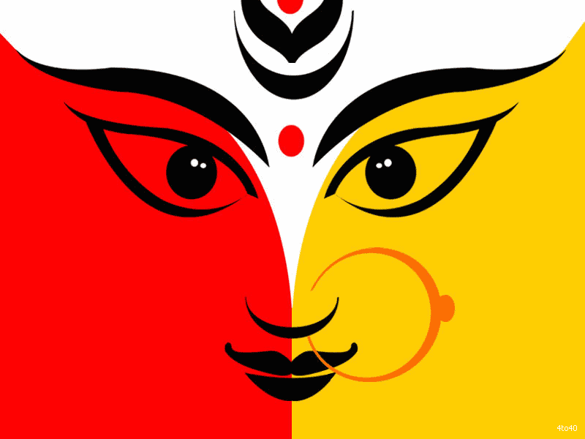
She went to battle on her ferocious mount lion, armed with the weapons given to her by the other Gods. Durga is one of the angry and aggressive aspects of the goddess Shakti, whose role in Hindu mythology was to fight and conquer demons and also personify the Sakti or female aspect of any male deity. In the battle, she fought and killed the evil Mahishasura and restored heaven to the Gods. Since then the goddess is invoked for protection from the powers of evil. Durga Puja is observed in her honor, to celebrate her victory over evil.
Origin/ Historyof Durga- Why it is celebrated?

Slide 5
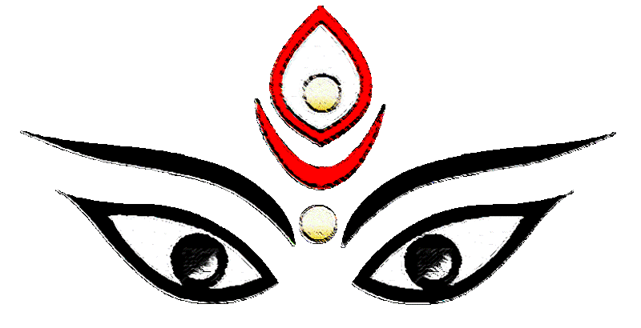
It is a five day festival for Bengalis and for Gujaratis this is a 9 day festival
Sashti
Saptami
Ashtami
Nabami and
Dashami or Dussera
Traditional music Link: https://www.youtube.com/watch?v=JbKm3a5CiJg

Slide 6
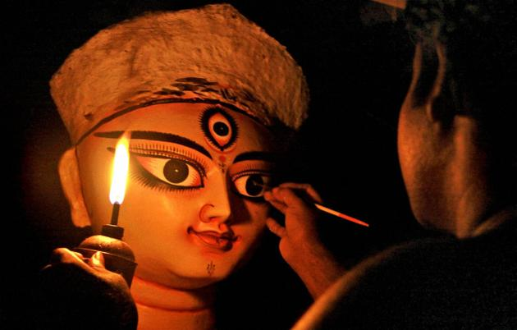
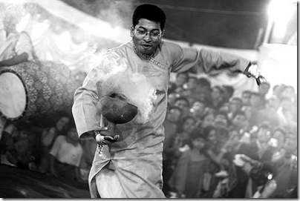
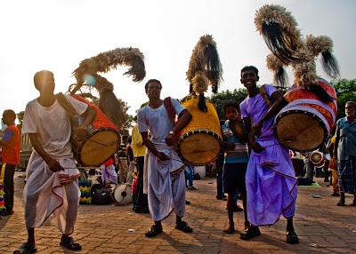
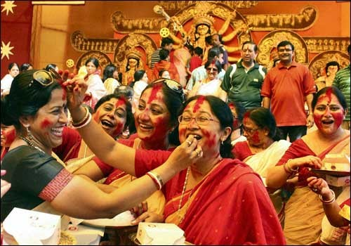
Dhunuchi Naach
Idol making
Dhaak
Celebration of the festival
Rituals' of the festival

Slide 7
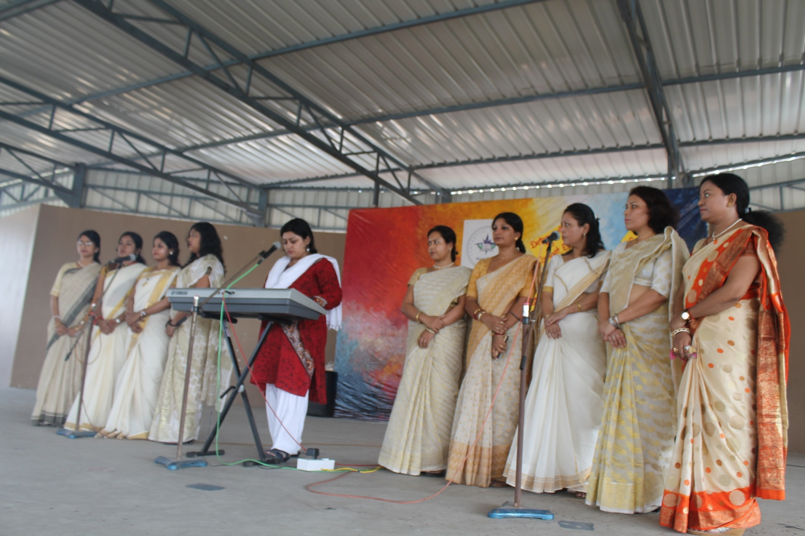
Song recital by teachers

Slide 8
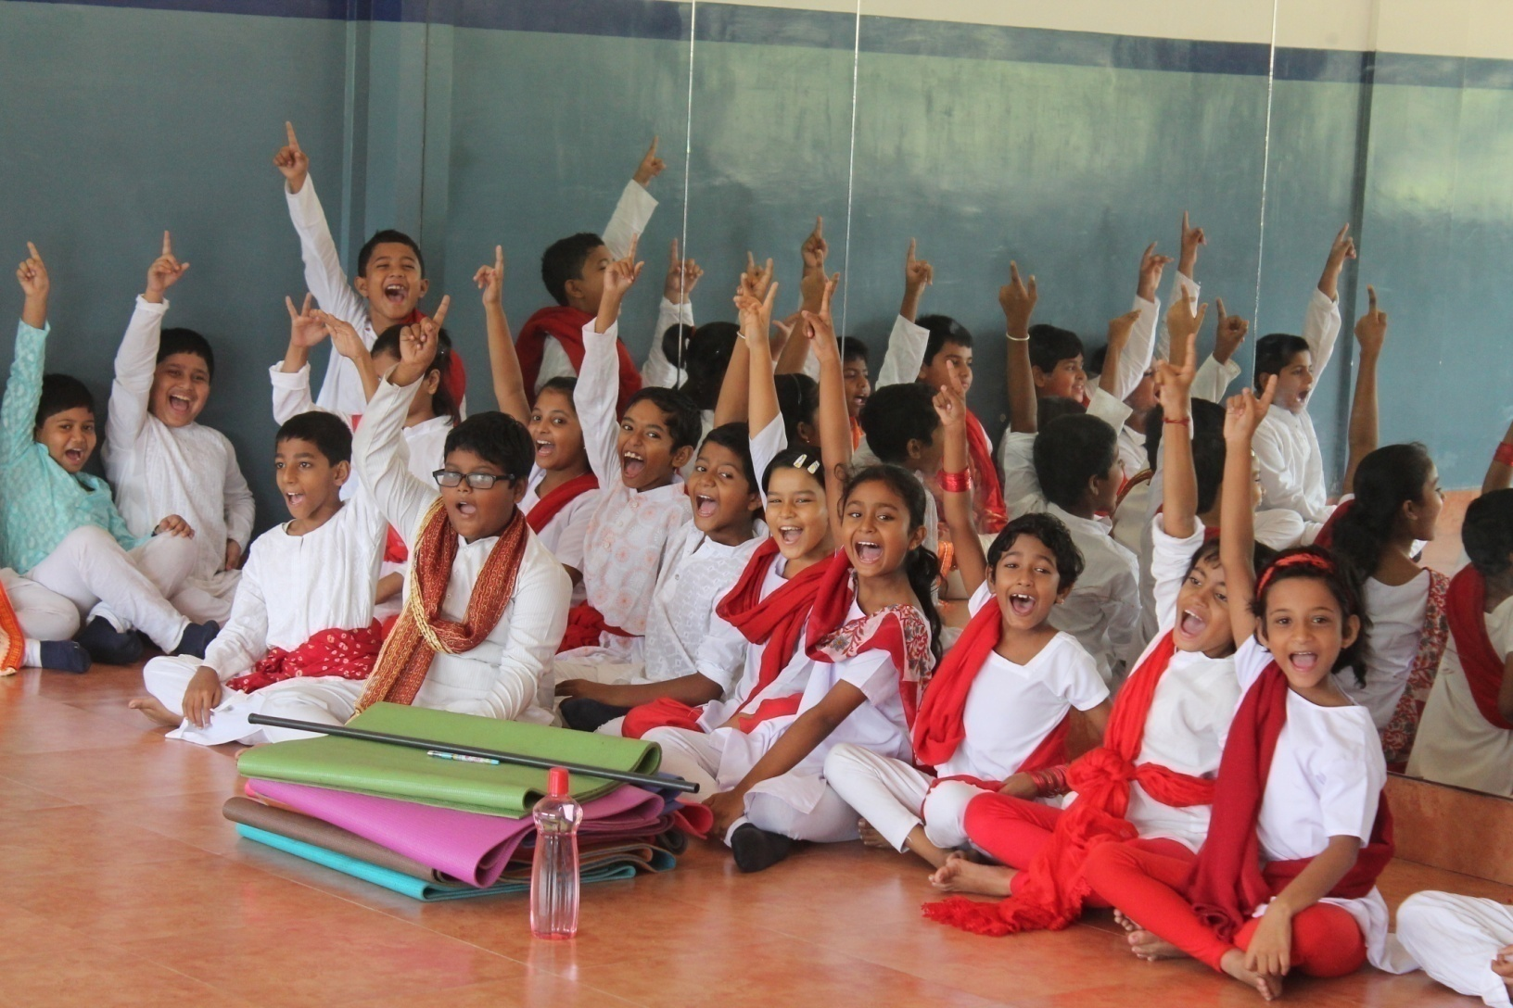
Theatre workshop by eminent theatre Jayashri Bhattacharya, Faculty at National School of Drama

Slide 9
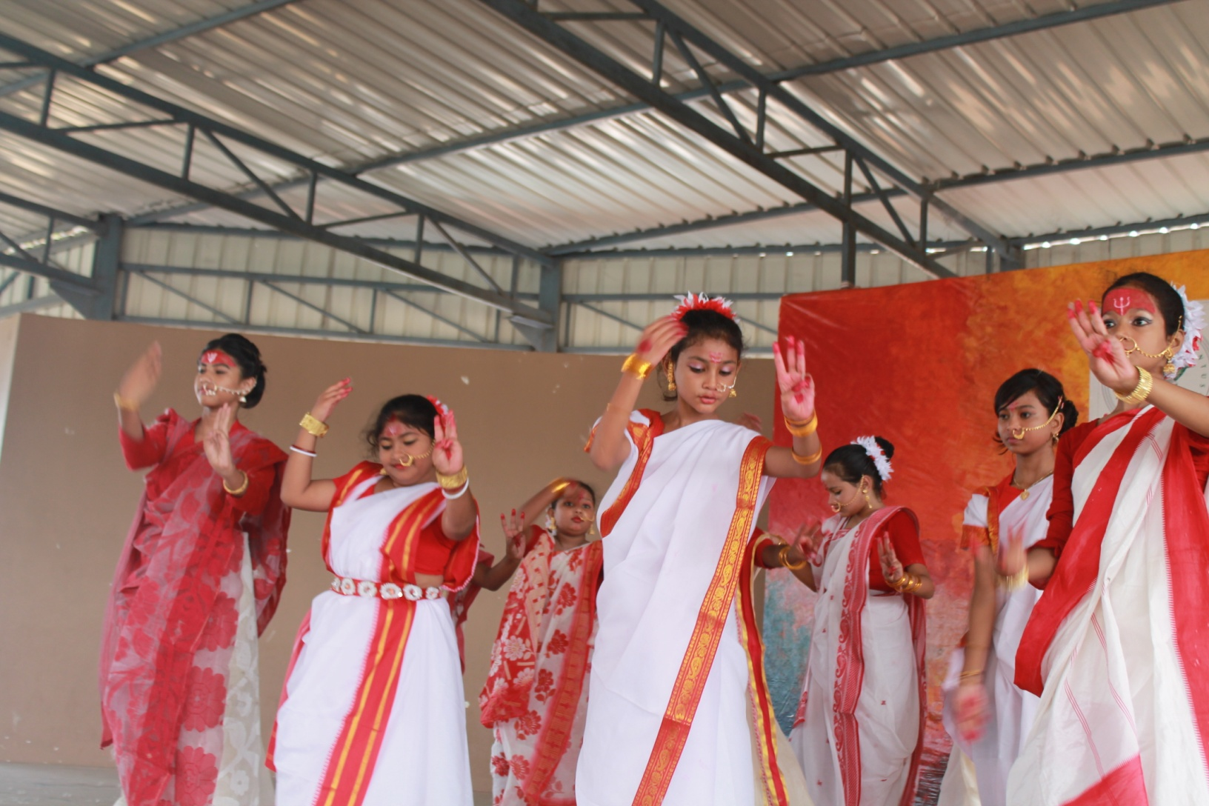
Dance performance by student

Slide 10
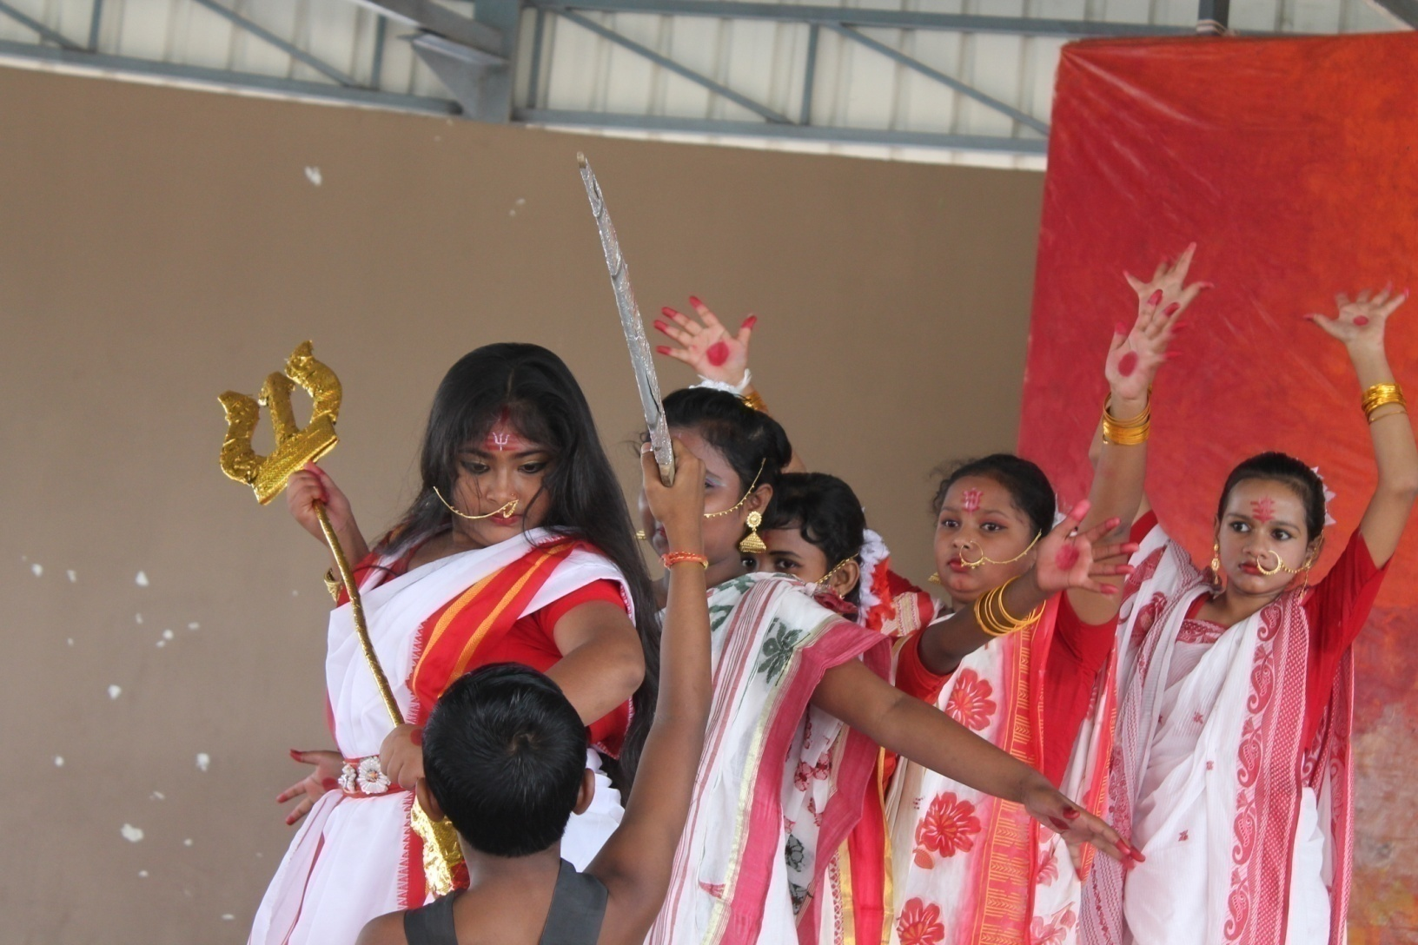
Dance performance by students

Slide 11
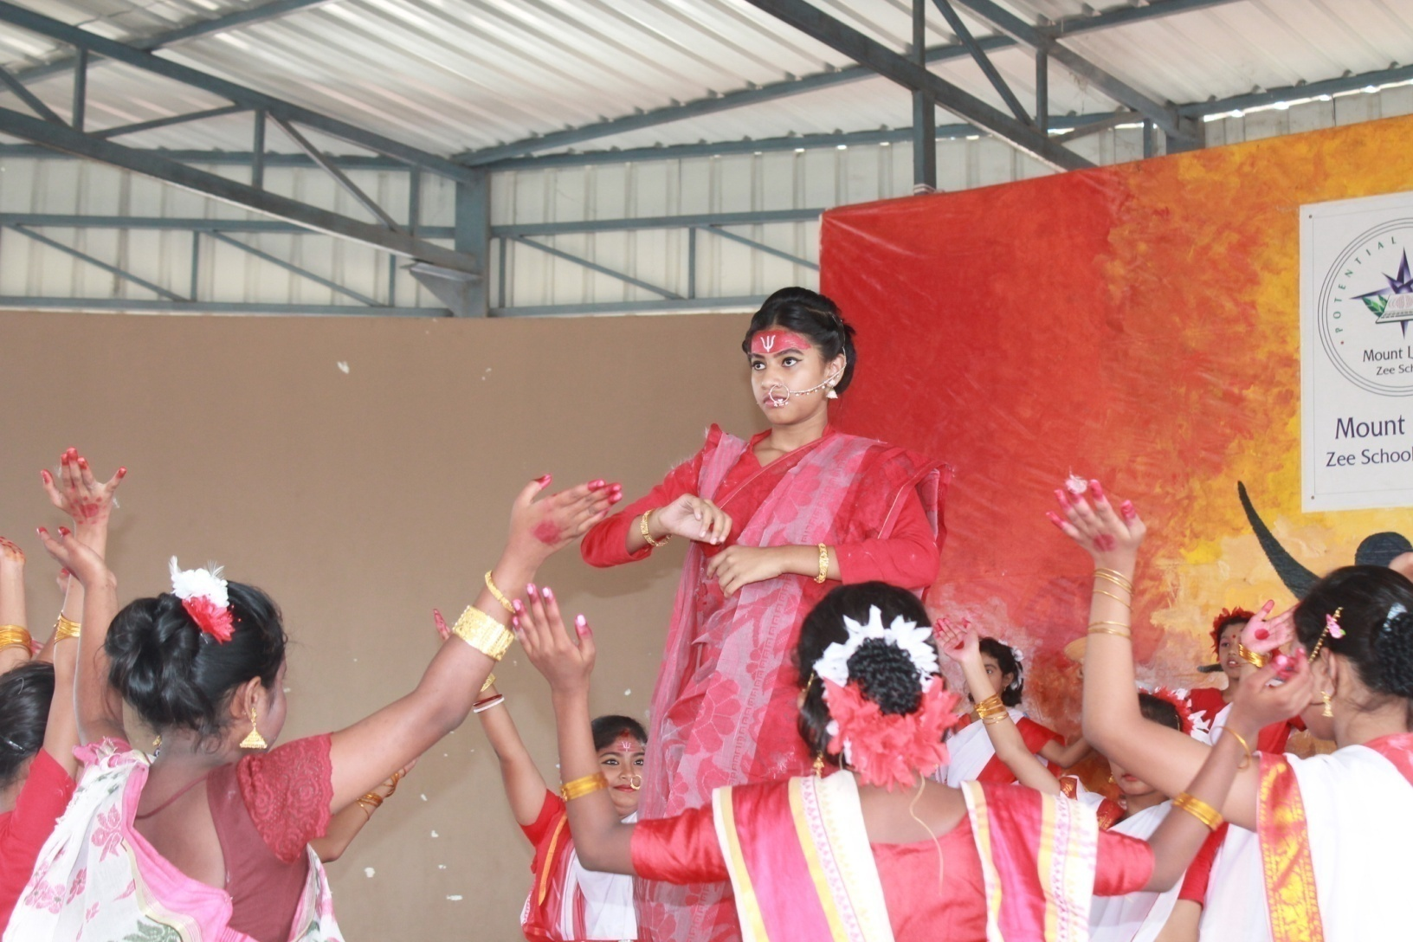
Dance performance by students

Slide 12
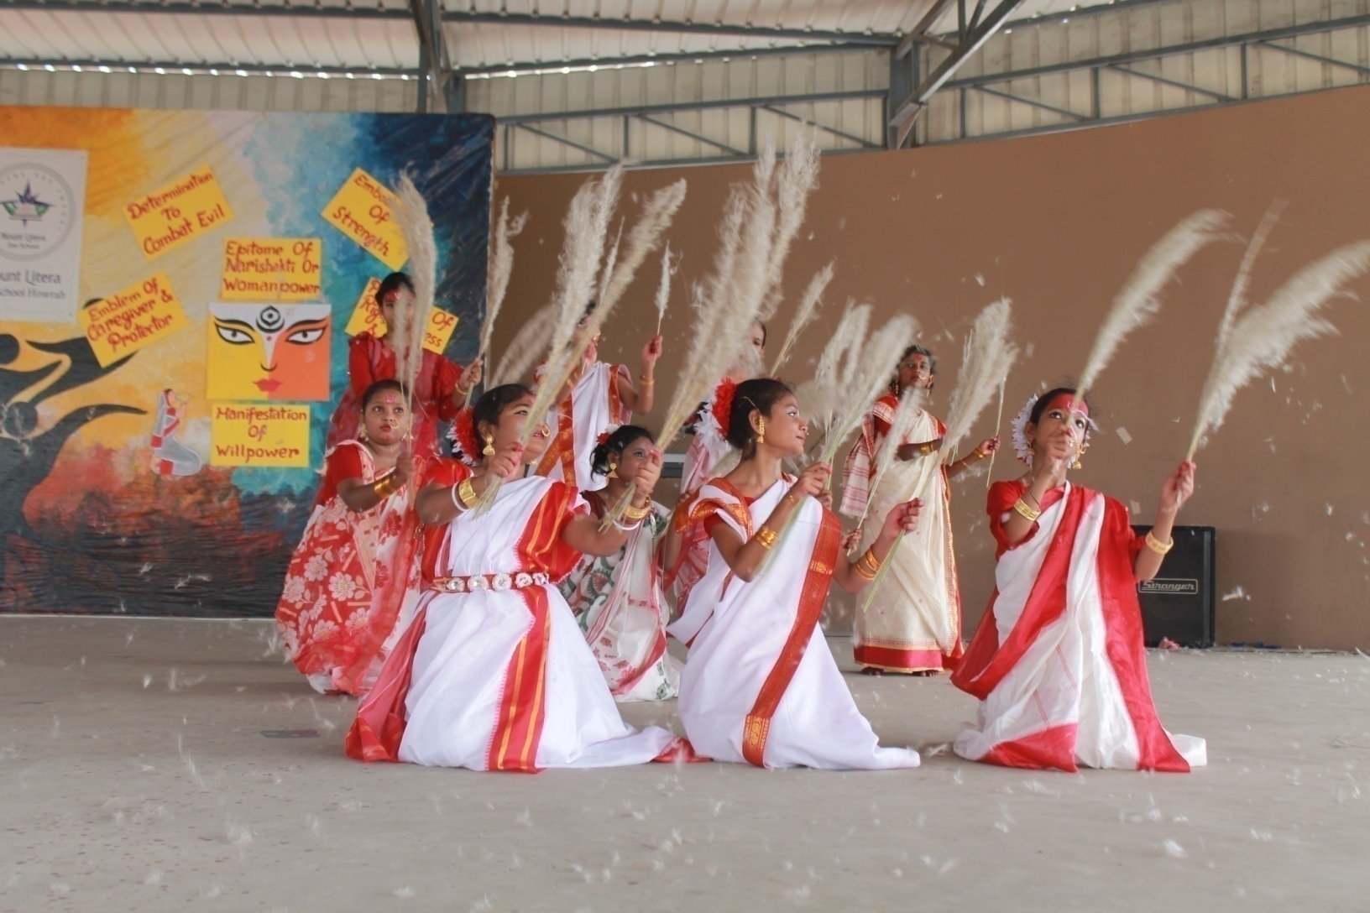
Dance performance by students

Slide 13
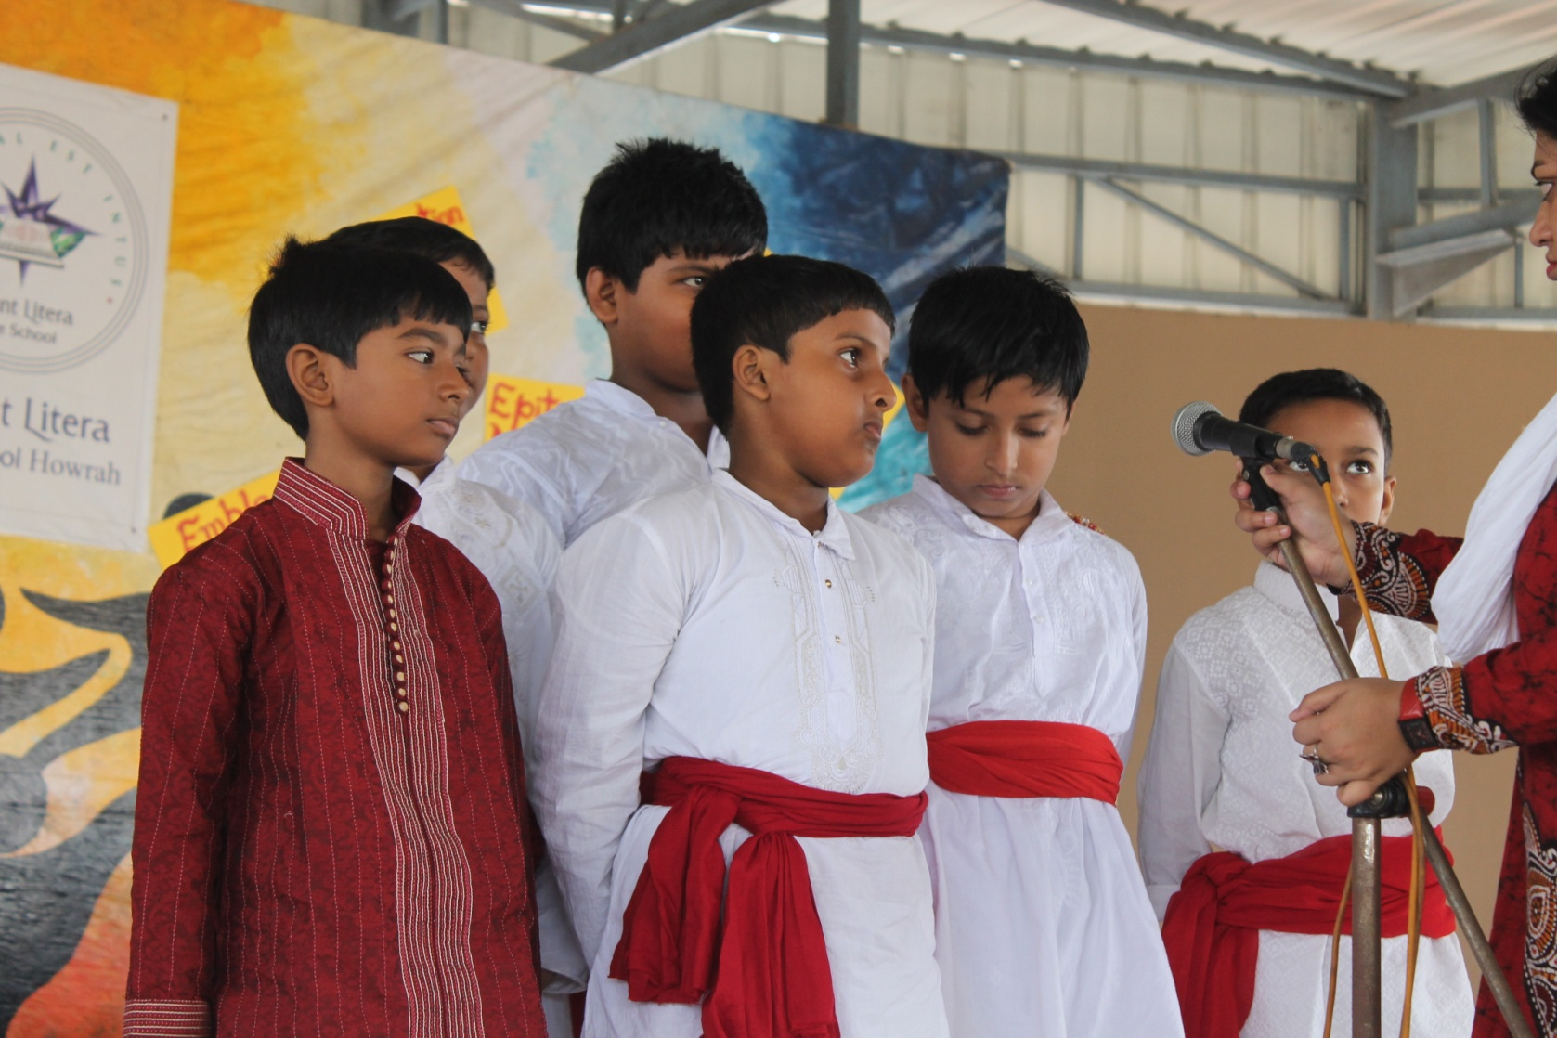
Song performance by school choir

Slide 14
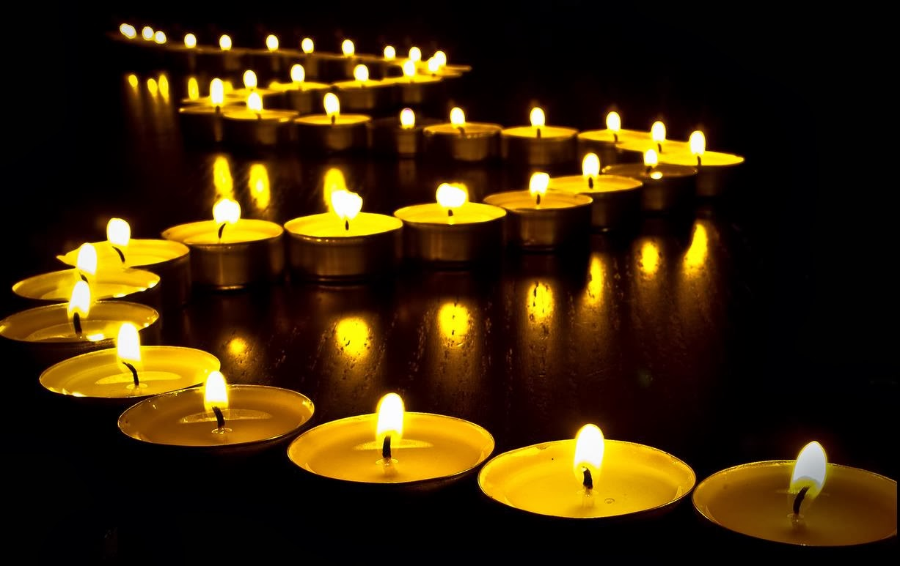
Diwali-by Shreyan Kabiraj, class 6, Mount Litera Zee School, India
Traditional music: https://www.youtube.com/watch?v=P3weLWM-zBU&list=PLvFLkxvl0zQQw6H-bGb-UeH_jS0jPrAJ_

Slide 15
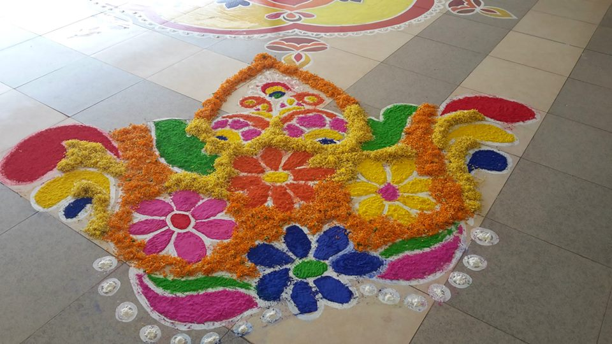
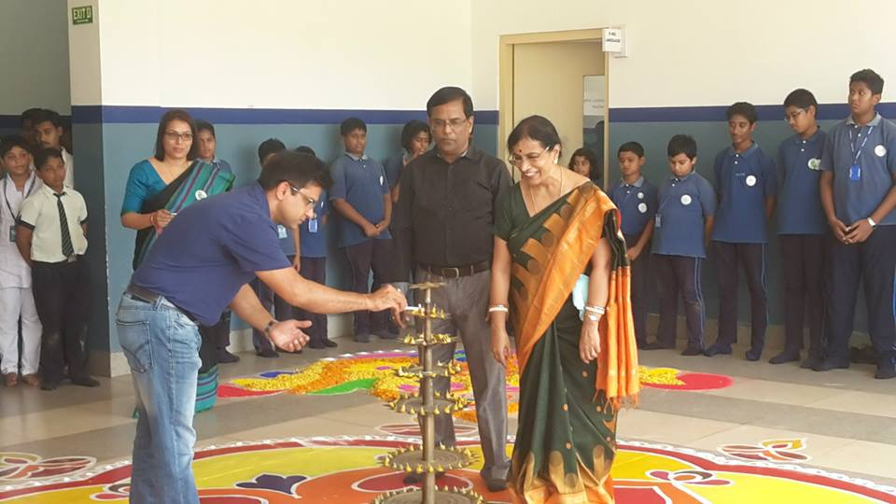
5 Reasons Why Diwali Is My Favourite Festival by Shreyan Kabiraj, Class 6,Mount Litera Zee School, India
The Victory of Rama
According to the epic Ramayana, it was the new moon day of Kartik when Lord Ram, Ma Sita and Lakshman returned to Ayodhya after vanquishing Ravana and conquering Lanka. The citizens of Ayodhya decorated the entire city with the earthen lamps and illuminated it like never before.
2. Festival of togetherness
It celebrates the spirit of togetherness, love, care for our family and friends
3. Festival of great food
A great advantage of this festival is food some great recipes areprepared and consumed during the festival

Slide 16
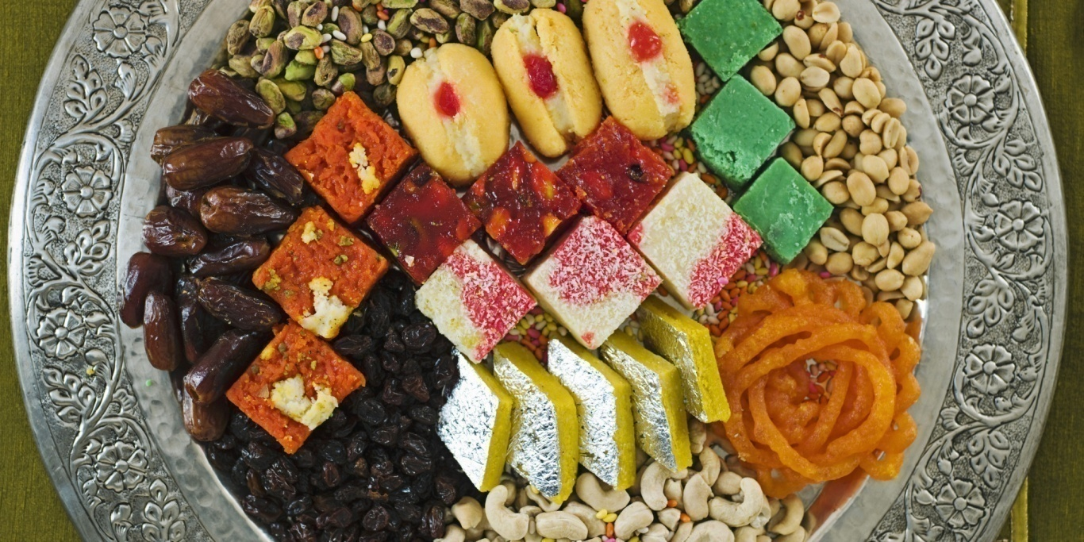
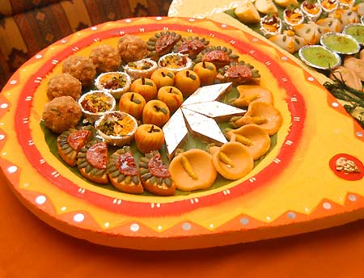
Diwali delicacy-
Exclusive sweets
prepared on this day

Slide 17
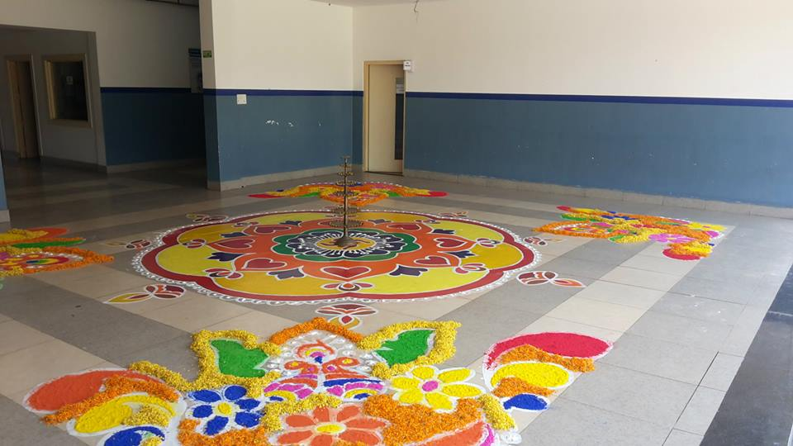
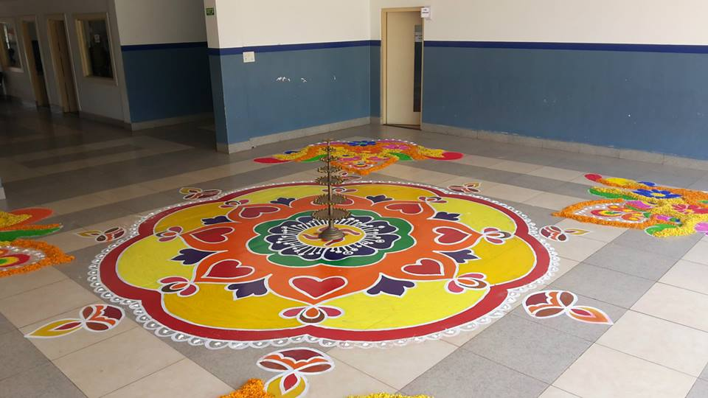
4. Beautiful rangolis to intensify the spirit of colour and grandeur

Slide 18
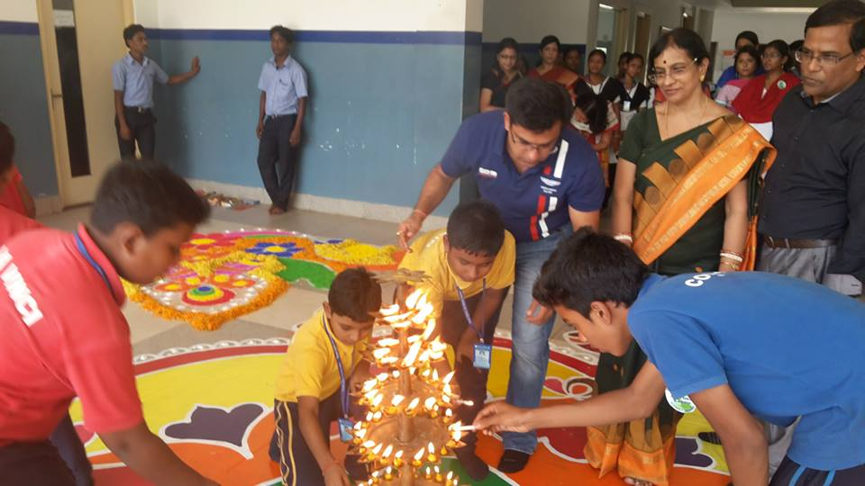
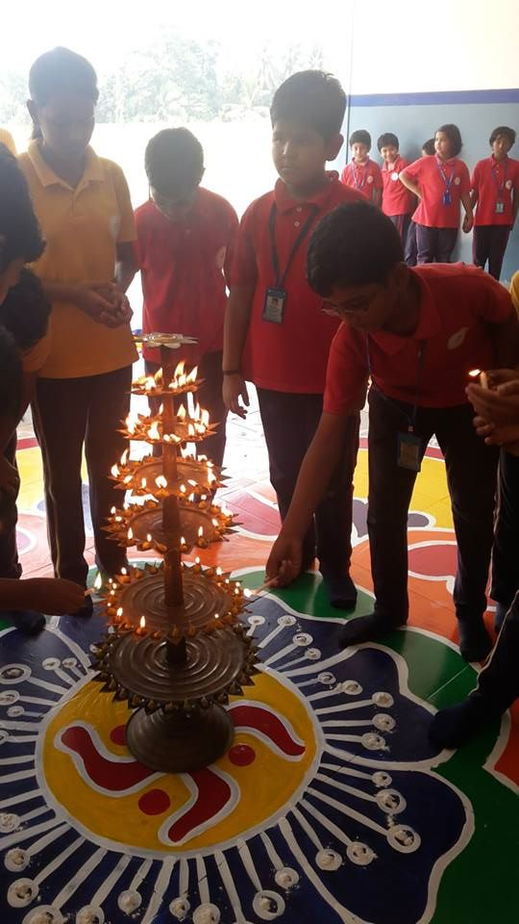
5. Beautiful diwas and crackers to usher in the happiness of Diwali

Slide 19
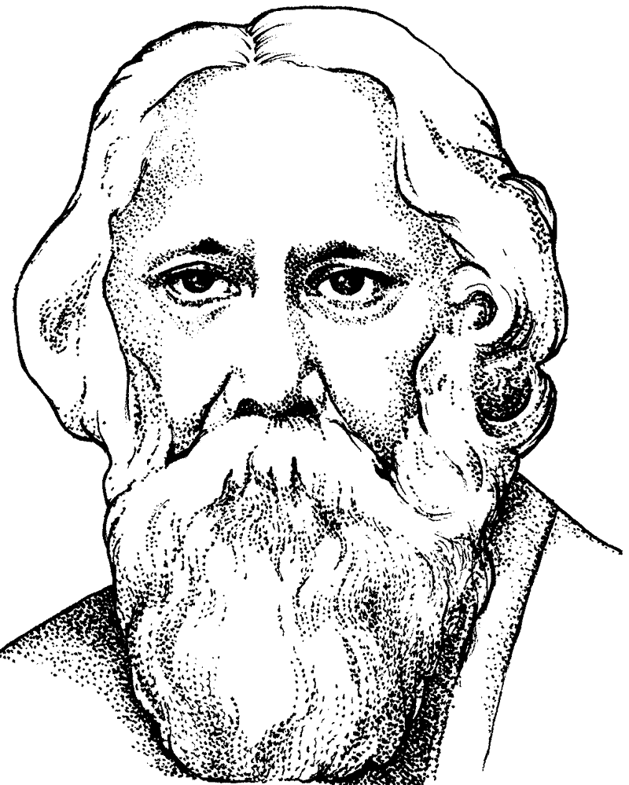
Rabindra Jayanti is the day which marks the birth anniversary of the great scholar and novelist Rabindranath Tagore. Birthday of the noble laureate Rabindra Nath Tagore is celebrated on 25th day of Baisakh. In Kolkata, it is popularly called Poncheeshe Boishakh and is celebrated ceremoniously and jauntiness all across West Bengal. According to the Gregorian calendar Rabindra Jayanti is celebrated on 8th or 9th of May. Rabindranath is remembered on this day.
Nobel laureate’s creation: https://www.youtube.com/watch?v=xnMCbD_oHMM
Banalikha, Class 6,
Mount Litera Zee School,india
Festival: Rabindra Jayanti

Slide 20
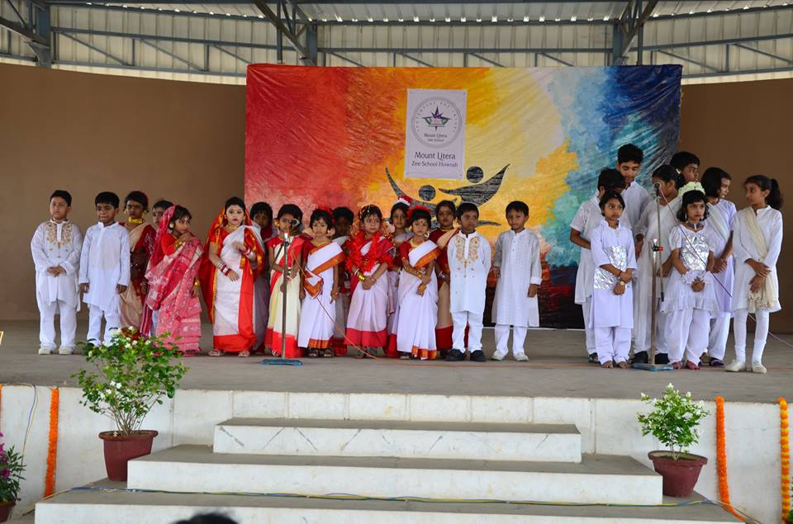
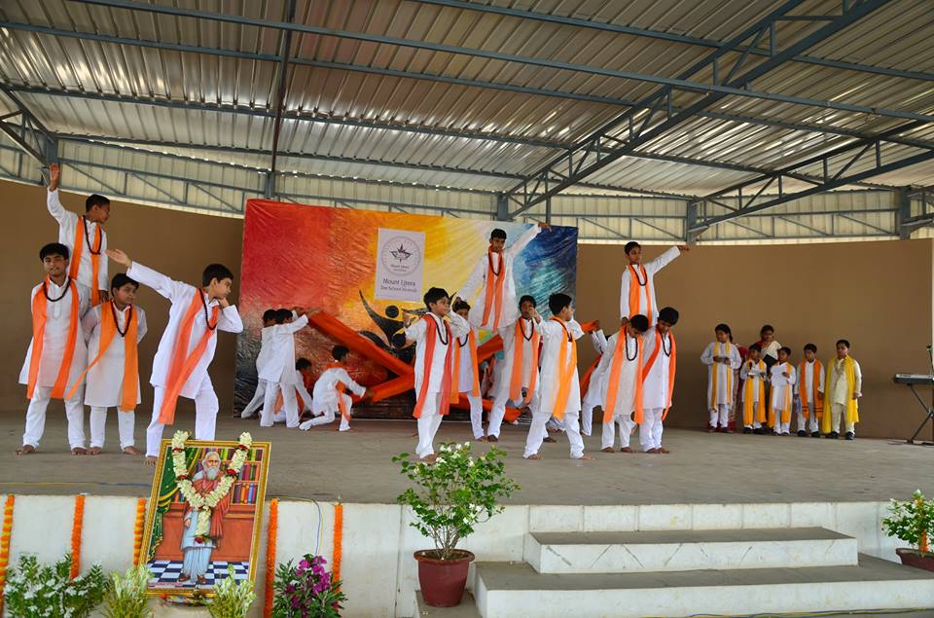
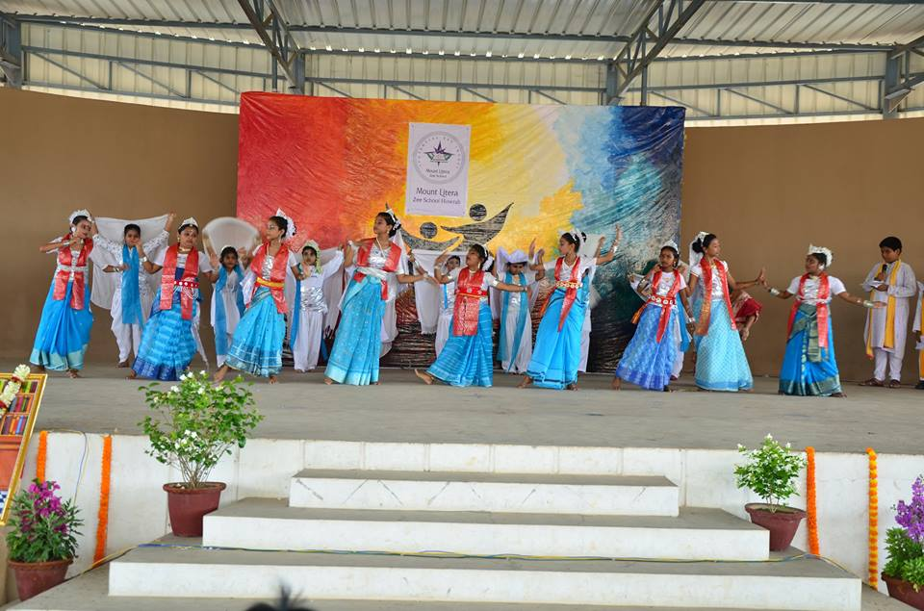
School Celebrations of Rabindra Jayanti

Slide 21
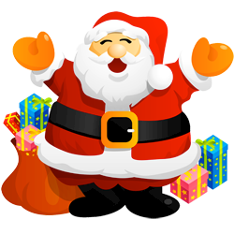
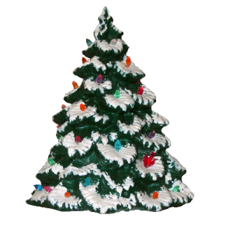
Christmas is celebrated to remember the birth of Jesus Christ who Christians believe is the Son of God.
The name 'Christmas' comes from the Mass of Christ (or Jesus). A Mass service (which is sometimes called Communion or Eucharist) is where Christians remember that Jesus died for us and then came back to life. The 'Christ-Mass' service was the only one that was allowed to take place after sunset (and before sunrise the next day), so people had it at Midnight! So we get the name Christ-Mass, shortened to Christmas
By Samprity, Class 6,
Mount Litera Zee School,india
Festival: Merry Christmas festival

Slide 22
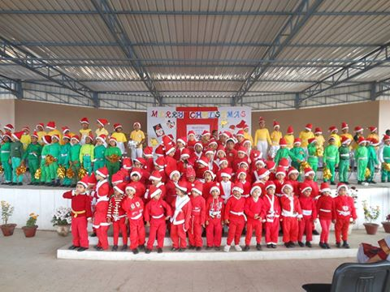
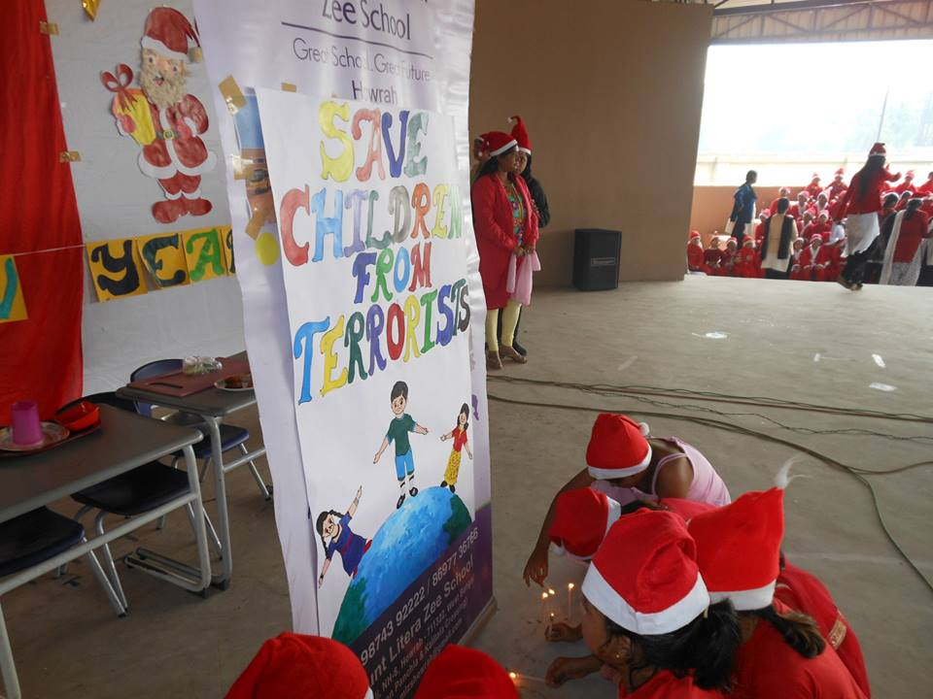
Charistmas carol: https://www.youtube.com/watch?v=oQhslZxHvcs
Samprity, Class 6,
Mount Litera Zee School,india
Festival: Merry Christmas festival

Slide 23
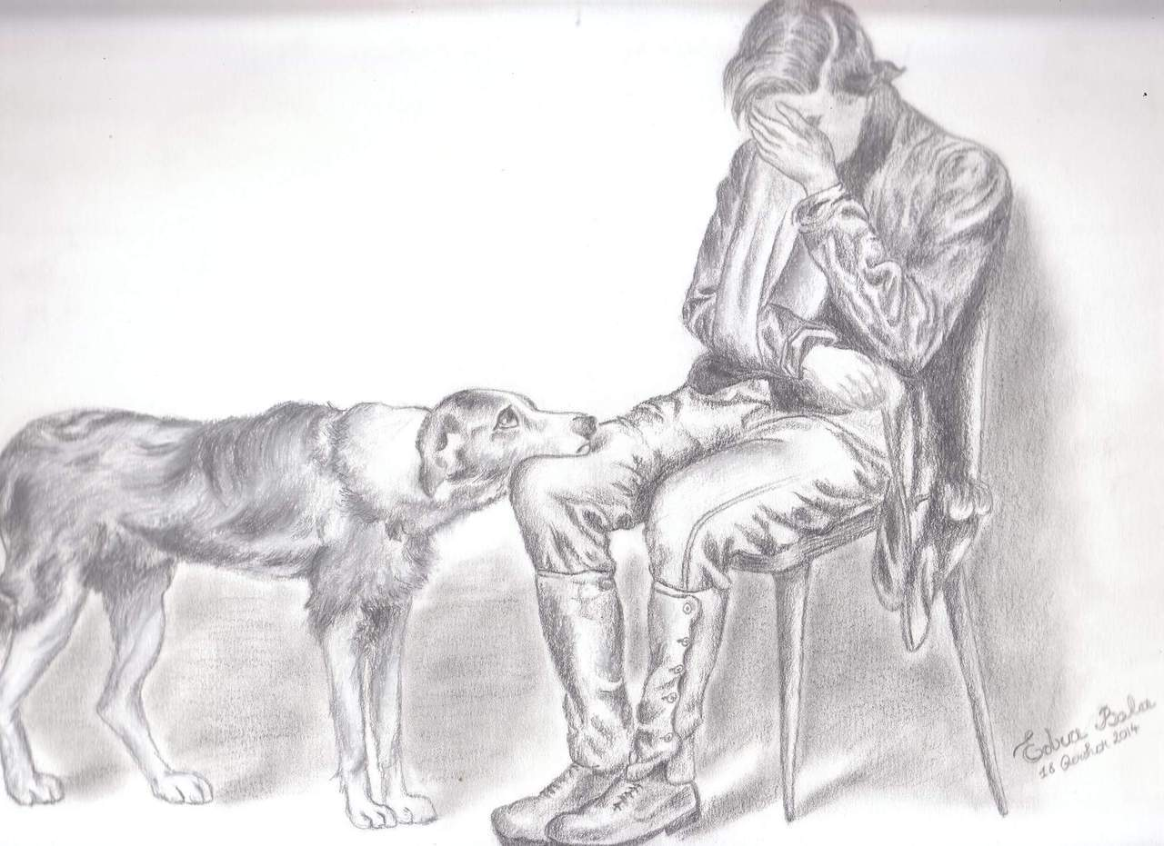
A celebration that the students of Mount Litera Zee School
International pet day
Animals are our best friend. They love us unconditionally and in return we love them. They can’t express their love to us. Lets celebrate a day for those little buddies and pledge against all forms of violence done on animals. W can bring our pets to school and tell our stories to our friends. We can click selfies with or pets and post them on website.
If you could create a new holiday that the entire world would celebrate on one day, which holiday would you create? Why? When would it be celebrated? How would it be celebrated

