Slide 1
Final project
Global Issues: Environment Learning
Circle 1 (Middle/High School)
September 2015 – January 2016
State Educational Institution “Lyceum under Gomel Engineering Institute
of the Ministry for Emergency Situations of the Republic of Belarus”
http://www.liceymes.by/

Slide 2
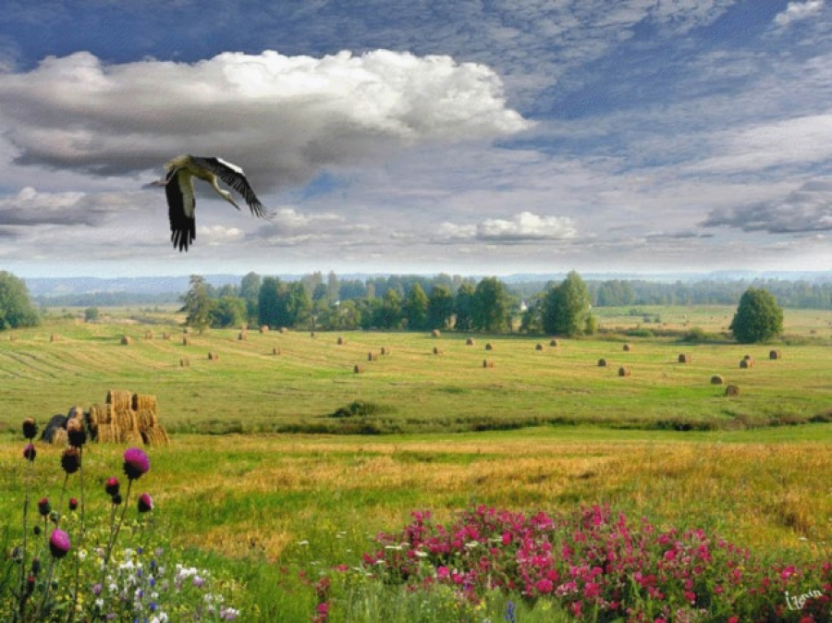
1. Man Made Environmental Problems
Belarus is a beautiful and clean country but it has environmental problems that damage its nature. Some of them are man made. We will tell about one of them, and it is the most serious environmental problem in our country.

Slide 3
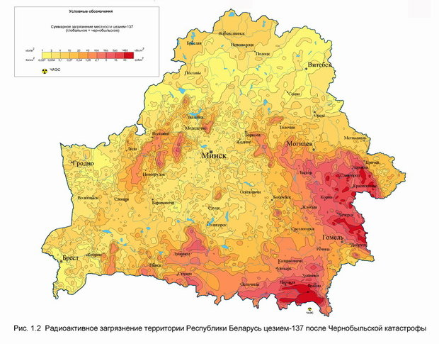
On April 26th, 1986 the Chernobyl disaster occurred. That night there was an experiment, and the protection of the experiment was disabled.
This picture shows the contamination of Belarus.

Slide 4
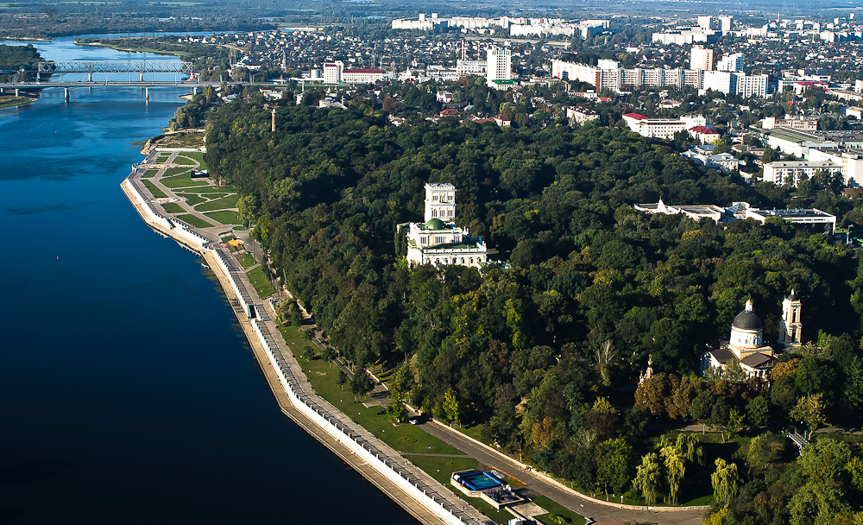
We live in Gomel. It is a beautiful city in the southern-eastern part of Belarus. Gomel stands on the river Sozh, has long wide streets,
beautiful parks and squares, and the landscape near it is very picturesque.
There are a lot of landmarks both in Gomel and in Gomel region,
and many tourists come to see them.

Slide 5
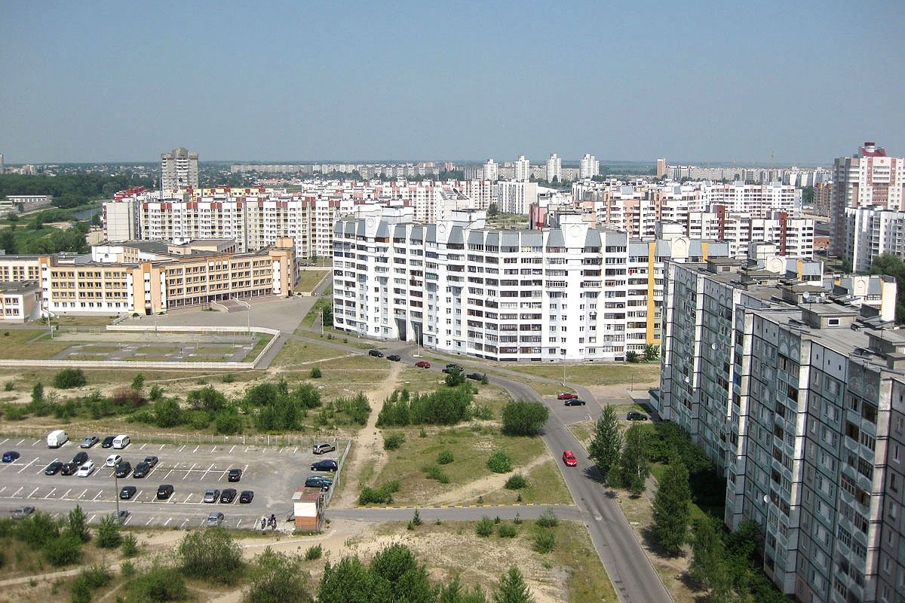
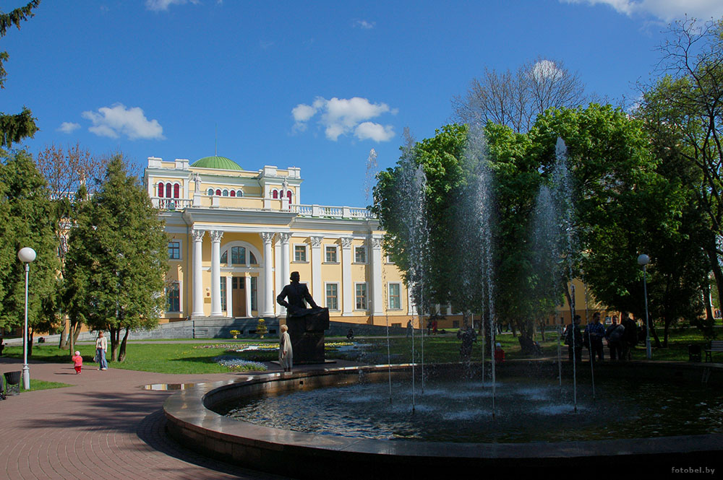
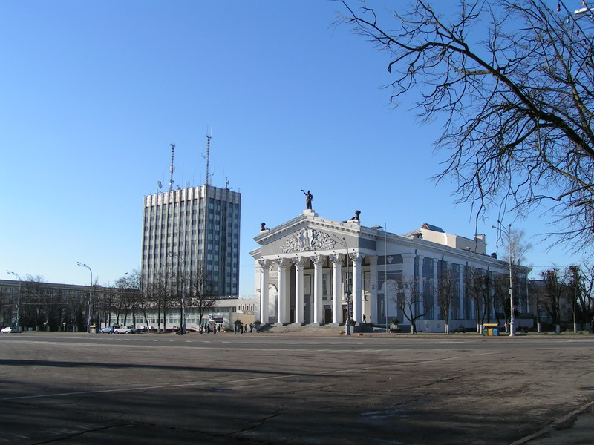
One of dormitory areas
Gomel Palace
Central Square

Slide 6
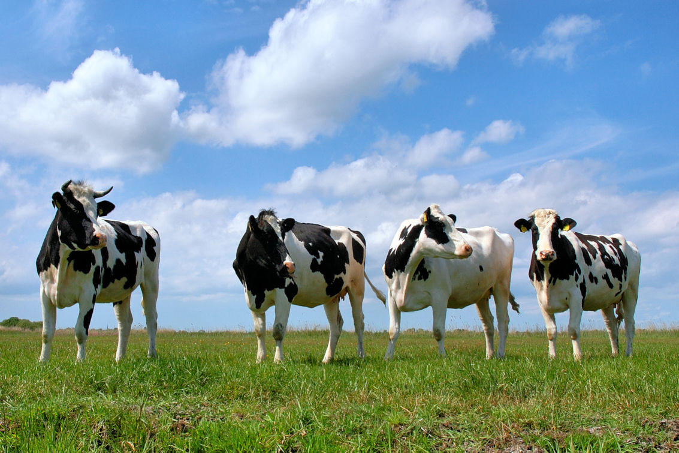
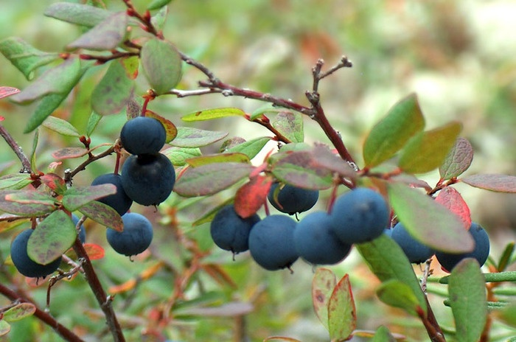
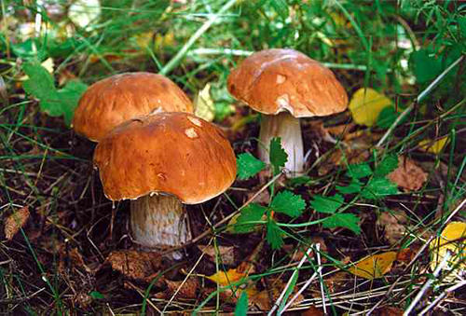
What are the consequences of the Chernobyl disaster?
The aftermath will last long as some chemical elements that got into the ground with the acid rain need a great period of decay. So, it is not recommended to eat mushrooms and berries picked up in forests.
Milk from village cows is also considered dangerous as they eat grass that grows
on the contaminated ground.

Slide 7
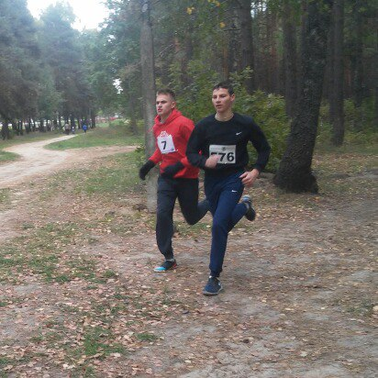
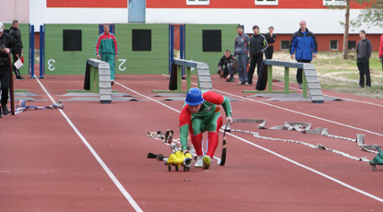
But the greatest issue is numerous health problems.
Cases with cancer have increased, more people have heart problems, and more babies are born with different disorders.
The consequences after Chernobyl catastrophe can be neither denied nor avoided. We take care of our health by doing sports and leading a healthy lifestyle.

Slide 8
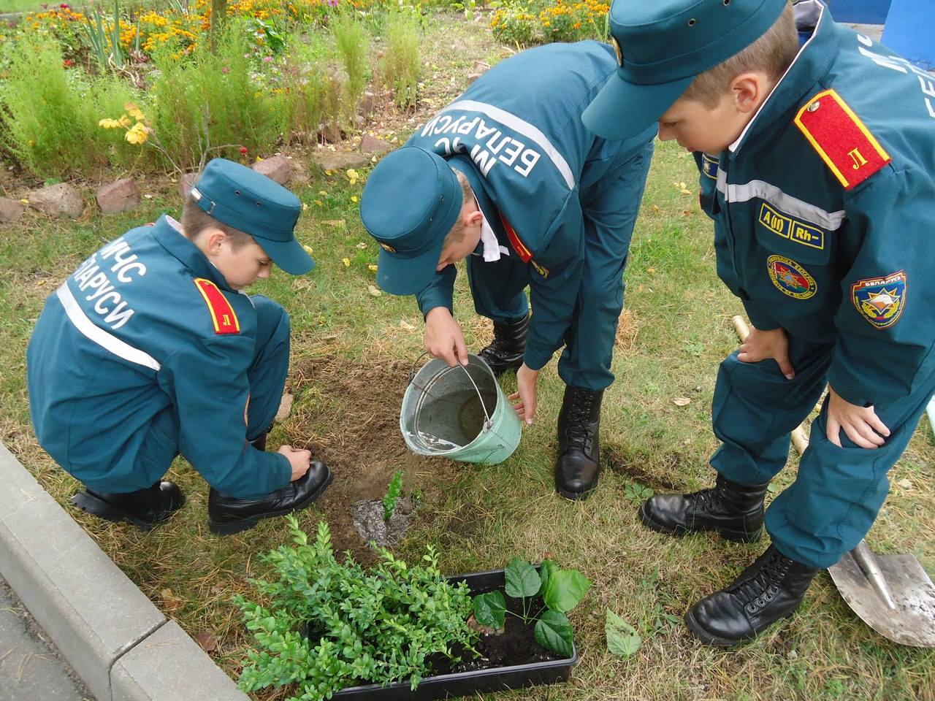
Also, we popularize environmental protection: we plant trees, clean the surrounding area and take part in Clean-up Your Town activities.
Together we can make a difference in the environmental protection and save our country clean and beautiful.

Slide 9
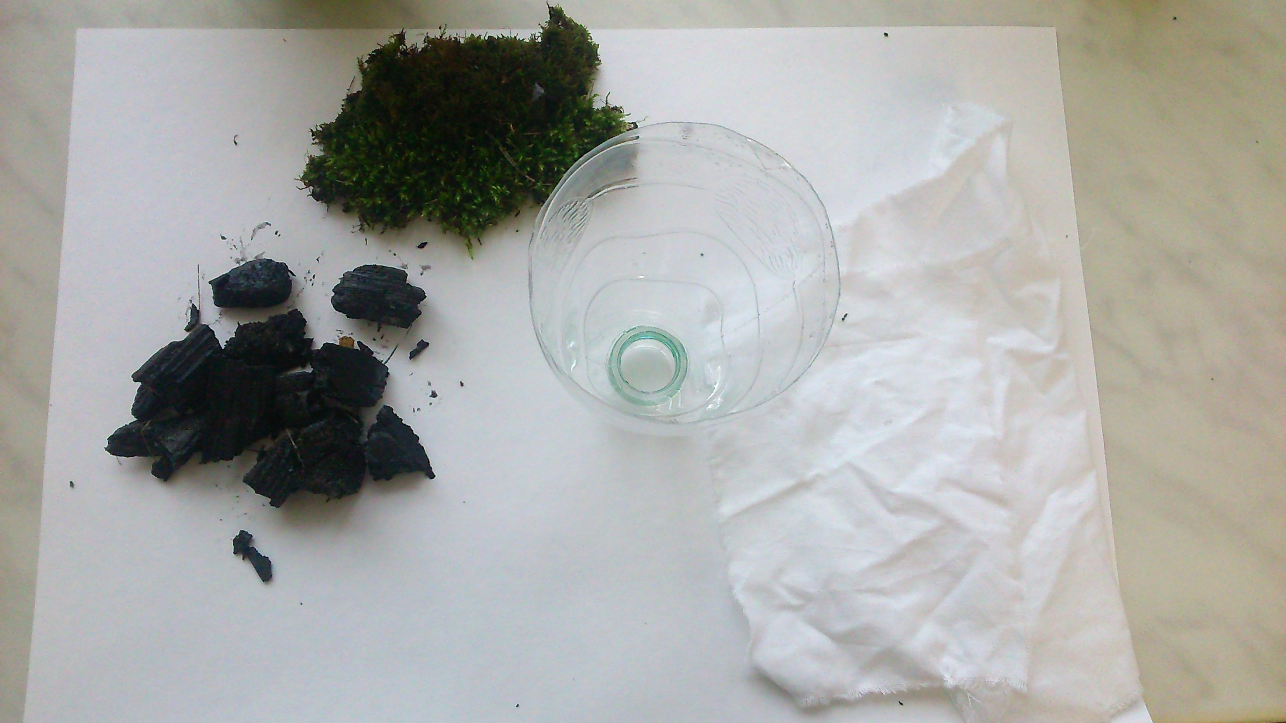
2. Clean Water Filtration Project
Within this project my students created a water filter made of moss, cloth and coal. This filter can be used in emergency situations to clean water, and also when you are outdoors.
First, we took moss, a piece of cloth and coal.
All this will clean the water.

Slide 10
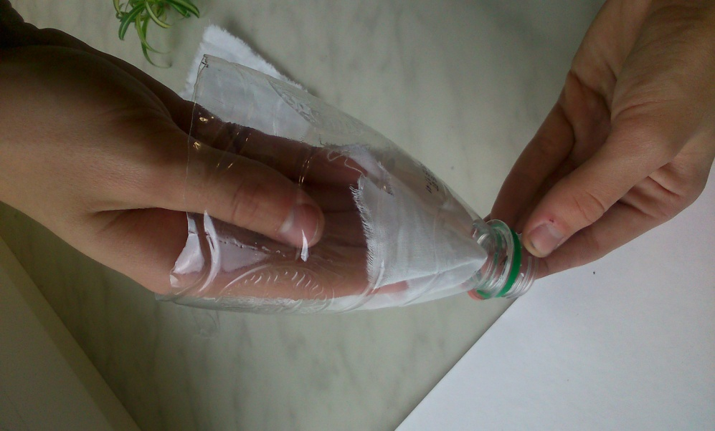
Then we put the cloth into the bottle.

Slide 11
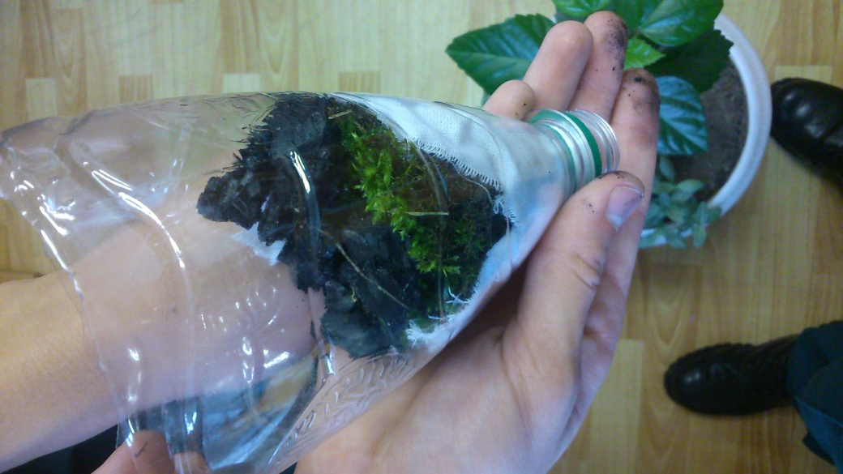
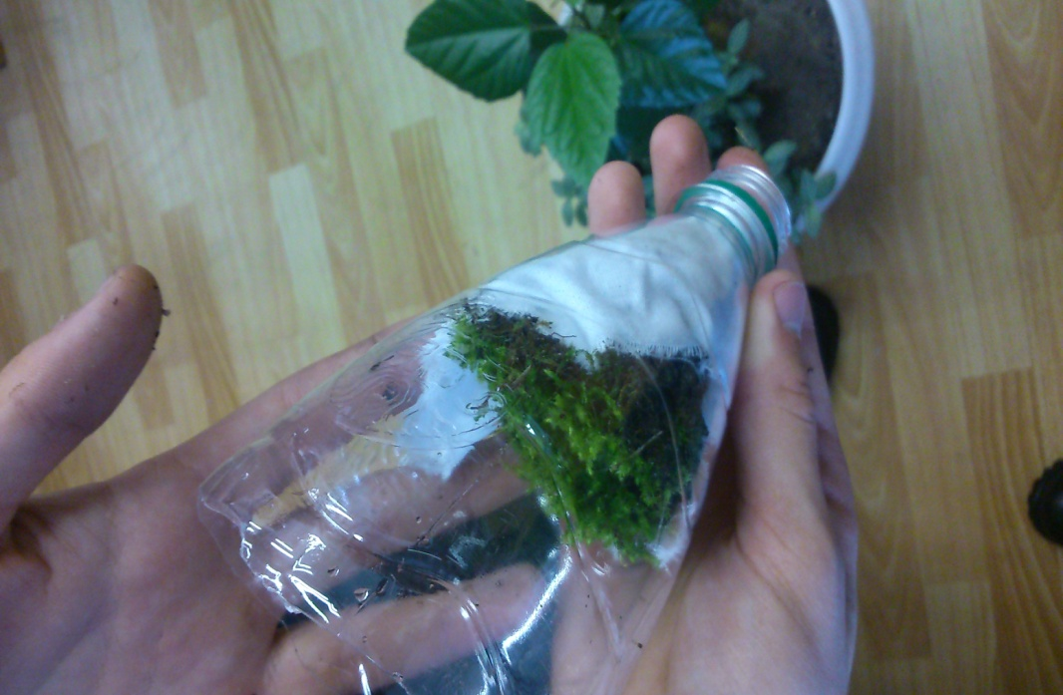
After that we put the moss and coal above the cloth in the bottle.

Slide 12
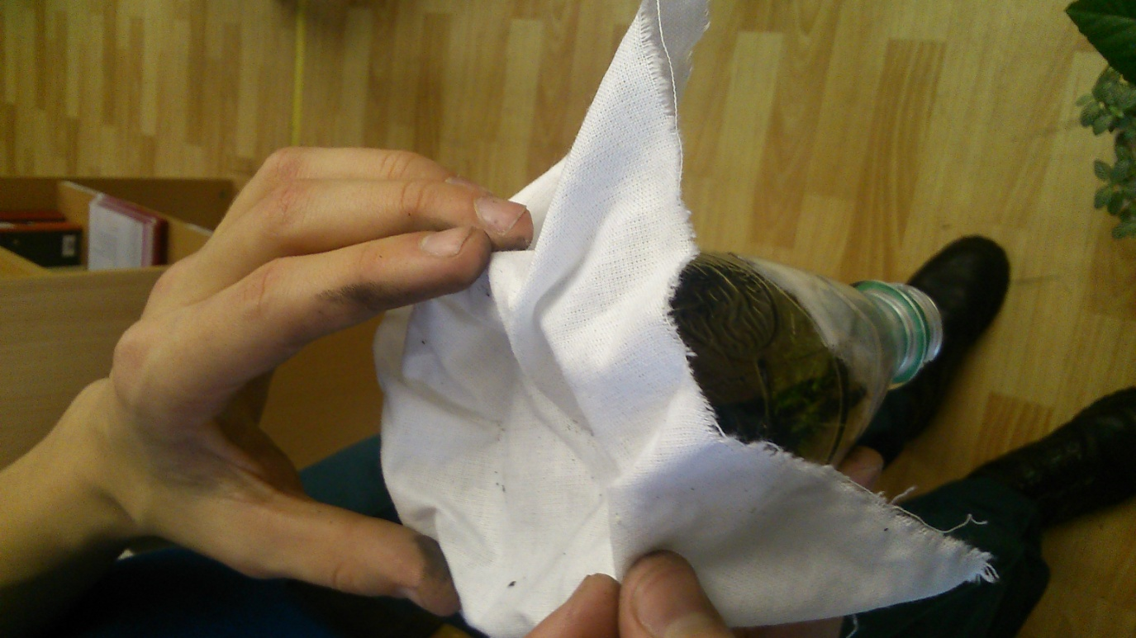
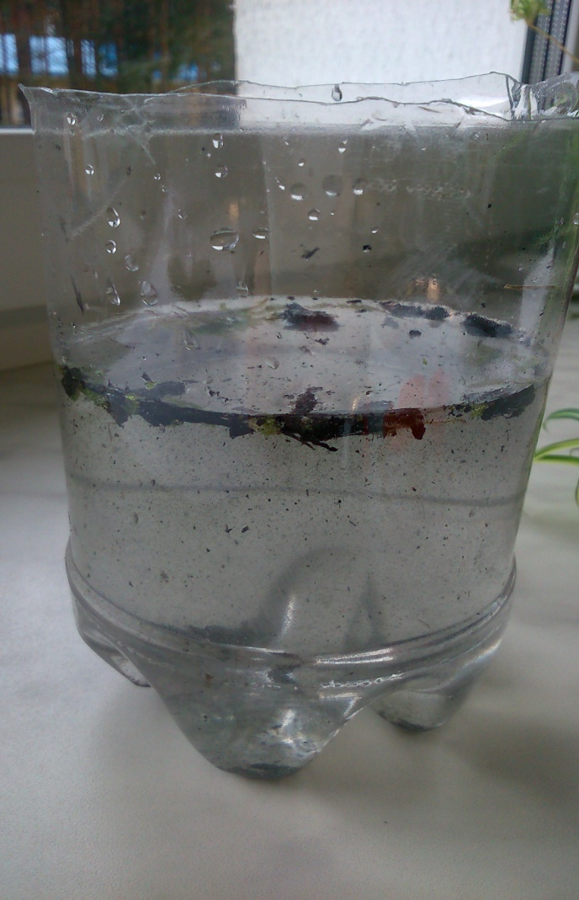
Then we poured the water through the moss, coal and cloth.

Slide 13
We waited till the dirt fell to the bottom.

Slide 14
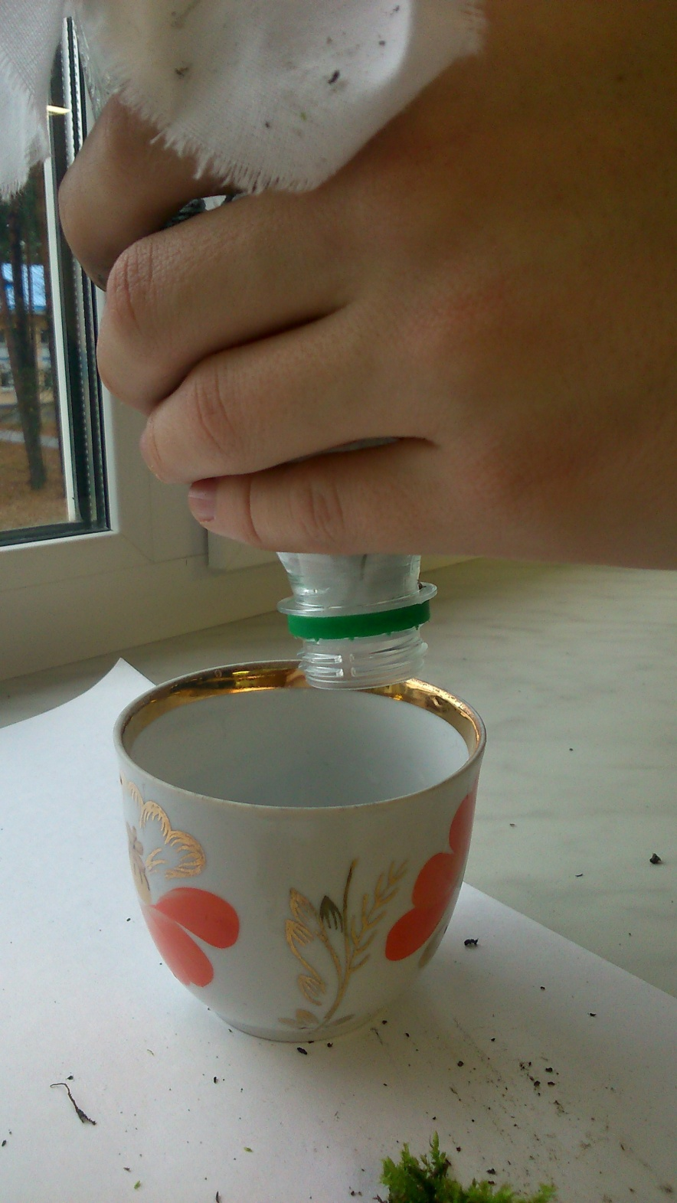
Finally, we poured the water through the cloth for the second time. You can see the results of our work in this video: https://iearn.org/cc/space-25/group-418/gallery/media-58496.

Slide 15
3. Man`s Impact on the Environment
My colleague and I got inspired by this project idea and prepared an integrated lesson in English and Biology on the topic
"Environmental Protection Is Our Main Task".
The lesson was for senior students as we have this topic in the school curriculum for them.
At the lesson we emphasized the importance of environmental protection and actualized the knowledge about the ways to save the environment.
Here are the photos from the lesson.

Slide 16
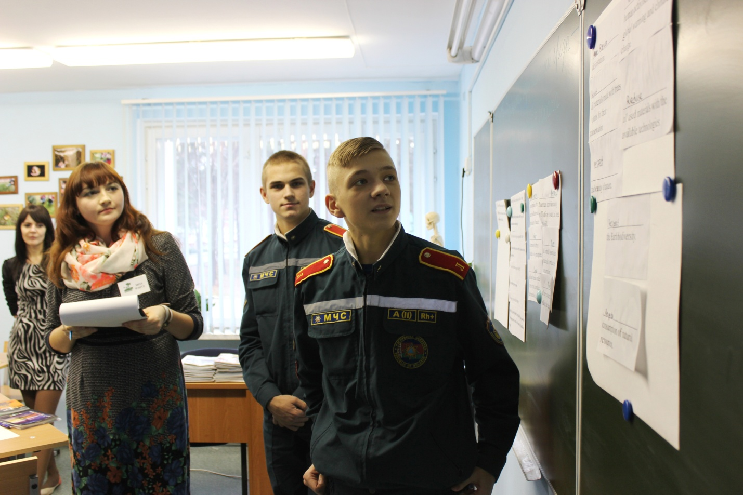
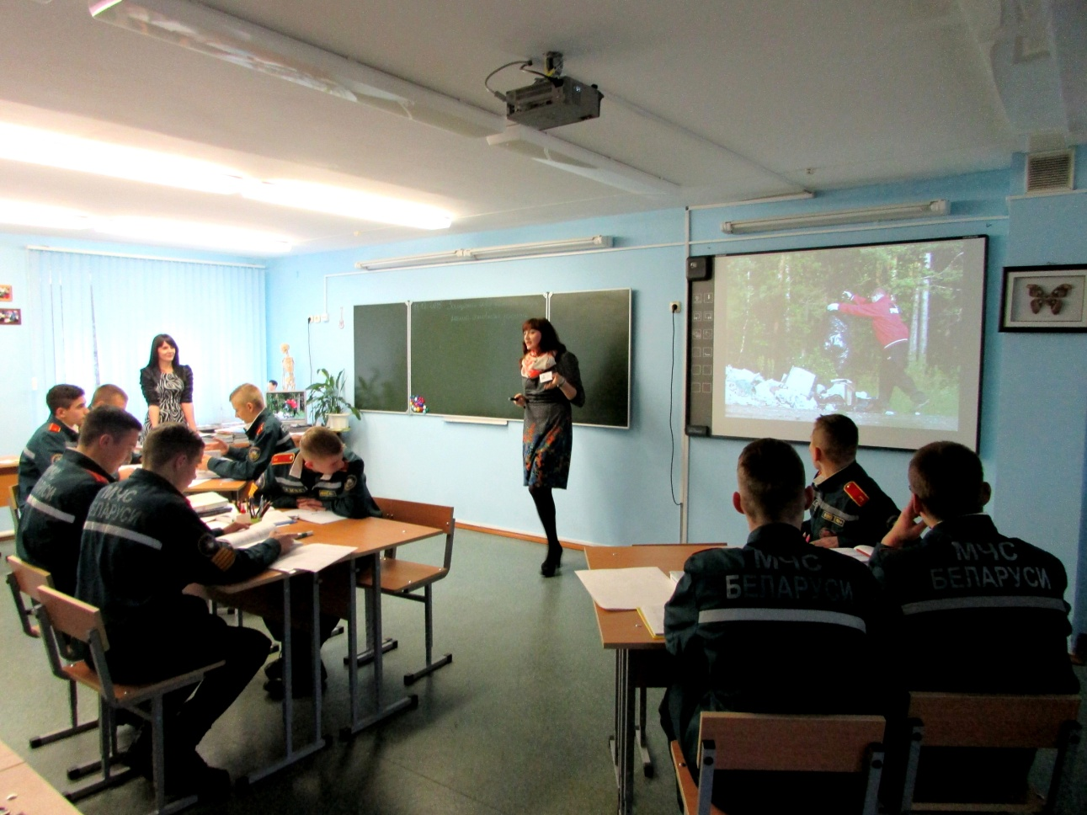

Slide 17
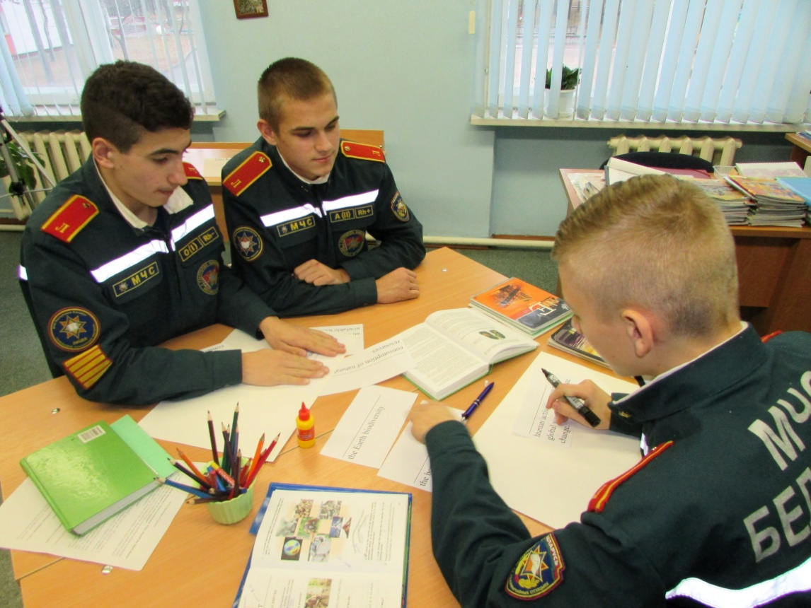
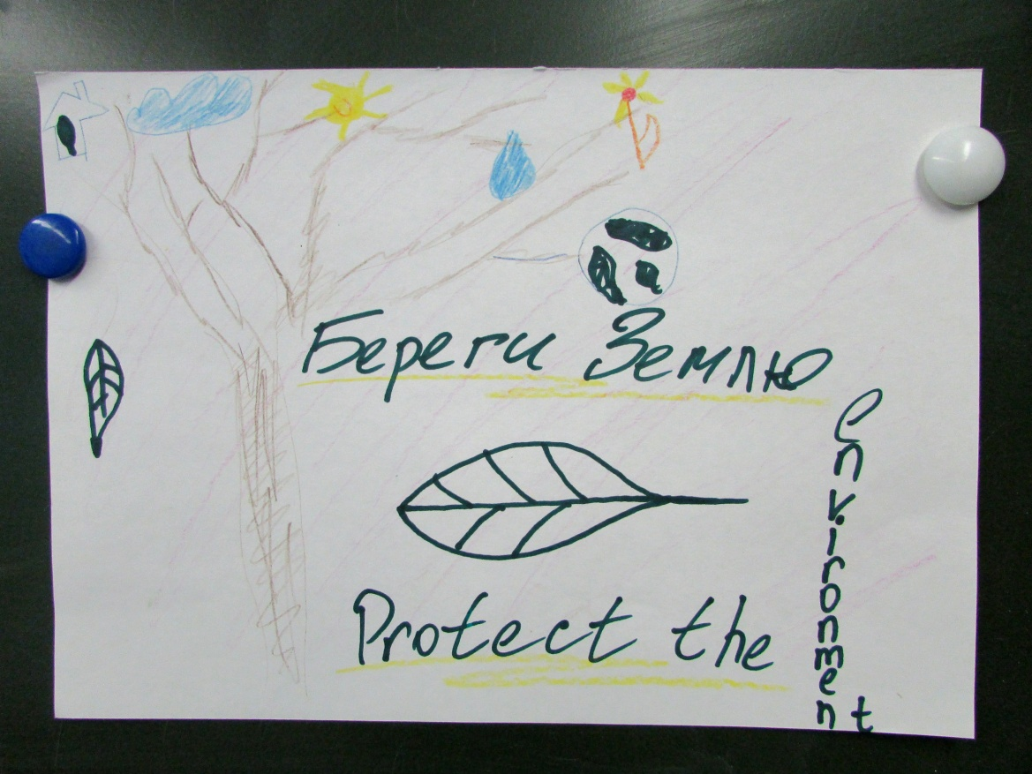

Slide 18
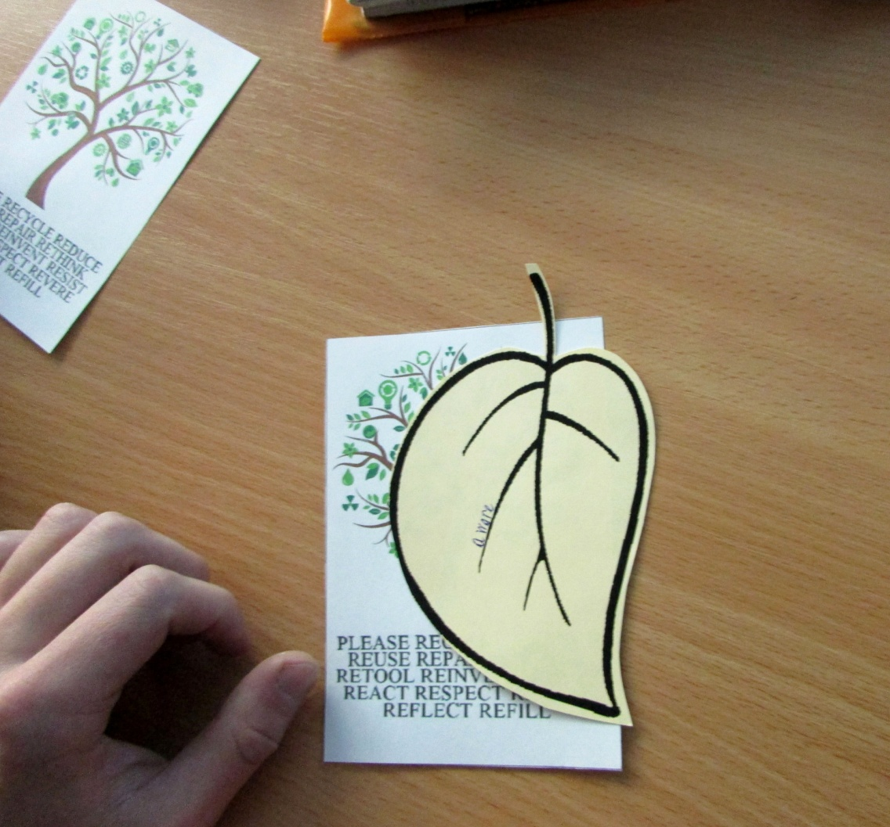
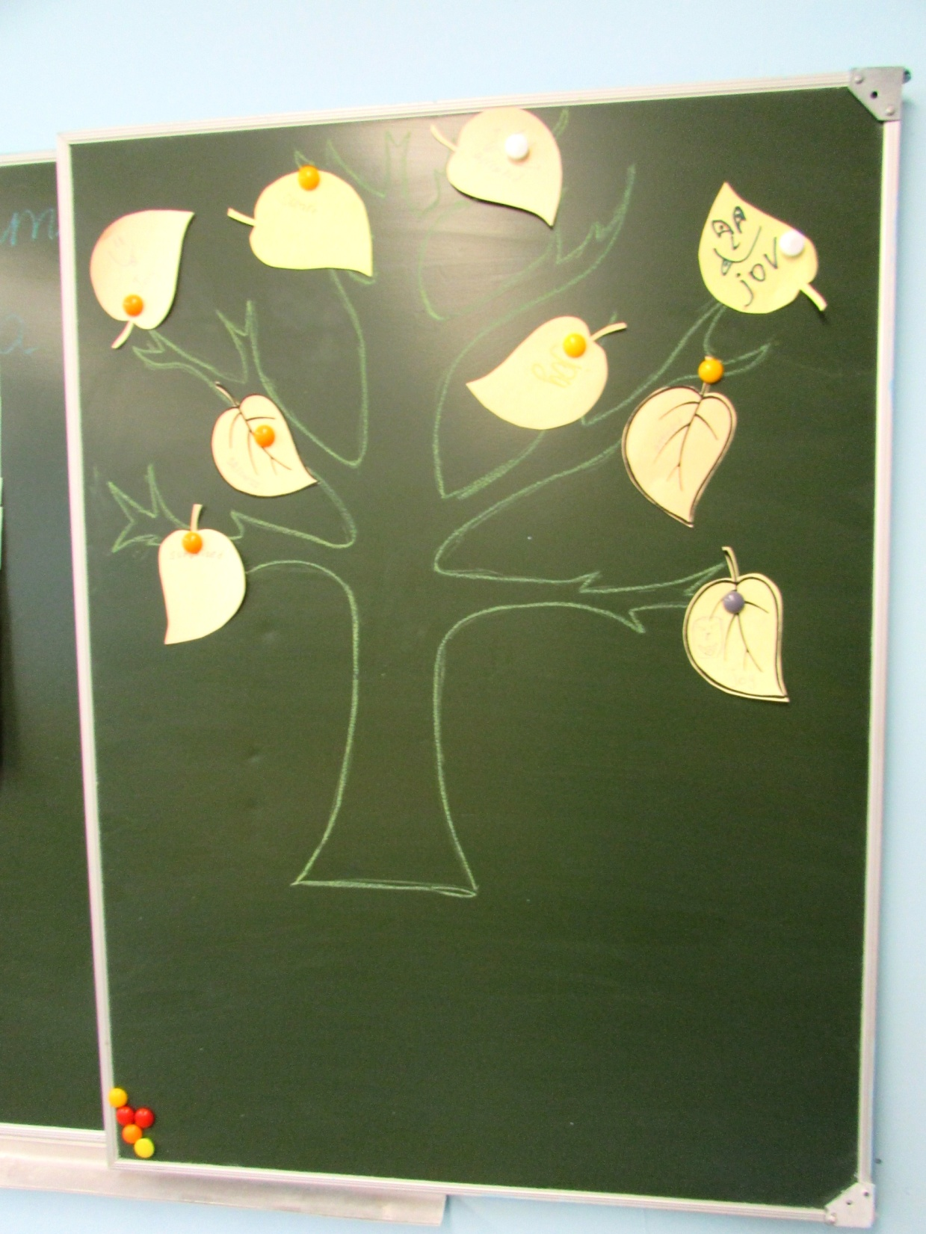

Slide 19
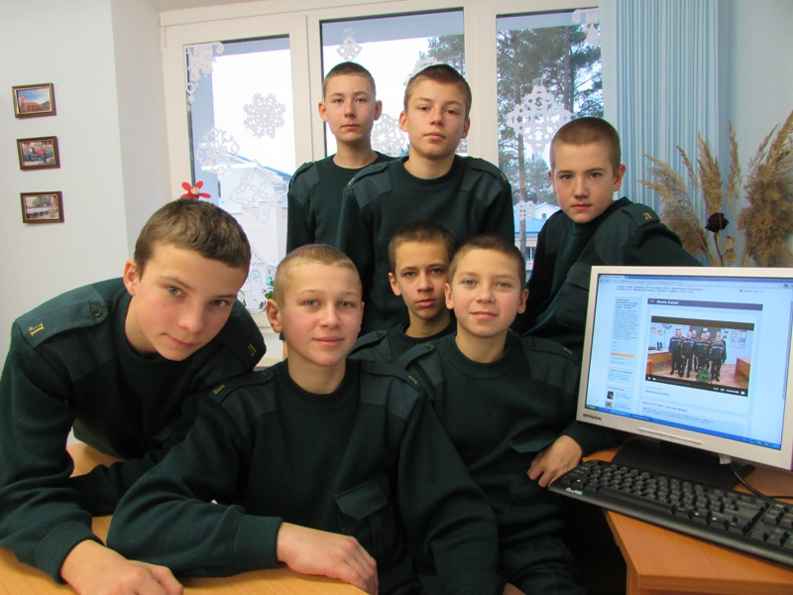
It`s been a pleasure to work with you!

