Slide 1
In the name of god
iEaRn Project
Monuments in Iran
i

Slide 2
Places and prespectives
Group members:
Amirreza Khalili
Arash Gholamian
Amir Hossein Yousefi
Artin Panahi
Parsa Sorkhei
Hirbod Azarli

Slide 3
Monuments
Ancient Monuments
A significant proportion of Iran’s monuments date back more than 2,000 years. Persepolis, for example, was founded in 518 B.C. and functioned as the capital of the Achaemenid Empire dominating the area at the time. The city was built into the foot of a mountain 400 miles south of present-day capital Teheran and, although its treasures were carried away by Alexander the Great in 330, the surviving stone carvings and friezes ensure it remains a very impressive site. Parsargad was another dynastic capital built around the same time. Surviving buildings here include the Mausoleum of Cyrus II, a fortified terrace and the remains of the royal palace.

Slide 4
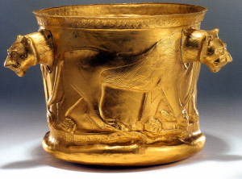
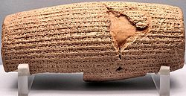
Ten Top Achaemenid Empire Articafts
Kalardasht Gold Cup
The Cyrus Cylinder is an ancient clay cylinder, now broken into several fragments, on which is written a declaration in Akkadian cuneiform script in the name of the Achaemenid king Cyrus the Great. It dates from the 6th century BC and was discovered in the ruins of Babylon in Mesopotamia in 1879.

Slide 5
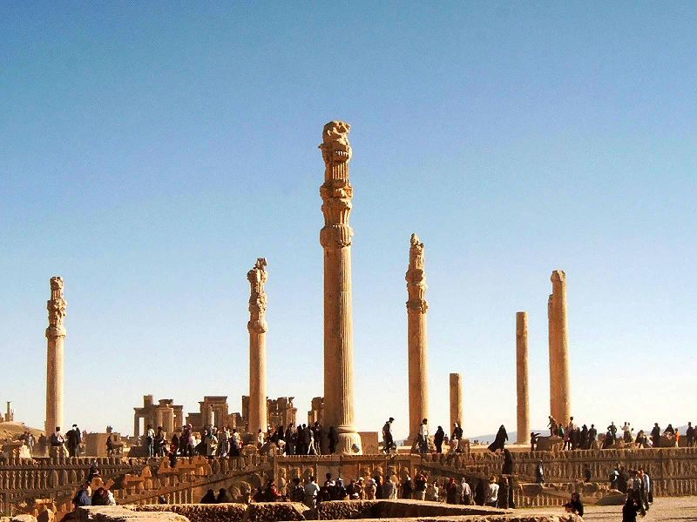
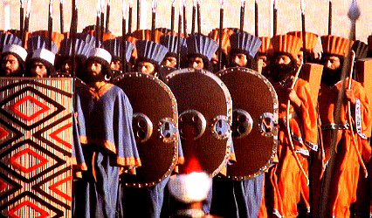
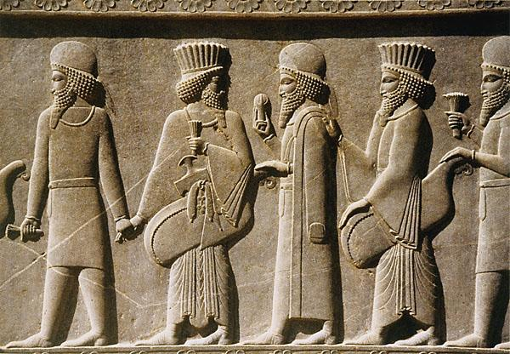
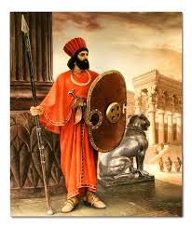
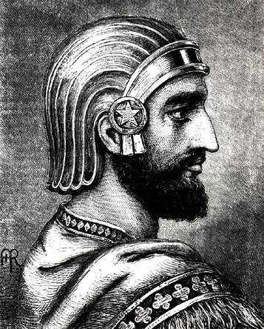

Slide 6
Religious Monuments
Chogha in Bakhtiari means "hill". Choga Zanbil means 'basket mount. It was built about 1250 BC by the king Untash-Napirisha, mainly to honor the great god Inshushinak. Its original name was Dur Untash, which means 'town of Untash', but it is unlikely that many people, besides priests and servants, ever lived there. The complex is protected by three concentric walls which define the main areas of the 'town'. The inner area is wholly taken up with a great ziggurat dedicated to the main god, which was built over an earlier square temple with storage rooms also built by Untash-Napirisha. The middle area holds eleven temples for lesser gods. It is believed that twenty-two temples were originally planned, but the king died before they could be finished, and his successors discontinued the building work. In the outer area are royal palaces, a funerary palace containing five royal tombs.
The ziggurat is considered to be the best preserved example in the world In 1979, Chogha Zanbil became the first Iranian site to be inscribed on the UNESCO World Herritage List.

Slide 7
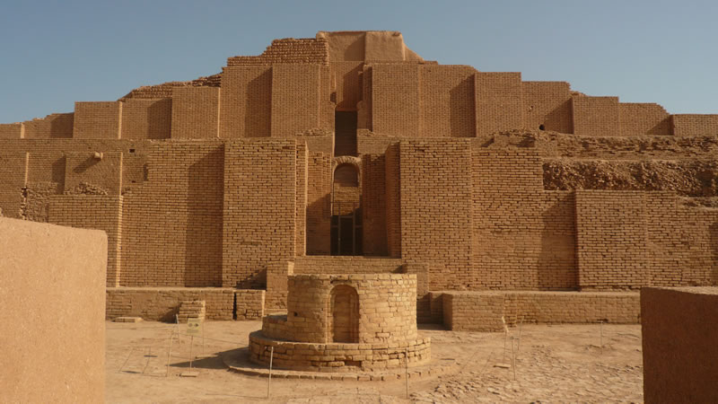
Religious Monuments Chogha Zanbil
New project will commence in Khomat village on the Chogha Zanbil site. The focus of this project is to support a improve tourism industry, and provide the requisite resources for preserving the heritage sites. Facilities considered for the project include lodging, coffee shops, foot paths, parking and air conditioning. The Shushtar hydraulic system and Chogha Zanbil historical site, in Khuzestan Province, are already inscribed on the world heritage list and the ancient city of Susa will be inscribed in the near future.

Slide 8
Trade Monuments
Two of Iran’s monuments owned their existence to ancient trade routes. Bam is a desert city that rose from the site of an oasis. It formed an important stopping point on many ancient trade routes. The period between the seventh and 11th centuries was the high point of Bam’s prosperity, as merchants traded their goods and it became known for the production of both cotton and silk. A more recent trading environment–albeit still dating from the 13th century–survives at Tabriz in the east of the country. The bazaar complex was constructed using red bricks and includes spaces for commercial activities, education, religion and social gatherings.

Slide 9
Outdoor Monuments
Shushtar is the location of a very early and ingenious use of water to power mills and irrigate 40,000 hectares of farmland. Dating from the fifth century B.C., the Shushtar hydraulic system draws water from the Karun River to the city of Shushtar via a series of underground tunnels.
The Persian Garden is in fact nine gardens scattered across Iran. Each was designed in the Persian style with four distinct areas intended to represent the Zoroastrian elements of water, sky, earth and plants. Taken as a whole, the gardens represented Eden, a paradise on Earth. The largest garden, Bagh-e Abas Abad stands close to the shore of the Caspian Sea and covers 420 hectares, while the oldest of the gardens is part of the complex at Pasargad.

Slide 10
Saadi cemetery
We have a lot of famous poets in Iran. Some of the ancient poets are buried in different cities in which their tombs are regarded as monuments at present time. Their cemeteries are visited by many tourists and the other people every year. Hafez, Khayam, Saadi, Baba Taher, Attar, Parvin Etesami, Shahriyar, …all of these poets’ tombs are monuments with special area and structures.
Sa’adi Shirazi better known by his pen-name as Saʿdī or simply Saadi, was one of the major Persian poets of the medieval period. He is not only famous in Persian-speaking countries, but has also been quoted in western sources. He is recognized for the quality of his writings and for the depth of his social and moral thoughts. His tomb is one of the most beautiful gardens in Shiraz you can go there for visit Saadi’s tomb and walk around the garden also there is a small natural water pool with beautiful fish.

Slide 11
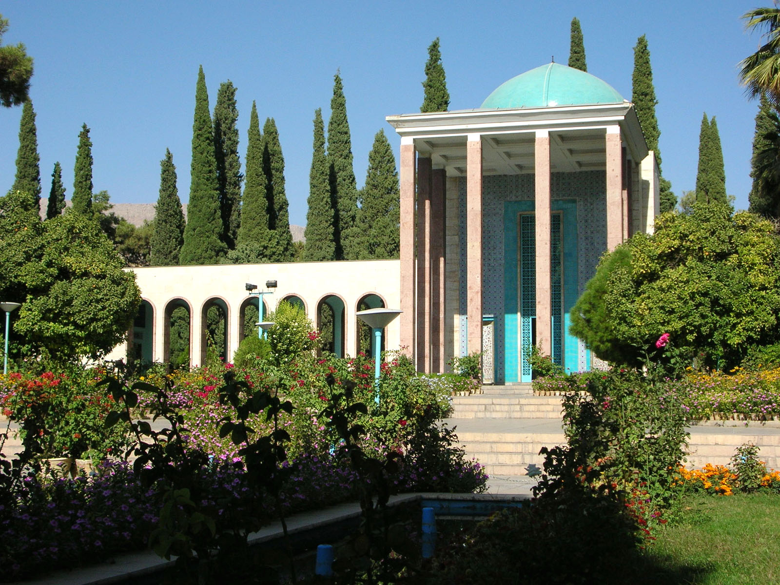
Photos of saadi tomb

Slide 12
Chehel sotoun palace
The Chehel Sotoun is a palace in the middle of a park at the far end of a long pool, in Isfahan, Iran, built by King Abbas the II to be used for his entertainment and receptions. In this palace, King Abbas the II and his successors would receive dignitaries and ambassadors, either on the terrace or in one of the stately reception halls.
The name, meaning "Forty Columns" in Persian, was inspired by the twenty slender wooden columns supporting the entrance of the palace, which, when reflected in the waters of the fountain, and are said to appear to be 40 columns.

Slide 13
Chehel sotoun palace
As with the Ali Qapu, the palace contains many frescoes and paintings on ceramic. Many of the Ceramic panels have been dispersed and are now in the possession of major museums in the west. They depict specific historical scenes such as the infamous Battle of Chaldiran against the Ottoman Sultan Salim the I, the reception of an Uzbek King in 1646, when the palace had just been completed; the welcome extended to the Mughal Emperor, Humayun who took refuge in Iran in 1544; the battle of Taher- Abad in 1510 where the Safavid King Ismail vanquished and killed the Uzbek King. A More recent painting depicts Nader Shah’s victory against the Indian Army at Karnal in 1739. There are also less historical, but even more aesthetic compositions in the traditional miniature style which celebrate the joy of life.

Slide 14
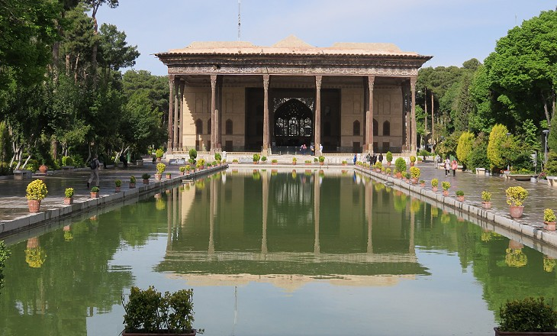
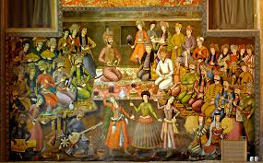
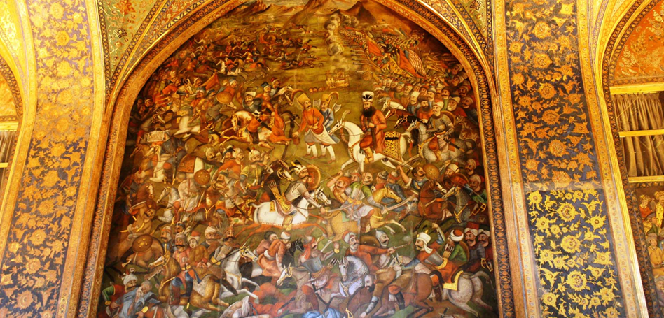
Pictures of Chehel Sotoun

Slide 15
Azadi tower in Tehran
Azadi Tower. has been the longstanding symbol of Tehran. It was constructed to commemorate the 2,500th anniversary of the Persian empire, combines elements of Sassanid and Islamic architecture.
The entrance of the tower is directly underneath the main vault and leads into the Azadi Museum on the basement floor.

Slide 16
Milad Tower In Tehran
Milad Tower (Persian : Borj e Milad) also known as the Tehran Tower is a multi-purpose tower in Tehran IRAN. It is the sixth tallest tower and the 17th tallest freestanding structure in the world.
It is located between the Gharb Town and Gisha Distinct, standing at 435 m (1,427 ft.) from base to the tip of the antenna. The head consists of a large pod with 12 floors, the roof of which is at 315 m (1,033 ft).
The tower is a part of a complex called International Trade and Convention Center of Tehran. The complex also includes a five-star hotel, a convention center, a world trade center, and an IT park.

Slide 17
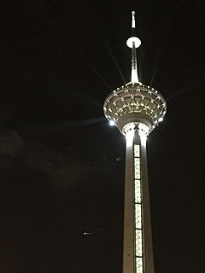

Slide 18
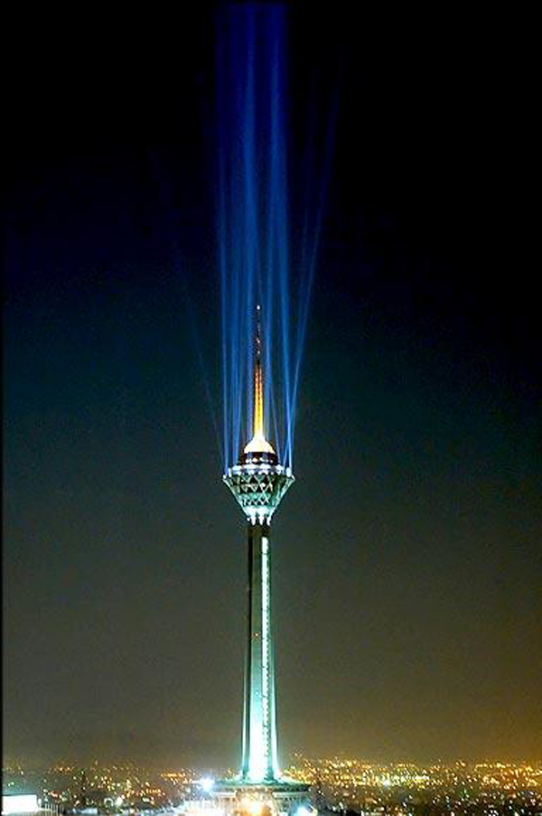
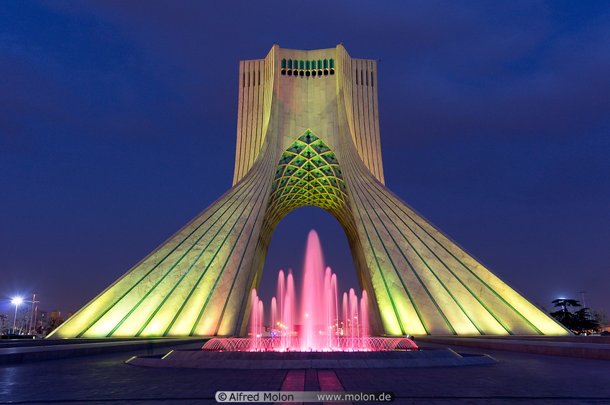
Milad and Azadi Towers at Night

Slide 19
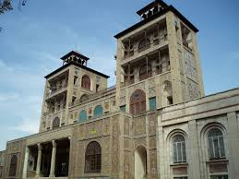
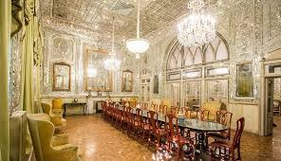
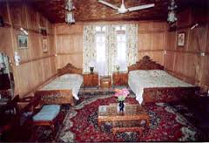
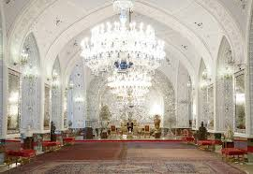
Golestan Palace
Golestan Palace: literally the Roseland Palace is the former royal Qajar complex in Iran's capital city, Tehran
Golestan Palace is the oldest of the historic monuments in Tehran. King Karim Khan of Zand (1750-1779) Agha Mohammad Khan of Qajar (1742–1797) chose Tehran as his capital.

Slide 20
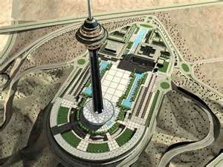
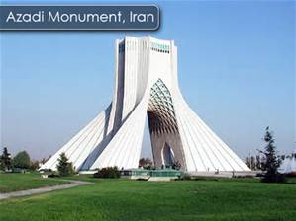
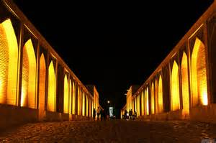
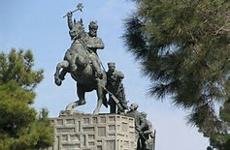
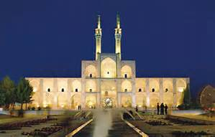
Monuments in IRAN

Slide 21
We hope see you in our county!

