Slide 1
Name of your group : Global Issues: Education (GEH1) Name of your school: OMAR IBN EL KHATAB Class which worked on the project: Second level Maths /Algiers , Algeria, Teacher : Mrs Daoud Fazia

Slide 2
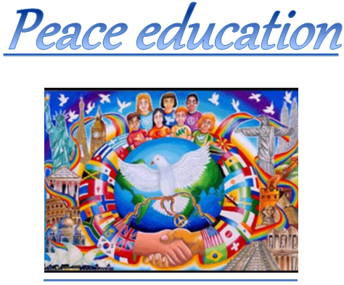

Slide 3
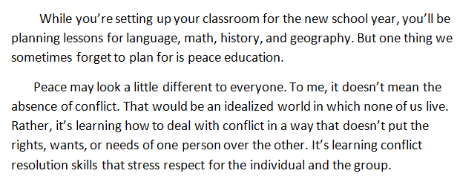
Introduction:

Slide 4
What is peace education?
Peace education is a participatory holistic process that includes teaching for and about democracy and human rights, non-violence, social and economic justice, gender equality, environmental sustainability, disarmament, traditional peace practices, international law, and human security

Slide 9
Smile is the beging of peace
☺ ☺ ☺

Slide 19
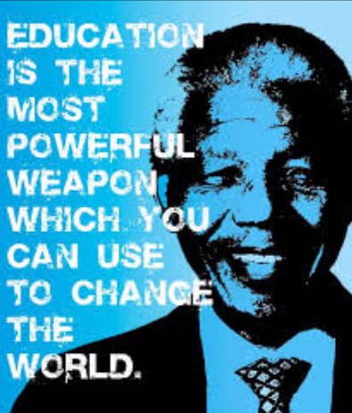

Slide 20
Peace is about Relationship

Slide 21
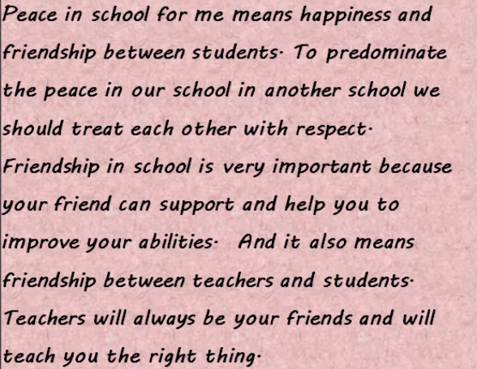

Slide 22
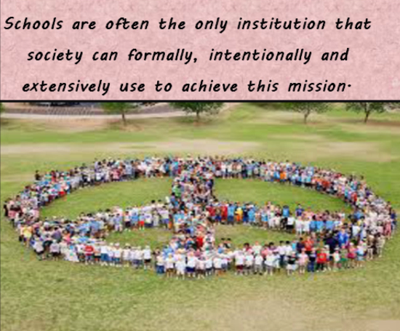

Slide 23
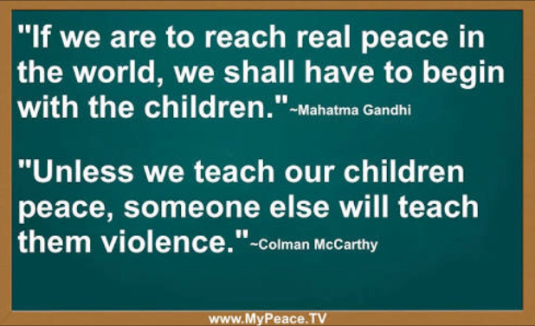

Slide 24
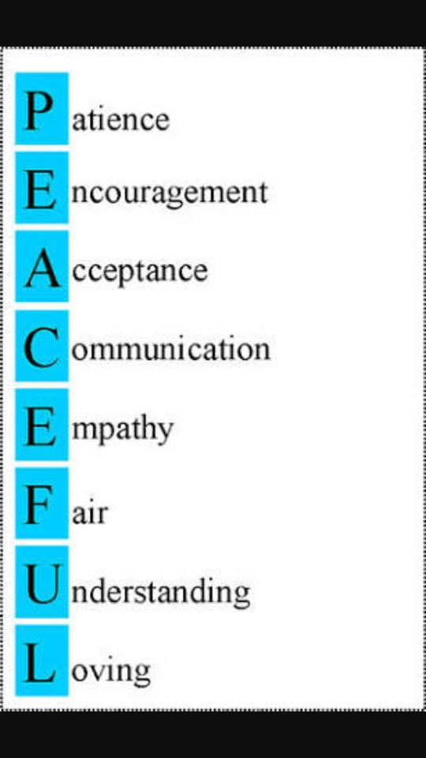

Slide 25
My opinion is that a good school is the place where you feel at home. Unfortunately, not all the schools can feel it. To be alone in school, students need to know their rights and to respect the commitments given. Each student has the right but not all of the bonds doing so as other students feel uncomfortable in school. All are equal and should live in peace and flavors. Schools help young people develop compassion, calm, emotional resilience, and self-awareness. When he first entered the school considers being: Wow, what a good school. Let it be so that i have the pleasure to sit in ot, do not want to leave the company of students and teachers. Teachers are like parents to us they really proves that we have come to a school where some students and professors with intelligent high. Good school is not that we are all kinds of scenery but where are souls waiting in the same « good school. In conclusion peace in school is necessary for students but also for teachers, because just so will always be happy.

Slide 26
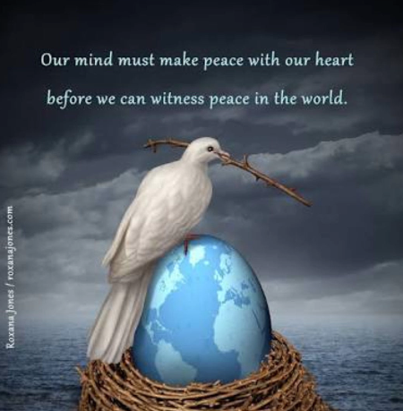

Slide 27
conclusion

Slide 28
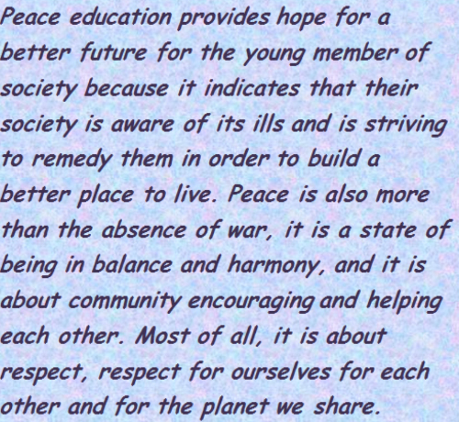

Slide 29
THE END
THANK YOU
☺ ☺ ☺

Slide 30
FROM:
MATH STREAM,
2 year
TEACHER:
Mrs Daoud

Slide 31
STUDENTS -Moncef Kahia -Islam Merdaoui -Ryad Namik Harroun -Anes Nabti -Sofia Ait Mohamed -AÏcha Mezhoudi -Rania Bournane -Maya Hadj Lazib

