Slide 1
SPACE EXPLORATION
Created by 8 grade, school №7, Korolyov, Russia
Sponsoring teacher Margarita Astakhova
Contributions from
countries: teachers:
Chelyabinsk, Russia Olga Timofeeva
Kumertau, Bashkortostan Aigul Gazizova
Starie Dorogy, Belarus Natasha Belozorovich
Chisinau, Moldova Elena Bogoeva

Slide 2
Goal Of The Project: To learn how our circle’s communities participate in space exploration projects.
1. How is your community involved in space exploration?
2. How are students involved in space research?
3. Tell us about museums of space exploration you have been to.
4. Does your country have a satellite?
5. How many astronauts are there in your community? Tell us about one of them.
6. Which questions would you ask the astronauts working on board the International Space Station?

Slide 3
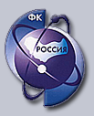
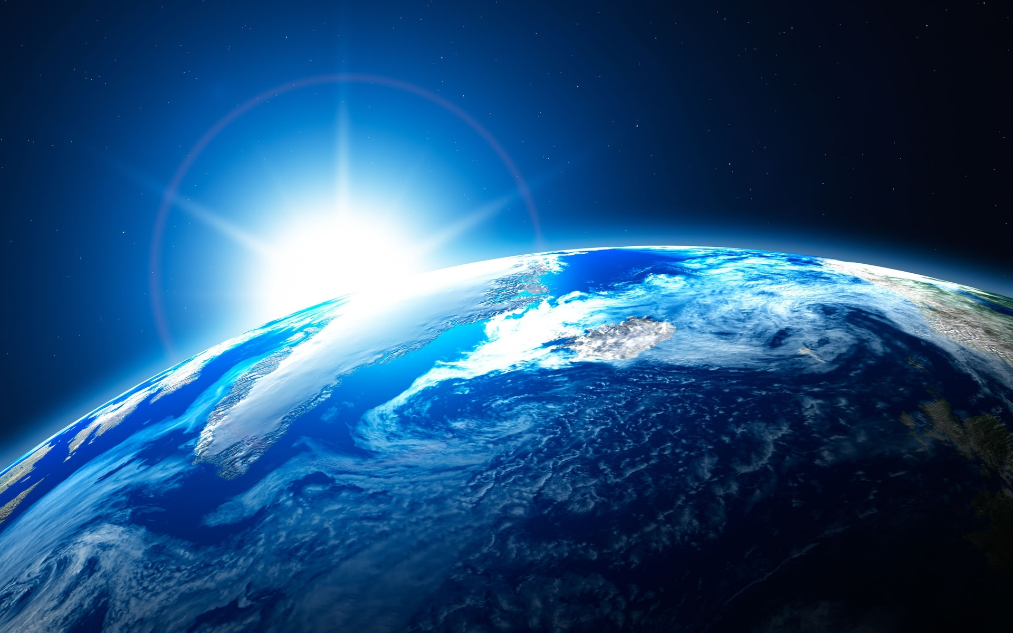
How is your community involved in space exploration?
Bashkortostan
In Ufa the 58th regional office of the Russian Federation of Astronautics was solemnly opened in 2010.
The Russian Federation of Astronautics is the non-political
voluntary all-Russian public organization uniting citizens and
the organizations for the purpose of promoting Russian Astronautics.

Slide 4
Belarus
The observatory at Minsk Planetarium - is a socially significant urban site, the only public astronomical observatory in the city and Belarus.

Slide 5
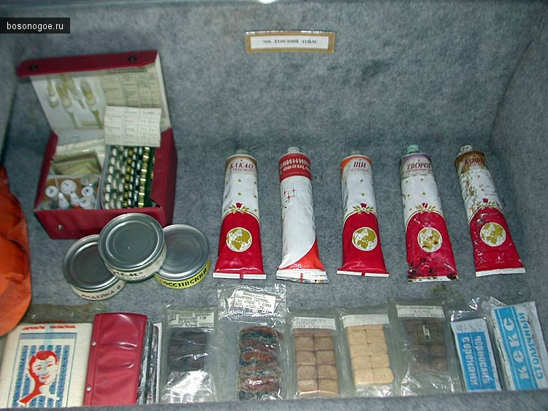
MOLDOVA AND SPACE EXPLORATION
The Republic of Moldova has contributed a lot in space exploration.
It was Moldovan scientists who invented a new technology of fruit and vegetable sublimation.
Tubas of the most various sizes with porridge and
juice, soups and
garnishes, salads
and forcemeat were
in demand up to
1982.

Slide 6
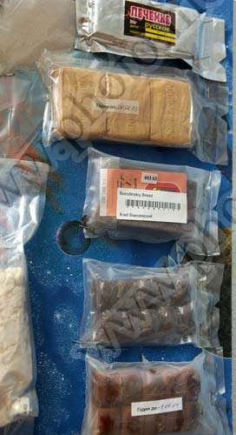
MOLDOVA AND SPACE EXPLORATION
Then special vacuum
packages were
Developed and
sublimated products
received new
packaging.

Slide 7
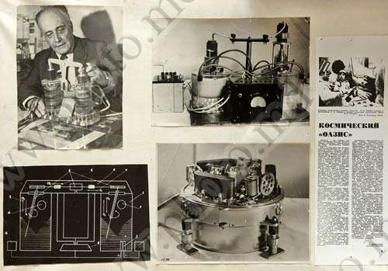
MOLDOVA AND SPACE EXPLORATION
The device “Oasis" for the production of biomass in -orbit is also the invention of the Moldovan scientists. “Oasis” grew “cosmic meat”and cosmonaut
Lebedev cooked
meatballs on board
"Soyuz-13".

Slide 8
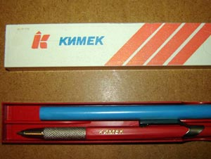
MOLDOVA AND SPACE EXPLORATION
American scientists worked decades on a problem of records in the
conditions of weightlessness. They spent about one million dollars. But
everything was ineffective: the ink in ball pens refused to leak in the
necessary direction flatly, and would break into a thousand of the smallest
drops all over the station. The
Chisinau workers and scientists
had no one million dollars, they
worked for the salary. But the
Party told «It is necessary!».
And the pencil with mechanical
giving of a lead was
invented.
It is still in use!

Slide 9
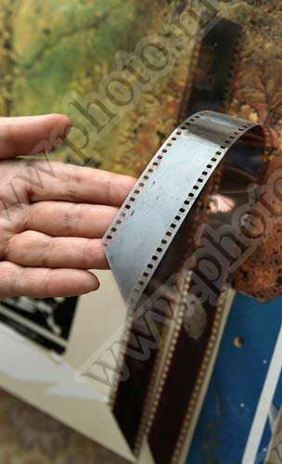
MOLDOVA AND SPACE
EXPLORATION
There is another but a little-known
invention: a reusable film roll. Each
shot of a film is covered by several
layers of special photosensitive
connection that allowed to use it to
thousand times -well then, tell, if it
differs from the modern multipurpose
technics?

Slide 10
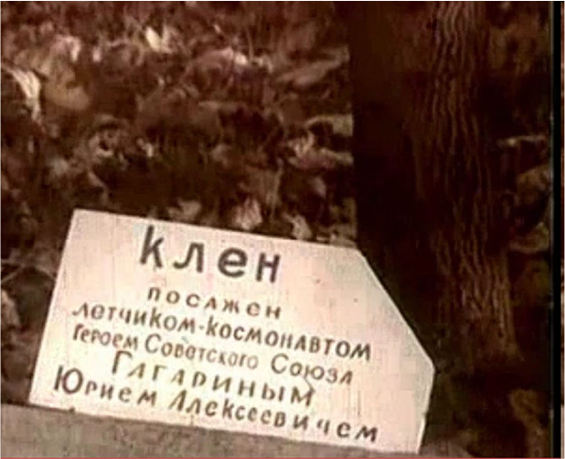
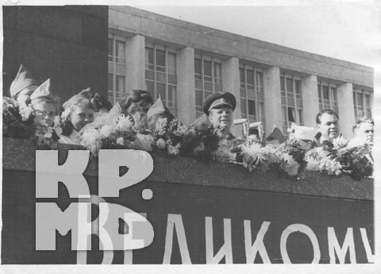
GAGARIN’S ARRIVAL
The great cosmonaut arrived in Chisinau in April, 1966 and spent three days here. Gagarin planted a maple tree in the Alley of Friendship in Pushkin’s Park and a linden – near “Shipka” movie theater, and tried a hominy at a wedding of simple Moldavian couple and delivered a speech in Moldova State University beginning it with "Drazh Tovareshch!“ .

Slide 11
2. How are students involved in space research?
Bashkortostan

Slide 12
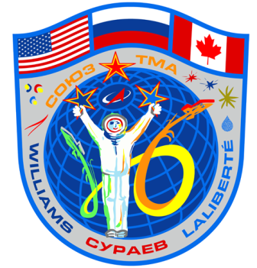
Our students are involved in competitions devoted to space exploration
Our students participate in the contest for the Cup of the first Russian astronaut Yuri Gagarin. Also, this year our students have taken part in the competition on creating the logo for the crew of the spaceship Soyuz TMA. The first prize went to the 14-year-old Nastya Mestyashova from Sakmara, Orenburg region, Russia.

Slide 13
Chelybinsk
Russia is country of first astronaut that is why more and more Russian people seek to know more than world knows about space. I live in Chelyabinsk; Chelyabinsk was the area of meteor that is why our school was learning a lot about this topic. The Chelyabinsk meteor was a super bolide caused by a near-Earth asteroid that entered Earth's atmosphere over Russia on 15 February 2013 at about 09:20 , with a speed of 19.16 ± 0.15 kilometers per second (60,000–69,000 km/h or 40,000]–42,900 mph). It quickly became a brilliant super bolide meteor over the southern Ural region. The light from the meteor was brighter than the Sun, up to 100 km away. It was observed over a wide area of the region and in neighboring republics. Some eyewitnesses also felt intense heat from the fireball. The bulk of the object's energy was absorbed by the atmosphere, with a total kinetic energy before atmospheric impact equivalent to approximately 500 kilotons of TNT , 20–30 times more energy than was released from the atomic bomb detonated at Hiroshima. http://www.space.com/19959-russian-meteor-explosion-all-you-need-about-chelyabinsk-s-surprise-space-rock-video.html What about our lessons about space? Junior School has been reinforced this topic by creating a variety of projects and exhibitions, who knows, maybe these young geniuses in the future will have mission to Mars?

Slide 14
3. Tell us about museums of space exploration you have been to.

Slide 15
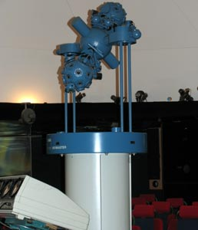
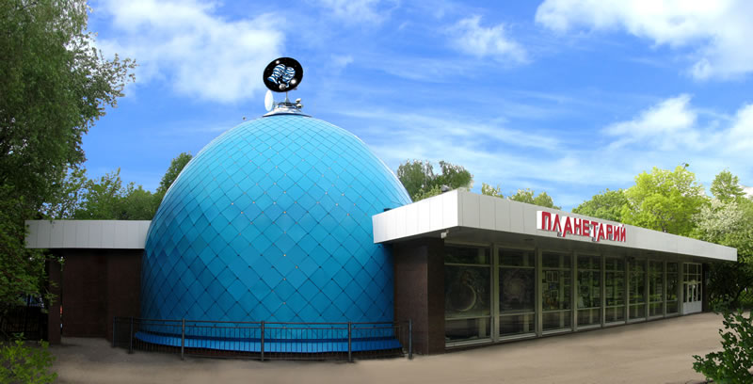
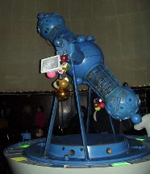
Museums of space exploration
In our capital city, Ufa, there is a planetarium. This planetarium is very interesting and you can learn a lot about space there.

Slide 16
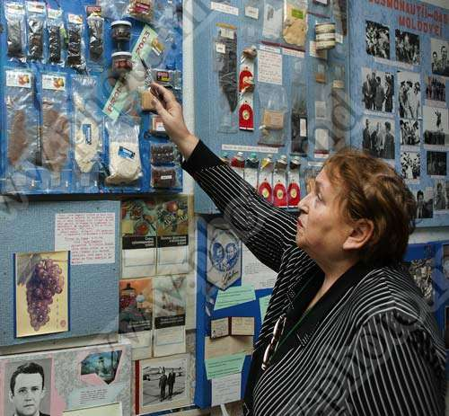
SPACE EXPLORATION MUSEUM
In Chisinau there is one small, but very interesting
museum. The exposition in it is devoted to space.
It was founded in 1970s on the basis of one of the city
schools. The museum
received its second
breath in 2001 and
since then has been
constantly opened for
all visitors. The Museum
Exhibits are witnesses of
a great epoch of the origin
of space flights.
Its address: Krynguluy St., 7.

Slide 17
4. Does your country have a satellite?

Slide 18
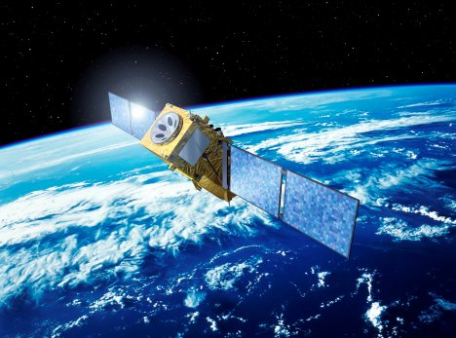
MOLDOVA AND A SATELLITE
Our country has not got a satellite yet. But an artificial satellite called “Satum" has been under development for three years in the Moldovan Technical University. It is being made by a group of young engineers. The Kid " Satum " (it measures just 10x10x10 cm) is designed to assist in mapping and monitoring the ecological state of rivers and lakes in Moldova. In space it is planned to start either by using the European rocket "Vega" or by the Russian "Soyuz" ." Satum " is also called " nanosatellite ".

Slide 19
So far Belarus has no satellites but soon it will have.
Belarusian high-end satellite is planning to be launched into orbit in 2017.

Slide 20
5. How many astronauts are there in your community? Tell us about one of them.
Bashkortostan

Slide 21
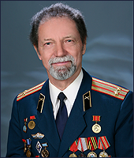
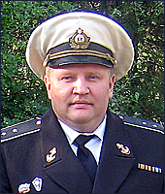
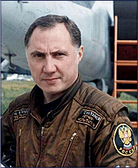
Astronauts in our republic
Here are the citizens of the republic who made a powerful contribution to the implementation of Federal programs for space exploration.
Nikolai Eskov carried out tasks of chemical ensuring tests of intercontinental strategic rockets and space objects.
Sergey Plyukhov provided maintenance of starts-up of the piloted spacecrafts in the water area of the World Ocean.
Ural Sultanov, an astronaut-tester

Slide 22
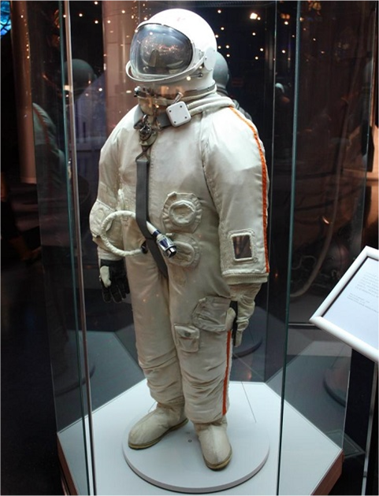
ASTRANAUTS/ COSMONAUTS IN MOLDOVA
Unfortunately, there is no
astronauts in our
country.

Slide 23
Belarusian cosmonaut Oleg Novitsky
Oleg Novitsky, born October 12, 1971 in Cherven, Minsk region, in 1988 - graduated from high school number 2 in the town of Cherven, in 1994 - Kachin Higher Military Aviation School, and in 2006 - Gagarin Air Force Academy.

Slide 24
6. Which questions would you ask the astronauts working on board the International Space Station?

Slide 25
Bashkortostan
1. Is it easy to stay in space?
2. What are the most interesting effects you can observe in the space?
3. Do you like to be in space?
4. What are the main characteristics of the astronauts?
5. Did you know that you would become an astronaut when you were a child?

Slide 26
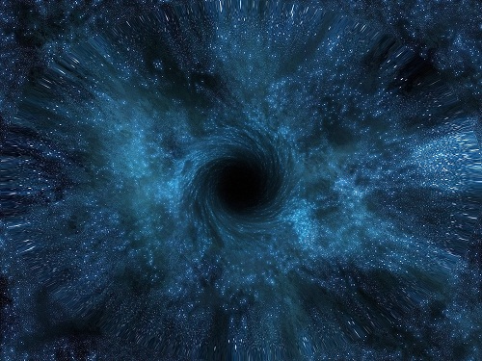
Moldova
How do you cope with stress?
Are you afraid to be dragged by Black Holes?
Have you ever seen meteorites fall from the space station?
Do you believe that we aren't lonely in the Universe?

Slide 27
Belarus
Is food in tubes delicious?
Do you sleep well in space?
Is it scary to fly in a rocket?
Is the space beautiful?
What do you do in your spare time in a rocket?

