Slide 1
“ How To Save The Rivers ”
Presented by :
Radin Shahdaei
Alireza Hosseini
From Elementary Mehraein School
Iran Tehran

Slide 2
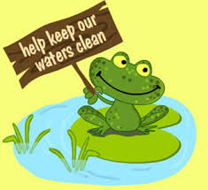
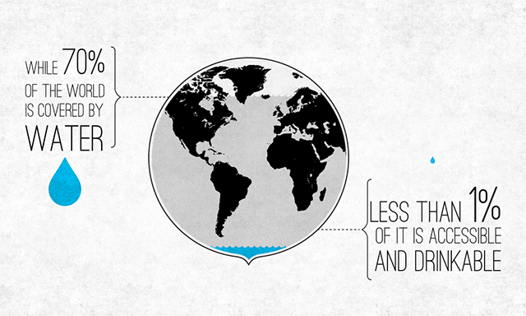
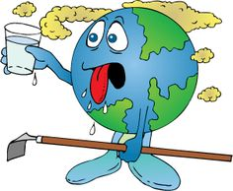
“ Danger For the Rivers ”
As you know more than 70% of the planet earth is contained of water. But only 1% of it is accessible drinkable, and day by day the water is decreasing. So We have to protect the water and DO NOT POLLUTE IT.

Slide 3
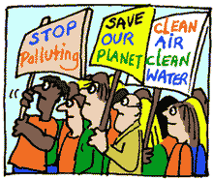
“ How to protect the Rivers in Our HOMES ”
Run washing machines & dishwashers only when they’re full. Large loads = less water used. And save energy by turning off the auto-dry setting and letting your dishes dry naturally.
Keeping a timer in your bathroom will help you take a shorter shower. And please turn off the faucet while brushing your teeth. All that perfectly clean tap water is just going down the drain.
Turn off lights and unplug chargers. Water is used in all forms of energy generation. It can take over 4 gallons of water to keep a 60-watt light bulb lit for 12 hours.
Use cleaning products. The water that goes down your drains will eventually flow into streams and bays.
Skip meat for one meal a week. It can take about 600 gallons of water to produce a hamburger. (Think of all the grain that’s grown to feed the cattle.)

Slide 4
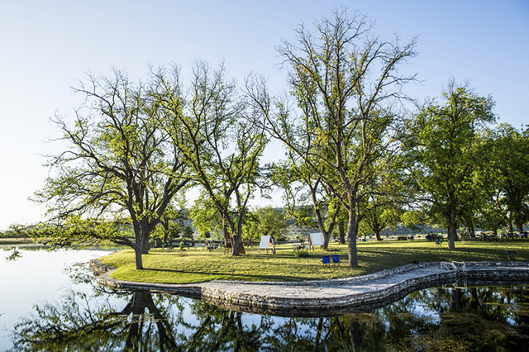
“ Water is From River ”
Water that we use is came from rivers. we can’t use the water of the oceans or the rain, either. So if we use less water, we are actually saving the rivers.

Slide 5
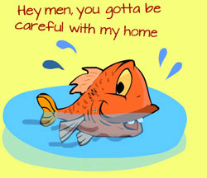
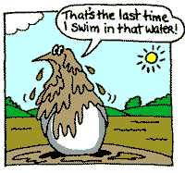
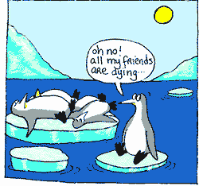
“ Do Not Pollute The Rivers ”
If we pollute the rivers or oceans, we’re actually killing ourselves, beside of killing the fish and making the water dirty. We can’t drink that water either. So we have to let the rivers be clean. The first move is to DO NOT throw our trash in the water. The other way is to CLEAN the rivers. This can make other people to do this, too. Also we can BE IN THE SITES OR DONATIONS that save the environment.

Slide 6
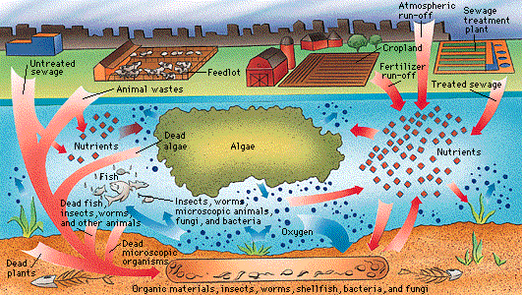
“ What does pollute the water ”
The water that we can drink is 1% of the whole water in earth , and more than half of it is so polluted that we can’t use them , but what does pollute the waters ? Nearly all of the big cities and ports , dumb their wastewater in the rivers and the sea , and also big ships that carry oil and oil products and pipes that carry oil and oil products under water , might have a hole and the oil will go into the water and rivers and lakes and pollute them.
This diagram shows the many things that can pollute the water.

Slide 7
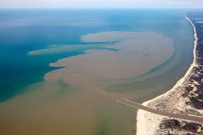
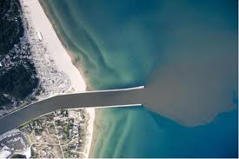
Images
Big cities and ports dump their wastewater in the rivers and the sea

Slide 8
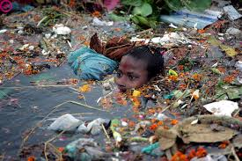
“ Water pollution problems ”
As I said , less than 0.5% of the water in earth is drinkable , and we are polluting the rivers and ocean more and more. People dump wastewater and trash in rivers and also they throw away some dangerous chemicals in the rivers that they don’t need. So more people won’t have fresh and drinkable water by the time goes on. That causes more people to die from hunger and from being thirsty.

Slide 9
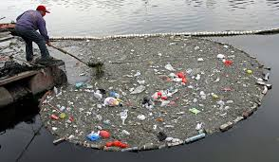
“ Fish Problems ”
by dumping dangerous chemicals and wastewater and trash in the water, fish and other animals in water will be in a big and horrible danger. Fish will die by the chemicals , turtles will eat plastic bags instead of jelly fish and plastic will be stuck to pelicans head.

Slide 10
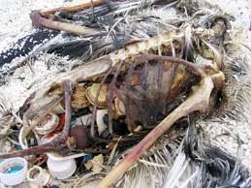
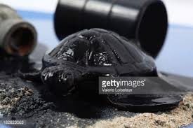
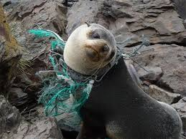
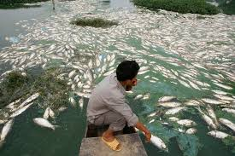
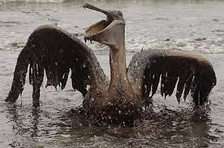
Images

Slide 11
The end Thanks For Your Attention

