Slide 1
iEARN Global Learning Circle
Our Project: My City and Me
Middle School

Slide 2
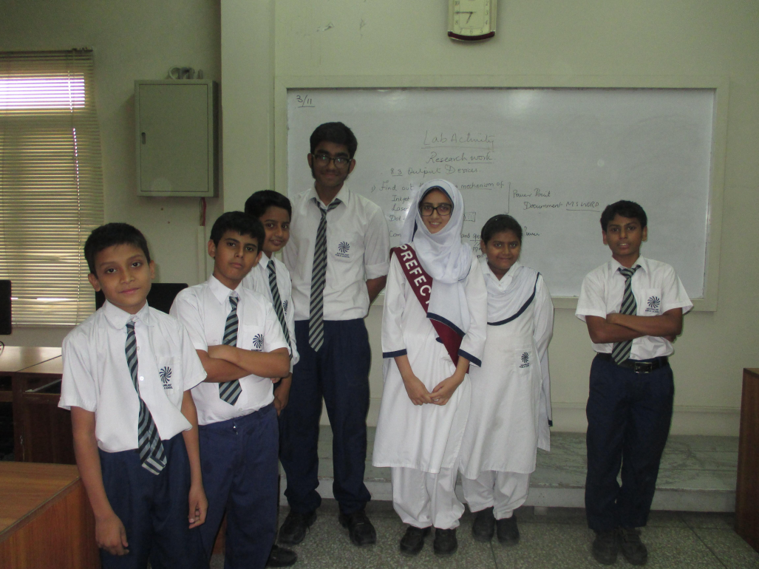
We are the students of Shahwilayat Public School Karachi, Pakistan

Slide 3
Names of the participating students
1. Muhammad Irtiza 8. Wania Shehzad
2. Ammar Raza 9. Wafa Zehra
3. Muhammad Sarim Imam 10. Mujtaba Jafri
4. Saheer Mansoor 11. Sajjad Shehzad
5. Muhammad Ibrahim
6. Eman Ali
7. Nabiha Sheikh

Slide 4
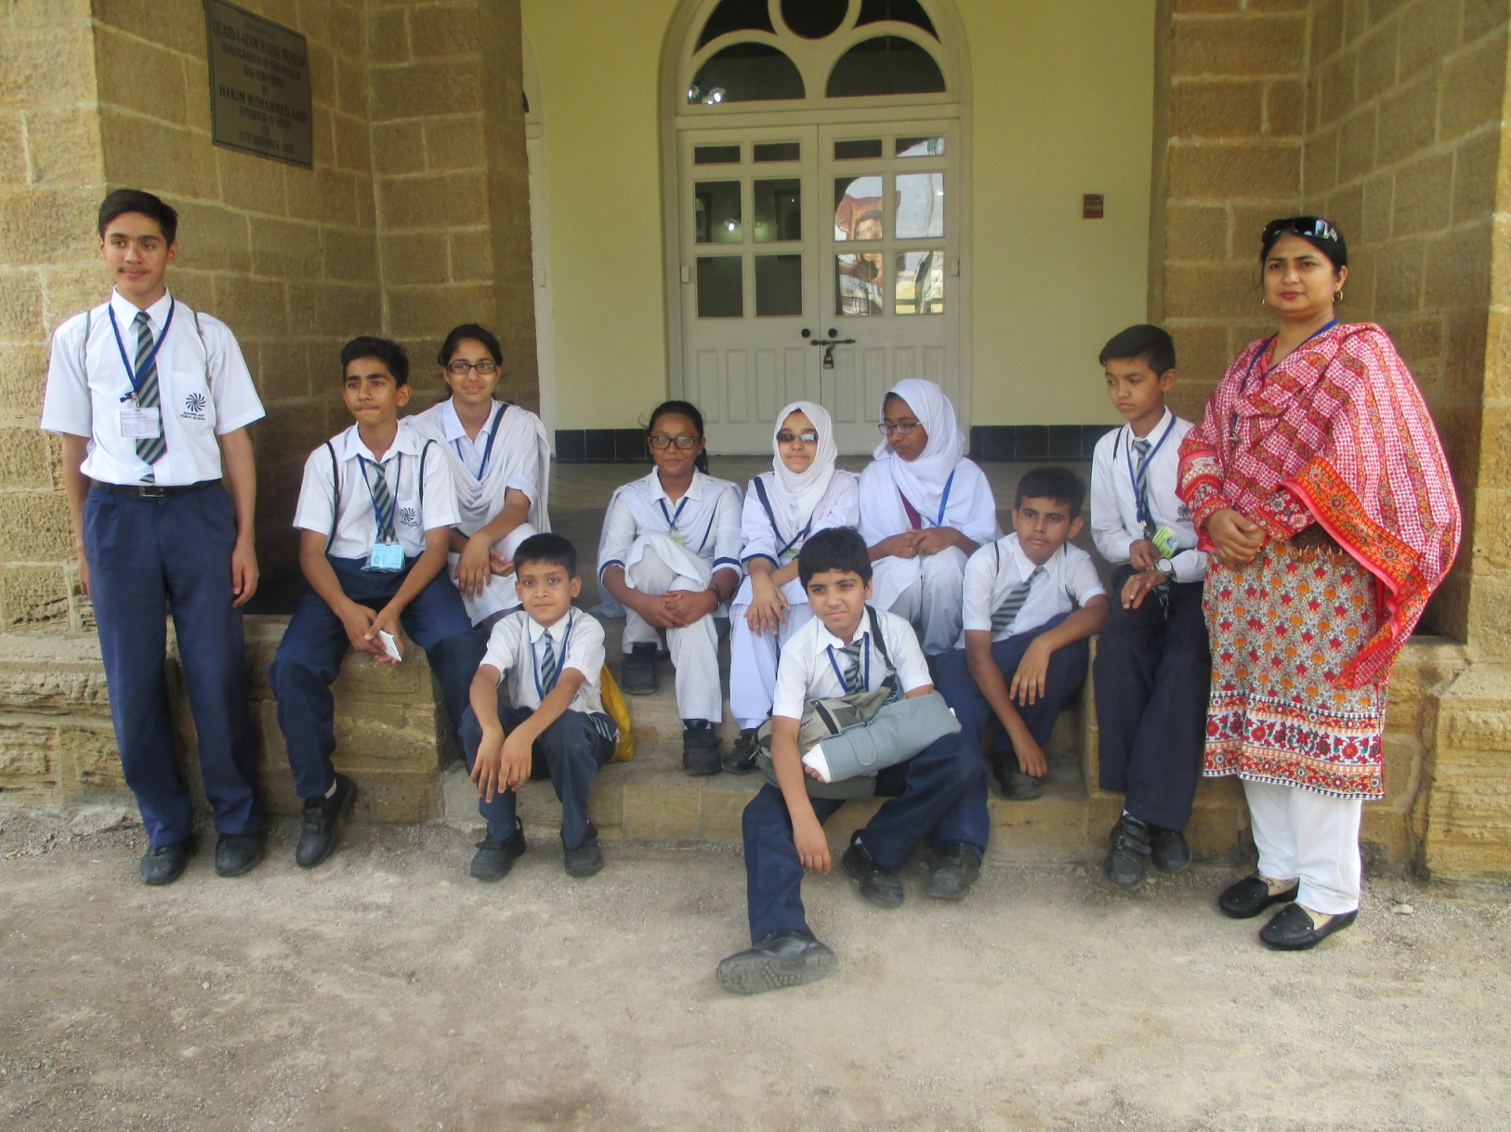

Slide 5
Name of our teachers
Ms Shahida Ajaz and Ms Shahnaz Rehan

Slide 6
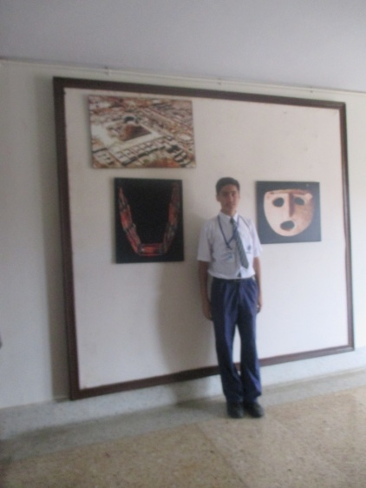
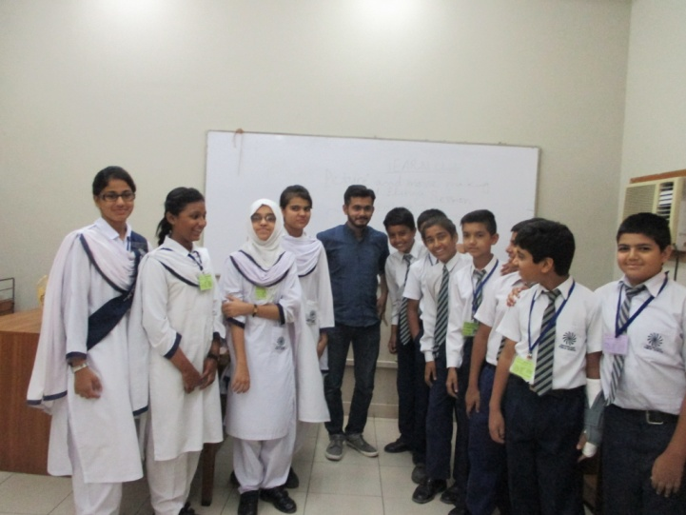
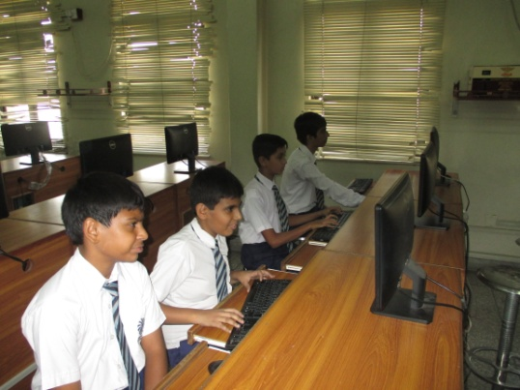
During project assignments
Data collection (internet, visiting the site)
Analysis
Presentation
We completed our work in groups

Slide 7
Title of our project
Historical Buildings in My City
(Karachi)

Slide 8
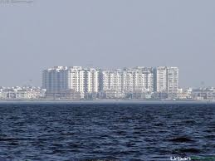
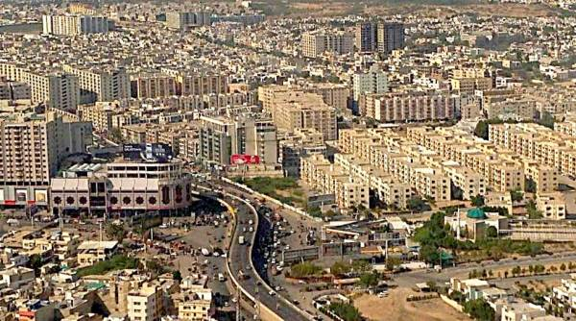
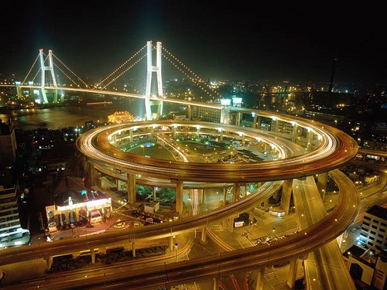
Introduction of our city : Karachi
Our city name is Karachi. It is located in Pakistan (South Asia). It is one of the busiest cities of the world.

Slide 9
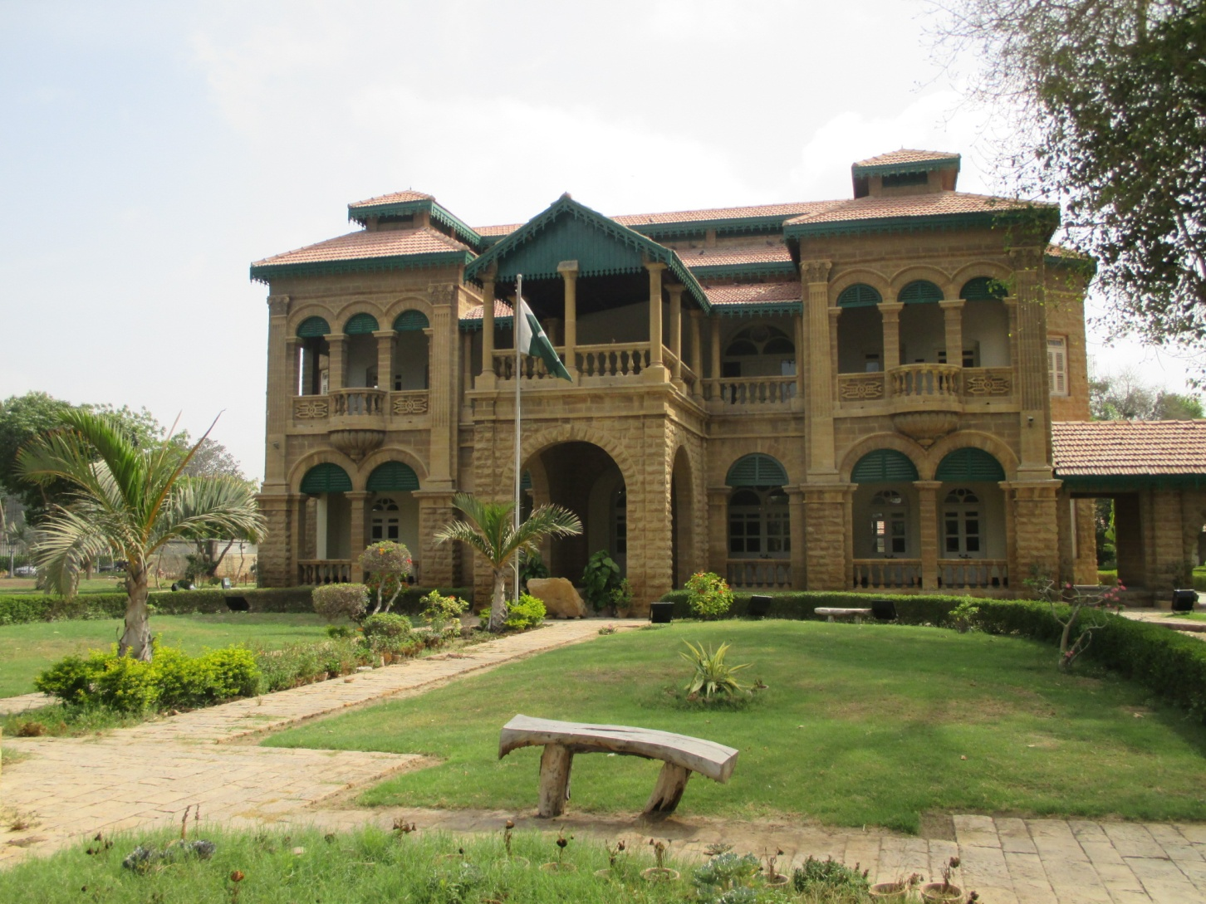
We selected a historical building of Karachi: The National Museum

Slide 10
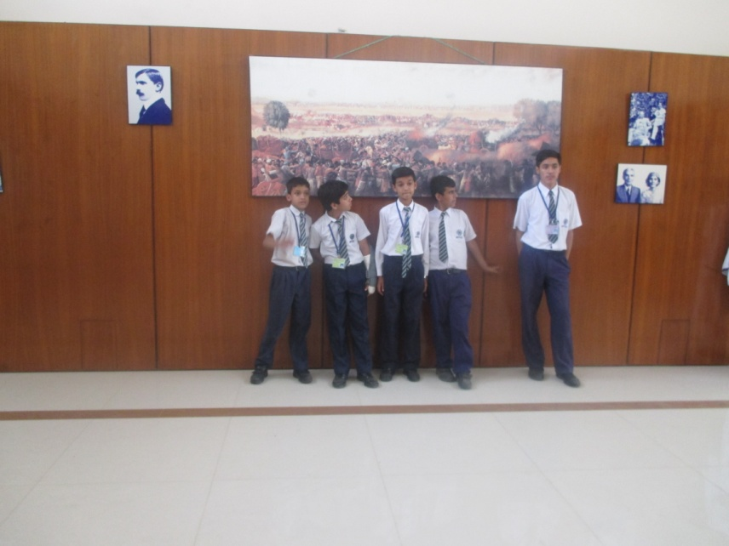
National Museum Karachi, Pakistan

Slide 11
Information about our historical place
Location: National Museum of Pakistan, Karachi National Museum of Pakistan is located at Dr. Ziauddin Ahmed Road, Karachi, Pakistan.
Purpose of building: This museum was built in Frere Hall on April 17, 1950 for replacing Victoria Museum. The main purpose of creating was to promote people and history of Pakistan. National Museum of Pakistan is a best place for history and art lover students.
Address: Burnes Garden, Dr. Ziauddin Ahmed Road Karachi Pakistan

Slide 12
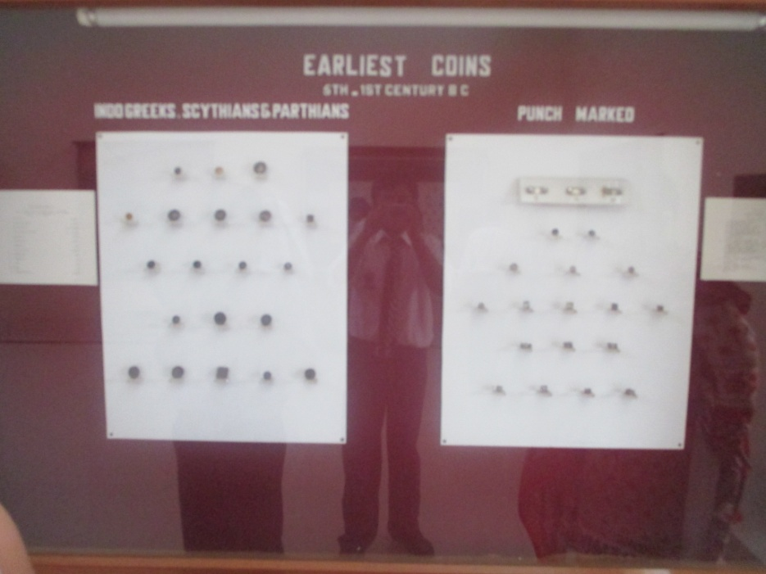
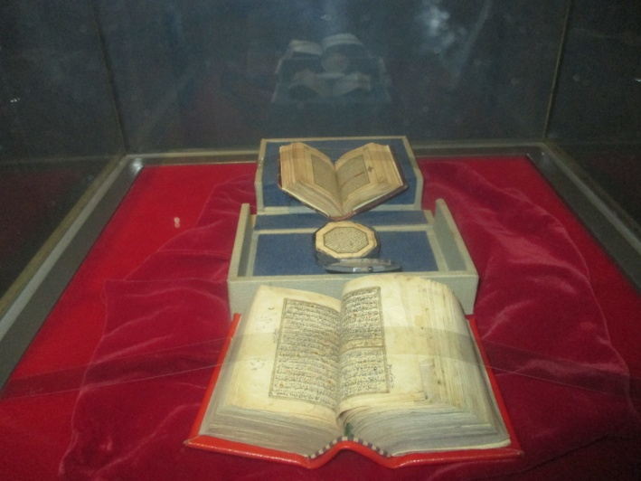
Special features of National Museum
There are famous antiquities and works of Arts including "The Priest King" statue wearing Sindhi Ajruk. Nation Museum of Karachi has a set of 58,000 old coins, 70,000 books & reading materials, and there are 11 balconies in this museum and nice "Gallery Koran" for increasing its beauty that attracts everyone.

Slide 13
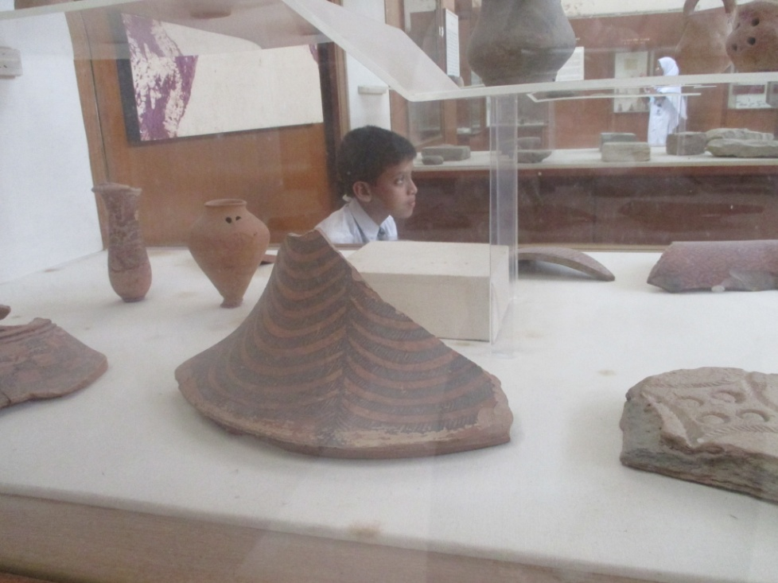
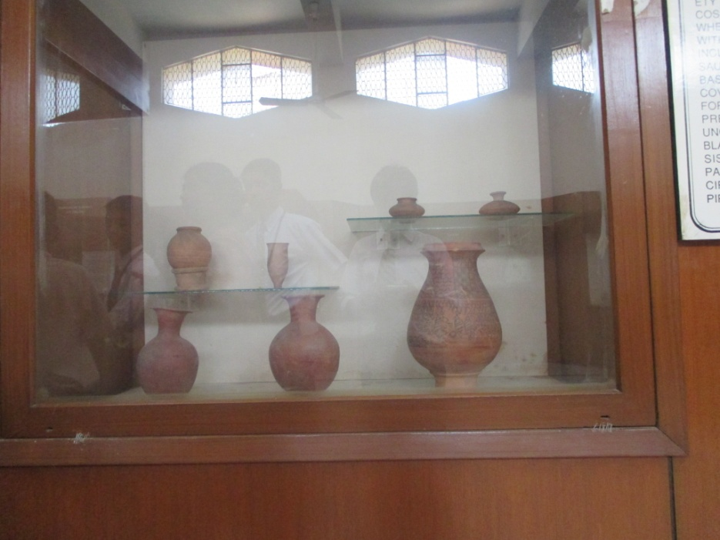
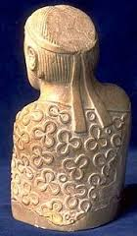

Slide 14
Pictures of Pakistani national heroes

Slide 15
Information about us
Teachers : Shahnaz Rehan, Shahida Ajaz
Group Name: Middle School
Title of project: “Historical Buildings in Karachi, Pakistan”
Class : Grade 7 and 8
Name of our school: Shahwilayat Public School
City & country of school: Karachi, Pakistan

Slide 16
Special Thanks to;
Ms Shahnaz Rehan &Ms Shahida Ajaz
Our principal Mr Altaf Ahmed for logistic support
Head Mistress Ms Irum Aamir
Photographer Mr Ali Raza who taught us photography skills
Mr Hussain our IT manager

Slide 17
Thank You for watching our work

