Slide 1
National Parks of Belarus and Iran
Prepared by
Students of the 6th form
Gymnasia No.1
Starye Dorogi
Belarus
Teacher
Natasha Belozorovich
2016

Slide 2
belarus
Narochansky National Park
Pripuatsky National Park
Belovezhskaya Pushcha National Park

Slide 3
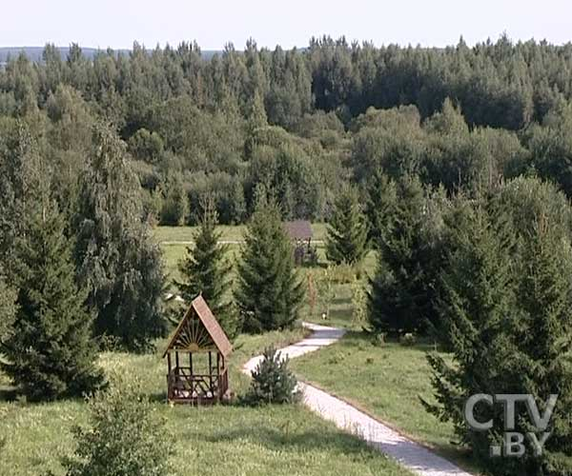
Narochansky
National
Park

Slide 4
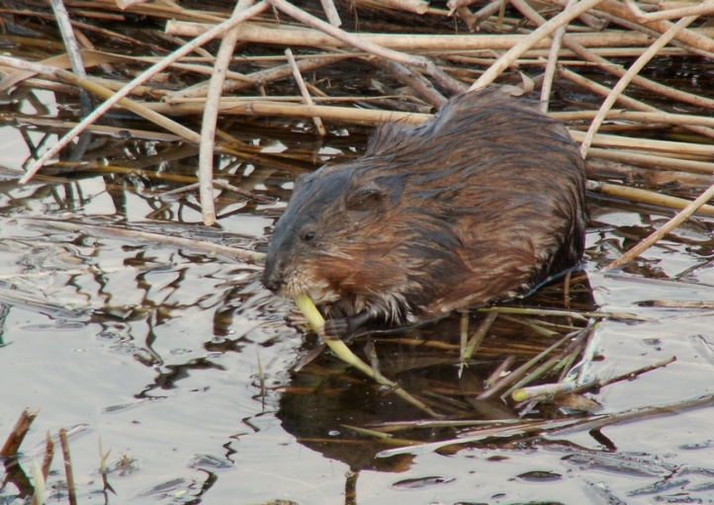
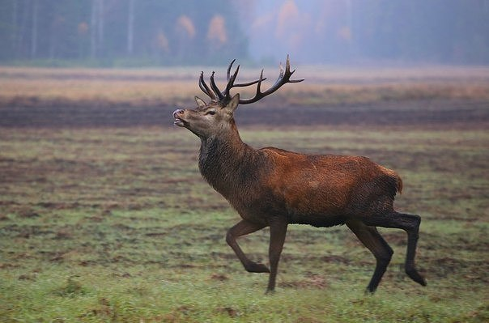
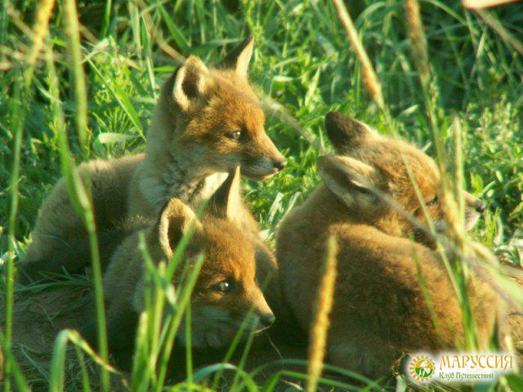
There are 49 species of mammals in Narochnsky National Park
beaver
deer
fox

Slide 5
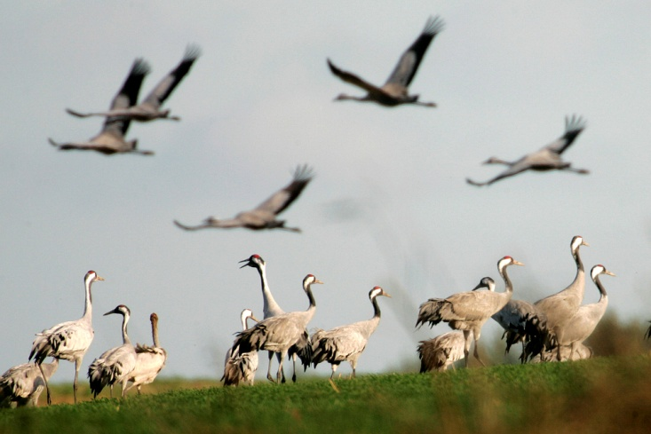
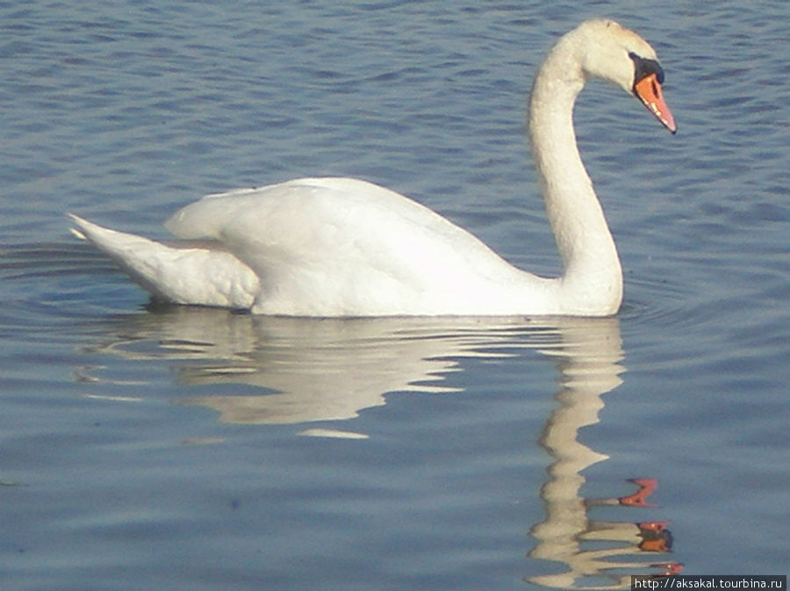
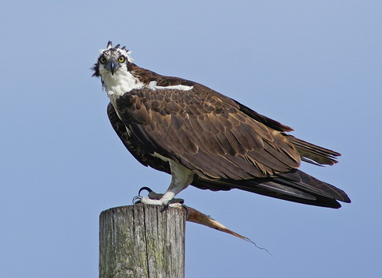
There are 185 species of birds in
Narochansky National Park
crane
swan
accipiter

Slide 6
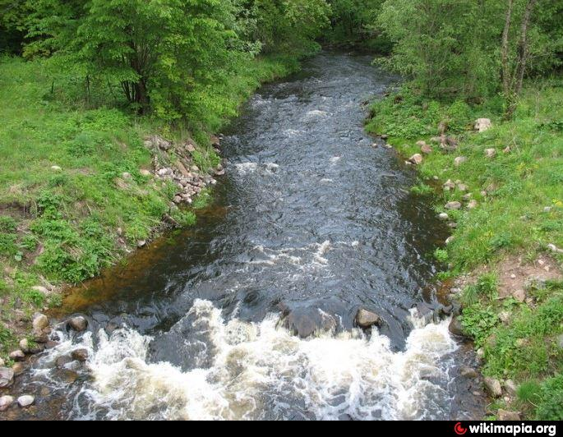
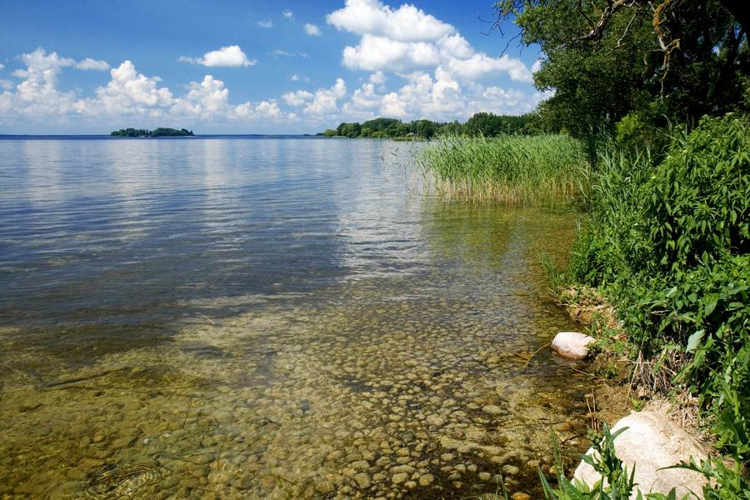
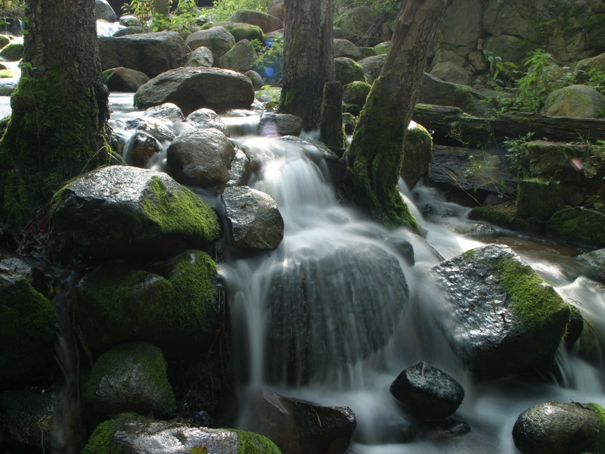
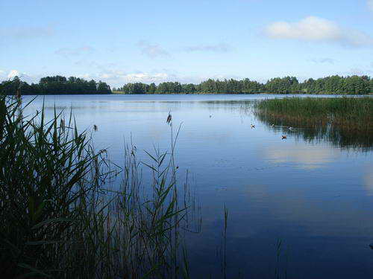
There are 40 lakes in the Park

Slide 7
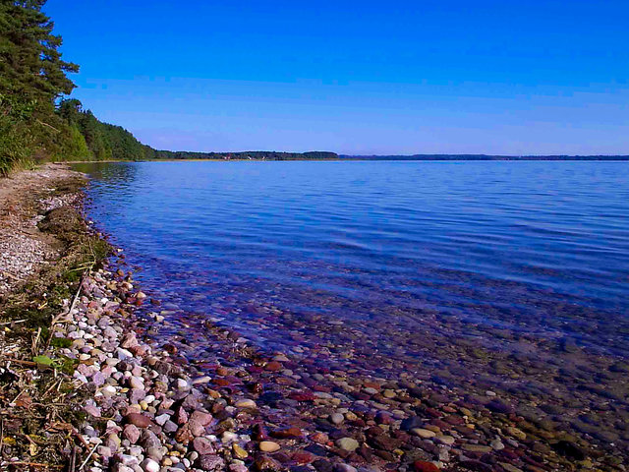
Lake Naroch is located here. It is the biggest lake in Belarus.

Slide 8
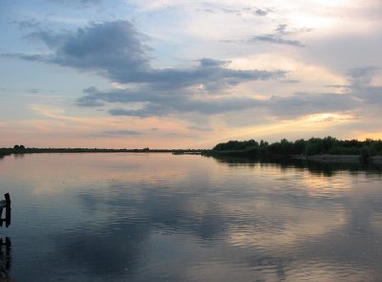
Pripiatsky
National
Park

Slide 9
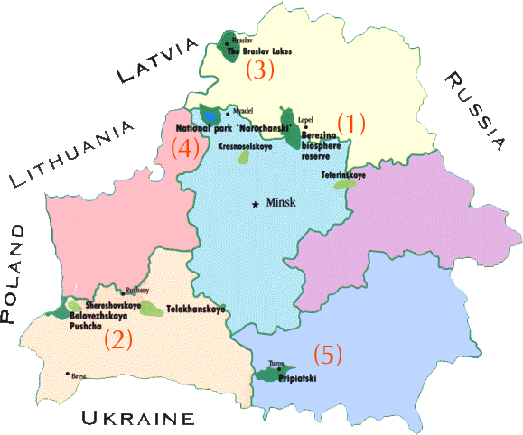
Distance
From
Minsk is 250 km

Slide 10
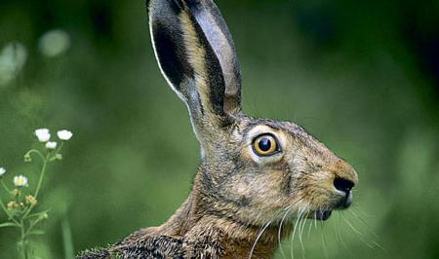
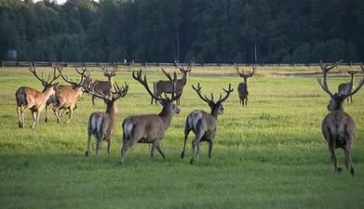
ANIMALS:
Rabbit
Deer

Slide 11
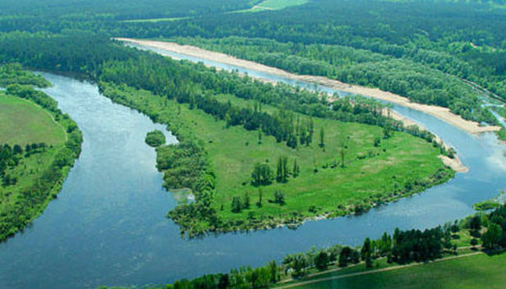
Area:
More than
180,000
Hectares

Slide 12
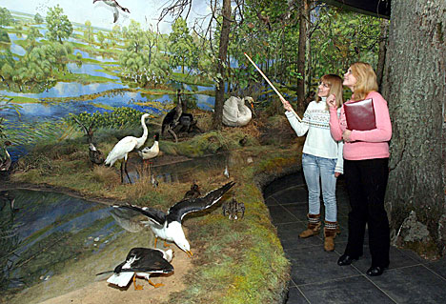
Opened in:
1969,1988
(1996-National Park)

Slide 13
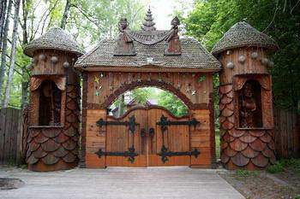
Belovezhskaya Pushcha National Park

Slide 14
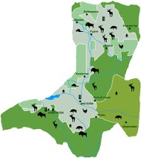
Area: more than
150.000 hectares

Slide 15
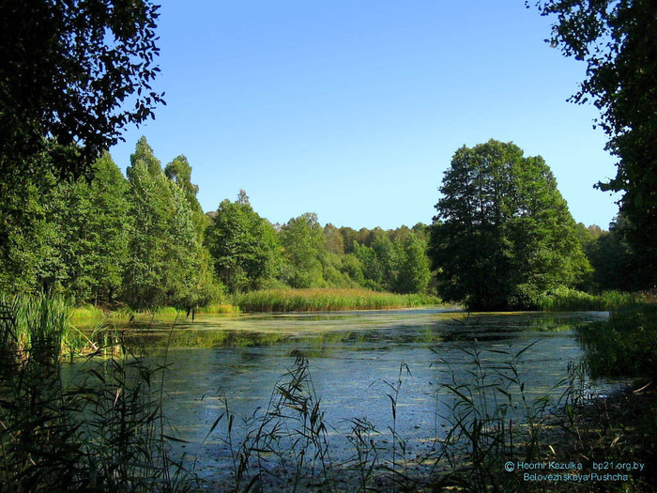
Opened in:1932(1991-
National Park),a protected
territory-since 15th century

Slide 16
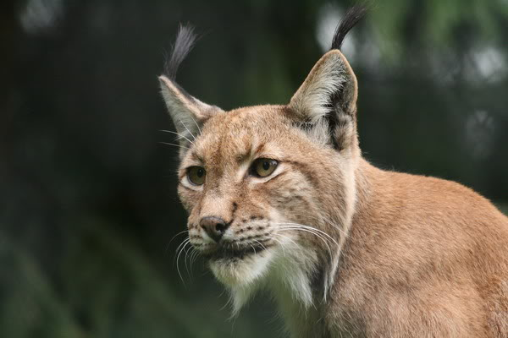
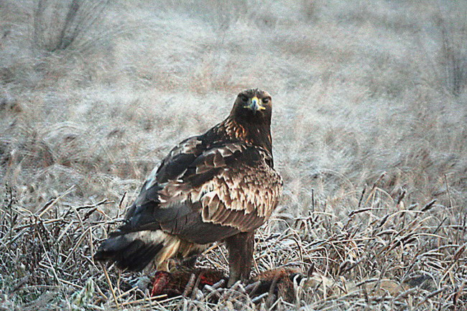
There are 59 species of
mammals,250 species of
birds
Lynx
Eagle

Slide 17
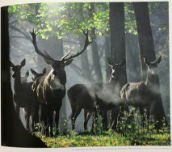
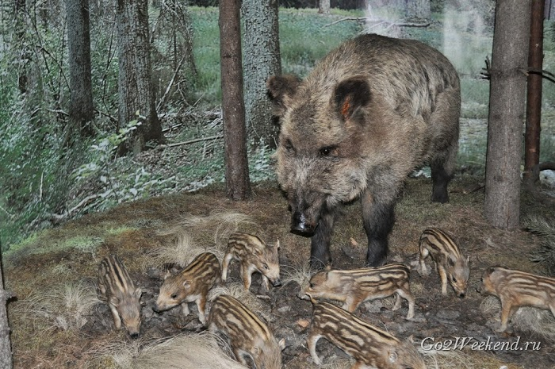
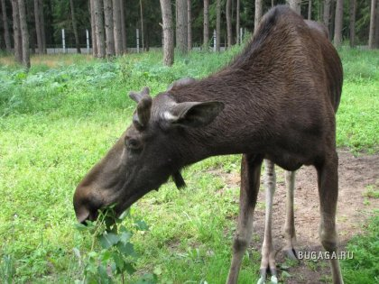
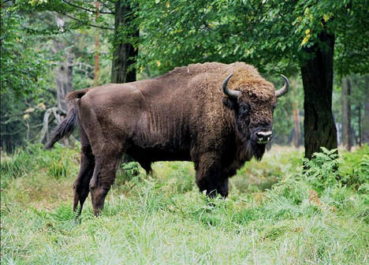
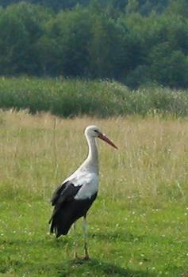
Deer
Wild boar
Deer
Elk
Bison
Stork

Slide 18
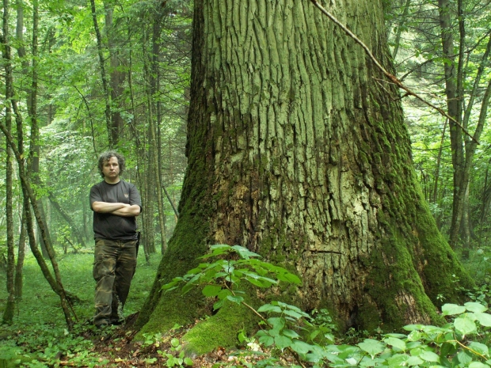
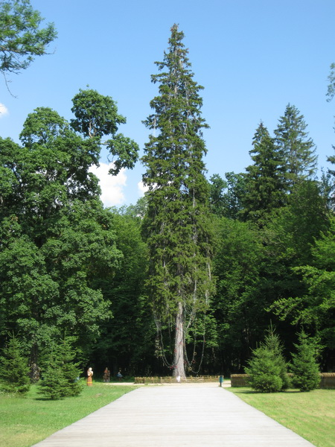
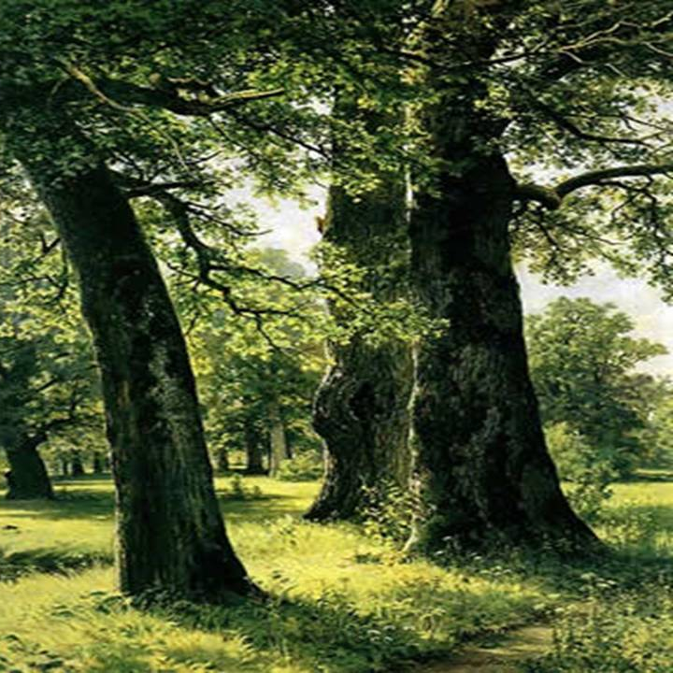
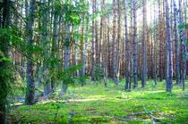
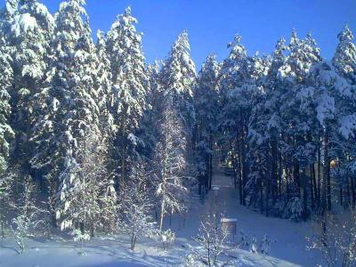
Trees:26 species
Fir-tree
Ash-tree
Oak-tree
Birch-tree

Slide 19
iran
Chitgar park
Jamshidieh Park
Water and Fire Park
(Ab o Atash Park)

Slide 20
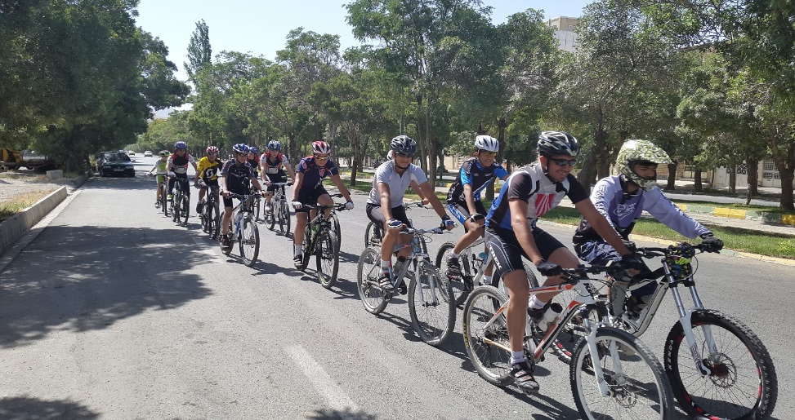
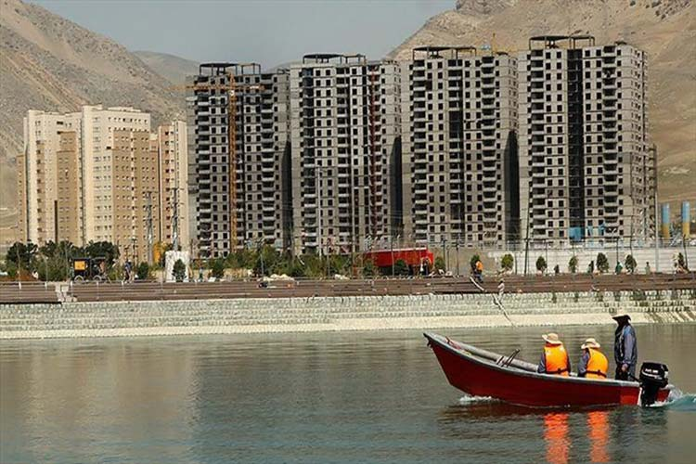
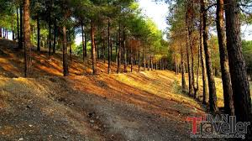
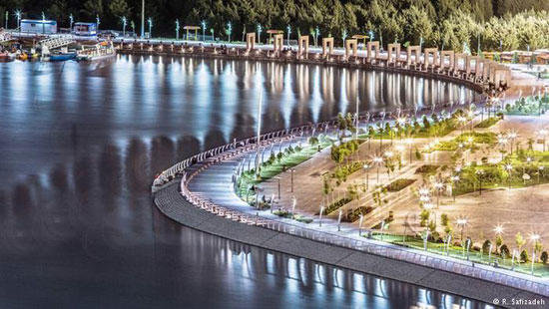
Chitgar park

Slide 21
Chitgar Forest Park
Chitgar Park is situated in Tehran, Iran. It is an artificial forest and covers an area of 14.5 square kilometers west of Tehran. It lies within the borders of Tehran strict 22. It also has different ramps and facilities for cycling and skating. It is one of the largest parks of the province, and can be used throughout the year. This park is very popular with the population of Tehran and Karaj, and being situated on the way of the West-East wind in the province it has a purifying effect on Tehran's air.
The Chitgar Park is served by a highway and a metro line. The metro station is also called Chitgar . The forest areas of this huge park are irrigated by the rivers Kan] and Vardavard. A man-made lake is planned for construction between the two Chitgar hills.

Slide 22
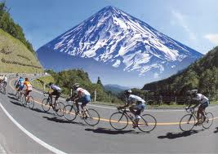
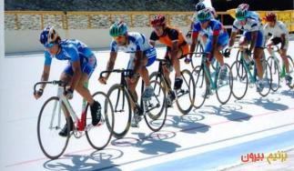
Cycling Track In addition to nature trails in the forest park, resort recreational facilities such as horse riding, skating, track cycling and bike lanes in the park is designed. Chitgar bike track is including track speed, endurance and mountain. Endurance track is inside the park and has crossed green route. Pine and cypress trees along the way have led to relatively cooler climate than the rest of the park on the way there. The endurance track with alternate routes around 7- 8 km.

Slide 23
Chitgar lake
Khalij Fars lake ( Persian Gulf ) Also known as Chitgar Lake is a manmade lake located in west part of Tehran & constructed in 2012 as an entertainment complex in Chitgar Park . It takes 60 minute to get there from the city center considering the traffic. It is a new developed part of Tehran with the high rises in its surroundings . There is a Luna park nearby . The lake has an area of one hundred and thirty hectare but along with the Luna park and the attached garden it covers an area of 250 hectare. The initial plan of this lake dated back to many years ago but the actual construction was just started in 2012 . The water led to the lake from Kan River in domains of Alborz Mountain Chain. It was reported that in the past few years , by existence of this lake , there are so many migrant birds which spend their winter on it . We recommend you to pay a visit there as an attraction to take some memorable pictures .

Slide 24
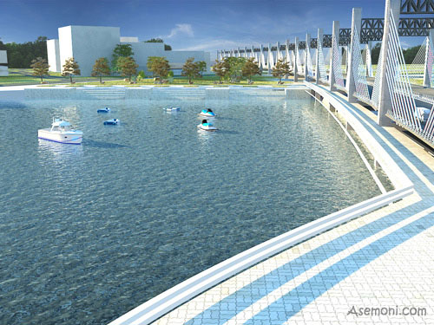
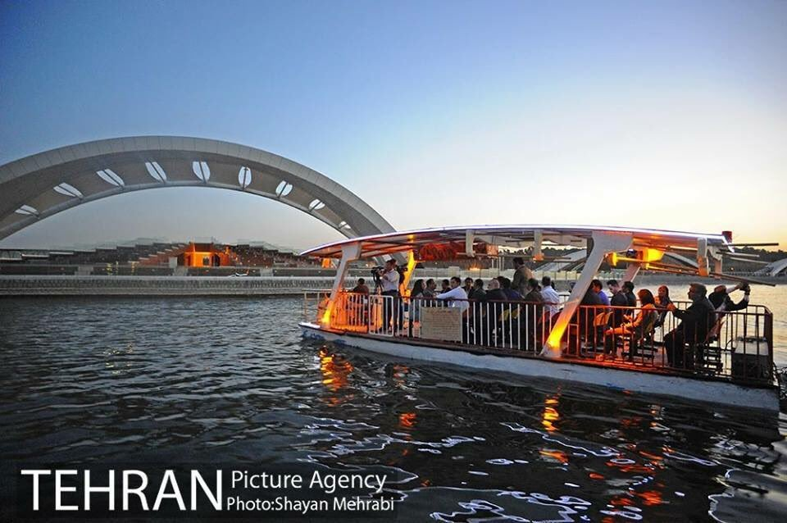
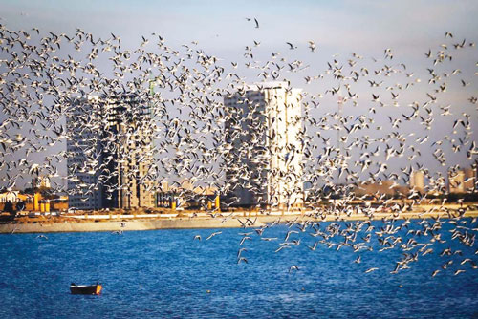
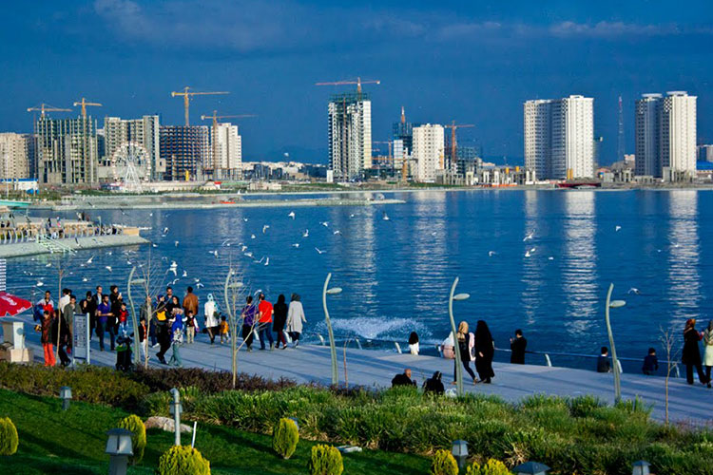
Chitgar Lake

Slide 25
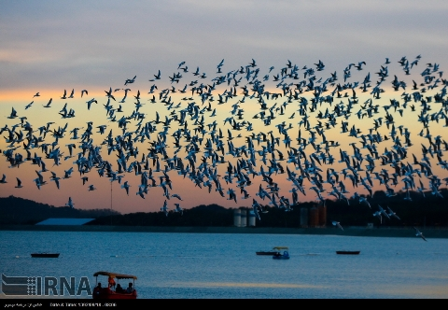
Chitgar lake is a paradise for migrant birds

Slide 26
Jamshidieh Park

Slide 27
The History of Jamshidieh Park
Since 1950s, fast population growth in Tehran has created huge pressure for land on which to build, resulting in the destruction of many of the public and private gardens that once graced the city. As part of a wider range of measures to limit urban sprawl, Tehran Municipality has supported efforts to protect the natural environment of Alborz Mountains that form the city's northern perimeter. During the late 1970s, a 12-hectare park, Jamshidieh Stone Garden, was created at the foot of the mountains. It proved to be highly popular.

Slide 28
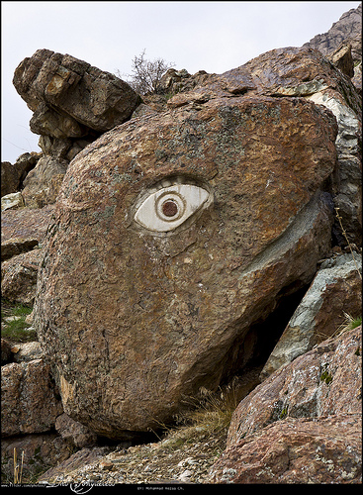
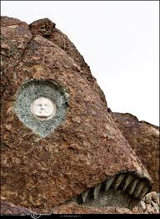
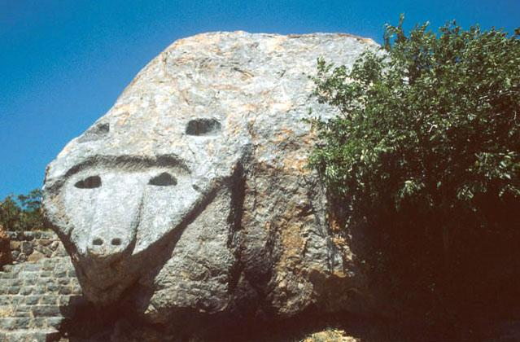
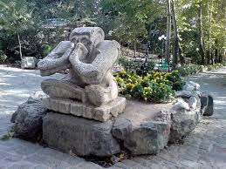
Stony Ocean

Slide 29
In the foothills of the Alborz Mountains, at the northernmost reaches of the city, is Jamshidieh Park, a favorite for budding mountaineers, hikers, and anyone who enjoys a good view.
This park is also known as Stone Garden, and offers a clean and relatively quiet atmosphere in which to enjoy the views and escape the smog. It’s the sort of place you could happily while away an entire afternoon sipping tea, chatting with random Tehranis and watching the lights of this huge city slowly come to life . If you’re feeling energetic, a steep trail leads from the northwest corner of the park (beyond the Turkomen restaurant) along the side of the mountain for about 5km to Darband, making a thigh-burning but enjoyable and relatively pollution-free hike. Particularly picturesque after the first snowfall of winter. The park also has a restaurant and teahouse in the center.

Slide 30
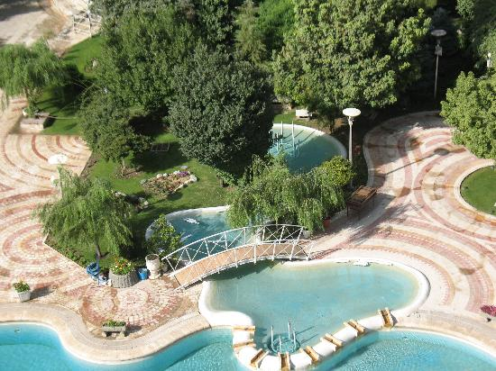
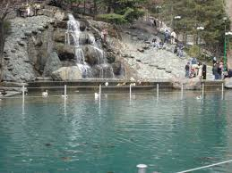

Slide 31
Paths… Sitting areas…Cultural houses…
The primary intervention is a series of stone-pave paths and steps that rise up the hill, providing views over the city. Along these paths, areas for sitting, refreshment and entertainment have been created within the natural topography, including four cultural houses, built to represent the distinctive style of Iran's Azeri, Kurd, Turkmen and Zagros ethnic groups. The paths ultimately lead to a sculpture garden, being developed to the east and hiking trails into the upper valleys.

Slide 32
Ferdowsi Garden
The project, which was completed in 1997, enjoys great popularity and has had a direct and positive impact on the city, alleviating pressure for the development on the slopes of the Alborz Mountains and creating an environment, where people, nature and culture thrive. An imaginative reinterpretation of the traditional Persian "Paradise" garden adopted to modern needs, Ferdowsi Garden, pays testimony to the importance of environmental design within the overall process of urban development.

Slide 34
In the name of god
Water and fire Park
(Ab o Atash Park)
Tehran
Iran

Slide 35
Water and Fire Park
Ab-o Atash (Water and Fire) Park or Abraham garden, is the most beautiful park, with an area over 24000 square meters in Tehran city. The park has various recreational facilities such as; silk bridges, light house, cubby hole, fire towers, alcove, ceremony , an area for playing with water, and equipment such as four fire towers, and a tent with 700 meters. Every day many tourists from Tehran and other cities visit this place. The park has two entrances, one from Shahid Haghani highway, and another one from an alley beside park. This park has four fire towers, which make a flaming fire as high as 6 to 8 meters, and throw the water that comes out of it, with music.

Slide 37
Fire come out of towers
The fire that comes out of these towers is very exciting, and this ceremony is performed every evening. Horse training is also one of the facilities; it is only the first phase of the park. The next phases are in the project of developing the park. They are going to make this park to the largest entertainment center in Iran. Skate Park in Abbas Abad, the biggest skate park in the Middle East, is near the intersection of Shahid Hemmat and Modarres highway

Slide 39
Going around the Park
It is worth knowing that due to the specialized nature of building such an environment, the knowledge and the experience of technicians from Germany was used. The montage of prefabricated components, are done by Germans. Stood bicycle is a wired device, despite moving on two wheels it has an interesting balance. With this electrical device you can easily go around the park. Pulleys, which one can move hanging on the rope is another device in this park to entertain families. The light house that you can go up and see the scenery, In addition to water and fire Amphitheater located in Abraham garden, is a membranous covering 700 square meters.

Slide 42
water, wind, soil, and fire
In water and fire Amphitheater, the combination of structural and architectural, form the basis of plan. Other project related to water and Fire Park and Abbas Abad area is, the silk bridge and Nature Bridge. Here in the park, four critical elements are together to entertainment; water, wind, soil, and fire.

Slide 43
We hope to see you here …..

