Slide 1
ACTS OF GREEN AT HYDERABAD,TELANGANA, INDIA
BY GIRIESH

Slide 2
ENVITONMENTAL PROTECTION
Environmental protection is the protection of natural environment on individual, organization controlled or government levels, for the benefit of both, the environment and humans.

Slide 3
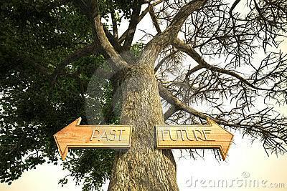
ENVIRONMENTAL​ CHANGE WITH TIME
THEN
NOW
Population and industry was less and nature had a lot of trees which provided enough oxygen for humans to breathe.
Due to very less atmospheric pollution, there were no acid rains.
Due to population explosion forests have yeilded place for construction which reduces the of oxygen and gave rise to diseases.
Due to increasing factories, more amount of chemical effluents are being released in the atmosphere causing acid rains.

Slide 4
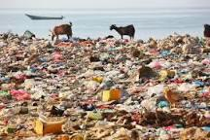
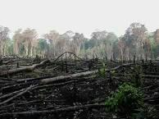
ENVIRONMENTAL DEGRADATION
Environmental degradation is the deformation of the environment through depletion of and resources such as air, water and soil ,the destruction of ecosystem.

Slide 5
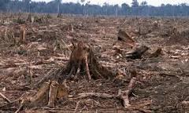
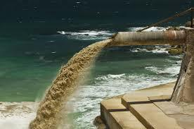
CAUSES OF ENVIRONMENTAL DEGRADATION
High quantity of exhaust gases.
Deforestation.
Chemical effluents released by factories.
Hydrocarbons released by vechiles.
Unprecedented construction Population explosion.

Slide 6
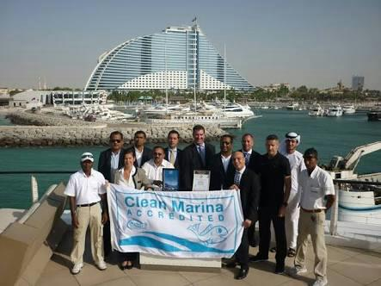
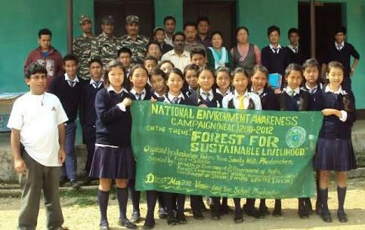
ENVIRONMENTAL CAMPAIGNS HELD
300 volunteers from YOUTH EXNORA INTERNATIONAL and HCL TECHNOLOGIES cleaned the Marina beach in Chennai on July 4.
The NATIONAL ENVIRONMENTAL AWARNESS CAMPAIGN has conducted many campaigns to create environmental AWARNESS among the general masses.
Telangana government officials have decided to conduct a campaign to save the Music river, which is the tributary of River Krishna.

Slide 7
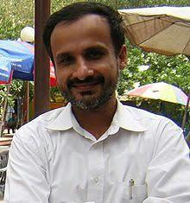
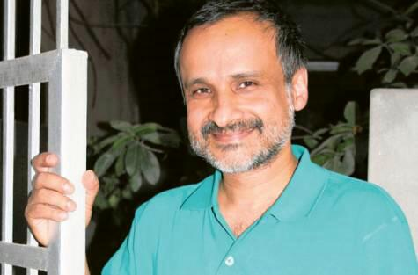
ENVIRONMENTALIST AND THEIR CONTRIBUTION
ANADISH PAL
Anadish Kumar Pal is an Indian inventor, poet and environmentalist.He has obtained nine UNITED STATES patents, a significant patent issued in 2009 for an electromagnetically controlled, fuel efficient internal combustion engine.

Slide 8
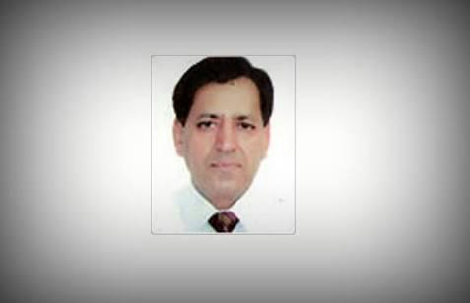
TILAK VIJ
Tilak VIJ is an Indian environmentalist who created six nature clubs and encouraged growing trees to increase the state’sgreen cover. He is also planning to set up a leopard conservation centre with the help of Himachal Pradesh state government.

Slide 9
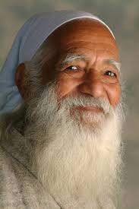
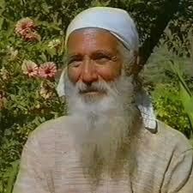
SUNDERLAL BAHUGUNA
Sunderlal BAHUGUNA who was the leader of the Chipko movement was a great Indian environmentalist. He also fought for the preservation of forests in the Himalayas. He was awarded THE PADMA VIBHUSHAN on 26 January 2009.

Slide 10
MY OPINION AND CONTRIBUTION TO PROTECT THE ENVIRONMENT
One can use the 3R’s ;reduce, reuse and recycle so that he/she can protect the environment.
Composting involves turning bio-degradable waste materials into compost to increase soil fertility and reduce the amount of waste in landfills
Transportation which releases harmful gases in the environment can be reduced by using transport conservation. Through this several people going in the same office can use carpool and also bicycle to near distances to reduce impact on environment.

