Slide 1
Places and perspective : Learning Circle 1 (Elementary School)
ppE1

Slide 2
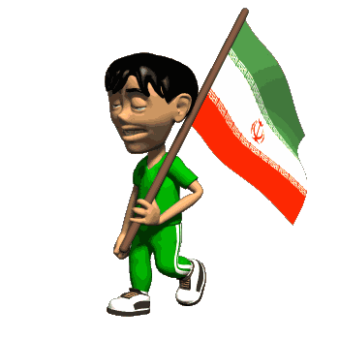
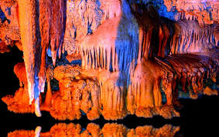
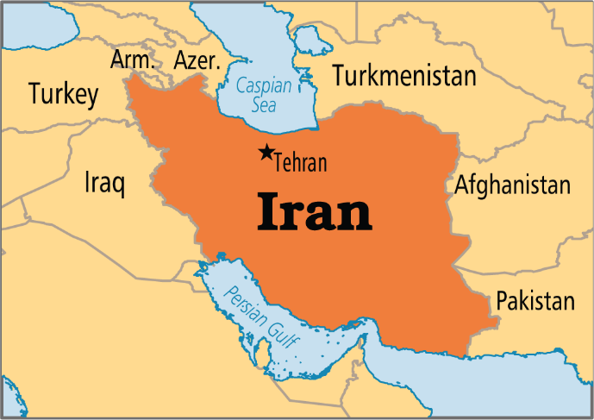
In The Name Of God
Hamedan Province and Ali-Sadr water cave
Mehr Aein Elementary School
Iran - Tehran
By:
Mohammad J. Mote Sharei
Armin Moayed Jafari
Parsa Livani

Slide 3
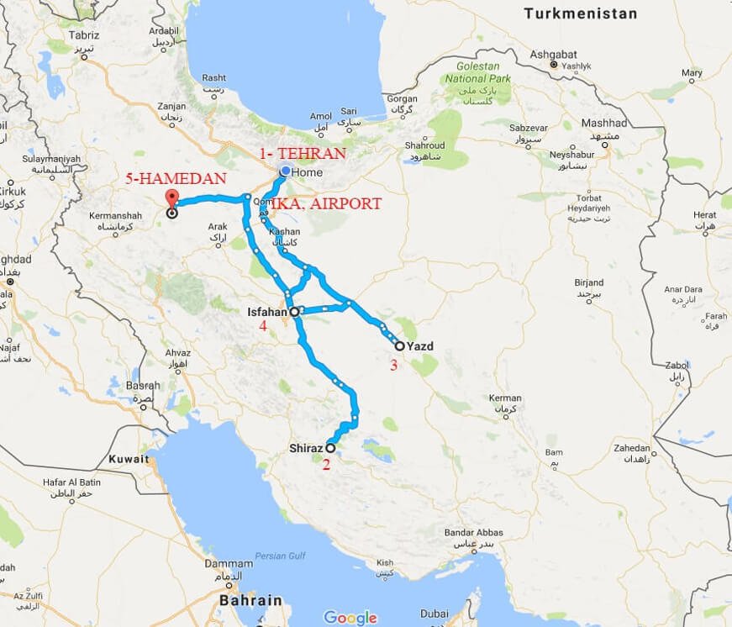
HAMEDAN
COUNTRY | IRAN
PROVINCE | HAMADAN
COUNTY | HAMADAN
BAKHSH | CENTRAL
Hamadan is believed to be among the oldest Iranian cities and one of the oldest in the world. It is possible that it was occupied by the Assyrians in 1100 BCE ; the Ancient Greek historian-Herodotus-states that it was the capital of the Medes-around 700 BCE. Hamadan has a green mountainous area in the foothills of the 3,574-meter Alvand Mountain

Slide 4
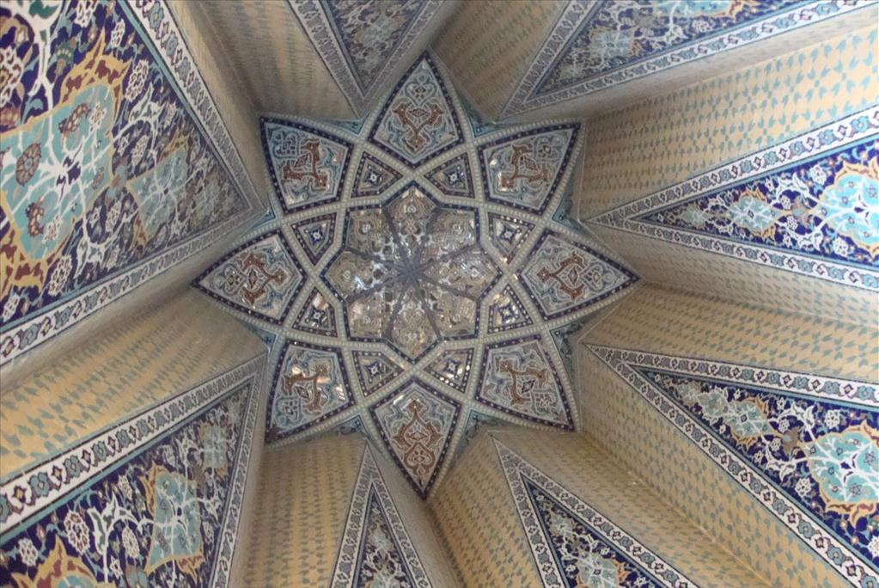
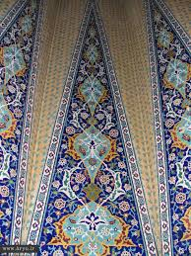
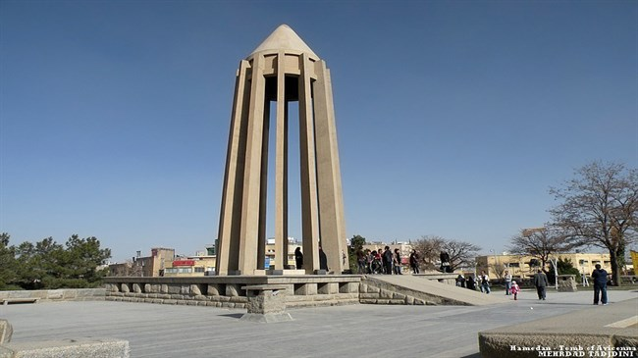
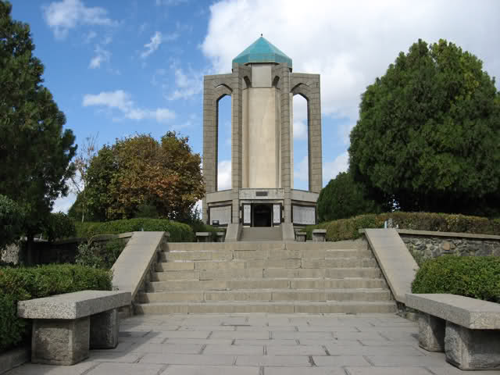
Hamedan is a home to lots of historical and cultural monuments that have roots in the 3,000-year-old civilization of the province.
Internal part of Avicenna Monument (ceiling & walls)
Avicenna Monument
Hamadan has been the land of great heroes and scientists; The world-famous Iranian scientist, philosopher, and physician Abu Ali Sina known to the West of Avicenna. His works as a poet and philosopher are still studied by many people from the all over the world.
Baba Taher Oryan Monument.

Slide 5
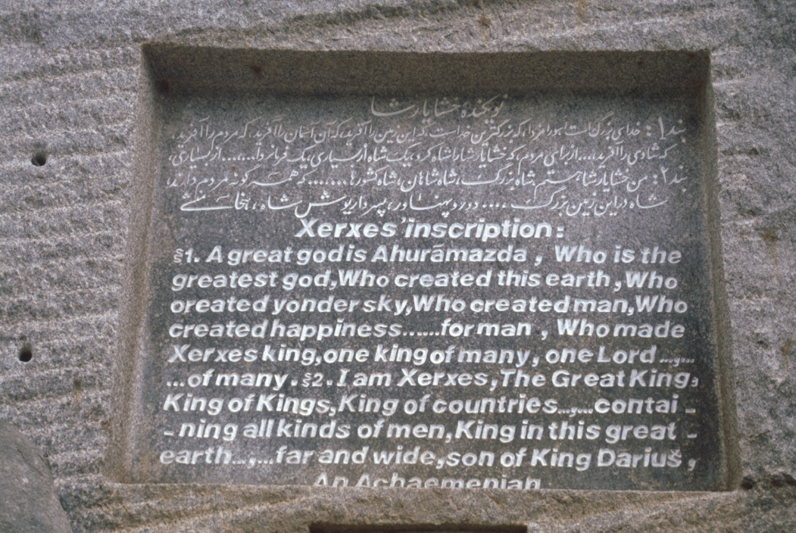
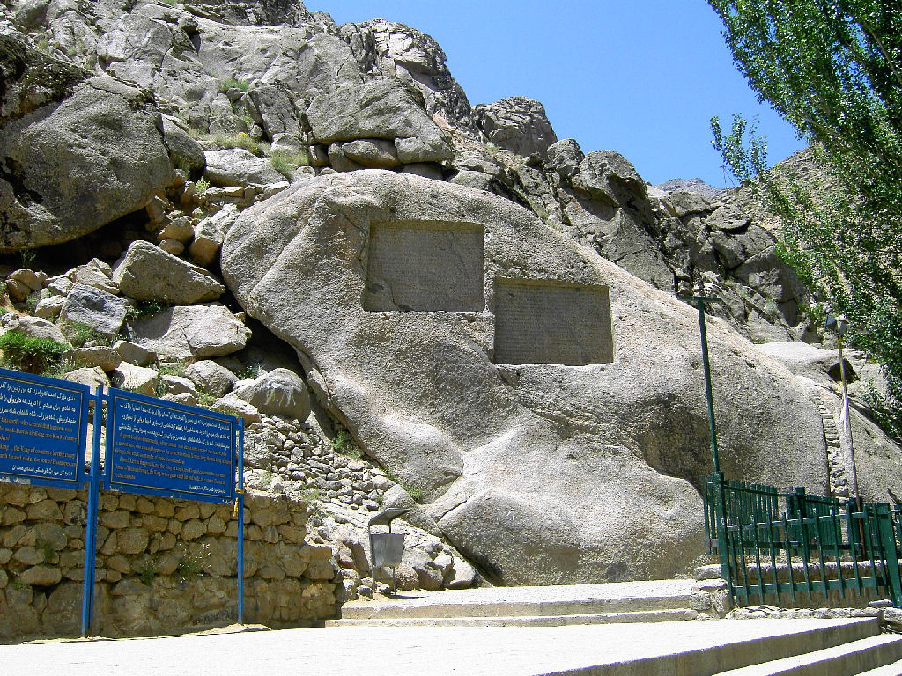
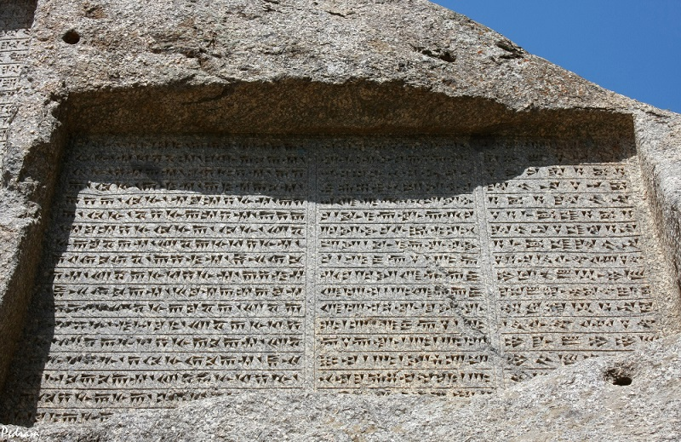
Ganj Nameh( the letter of treasure) is an ancient inscription, south-west of Hamedan, on the side of Alvand Mountain in Iran. The inscriptions were carved in two sections. The one on the left was ordered by Darius the Great (521-485 BC) and the one on the right by Xerxes the Great (485-65 BC).
Both sections were carved in three ancient languages: Old Persian, Neo-Babylonian and Neo- Elamite.
The inscriptions start with praise of the Zoroastrian God (Ahura Mazda). Later generations who could not read the alphabets of the ancient Persian thought that they have the guide to an uncovered treasure; so they called it Ganj nameh( the letter of a treasure.

Slide 6
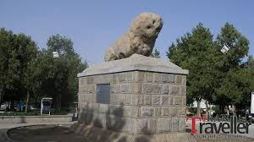
The Stone Lion of Hamadan is the city's most famous monument.

Slide 7
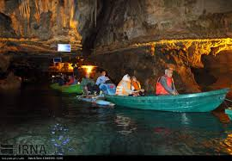
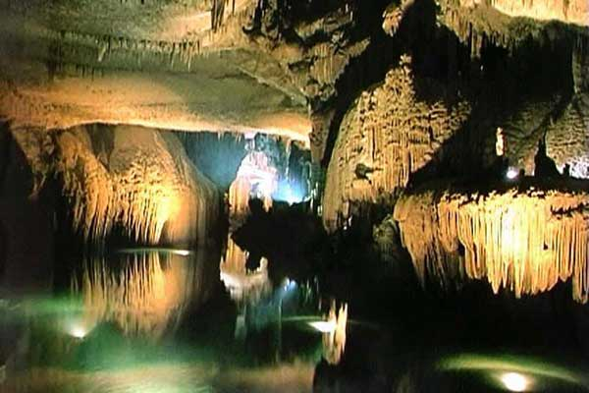
Ali-Sadr Cave
Ali-Sadr Cave is the world's largest and most important water cave which attracts thousands of visitors every year. The cave is 11200 Meters long. Its height is 2100 Meters. The cave is located in Sari Heights (Zagros Mountains) near Ali-Sadr Village, Kaboodar Ahang County, in the East-North of Hamedan.
The water in the cave is so clear and clean that ten-meter depth can easily be seen with normal light and naked eye. The depth of water ranges from Centimeters to 14 Meters.

Slide 8
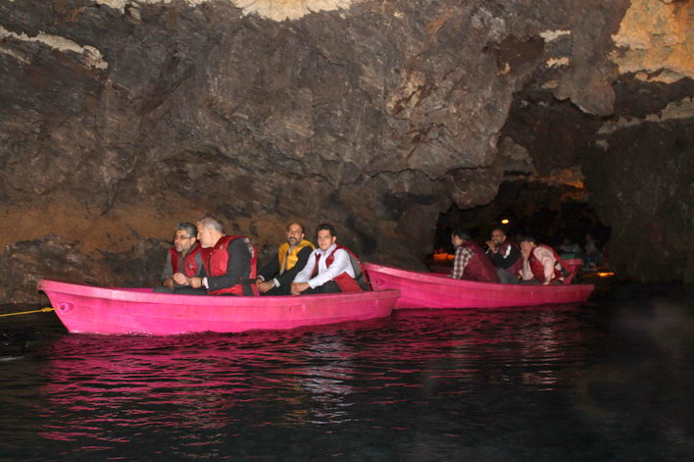
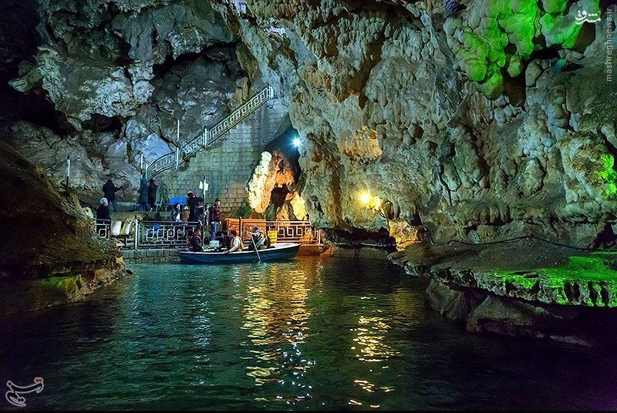
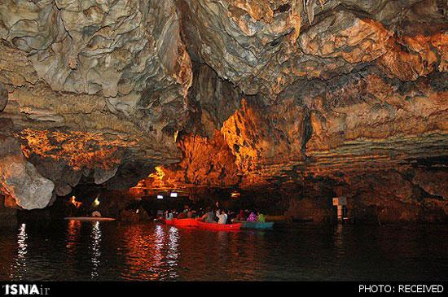
Visitors can go to different parts of the cave by boats.

Slide 9
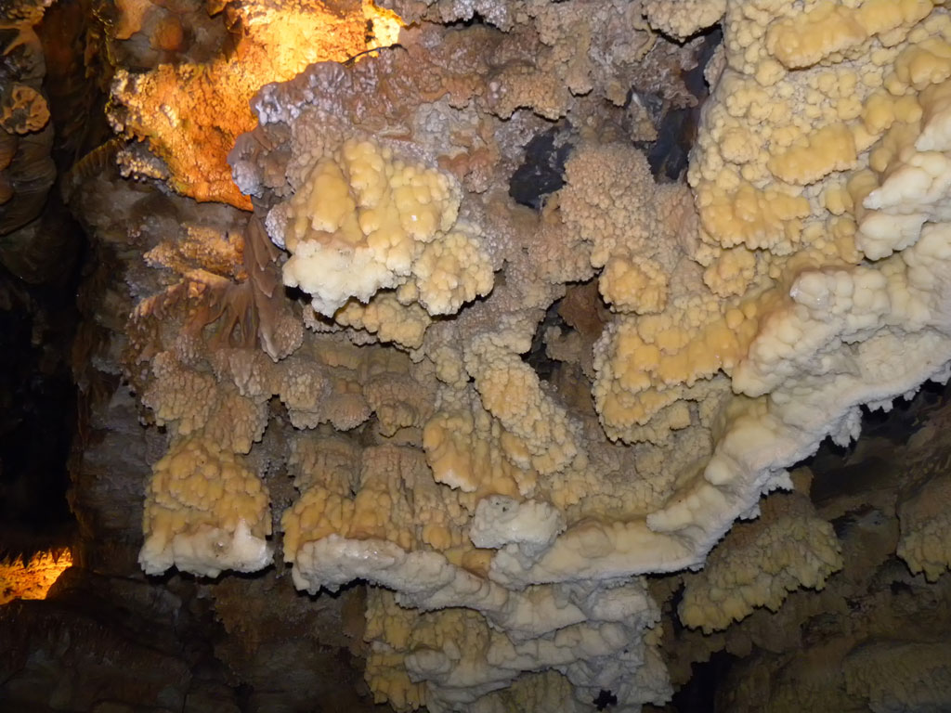
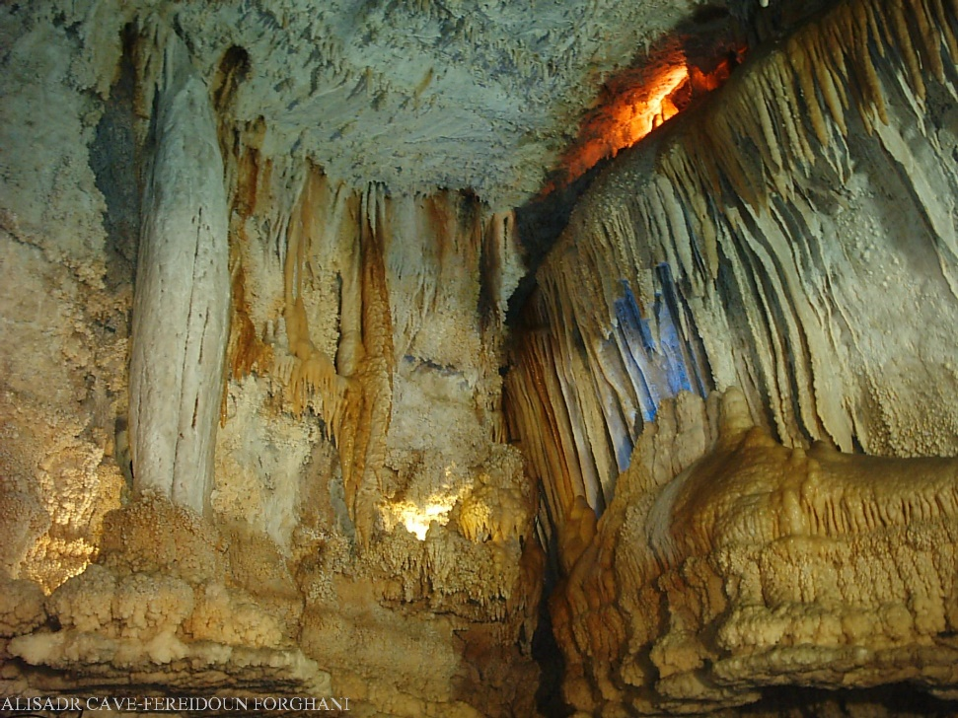
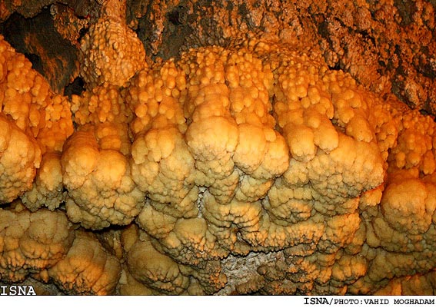
The walls and ceiling of the cave.

Slide 10
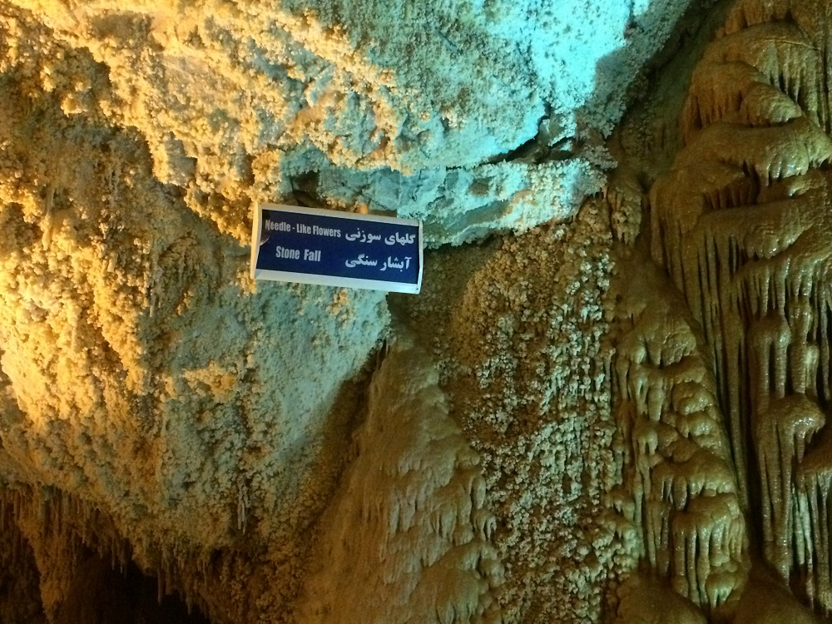
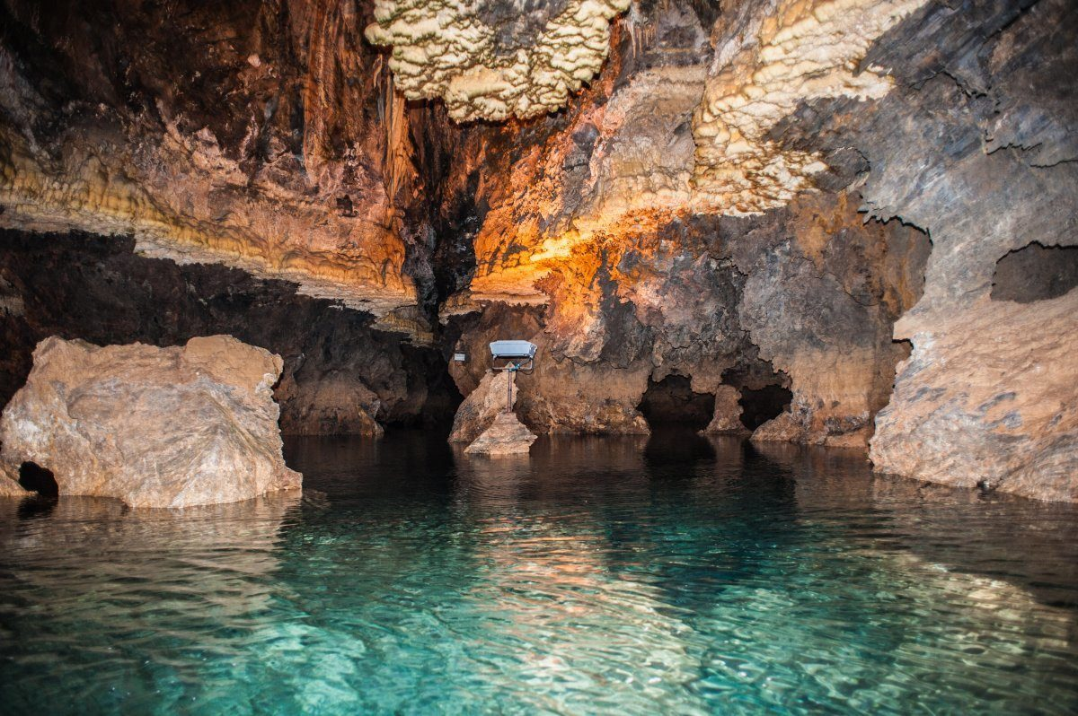
The colors, silence, and patterns are amazing.
Stone waterfall, Needle-like flowers

Slide 11
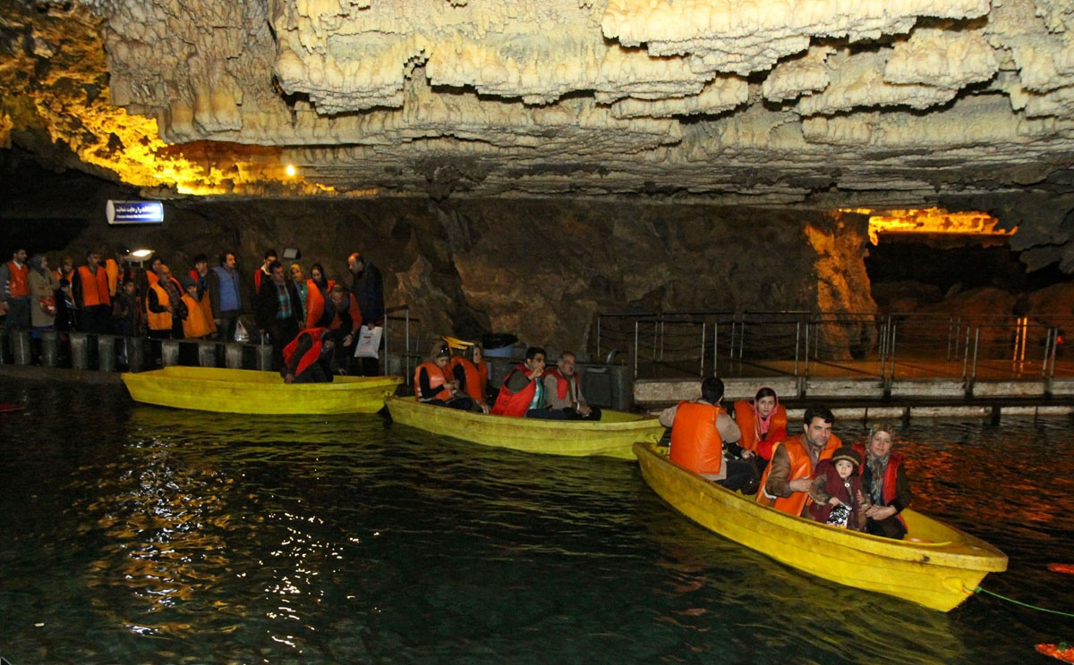
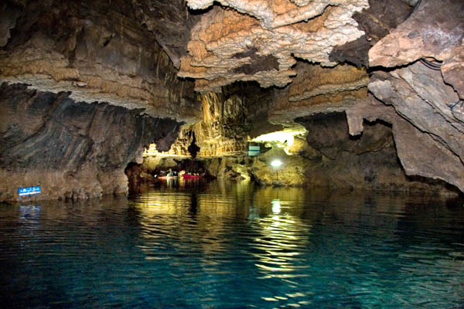
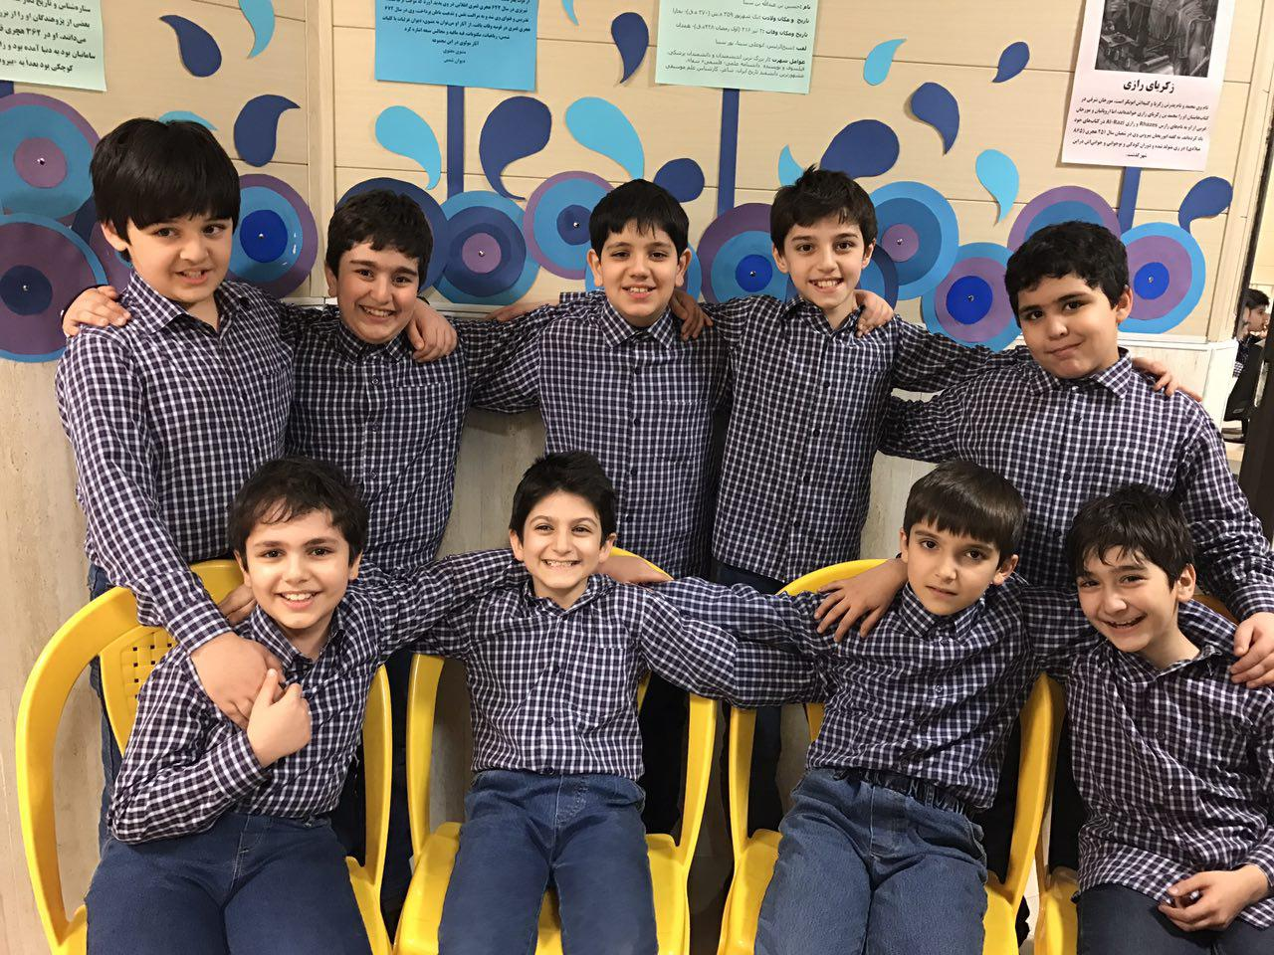
Thanks for your attention.

