Slide 1
Culture and Traditions
Learning Circle Group: My City and Me Sponsor School: LT “Gaudeamus”
Donduseni,
Moldova
April, 2017

Slide 2
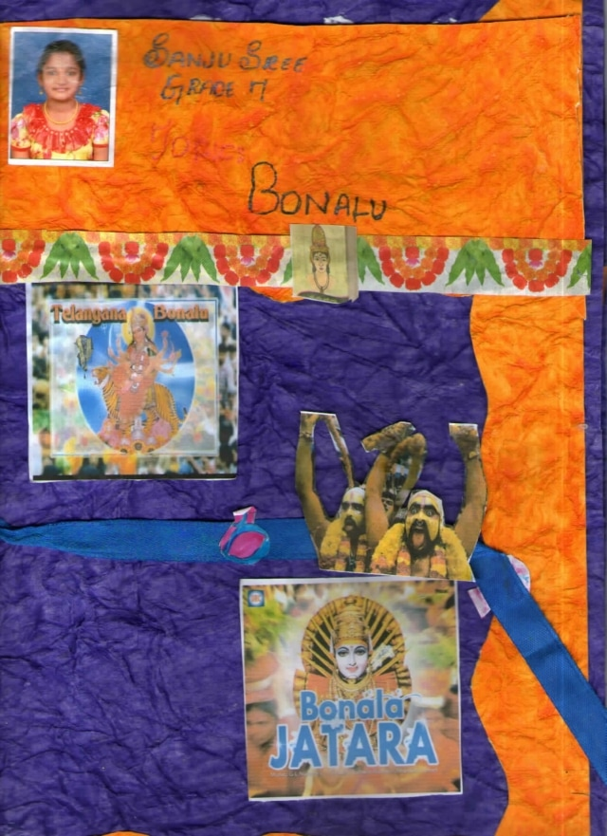
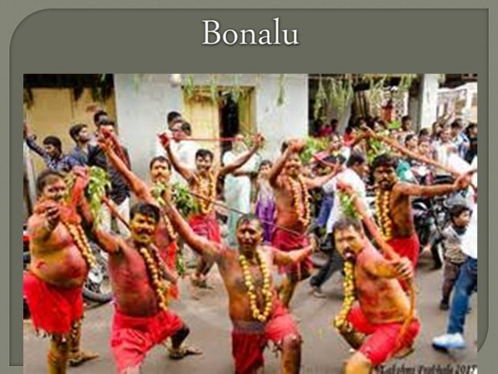
Culture of India
Bonalu
ST.PETER'S HIGH SCHOOL, TELANGANA, India
Bonalu is a Hindu Festival where Goddess Mahakali is worshiped. It is an annual festival celebrated in the twin Cities Hyderabad and Secunderabad and other parts of Telangana state, India.

Slide 3
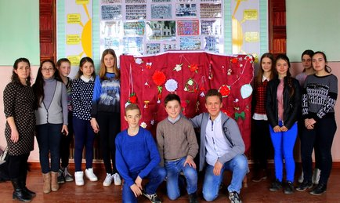
Martisor
TL “Gaudeamus”,Donduseni
We celebrate the 1st of March like the Springtime and we offer small things made from red and white colours. These small things we wear all the March monthon our coat and then we hang them on a tree that symbolizes the prosperity and wealth for the entire year.

Slide 4
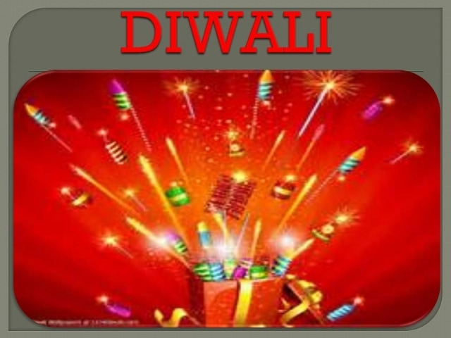
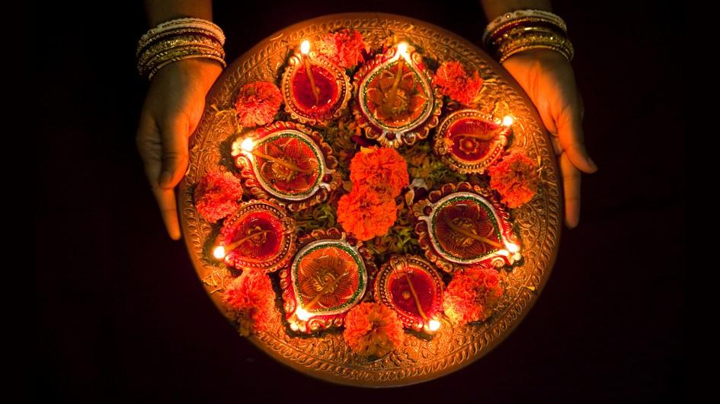
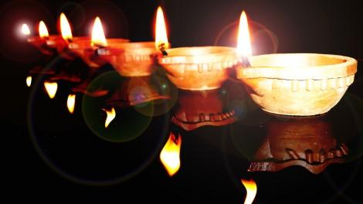
Festivals of Telengana
ST.PETER'S HIGH SCHOOL, TELANGANA, India
Diwali, or Dipawali, is India's biggest and most important holiday of the year. The festival gets its name from the row (avali) of clay lamps (deepa) that Indians light outside their homes to symbolize the inner light that protects us from spiritual darkness. This festival is as important to Hindus as the Christmas holiday is to Christians. It is Indian New Year.

Slide 5
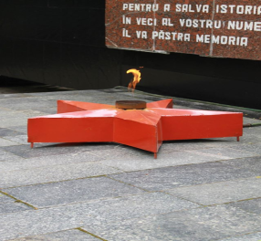
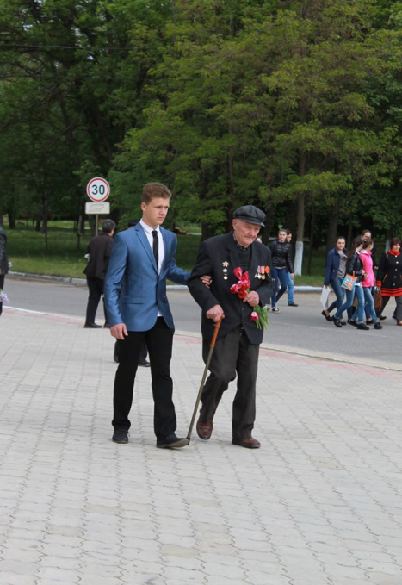
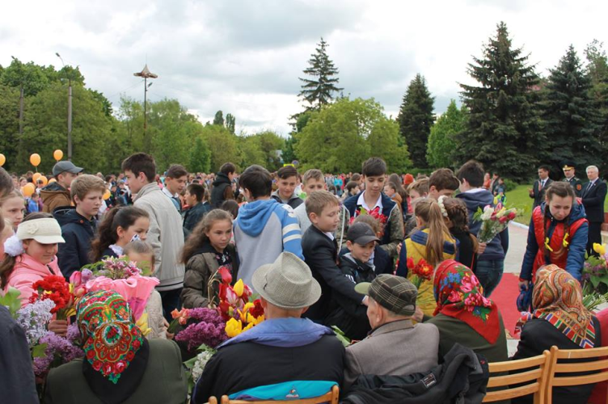
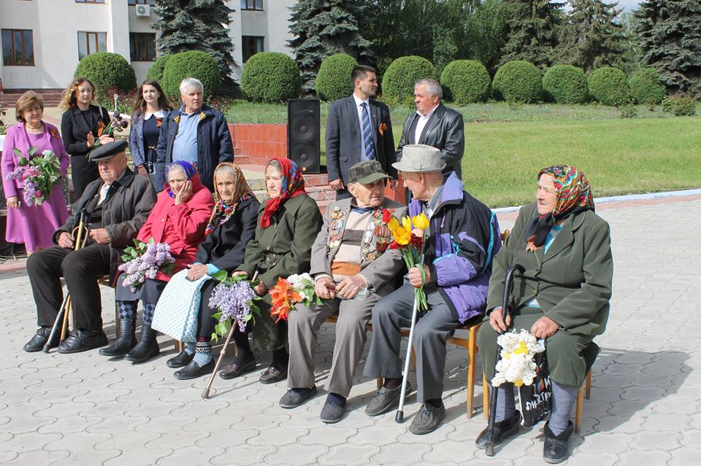
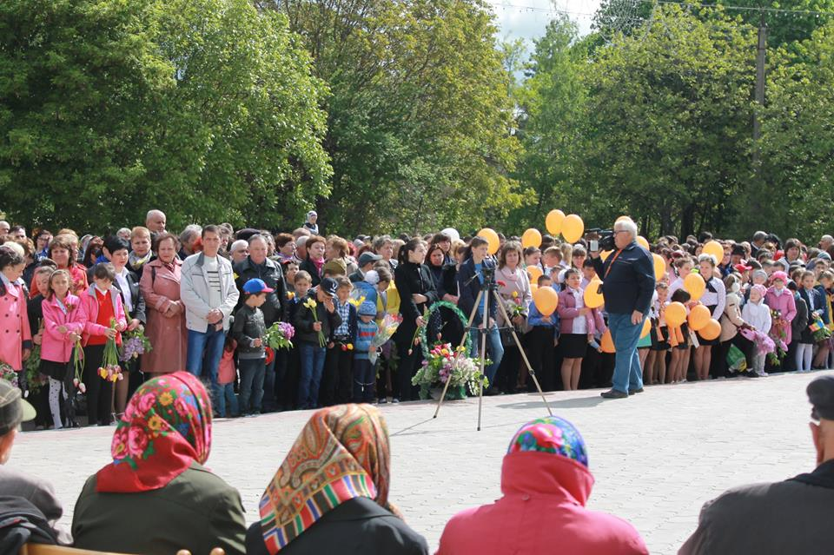
The 9th of May Commemorative Day
TL “Gaudeamus” Donduseni
This is the day when we commemorate people who died in the Second World War fighting for the peace of our country. We go with the remained veterans and put flowers at the monuments consecrated for this event. We say thanks to those veterans who are still alive.

Slide 6
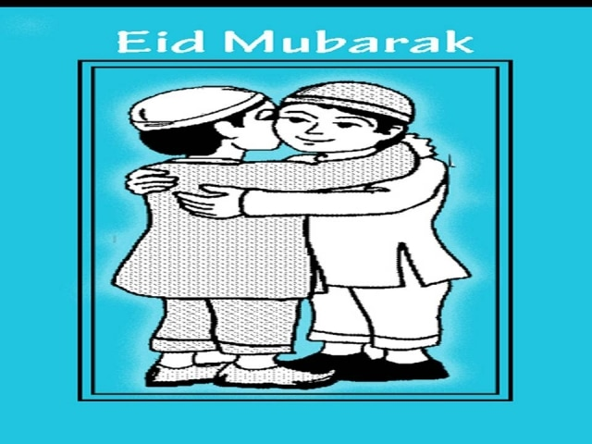
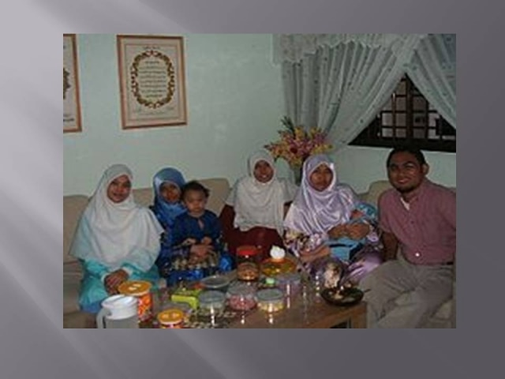
EID-UL-FITR
ST.PETER'S HIGH SCHOOL, TELANGANA,INDIA

Slide 7
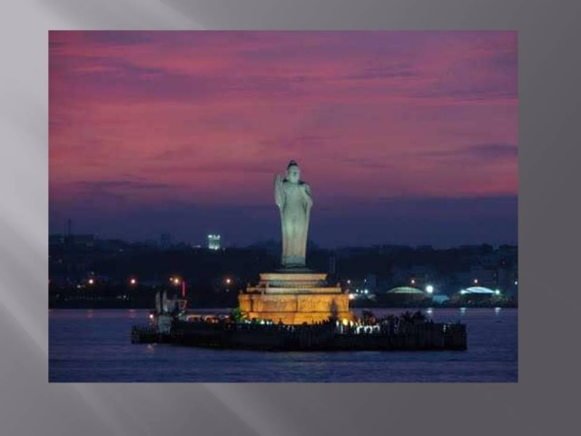
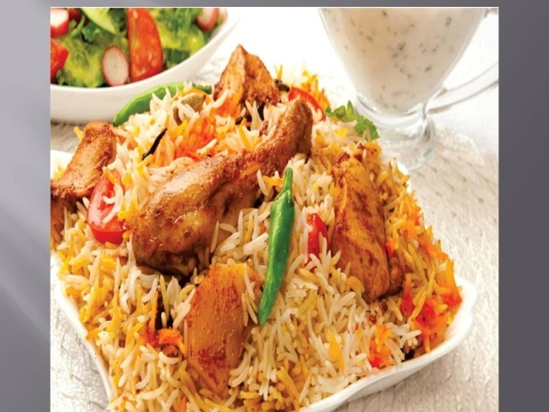
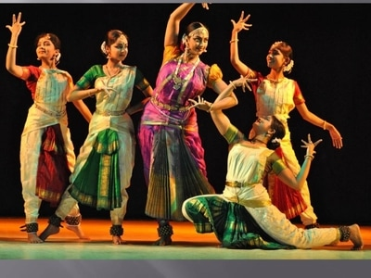
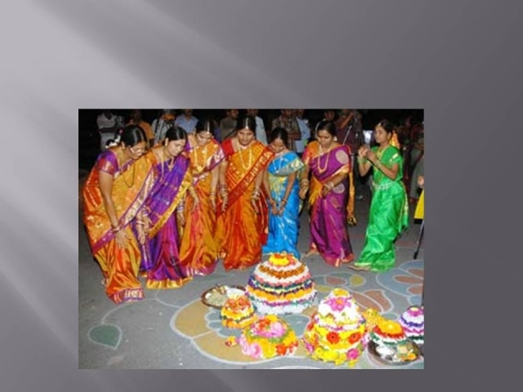
Hyderabad
Since inception of Hyderabad, the nobles have a tradition of courtesans dance and poetry, which had led to a unique style of dance form in court dance in Hyderabad, the Taramati of the early 16th century and Mah Laqa Bai 18th century are some of the early courtesans who popularised Kathak dance and poetry culture in the early history of Hyderabad. Some of the dance festivals organised by the AP Government are; Golconda Music and Dance Festival, The Taramati Music Festival, The Premavathi Dance Festival.

Slide 8
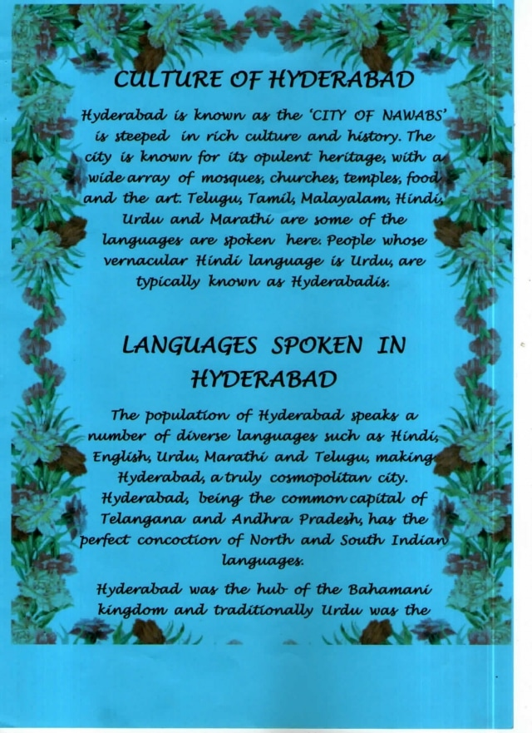
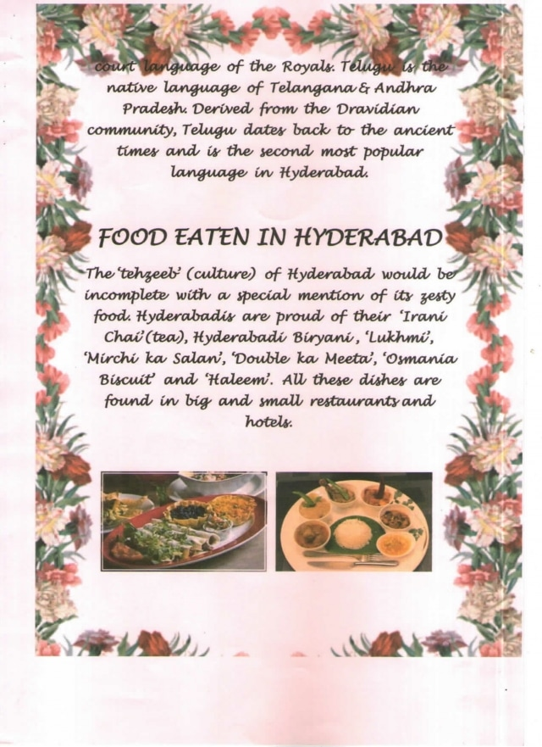

Slide 9
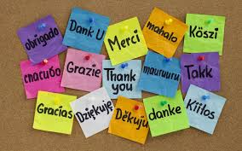
Thank you !!!
to all the teachers and students who shared information and knowledge about their country, culture and traditions. Thank you to the people who organized this project.
We were glad to be a part of it.

