Slide 1
Rivers Around The World
Joined project of the students from
Samara, Russia
Teaneck, New Jersey, USA
Indonesia

Slide 2
The Volga River
The longest river in the European part of Russia

Slide 3
Have you got an embankment along the river in your city?
We live in the city of Samara. It stands on the Volga river.
The Volga is the longest river in Europe. No wonder, there is a beautiful embankment in our city. It is 4.2 kilometers long.
In 1935, it was decided to clean the coastal zone from the buildings completely and to begin strengthening the shore. They began to work on expanding the embankment, creating beaches and landscaping. The embankment looks attractive both for tourists and city citizens. You can see lots of green trees, bright flowers and a monument to Grigory Zassekin, the founder of Samara. The embankment is constantly changing. Our citizens want it to be more comfortable and favourable for everybody.

Slide 4
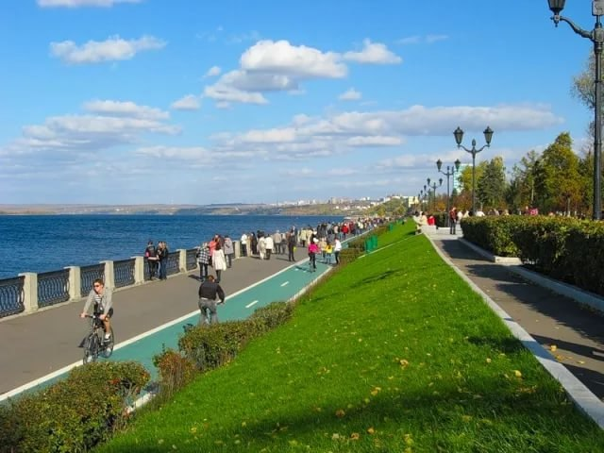
Our embankment

Slide 5
Are there any legends or folk tales connected with your river? Volga and Vauza
Once upon a time there lived two sisters – Volga and Vauza. One day they argued which of them was smarter and more beautiful. To settle their argument they agreed to go to Khvalynskoe Tsarstvo. The one who got there sooner was the winner. The younger sister, Vauza, decided to cheat. While Volga was sleeping, Vauza left the house and moved to the destination. Unfortunately, she got lost on the way and Volga easily caught up with her in the morning. Vauza felt sorry and begged Volga to forgive her. Volga did so and they moved to Khvalynskoe Tsarstvo together. The sisters turned into rivers and since that time they have been flowing down together in parallel ways and meet again in the Caspian Sea.

Slide 6
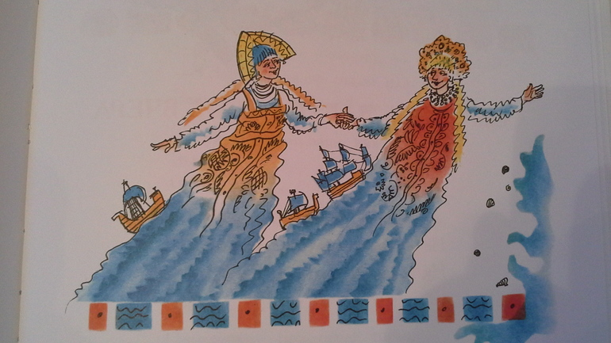
Volga and Vauza

Slide 7
What role does the river play in the life of the people, in the life of your city, in the life of your country?
1. The river plays an important role in people`s life, it is transport water way from the higher to the lower regions and it’s a way of travelling from one place to another. 2. In our city the river plays an important role too, that is having a rest on the shore, fishing, ferry crossing and many others. 3. In Russia rivers have always played an important role in the settlement, development, history, and tourism around the country.

Slide 8
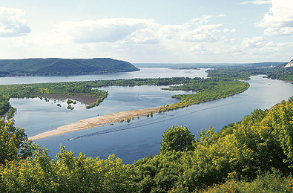
The Volga landscape

Slide 9
What’s the average temperature of the water in your river in different seasons (months)? Does the water in your river freeze in winter?
The Volga changes naturally in connection with changes in the ambient temperature. There's nothing wrong with that in winter, at low temperatures it turns to ice. In spring the snow is melting, which consequently leads to the spring tide, which occurs at the end of the first-beginning of second decade of April, and reaches its maximum by May. On the Volga there are also autumn rain floods appearing in the middle of October. The ice cover is set in late November, early December.

Slide 10
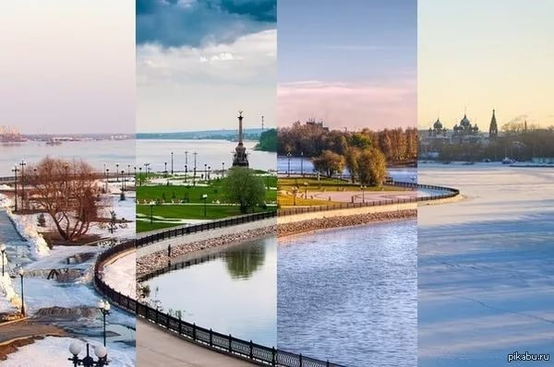

Slide 11
What does your river connect to?
The Volga River connects to many rivers and channels. The Moscow channel, the Volga–Don channel, and the Volga–Baltic Waterway form navigable waterways connecting the Moskva river to the White Sea, the Baltic Sea, the Caspian Sea, the Sea of Azov and the Black Sea. The Volga flows into the Caspian Sea (lake).

Slide 12
Do people go fishing in your place? What sorts of fish live in your river? How do you cook the fish? Is there any regional recipe how to cook fish from your river?
1.The Volga is the biggest river in Europe and one of the longest rivers in the world. 2. Every our citizen likes fishing from his childhood and most of them are good fishermen. 3. In the river Volga there are a lot different sorts of fish, like: Catfish, crucian carp, vobla, bream, pike, perch, carp and others. 4. Every family in Samara has their own recipie how to cook fish, but the most popular dish everywhere is fish soup, called "Ukha". It's an old Russian soup from different sorts of fish. It's very tasty!

Slide 13
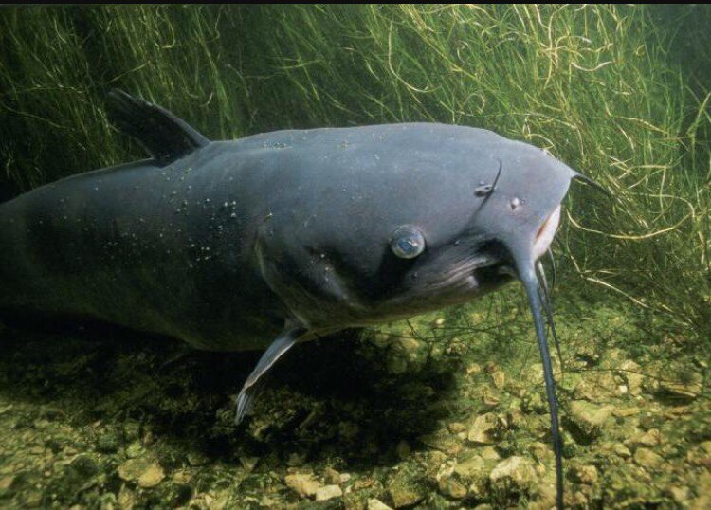

Slide 14
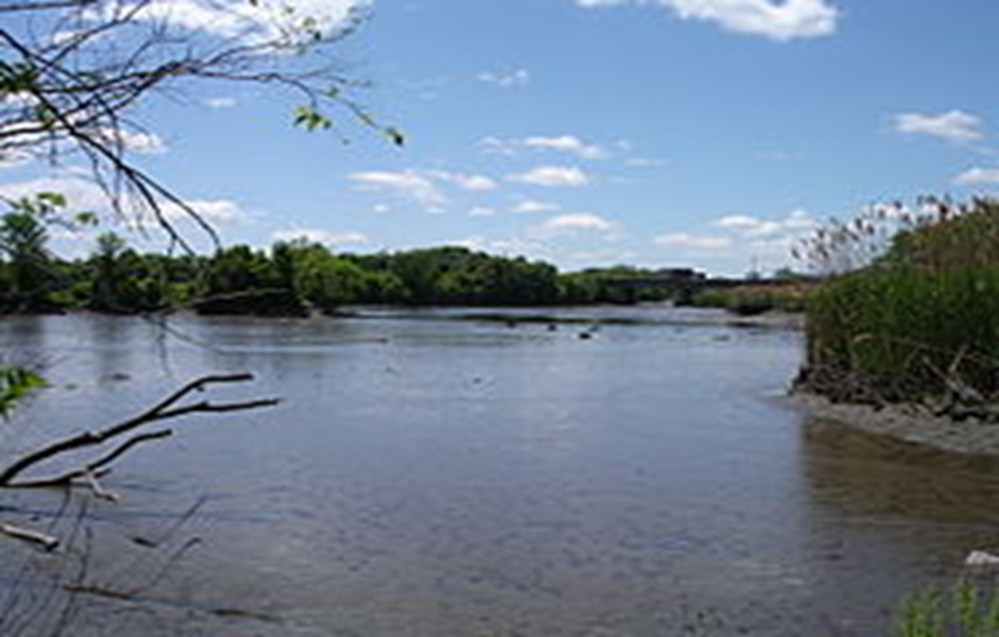
The Hackensack River
the USA

Slide 15
Origins and Folk Tales
The origin of the name is from the Lenape word Achinigeu-hach, or Ackingsah-sack, meaning flat confluence of streams.
There is no folklore surrounding the hackensack river, or any that are widely spread about the river.

Slide 16
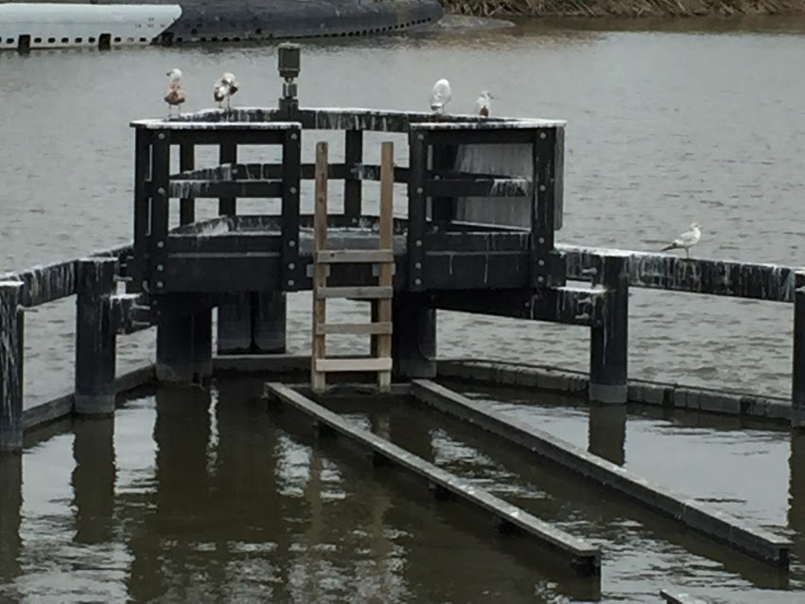
Roles of The River
A swing bridge allows boats to travel through with its swinging bridge, and the bridge can also let people walk over it.
In the past it was used for transportation and shipping. Also in 1776, a colonial army, led by George Washington, hid there and had protection on the riverbanks from the British.

Slide 17
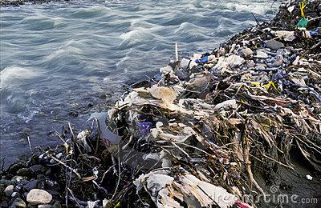
Pollution, Bridges, and Beaches
The river is very heavily polluted, the pollution started about 200 years ago, and it is not safe to swim in or consume fish from the river. Most of the pollution is industrial pollutants and sewage.
The river has many bridges and crossing, but the main one is the Portal Bridge, which has been around since 1910
There are no beaches on the Hackensack River.

Slide 18
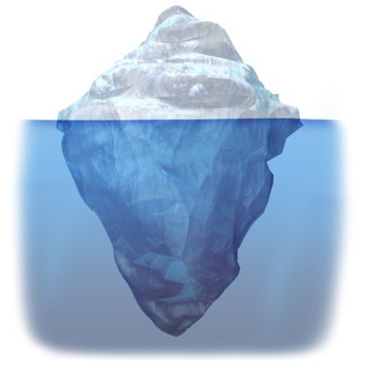
Water Temperature,Freezing, and Embankments
We cannot find the temperature of the river.
The river has frozen over frequently in the past.
The Hackensack River has multiple embankments, but there are none in Teaneck.

Slide 19
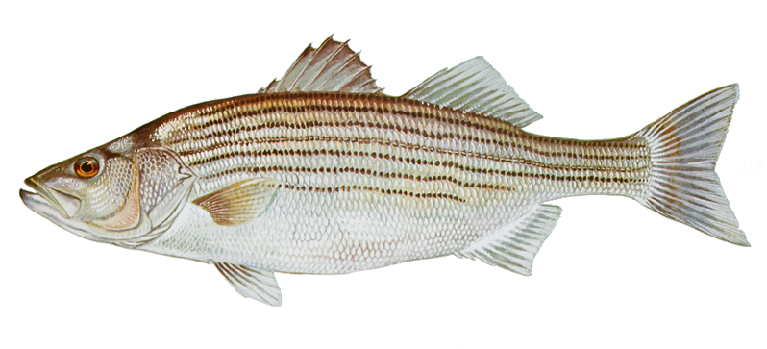
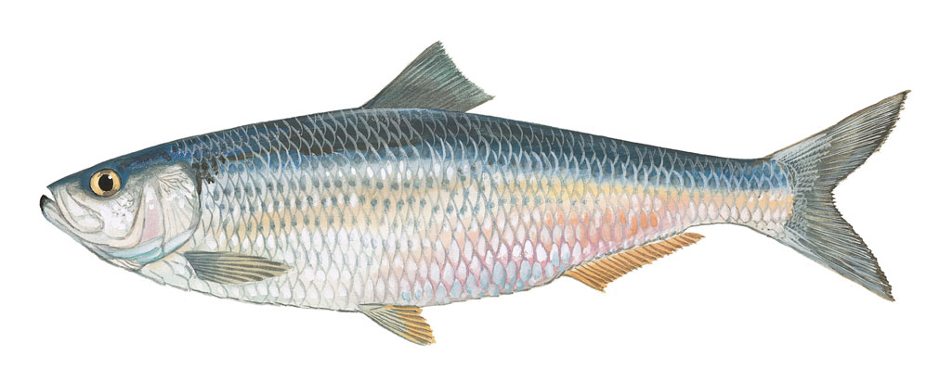
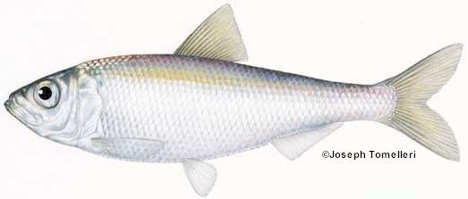
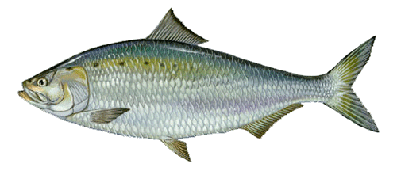
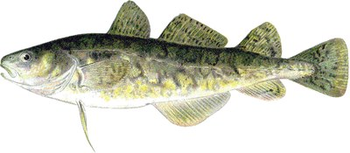
Fishing, Fish Types, Cooking The Fish?
Fishing is a common thing to do in the Hackensack River, but it's usually catch and release. Due to the pollution, the fish may be inedible. They can carry mercury and PCBs.
Some fish found in the Hackensack river include: Anadromous fish, alewife, blueback herring, American shad, Atlantic tomcod, and striped bass, etc.
There are no recipes for preparing or cooking the fish, due to the fact that most of the fish are poisonous (from pollution).

Slide 20
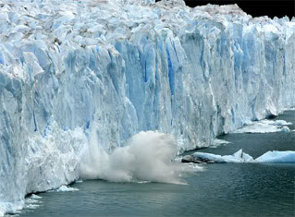
What is the origin of the name of your river?
The process that eventually formed the river began some 15,000 years ago when a finger of the Wisconsin Glacier retreated, scouring and compressing bedrock to form what paleontologists have named Glacial Lake Hackensack.

Slide 21
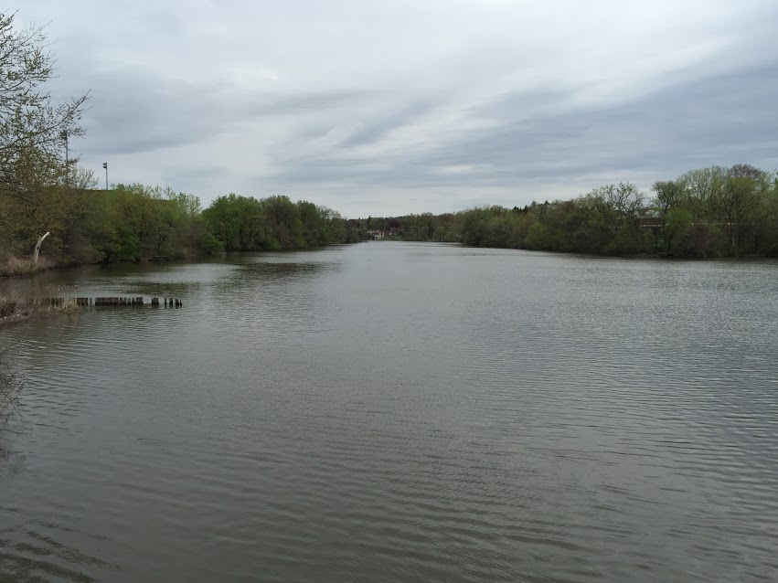
What role does the river play in the life of the people, in the life of your city, in the life of your country?
In our daily life, we do not use the river. Some people like to go kayaking on the river. Some fish for fun. Most people who go fishing throw the fish back and do not eat it. We do not use it as a source of drinking water, or fun time at the beach. We do use it for transporting freight.

Slide 22
Do people go fishing in your place? What sorts of fish live in your river? How do you cook the fish? Is there any regional recipe how to cook fish from your river?
People do fish in our river, but only for recreational purposes, because it is vastly polluted. Manufacturers used to pour things into our river. We do indeed have fish it just isn’t recommended to eat. (seagulls eat the fish)

Slide 23
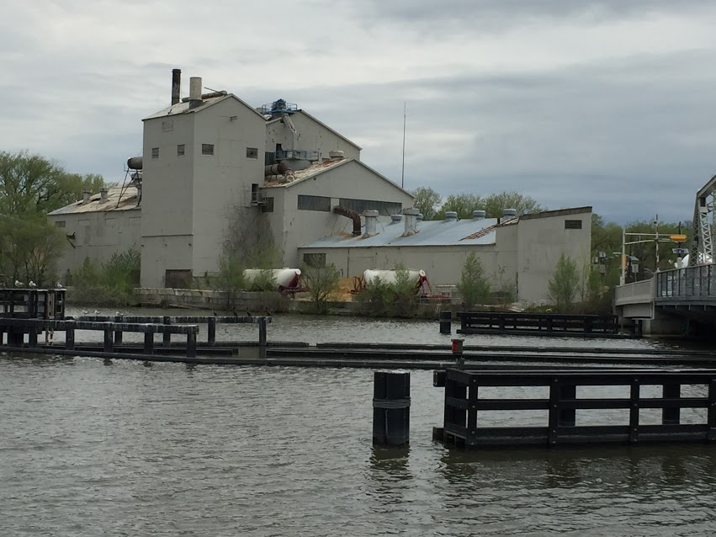
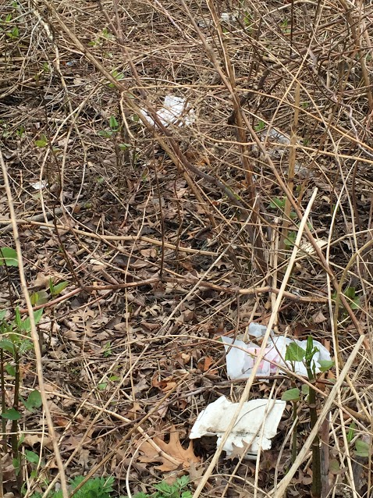
Do you think that your river is polluted?
Yes the river is polluted. There is some trash and chemicals that can be found in the river.

Slide 24
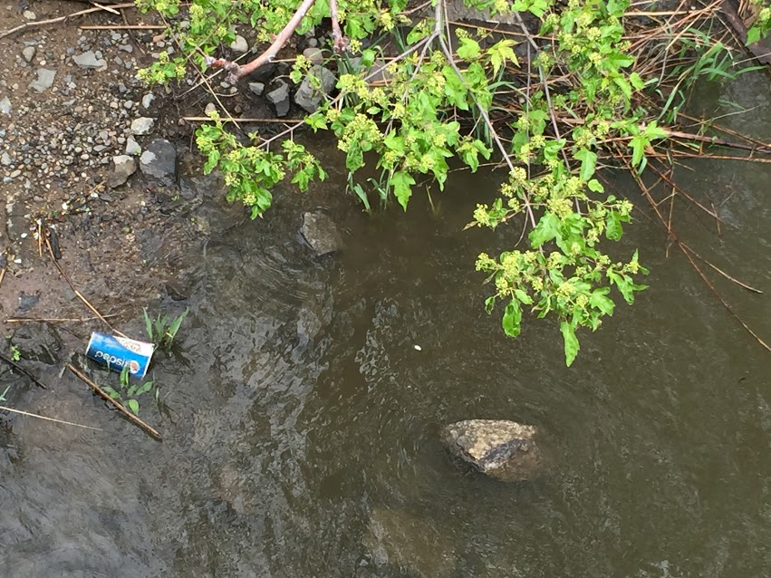
Have you got an embankment along the river in your city?
We have an embankment. There is a path where people can walk along the river, but people don’t use it on a daily basis. People also fish along the embankment.

Slide 25
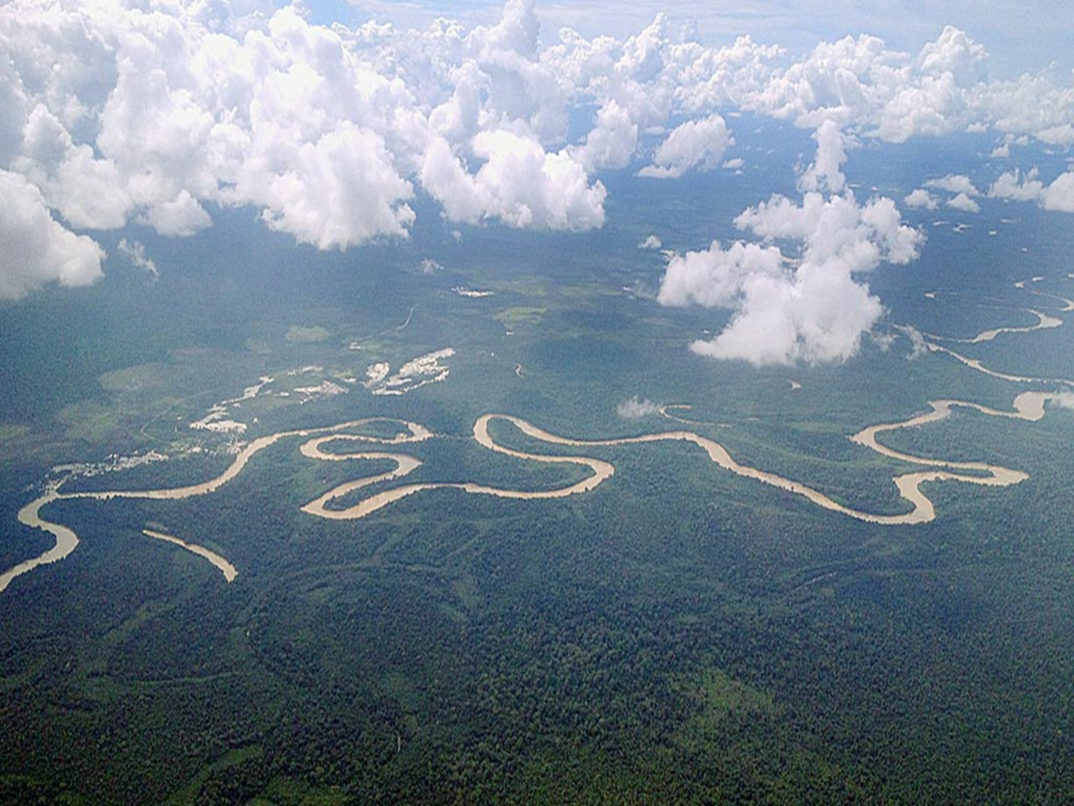
Rivers in Indonesia

Slide 26
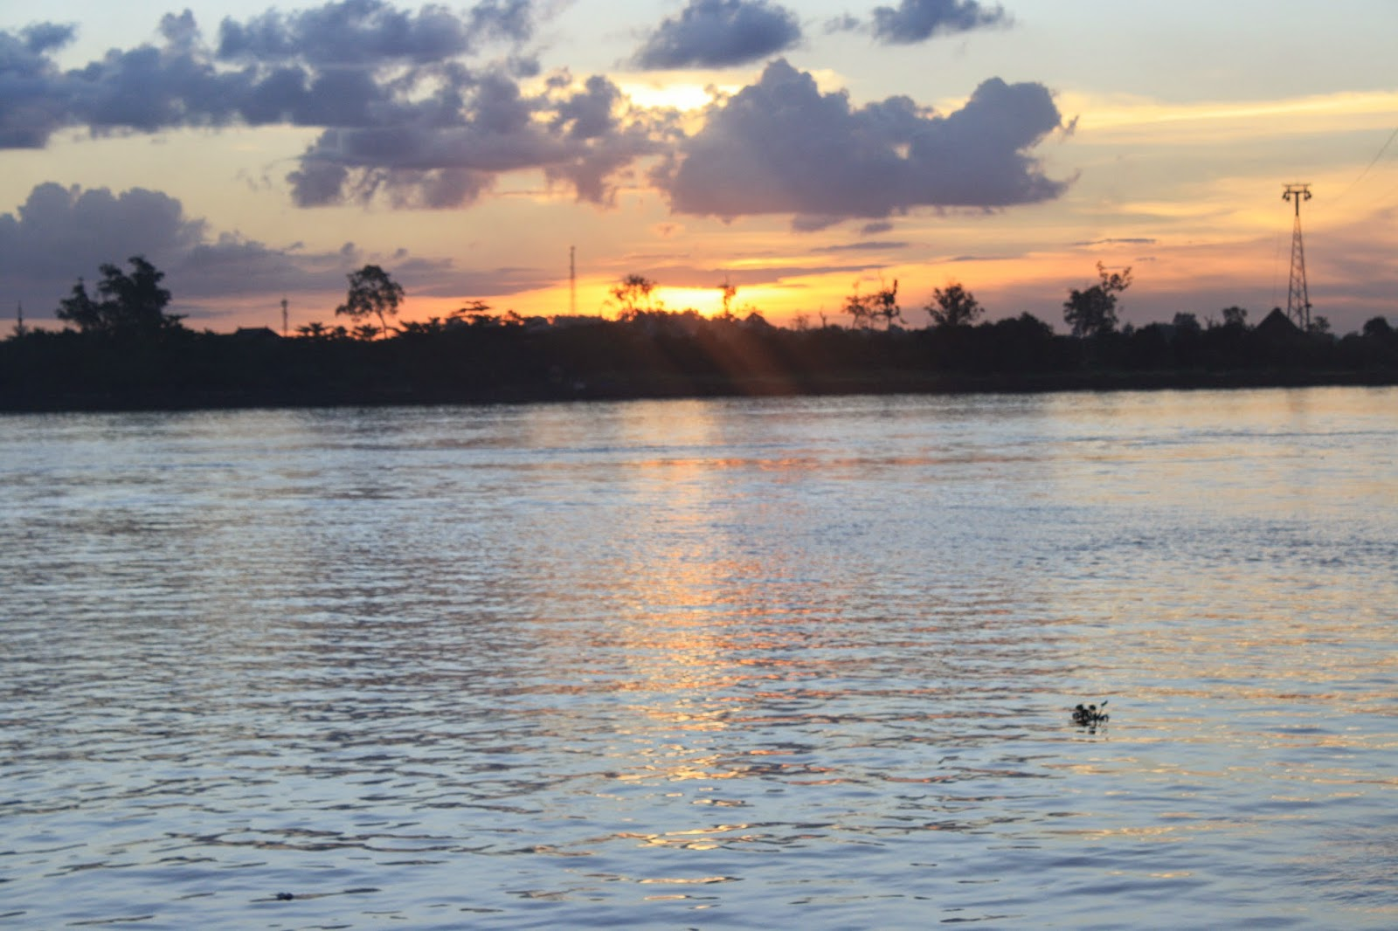
In Indonesia,it is said that there are more than 500 rivers,but there are only 333 rivers which is known,and the remain is still unknown
The rivers are spread on every main island on Indonesia,which is sumatera,java,sulawesi,kalimantan,and papua
And These are the 10 longest river in indonesia

Slide 27
The Longest River in Indonesia
Kapuas river
It is 1.143 km in length
it is located on kalimantan island
it is the longest river on indonesia and kalimantan
Mahakam river
it is 920 km in length
it is located on kalimantan island
it is the second longest river in indonesia and kalimantan

Slide 28
The Longest River in Indonesia
Barito river
It is 909 km in length
it is located on kalimantan island
it is the third longest river on indonesia and kalimantan
Batanghari river
it is 800 km in length
it is located on sumatera island
it is the longest river In sumatera and the fourth longest in

Slide 29
The Longest River in Indonesia
Musi river
It is 750 km in length
it is located on Sumatera island
it is the second longest river on sumatera and the fifth longest river in Indonesia
Mamberamo river
it is 670km in length
it is located on Papua island
it is the sixth longest river in indonesia

Slide 30
The Longest River in Indonesia
Bengawan Solo river
It is 548 km in length
it is located on jawa island
it is the longest river on jawa and seventh longest in indonesia
Digul river
it is 525 km in length
it is located on Papua island
it is the eighth longest river in indonesia

Slide 31
The Longest River in Indonesia
Indragiri river
It is 500 km in length
it is located on sumatera island
it is the ninth longest river on indonesia
Seruyan river
it is 350 km in length
it is located on kalimantan island
it is the tenth longest river in indonesia

Slide 32
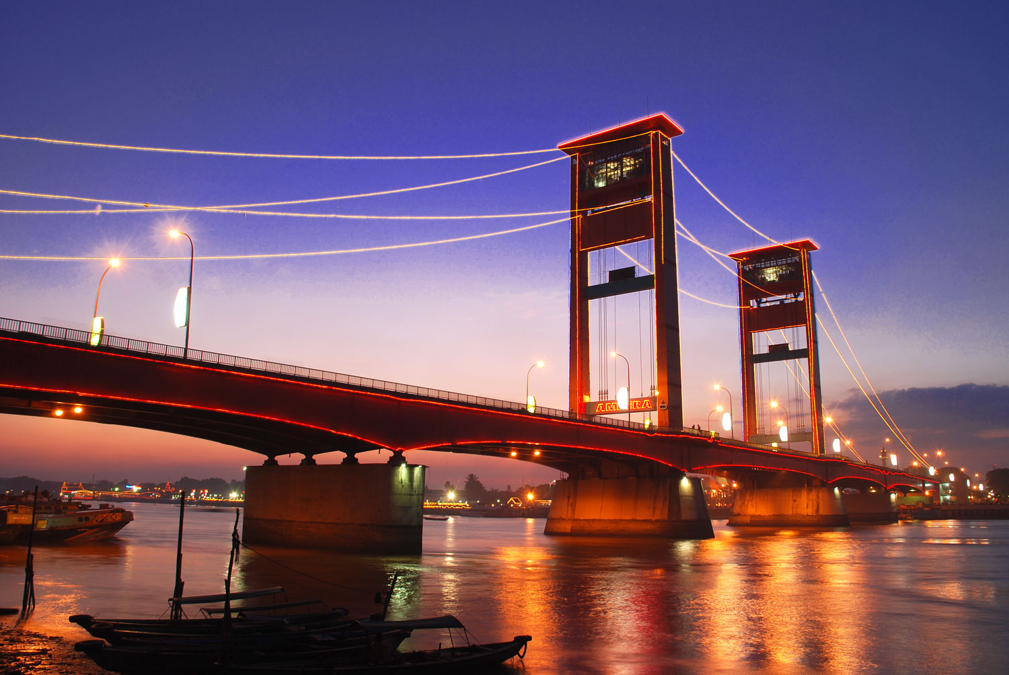
Kind of fish in Musi river

Slide 33
Musi river is 750km in length,and it is known that it has more-or-less 215 species of fish in it
The usual inhabitant are catfish,snapper, Baung, sneakhead,puffer fish,groper fish.
There are also fish which have traditional name like Beringit, Jelawat, Lais, Tapah, Tilan, Selincah, Seberau, Betok, Betutu
All of the fish live freely in the river,except fish which is cultivated by the villagers.but the villagers make the fishpond in the river itself

Slide 34
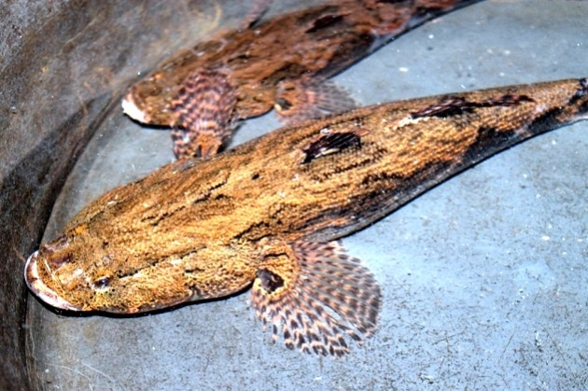
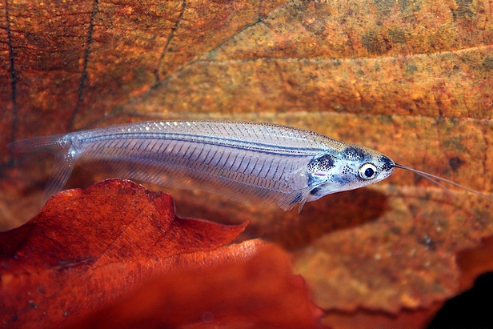
Some pictures of the fish
betutu fish
Lais fish

Slide 35
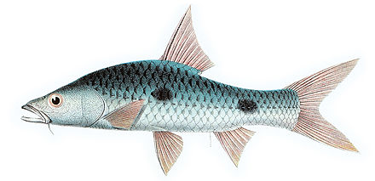
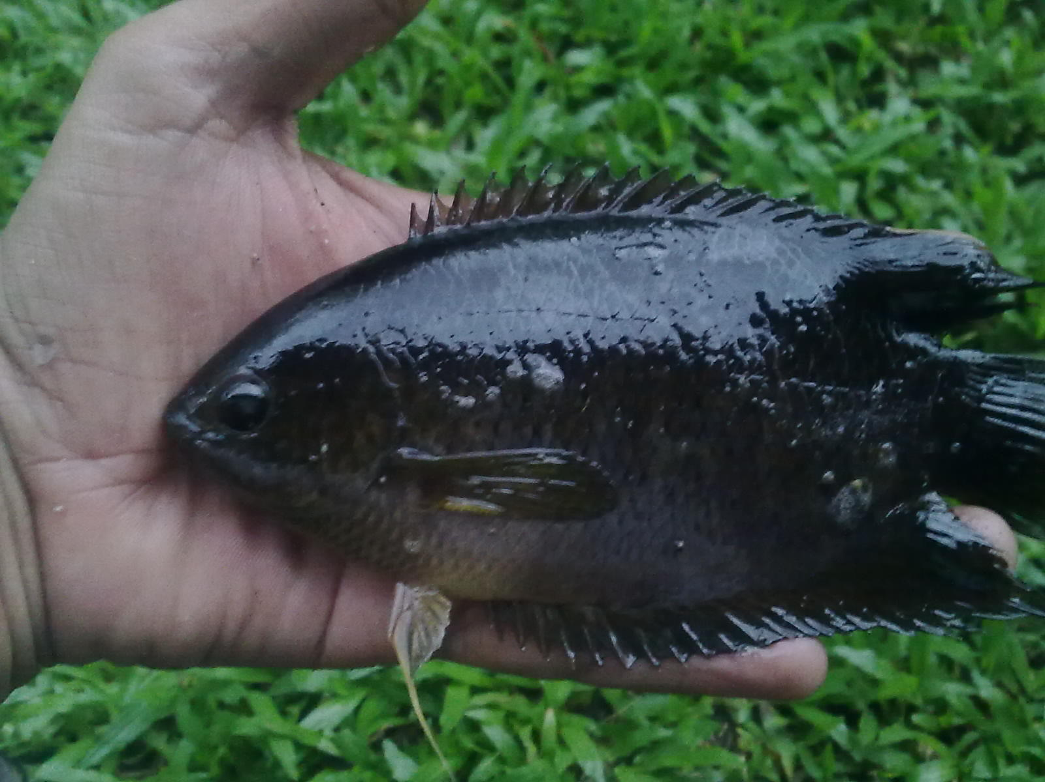
Some pictures of the fish
Seberau Fish
Selincah fish

Slide 36
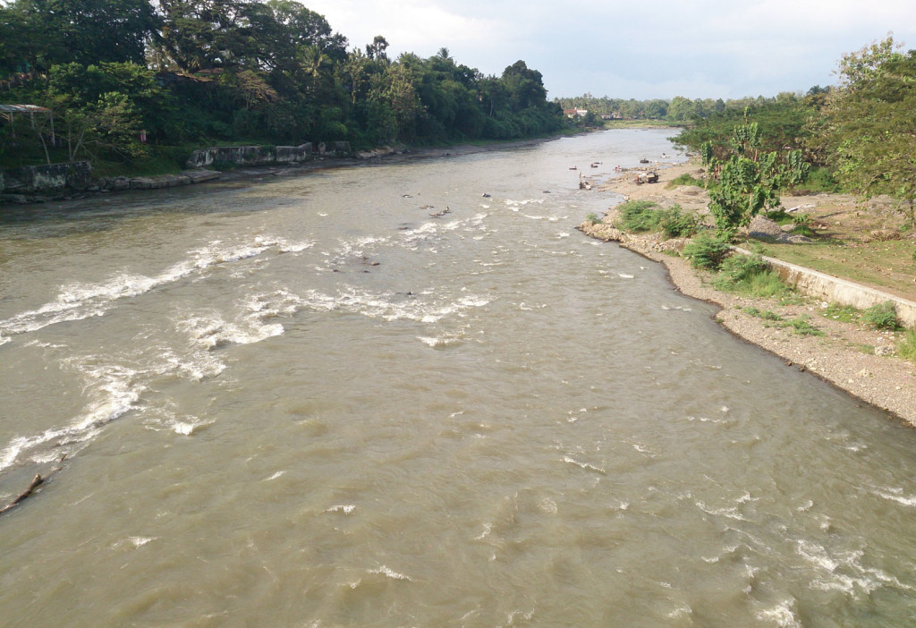
Activities that the villagers do in Lematang river

Slide 37
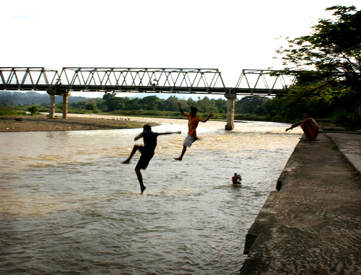
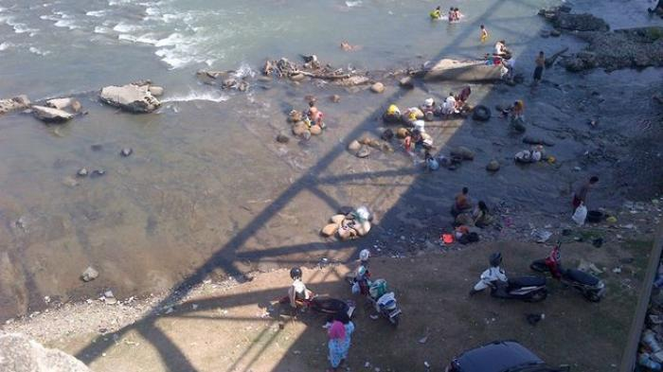
Some villagers do their daily activities in Lematang river
Like washing their clothes or take a bath,and sometimes there are kids who play in the side of the river

Slide 38
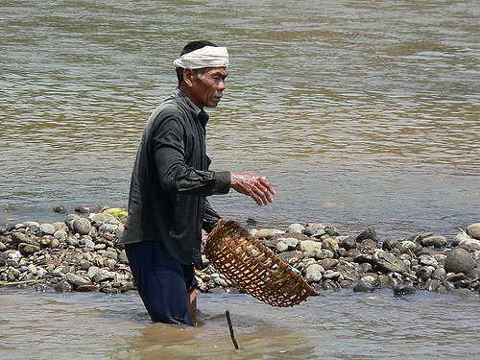
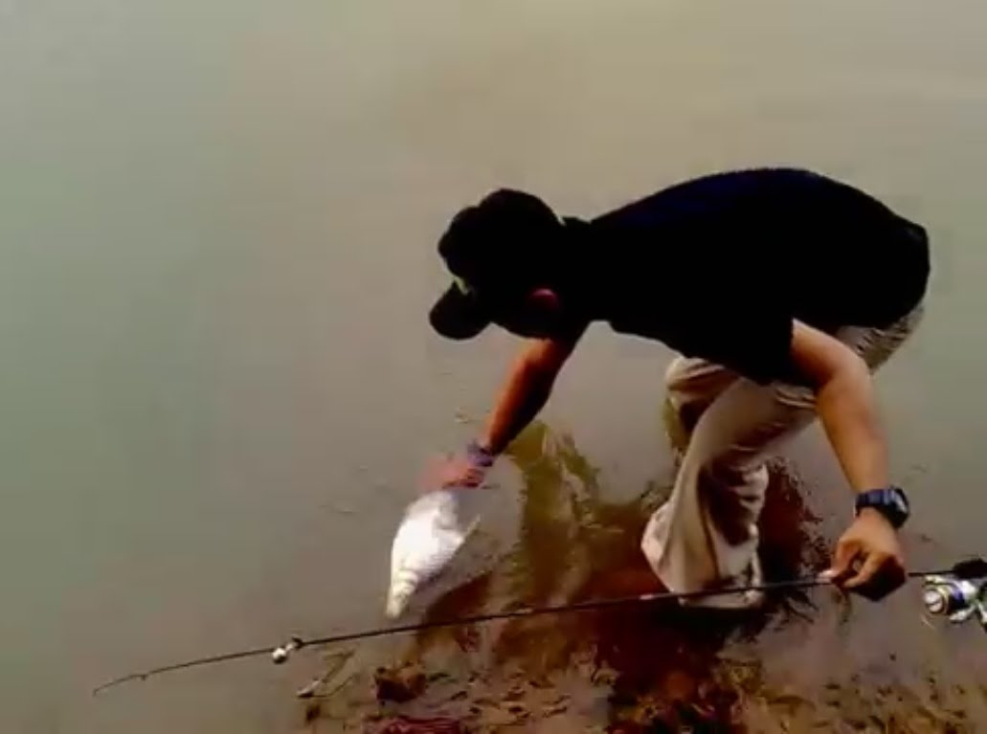
The other villagers, use the rivers as a place to work
The most common things they do are fishing or digging the sand

Slide 39
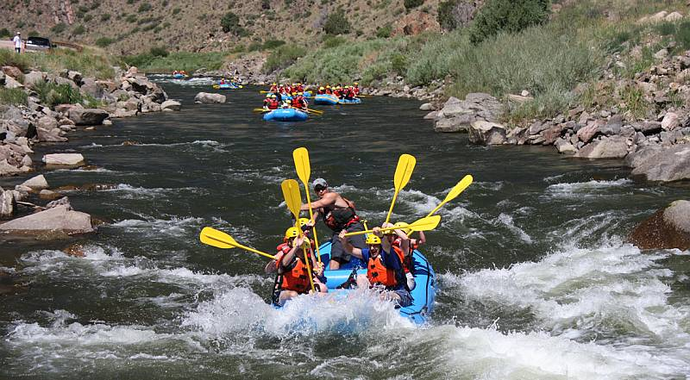
Beside of those “serious” stuff Lematang river can be used for some fun activities
The most famous “fun activity” is rafting

Slide 40
The End
We thank everyone who took part in this project!

