Slide 1
Places and perspective : Learning Circle 1 (Elementary School)
ppE1

Slide 2
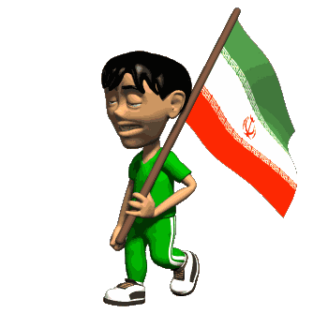
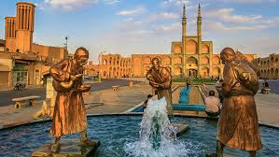
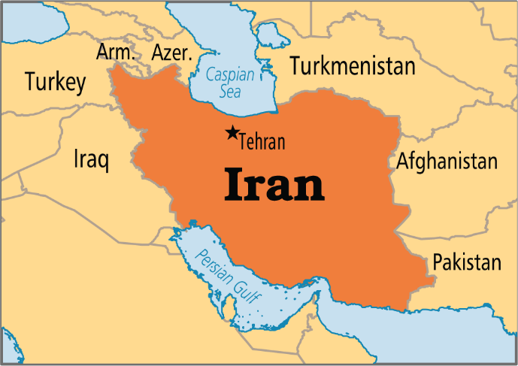
In The Name Of God
Mehr Aein Elementary School
Iran - Tehran
Wind catchers
in
Yazd Province
By:
Bardia Esfahani
Radin Khodabandeloo
Aien Abedi
Parham parvin

Slide 3
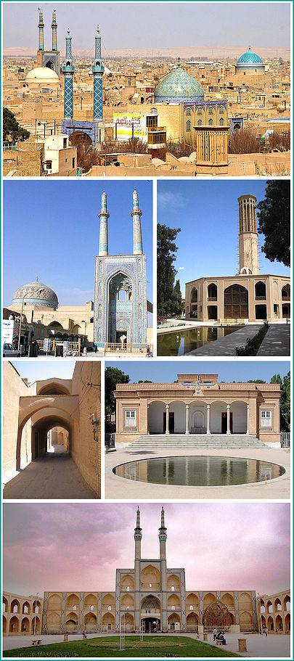
YAZD
The word Yazd means, feast and worship. Yazd has a history of over 5,000 years, dating back to the time of the Median empire, when it was known as Ysatis or Issatis. It is located in the center of Iran. The province consists of 11 towns, 23 townships and 51 villages. Yazd is the one of the most ancient and historical cities known for its mud-brick houses. Because of its remote desert location and the difficulty of approach, Yazd had remained largely immune to large battles and the destruction and ravages of different wars. In 1272 it was visited by Marco Polo, who remarked on the city's fine silk-weaving industry. Yazd is the driest major city in Iran. Of time long people were monotheistic and religion.

Slide 4
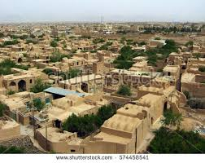
Climate Persian architecture Wind catcher
Yazd is a center of Persian architecture. Because of its climate, it has one of the largest networks of qanats in the world, and Yazdi qanat makers are considered the most skilled in Iran. Because of extremely hot summers, many old buildings in Yazd have great wind catchers, and large underground areas. The city is also home to simple things like Yakhchal used to store ice getting from glaciers in the nearby mountains. Yazd is also one of the largest cities built almost entirely out of adobe.
Yazd's heritage as a center of Zoroastrianism is also important. There are a Tower of Silence and a Fire Temple, which holds a fire that has been kept alight continuously since 470 AD. Presently, Zoroastrians make up the least population.
Built in 12th century and still being in use, Jame mosque of Yazd is an example of finest Persian mosaics and excellent architecture. Its minarets are the highest in the country.

Slide 5
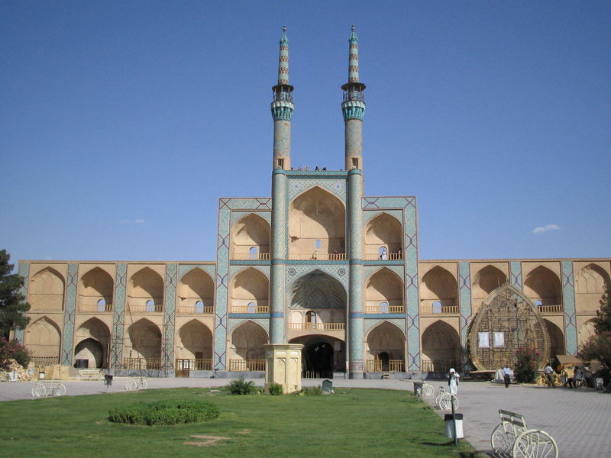
Amir Chaqmaq Complex
During Timurid rule Amir Jalal Al-Din Chaqmaq-e-Shami was appointed ruler in Yazd. He and his wife ordered the construction of a spacious square ringed by a water reservoir, a house for dervishes, a school, a caravanserai, a well, and a mosque.

Slide 6
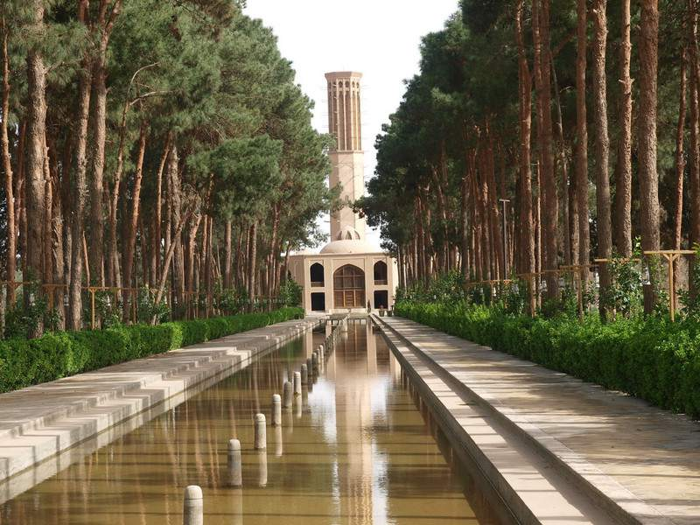
The wind catcher of Dolatabad, one of the tallest existing wind catchers
The soaring 34 meter wind tower, the highest in the world, extends to the envious estate a great beauty and preoccupies the minds of visitors young and old.
Dolatabad Garden

Slide 7
Ice storage (Yakhchal)
In Yazd province, during the winter when there was sufficient water, it was led to the little pools. During the night due to low temperatures the water of these pools used to freeze. A tall wall surrounded the pool that prevented sunlight from getting to the ice and created a condition for ice-layers to thicken gradually at nights. Then the ice was broken and transferred to the icehouse underground where it was stored in summer.
.

Slide 8
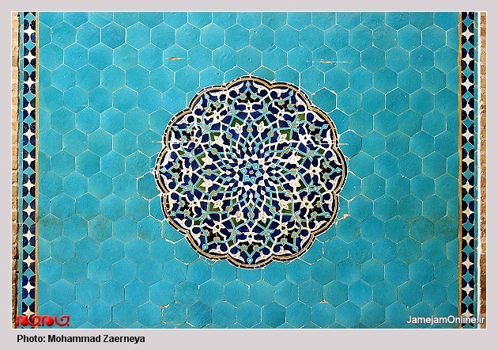
Elegant patterns of brick work and the great inscription of mosaic tiles create a sense of timeless beauty.

Slide 9
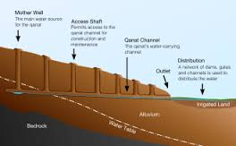
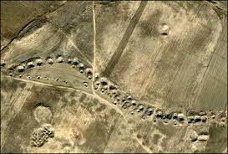
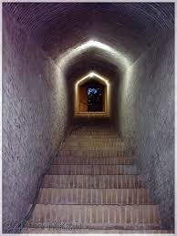
Qanat and Kariz
Zarch Qanat is longest and one of the country's most
ancient Qanats in Iran and has 3000 years old. This Qanat known as longest Qanat in world and One of its features is its square section.
Qanats length is 80 km(with branches) and this Qanat has
2115 shafts .
It is about 80 meters deep mother well that 4 meters is
inside of underground aquifers.

Slide 10
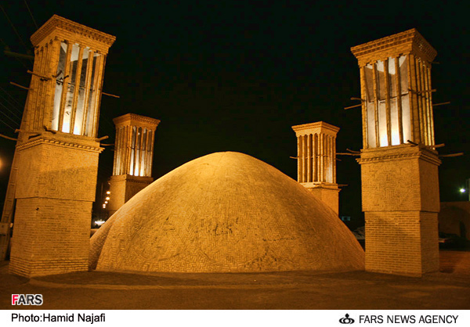
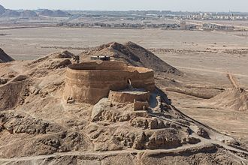
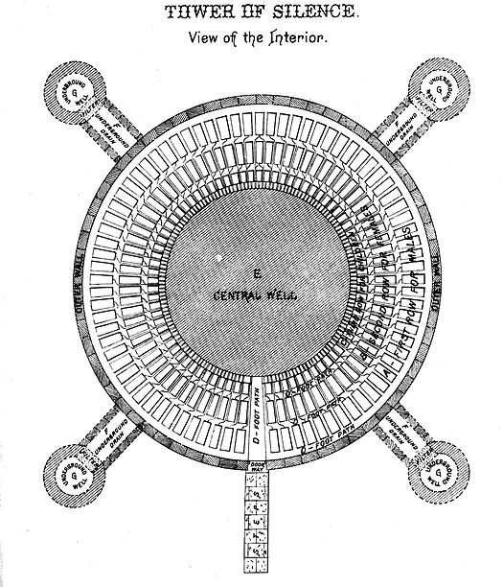
Tower of Silence
A Dakhma, also called a Tower of Silence, is a circular, raised structure built by Zoroastrians for excarnation – that is, for dead bodies to be exposed to carrion birds.

Slide 11
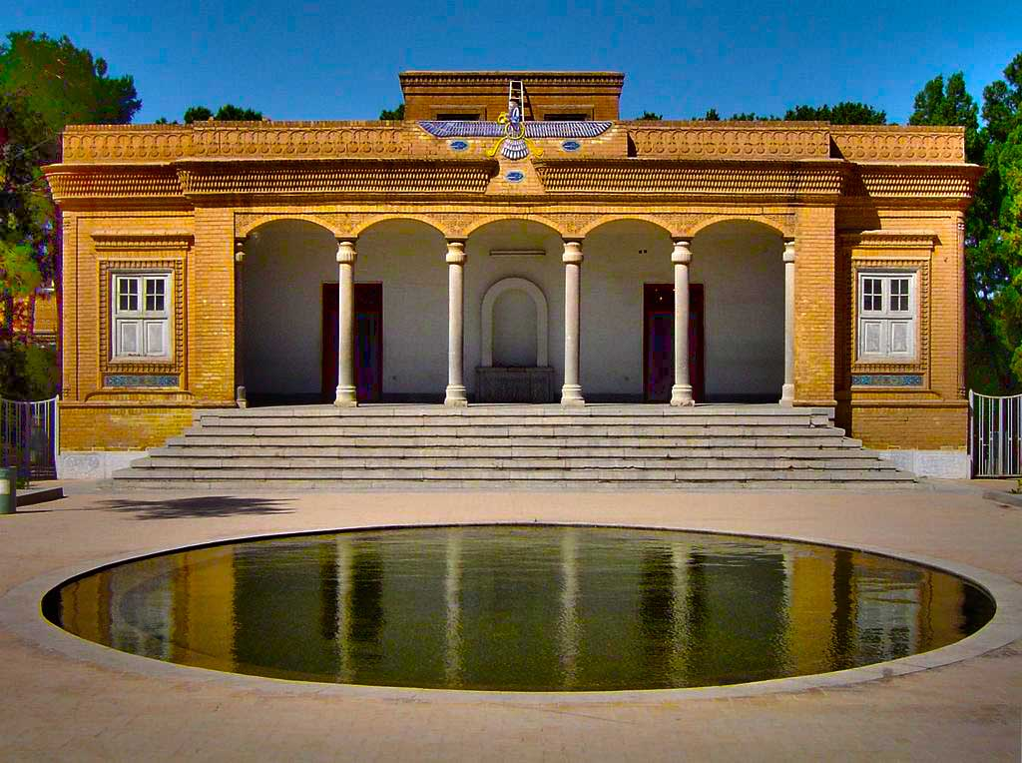
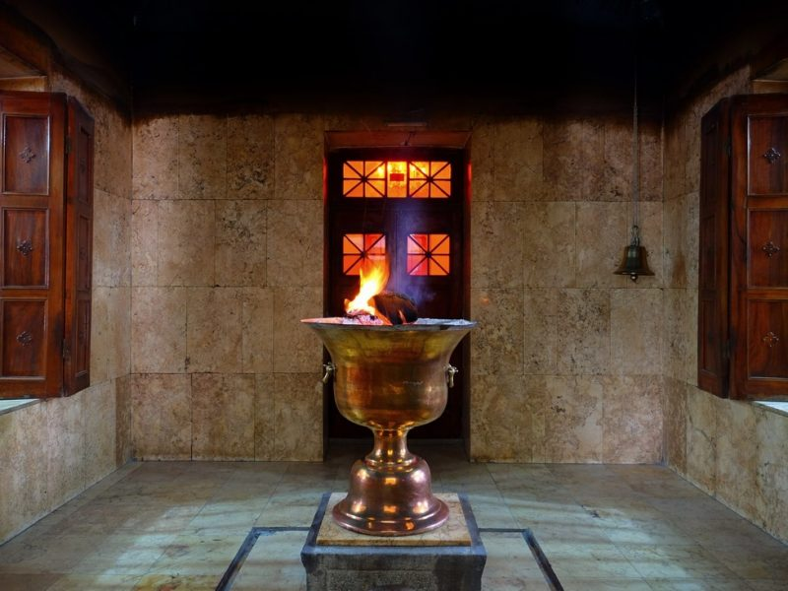
Fire temple in Yazd

Slide 12
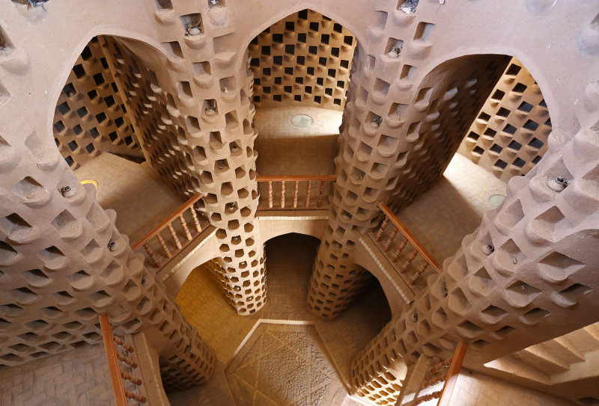
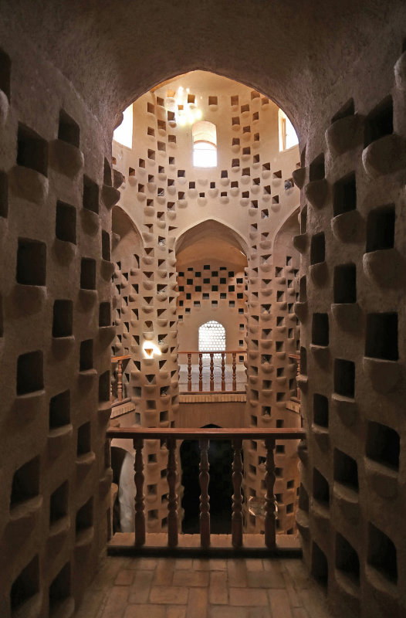
Pigeon Tower
This tower was made during the Qajar Era. It stands 3 stories tall and is home to thousands of pigeons. The design of such towers is unique in a way that not only were they skillfully made, but also attracted pigeons and provided a safe place for them to nest and live in. Since many animals prey on pigeons, such towers act as a safe place that protects the pigeons from predators. The design of the towers, specially the size of their entrances, is such that birds such as hawks, owls or crows are unable to enter the towers.

Slide 13
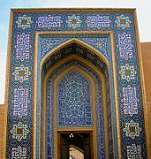
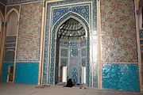
Jame Mosque of Yazd

Slide 14
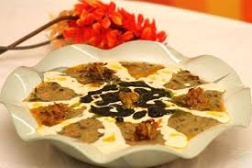
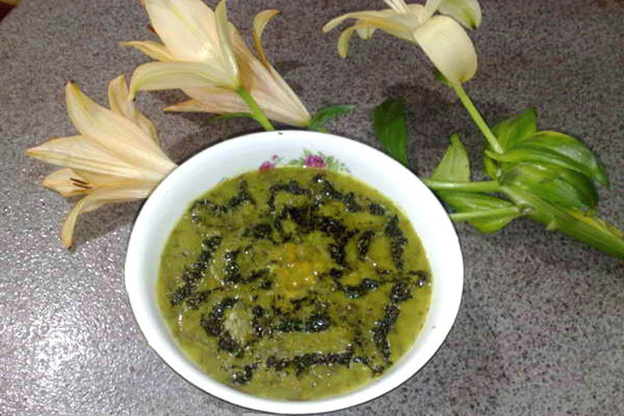
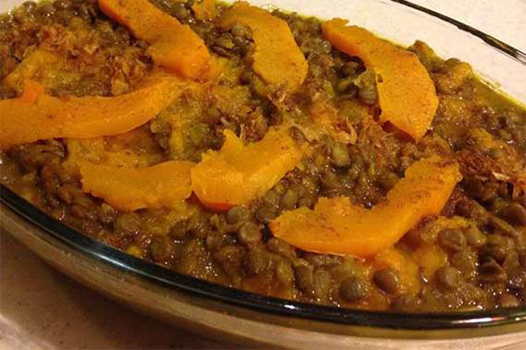
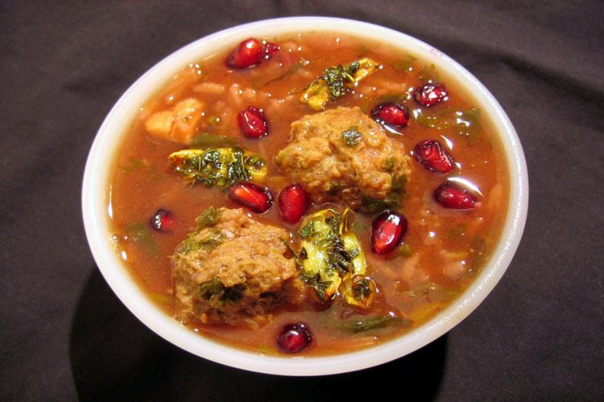
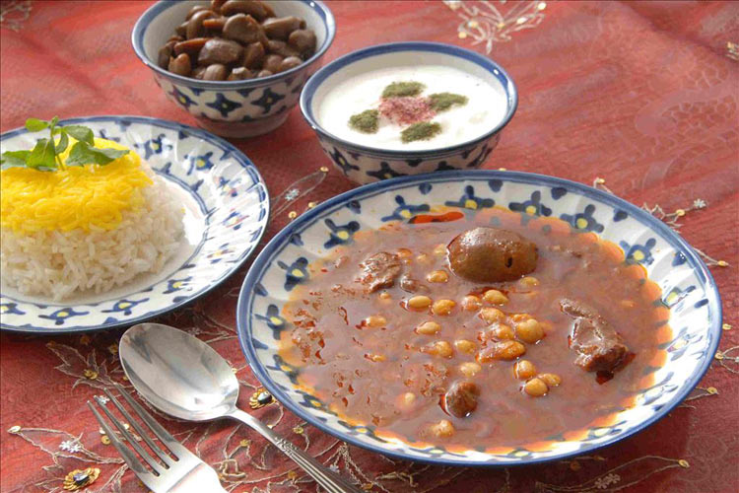
Favorite food
KOJARO
Ashe Gandom
ASHE SHOLI

Slide 15
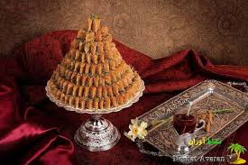
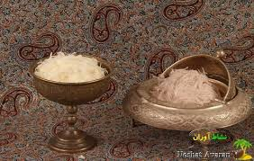
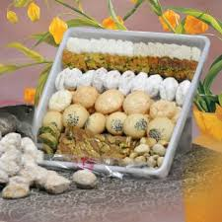
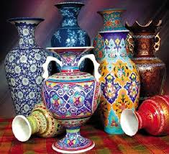
Souvenir

Slide 16
IF YOU WANT FOLLOW YAZD

Slide 17
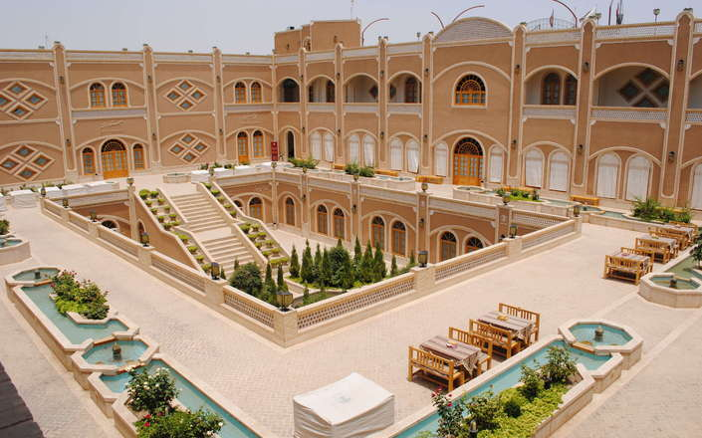
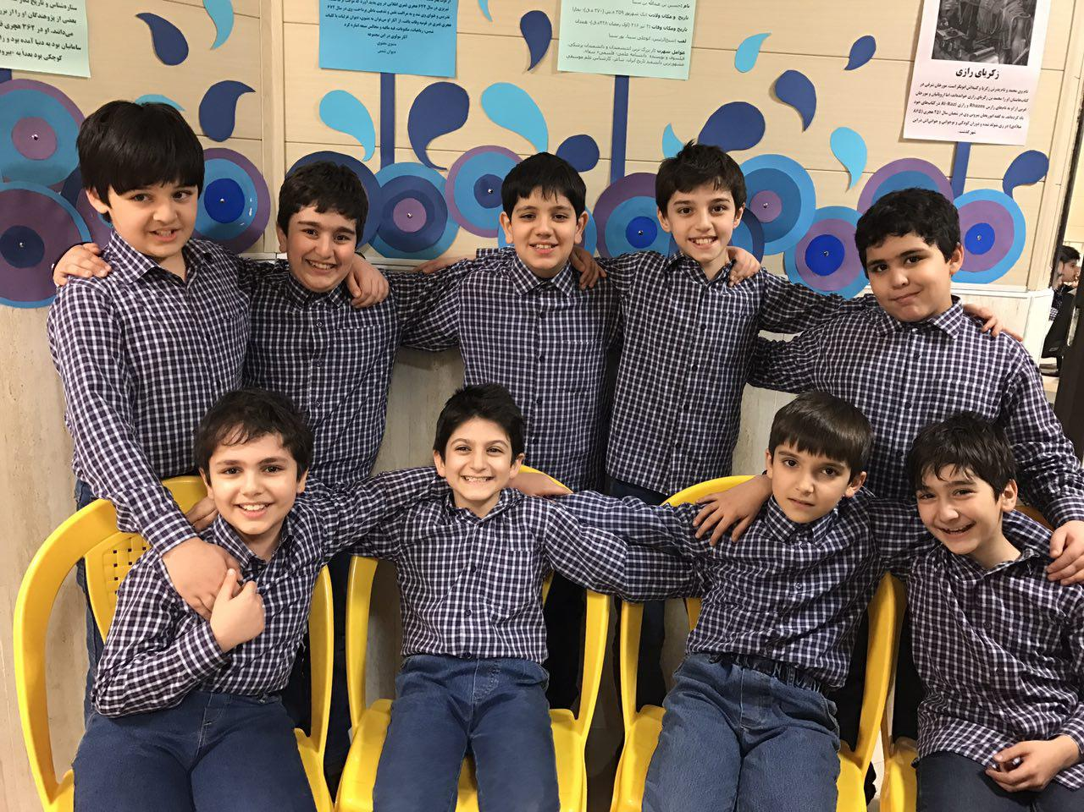
Thanks for your attention! We hope to see you in ancient, desert city Yazd
Dad Hotel in Yazd

