Slide 1
ALGERIA

Slide 2
Environment Project for the BRIDGE Program Saving Plants in their way of extinction

Slide 3
Rabeh Sehdi High School IBN ZIAD, CONSTANTINE

Slide 4
THE IMPORTANCE OF PLANTS FOR LIFE EXISTENCE ON EARTH
Green plants and trees are not just important to the human environment; they form the basis for the sustainability and long-term health of environmental systems. Green plants remove carbon dioxide from the atmosphere and generate the oxygen required for life. Green plants are also a good source of food and protection.
An important byproduct of photosynthesis is oxygen. A single large tree can produce enough oxygen for four people in one day.
Plants use carbon dioxide while photosynthesizing. They remove it from the atmosphere. The World Bank estimates that 20 percent of increasing atmospheric carbon dioxide levels has resulted from deforestation. They estimate that as much as 50 percent of global warming over the past 50 years is due to changing land use patterns and deforestation in the modern age. A single tree is estimated to absorb 1.33 tons of carbon dioxide per 100 years, an average of just over 26 pounds of carbon dioxide per year.

Slide 5
Green plants provide natural cooling. Their leaves block the heating effect of the sun. Green plants can also cool through transpiration. Transpiration is the process by which water evaporates from plant pores, cooling the environment via evaporative cooling. Evaporation consumes heat and is most effective for cooling when the humidity is low. Plants also stabilize the soil through their roots, which bind soils, and through their leaves, which keep raindrops from eroding soils. Areas without adequate vegetative cover often suffer from large quantities of sediment washing into streams and lakes, diminishing water quality.

Slide 6
This work was achieved bu: Manel Boukebous & Taj Seif Elmajd Touil.
Green plants are the basis of food webs. Animals, birds, insects and microbes feed on green plants. These organisms are subsequently eaten by larger animals, which are themselves eaten by even larger animals. For example, a rabbit eats grasses. The rabbit is eaten by a fox, which a mountain lion may then consume.
Green plants, especially trees, provide cover and shelter for many animals and plants. A tree provides shade for smaller plants growing in the understory. The same tree may provide an ideal place for a bird to build a nest. The removal of the trees, combined with severe drought, allowed wind to remove the topsoil of many farms, causing severe crop damage. One solution to the problem was to plant rows of trees around cultivated fields to block the wind.
Plants are so precious creatures that we must save them from extinction by protecting them planting more and more plant species and taking care of them. To preserve the eco-system.

Slide 7
Biodiversity crisis in Algeria Like all countries in the world, Algeria is facing a crisis in biodiversity as 51–66% of its plants and animals are endangered by human activities and changes in natural habitat besides the booming population and unsustainable development programs for the biodiversity crisis. Forest fires, clearing forests, overgrazing and drought in some areas are the largest threats posed to biodiversity in our country. All these are causing desertification and extinction of plants. Besides this, many plants are abused for extracting their oil which is used in herbal medicines. Algeria is home to more than 1,000 endangered plants, 100 of which are endemic to North Africa. So, What is the future hiding to us? Imagine Algeria without these plants. What will be the air like? Will there be any Oxygen? What will we breathe then? What about the world?

Slide 8
The importance of involving civil society in preserving endangered plants (plants in their way of extinction) is a necessity. As a part of this civil society we have to act swiftly and collectively to diminish the risks of plant extinction and do our best to save them and engender more plants to preserve the different varieties. Algeria is a country home to a large variety of cactus and succulent plants like Aloe Vera, Barbari Fig, Barrel cactus, Wandering jew, Aloe polyphylla and some other medicinal plants such as Rose mary, Dioecious, Artimisia and others.

Slide 9
Cactus, secculent and medicinal plants
All these plants are victims of human activities and his carlessness towards this pricious resource of life.
Since Man is responsible on this crisis he must find a solution to protect these plants and save them from extinction.

Slide 10
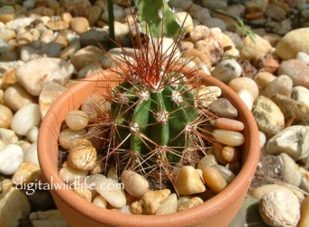
Barrel cactus
Thelocactus
.
Barrel Cactus, thelocactus, and Mammillaria bocasana are often grown in gardens. They also grow in pots.
We can save them but we need a long time to do because they grow slowly.

Slide 11
Mammillaria bocasana
As these species of cacti, succulent plants and medicinal ones can be grown in gardens and pots we can do something to help them survive, protect and balance the ecosystem, embellish the environment give us oxygen as they are the main source. We can extract their oils providing that we keep growing more and more plants and taking care of them.

Slide 12
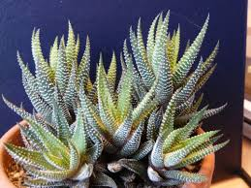
Here are varieties of Aloe Vera
This plant is endangered because of its oil extraction used in making ointments and shampoing.
Producers of such products are abusing them and destroying nature. They ought to be more responsible and rather save them.
Aloe Vera is often grown in gardens. It also grows in pots.
We can save them easily as we can separate young plant from adults and can grow them from the leaves only. So, there is big opportunity to get a huge number of Aloe Vera.

Slide 13
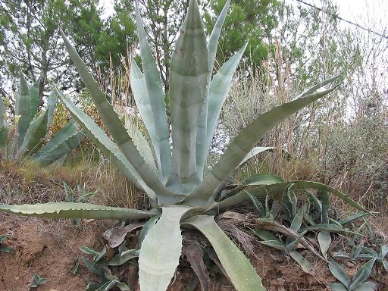
These cacti which look less beautiful than other plants are vital to our existence. If they extinct , the ecosystem will be disturbed and life will disappear on Earth. God has created them for a purpose. We must respect their right in living.

Slide 14
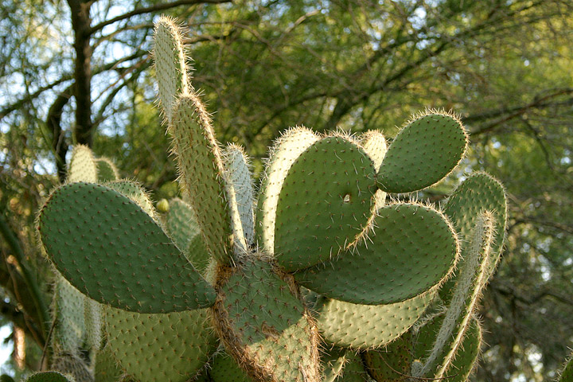
Many cacti are not appreciated by people because of their thorns. So, they don’t take care of them.
These thorns are their weapon to defend their life.
We must think positively to preserve this plant. It is beneficial.

Slide 15
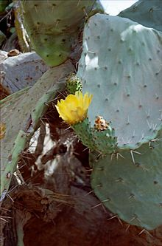
Barbary Fig
Barbary fig is in a miserable condition though people in Algeria like its delicious fruit.
It’s worth to save this plant from extinction.
Urge the present generation to save it for the future one.

Slide 16
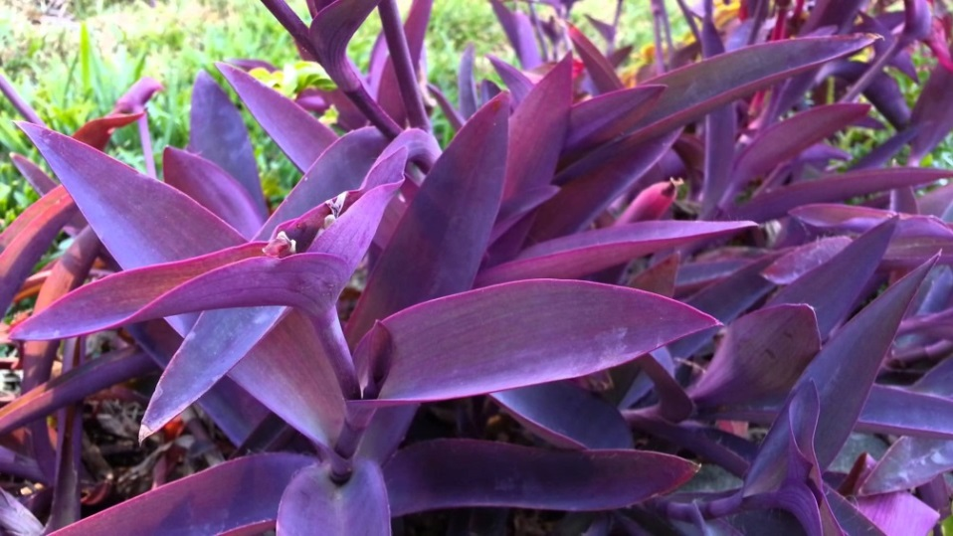
Wandering jew
Tradescantia zebrina
Tradescantia zebrina is a very fragile plant that need a lot of care to make it survive.
Tradescantia pallida This is a houseplant that really thrives in bright but indirect sunlight. The brighter the light you provide your wandering jew plant, the more flowers it will produce.
If it's not getting enough light, the brightly-colored foliage will begin to fade.
These plants must not be kept soaked or dry. Keeping the soil moist is the best.
Tradescantia pallida

Slide 17
Aeonium
Aeoniums are succulent plants, with long, arching stems and rosettes of leaves. There are about 35 species. They prefer a Mediterranean climate - not too hot, not too cold, not too dry.
They grow in full sun.
Let’s give them the chance to share the planet with us.

Slide 18
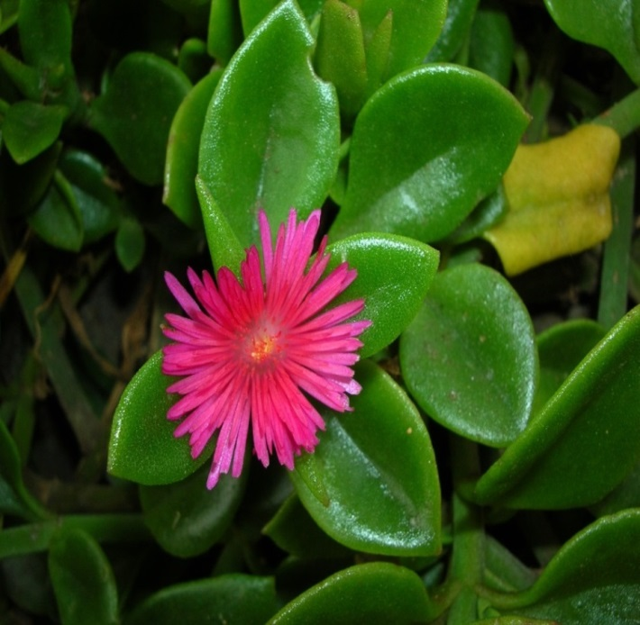
Aptenia cordifolia is a species of succulent plant. It has magenta purple flowers and more heart-shaped, mid-green, textured leaves. This species has become widely known as an ornamental plant. This is a mat-forming perennial herb growing in flat clumps on the ground from a woody base. Stems reach up to about 60 centimeters long. The bright green leaves are generally heart-shaped and up to 3 centimeters long. They are covered in very fine bumps. Bright pink to purplish flowers appear in the leaf axils and are open during the day. Its far more vigorous growth and ability to root from small bits of stem makes it a poor choice for planting adjacent to wild lands. Water Aptenia only when the soil is completely dry, and then provide enough to drench the soil to a depth of about 15 cm. To check for dryness, poke your finger into the soil. Never water if the soil feels damp or cool, as Aptenia, like all succulents, is prone to rot in soggy, waterlogged soil. Water Aptenia lightly during the winter if the leaves begin to look shriveled. Provide only enough water to moisten the soil as the plant deteriorates quickly in cool, damp soil. Take care of them.
Aptenia cordifolia

Slide 19
Medicinal plants a large range of medicinal plants is endangered
Pistacia lentiscus is an evergreen Shrub growing to 5 m (16ft) by 3 m (9ft) at a slow rate in costal areas of north Algeria. The flowers are dioecious (individual flowers are either male or female, but only one sex is to be found on any one plant so both male and female plants must be grown if seed is required)The plant is not self-fertile. Suitable for: light (sandy), medium (loamy) and heavy (clay) soils and prefers well-drained soil. Suitable pH: neutral and basic (alkaline) soils and can grow in very alkaline soils. It cannot grow in the shade. It prefers dry or moist soil and can tolerate drought. Forests are their habitat and can’t be grown in pots. Our duty is to protect forests from fires and extract its oil wisely.
Pistacia lentiscus

Slide 20
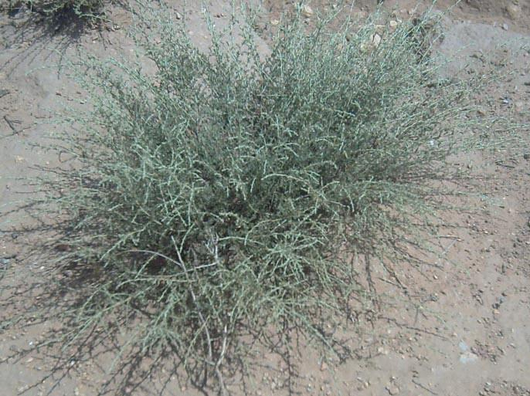
white wormwood
The white wormwood, is a medicinal plant that grows to 20-40 cm in the Algerian Sahara. Leaves are strongly aromatic and covered with fine glandular hairs that reflect sunlight giving a grayish aspect to the shrub.It is used as an antiseptic and antispasmodic in herbal medicine.
Our call here is for inhabitants of that areas to grow more Artiminisia and preserve this plant from extinction and protect desert’s biodiversity.

Slide 21
Medicinal plants are endangered because of the extraction of their oil and distilation
Rosemary, is an aromatic woody, perennial herb with fragrant, evergreen, needle-like leaves and white, pink, purple, or blue flowers, native to the Mediterranean region. It can withstand droughts, surviving a severe lack of water for lengthy periods. Forms range from upright to trailing; the upright forms can reach 1.5 m tall, rarely 2 m. The leaves are evergreen, 2–4 cm long and 2–5 mm broad, green above, and white below, with dense, short, woolly hair. The plant flowers in spring and summer in temperate climates, but the plants can be in constant bloom in warm climates.
Rosemary

Slide 22
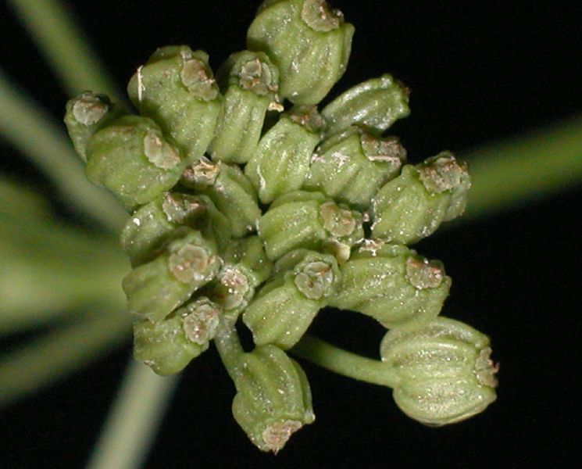
Carum Foetidum is a species of flowering plant in the Apiaceae family. It is found in Algeria and Spain. Its natural habitats are rivers and saline marshes. It is rare and known from seven locations distributed between the high plains of Algérois and Oranais, the Constantinois plains, the Saharan Oranais Atlas, the Algérois Atlas and the Constantinois Atlas. It is threatened by habitat loss.
Carum Foetidum

Slide 23
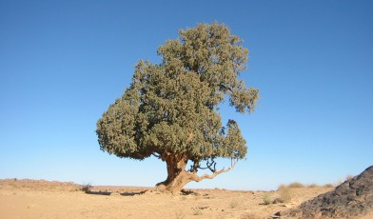
The Saharan cypress, or tarout, is a very rare coniferous tree native to the Tassili n'Ajjer mountains in the central Sahara desert, southeast Algeria, where it forms a unique population of trees hundreds of kilometres from any other trees. There are only 233 specimens of this critically endangered species, the largest about 22 m tall. The majority are estimated to be over 2000 years old, with very little regeneration due to the increasing desertification of the Sahara. The largest one is named Tin-Balalan is believed to be the oldest tarout tree with a circumference of 12 meters or 36 feet. This species is distinct from the allied Mediterranean cypress in its much bluer foliage with a white resin spot on each leaf, the smaller shoots often being flattened in a single plane. It also has smaller cones, only 1.5–2.5 cm long.
The Saharan cypress

Slide 24
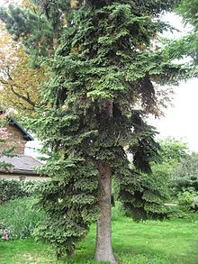
It is a species of fir found only in Algeria, where it is endemic on Djebel Babor, the second-highest mountain (2,004 meters) in the Algerian Tell Atlas . It is of medium-sized to large evergreen tree growing to 20–35 meters tall, with a trunk up to 1 meter diameter. The leaves are needle-like, moderately flattened, glossy dark green with a patch of greenish-white stomata near the tip above, and with two greenish-white bands of stomata below. The tip of the leaf is variable, usually pointed, but sometimes slightly notched at the tip, particularly on slow-growing shoots on older trees. The cones are glaucous green with a pink or violet tinge, maturing brown, 10–20 centimeters long and 4 centimeters broad, with about 150–200 scales, each scale with a short bract (not visible on the closed cone) and two winged seeds; they disintegrate when mature to release the seeds. This tree is threatened by a combination of factors including fire, fuel-wood collection and grazing by herds of cattle and goats in the summer. It appears that the young saplings are unable to establish due to a combination of dense under-storey and deep winter snow. The threats to the forest and endemic species are presumed to be ongoing, although the difficulties of access to the site, especially in winter, afford some degree of protection.
Abies numidica (Algerian fir)

Slide 25
All these plants are threatened and endangered. They need to be saved. So, we must unify our efforts to cultivate more plants of these species, save them from extinction and preseve life on our planet EARTH.

Slide 26
As a part of this community who loves nature and wants to do something to help save the environment, we are going to plant a variety of Aloe Vera,Rosemary,Tradescantia pallida, Aconium, Echeveria, Aptenia cordifolia and crasula ovata in pots to get more plants and then, plant them in our schoolgarden.

Slide 27
This work was achieved by: Nawel Rouini Rania M’cili Nihal Kaabouche Chiraz Brahimi Darine Nouioua Tadj Seif Elmajd Touil Nahla Chiraz Chaabane Ahmed Nadjib Alikeche Manel Boukebous Supervised by their Teacher: Mrs Fatiha Touafek

Slide 28
Youths’ promise ( A poem achieved by Mecili Rania) We are conscious, life is precious We have to save all creatures We plant plants and we breed pets To not disturb the ecosystem We avoid nature polluting Ozone layer destroying And stop global warming To not disturb the ecosystem Use our technology To preserve ecology Botany and zoology To not disturb the ecosystem Save it. It’s our duty Towards biodiversity. We don’t want a calamity We want to live in harmony for eternity.

Slide 29
Plants’ Call For Man ( A poem achieved by Darine Nouioua) People of the world fight pollution We’re in our way of extinction Hurry up Man and do an action With your help change our destination Just a gesture to save nature. It’s our earth Don’t cause our death We need a rebirth And survive together Just a gesture to save nature. We are the beauty A cure to be healthy The smells you like We call for equality We are a living creature Please, save nature You should be aware And take of us care We purify the air All around everywhere Do something to Save the Earth

Slide 30
Achieved by: Nahla Chiraz Chaabane & Nihal Kaabouche
A plant’s Talk
Tell me MAN how much you matter.
I need some care, soil & fresh water.
Just to survive & engender.
purify the air , making it cleaner.
& live together for ever & ever.
Be my friend and be my saver.
Don’t disobey the laws of nature.
Both erosion, and destruction
Add Over grazing cause my extinction.
We are behind precipitation
All that we need is regeneration
We want rebirth, a new generation.
Be my friend and be my saver.
Don’t disobey the laws of nature.
Why we are dying you are not caring
We are precious we are not lying
Do just a gesture and let ‘s living
Your life on earth on us is depending
Be my friend and be my saver.
Don’t disobey the laws of nature.
Biodiversity is a reality
we live side by side till eternity.
Seed some seeds & some water we need
A simple action a saver in deed
Be my friend and be my saver.
Don’t disobey the laws of nature.

Slide 31
A song written by Nawel Rouini & Chiraz Brahimi
Save plants
Be like a bee, don’t be lazy
Do something to save a daisy
All roses, iris, daffodils
Save nature, keep it tidy.
***************************
Be friendly and love nature
Conserve it for the future
Save any creature
Don’t be a destructor
****
Plant a pine, plant cacti
Regenerate them and get plenty
Save lily and honesty
Do something don’t be naughty
****************************
Be friendly and love nature
Conserve it for the future
Save any creature
Don’t be a destructor
Save all plants from extinction
Reduce drought and erosion
Stop all kinds of pollution
Work always for preservation
**************************
Be friendly and love nature
Conserve it for the future
Save any creature
Don’t be a destructor
****
Let’s all work as one nation
Just to stop deforestation
And soil degradation
The habitat of vegetation
**********************
Be friendly and love nature
Conserve it for the future
Save any creature
Don’t be a destructor

Slide 32
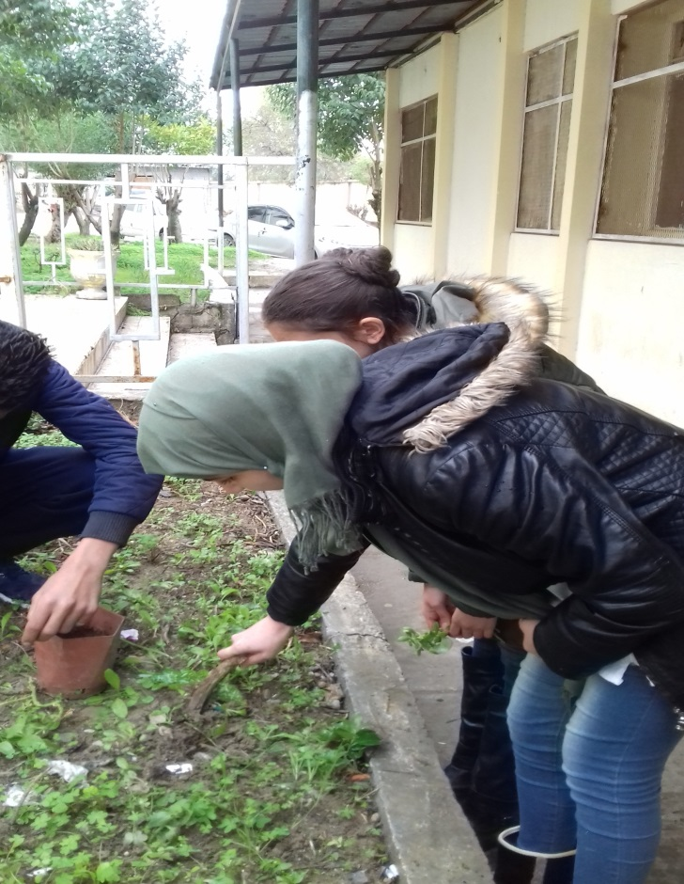
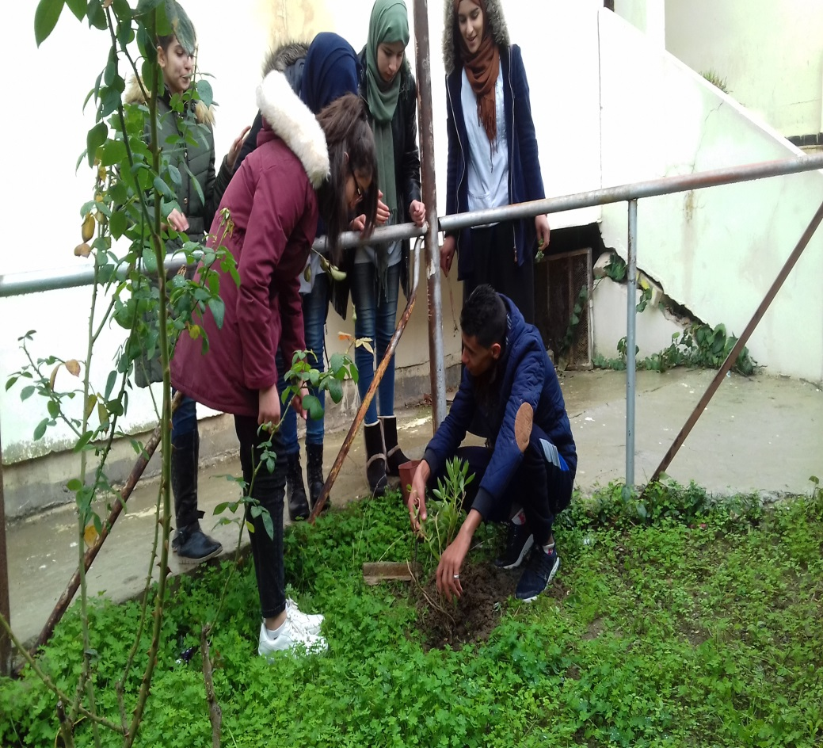
Students planting some endangered plants in the school garden

Slide 33
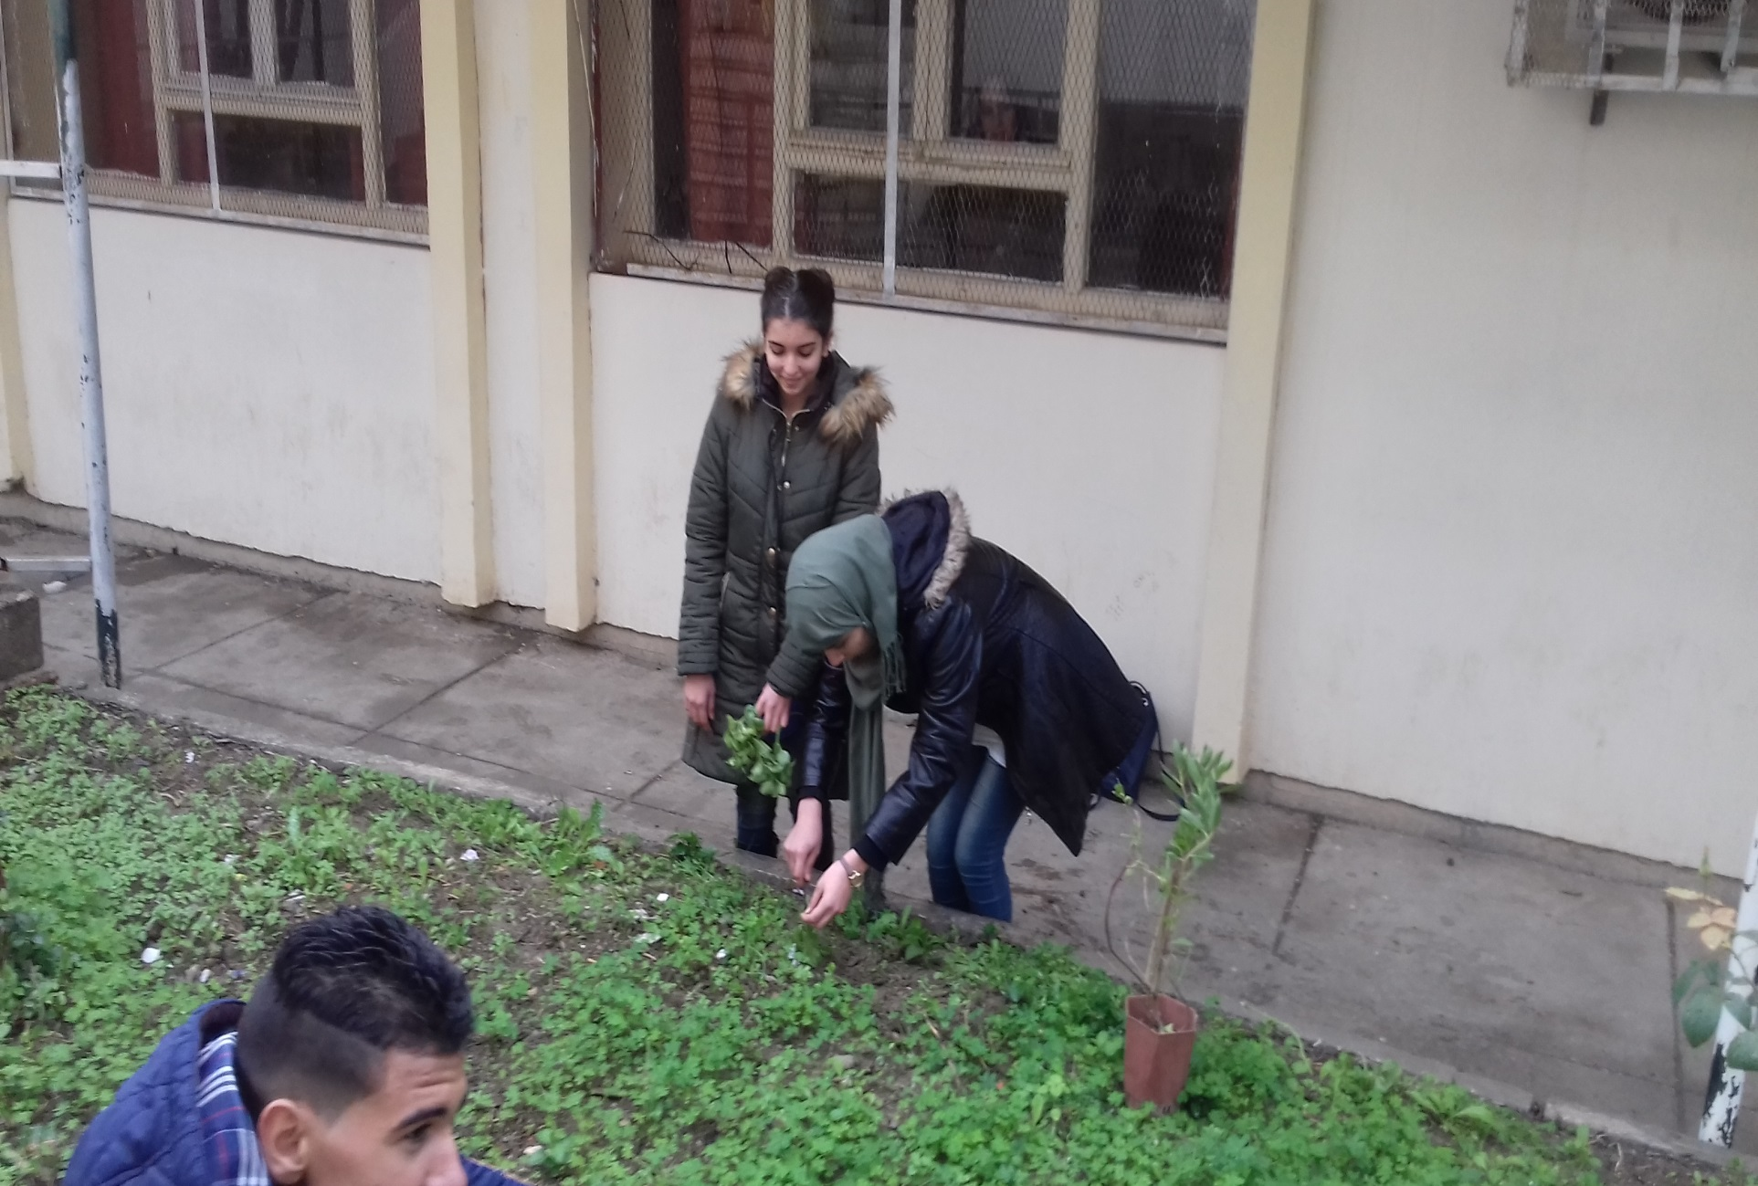

Slide 35
This is the mini dictionary from Gomel school Thank you for Kate and her students. My students have really liked it.

