Slide 1
Quality education requires safe disciplined and peaceful schools
by Buznea Ion, Agachi Alexandru
”George Coșbuc” Lyceum, Bălți, Moldova

Slide 2
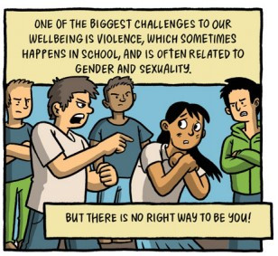
All schools work to prevent school violence.
Students, staff, and parents all have an important role in promoting school safety. Adults can provide leadership by reassuring students that schools are generally very safe places for children and youth and reiterating what safety measures and student supports are already in place in their schools

Slide 3
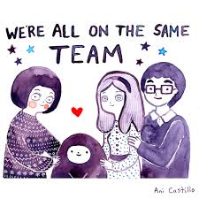
What is peace education?
Peace education proposes and promotes a theoretical framework and teaching practices to ensure a democratic educational system with opportunities to learn and practice skills related to peaceful conflict resolution, intercultural dialogue, the exercise of individual and collective rights , and freedom of conscience and thought in a plural and egalitarian society.

Slide 4
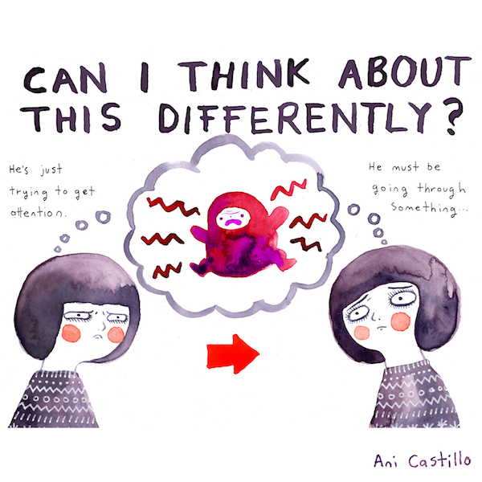

Slide 8
Solutions
What can we (students and teachers) do in order to stop school violence ?
-Create a safe, supportive school climate (e.g., school-wide behavioral expectations, caring school climate programs, positive interventions and supports, and psychological and counseling services).
-Encourage students to take responsibility for their part in maintaining safe school environments, including student participation in safety planning.
-Reiterate the school rules and request that students report potential problems to school officials.
-Remind students of the importance of resisting peer pressure to act irresponsibly.
-Create anonymous reporting systems (e.g., student hot lines, suggestion boxes, and “tell an adult” systems).
-Control access to the school building (e.g., designated entrance with all other access points locked from the exterior).
-Monitor school guests.
-Use security systems.
-Highlight violence prevention programs and curricula currently being taught in school.
- Emphasize the efforts of the school to teach students alternatives to violence including peaceful conflict resolution and positive interpersonal relationship skills.

