Slide 1
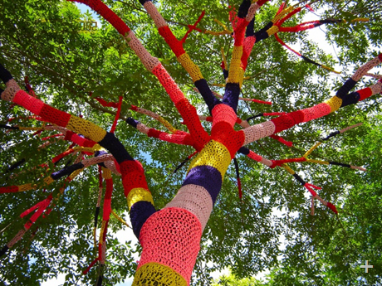
Yarn Bombing Around the World

Slide 2
What is yarn bombing?
Yarn Bombing is a type of graffiti art done in streets, meaning the action or activity of covering objects or structures in public places with decorative knitted or crocheted material, as a form of street art . It is illegal if done without a official authority from a host organization.

Slide 3
HISTORY
Yarn Bombing is believed to have originated in the U.S. with Texas knitters trying to find a creative way to use their leftover and unfinished knitting projects .The start of this movement has been attributed to Magda Sayeg from Houston, who says she first got the idea in 2005 when she covered the door handle of her boutique with a custom-made cozy .The movement moved on from simple 'cozies' with the innovation of the 'stitched story'.

Slide 4
The concept has been attributed to Lauren O'Farrell from London, UK, who founded the city's first graffiti knitting collective Knit the City .The 'stitched story concept' uses handmade amigurumi characters and items to show a theme.

Slide 5
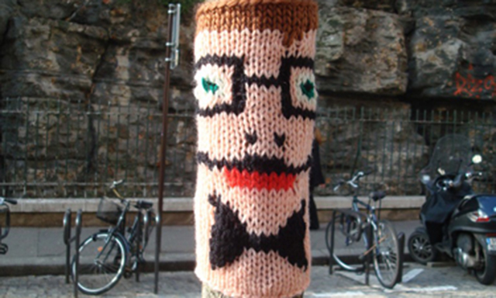
YARN BOMBING IN FRANCE
France has not escaped this wind that has blown in from Texas; the France Tricot Collective was the 2009 brainchild of 2 knitting addicts, Emmanuelle Barrère and Solène Lebon-Couturier, who unwind their balls of yarn between Paris and Berlin. “It is a different way of looking at the city, and even if it is just for 5 seconds, it is surprising and offers something unexpected to others”; such is their vision of Yarn Bombing.

Slide 6
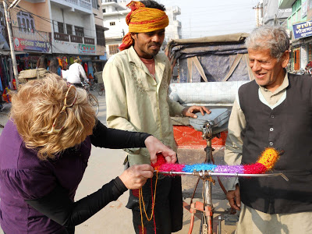
Yarn bombing in Nepal
Yarn bombing is a rare to see yet beautiful art in Nepal . Carol hummel, a adventurer has shown her talent with such a beautiful masterpiece in Nepal in her journey of yarn bombing. Yarn bombing is seriously a rare form of street art hardly seen in Nepal although knitting is quite common here.

Slide 7
These are traditional nepali caps which are yarn knitted during the yarn bombing campaign held in Nepal .

Slide 8
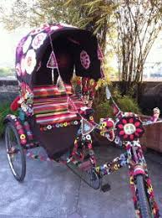
Carol hummel:
“Bicycle Rickshaw Bombing.... When the rickshaw driver walked up and saw me "bombing" his rickshaw, he stood there as if it was like any other normal event of the day... when I finished, he stood back, looked it over, approved it and then rode away on his bicycle rickshaw... As he pedaled away the yarn blended into the colorful surroundings as if it was just another patch of the Nepali fabric of (very colorful) life... And then another bicycle rickshaw pulled up and gestured me to do his rickshaw, too! Gotta love it”

Slide 9
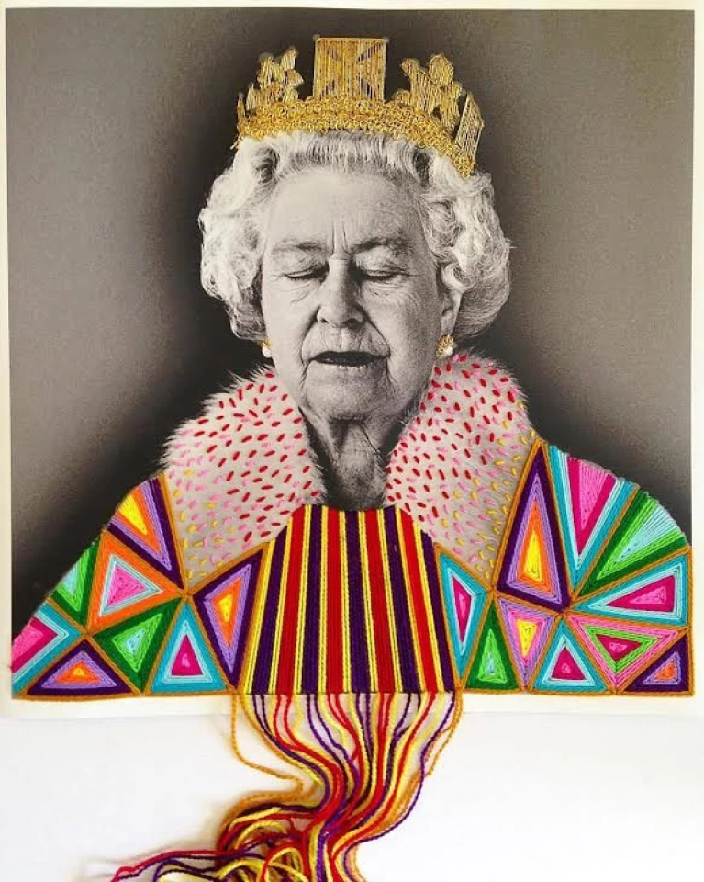
YARN BOMBING IN MEXICO
The Mexican artist Victoria Villasana creates her own yarn bomb version of street art by ‘tagging’ her unique style of artwork around various cities in the country and worldwide. From Frida Kahlo to Mohammad Ali, Donald Trump, New York fashion icon, Iris Apfel and even Queen Elizabeth, Victoria takes some of the world’s most famous faces and infuses them with colour, humour and personality using nothing but balls of yarn.

Slide 10
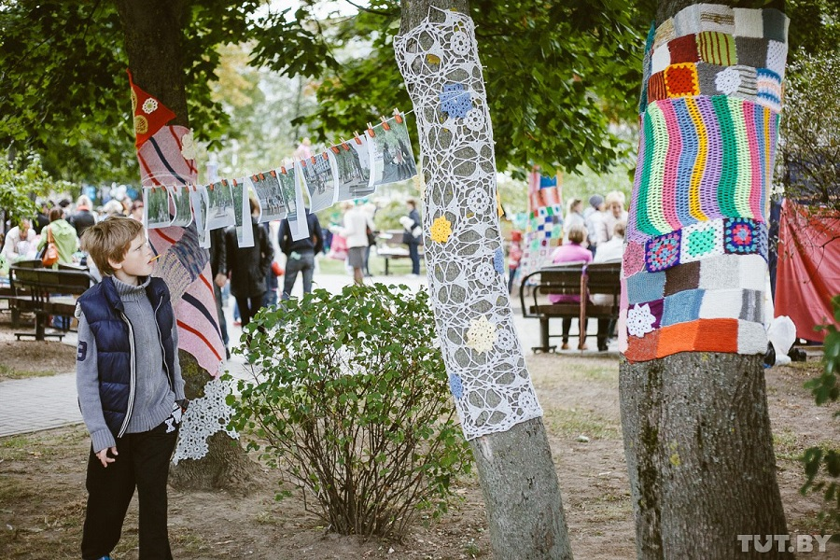
YARN BOMBING IN BELARUS

Slide 11
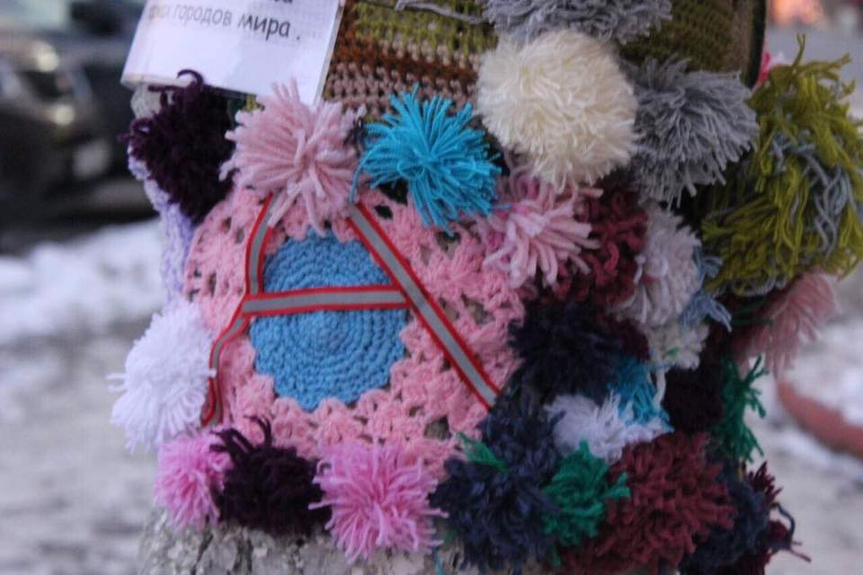
ACCESS GROUP YARN BOMBING
Trees, stay warm! Access students in Borisov have taken part in a community service project "Yarn bombing". Access students made a colourful "yarn bomb" - a knitted fabric with a light-reflecting capital letter 'A' in the middle, the first letter of the group they represent, which decorated one of the trees in front of the town library.

Slide 12
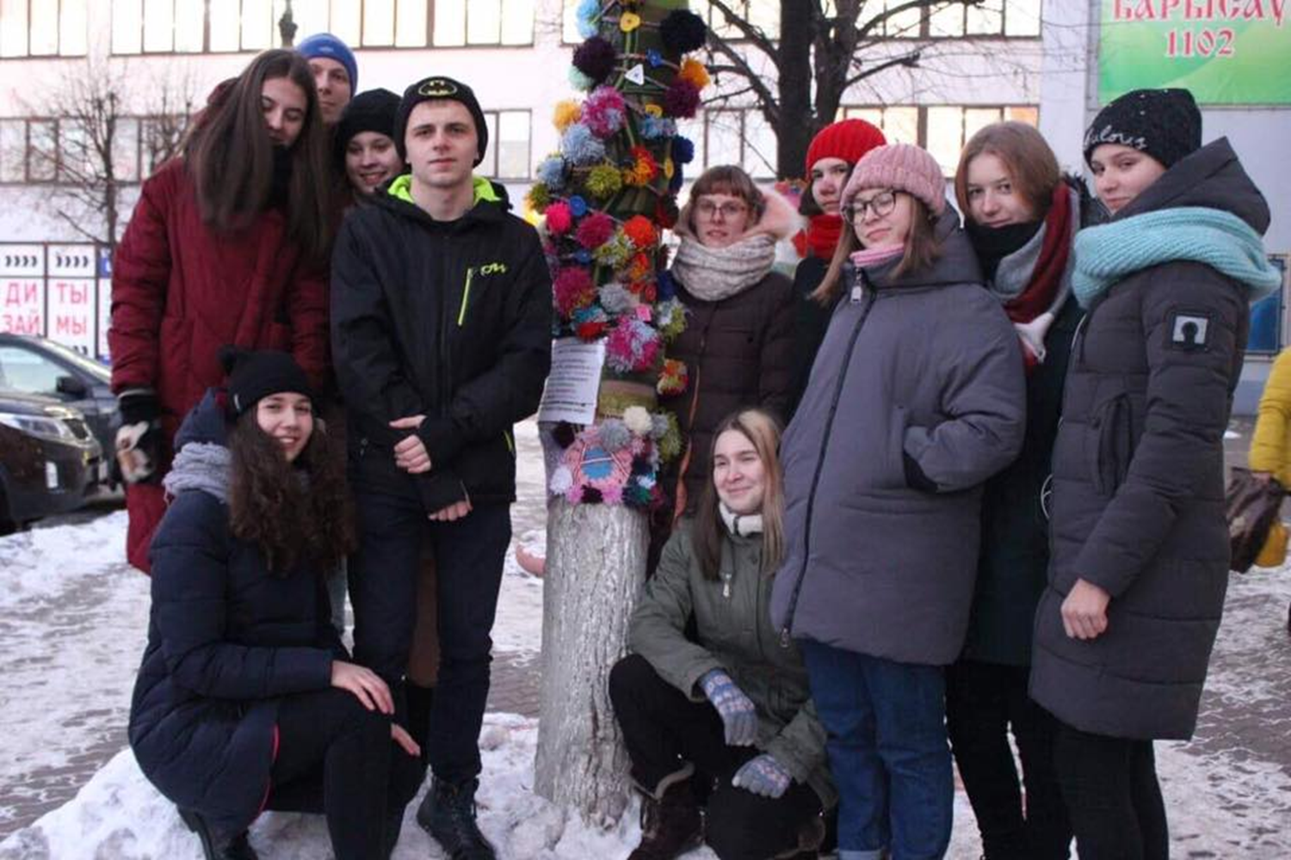

Slide 13
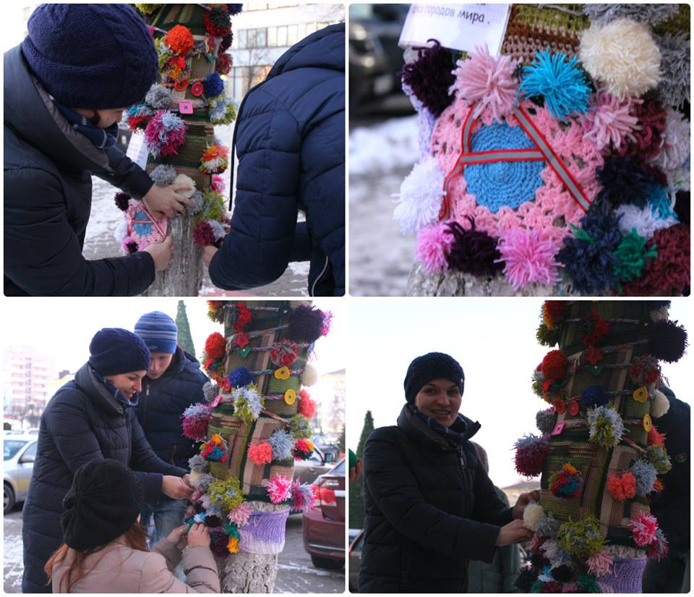

Slide 14
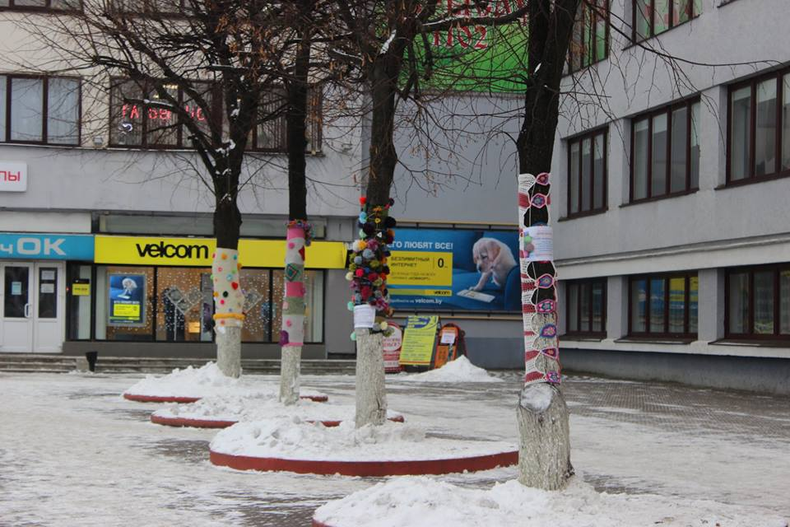

Slide 15
Positive sides of yarn bombing:
It truly helps to express art in a freestyle into the public as public structures are bombed with colourful yarn. It helps to enhance the beauty of any public structure. Moreover,it’s a good way to unite people in the community.

Slide 16
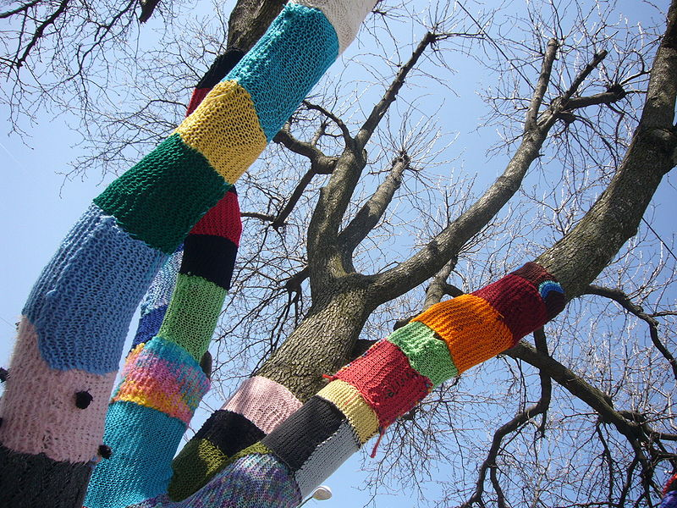
Negative impacts
Yarn bombing has been under some scrutiny for the potential negative environmental impact that the yarn can have when placed on plant life. Yarn can restrict sap production on trees and constrict growth. It is considered proper yarn bombing etiquette to avoid "bombing" things like trees, bushes, and other plant life due to the negative impact it can have. “Yarn bombing public property instead of providing yarn products to the needy also seems quiet unfair,” say some knitters.

Slide 17
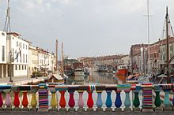
International Yarn Bombing Day was created on June 11th in 2011 by Alberta knitter Joann Matvichuk as a way to unite the diverse groups of “guerilla knitters” in cities across the world. Yarn Bombing Day is a day when fiber-freaks from around the world go on a knitting rampage to embrace the world in warm fuzzy comfort.

Slide 18
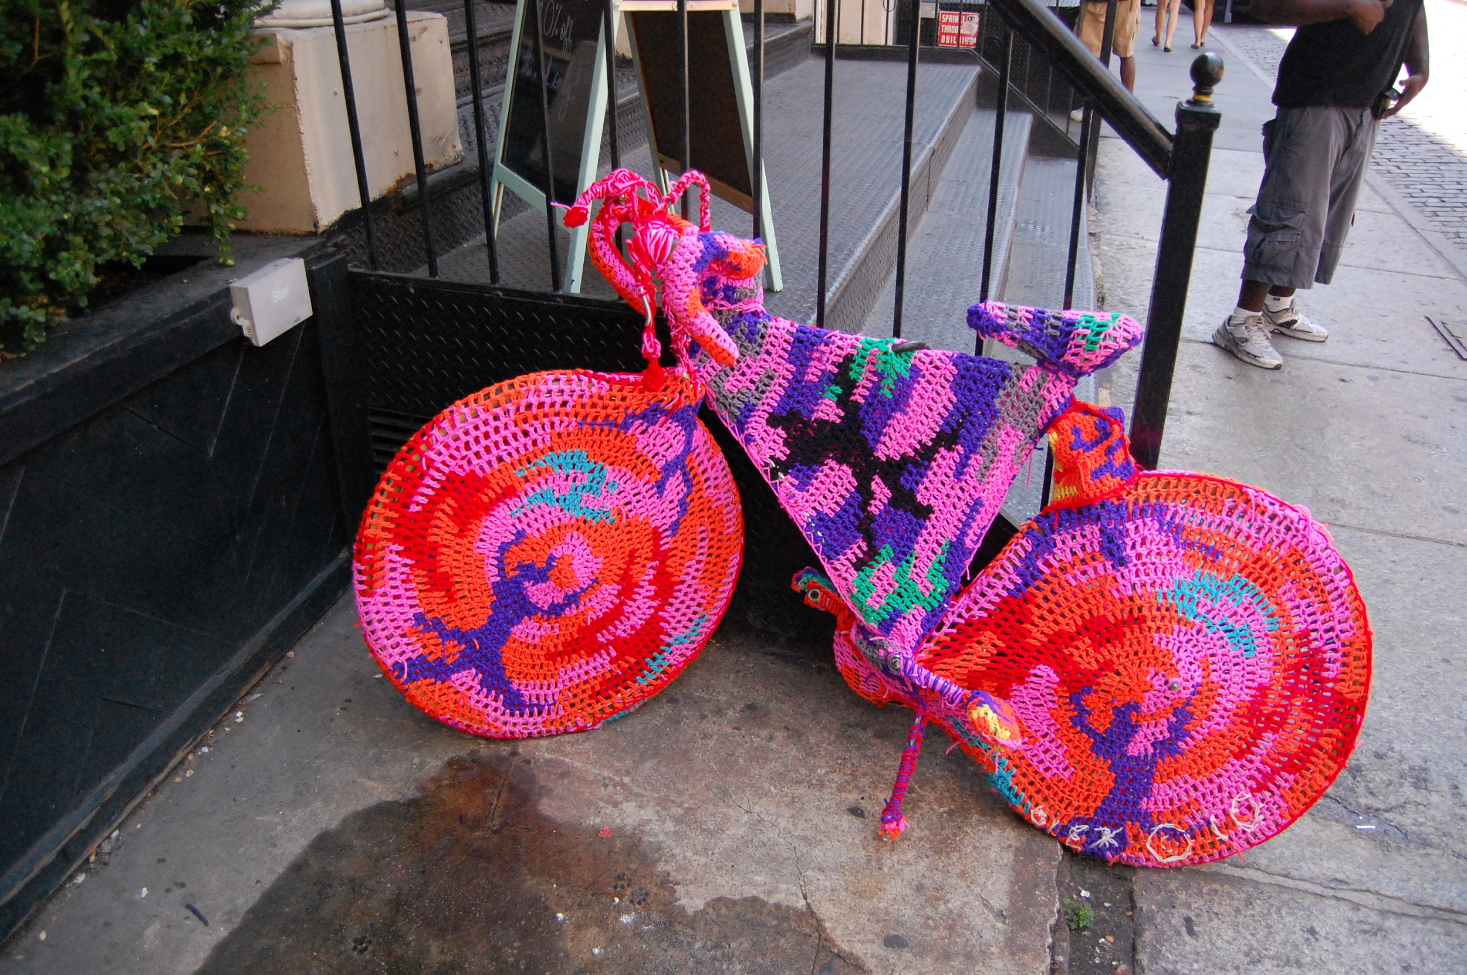
Some examples

Slide 19
Among the various yarn bombing projects held around the globe ,the aqua swim show using yarn bombed suit was a major attraction . In this project ,a swimmer was hired to do an under aqua swim show wearing a yarn bombed suit ,which was a difficult task as the suit would get denser with water , yet this project was viewed and appreciated by hundreds of people.

Slide 20
Yarn bombing is an expressive beautiful art but can harm the nature , thus should be utilized properly in a wise way to avoid any natural degradation.

