Slide 1
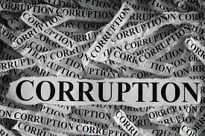
Ways to fight corruption
Mohamed Seddik Ben Yahia,High School, Batna ,Algeria,

Slide 2
What is corruption ?
The global coalition against corruption « Transparency International » define corruption that it is the abuse of entrusted power for private gain. It can be classified as grand, petty and political, depending on the amounts of money lost and the sector where it occurs.

Slide 3
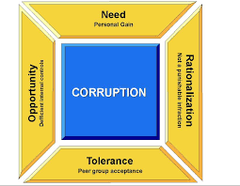
What are the main causes of corruption ?
With rare exceptions, low-income countries.
Countries which have a closed economy.
The influence of religion is visible (Protestant countries have far the lowest level of corruption).
Low media freedom.
A relatively low level of education.

Slide 4
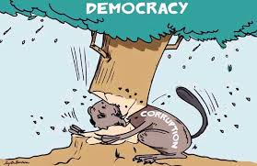
The impacts of corruption
It costs lives, it costs people their freedom, health or money.
Corruption is a major obstacle to democracy and the rule of law. It is extremely challenging to develop accountable political leadership in a corrupt climate.
Corruption depletes national wealth. Corrupt politicians invest scarce public resources in projects that will line their pockets rather than benefit communities.
Corruption corrodes the social fabric of society.
Environmental degradation is another consequence of corrupt systems. For instance: from mining, to logging, to carbon offsets, companies across the globe continue to pay bribes in return for unrestricted destruction.

Slide 5
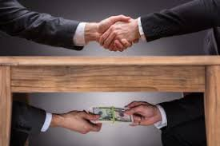
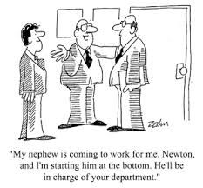
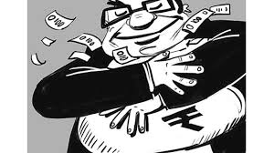
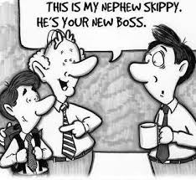
Kinds of corruption
Extortion
Cronyism
Nepotism
Bribery
Graft
Embezzlement

Slide 6
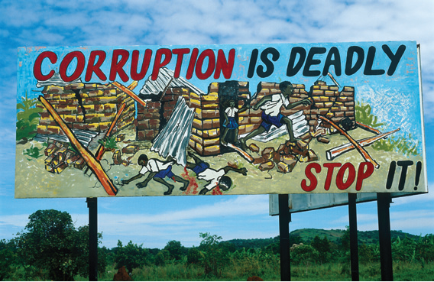
How to stop corruption?
1. End impunity
2. Reform public administration and finance management
3. Promote transparency and access to information
4. Empower citizens
5. Close international loopholes

Slide 7
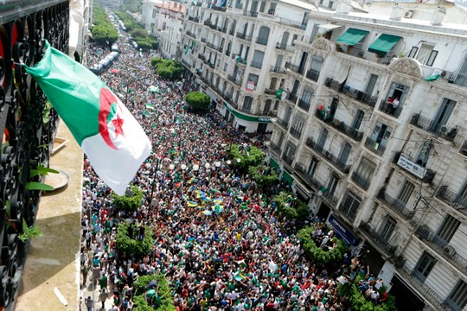
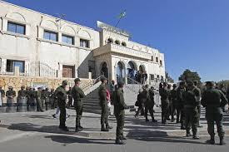
Fighting corruption in Algeria
Algeria is trying to stop corruption by practicing several different methods are:
Judicial System
Police
Public Services
Land Administration
Tax Administration
Customs Administration
Public Procurement
Natural Resources
Legislation
Civil Society

