Slide 1
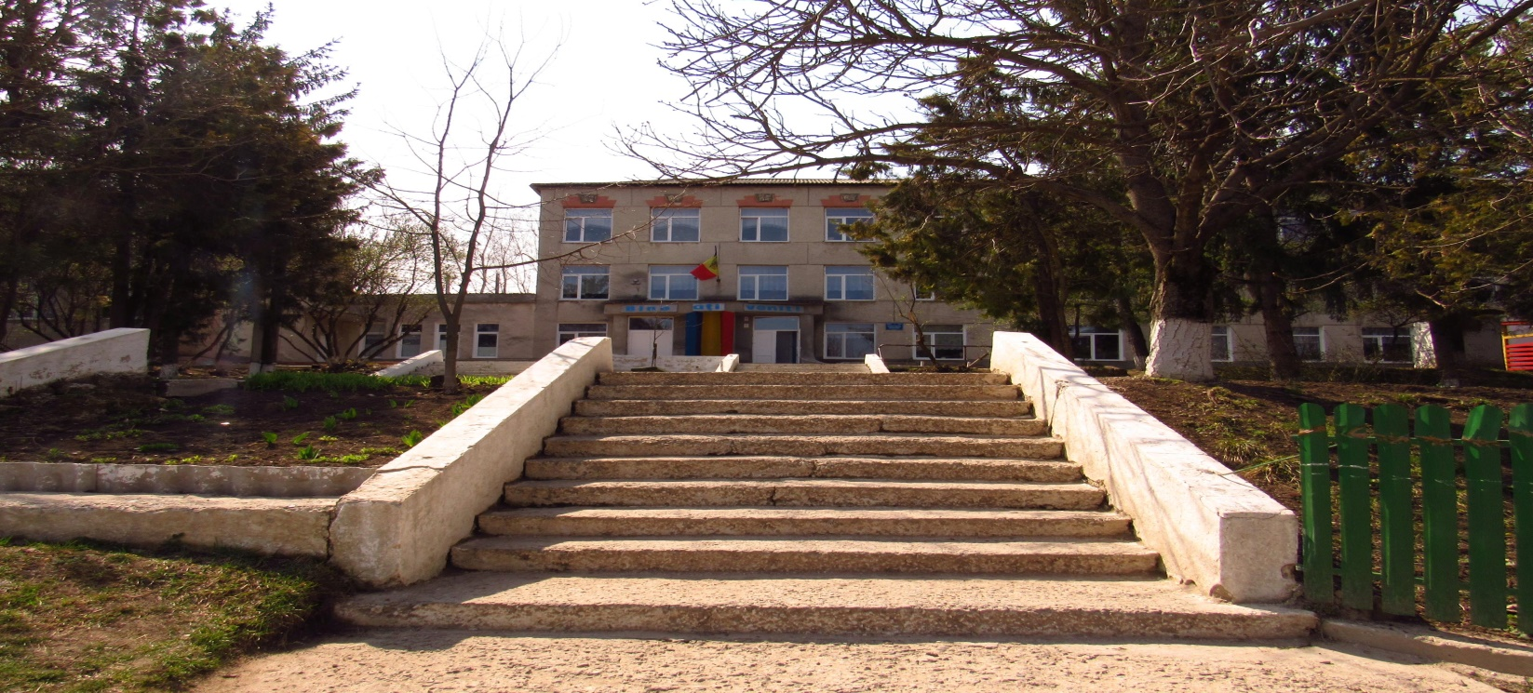
My School The most important seasonal holidays in our school
Elaborated by 5th form pupils
iEarn Projects.
Learning Circles. Middle School.

Slide 2
This is our village’s House of Culture!

Slide 3
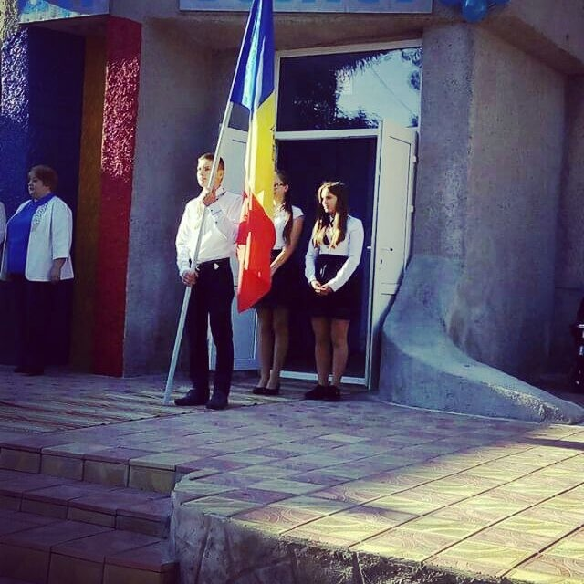
This is our national flag!

Slide 4
This is our class! Girls and boys!

Slide 5
Autumn holidays
The first bell
The teachers’ Day
The autumn harvest Day

Slide 6
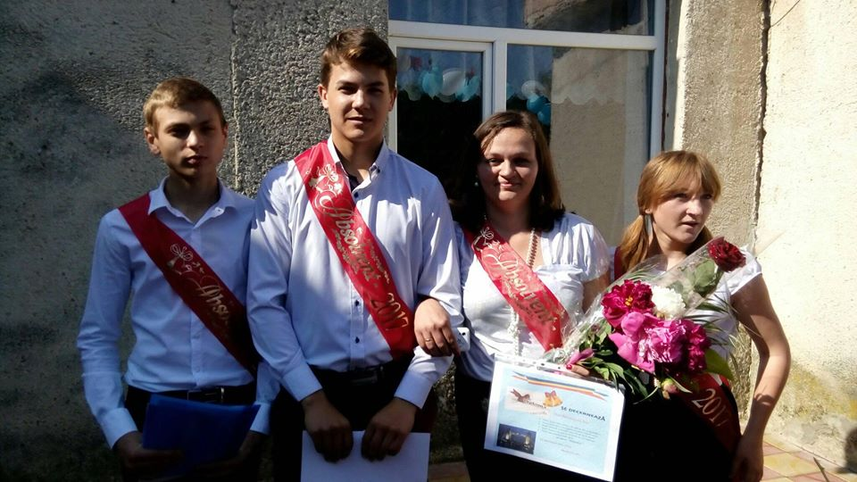
The first Bell! 1st of September

Slide 7
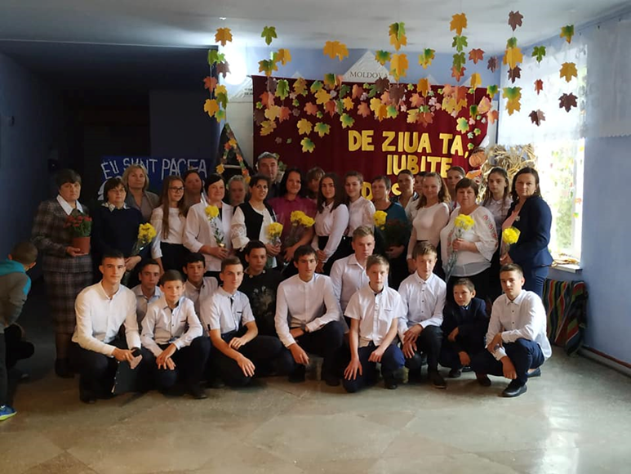
Teacher’s Day

Slide 8
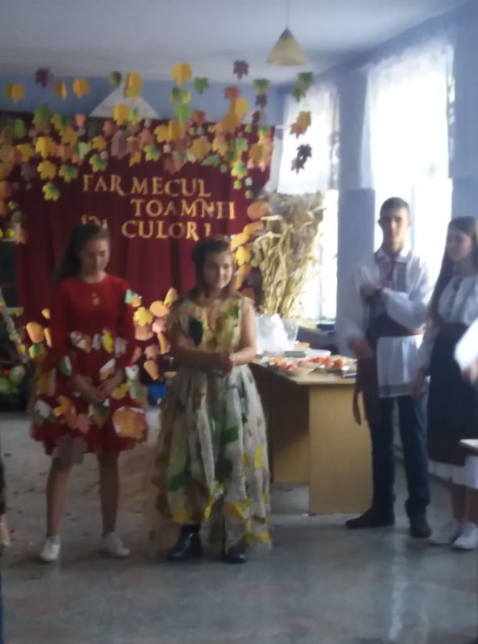
The Autumn harvest day
Autumn’s Fairy
Autumn’s expositions

Slide 9
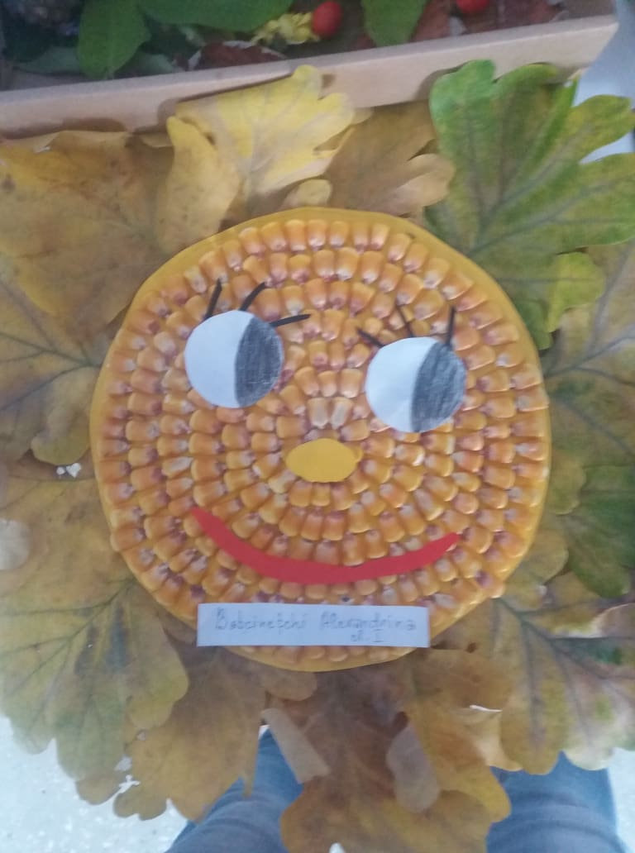
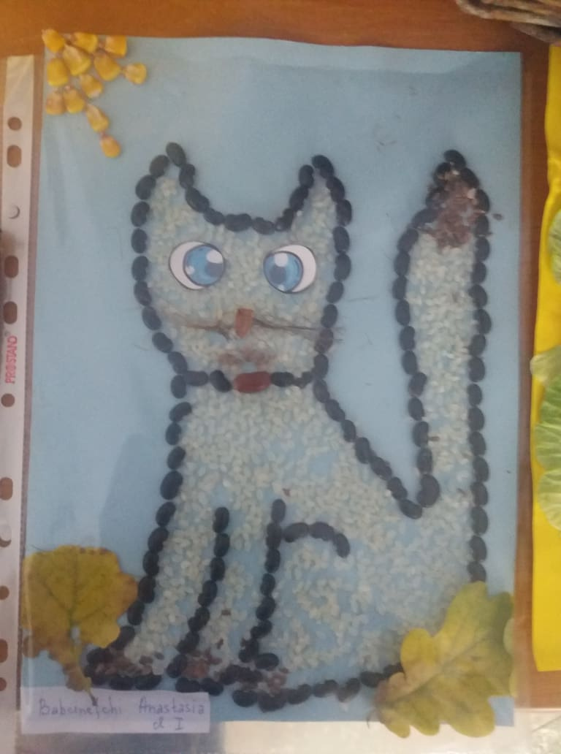
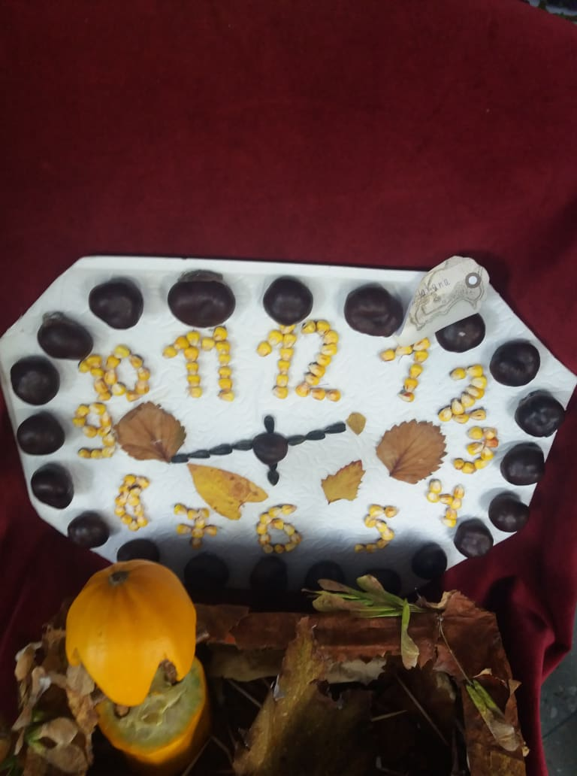
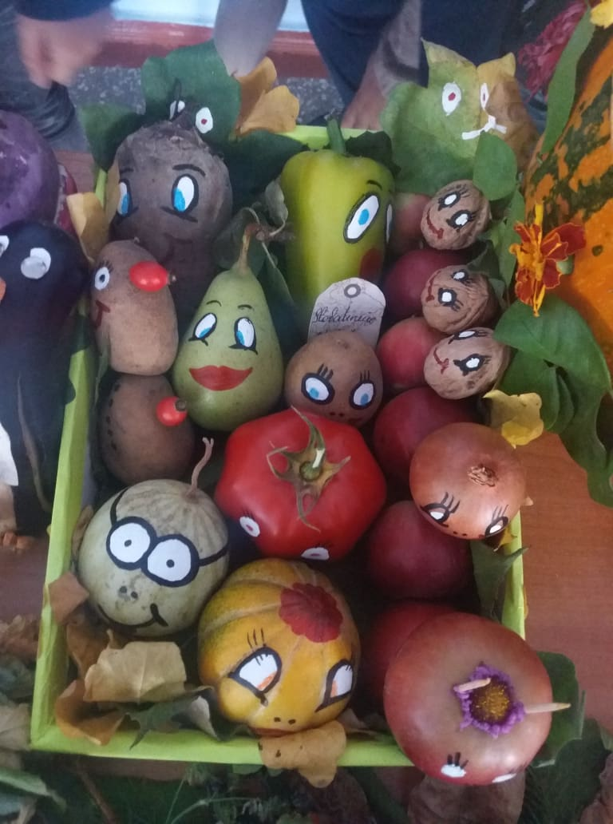
Students’artscrafts ( made from natural fibres)

Slide 10
Winter holidays
-Christmas Holiday
-Safer Internet Day, February

Slide 11
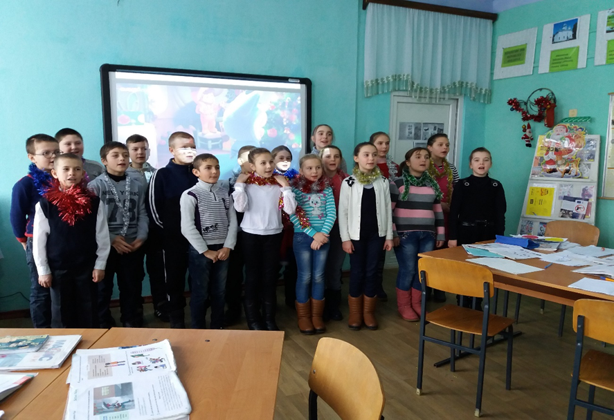
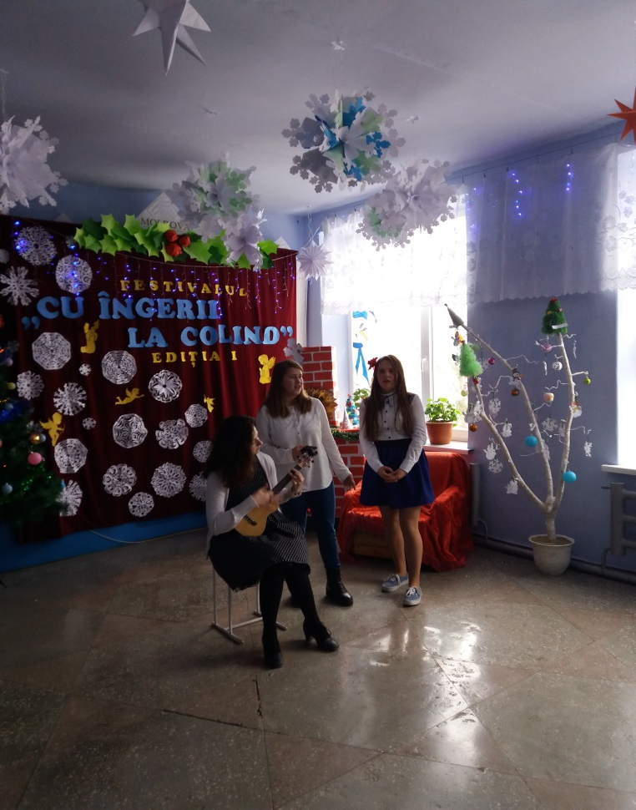
Christmas carols’Festival
https://www.youtube.com/watch?v=oFEuzEgoNnk

Slide 12
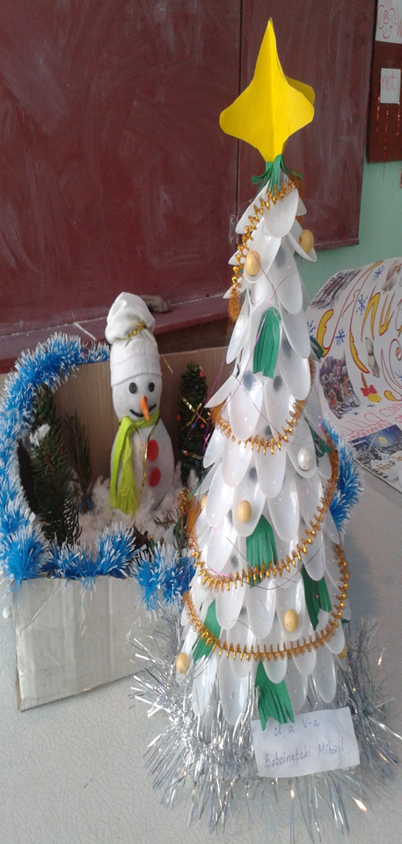
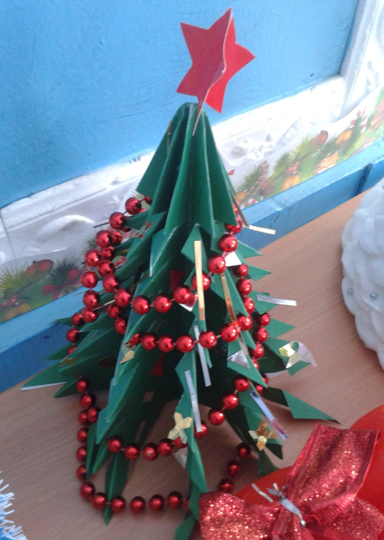
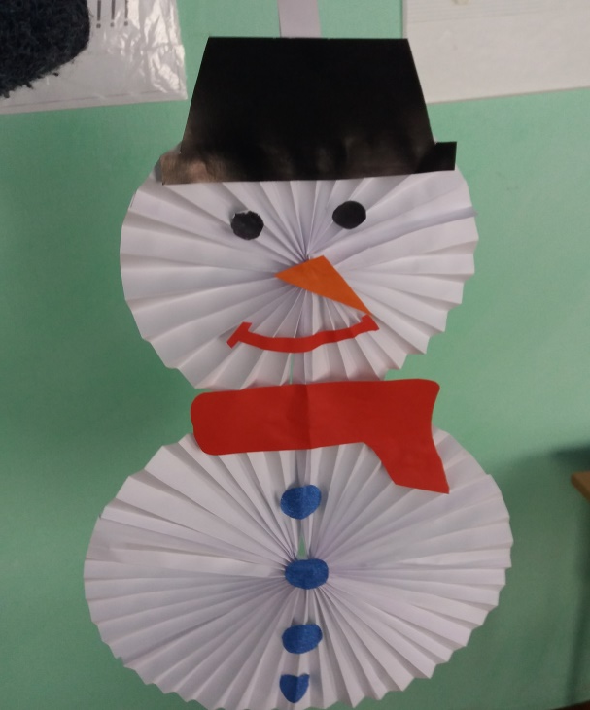
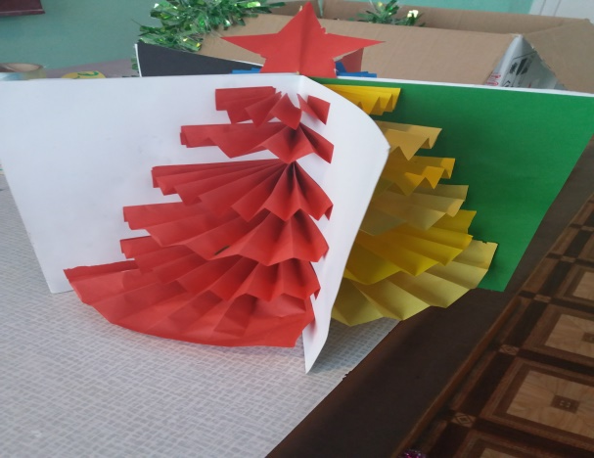
Students’ Christmas Artcrafts

Slide 13
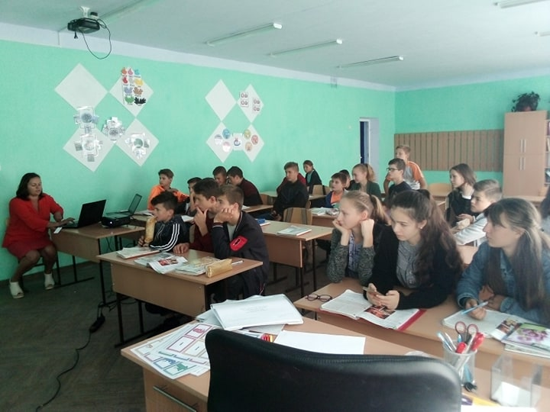
Safer Internet Day , February 9th form pupils organized a flash-mob
https://www.youtube.com/watch?v=6XJbn2st75Q

Slide 14
Spring’s holidays
1st of March Martisor’s Day
8th of March Mother’s Day

Slide 15
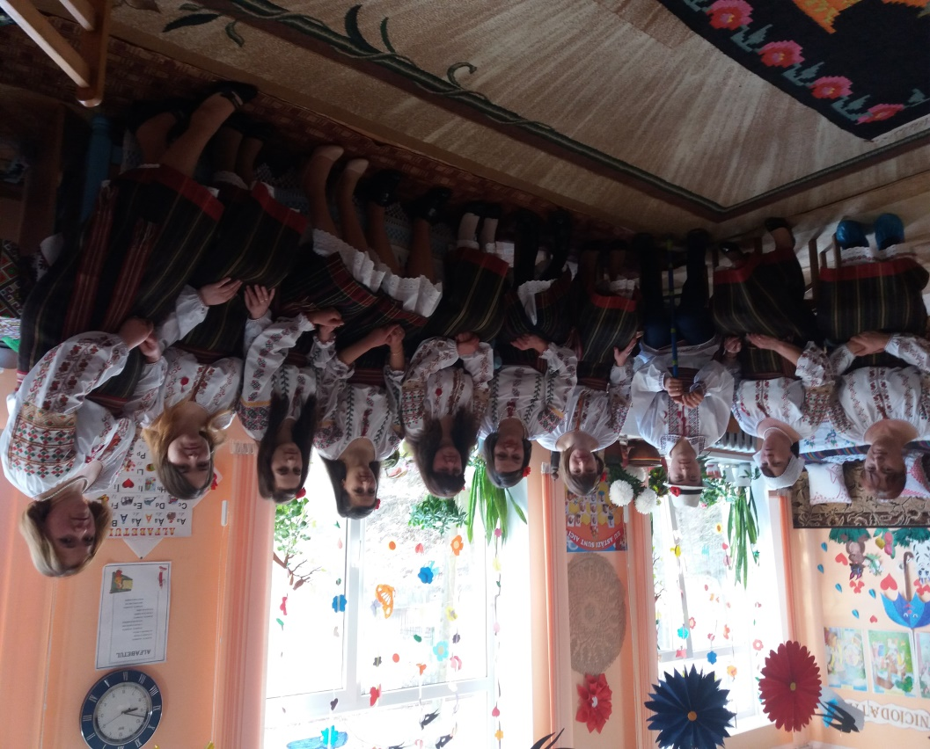
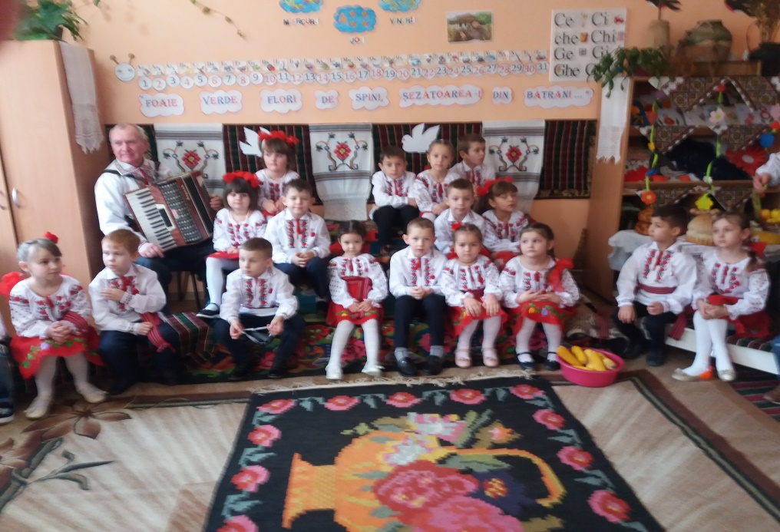
1st of March – Martisor’s Day, national holiday!

Slide 16
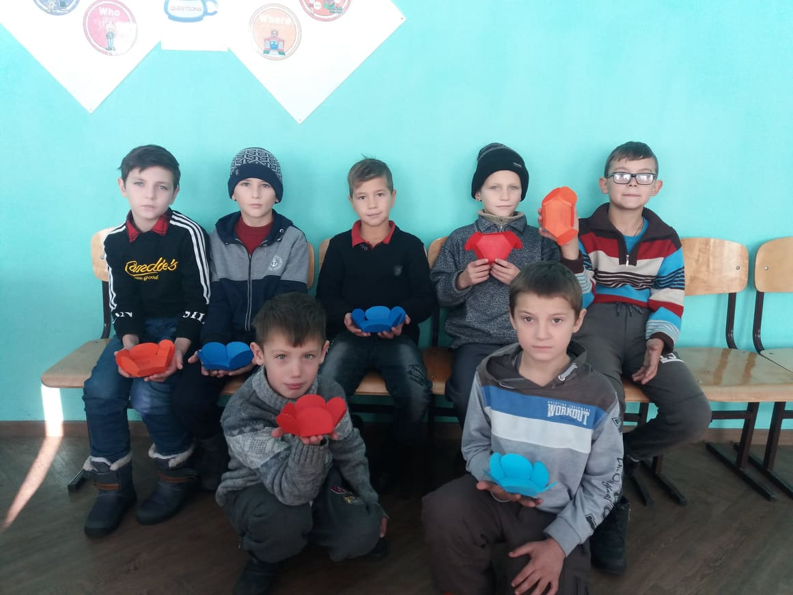
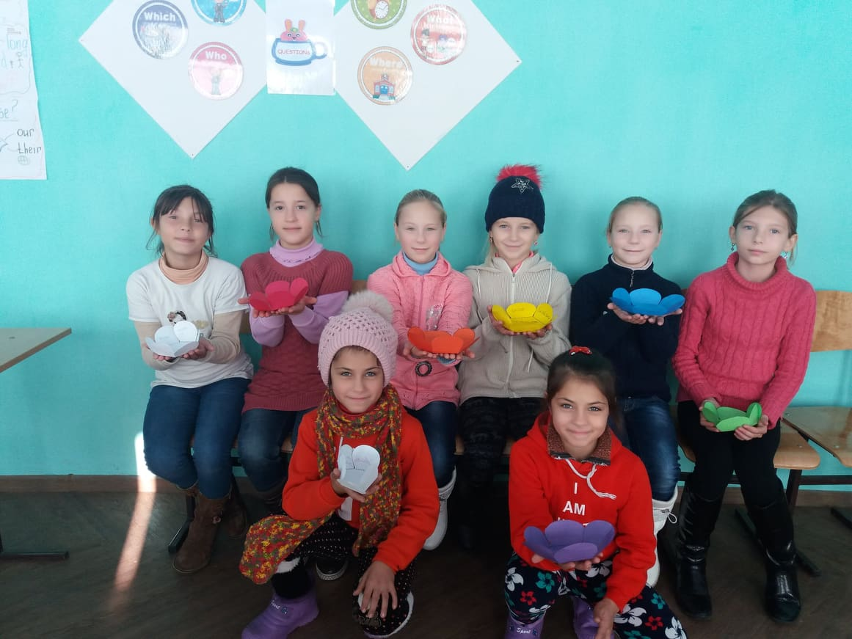
8th of March, Mother’s Day- national holiday! 5th for girls danced the Dance of Flowers for all Mothers invited at the festival
https://www.youtube.com/watch?v=twtSmLn5JmY

Slide 17
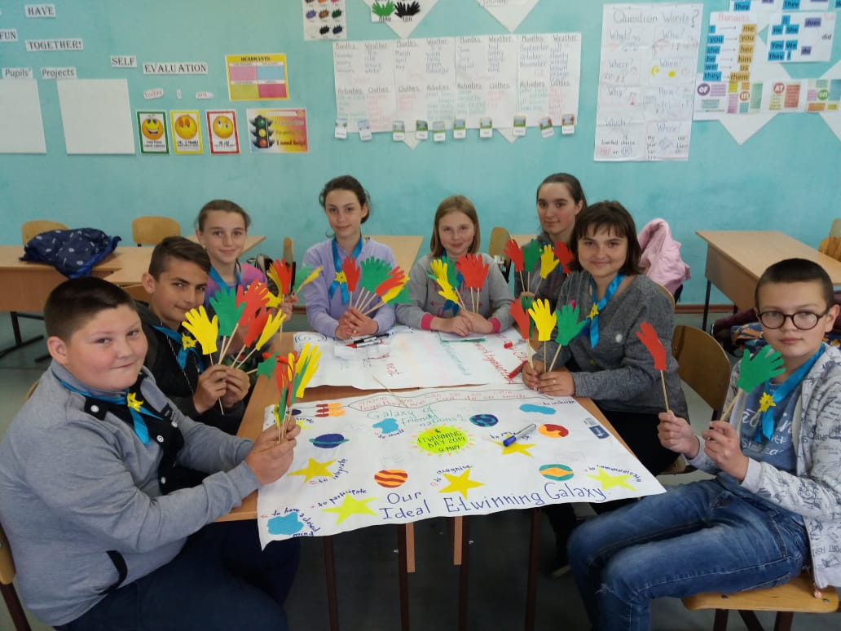
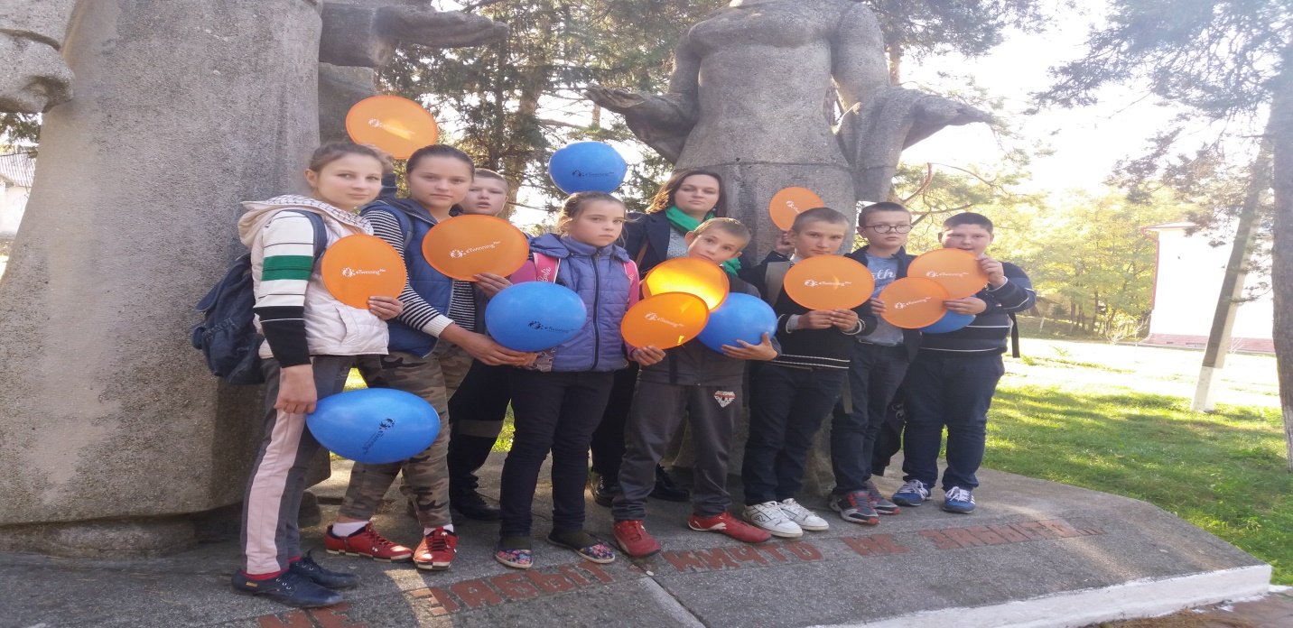
Etwinning Projects

Slide 18
Thank you!
Our school is our favorite place!

