Slide 1
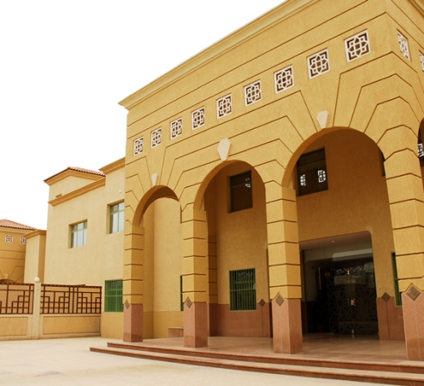
MY SCHOOL JUBAIL INTERNATIONAL SCHOOL
RANEEM FAHAD

Slide 2
Overview
Location :Huwaylat District, in Jubail Industrial City, Saudi Arabia
Established : 1999
Area: 19700 sqm
A part of group of International Schools in:
Khobar, Riyadh, Jubail and Yanbu

Slide 3
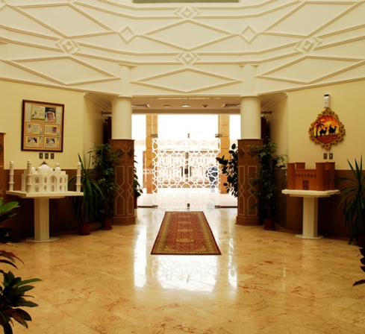
Overview
Students from over 35 nationalities
Teachers from more than 15 nationalities
Strength : 1300 Students
School has 3 sections:
Boys
Girls
Administration Offices

Slide 4
School Stages
Early Childhood –Pre K to KG 2
Primary School- Grade 1-5
Middle School- Grade 6-8
High School- Grade 9-12

Slide 5
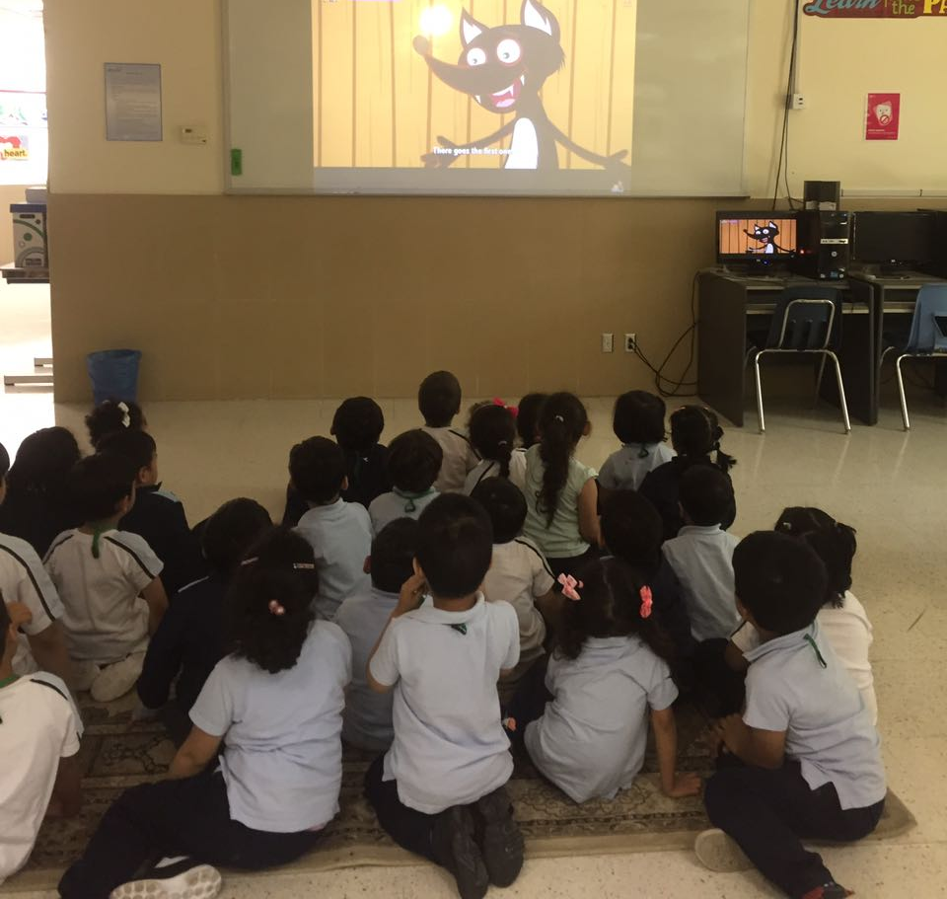
Classrooms
20 – 25 students
Airconditioned
Interactive teaching using:
White board
Smart board

Slide 6
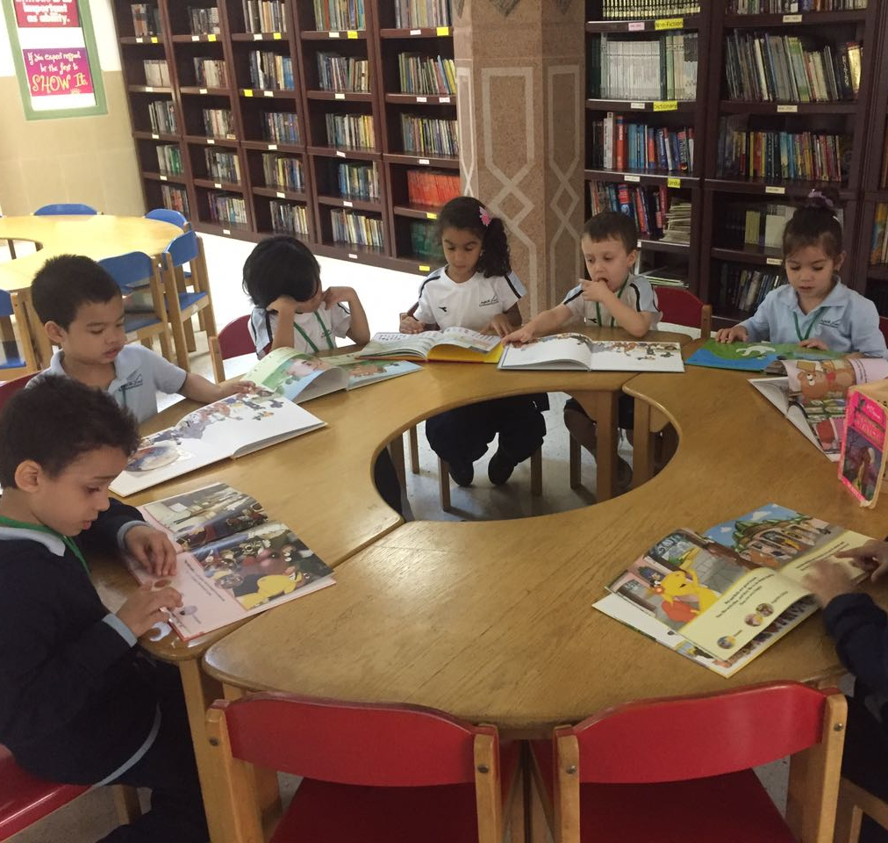
Libraries
Books suitable for all ages and groups
Serene atmosphere for reading
Internet Access
Over 7000 books

Slide 7
Computer Laboratories
2 fully equipped computer laboratories
Audio-Visual facilities
Printing facilities

Slide 8
Science Laboratories
4 adequately equipped laboratories
Suitable for Biology, Physics and Chemistry Experiments

Slide 9
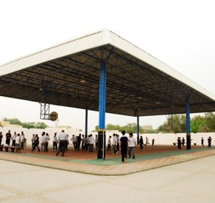
Sports Facilities
2 gyms
Separate courts for Volley Ball and Basketball
Other indoor games : e.g. Table tennis, Badminton

Slide 10
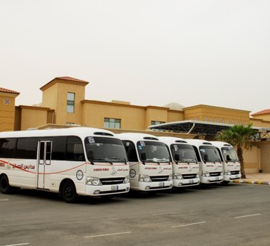
Other Facilities
Art Rooms
School Clinic
Cafeterias
Buses Fleet

Slide 11
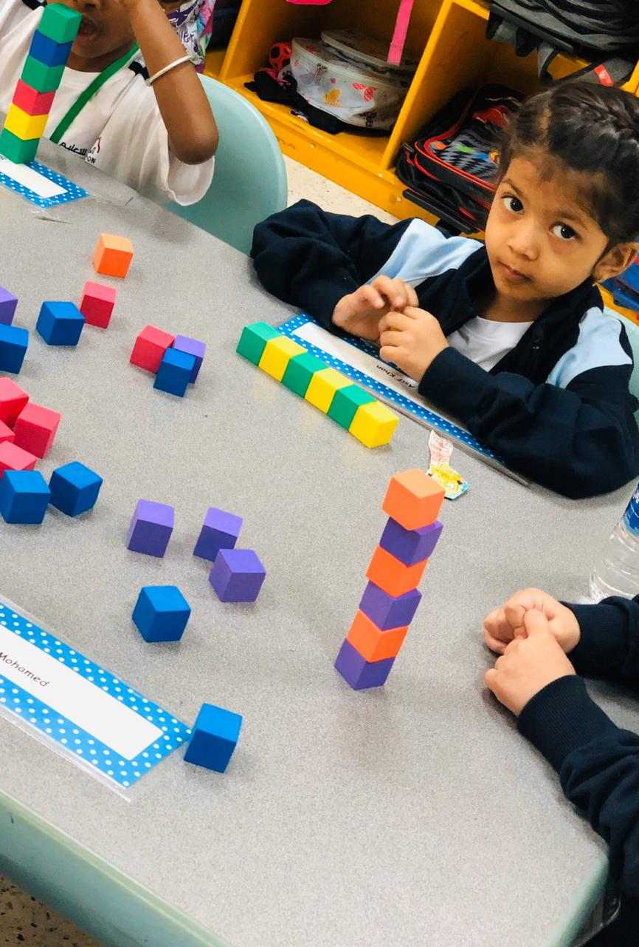
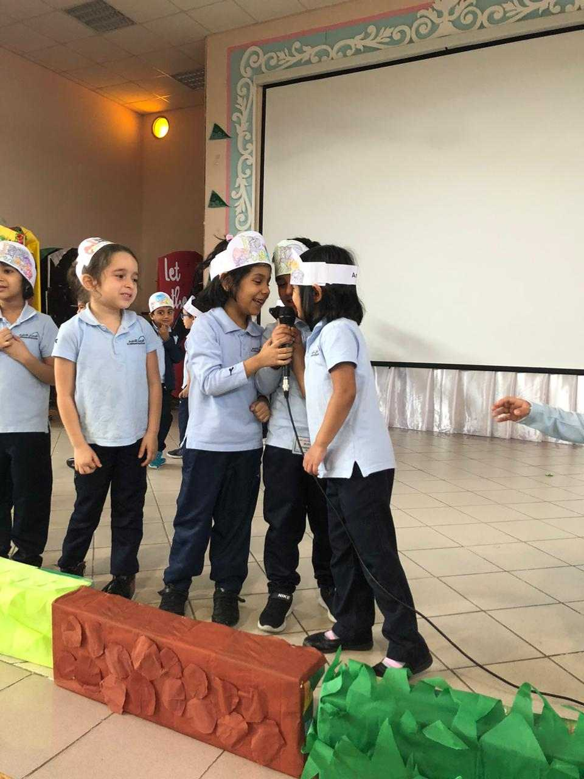
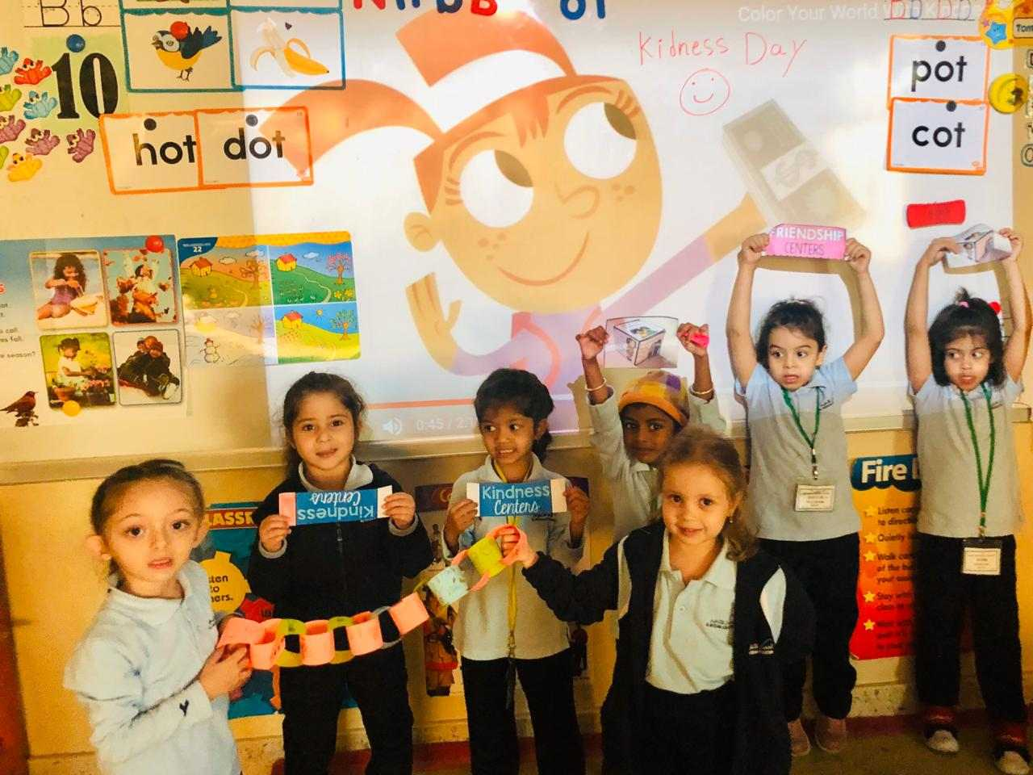
Activities

