Slide 1
My School Elementary
November 2019
AL HUSSAN INTERNATIONAL SCHOOL

Slide 2
My School

Slide 3
Learnings
It helps me to learn and discover many new things in Math, Science, English, French, and Arabic subjects.

Slide 4
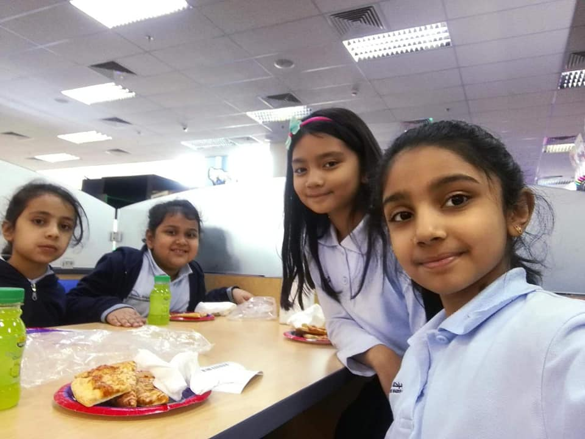
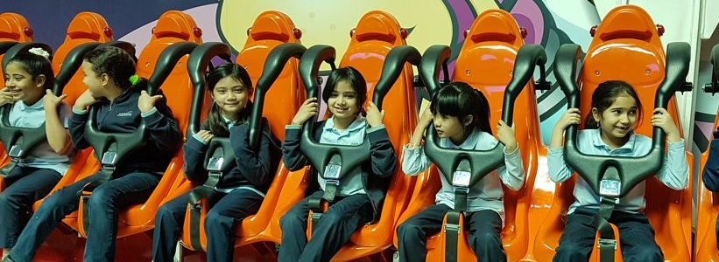
My Teachers and Classmates
I am thankful with my teachers for they help me to become a better student and with my classmates whom I also created friendship.

Slide 5
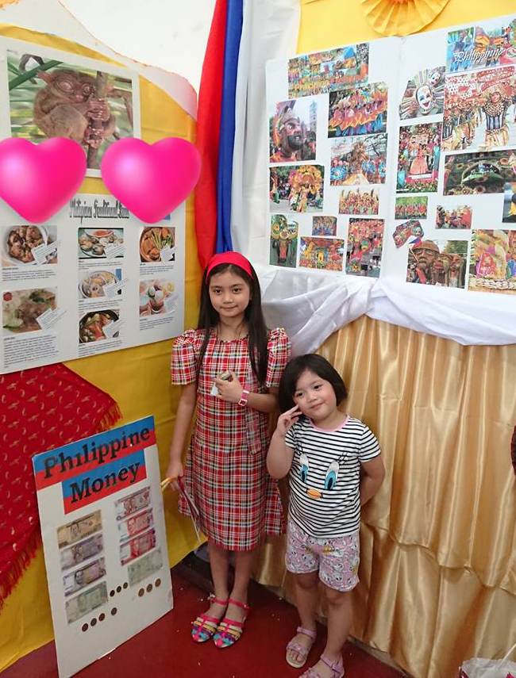
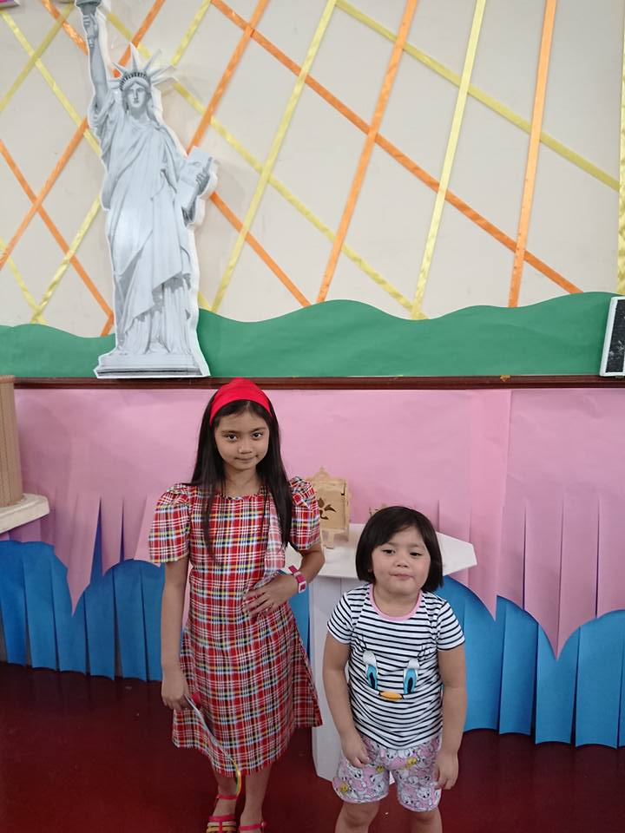
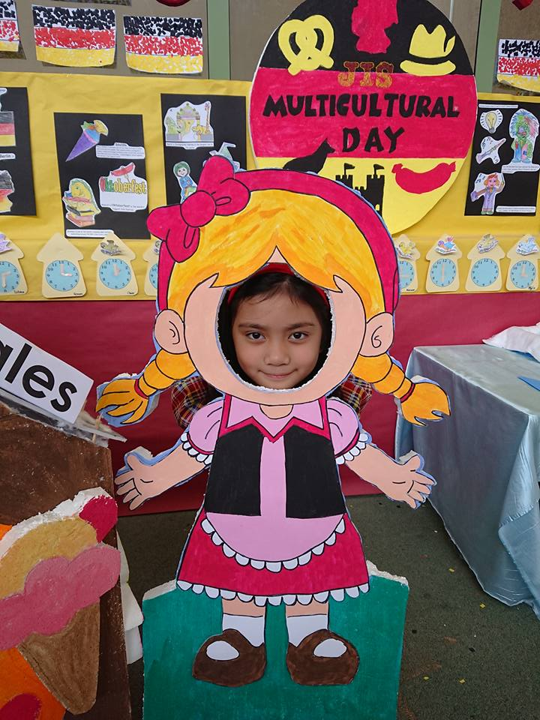
Activities
Taken during our Multicultural Day, I wore Philippine dress. I was in 2nd grade.

Slide 6
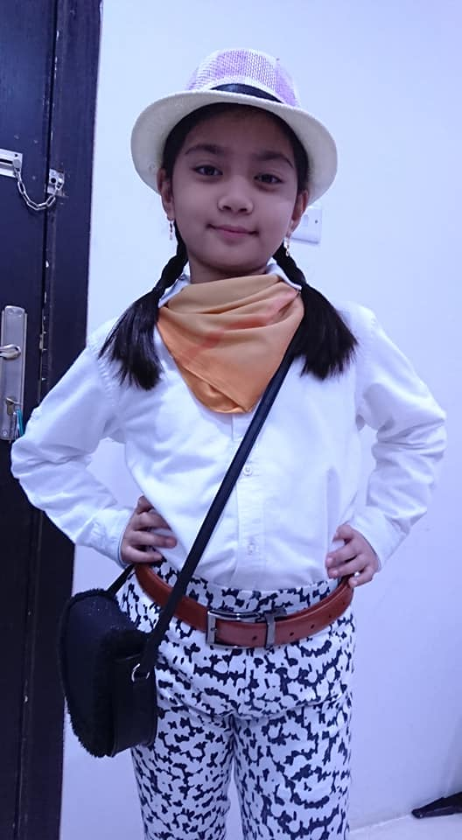
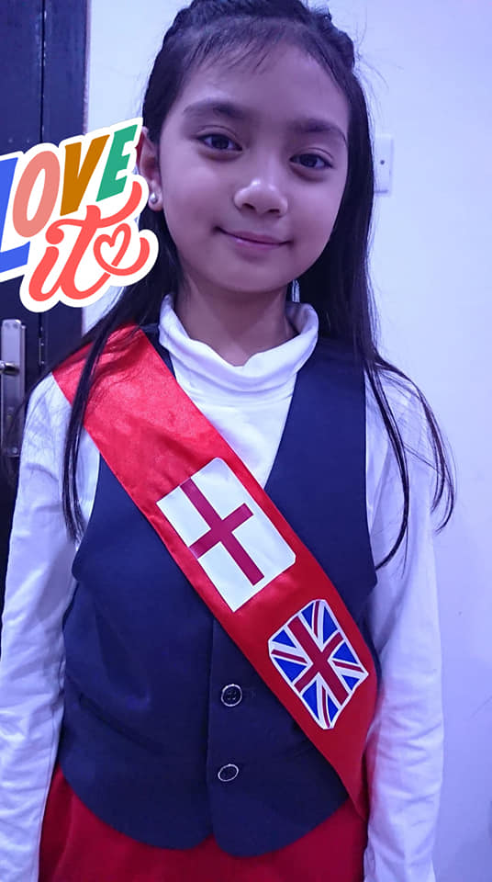
Activities
Taken during Carnival Day and International Day. I was in 3rd grade this time.

Slide 7
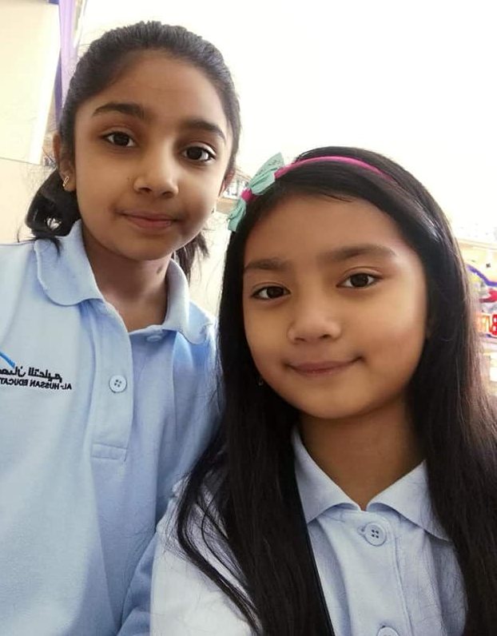
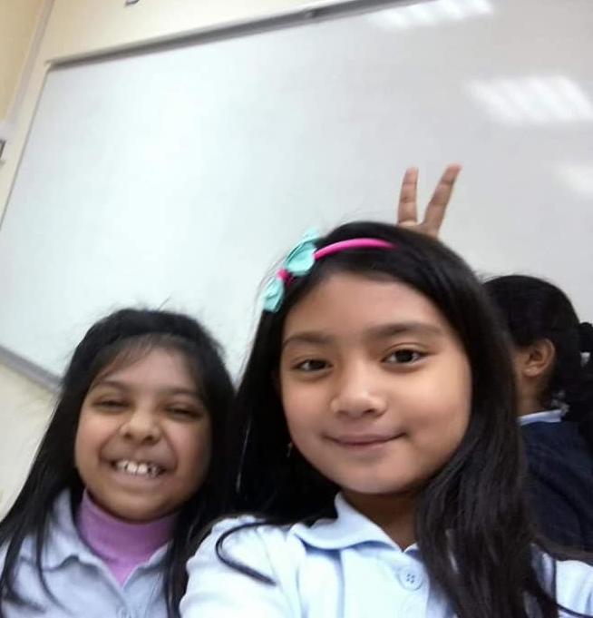
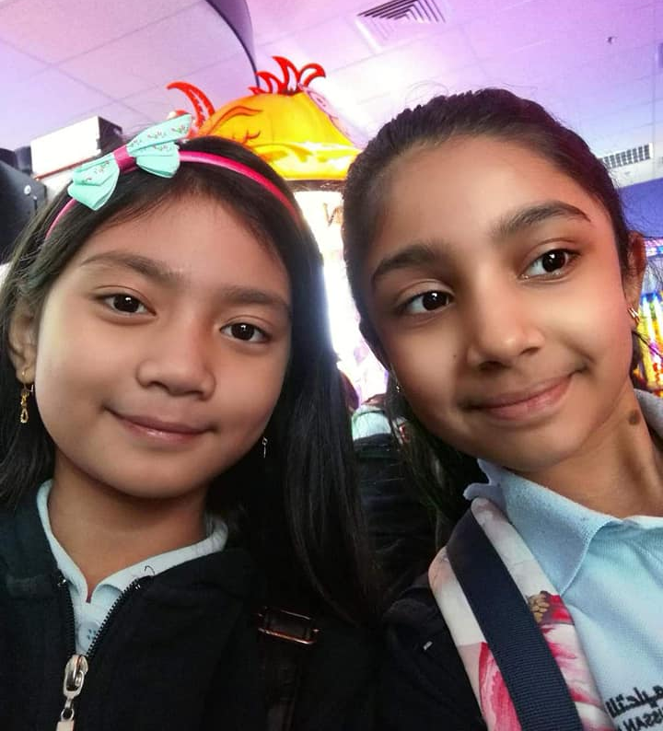
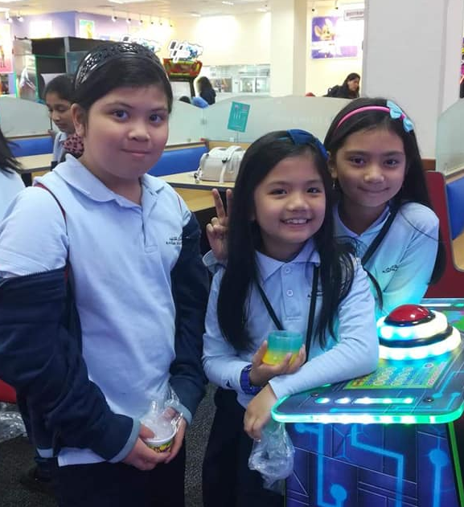
Friendships
I am grateful with all my classmates and friends. I will treasure all the memories that we have.

Slide 8
Thank You!
Ayesha Nichole S. Amarille

