Slide 1
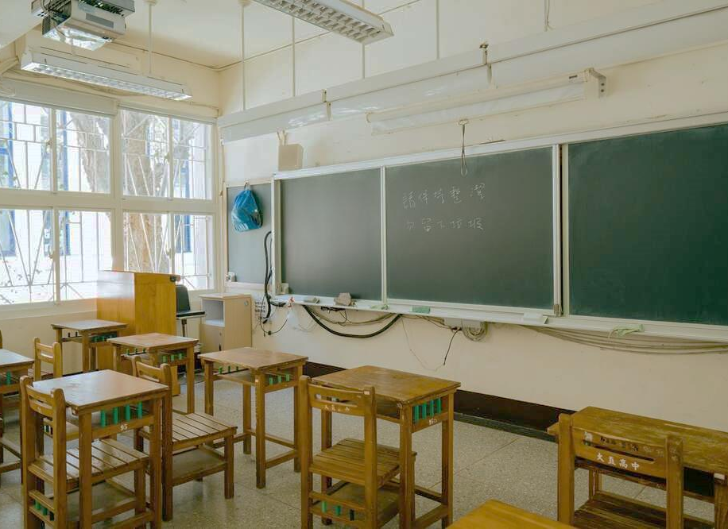
教室聊天照

Slide 2
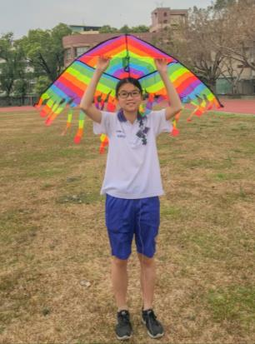
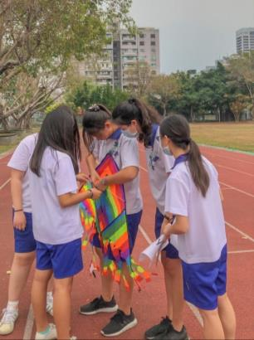
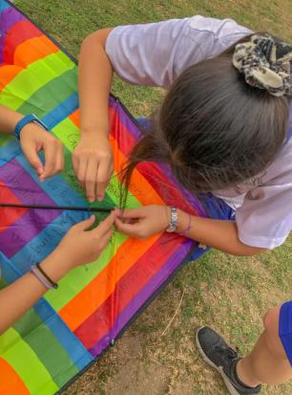
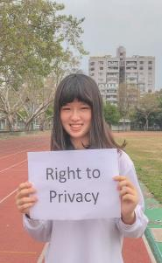
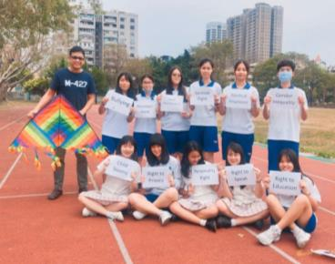
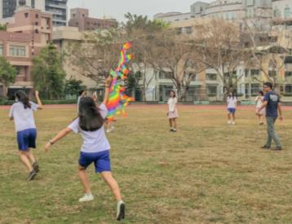
Fly Kites

Slide 3
United States
Brazil
Israel
Algeria
India
Taiwan

Slide 4
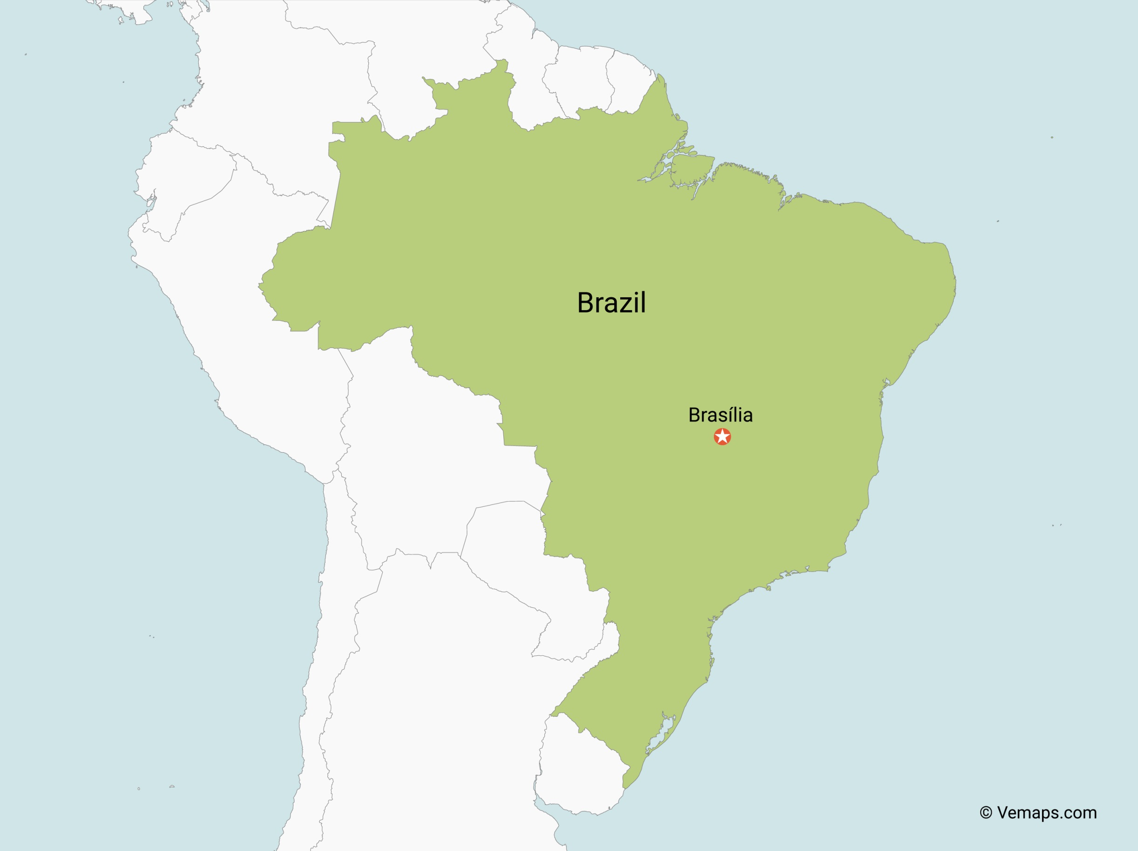
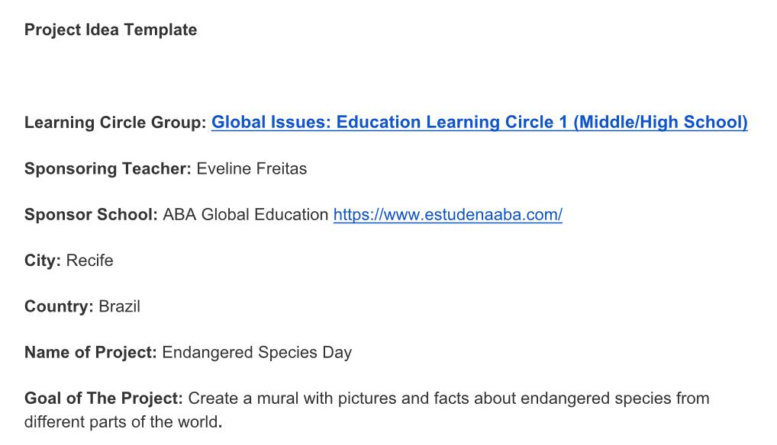

Slide 5
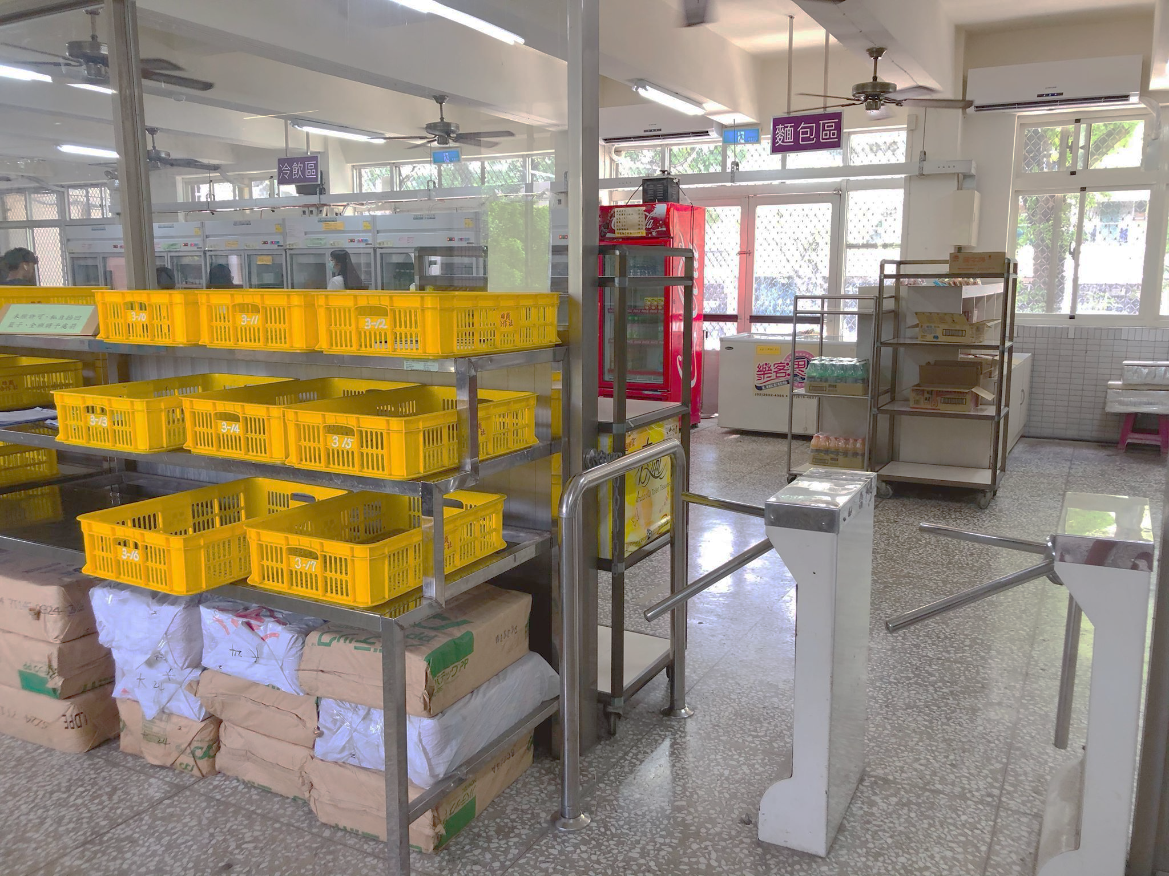

Slide 6
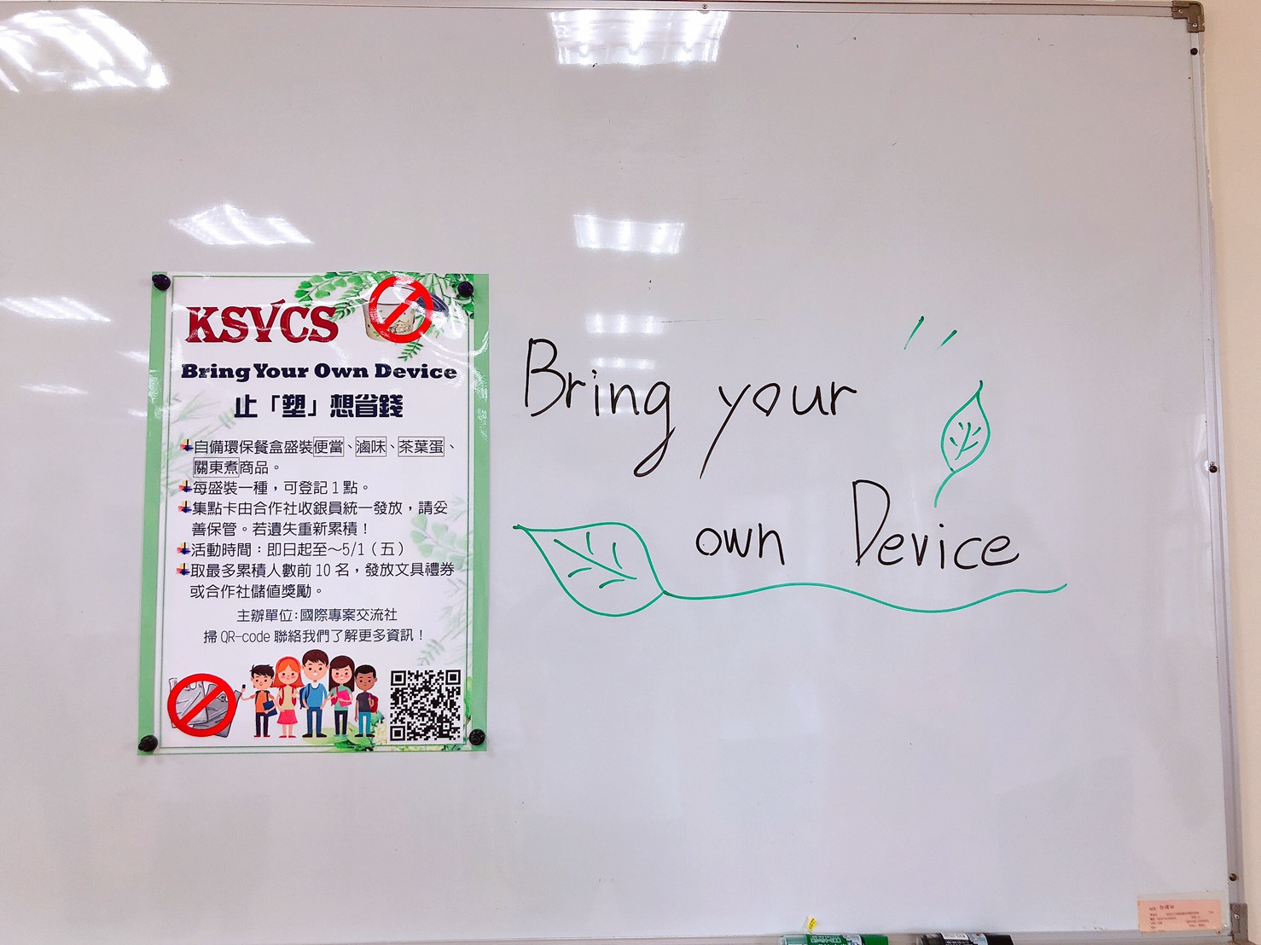

Slide 7
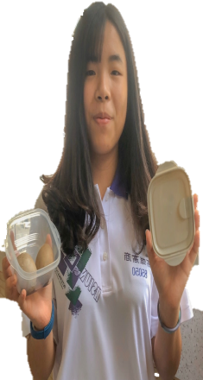
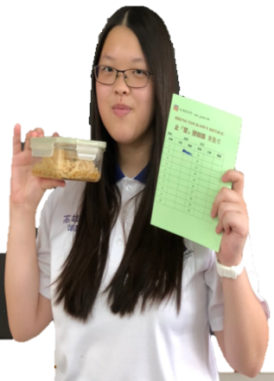
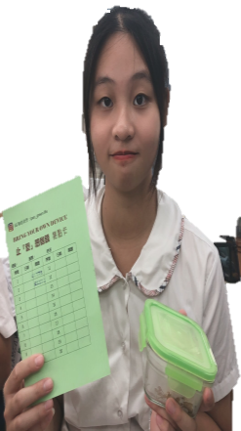
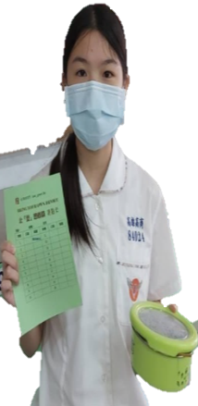
Bring
Your
Own
Device
Bring Your Own Device

Slide 8
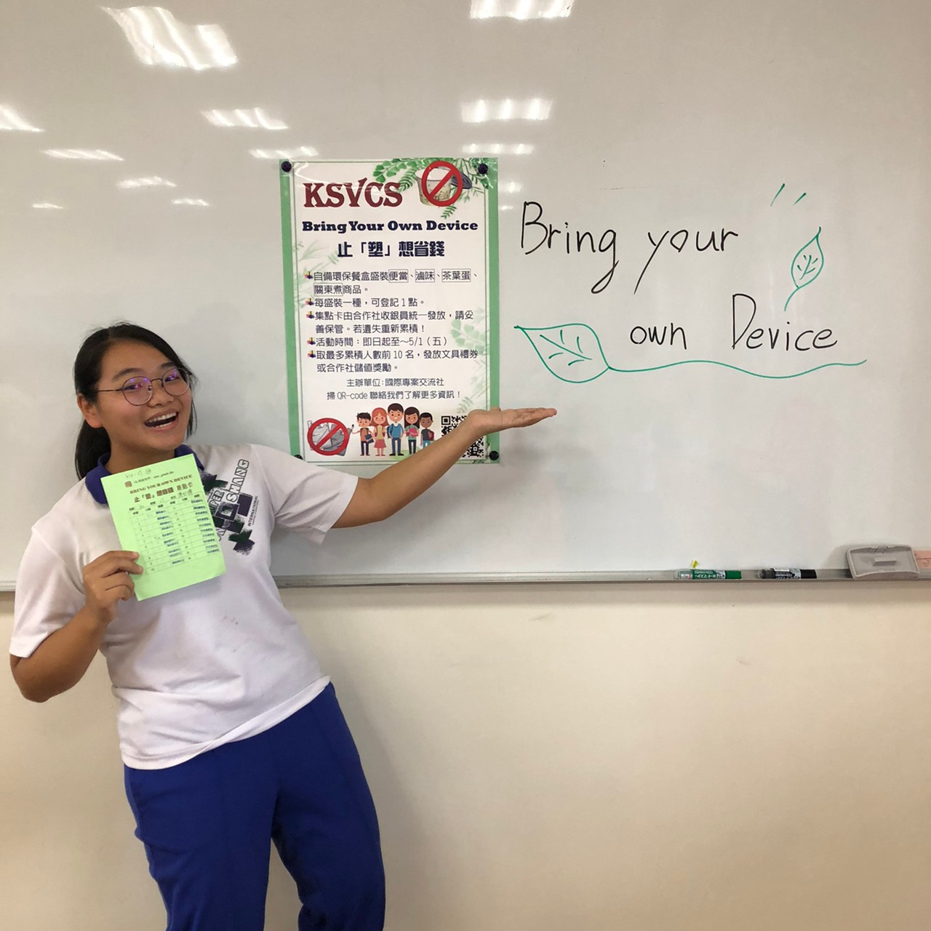
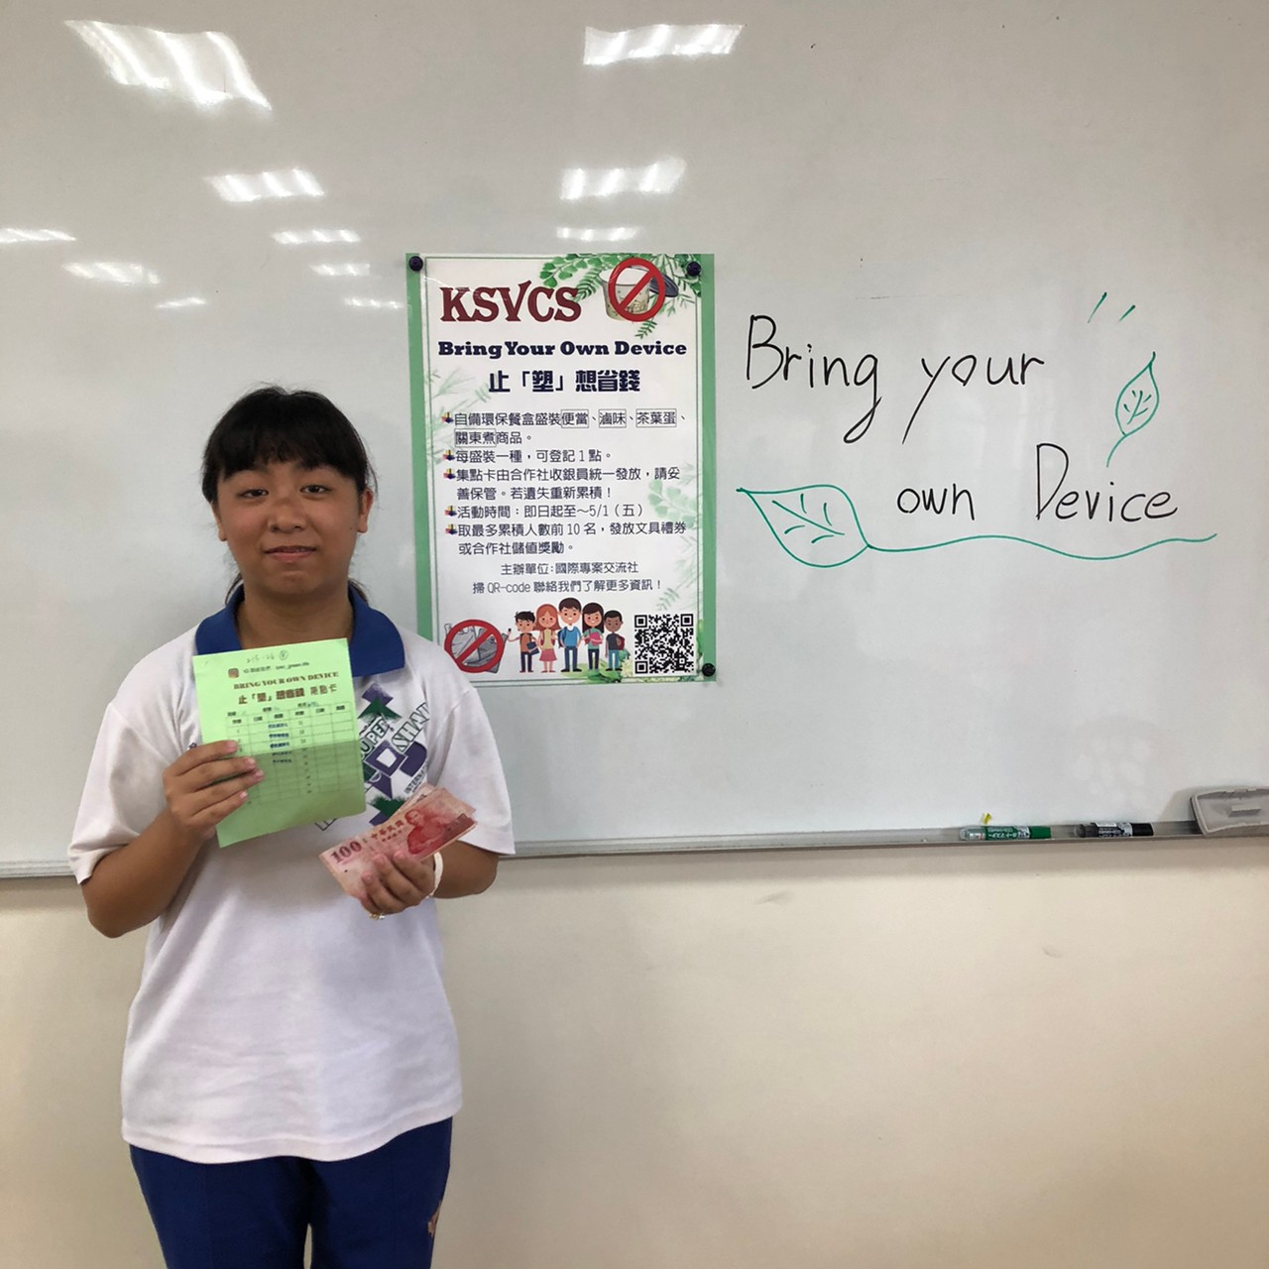
Bring Your Own Device

Slide 9
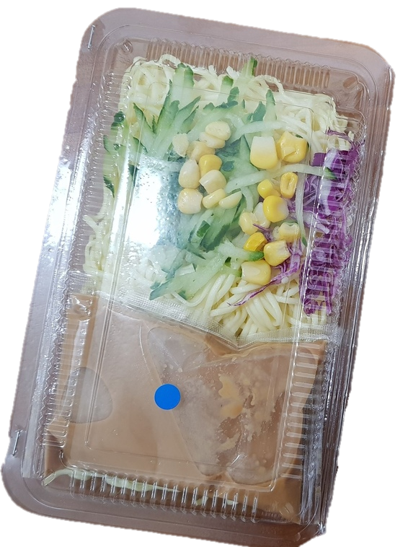
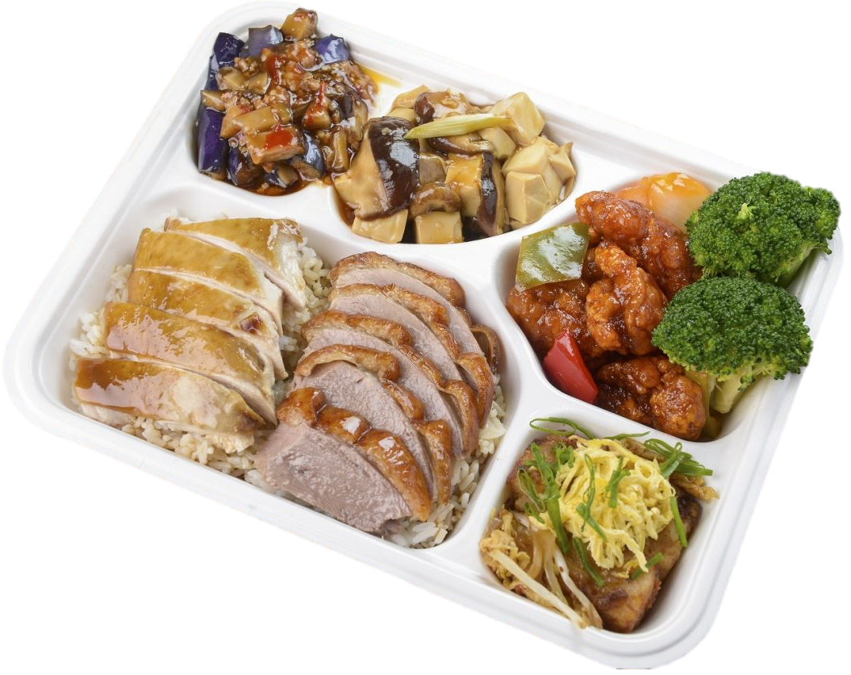

Slide 11
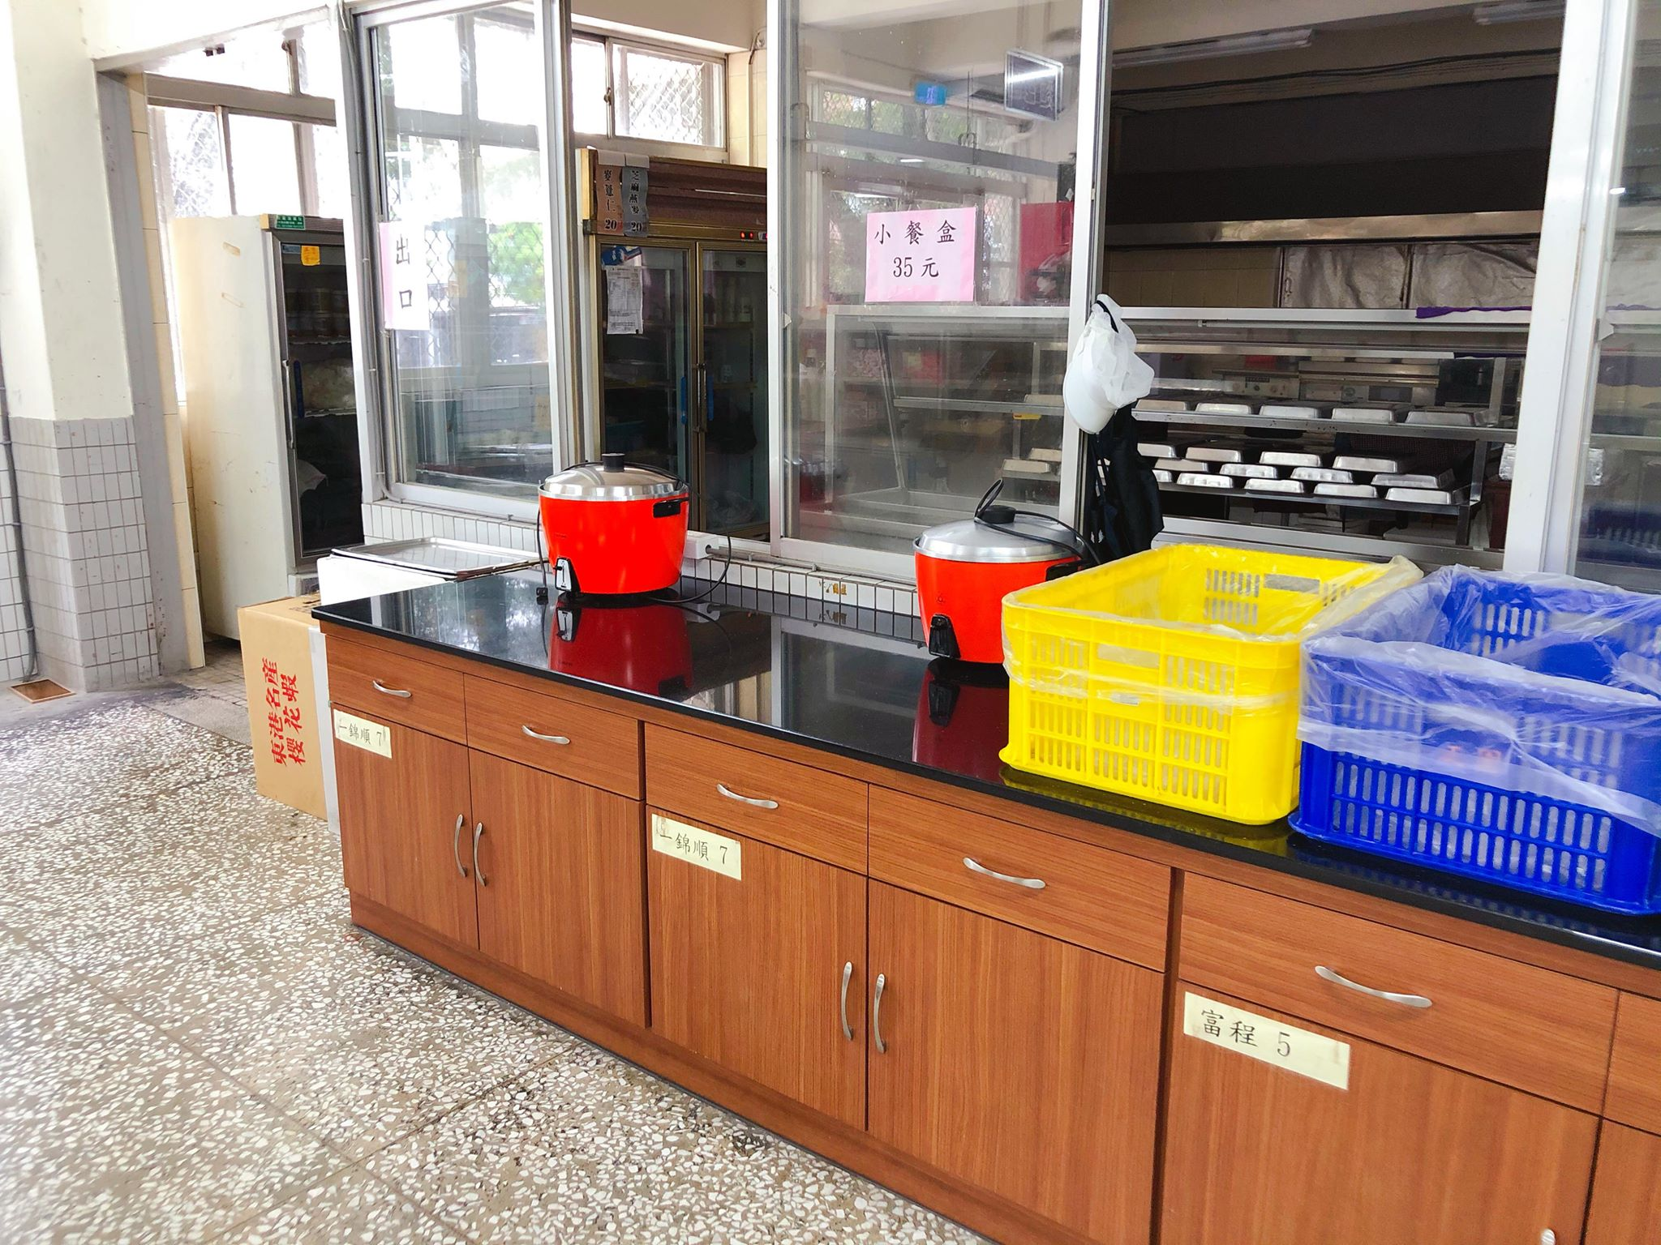

Slide 12
Three Weeks
April
May
Sun | Mon | Tue | Wed | Thu | Fri | Sat
 |  |  | 1 | 2 | 3 | 4
5 | 6 | 7 | 8 | 9 | 10 | 11
12 | 13 | 14
Sun | Mon | Tue | Wed | Thu | Fri | Sat
 |  |  |  |  |  | 2
3 | 4 | 5 | 6 | 7 | 8 | 9
10 | 11 | 12 | 13 | 14 | 15 | 16
17 | 18 | 19 | 20 | 21 | 22 | 23
24 | 25 | 26 | 27 | 28 | 29 | 30
1
15
16
17
18
19
20
21
22
23
24
25
26
27
28
29
30

Slide 13
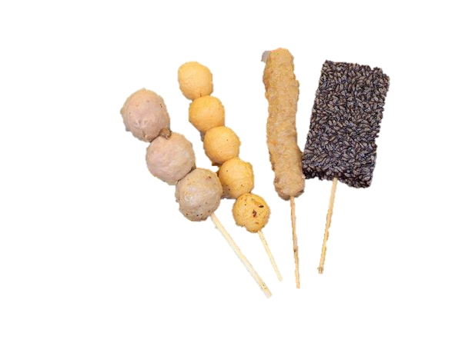
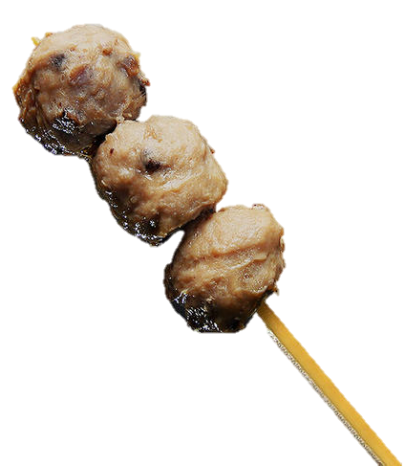

Slide 14
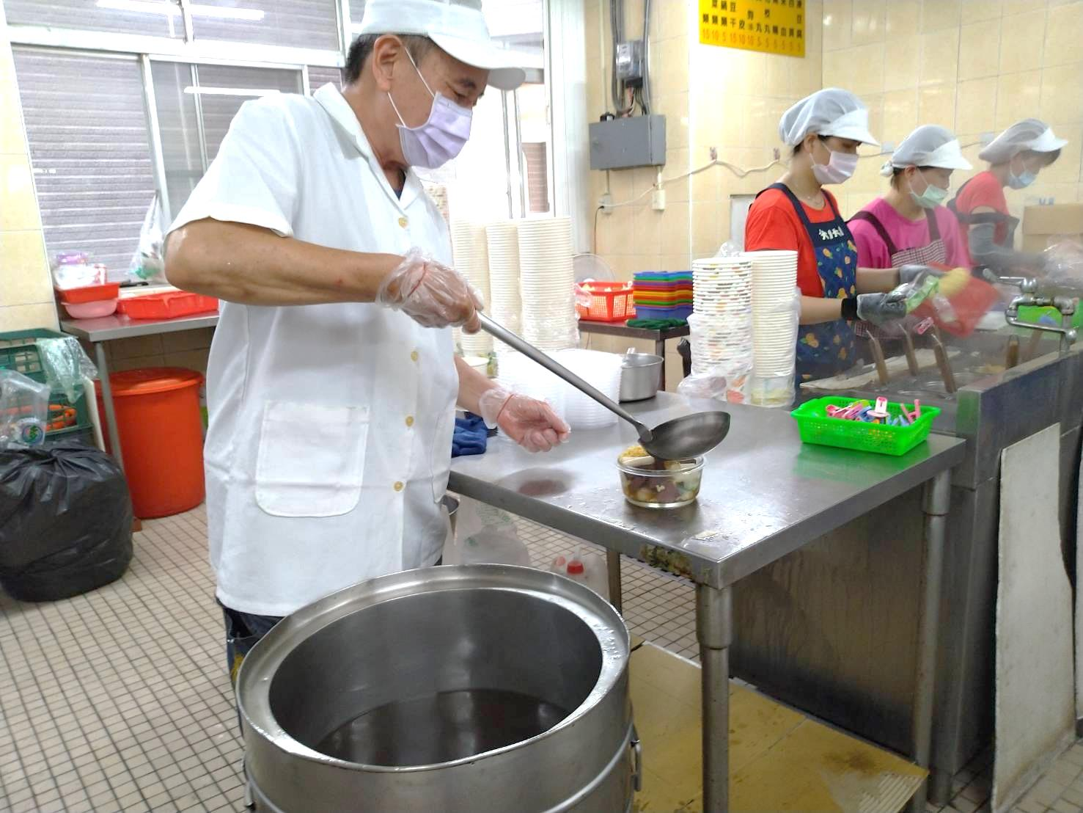

Slide 15
Number of
Participants is low

Slide 16
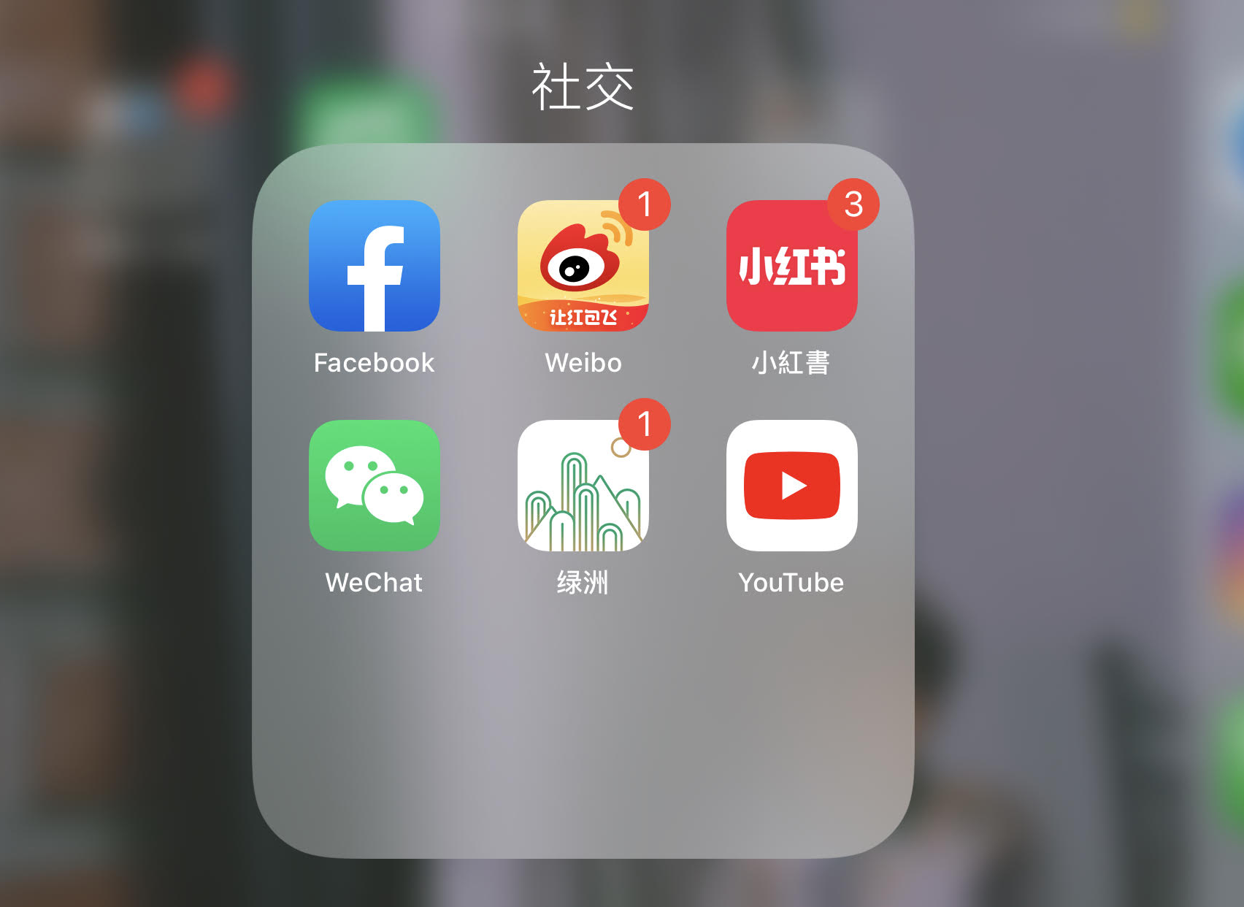
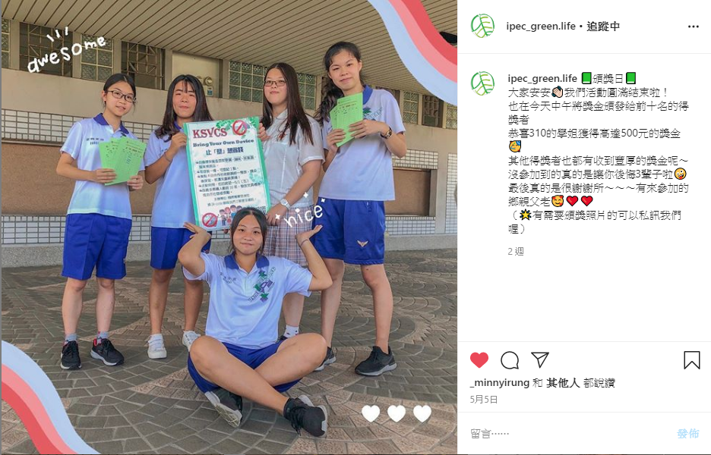
Instagram

Slide 17
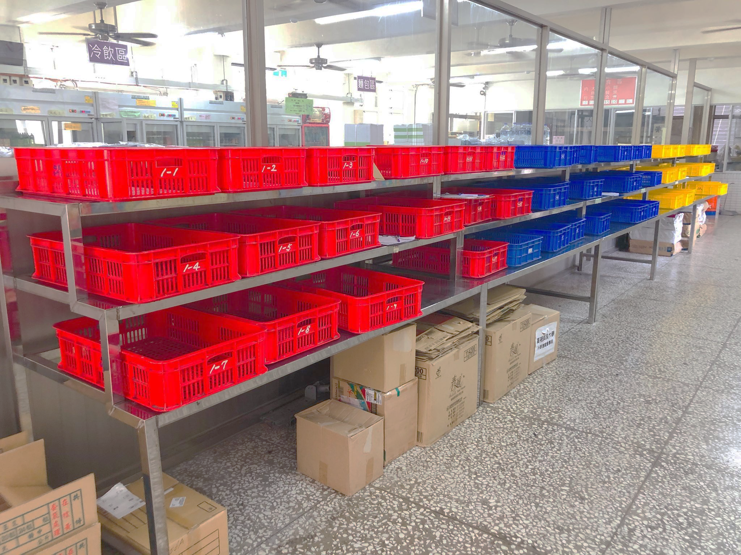
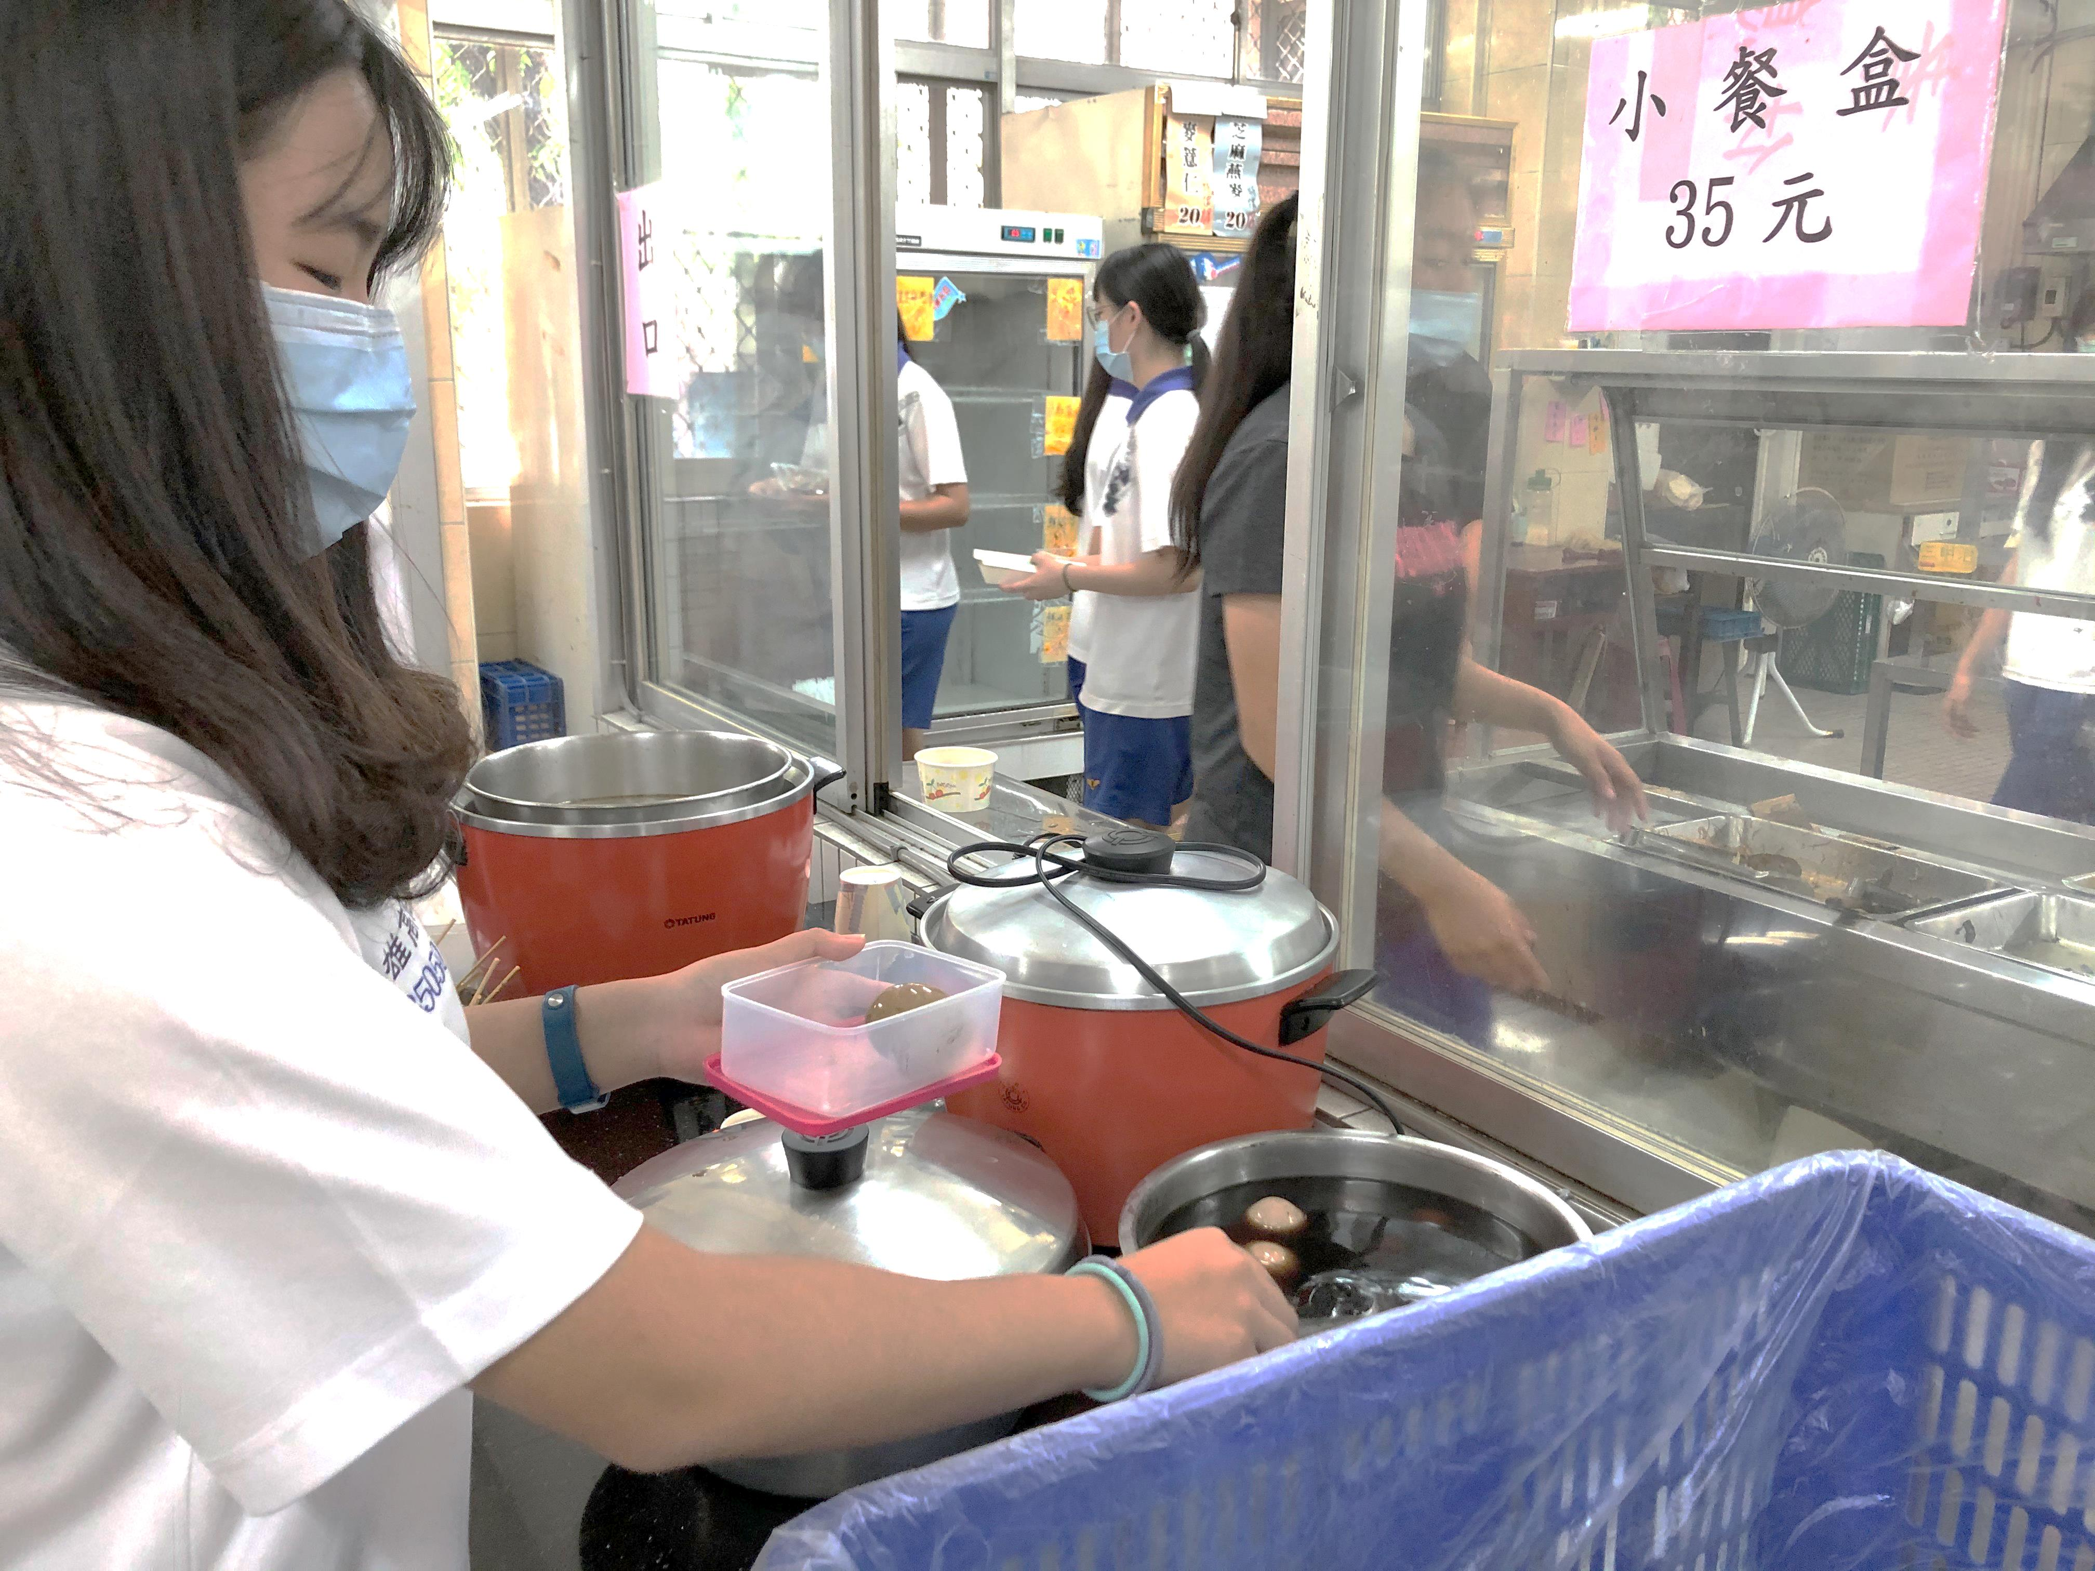

Slide 21
Thank you for your kind attention.

