Slide 1
Till 3rd MAY
Way To Goal
目的 :鼓勵學生多運動
實施方式：以手機APP的計步程式計算步數
承辦單位 :高雄高商國際專案交流社

Slide 2
CONTENTS
1
iEARN and the Learning Circle
2
Class Survey
3
Giving Project Ideas
4
Our Project−Way to Goal
5
Difficulty: Lack of interaction due to COVID-19
6
Impact and influence

Slide 3
SECTION 1
iEARN
and the Learning Circle

Slide 4
Global issue Education
Algeria
Brazil
India
Israel
United States
SECTION 1

Slide 5
SECTION 2
Class Survey

Slide 6
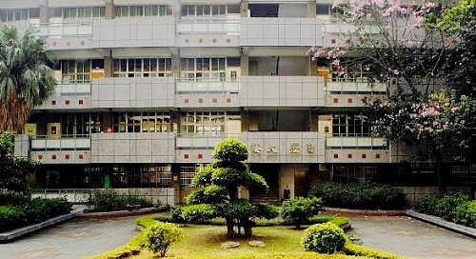
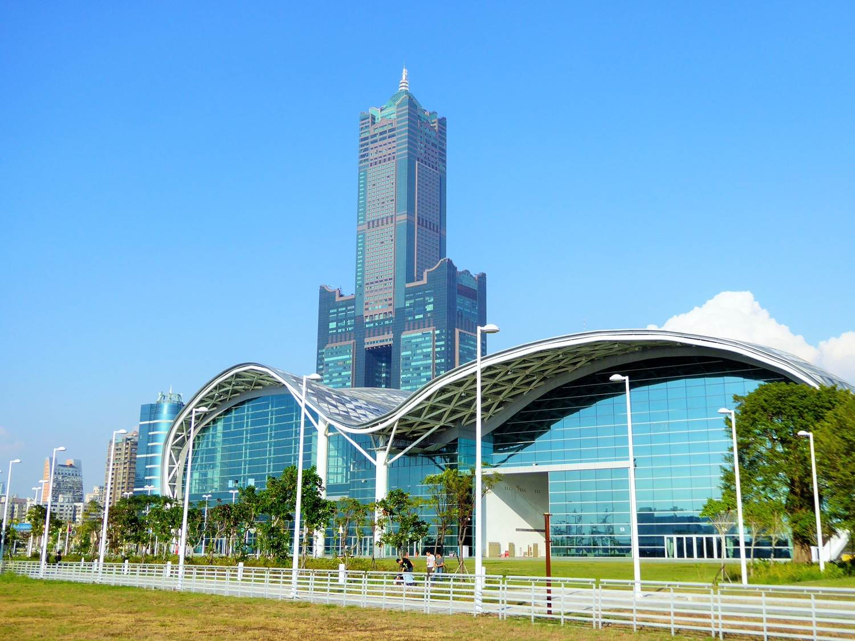
SECTION 2
The School
The Class
The Community

Slide 7
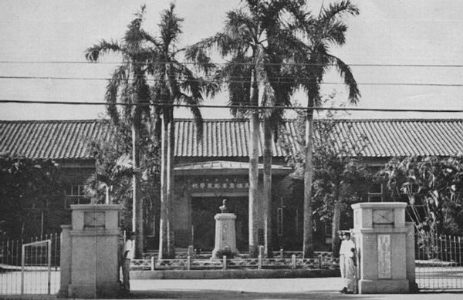
SECTION 2
Kaohsiung City
School History

Slide 8
SECTION 3
Giving Project Ideas

Slide 9
SECTION 3
USA
Brazil
Japan
Education

Slide 10
SECTION 3
Enhancing motivation
Arts
Drama
Algeria

Slide 11
SECTION 3
To Explore the Different Skills
India

Slide 12
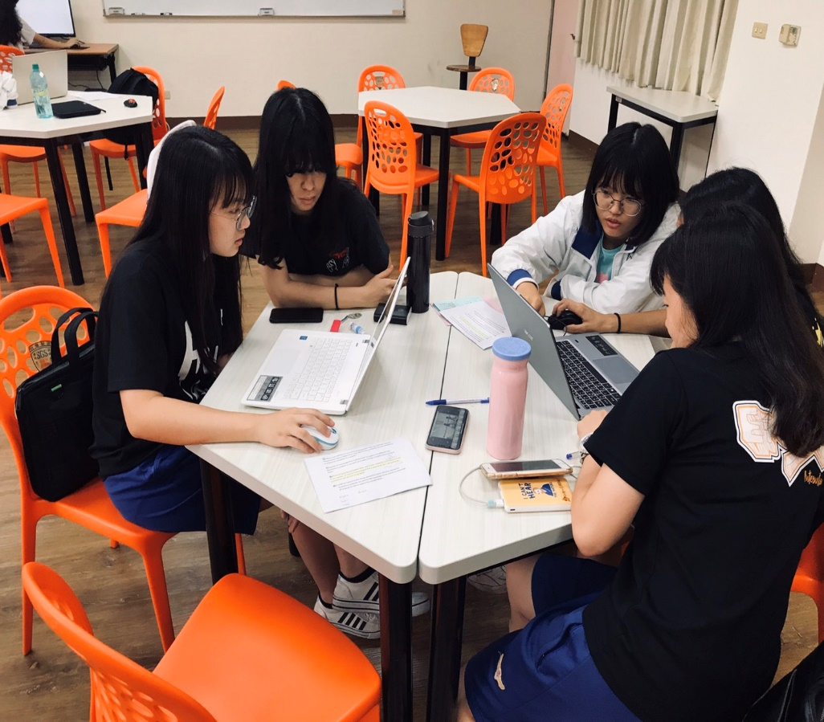
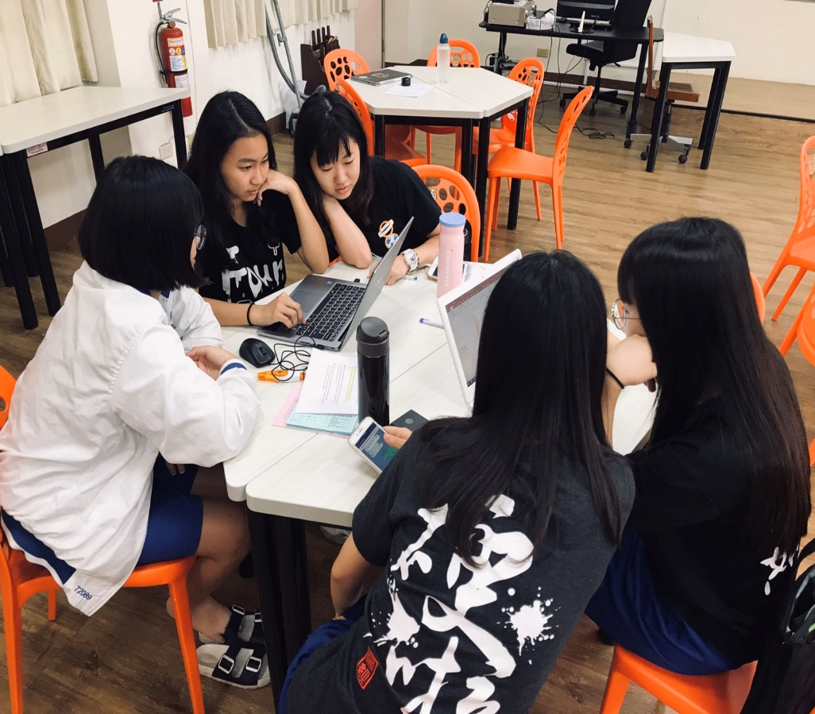
SECTION 3

Slide 13
SECTION 4
Our Project −
Way to Goal

Slide 14
Motivation
/
Rules and awards
/
Data analysis
SECTION 4
/
Limitation and room for improvement
Coronavirus outbreak
Taking the transportation
Walking

Slide 15
Motivation
/
Rules and awards
/
Data analysis
SECTION 4
/
Limitation and room for improvement
Increase The Immunity

Slide 16
Motivation
/
Rules and awards
/
Data analysis
SECTION 4
/
Limitation and room for improvement
Campaign

Slide 17
Motivation
/
Rules and awards
/
Data analysis
SECTION 4
/
Limitation and room for improvement
Earning 1 point
Sending the screenshot
6,500
steps

Slide 18
Motivation
/
Rules and awards
/
Data analysis
SECTION 4
/
Limitation and room for improvement
the Top 10
GET

Slide 19
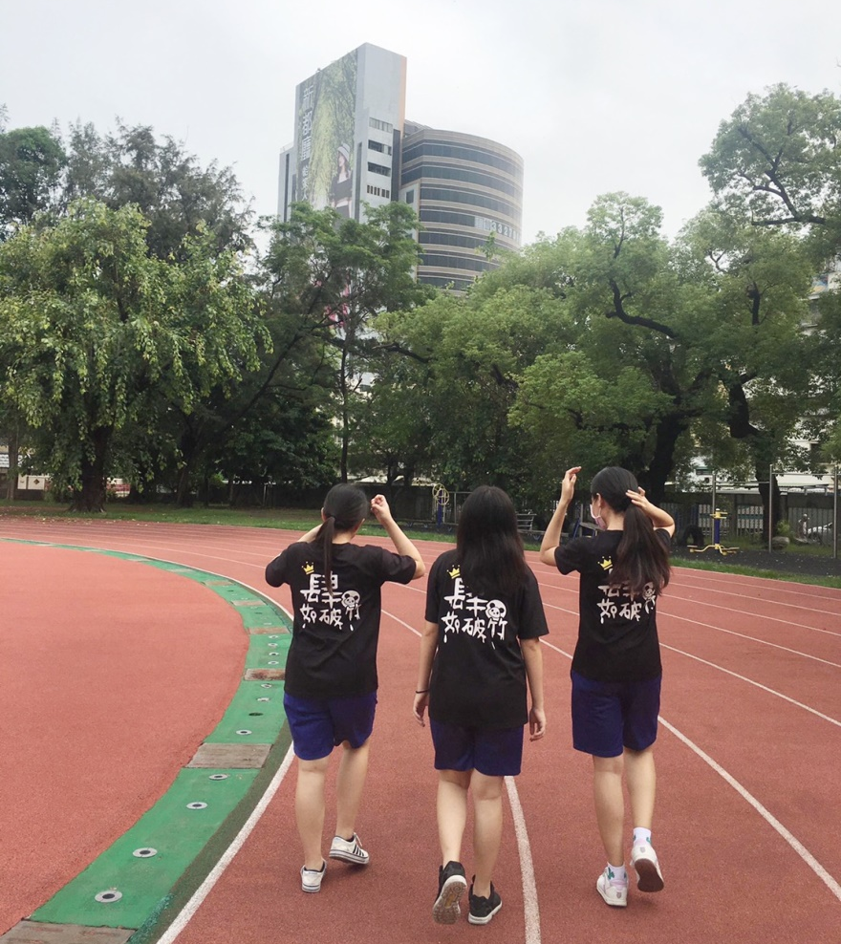
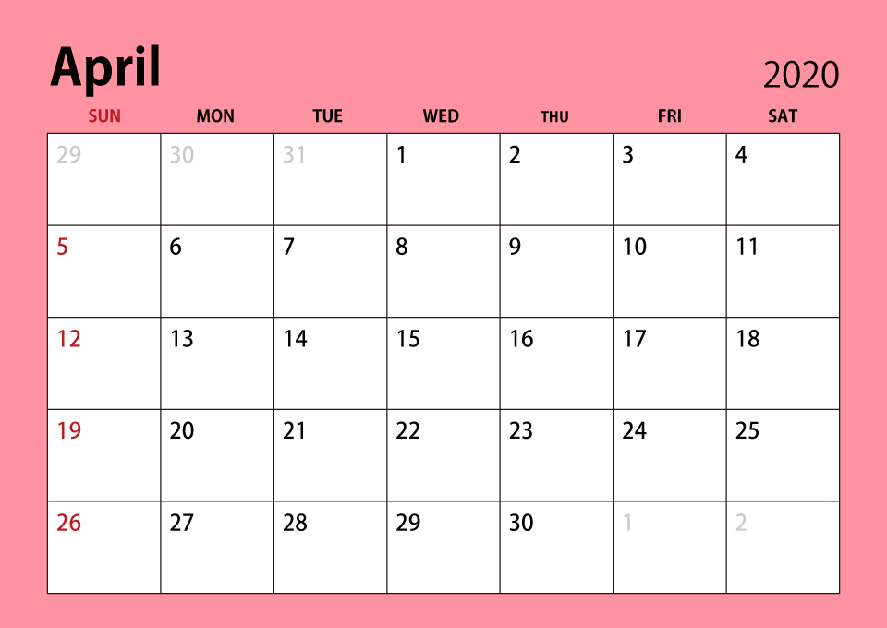
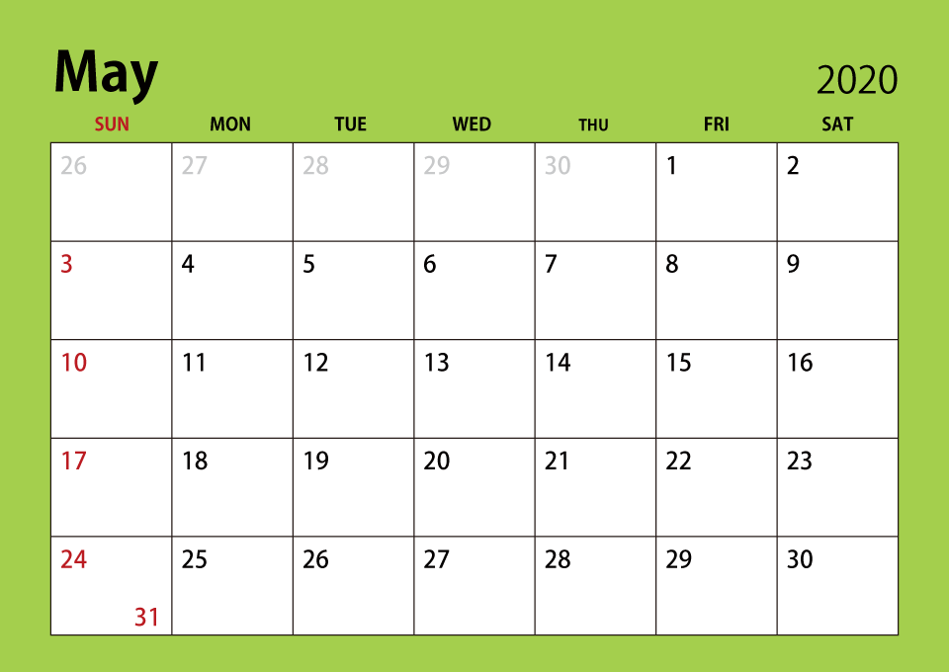
Motivation
/
Rules and awards
/
Data analysis
SECTION 4
/
Limitation and room for improvement

Slide 20
Motivation
/
Rules and awards
/
Data analysis
SECTION 4
/
Limitation and room for improvement
Most 12400
Lowest 6600

Slide 21
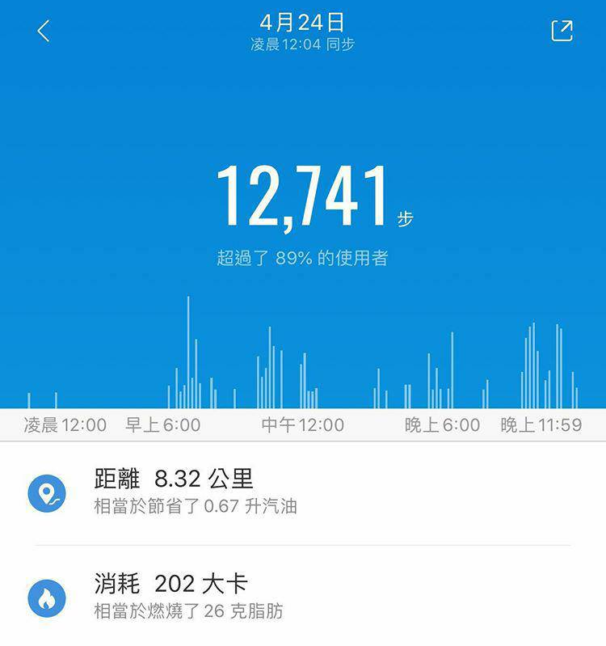
Motivation
/
Rules and awards
/
Data analysis
SECTION 4
/
Limitation and room for improvement
Two High-level Performers
12,741
12,347

Slide 22
Motivation
/
Rules and awards
/
Data analysis
SECTION 4
/
Limitation and room for improvement
Home

Slide 23
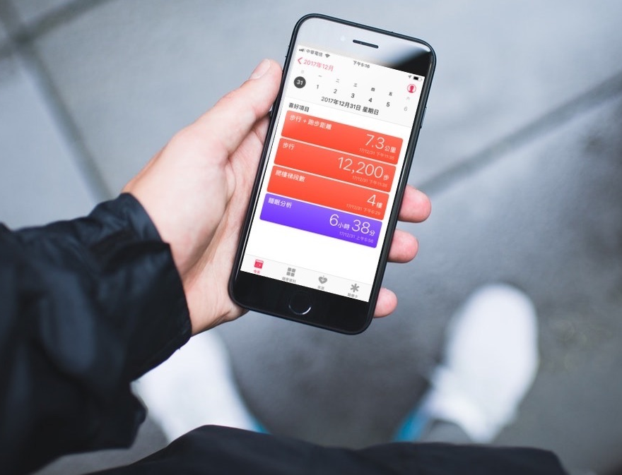
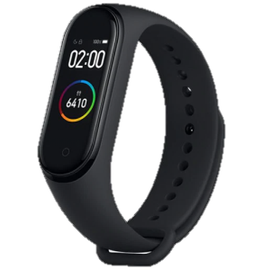
Motivation
/
Rules and awards
/
Data analysis
SECTION 4
/
Limitation and room for improvement

Slide 24
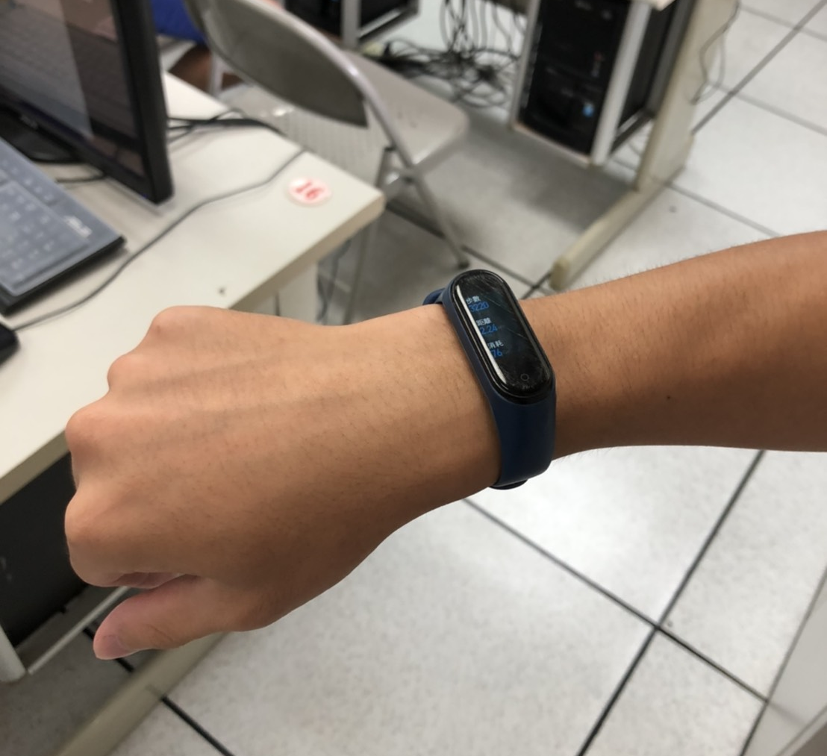
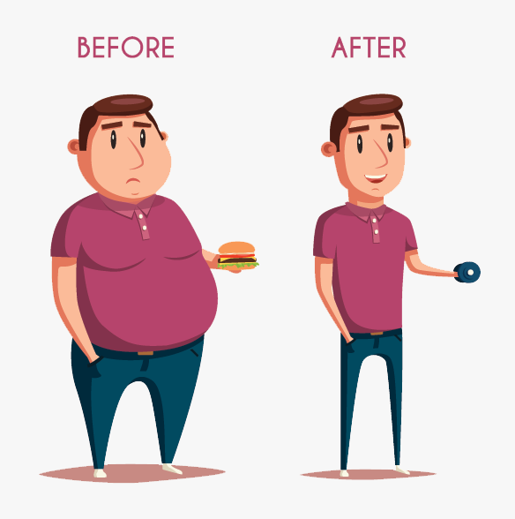
Motivation
/
Rules and awards
/
Data analysis
SECTION 4
/
Limitation and room for improvement
Steps
6378
Dist.
5.24km
Cal.
342

Slide 25
Motivation
/
Rules and awards
/
Data analysis
SECTION 4
/
Limitation and room for improvement
B
E
F
O
R
E
AFTER
8,000 steps
6,500 steps

Slide 26
SECTION 5
Difficulty: Lack of interaction due to COVID-19

Slide 27
Swept by the
COVID-19 pandemic
SECTION 5

Slide 28
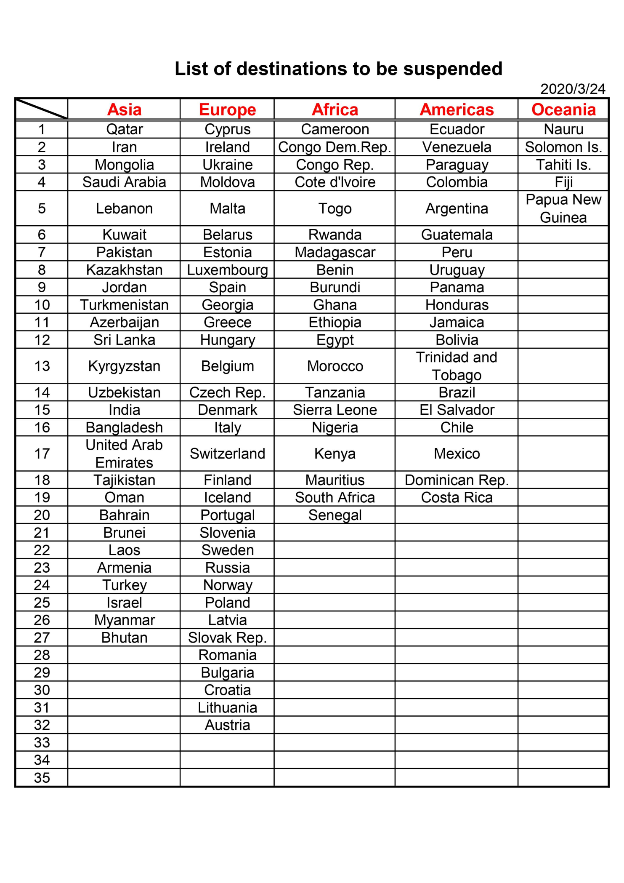
Banned
Delivery Service！
SECTION 5

Slide 29
SECTION 6
Impact and influence

Slide 30
the World
People around us
SECTION 6

Slide 31
SECTION 6

Slide 32
Thank you for your
kind attention.

