Slide 1
Specialized Lyceum under the University of Civil Protection of the Ministry for Emergency Situations of the Republic of Belarus
iEARN Global Learning Circles: September 2020 to January 2021
Places and Perspectives Learning Circle 1 (Middle/High School)
Final Project
«PARKS OF MY REGION»

Slide 2
In this project we will present both local and national parks.

Slide 3
Contents
«Parks of My Country» – Pelesa school, Pelesa, Belarus
«Lyuba Gaiduchenok Park» – Lyceum of MES, Gomel, Belarus
«Central Children's Park: Maxim Gorky Park in Minsk» – Lyceum of MES, Gomel, Belarus
«The National Park “Elk’s Island”» – School # 7, Korolyov, Russia
«Parks» – Lausanne Collegiate School, Memphis, Tennessee, the USA
«25 Best National Parks in the USA» – a link by Christine Hockert, the USA

Slide 4
-1-

Slide 5
Parks of My Country
Pelesa school
Belarus

Slide 6
Our country Belarus is very beautiful with its age-old oak woods, ancient forests and lakes, graceful mighty bison, hundreds of species of wild plants and animals and picturesque landscapes. As for our Grodno region, there are 3 parks and 2 reserves in the region we live in.

Slide 7
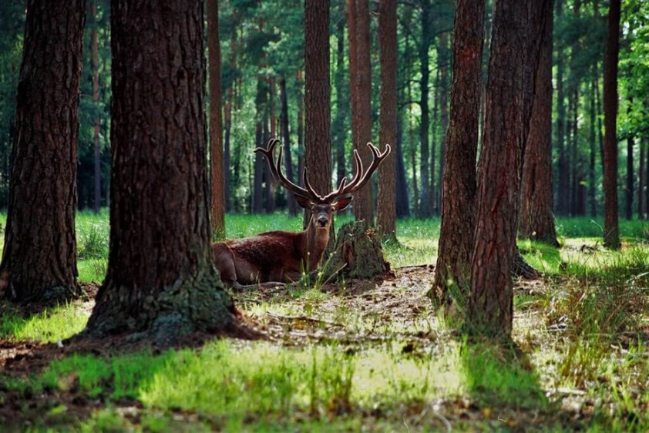
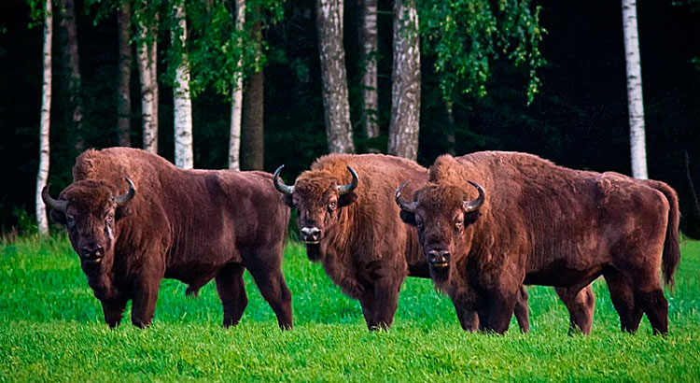
Belovezhskaya Pushcha
Belovezhskaya Pushcha is the largest national park in Belarus which is located on the territory of Grodno and Brest regions and Poland. It was founded in 1991. The park contains hundreds of ancient oak trees that are over 500 years old. Also in Belovezhskaya Pushcha there are bison, which are considered one of the symbols of Belarus.

Slide 8
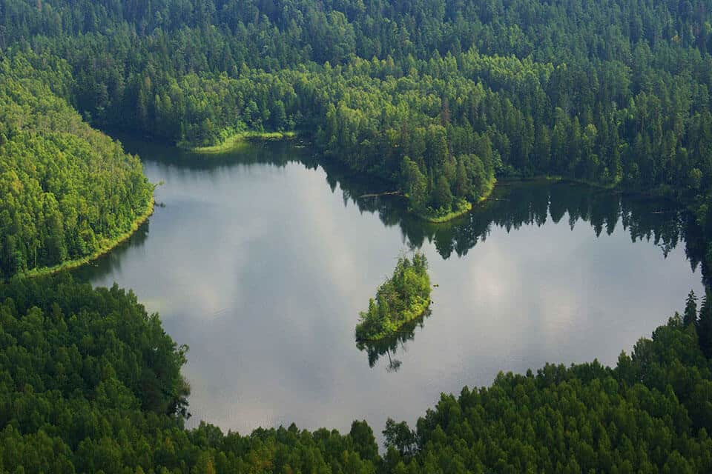
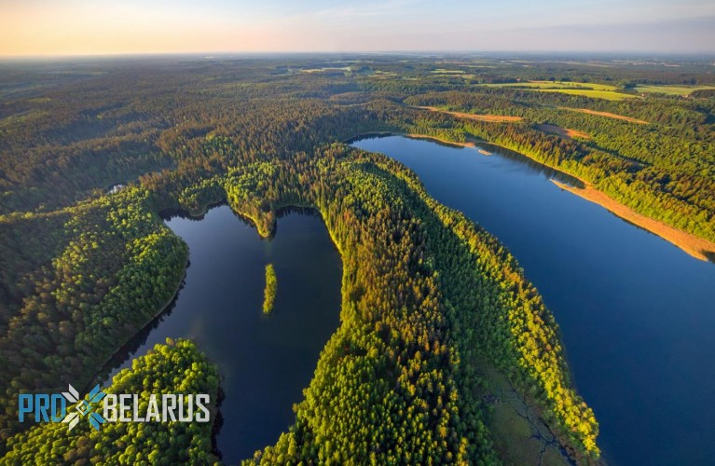
Narochansky National Park
17 % of the park’s area is occupied by lakes, in total there are about 40 of them. The lakes are surrounded by untouched forests with rare species of animals. In total, there are three groups of lakes on the territory of Narochnsky National Park and the leading place is occupied by Lake Naroch. This is the largest natural reservoir in Belarus (its area 80 sq. km.). The park was founded in 1999. There are 10 species of amphibians, at least 95 species of birds and 40 species of mammals living on the territory of Narochnsky National Park.

Slide 9
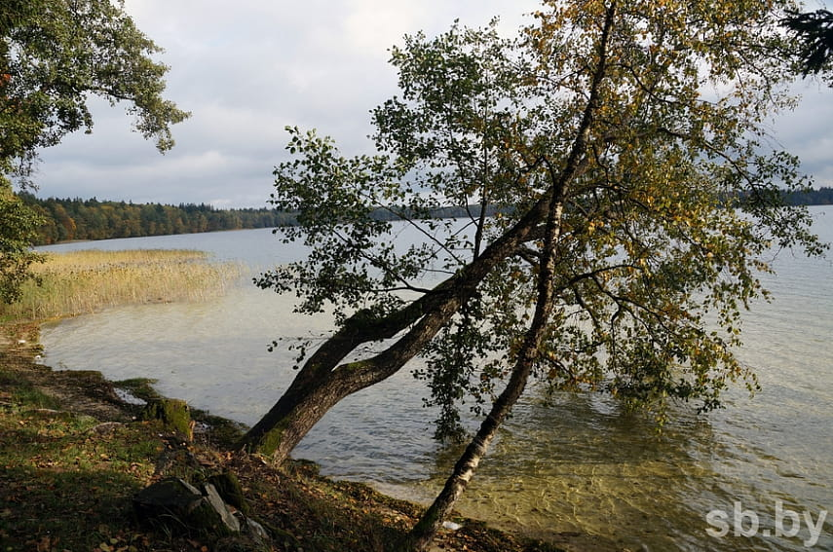
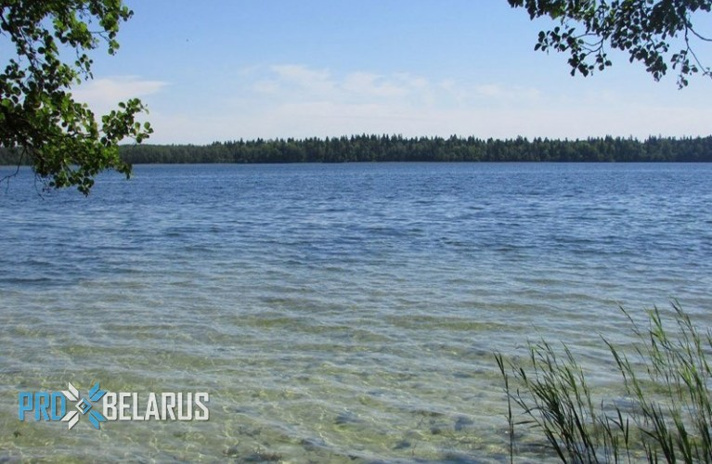
Svityazyansky Park
The landscape reserve “Svityazyansky” is located in the Novogrudok district of Grodno region and occupies 1193.8 hectares. The main pride of the reserve is Lake Svityaz – one of the largest and most beautiful in our area. It is famous for its clean and pure water. The area of the lake is 2.24 sq.km. A famous Polish-Belarusian writer Adam Mitskevich was born not far from this place.

Slide 10
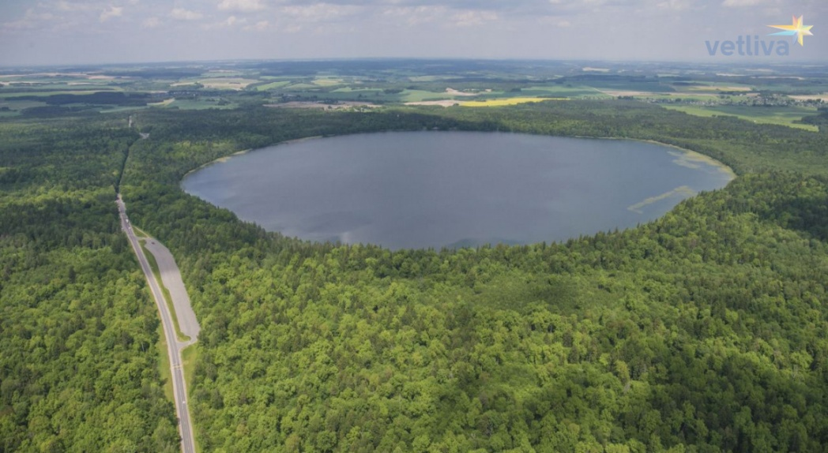
We often visit Lake Svityaz during our summer vocations.

Slide 11
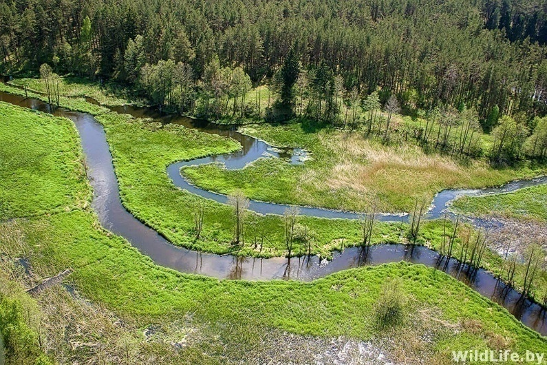
Reserve “Kotra”
The republican landscape reserve “Kotra” has been declared on the territory of Grodno region on the border with Lithuania in order to preserve valuable landscape and plant communities that form a single natural complex with the reserve “Chapkeliai” which is located on the territory of the Republic of Lithuania.
The area reserve is 10463.5 hectares.
The territory of the reserve was known in the past as the Kotranskaya Pushcha. Until now, about 90% of the reserve is covered with forests, mainly pine forests in bogs. There are meadows in the floodplain of the Kotra. River ( about 5 % of the territory). 19 plant species and 37 animal species that live here are protected by the Red Book.

Slide 12
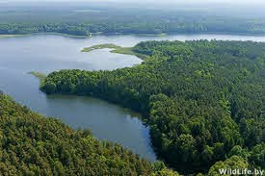
The Ozyory reserve was founded in 1990 to preserve the landscape complex with rare species of plants and animals, as well as to stabilize the hydrological regime of the Kotra River and some other bodies of water. The area of ​​the reserve is 21 852 hectares. In total, 20 species of mammals, more than 140 species of birds, 6 species of reptiles and 9 species of amphibians are registered within the boundaries of the reserve. About 25 species of animals living in the reserve are protected in Belarus.
Reserve “Ozyory” (“Lakes”)

Slide 13
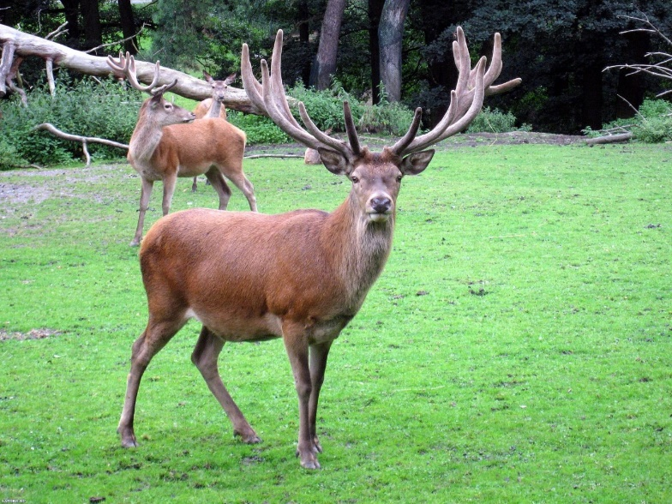
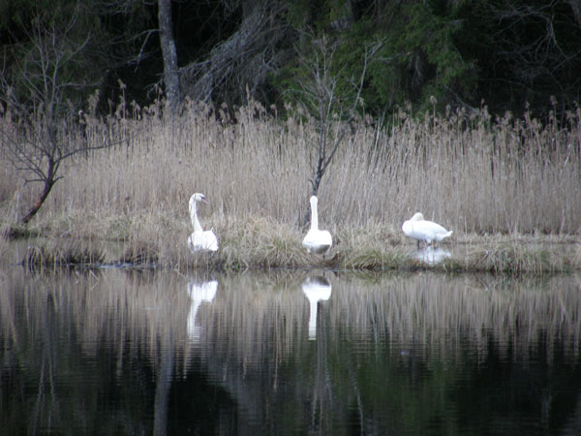
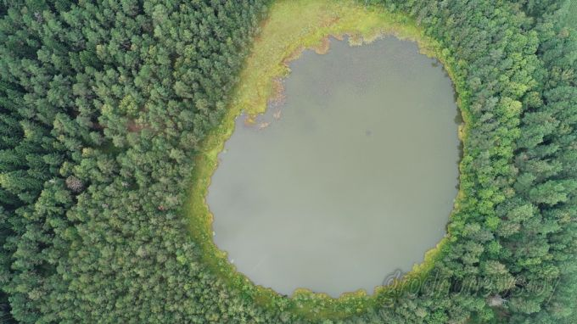
Here you can find such animals as red deer, roe deer, wild boar, moose are found in wetlands of the forest. At any time of the year, foxes and hares can be seen on the edges of forests and fields. Among the rare species of mammals in the reserve, the European lynx and the badger are registered.

Slide 14
-2-

Slide 15
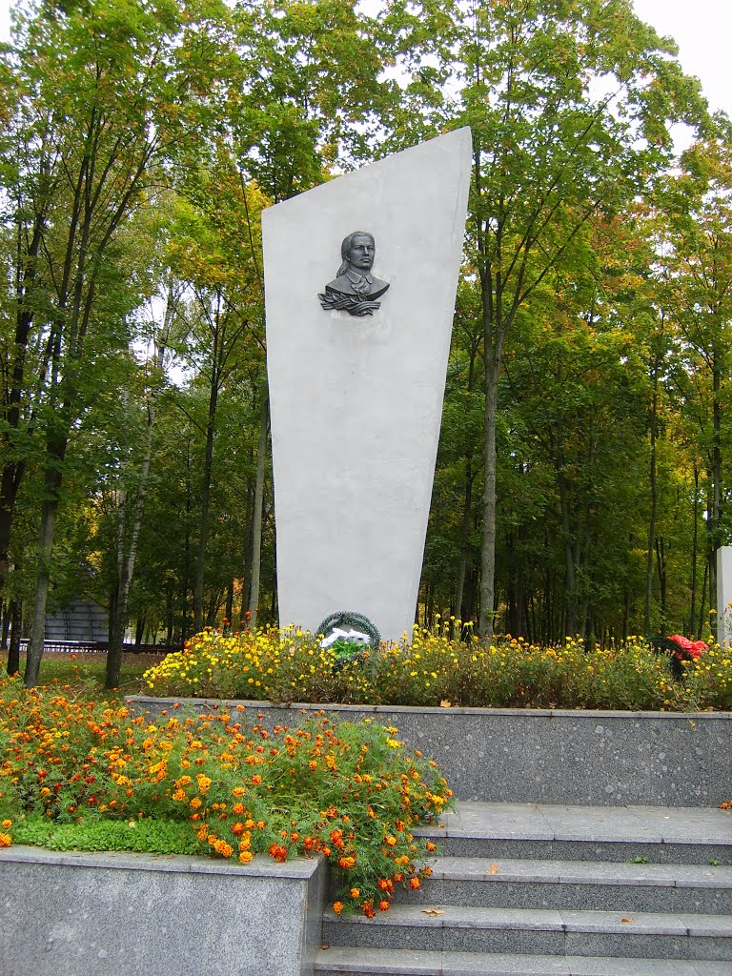
Park named after Lyuba Gaiduchenok (Minsk region)

Slide 16
The park is located: Minsk Region, Pukhovichi district, Maryina Gorka town.
Not far from the entrance to the park (about 70 m) we see a monument to Lyuba Gaiduchenok.
Gaiduchenok Lyubov Georgievna
Place of birth: village Berlizh, Pukhovichi district, Minsk region, BSSR
Date of birth: 1921
Nationality: Belarusian
Nominated for the award: Order of the Great Patriotic War, II degree
The heroine-patriot, a student of the Minsk Pedagogical Institute Lyubov Gaiduchenok, on the instructions of the Central Committee, in July 1942 penetrated into the rear of the enemy, where she became part of the Minsk underground Komsomol interregional center.
Comrade Gaiduchenok in the city of Minsk created many underground Komsomol groups, which, under her leadership, carried out a number of large-scale sabotage. The underground fighters burned down several warehouses with bread and food intended for the German army, transferred a lot of weapons to partisan detachments and transported a large number of Soviet citizens and prisoners of war to partisan detachments. On the night of May 22, 1943, returning from a combat mission with two comrades, Lyubov Gaiduchenok was ambushed and wounded in the leg. Despising death, to the last bullet she shot the Germans trying to take her alive and shot herself with the last bullet.

Slide 17
On the left side of the central path we see the summer amphitheater.

Slide 18
On both sides of the central track there are children's playgrounds.

Slide 19
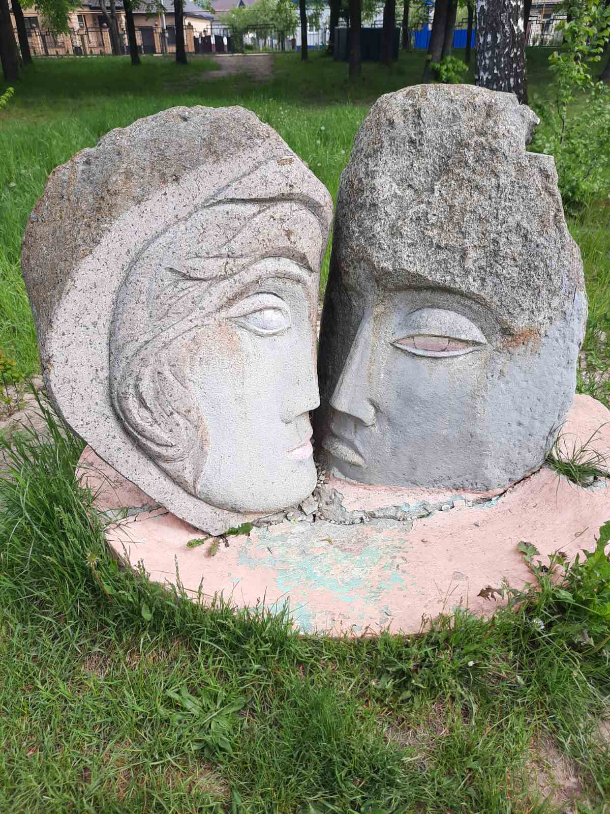
There are also amazing engraved stones in the park.

Slide 20
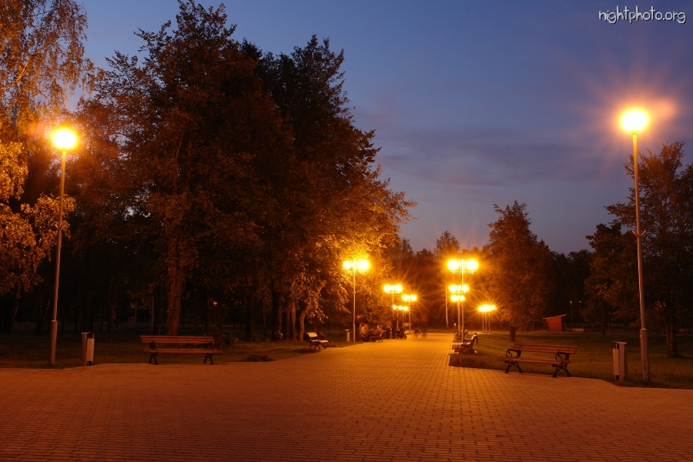

Slide 21
-3-

Slide 22
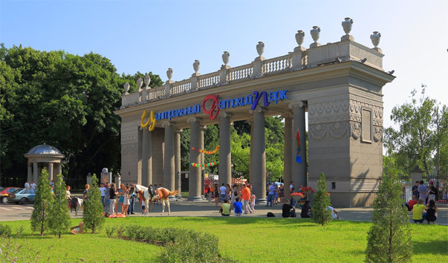
Central children's park in Minsk – Maxim Gorky Park

Slide 23
Park of culture and rest in the center of Minsk near Victory Square. It is located between Yanka Kupala, Frunze, Pervomaiskaya streets and Independence Avenue and today it covers an area of ​​28 hectares.
The park was founded in 1805 by the first governor of Minsk Z. A. Korneev and was originally named as the Governor's Garden, in honor of the founder of the park. The park was the first public recreation area in Belarus. It was a large park with flower beds, alleys and artificial canals. Its area was about 18 hectares. There were benches along its picturesque alleys, on which one could calmly sit down to relax in the shade of trees. On one of the pillars in the park it was carved in Latin: "Post laborem requies" (after work comes rest).
At the end of the 19th century, the first stadium with a cycle track, lawn tennis, croquet, and bowling alleys appeared in the park. Bicycles could be rented, and gymnastics classes and children's parties were arranged for the children. Drinks in the park were sold exclusively non-alcoholic: mineral water, milk, kefir, tea, coffee.

Slide 24
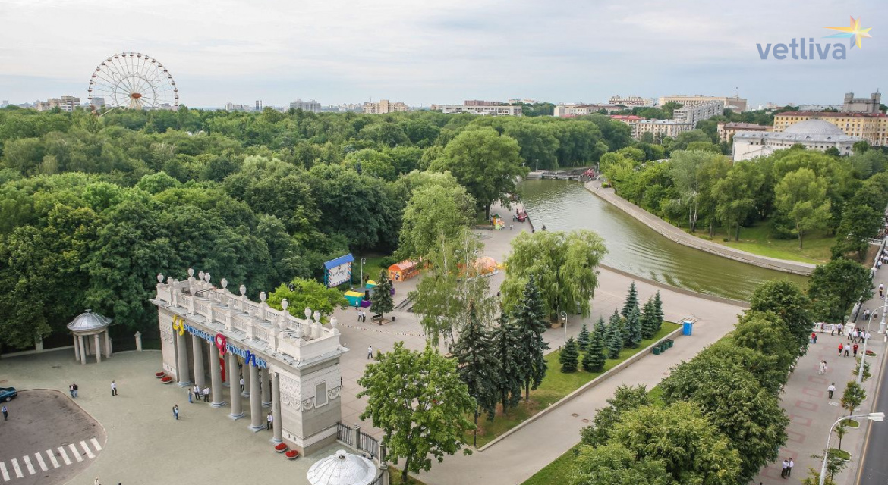

Slide 25
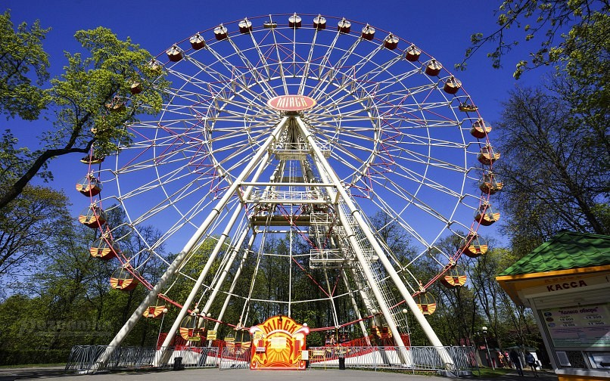

Slide 26
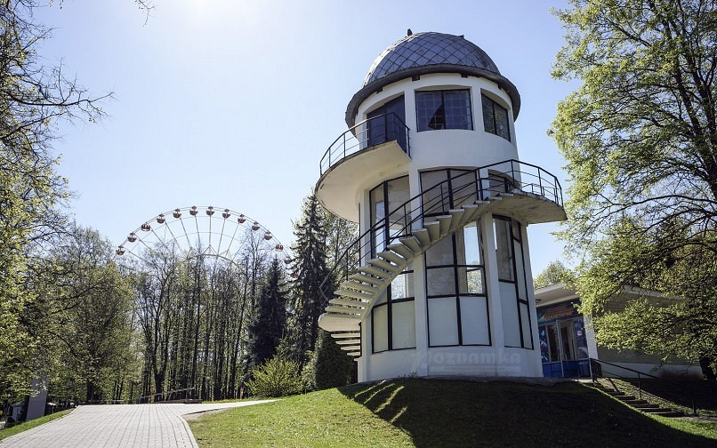

Slide 27
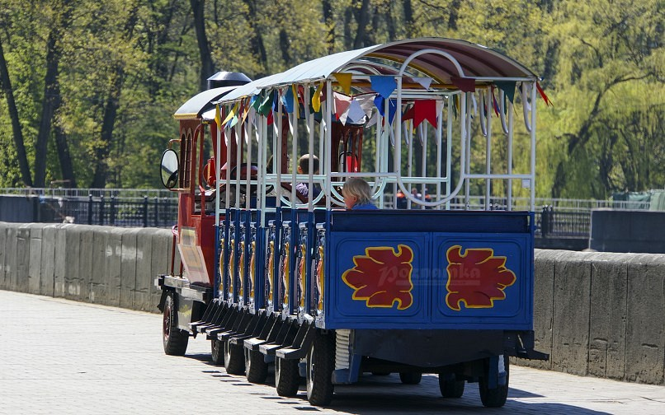

Slide 28
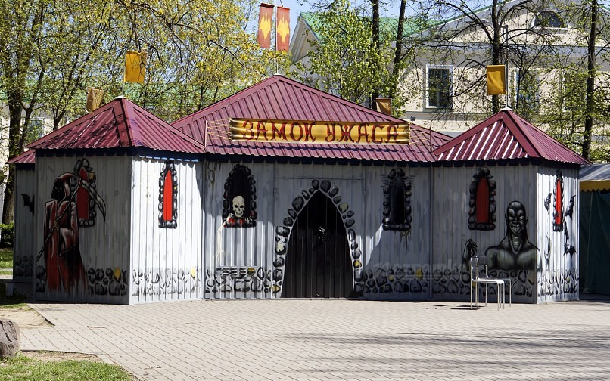

Slide 29
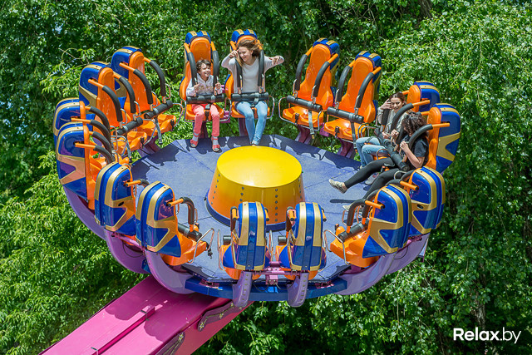
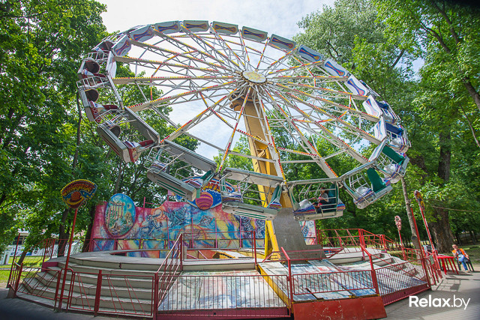
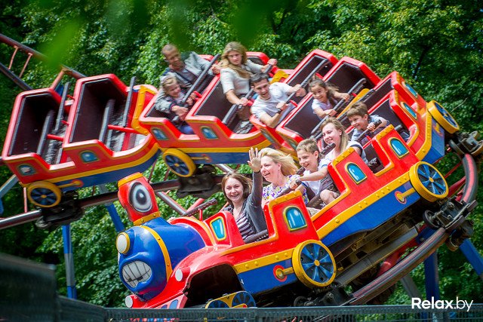
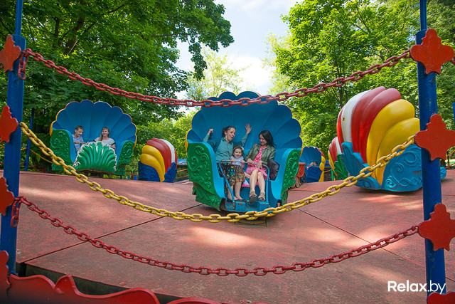

Slide 30
-4-

Slide 33
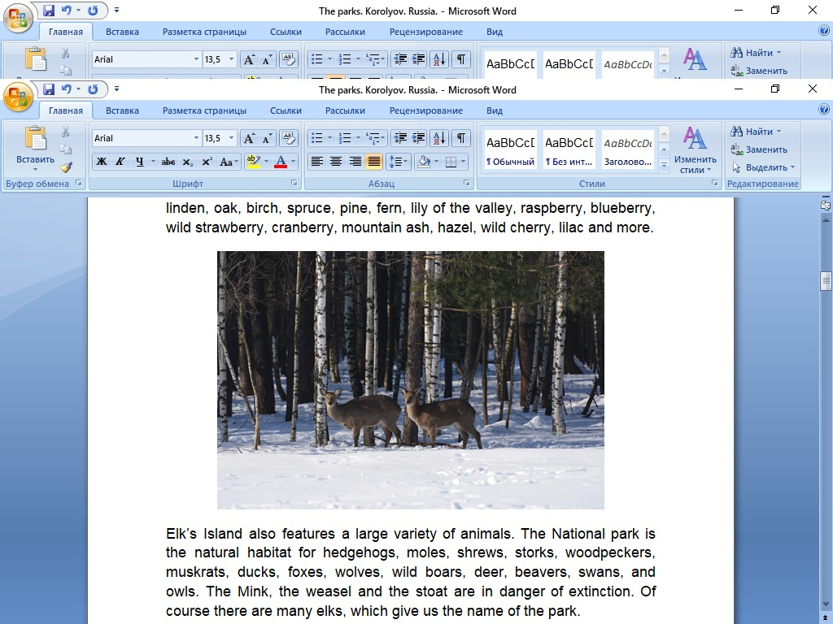

Slide 36
The city Park appeared in June 1940. It wasn't planted on purpose. A part of a natural woodland area was turned into a park, and it turned out to be very beautiful. But, during the Great Patriotic war, in the winter of 1941-1942, residents had to cut down their Park, because there was a catastrophic lack of fuel. Thus, the Park actually saved the residents of the city from the cold.

Slide 37
They began to restore it in 1948. Whole families, in the evenings and at the weekends, worked in the Park to restore it in gratitude for saving them during the difficult years of the war.

Slide 46
-5-

Slide 47
PARKS
From IB Anthropology Year 1 HL
Lausanne Collegiate School

Slide 48
National Parks
By Skylar, Amaya, Alyssa, MaryLee, Kai, Analise,
and Olivia
Notes:
National Parks group

Slide 49
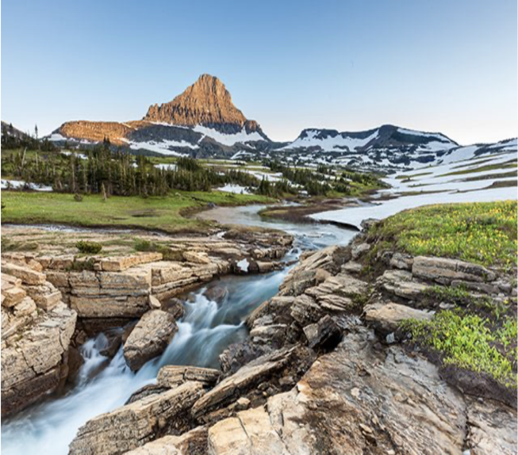
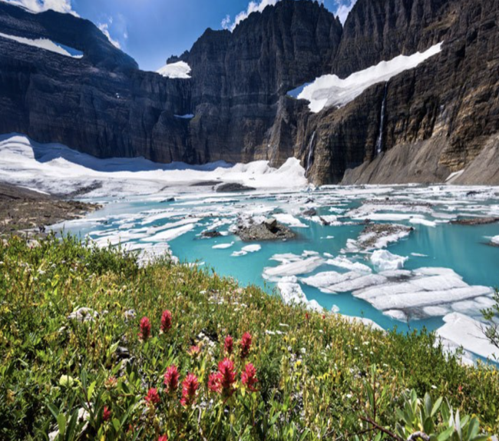
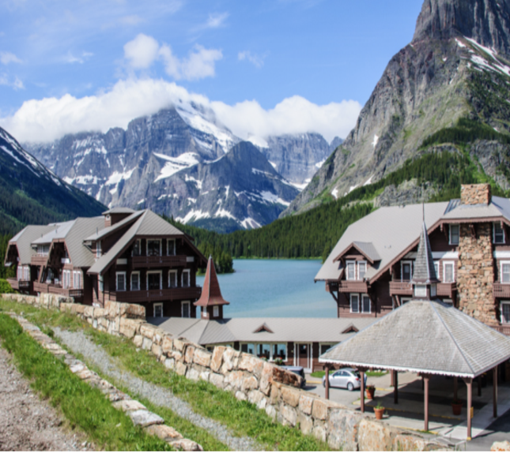
Glacier National Park
Anthro term: Globalization
The US created the Glacier National Park and Canada created the Waterton-Glacier International Peace Park in tandem to represent newfound peace and friendship between the two countries. Now, both parks work together to promote reservation, conservation, and research.
Why Analise and Mary Lee picked: We picked the Glacier National Park because of its beauty, history, and unfamiliarity.
Notes:
Analise and Mary Lee

Slide 50
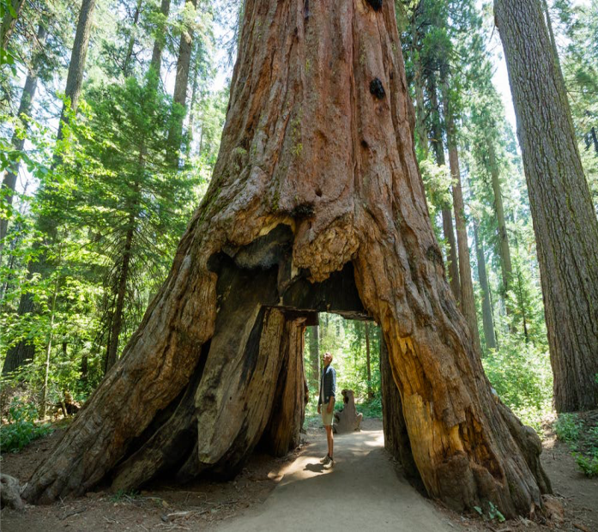
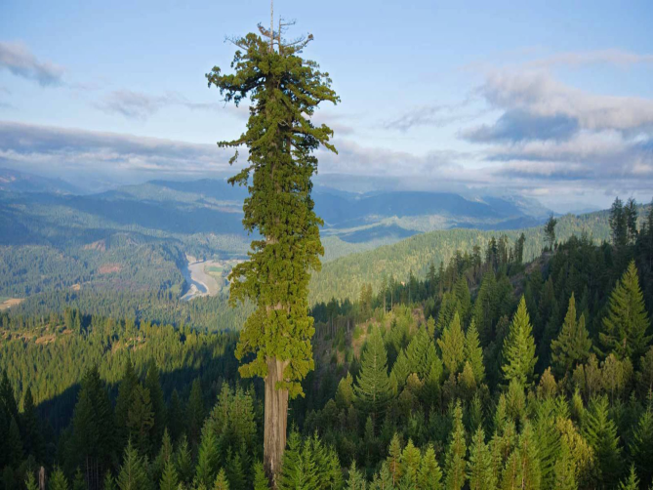
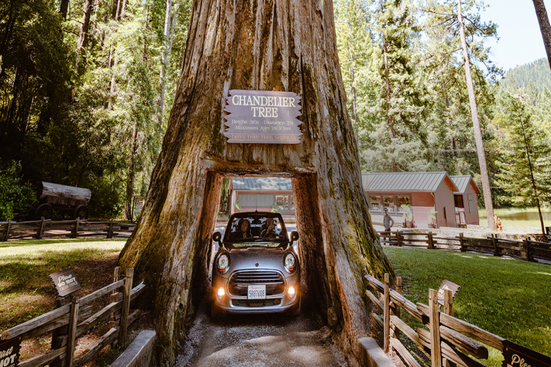
Redwood National Park
Anthro Term: Conservation
The earliest redwoods showed up on Earth shortly after the dinosaurs. Redwoods have been around for about 240 million years and in California for at least 20 million years. Redwood trees can grow up to 300 feet or more.
The tallest tree in the park is named Hyperion stands at 379.9 feet tall.
I have always wanted to go to this national park to take pictures with some of the biggest trees in the world.
Notes:
Olivia

Slide 51
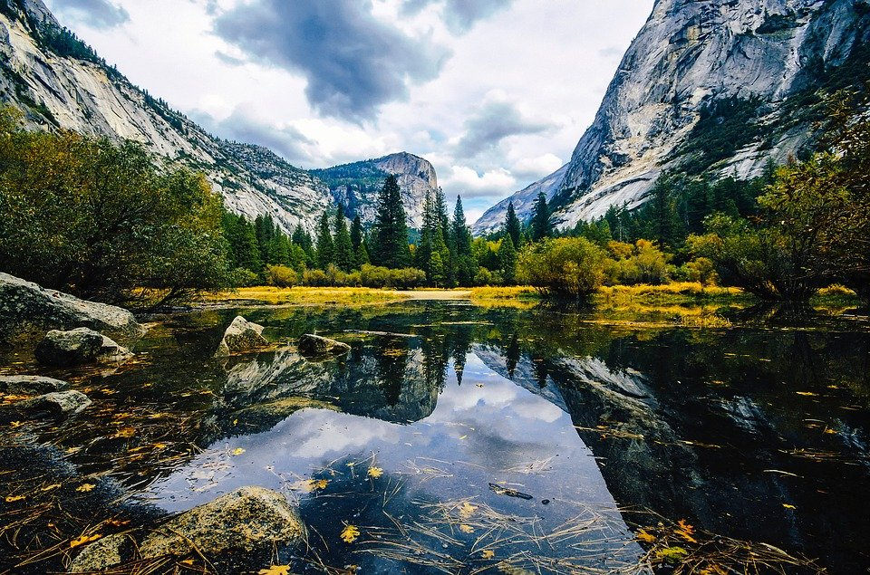
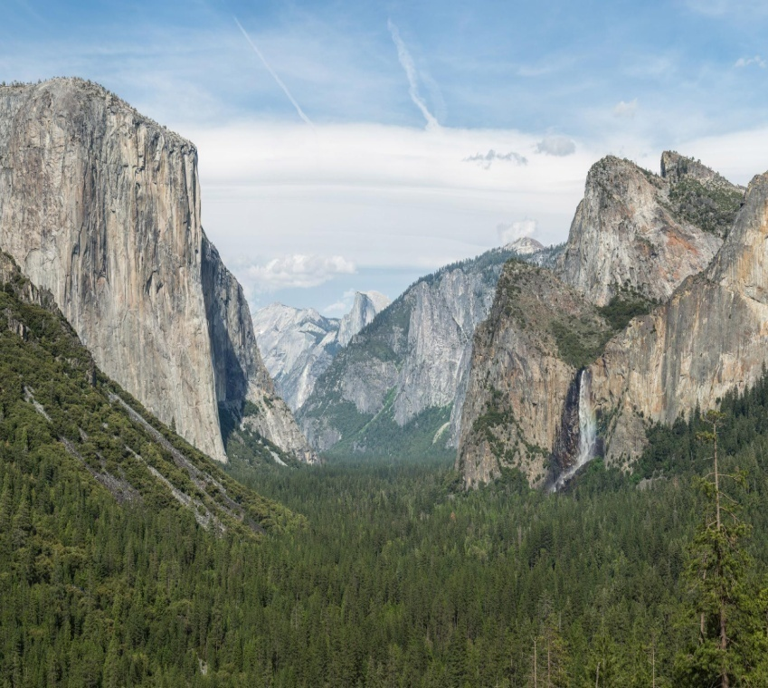
Yosemite National Park
Sustainability: COVID 19 has been an issue for the park since there is not a way to monitor which of the visitors coming, and no way to see if they have COVID. The park closed in March in order to not strain the healthcare system even more with more cases. Now the park has required all visitors to make a reservation and has cut its attendance by half. For how long the park can continue to be sustained with the limited amount of revenue coming in due the limited amount of people allowed to enter which less money coming in from hotels, gift shops, etc. I chose this park because it is a very beautiful park with many mountains and waterfalls. I would love to visit it someday.
Notes:
Alyssa

Slide 52
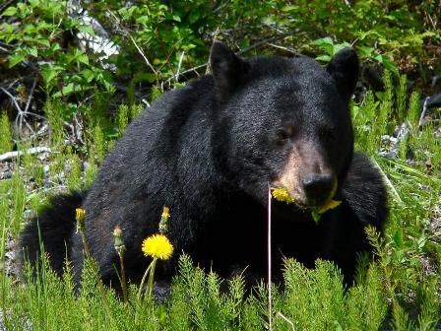
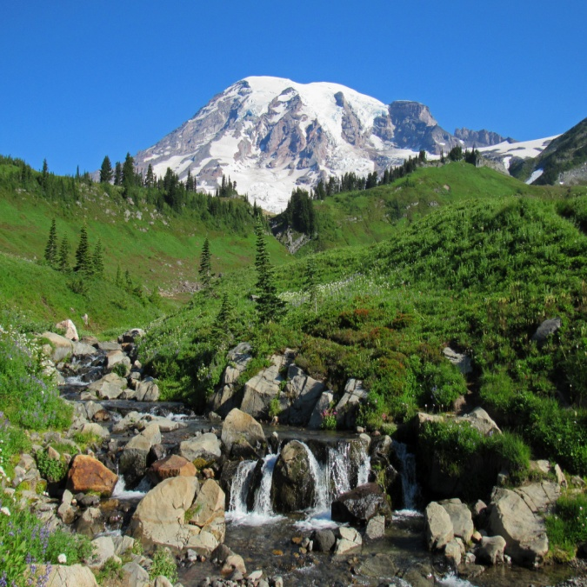
Mount Rainier National Park
https://www.nps.gov/mora/planyourvisit/conditions.htm
Anthro term: Sustainability
Explanation: Mount Rainier is one of the most dangerous Parks in the U.S because of its Volcano. While it hasn’t erupted in over 500 years, it causes frequent earthquakes and has an active hydrothermal system.
“Hike with the wildflowers and gaze upon powerful waterfalls this summer. Marvel at the fall colors each autumn. Discover epic skiing, snowboarding”.
Notes:
Skylar and Amaya

Slide 53
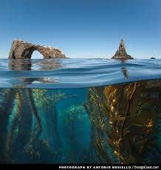
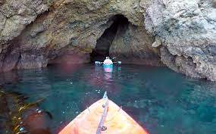
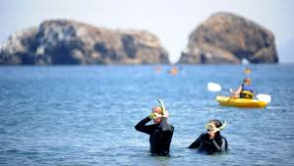
Channel Islands National Park
Anthro Term: Natural Resources
Explanation: People come to the park mainly for fishing or exploration. Natural resources are relied on heavily because the park is an island off the coast of Ventura, California and can’t be traveled to and from very quickly
Notes:
Skylar , Amaya

Slide 54
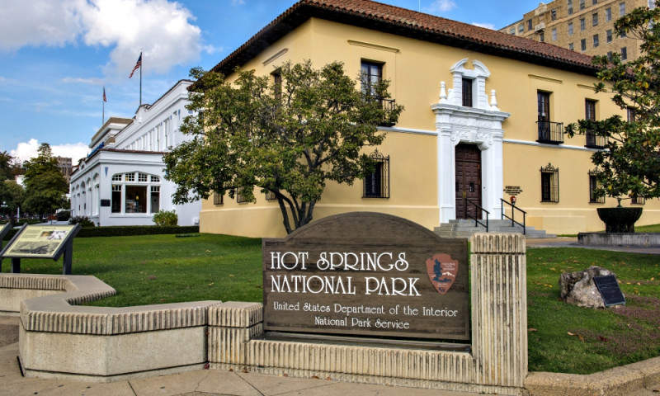
Hot Springs National Park
Anthro Term:
Violence and Human Rights
Congress and President Jackson created Hot Springs Reservation as a home for confederate soldiers during the Civil War. By 1860 the reservation was home to 616 slaves. When war struck, food, clothing, and shelter were scarce. Civilians with the “wrong sympathies” were murdered or forced to flee. It wasn’t until Frederick Steele wrote a letter to General Marmaduke that Hot Springs became a honorable and safe place to live. Now the park is known for its rich history and beautiful nature.
I chose this Park because we’ve taken multiple vacations here, but never knew the rich history.
Notes:
kai

Slide 55
Parks in Tennessee
By Seth, Suhani, Hayley, Simi, Mya, Tala

Slide 56
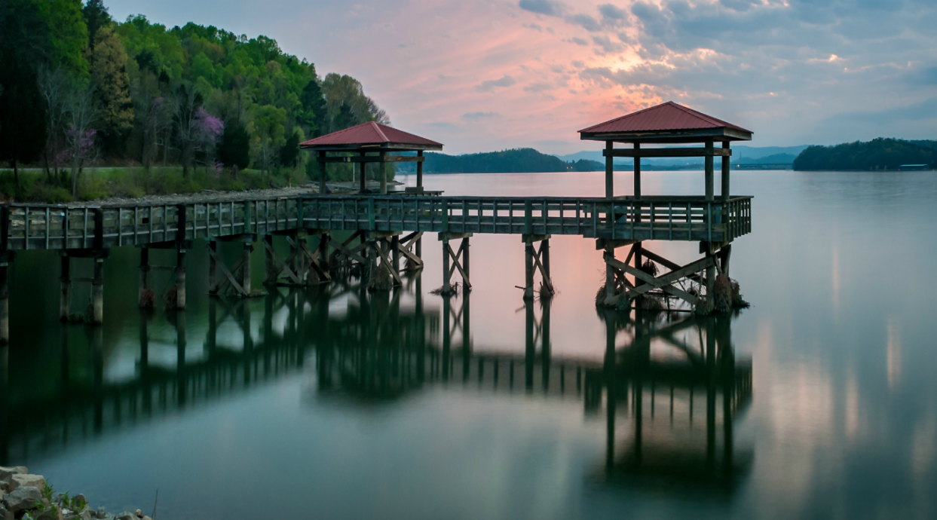
Booker T. Washington State Park
Booker T. Washington State Park is named in honor of the famous leader, Booker Taliaferro Washington, who was born into slavery and freed at the age of nine. Washington fought throughout his life to earn a higher education, and eventually became president of the Tuskegee Institute, a black organization for higher education. Washington strongly
believed that agriculture and education was the key to advance a newly freed race to a better life.
The park is located on the Chickamauga Lake, not far from the city of Chattanooga. Many visitors enjoy the park for its beautiful scenery throughout the challenging 6-mile mountain biking trail. The park also has an Olympic size swimming pool that includes a diving board and children’s play area. Although I’ve never been to this park, I’ve visited Chattanooga and seen the beautiful mountains and lakes the area has to offer, so I’m sure this park exhibits the same phenomenal scenery! :)
Notes:
SETH SLIDE bruh

Slide 57
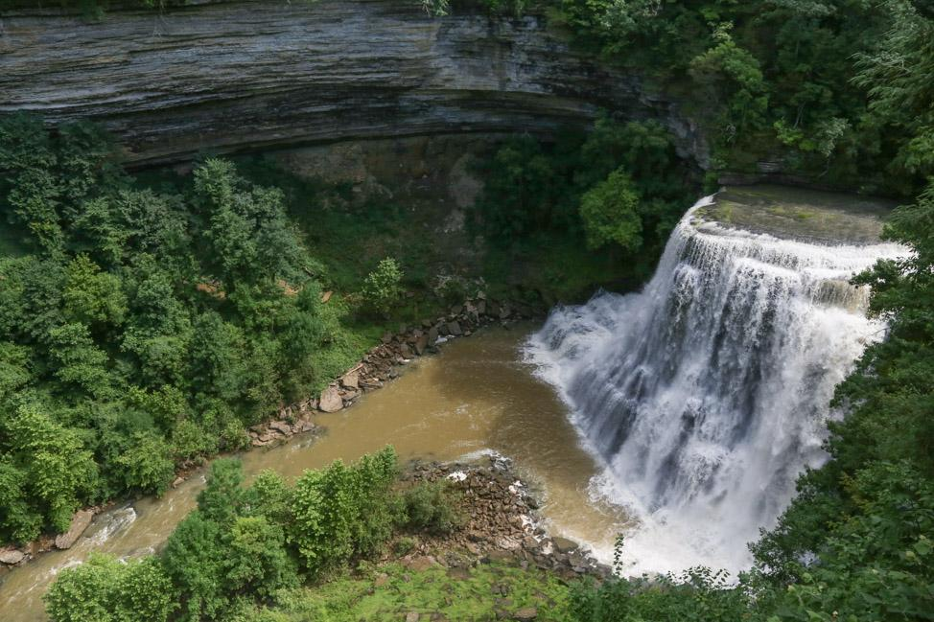
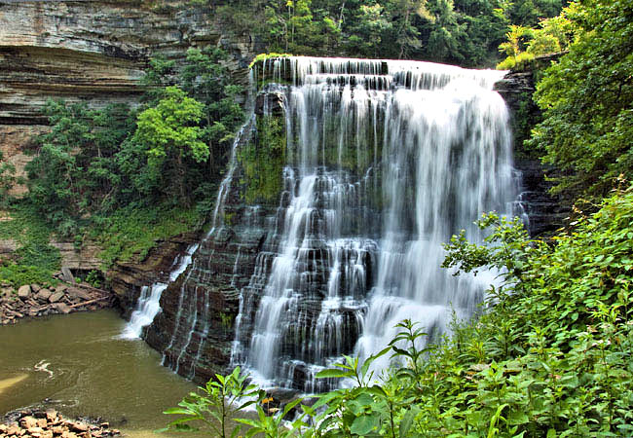
Burgess Falls State Park
Burgess Falls State Park is known for its natural beauty and the 4 waterfalls that flow from over 250 feet high. This area was originally occupied by Native American tribes like the Chickasaw and Cherokee groups. In 1973, it became a Tennessee State Natural Area, which protects the forests and aquatic habitats.
There is a 2.7 mile hike within the park that is considered to be difficult because of the tiring exercise. Although, many people say that the view is worth it. The park also holds events such as New Year's hikes and fundraisers.
Notes:
Suhani and susie

Slide 58
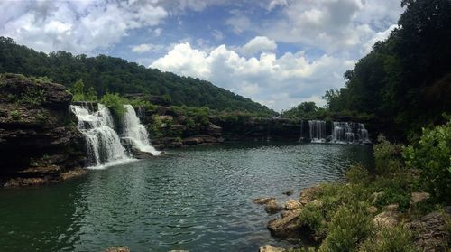
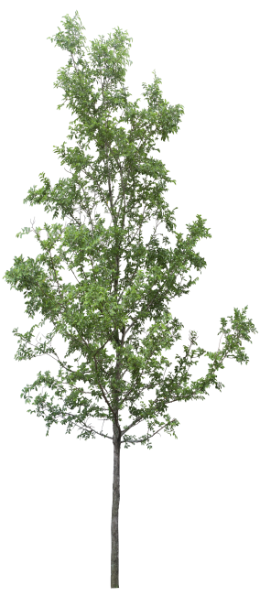
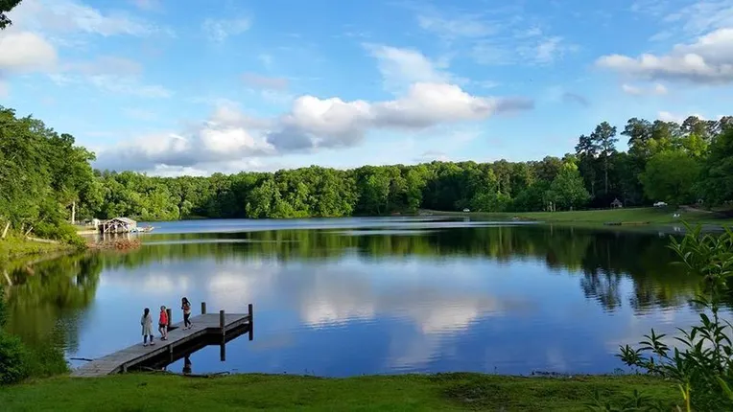
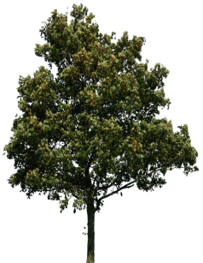
Chickasaw State Park
Henderson, TN
After becoming a state make in 1955, the park is names after the Native American Chickasaw Tribe who once inhabited the area that the park now stands on. Chickasaw Park completed the Bronze Recognition evel of Tennessee’s “Go Green” initiative. This means the people maintaining the park have education and outreach, water conservation, energy efficiency, recycling, and more.
14,384 acres of forest and 1,280 acres of recreation (lodging, activities, trails)
Notes:
Simi’s slide

Slide 59
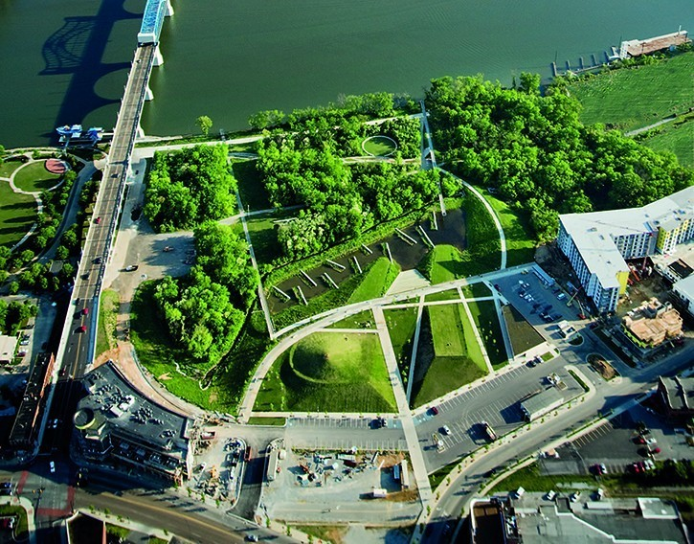
Renaissance National Park
Renaissance Park is in downtown Chattanooga in the north shore area of town. It is right beside Coolidge Park but it's design is a stark contrast. Coolidge is a more formal park and features large manicured lawns, fountains and an antique carousel. Renaissance is meant to be much wilder. There are multiple pathways, piers for viewing the skyline and a wetland area. There are stone picnic tables and grills. There are several various stone structures with signs indicating their use and historical significance. Parking is found in Coolidge Park or in a lot off Manufacturers Road. While there is nothing overly showy in the park it is a great use of the space and a fun place to take a stroll along the Chattanooga riverfront.

Slide 60
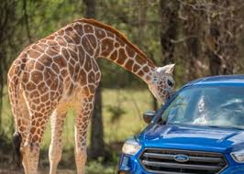
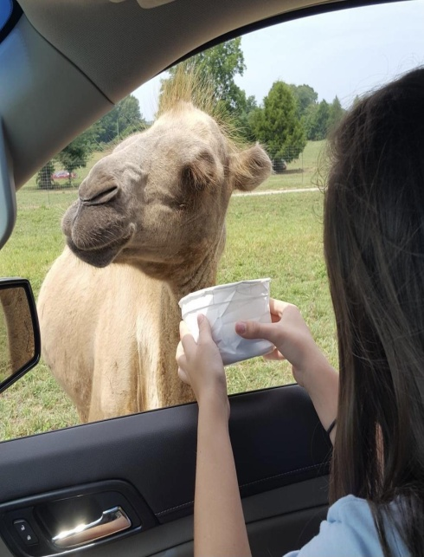
Tennessee Safari Park
Anthro term: anthropocentric and animal rights
The Tennessee Safari Park opened in 2007, and it owned by Claude Conley Jr. the land takes up around 300 acres of space. People come from all over to pet and feed over 80 species of animals, from antelope to zebra, in the drive-thru zoo. You get an up close and personal experience with a wide variety of animals and your level of interaction is determined by how much you open your window. I visited this safari park with my family and made some amazing memories that i’ll remember forever!
Safari parks overall have more benefits in respect to animals compared to zoos. They allow animals to have a larger space to explore and receive food all day long. The major ways humans are using animals at this safari park is to make a profit off of, without endangering them. Safari parks are viewed anthropologically with an Anthropocentric approach, meaning human beings are the most significant things in nature.
Notes:
Hayley

Slide 61
Chickasaw State Park
Nature: the phenomena of the physical world collectively, including plants, animals, the landscape, and other features and products of the earth, as opposed to humans or human creations.
a state park located in Chester County, Tennessee, in the Southeastern United States
Consists of 1,280 acres amidst a 14,384 acres state forest
Includes Lake Placid, Lake Lajoie, and some of West Tennessee's highest areas
Notes:
zoey

Slide 62
Big Hill Pond State Park
-Pocahontas, Tennessee
Big Hill Pond State Park is a state park in the southwestern part of McNairy County in southwestern Tennessee. The park has an area of approximately 5,000 acres and is forested with timberland and hardwood bottomland. Cypress Creek and the Tuscumbia River border the property.
Environment within this park:
Small oxbows and swampy areas which are desirable habitat for waterfowl, wildlife and fish.
Lots of Camping, hiking, mountain biking, fishing and paddling.
Very hot and humid in the summers and cold in the winters
Lots of campers
Notes:
Tala

Slide 63
Parks in Memphis
By Emma, Alyssa, Sinema, Lillian, Sara

Slide 64
W.C. Johnson Park
Environment:
271.19 acre park
2 football fields
2 Soccer fields
5 softball/baseball complexes with concessions
5 lakes
Spray parks
Collierville was the first community in the area to have spray parks
This park is a family and friends friendly park. Want to take a day with your family to play some ball or go to the water park on a hot sunny day. This is you park then. Perfect for playing and practicing sports, playing around in the grass or sand, having a picnic with your friends, or going on a nice run in the morning breeze.
Notes:
Sara and Sinema

Slide 65
Overton Park
- 342 acres
- Established 1906 and designed by architect George Kessler
- The forest section of Overton Park is called The Old Forest Arboretum. It is one of the few remaining old growth forests in Tennessee making it a great example of environmental conversation.
- In the 1970’s the a group called Citizens To Preserve Overton Park was formed to legally challenge a plan to get rid of 26 acres to make room for a highway. The group won in court and the 26 acres were saved. The same group later successfully nominated Overton to the successfully nominated to the national Register of Historic Places
PERSONAL EXPERIENCE!!!
- When I was in lower school and middle school, myschool would take us here on Air and Space day to do. Things like fly kites, launch rockets, fly parachutes. And shoot catapults.
Notes:
Lillian Deason

Slide 66
Shelby Farms
It is 4,500 acres making it one of the largest urban parks in the whole country.
Located in Memphis, Tennessee
At shelby farms there are buffalo and they are there to help the conservation efforts to help save the buffalo population.
My favorite things to do at the park include walking around the main lake, doing water activities in the lake, and then GoApe Zipline/ Ropes course
The buffalo are out and you can walk around the whole park and see them. Whenever i go visit the park i try and find the buffalo!
Shelby farms has 40 trails and there are 320 bodies of water.
There are also 3 playgrounds including a water park.
Notes:
Alyssa K. and Emma

Slide 67
Parks In the South
By Micah, Ebony, Arin, Ella, Paris, Ka Mya, Luca

Slide 68
Disney World
📍Orlando, Florida
A theme park and resort in Southern America founded by Walt Disney. A lot of the attractions are based off of movies, characters, and books from the Disney Company. It is an entertainment complex that both adults and children enjoy. It includes theme parks, water parks, golf courses, entertainment venues, and themed resorts.
Anthropomorphism - to attribute human characteristics to animals
One of the biggest symbols for Disney is the infamous Mickey Mouse. He is their main character in movies, tv shows, and the park.
Personal Experience: I went to Disney World during Christmas in 2018. My family stayed in the Lilo and Stitch (Disney movie) themed hotel. The entire park was decorated for Christmas along with the character’s attire. We took pictures with the characters, ate in their themed restaurants, and went to many of the night shows they had to offer. Disney World was so much fun and if you ever get the chance to go, you should!
Notes:
Micah, Ebony

Slide 69
Disney’s Themed Parks
Epcot Center: It offers more of a Utopian society and consists of two parks. It also features the Walt DIsney World monorail.
Magic Kingdom:
Disney World park based mainly off of their classic movies and characters.
Animal Kingdom: This park is all about nature. With attractions featuring Disney’s movies that are solely based off of animals.
Hollywood Studios: Consists of show based entertainment with live shows and musical performances.

Slide 70
Magic Springs and Crystal Falls
Hot Springs, Arkansas
Magic Springs and Crystal Falls was founded by Michael Jenkins. They have many rides and two different parks to go to. Magic Springs nor Crystal Falls have themes, but they do have rides that are common in amusement parks. Such as drop towers and water slides. They do have rides such as the Gauntlet, Big Bad John, Plummet Summit, and X coaster. Magic Springs and Crystal Falls has only one location. At these attractions they use technology. It’s used to help the rides operate and to also tell the people what to do and what not to do on the attractions. Technology the application of scientific knowledge for practical purposes, especially in industry. I remember watching the tv’s at the attractions telling me what to do and what not to do. I also remember having a lot of fun on the water rides and the roller coasters at the theme park.
Notes:
Paris McElwee

Slide 71
Universal Studios – Harry Potter World
Rides!
Forbidden Journey
Escape from Gringotts
Motorbike Adventure
Flight of the Hippogriff
Dragon Challenge
Food!
Frozen Butterbeer
Shepherd's Pie
Pumpkin Fizz
Fizzing Whizzbees
Butterbeer
The Great Feast Platter
Sticky Toffee Pudding
Chocolate Frog
Universal uses technology to curate fun, original, and entertaining rides.
Technology is machinery / equipment.
Notes:
Ella Peeples
Arin Adams

Slide 72
Wizarding World of Harry Potter
Locations
Universal Studios Orlando
Warner Bros Studio London
Universal Studios hollywood
Universal Studios Japan
Wizarding World of Harry Potter is based of off the famous movie series Harry Potter. In these locations they have made a real life Hogwarts and more. Places like Diagon alley, ollivanders wand shop, hogsmeade, Hogwarts, and more are all in these theme parks. Come and visit to get the real Harry potter experience.
Whenever I go to Orlando I make sure to always go to the Wizarding World of Harry Potter. My favorite ride is the one inside of hogwarts. While waiting in line to get on I see live paintings, live newspaper, The herbology greenhouse, The Griffin stairwell, and more. My favorite snack to get is called butter beer. Although the lines are long, i think it’s worth the wait. I get the frozen butterbeer. I love going with my family. I even met up with one of my friends and we hung out and bonded more in the Wizarding world of Harry Potter. Have you seen any Harry Potter Movies? If so Which one is your Favorite? Do you have a favorite character?
Notes:
Ella and Arin

Slide 73
Universal studios- Harry POtter World
Wizarding World of Harry potter
Notes:
Ella P Arin A

Slide 74
Six Flags
The six flags in the park represent the places that have had control over Georgia in the past (Spain, France, United Kingdom, the confederacy, and the United States). As the park developed it strayed away from its historical themes.
Six Flags over Georgia is one of the more lush parks out of all of them because it features more nature scenes filled with greenery that attracts different types of animals.
Six Flags is
personally one
of my favorite
theme parks
because it’s
one of the more
developed
theme parks
with over
30 rides and
games for
entertainment.
We chose Six Flags because it is one of the more well known theme parks in the country and we have both been to it.
There are many Six Flags all across the country too.
Notes:
KaMya, Luca,

Slide 75
-6-

Slide 76
25 Best National Parks in the USA
https://www.touropia.com/best-national-parks-in-the-usa/

Slide 77
Many thanks for participation!

