Slide 1
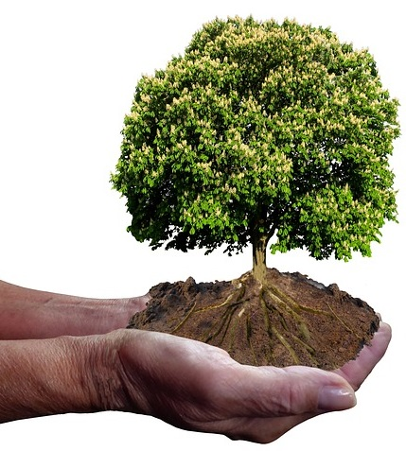
Learning Circle Group: Global Issues
Sponsoring Teacher: Nataliya Byzova
Sponsoring School: Troyeshchyna Gymnasium
City: Kyiv
Country: Ukraine
Name of Project: Saving plants
Goal of The Project: identify plant problems in your country
Final goal: Making a plan of helping plants near your house/school.
N.Byzova’s Class
Grade 7
Troyeshchyna Gymnasium
Kyiv, Ukraine
In collaboration with
O.Kulish’s
Class 201
St.Paul High school,
Taiwan
2021

Slide 2
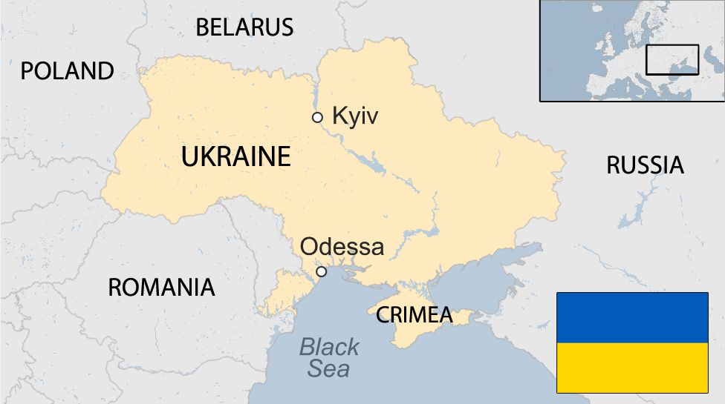
Identify plant problems in your country
Make up a plan of helping a plant(s) near your house/school.

Slide 3
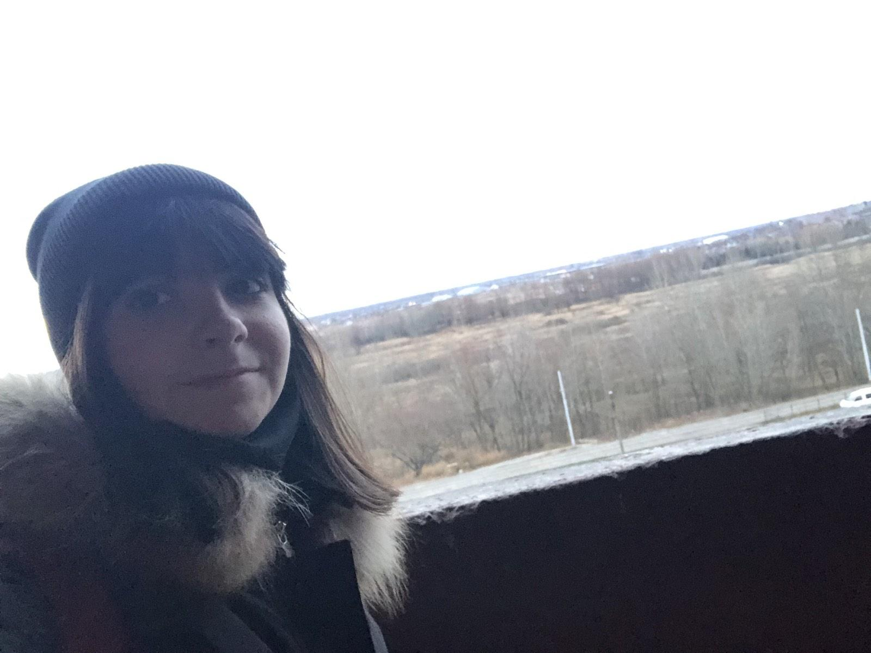
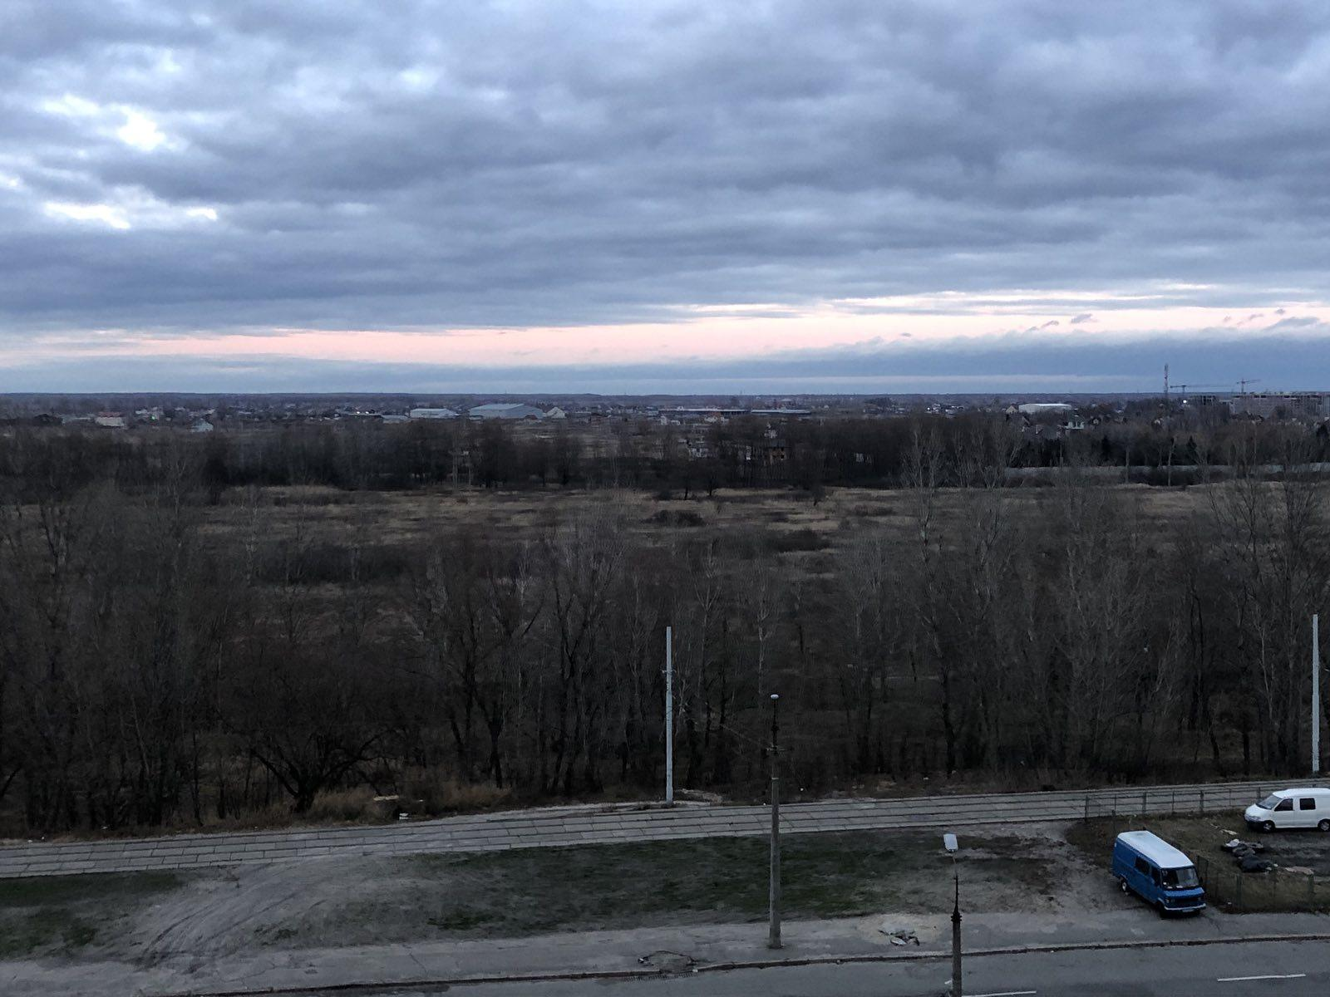
How can you help the trees near the house.
I live near the field. And there are many trees in the field. They are constantly in the trash and cars are constantly driving there. And the trees are constantly in the trash and breathe the gas of cars. And also our field is constantly teased and there is a possibility that these trees may burn out.
I take care of the poplars in my field
How can I help it, for example I can sometimes sort garbage near those trees
Sofi Shevchenko 7-D

Slide 4
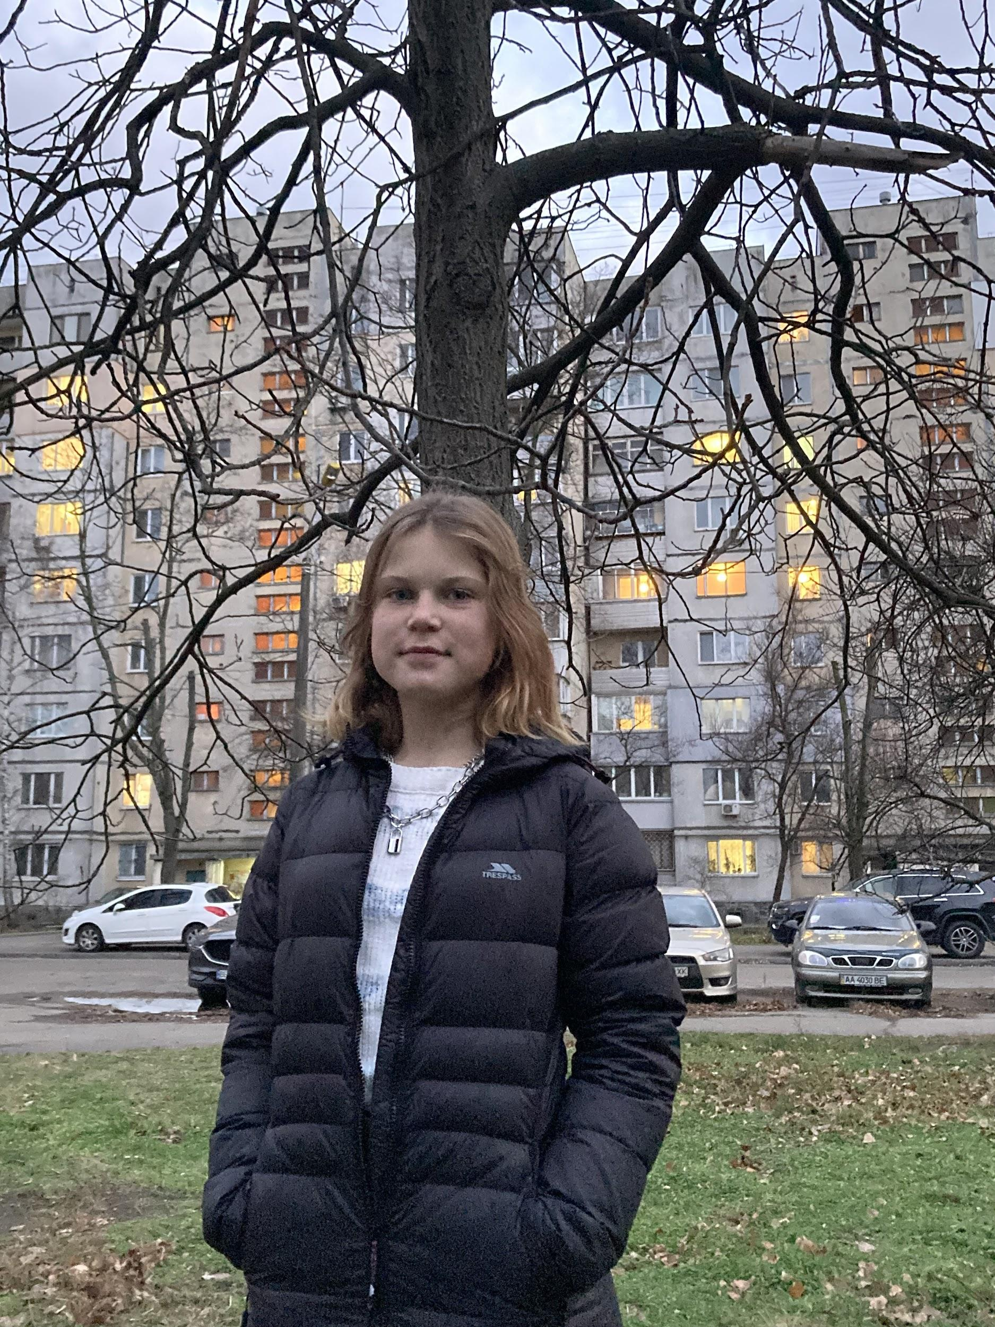
Birches
People use birches in agriculture and medicine.
We have a problem of drying out birches
For the health of birches, you need to cut off dead branches, clean the trunk
Oleksandra Kucher

Slide 5
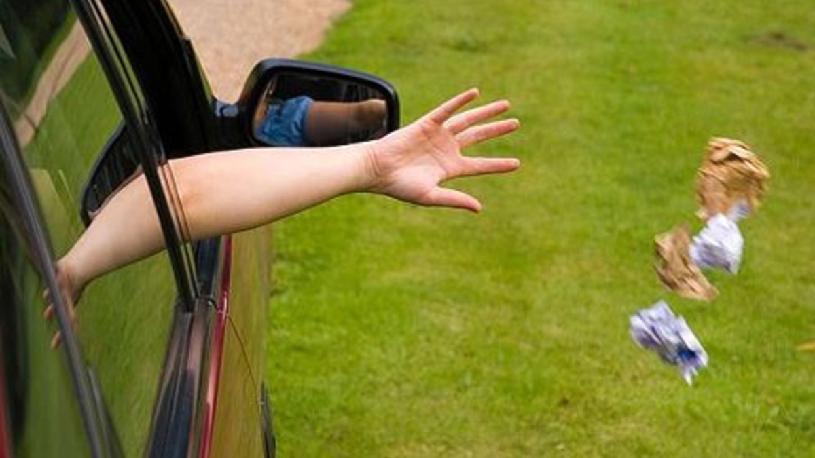
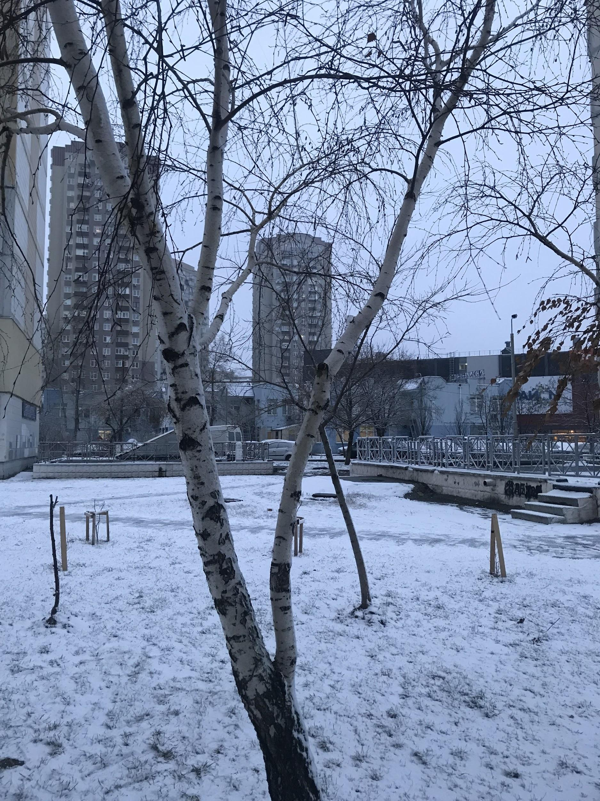
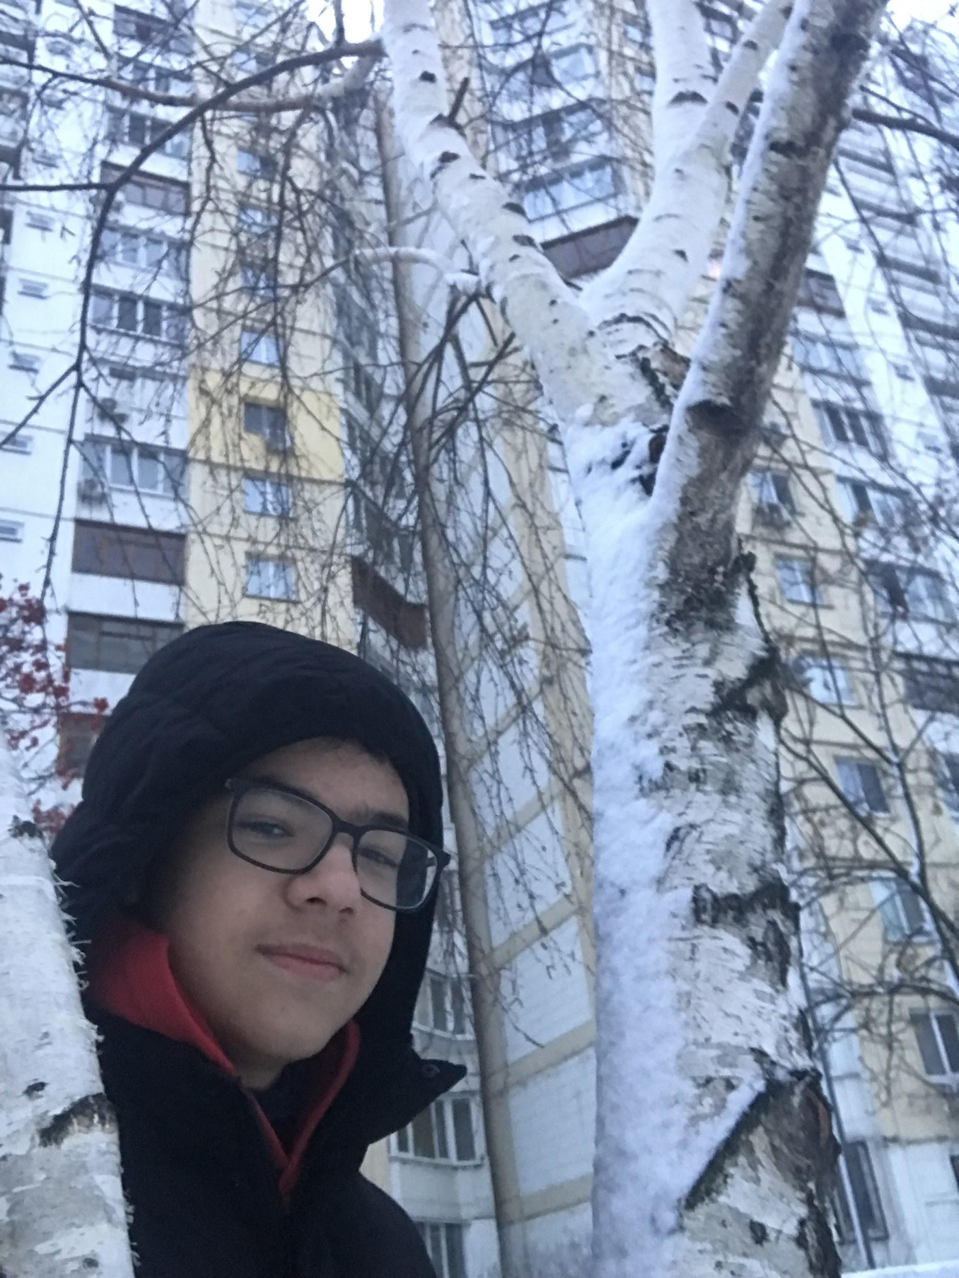
The biggest problem of nature is peoples’ indifference. Because people don’t plant trees , throw a trash in forests and fields , cut forests and nobody REALLY want to help a nature , even a funds that collect money and don’t move it for helping a nature. But there are many peoples who use not radical methods to protect a nature
The most popular problem of birches are mushrooms .
Mushrooms on a tree are like pests. They take away all resources or water, that kill a birch like every other tree. So I cleaned my birch of mushrooms on bottom of tree.
Bogdan Kuzin
my tree’s photo with me :)

Slide 6
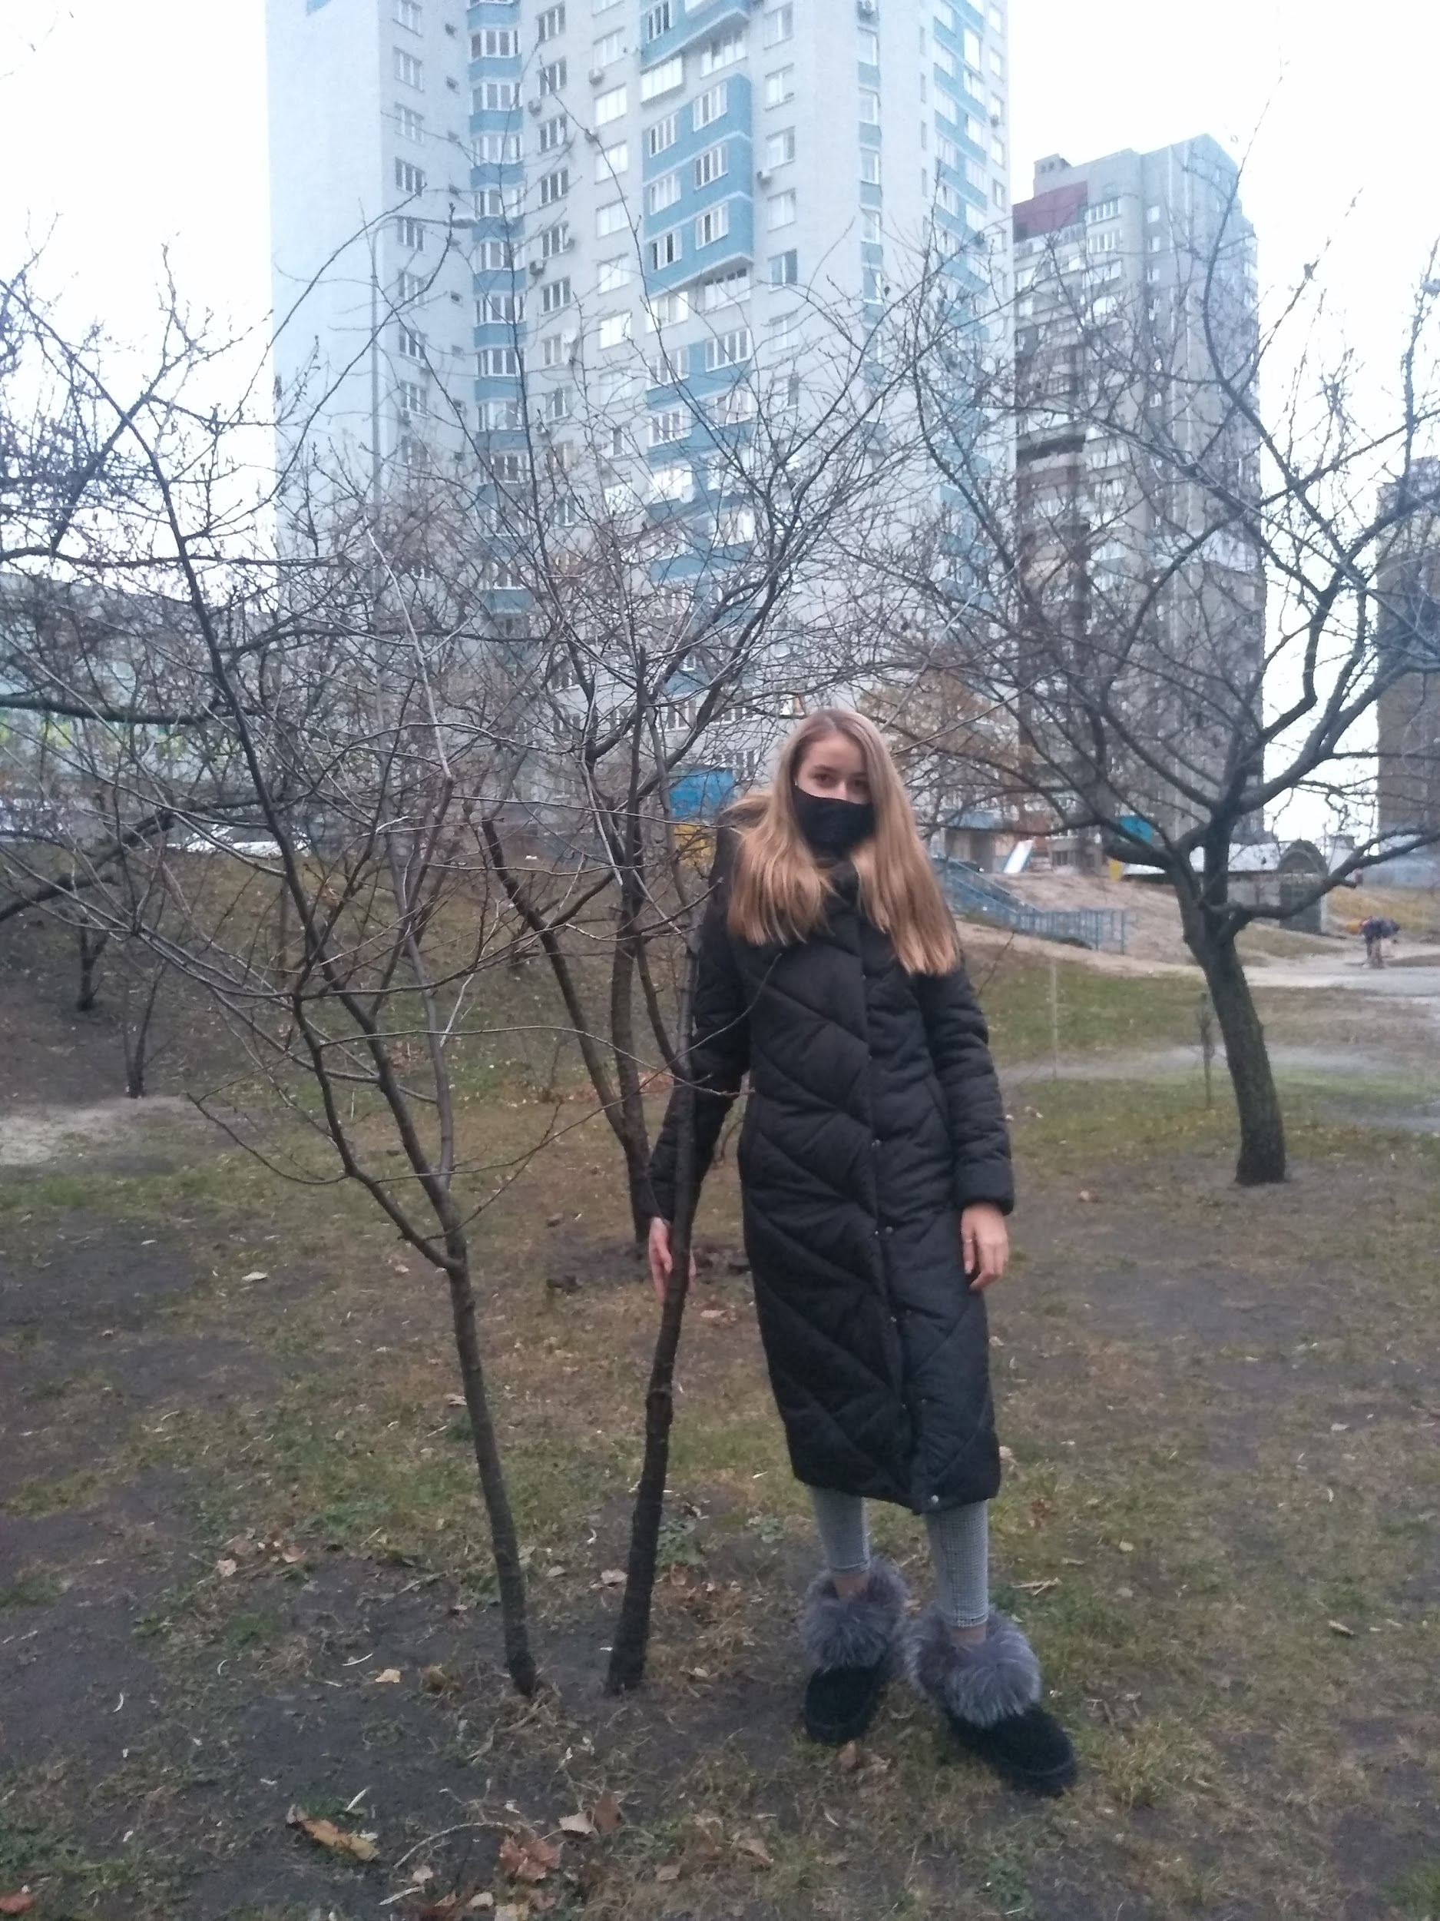
~Problems with cutting trees~
This is my plant. Its name is Apricot. This tree grows near my house.
I think that this plant has some problems like this:
People can damage tree.
This tree can freeze and then not survive.
It can dry out.
I think, I can help the plant to make some construction, that helps it in cold times.
Nataliia Mazurenko 7-D

Slide 7
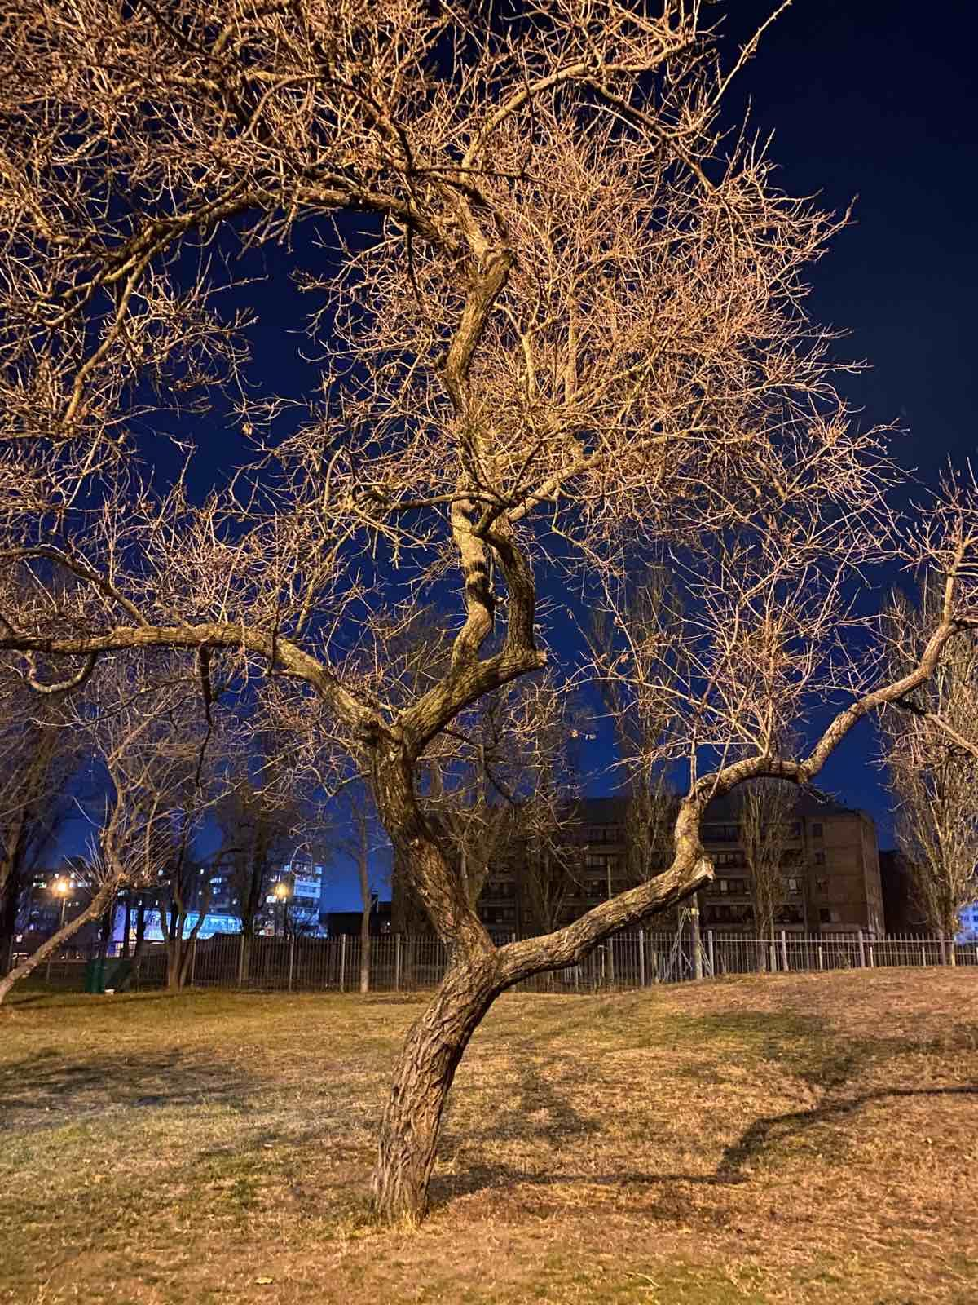
It's an apricot. People throw packages on the ground without taking themselves. Then these packages decompose in the ground for a very long time and because of this the earth deteriorates. Different beetles eat trees, so people spread cream on the trees so that the beetles do not eat them. It is still cold in winter, the trees must be covered. Still the trees must be watered to grow.
Tsenilova Anastasiia, 7-e

Slide 8
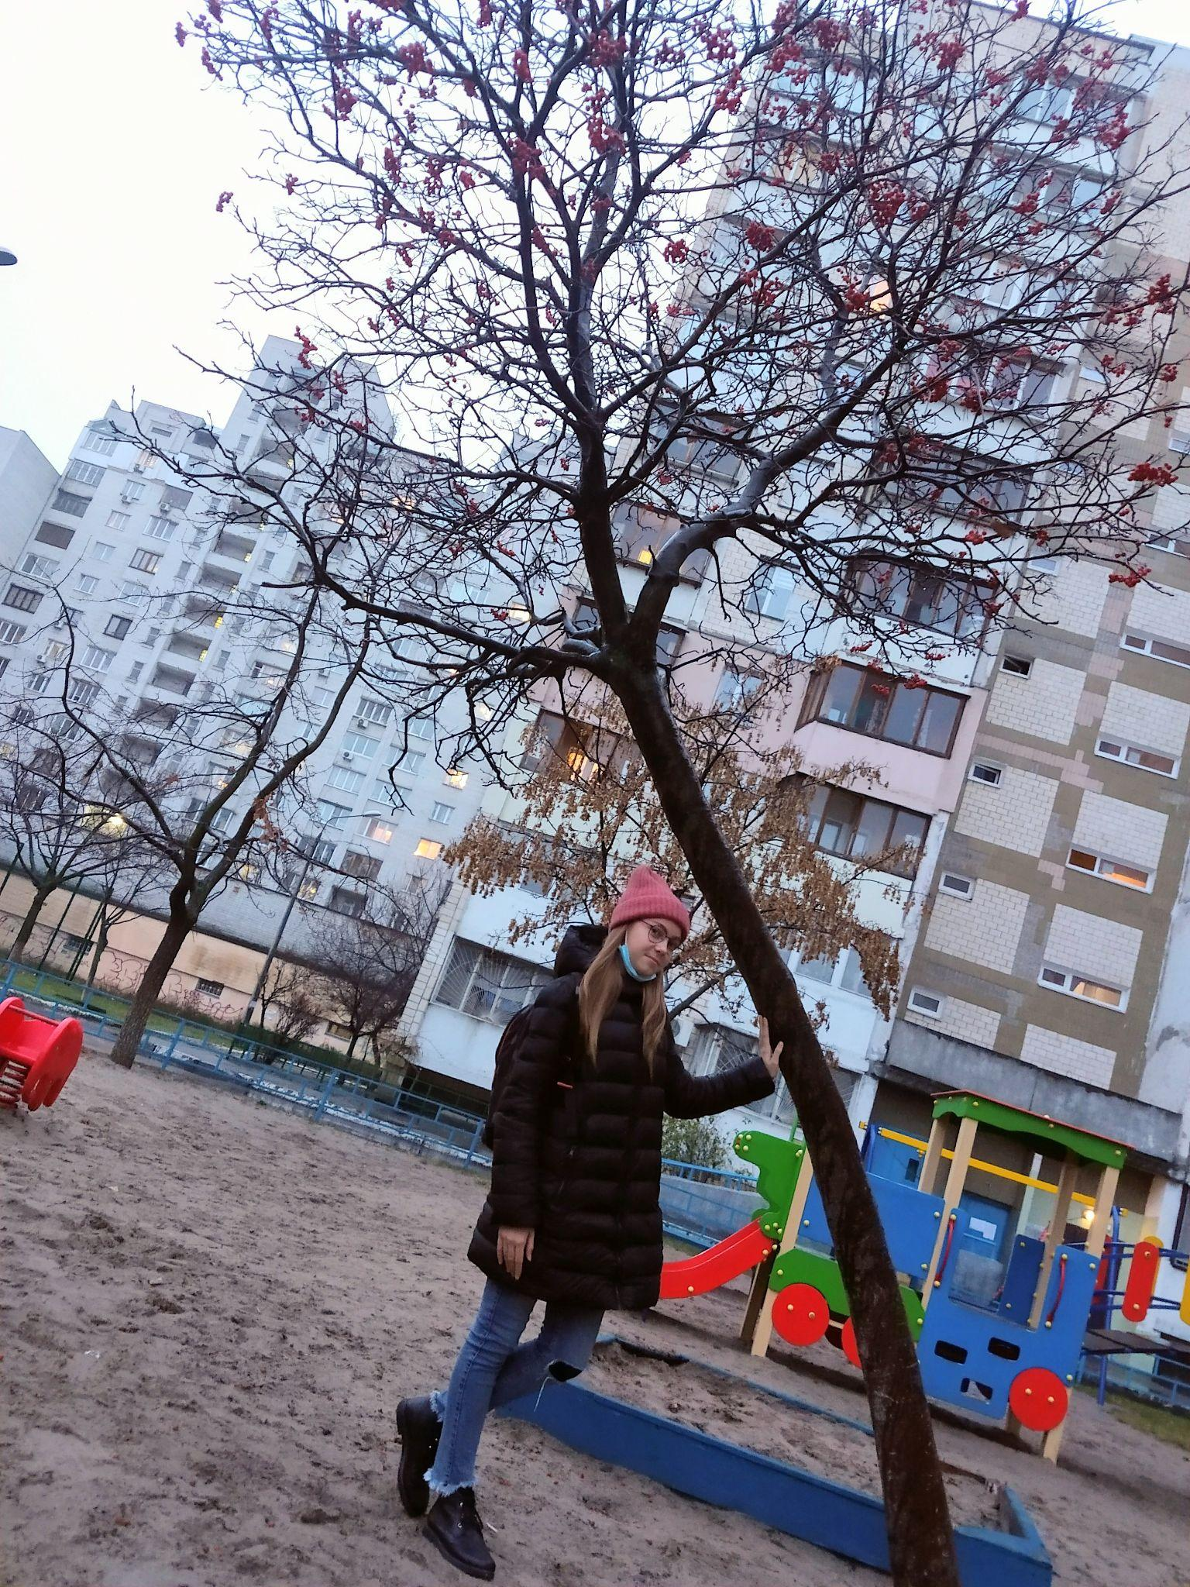
Rowan
Trees purify the air, land and water, so that life on the planet continues. Therefore, we must protect nature. I am very interested in this project. So I'm going to insulate the trunk circle for the winter. The fact is that the root system of columnar trees is close to the surface of the earth. The frozen soil will certainly harm the roots, they will get frostbite and the mini-tree will die.
Valeriia Tseba, 7-D.

Slide 9
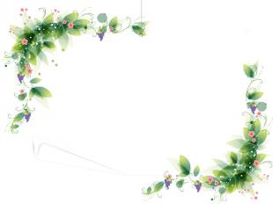
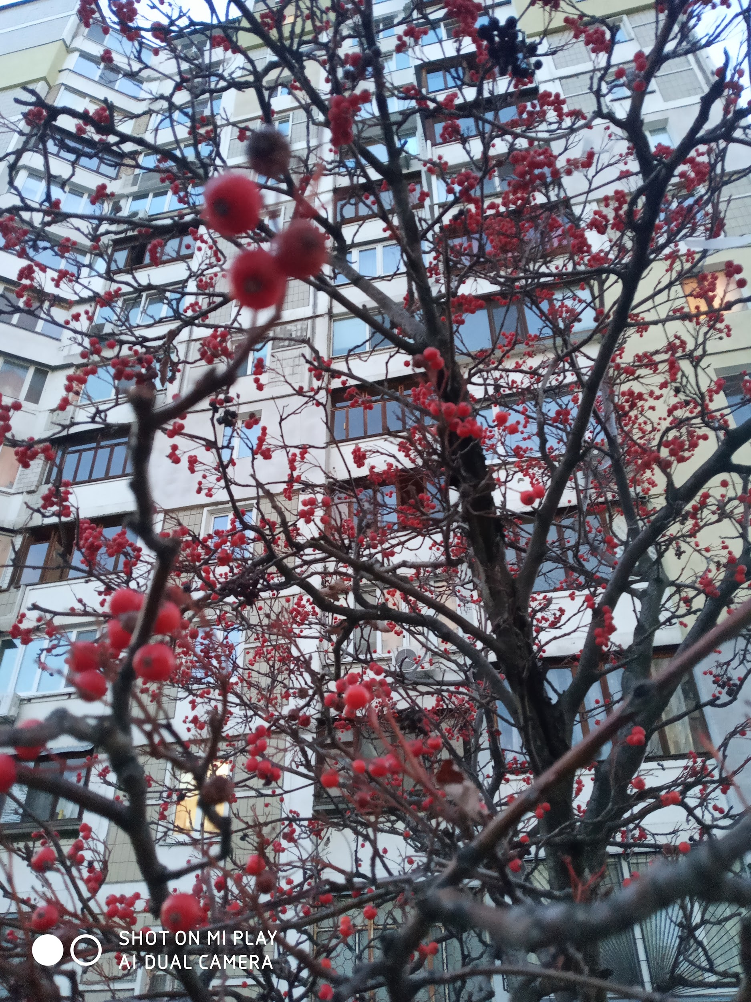
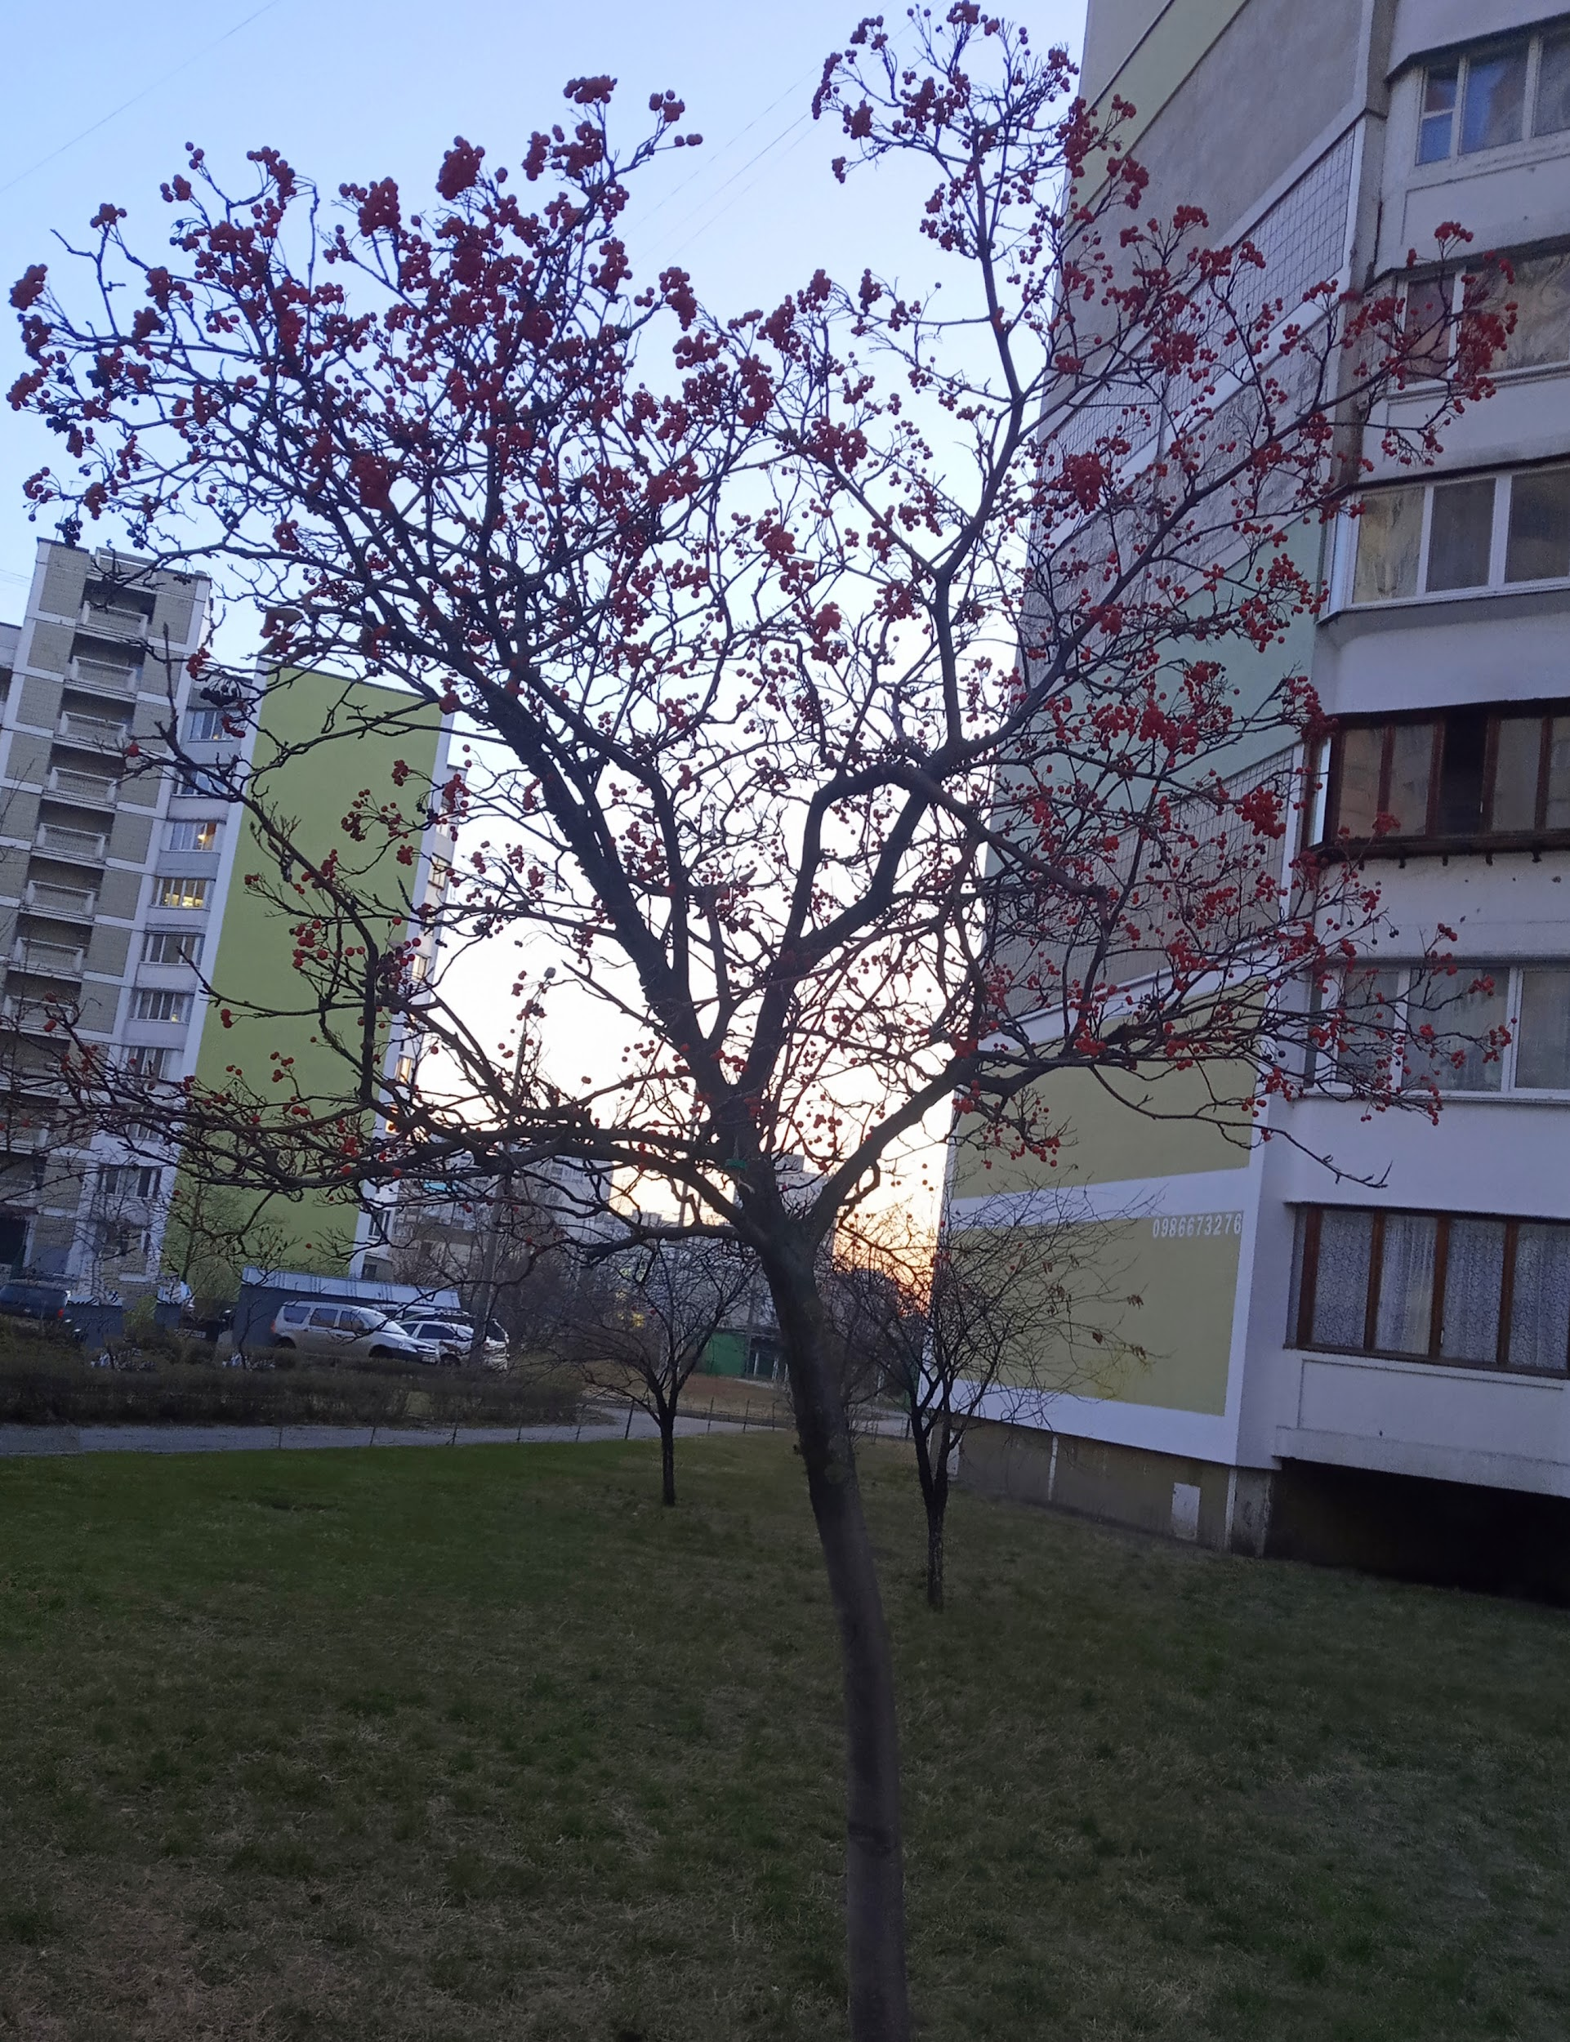
The problem with trees in Ukraine
Rowanberry
Rowan is capable of growing even in permafrost. It is one of the few trees that can adapt well to the habitat. Rowan is an important and easy source of food for birds, as its fruits remain on the plant until winter, after which it is eaten by birds, for which it is definitely easier to pick berries from the plant than to look for food under a layer of snow. Rowan berries are also useful for humans. For a long time, berries have been widely used in folk medicine to fight viral infections and loss of strength.
Yaroslava Kovalchuk 7-D

Slide 10
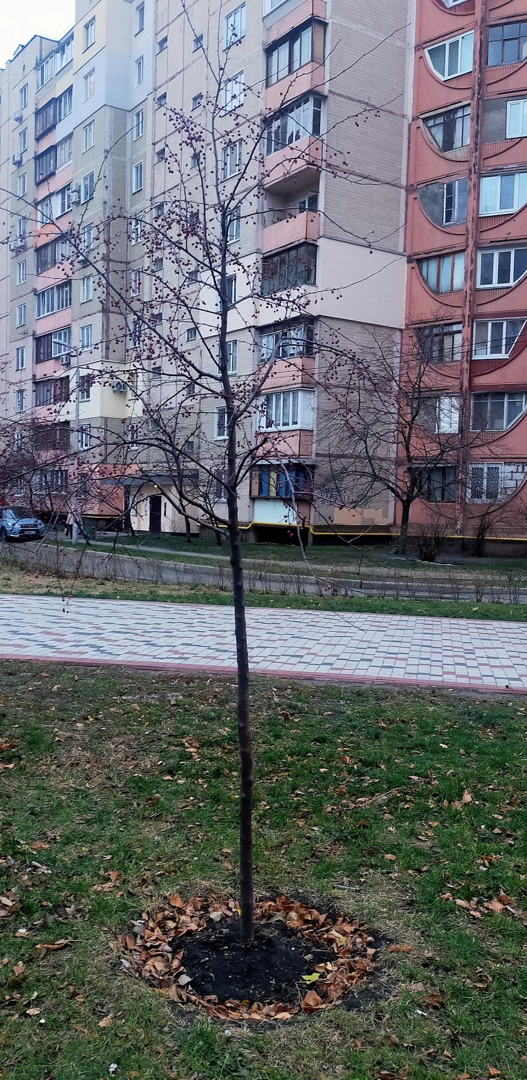
in Ukraine, trees are cut down in forests.trees give air, but they are cut down in large quantities.in winter a lot of snow falls on the trees, which can break them a little.winter in Ukraine is very cold, the temperature drops by -30 ° C but some trees survive only to -20 ° C
Rowan
plan
1) watering
2) clear a lot of snow (in winter)
3) watch that nobody broke
4)plant trees
Vadim Avramchuk

Slide 11
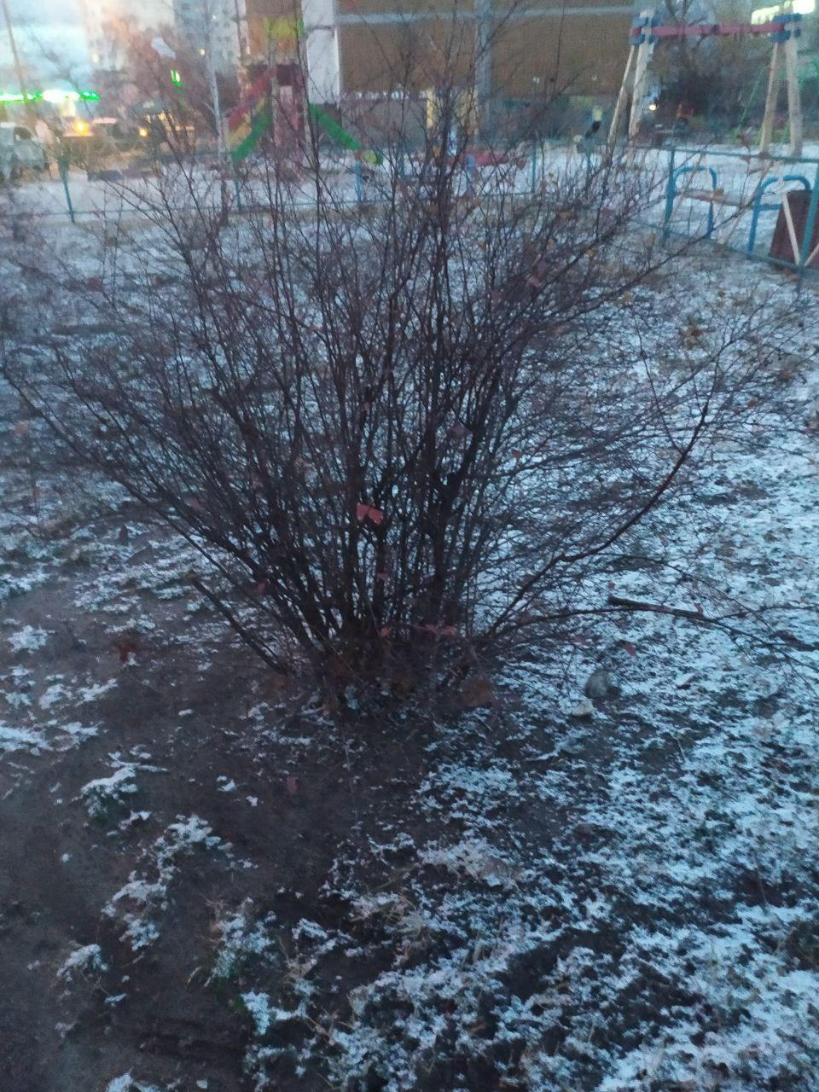
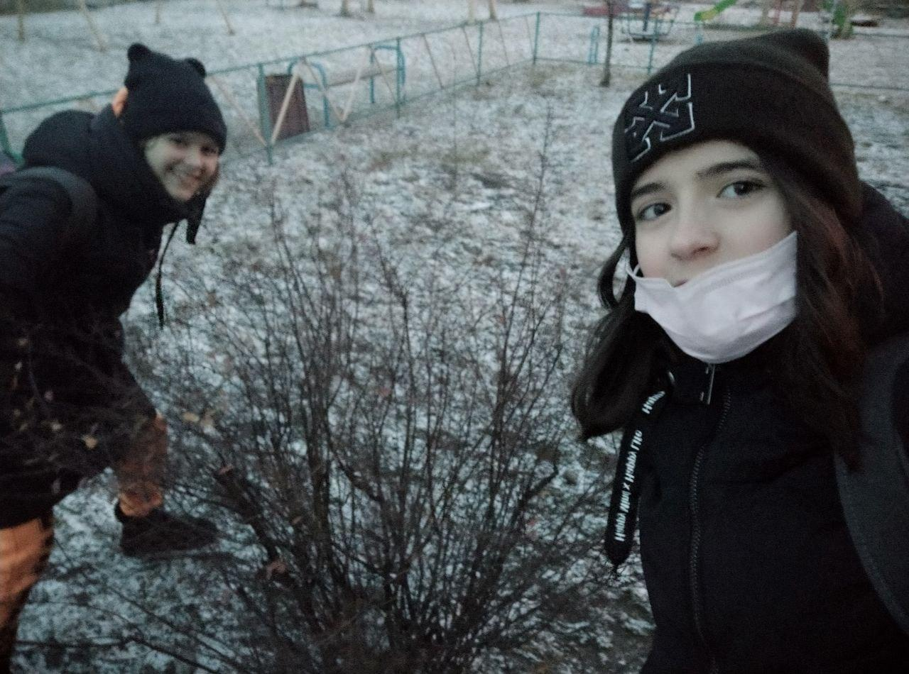
Bush problems
This is our bush. It is near our house.
Now it is winter and many plants have problems. But problems can be not because of the cold and winter. Animals can traumatize them too. In winter many mice or rabbits can traumatize them. But we can help them. We can tie them with a rope and the animals won't do much harm. We can also buy parasite or animal salve, but some of them can be harmful.
Mariia Mazur and Lera 7 - E

Slide 12
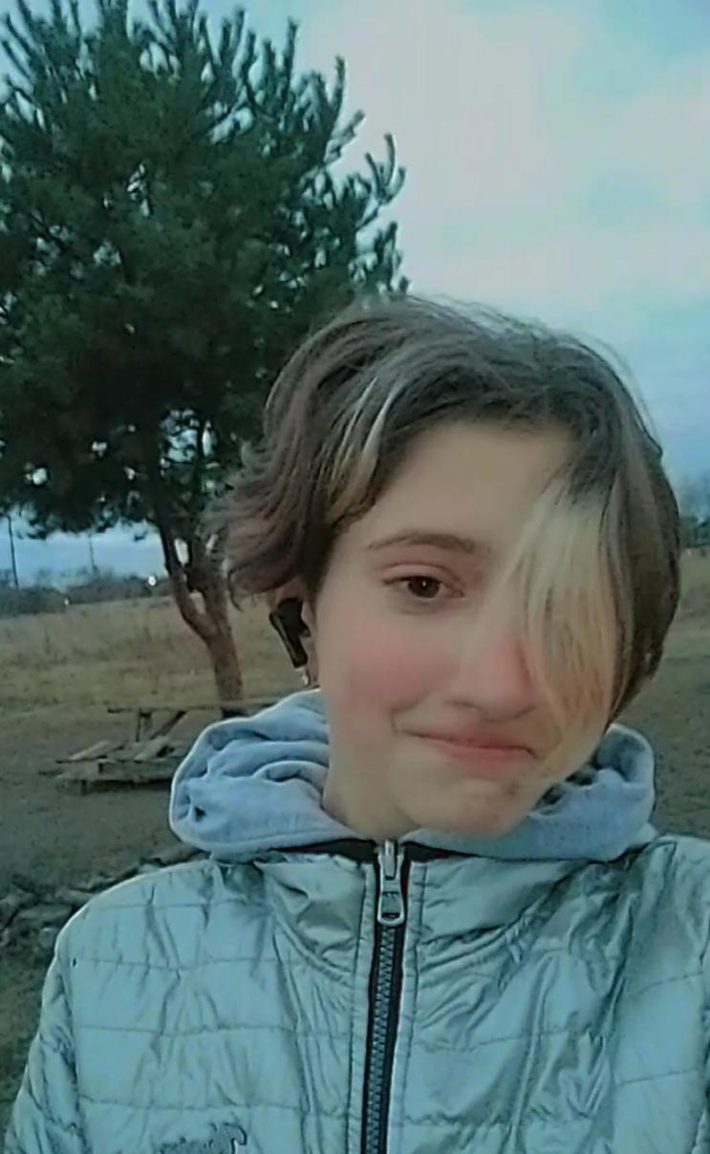
Pine Trees in Ukraine
In Ukraine, trees are often cut down. This is more often done in forests. We breathe clean air thanks to plants. That's why many people plant trees near their houses.
For example, this tree is not far from my house. It is young, but already big. A fire is lit near it every weekend. It hurts it a lot. But people remove the remnants of fire from there every Saturday.
Evelina Plaksiuk

Slide 13
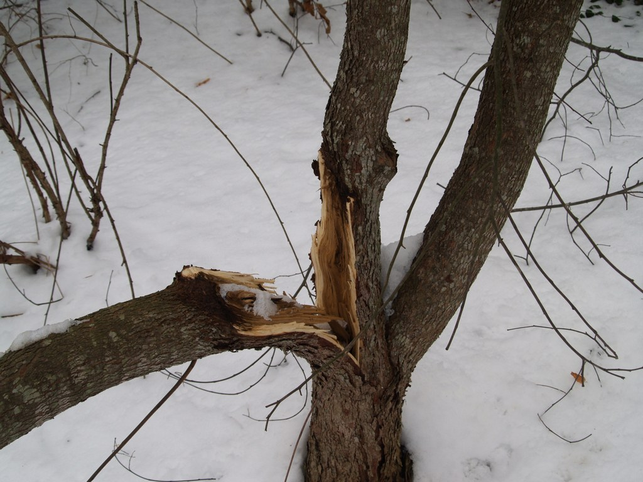
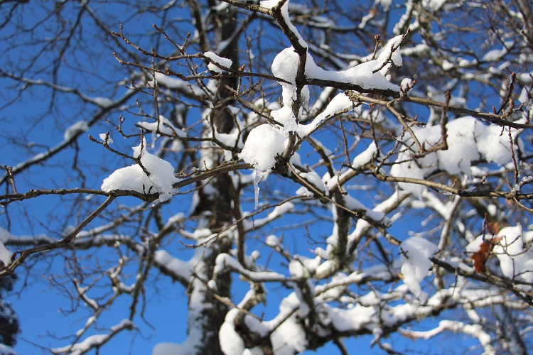
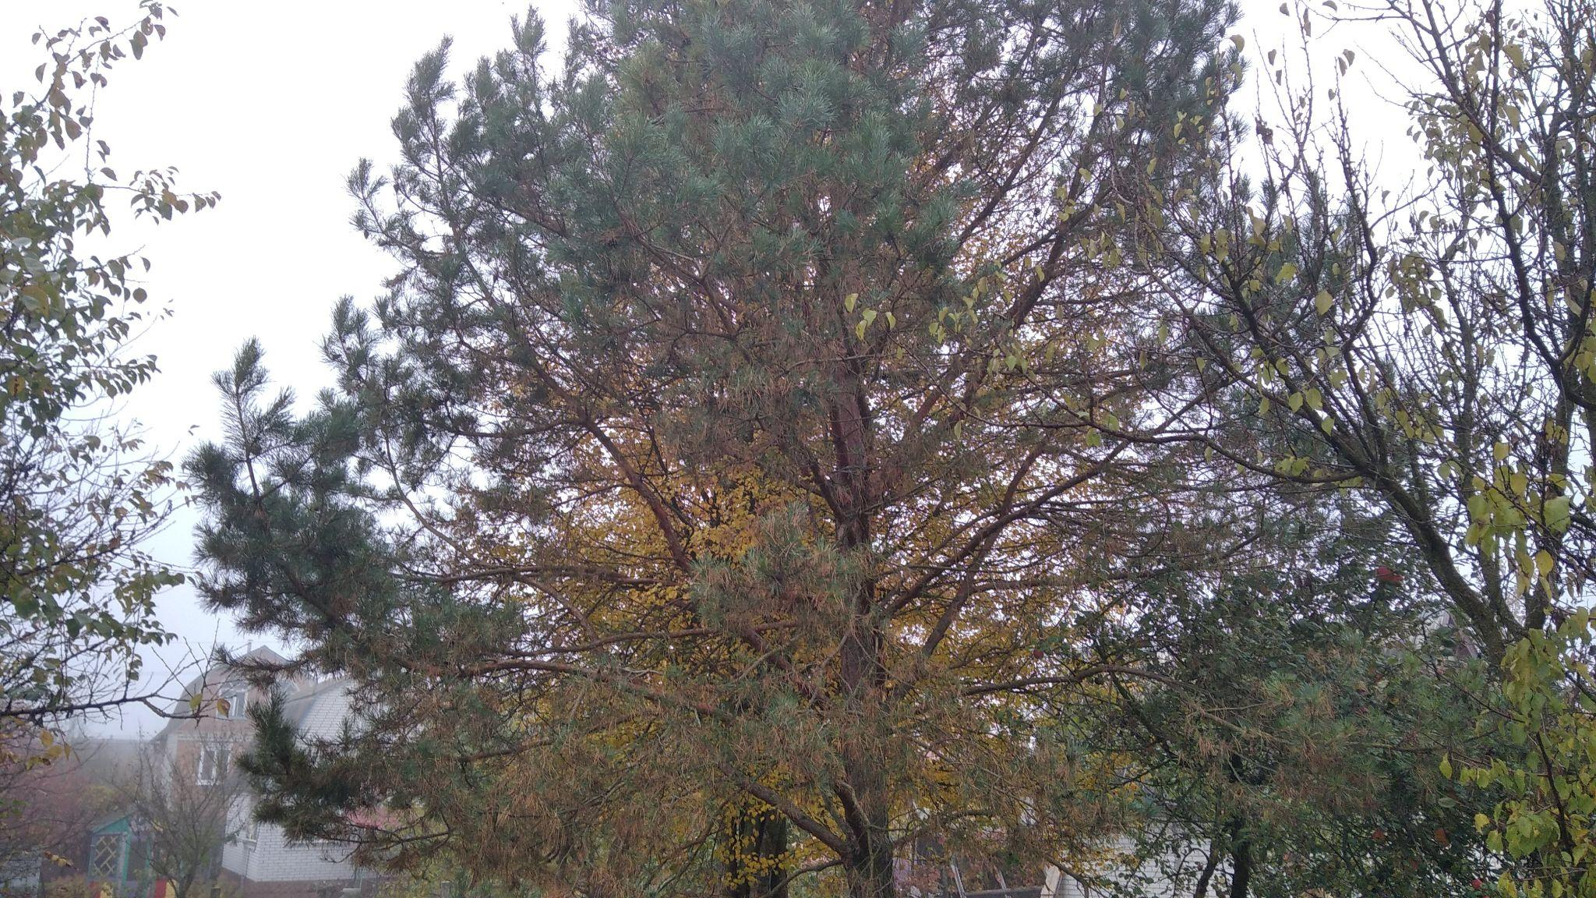
Tree problems in winter
Winter is a difficult time for small trees (and big too).
Branches can survive the temperature -45°С, but roots - only -15°С
Of course, the snow will keep them warm, but winter without snow can be a problem.
The snow can become a problem too. It can break branches with its weight.
The only way to save trees - follow up, don’t harm and always help.
Pine-tree in my village
>>
Dima Ilinov 7-A

Slide 14
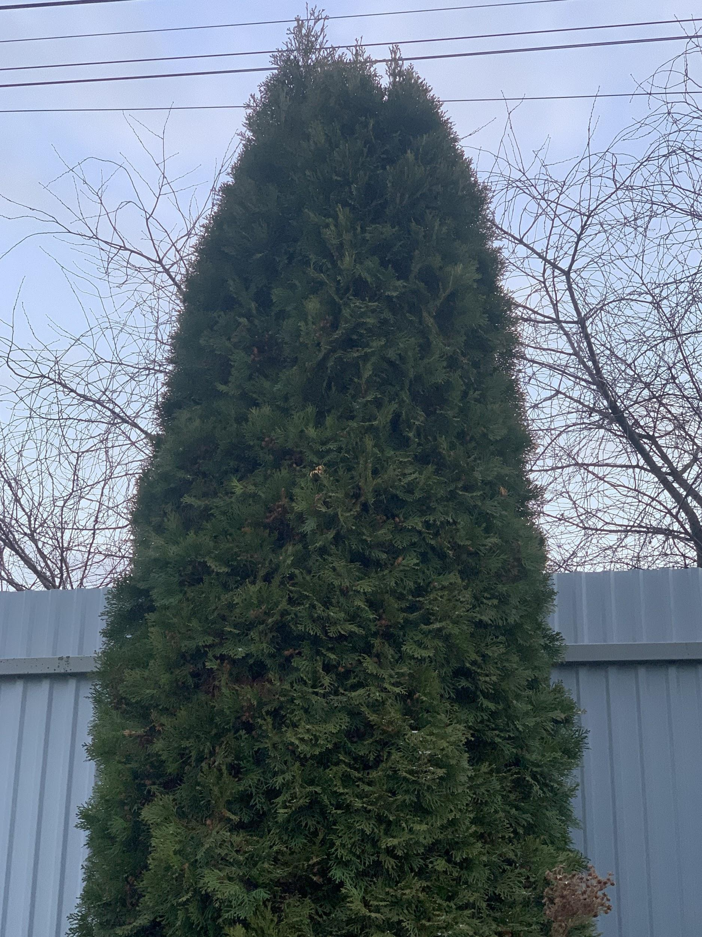
Tuya
1. The first problem is that during heavy snowfall, it falls on the branches and can break them. 2. The second problem is that when there is little snow in winter, trees can freeze. We can help them if a lot of snow has fallen, we could crush it, but not much, because the snow warms the tree. Next, we can insulate the root system with fallen leafs.
Sasha Chaiun 7-A
The tree I take care of Tuya

Slide 15
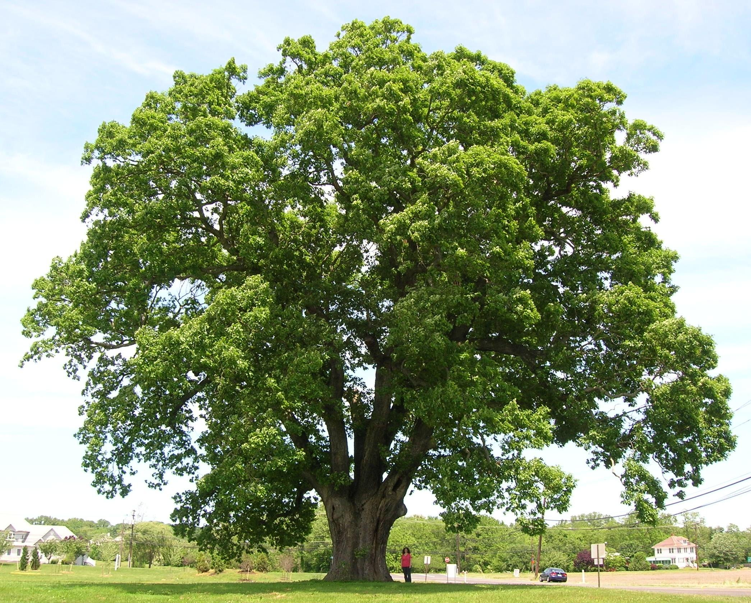
Ukraine’s Oak problem
I watched oak trees for quite some time because my family was near them a lot. From what I’ve seen one of the big problems is trees being cut down and it very much applies to oak as well. Humanity’s growing need for wood is one of the things that drives it’s population down drastically and soon we won’t have the ability to see some of the biggest trees in the world. One of the things that we could do is go for recycled material and wood so we don’t have to cut down trees for material. Recycled paper is also relatively easy and cheap to produce so we won’t have to worry about the costs of it. What I would do is ask my grandfather to stop cutting them down for wood and heat.
Presentation by Dima Baliuk

Slide 16
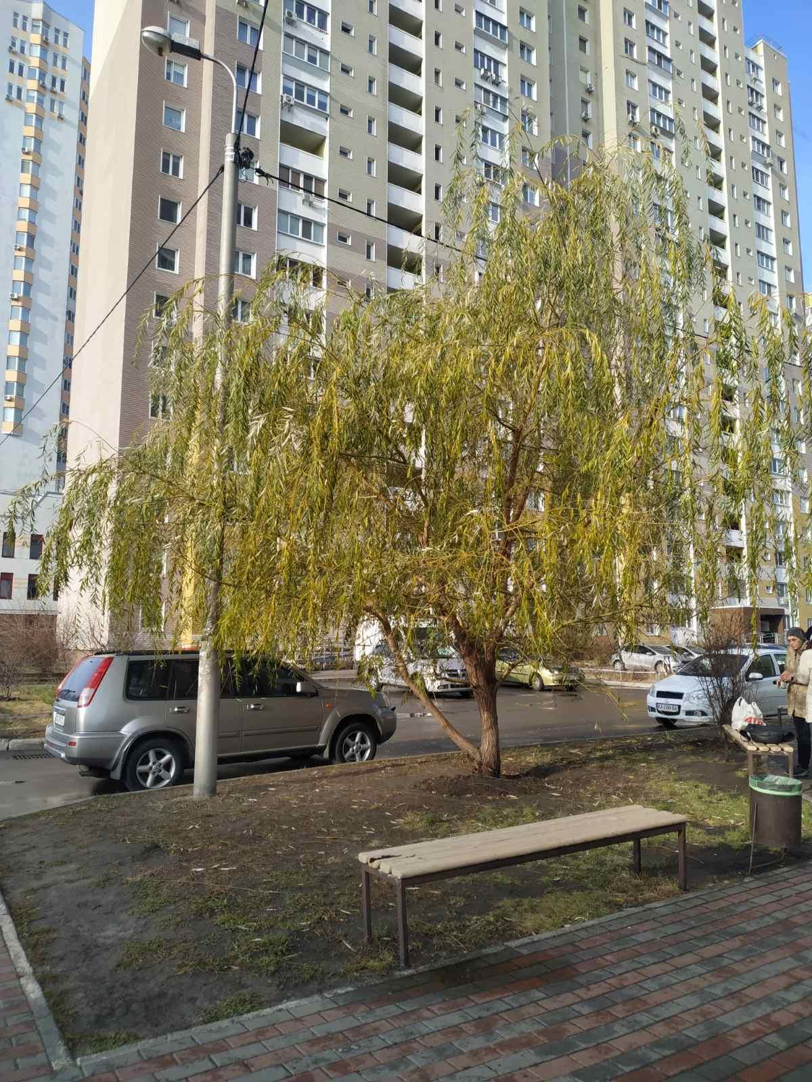
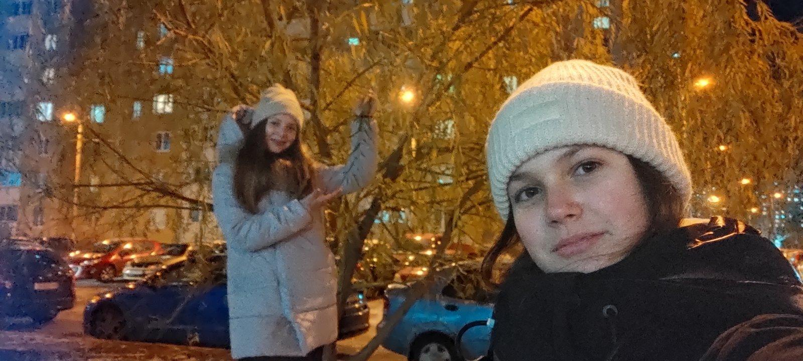
Trees problems
Problems exist not only in humans but also in trees. In winter, they can freeze. Leaves will no longer appear on them next year. Another problem is eating roots by different beetles. This can be easily solved by buying special fertilizers. But not all people understand the importance of trees in our lives. Children often play with this tree: they pull out leaves, pluck branches. We approach and say that trees are not a toy and it hurts too. Appreciate the trees and know that without them we will not be!
Vika Zinoruk
Liza Dovhopol
In this photo you can see a willow

Slide 17
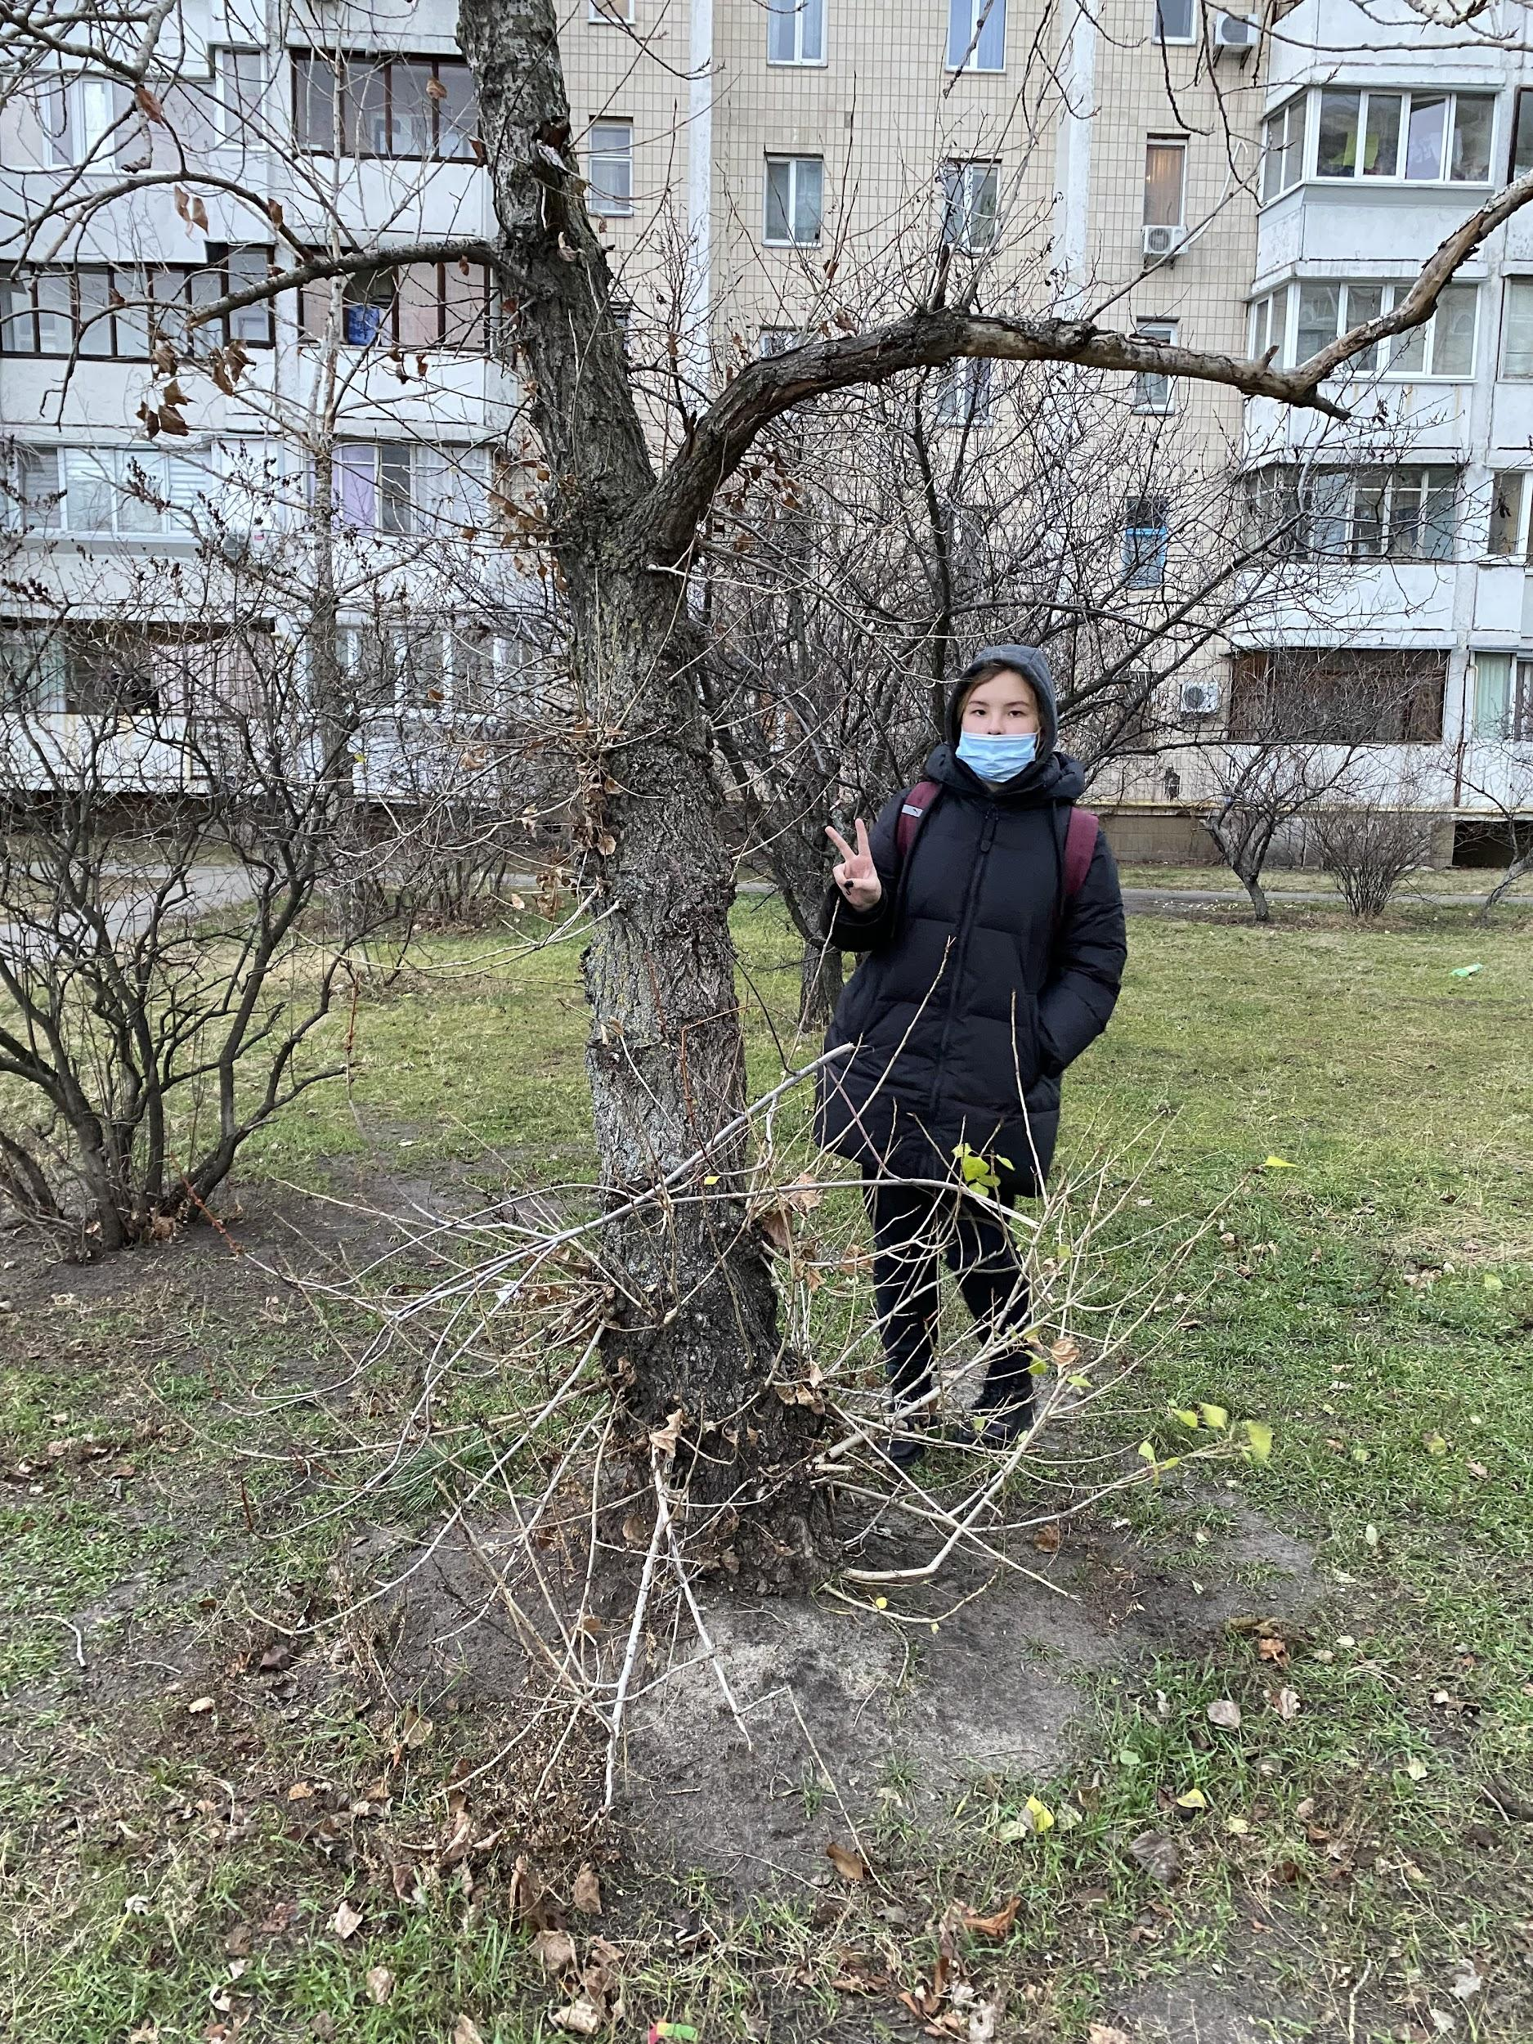
In big cities, plants, especially trees, feel very bad. Because of the exhaust gases from cars and a lot of debris.
Veronika Holodova
I look after the poplar
The tree had problems like debris next to it and freezing due to cold weather.
I can clean up the trash next to it and water the tree in the summer.
Plants also suffer from the dry climate in summer and people need to water them. People also cut down a lot of trees.

Slide 18
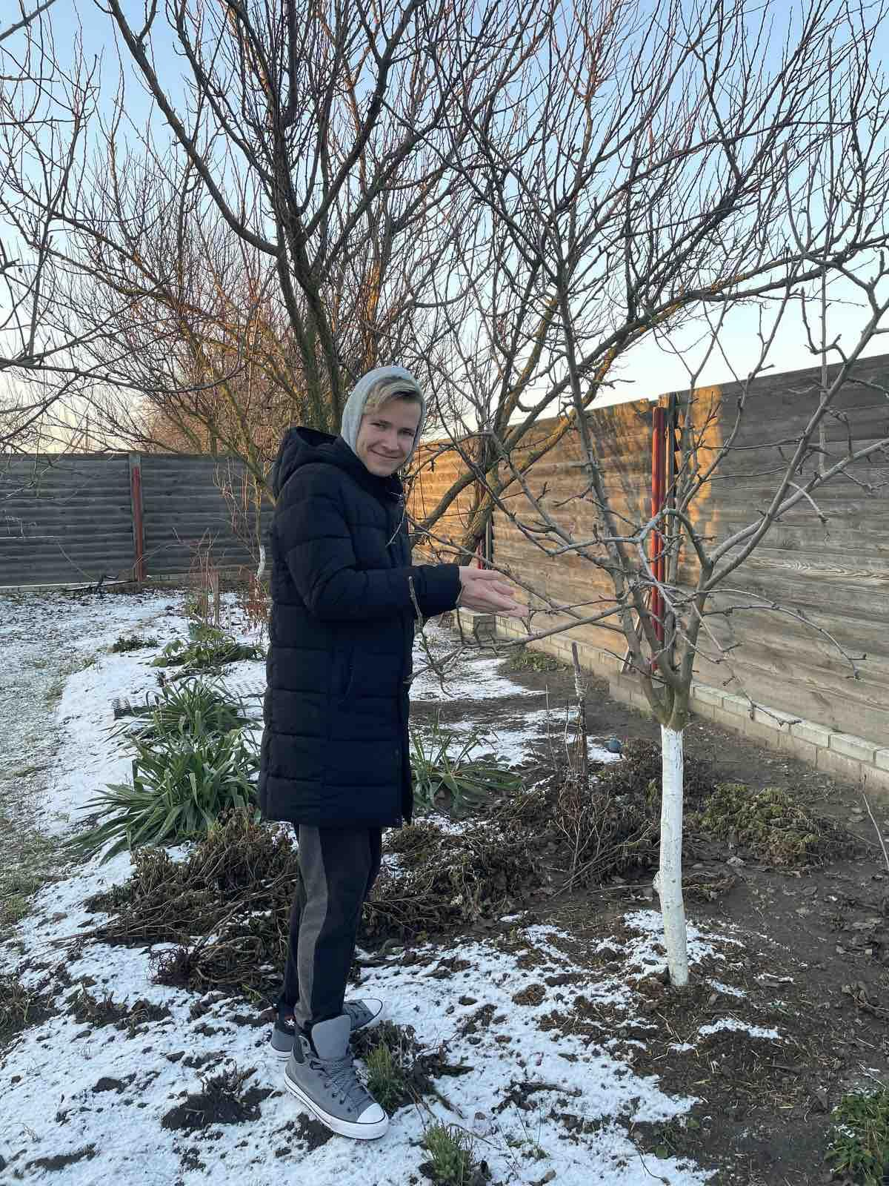
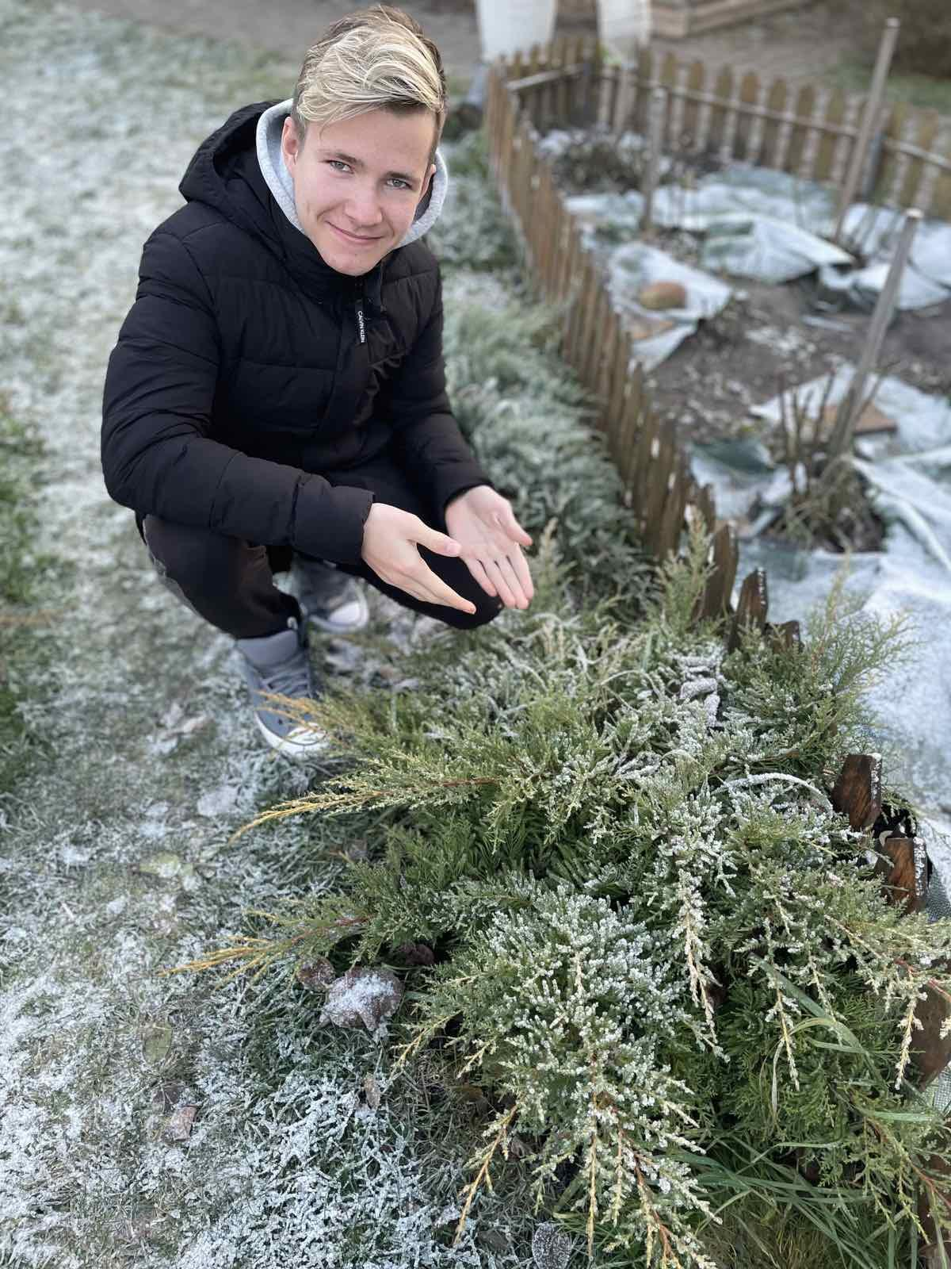
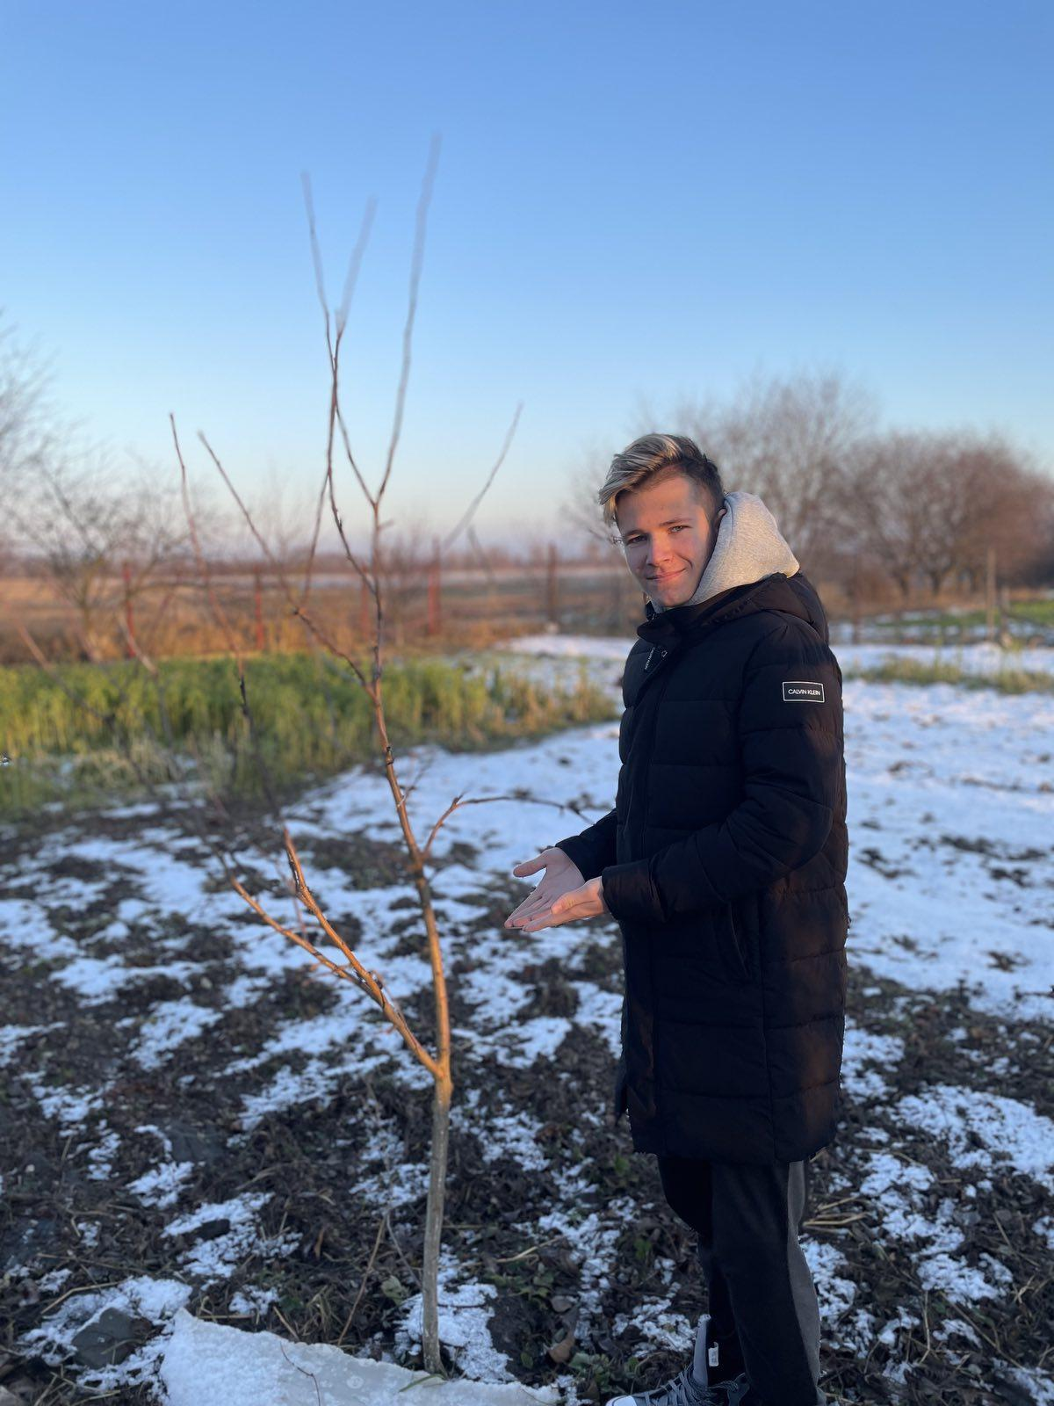
I think in Ukraine the most tree problem is tree felling. Because people destroy a lot of trees every day. If people do this every day in the future all trees will be destroyed very quickly.
Also a really big problem is a lot of water because the roots won’t absorb water and the tree will die.
Apple trees
Juniper
Artem Klymenko 7-A

Slide 19
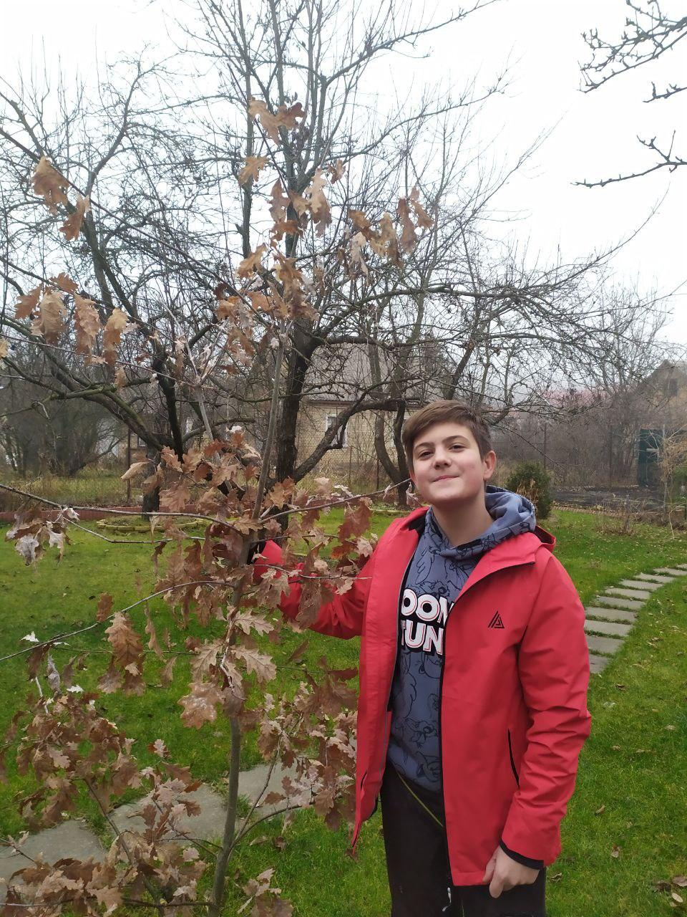
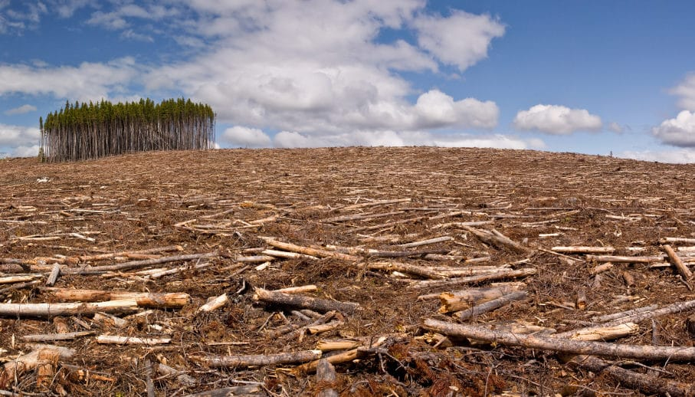
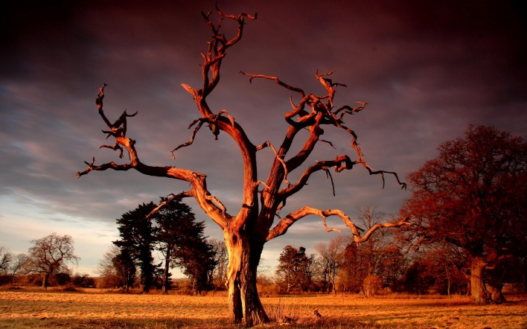
Problem with the trees in our country
1.Forest clearance.
I think it’s one of the most important issues in our country .Some people think that they can buy the forest and do with it things that they want.They cut down trees and don’t plant it again .So more and more forests are disappearing every day .We can stop it if we start to plant the trees in our countries.
2.Summer tree drying .
In the summer all the trees started to dry due to the temperature.Sometimes this temperature reaches +40C.So trees dying ,because they don’t have any water to drink .I think we must look after our tree :water it in the summer,protect it for the winter and try to do it more beautiful .
This is oak
Ivan Kravchenko

Slide 20
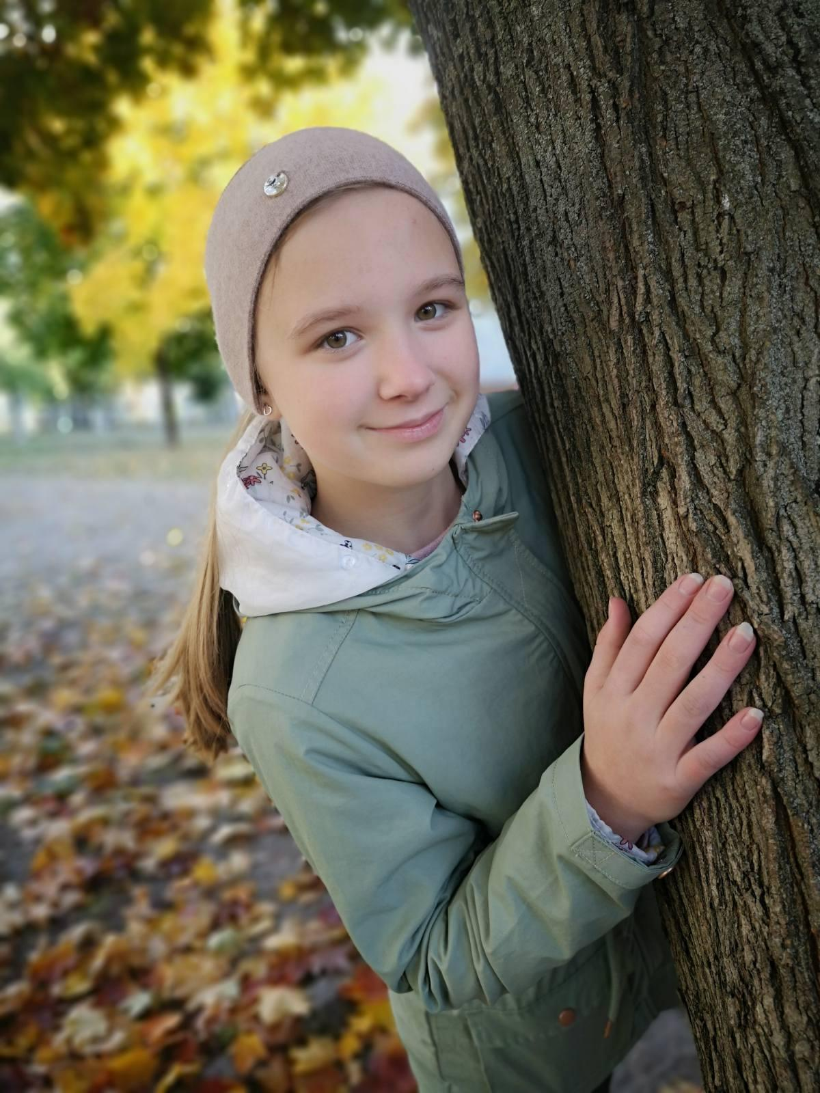
Problems trees
Many trees are cut down in Ukraine. People do it without even thinking that it can harm their health. Trees convert carbon dioxide into oxygen through which we breathe. If there are no plants in the world, we will not be able to live on our planet. Next to me in the photo is a tree that is in our yard.It name is Maple. With the onset of winter, it gets cold. We can make covers for trees so that they are not so cold.The tree is also eaten by parasitic beetles. They make the tree feel bad. This problem can be solved by a special tool that needs to be spread on the wood. Then the beetles will not want to eat it.
Anna Vashchenko

Slide 21
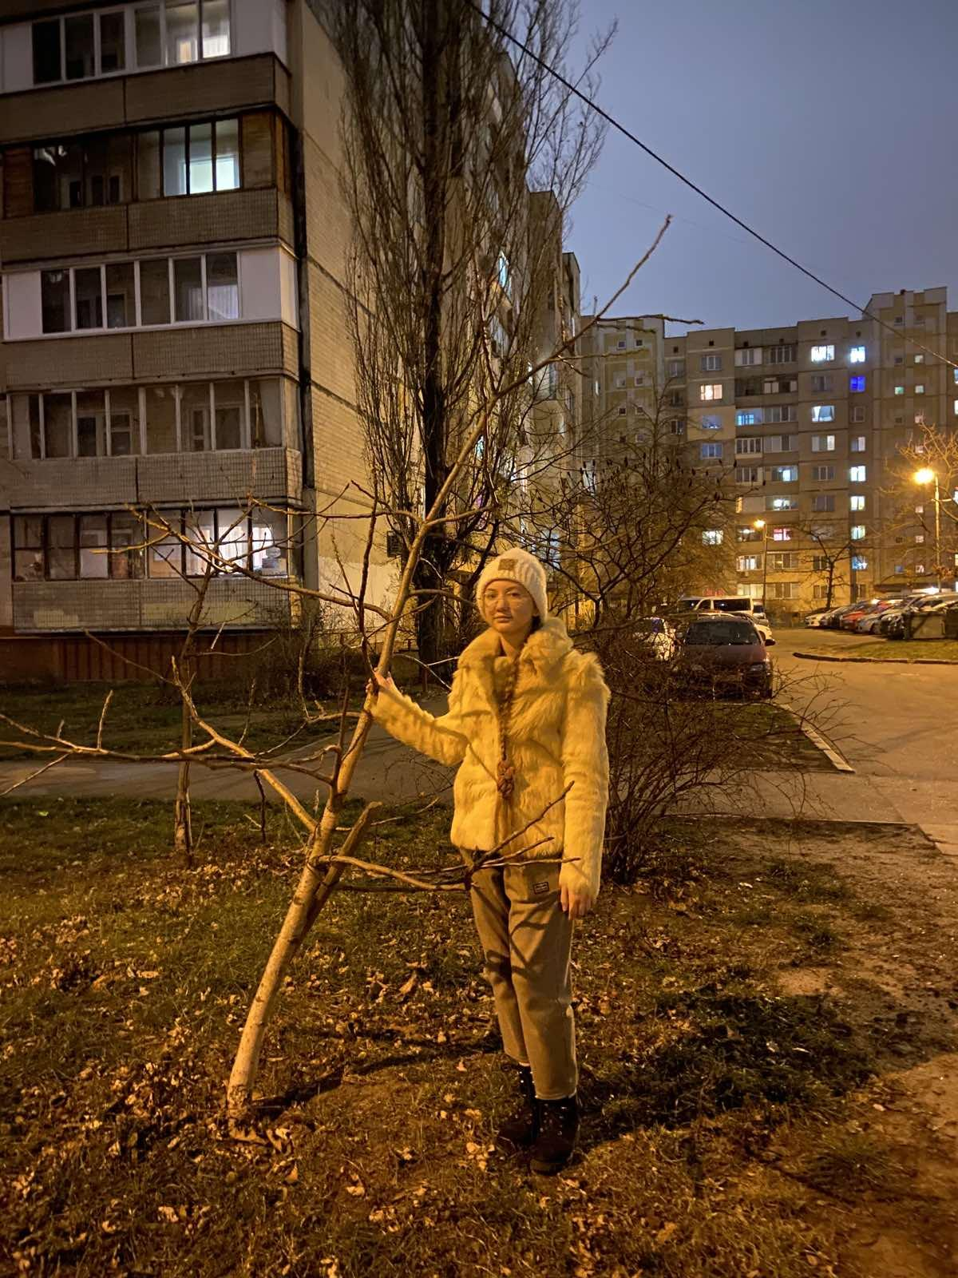
URBAN TREES
The cities are a big problem for the environment. They occupy only 2 % of land in the world, but produce 70% of greenhouse gas. Trees can help. If we have more trees and parks in the cities the air will be better. There are still many places in Kyiv where we can plant more trees. Also we have to take care of urban trees - cut broken and old branches, water, fertilize or fix them if they grow in a wrong direction.
Adelina Deriabina 7-D

Slide 22
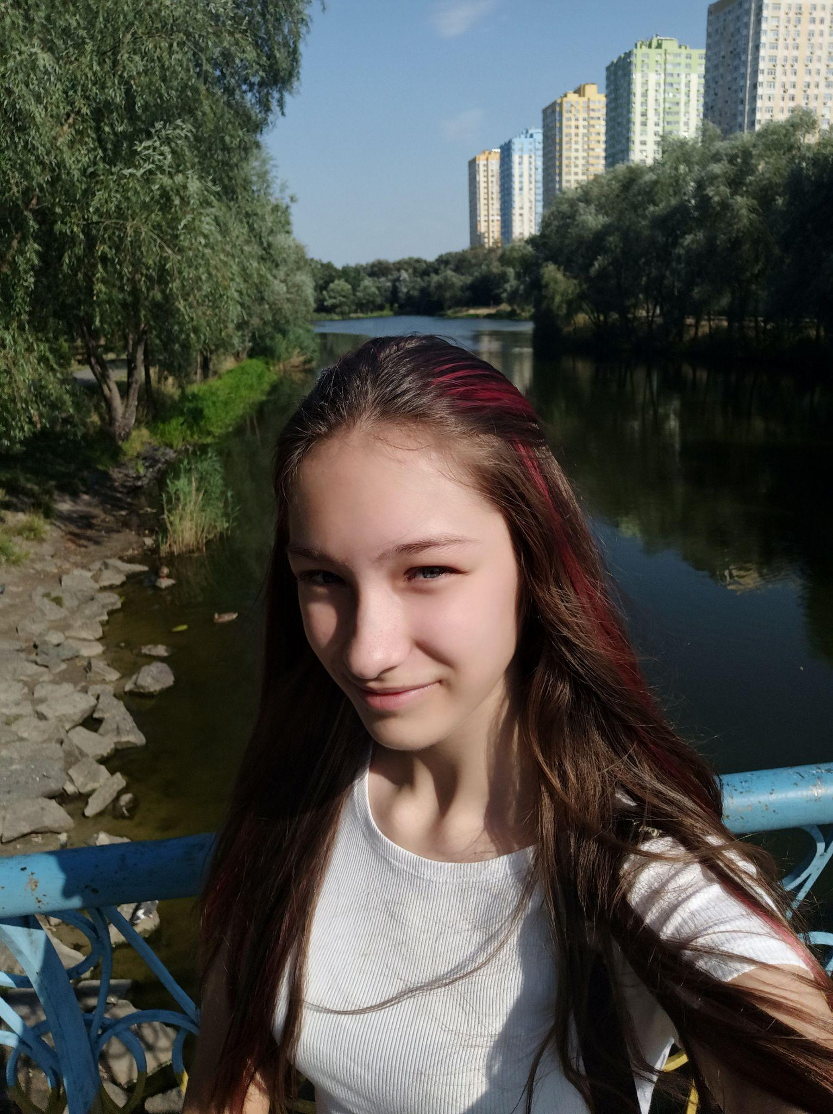
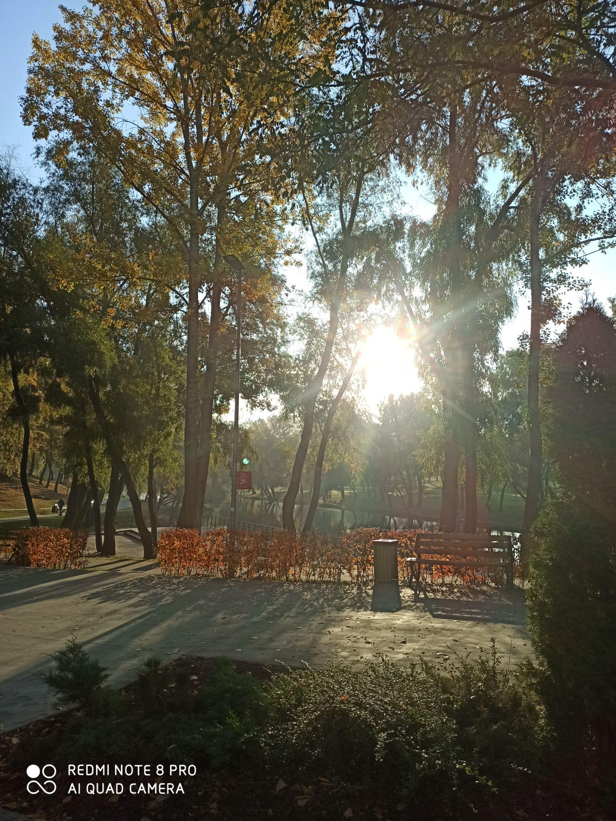
Let's save the trees
Very often the trees are just cut down. I really like trees. I really like watching the plants and I really want to save all the plants from being cut down.
Let's protect nature together? It's so cool!
Veronika Kuzmenko

Slide 23
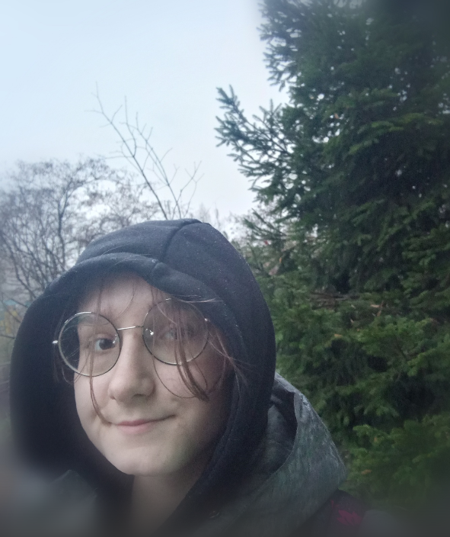
Trees in Ukraine
Cutting down trees. Many trees are being cut down illegally, so our forests are becoming smaller and smaller.
Winter. Many trees suffer from the cold because in winter their roots and leaves can fall off.
Medicine. Many people use natural resources to treat. Trees are also used and suffer from it.
Uliana Moshkova 7-D class

Slide 24
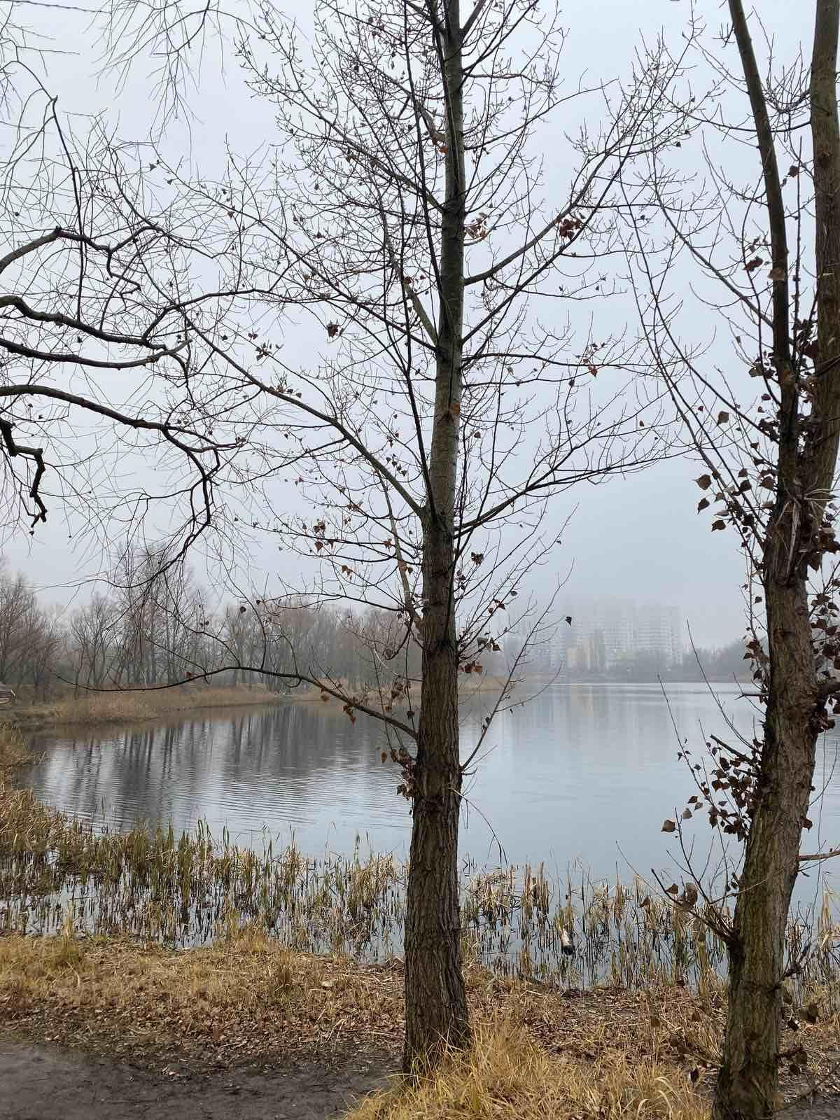
The problem of trees in Ukraine
People throw out a lot of rubbish and therefore trees grow in plastic. Also, people do not follow trees and can break them, cut down and trample. There are not many trees left that actually grow in a good location. Also in Ukraine it may not be raining for a long time, so the trees become dry and wither.
Kseniia Rudenko 7E

Slide 25
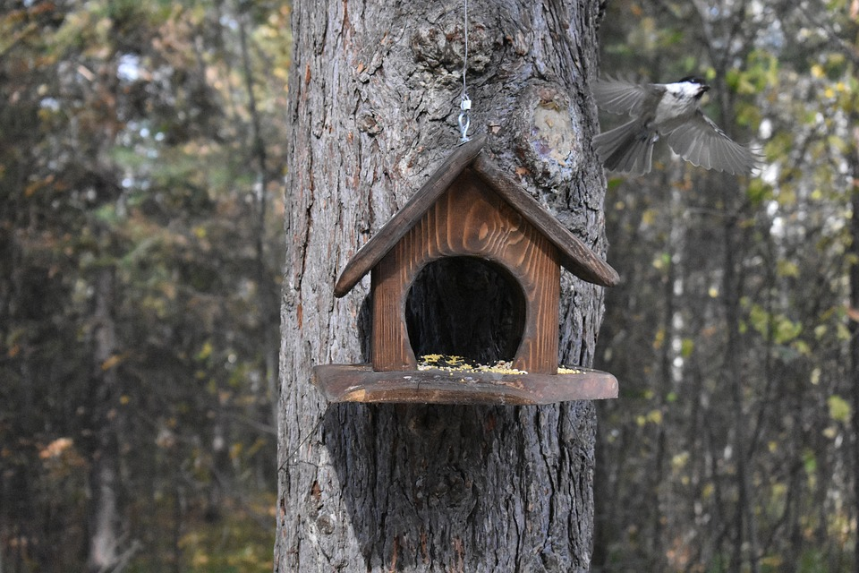
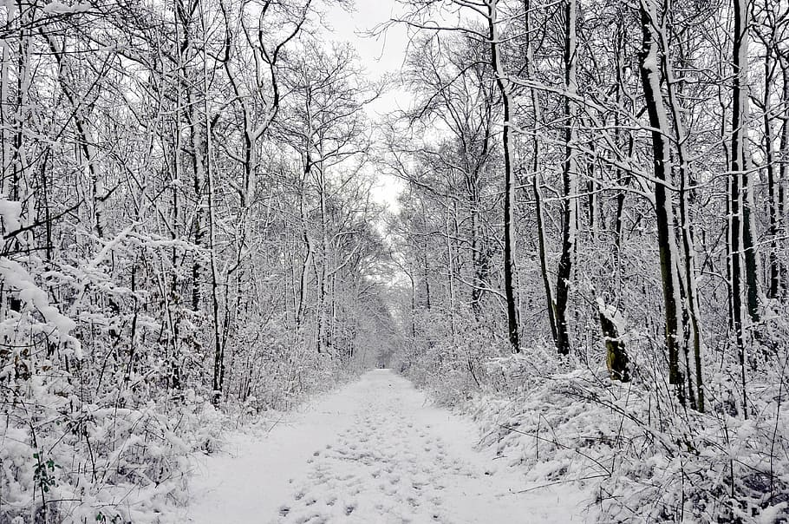
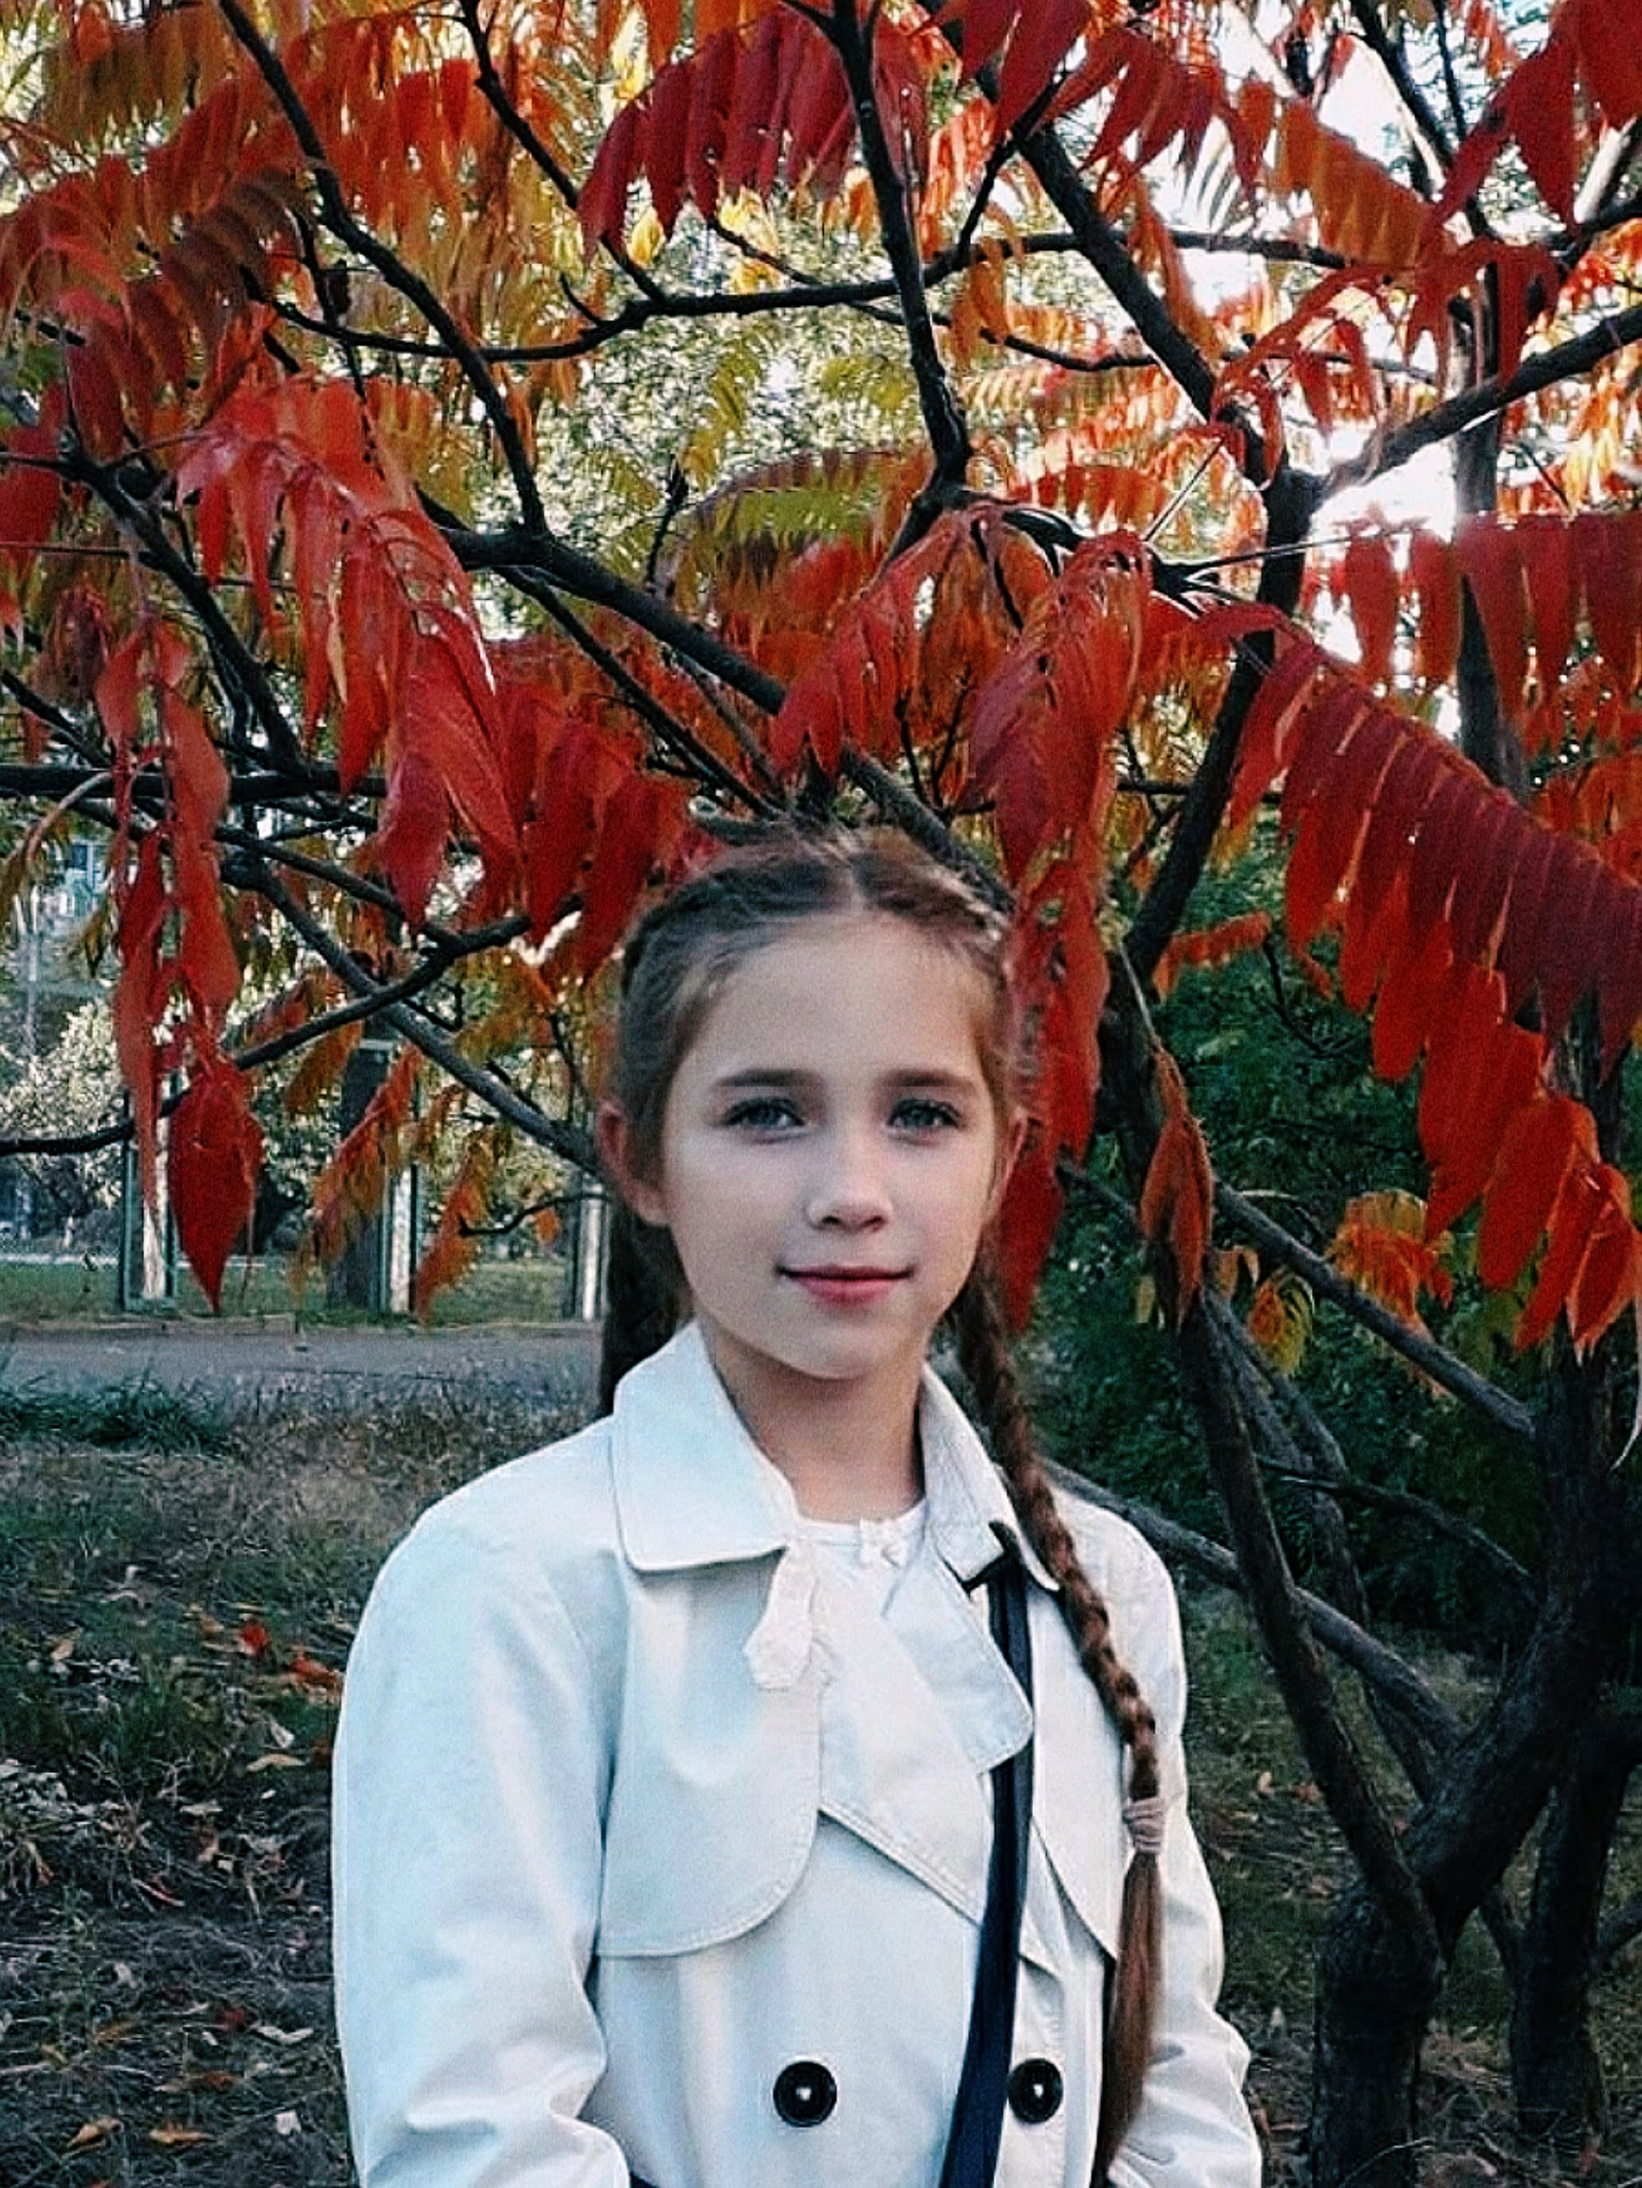
Saving plants
If you have planted a tree, you must take care of it. You have to water it. You have to fertilize it. You have to protect it from insects. In the summer, it is necessary that the tree does not dry out. In winter, it is necessary that the tree does not freeze. Also in winter, you can take care of the birds and hang feeders. We need trees to breathe.
Let’s save trees together!
Sumakh
Milana Yurchenko

Slide 26
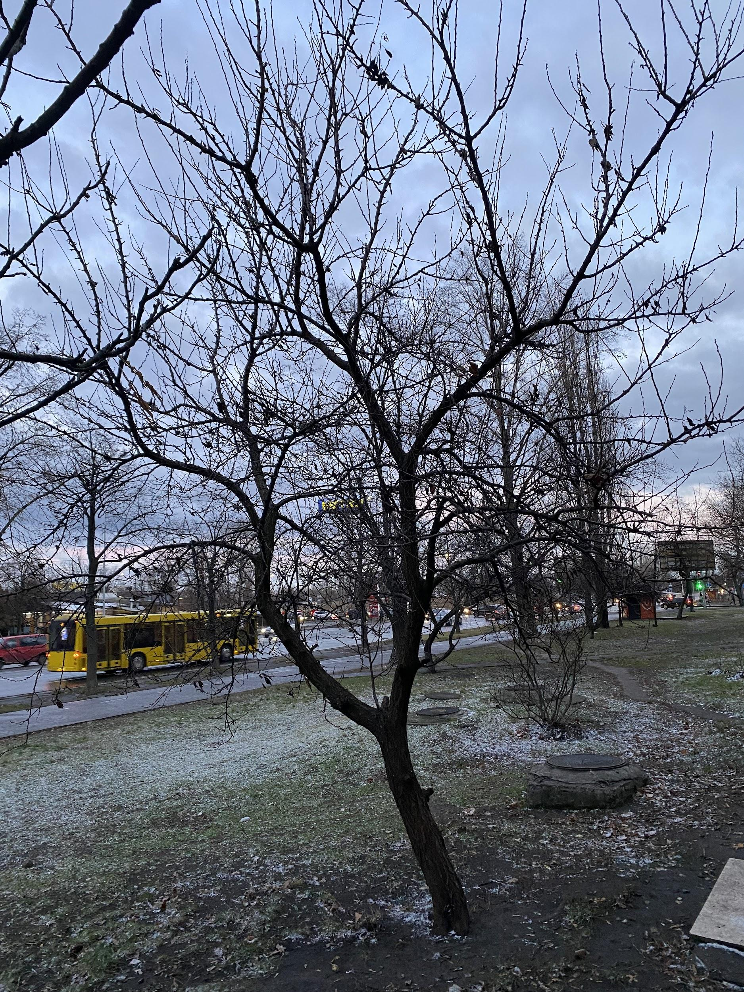
People don't think when they throw rubbish on the floor. They pollute the earth. We saw a tree and believe that if people cleaned up the rubbish, it looked much better. You need to take care of nature, you can also treat trees with different sprays so that pests (insects) do not damage the tree. Also, trees may not have enough water, so they need to be watered
Maria Vinichenko
Inga Surzhko
7-E

Slide 27
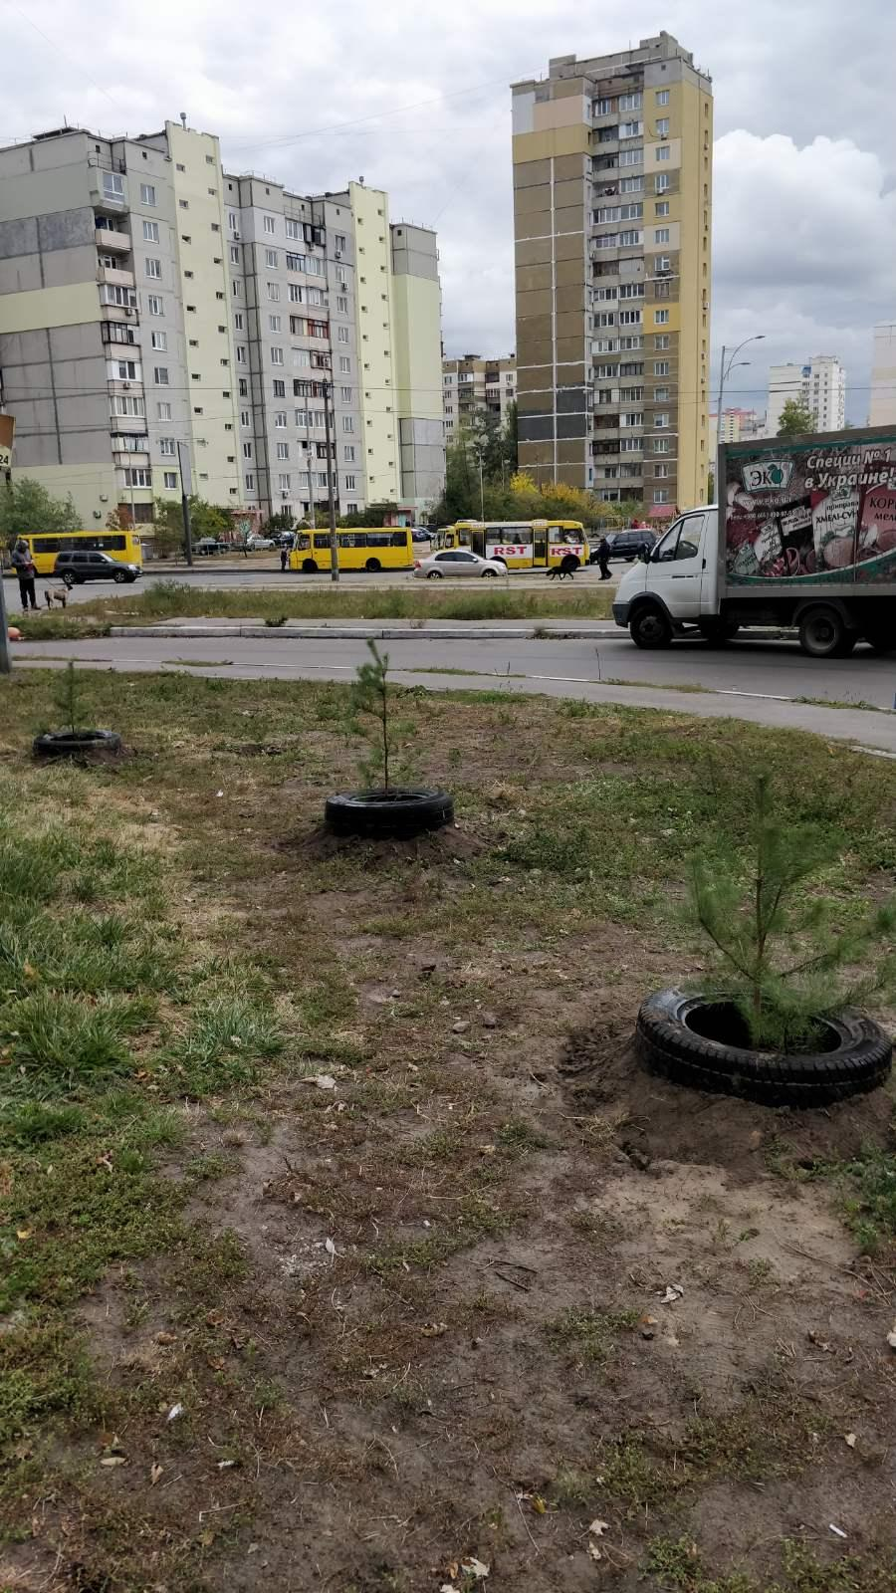
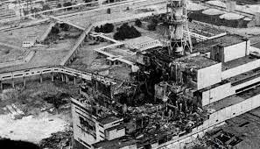
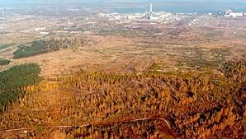
After the accident at the Chernobyl nuclear power plant, plantations ("red forest") on an area of ​​47 hectares were completely lost, and partially (6 km north of the nuclear power plant) on an area of ​​30 hectares. 25-40% of adult trees died in the affected area, and necrosis of growth and young shoots, drying of a large part of the crowns, sharp suppression, or complete absence of growth processes were observed in 90-95% of pine plantations.
Vlad Bevza 7-А

Slide 28
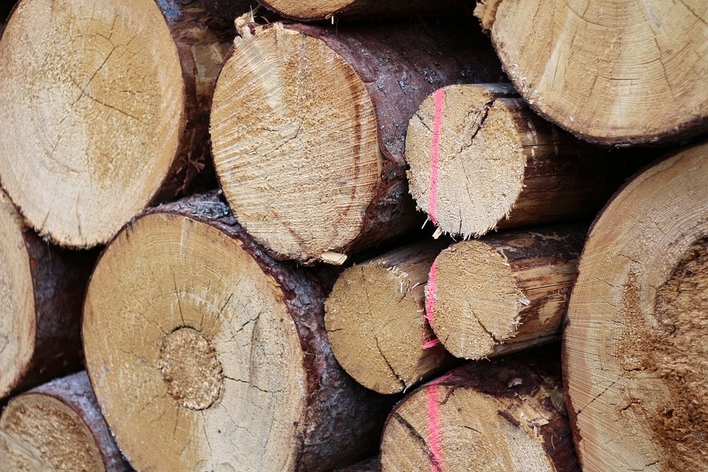
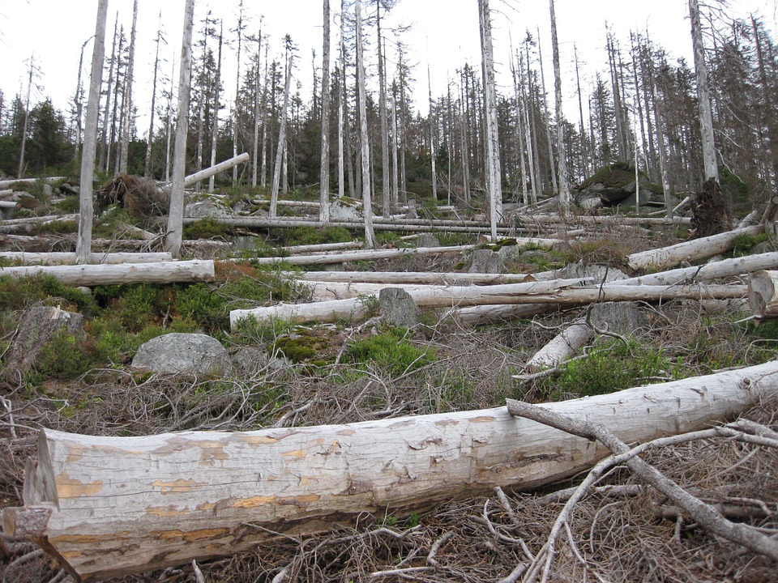
How to save the world
Unfortunately trees are often not considered a thing worth protecting but nothing more than an expendable commodity. This however can be fixed if you just change up your perspective a tiny bit. Since it’s really easy to just plant down a tree, why isn’t nobody doing it? It’s not even expensive. I propose that we first try to define the problem that we are looking to solve. There are mostly two big categories of reasons why trees are going away:
1 -- Trees getting cut down to produce products. This one is very self-explanatory. A lot of commodities that we have in our homes and buy every day use wood as one of their materials, which is usually produced by cutting down trees and recycling them into whatever form is needed.
2 -- Climate. Because of the rapid climate change, most trees and/or plants can’t adapt in time so they go extinct so the appropriate course of actions is to try stopping the climate as soon as possible since trees are not the only thing that it affects, but many others too!
By Dima Baliuk 7-A

Slide 29
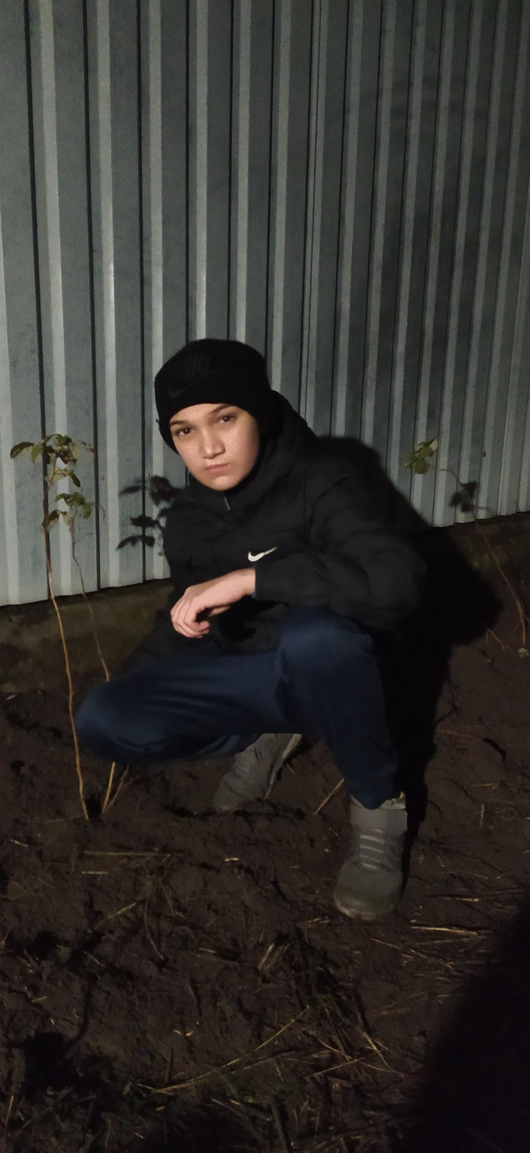
These are raspberries. It needs to be done before winter. Raspberries can be harvested in summer

Slide 30
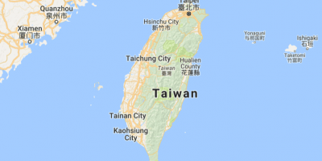
Taiwanese students’ information

Slide 32
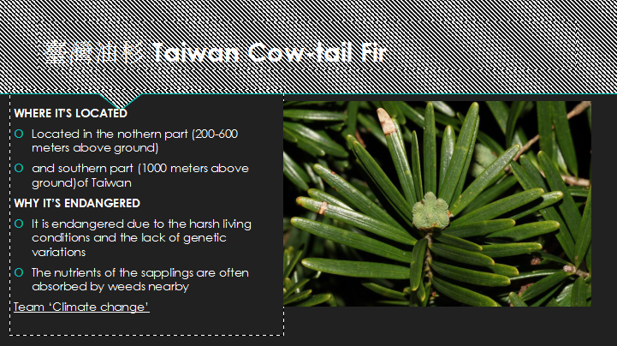

Slide 37
To sum up…

Slide 38
To sum up…
The main tree problem is deforestation.
Many trees get cut down and it is really awful!
And trees also let us breathe, so it won’t be possible for us to live without them.
Animals in forests have nowhere to live because of that.
Aydan Ozbay 7A

Slide 39
Helen Chepurko
Problems of a Birch tree
Heavy rainfall. Because there is too much water for the tree.
Small amount of precipitation. Because there is too little water for the tree.
Mole. Because moles gnaw at the root of the tree.
Pests. Because pests gnaw the leaves of the tree.
Natural disasters. One of the natural disasters is the burning of forests, and this is very bad. because nothing remains of the trees
1
But some of these problems we can solve for example:
water plants, biting rodents and there are even many ways to get rid of moles.
2
5
4
3

Slide 40
Today people do not value plants by cutting them down. Therefore, I want to tell you how to care for trees.
1
1Plant the right tree in the right place. Pick a tree meant for your area, then, find a spot that will get enough sun and provide enough space for its full-grown canopy. …
2Properly water. Just like any other plant, you need to water trees! …
3Fertilize the plant and transplant more if growing at home.
good luck to you
Sofia Didenko

