Slide 1
The Effact of Air Pollution
on
The Respiratory System

Slide 2
Element
in
Air pollution

Slide 3
Particulate Matter (PM)
Coarse particles (PM10)：particles that are less than 10 microns(µm) in diameter
Fine particles (PM2.5)：particles that are less than 2.5 µm in diameter
Ultrafine particles (PM0.1)：particles that are less than 0.1 µm in diameter

Slide 4
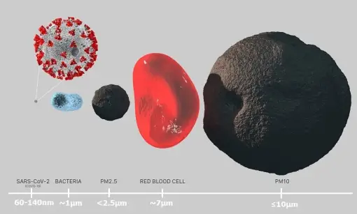
Schematic

Slide 5
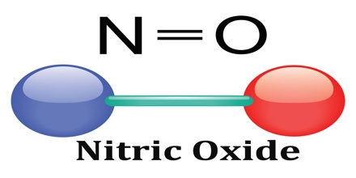
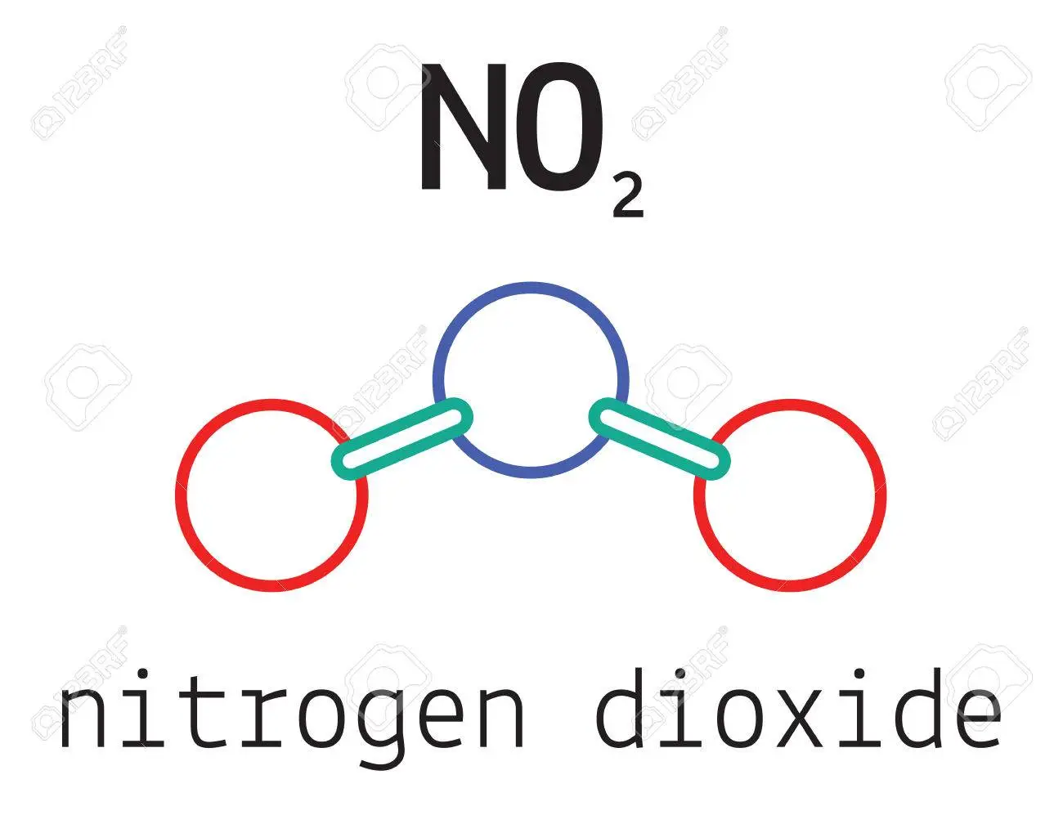
Nitrogen Dioxide(NO₂)
NO₂ is a gas that is produced along with nitric oxide(NO) by combustion processes.

Slide 6
How they
Effect
Our body

Slide 7
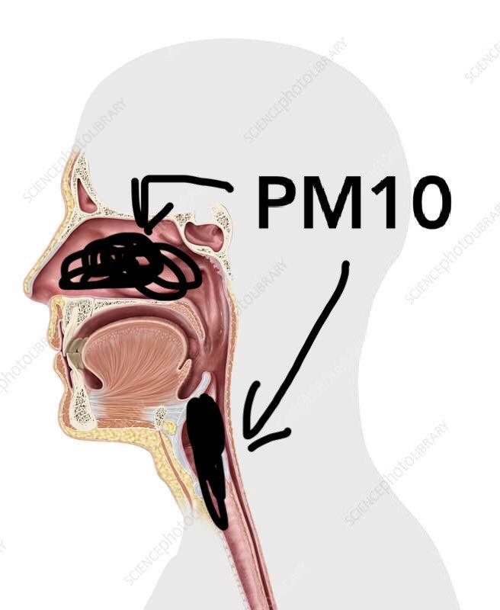
Particulate Matter (PM10)
Particles larger than 10 µm are mainly deposited in the nose or throat.

Slide 8
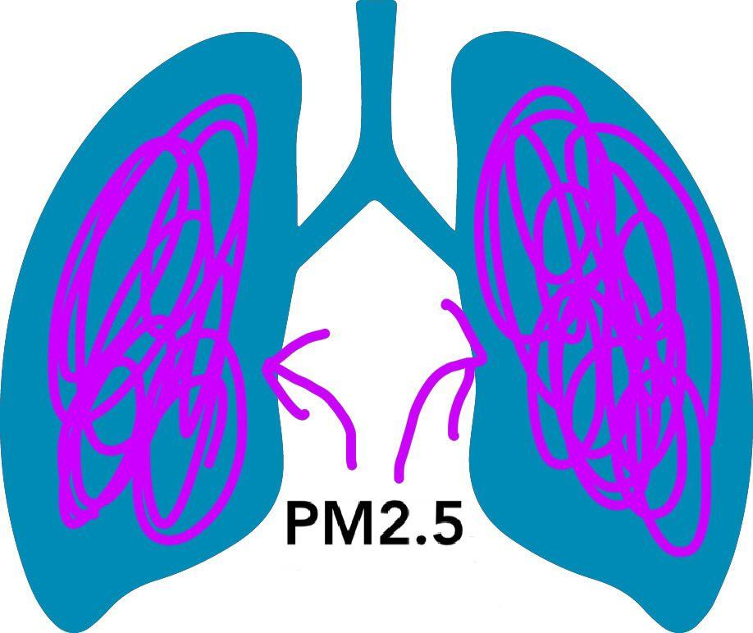
Partuculate Matter (PM2.5)
Particles samller than 10 µm pose the greatest risk because they can down deeper into the lung.

Slide 9
Nitrogen Dioxide (NO₂)
Short-term exposure to NO₂ ,particularly at high concentration,is a respartory irritant that can cause inflammation of the airways leading to.
For example：cough、production of the mucus and shortness of breath

Slide 10
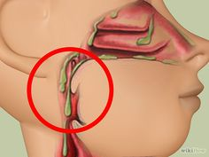
Schematic
Production of mucus
Shortness
of breath
Cough

Slide 11
Acording to our questionnaire
Q1.What respiratory are caused by airpollution
A1.58% is cough, 25% is shortness of breath,
17% is cancer.
Q2.Which gas has the worst effect on respiratory system
A2.43% is NO₂ , 37% is PM2.5, 20% is CO₂.

Slide 12
Acording to our questionnaire
There’re
49% students in our class want to know How your government solve the air pollution problems
28% want to konw What’s the main air pollution in your country
13% want to know How many people die in your country by air pollution each year

Slide 13
THE
END

