Slide 1
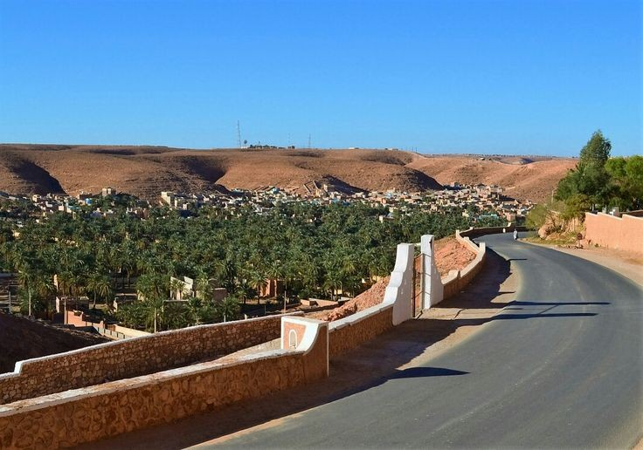
Welcome to heaven ....
Ghardaia

Slide 2
The valley’s of ghardaia :

Slide 3
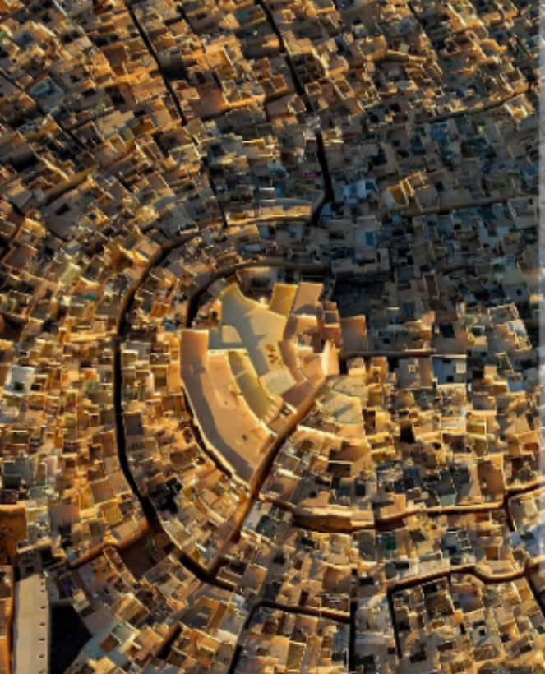
Al-atteuf place:
..

Slide 4
El Atteuf (Tajnint in Berber) was founded in 1012 under the leadership Of Khalifa Ibn Abghur. It was the first step of an action Urbanization through the M'Zab Valley. An action based on Unique urban planning rules.
..

Slide 5
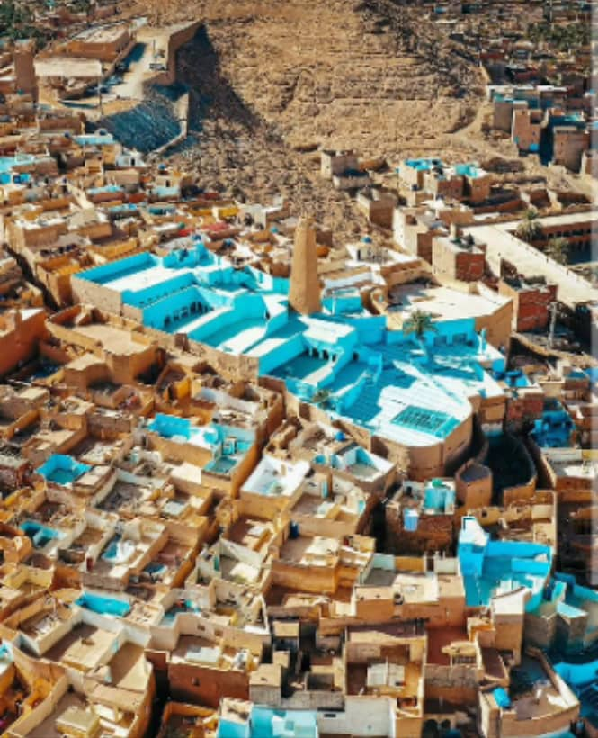
Beni-isgn place:

Slide 6
The Ksar of Beni-Isguen (At-isjèn in Berber) was founded in 1347 The Christian era. It is distinguished by its ancient mosque which keeps Always its initial architectural configuration, as well as its Defensive system across enclosure walls that surround the Ksar In full

Slide 7
Bounoura Place:

Slide 8
Bounoura (At Bounour in Berber) was founded in 1046Christian era.
Bounoura is known for its old Mosque as well as its front And houses ramparts.
The Ksar saw its extension after the disappearance of its part Higher than the former Ksar.
Remnants of old Ksar still remain.
The old Ksar is protected by a wall of interruption interrupted this and There by watchtowers.
We find in the center of the Ksar an old mosque and a Minaret Which dominates a large square, as well as a Mausoleum "SheikhBâ-Dahmane ", and various other Mausoleums.

Slide 9
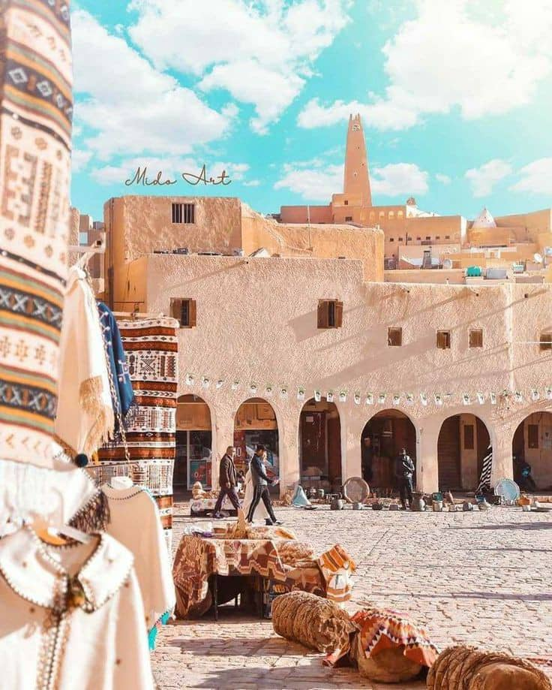
Ghardaia place :

Slide 10
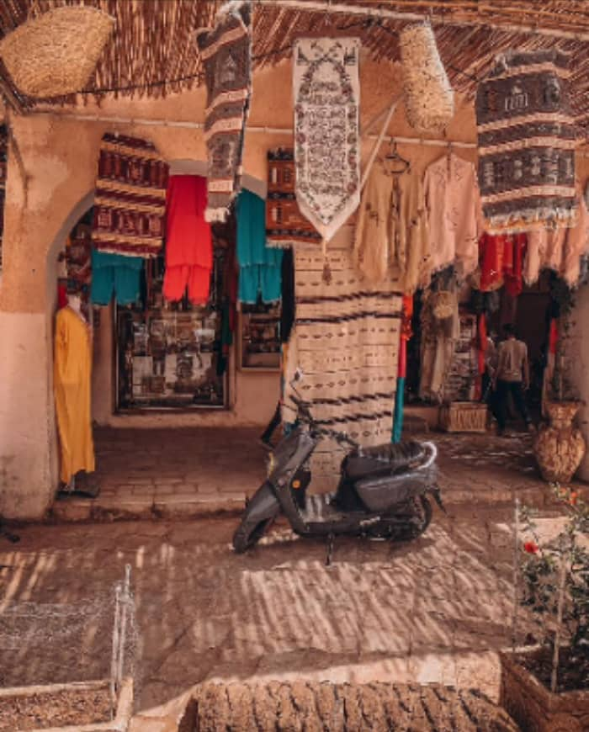
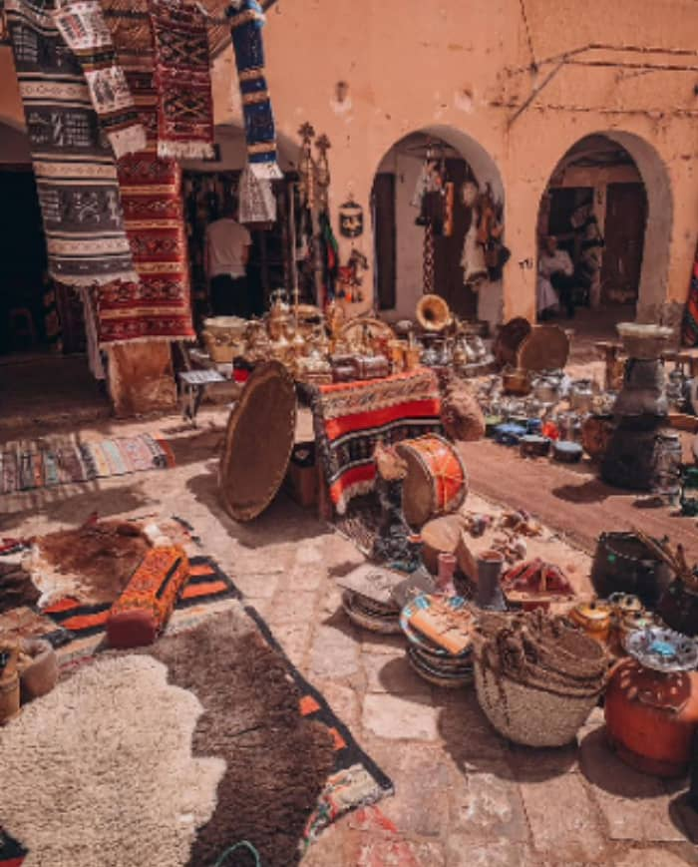
Ghardaïa is considered the Capital Of M'Zab.
It is the most important Ksar in the Valley from the point of view Of social and economic structures and was founded in 1048.
Ghardaïa is known for its Market Square, and some Mausoleums And buildings such as the Mausoleum "Ammi-Said El-Jerbi", "Baba-Ouljemma" And other Monuments.

Slide 11
The traditional food in ghardaia

Slide 12
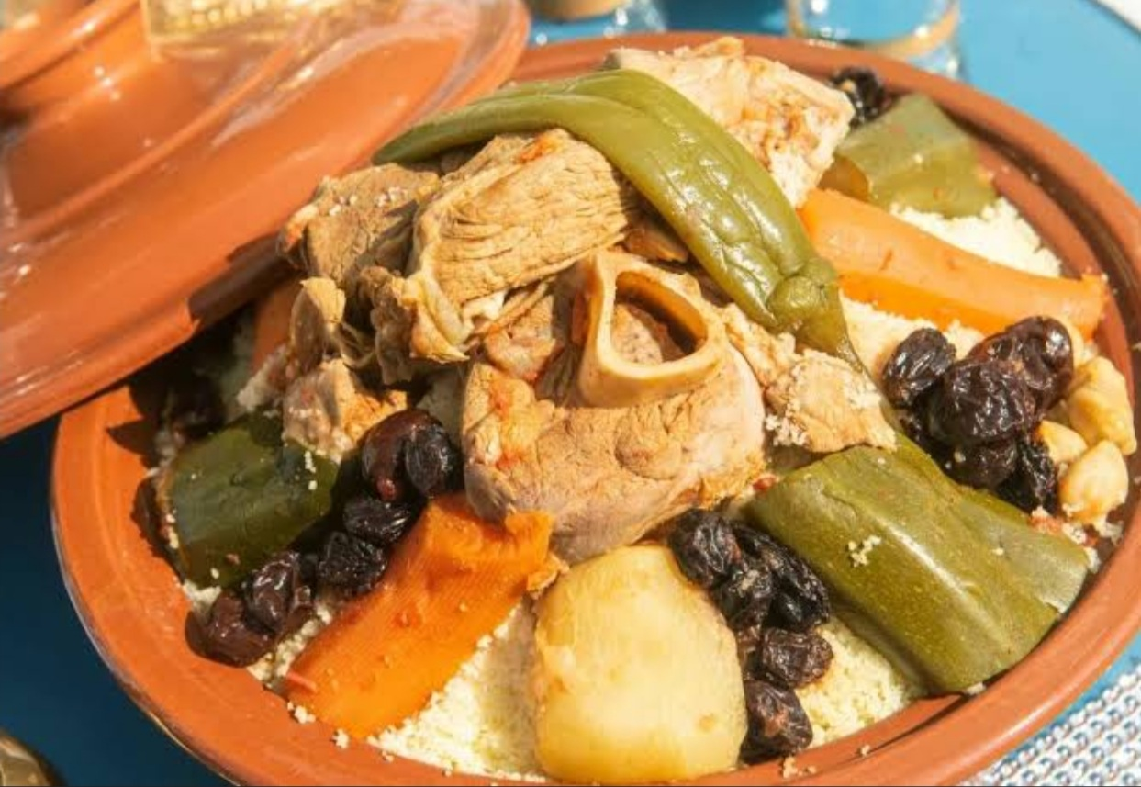
1st: COUSCOUS ​

Slide 13
Couscous is one of the most popular food in ghardaia and in Algeria generally.,we cook it in a different ways, with dates,red sauce and white sauce, the one with dates we generally cook it I weeding because it so delicious, the couscous is a food special for the weeke (friday( when the family meet in the house of the grand father which we call it the big house ​

Slide 14
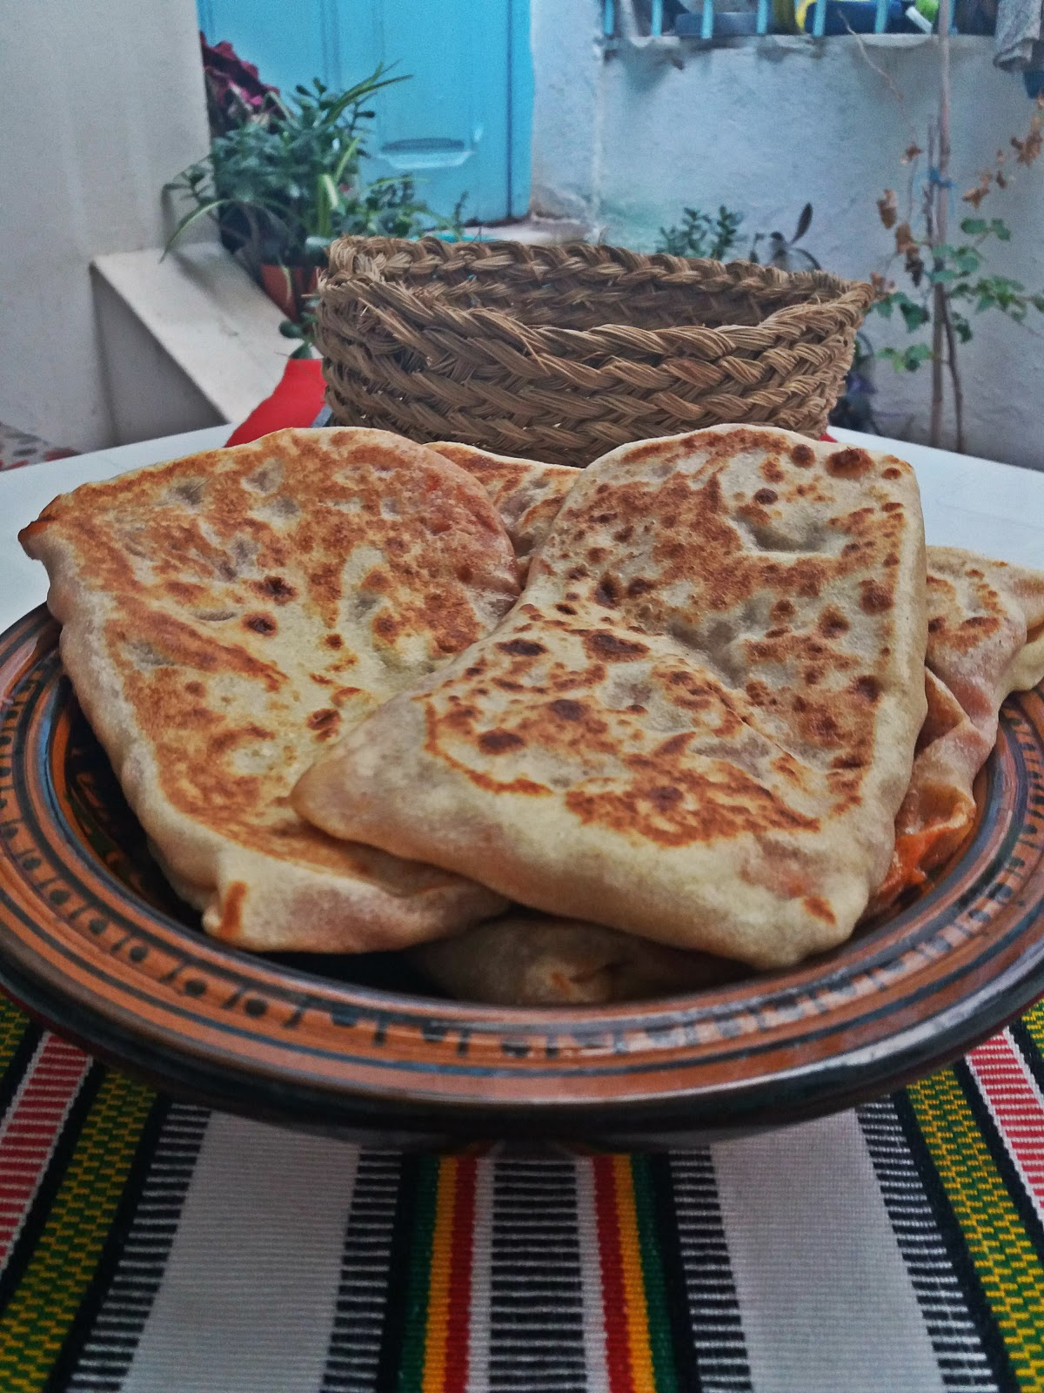
2nd: MAGHLOGA

Slide 15
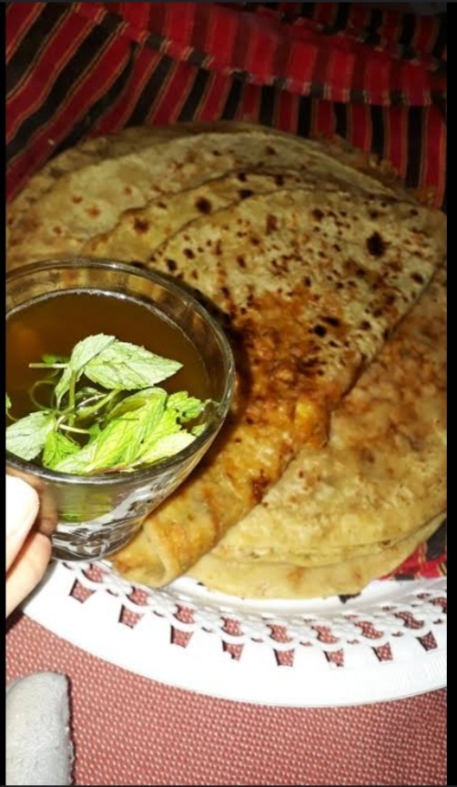
Mhadjeed, or as we call it in ghardaia maghloga, is a special food of ghardaia, its an Algeria but we in ghardaia we cook it a different way ,we put inside the meal different vegetables and other foods and in each valley they have there favourite way how to cook it​

Slide 16
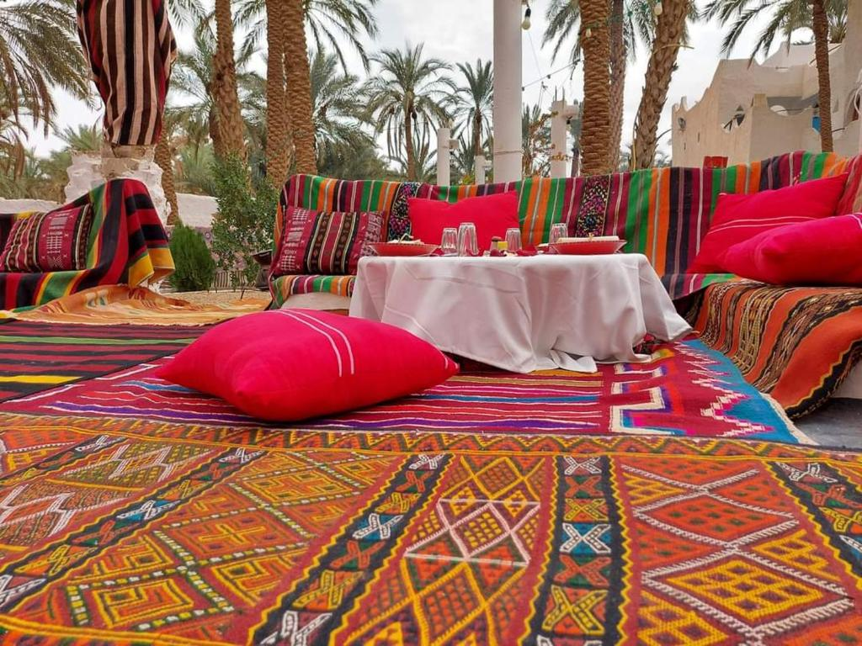
Selon‘s different styles

Slide 17
And all these styles are handmade by the woman

Slide 18
And each valley has its own and unique style of selon

Slide 19
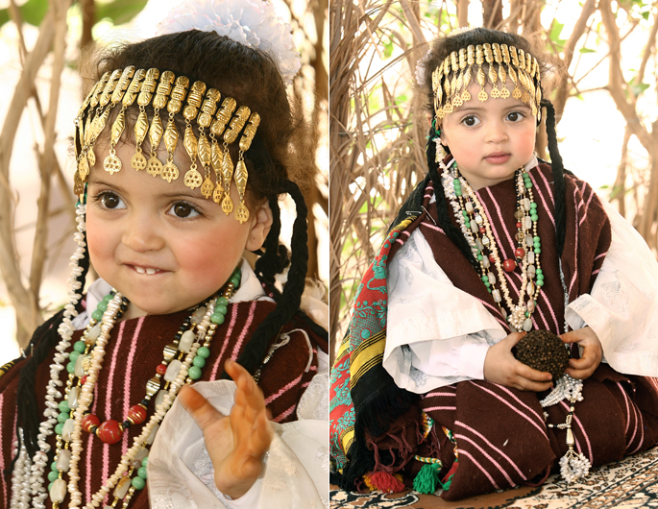
Traditional clothes
Maftoul is a woman traditional clothes which girls wear it in weddings and traditional celebrations

Slide 20
Is an other type of woman’s clothes called mallhfa,
It’s in different colours white and red and it’s generally for womens and teenagers

Slide 21
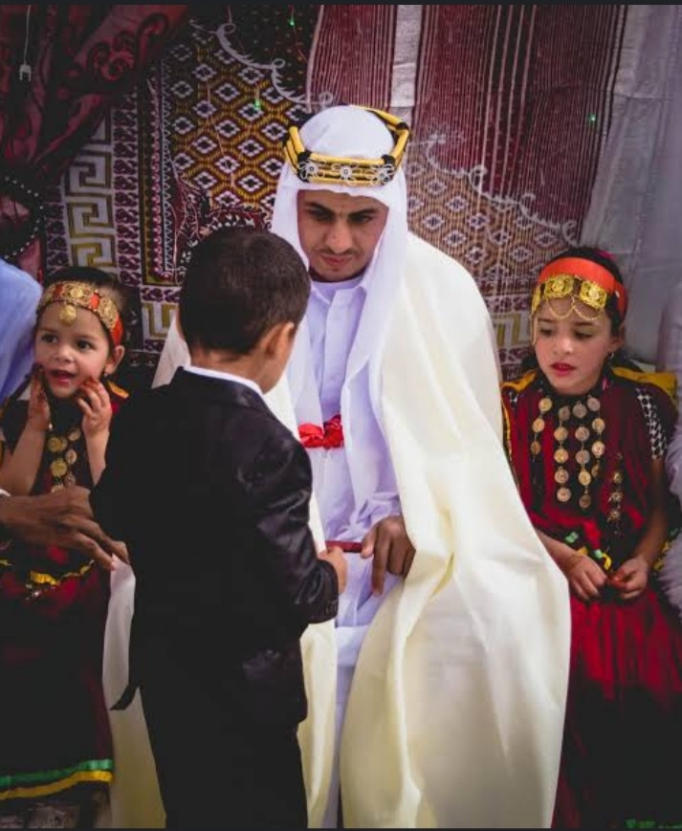
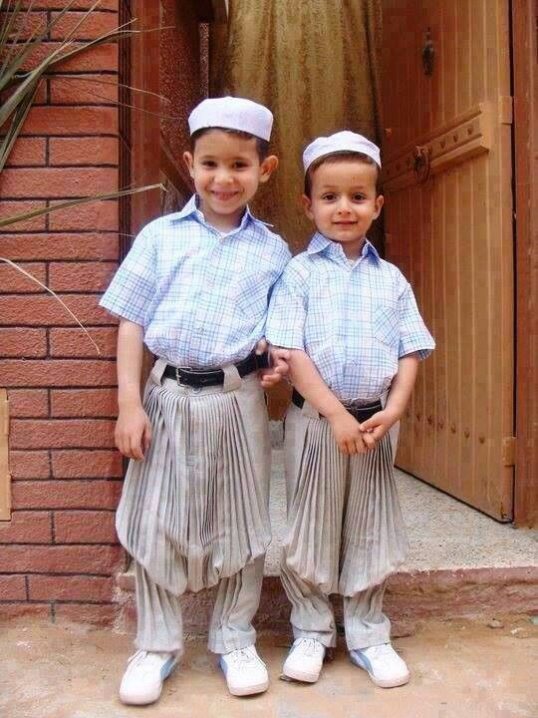
Different men’s clothes
Al abaya the one they wear it and the one in there heads it’s el amaama
The normally clothes )daily(
Special for the grooms

Slide 22
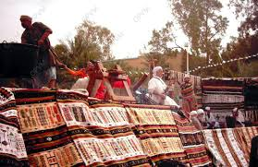
Festivals in ghardaia

Slide 23
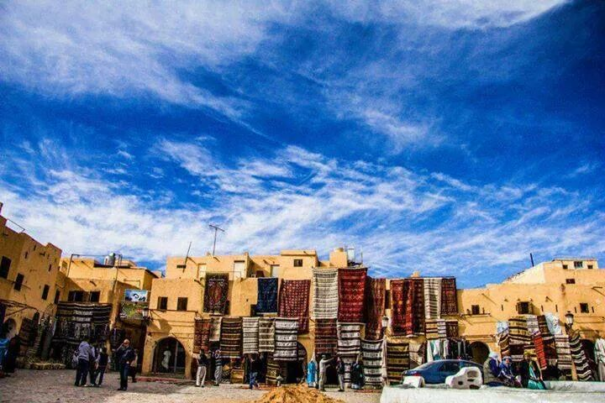
Carpets festival
We expose different styles of Carpets in the local bazaar souk which are hand madeed by the woman of ghardaia

Slide 24
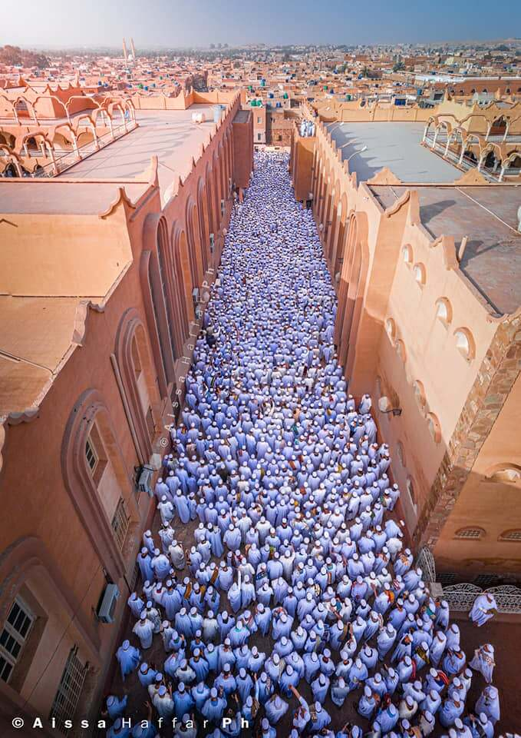
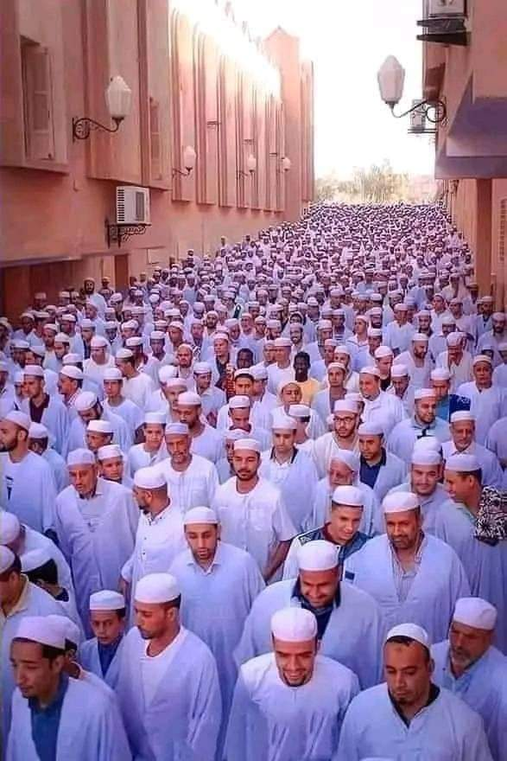
El-eid
It’s an Islamic occasion in which the muslims pray the eid salat and this was some photos from ghardaia in el-eid

Slide 25
New berber year

Slide 26
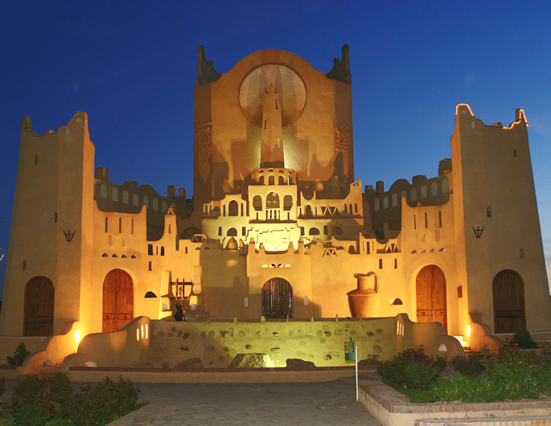
We invite you to visit our beautiful city ghardaia to know more about it
Thank you With love from erridoune school

