Slide 1
CLIMATE in South Taiwan
氣候

Slide 2
Kaohsiung Metropolitan Park
We went to the metropolitan park to observe the ecology in April 23. The weather was fine that day.
The hot season lasts for four to six mouths from May 17 to October 5,with an average daily high.
The hottest month of the year in Kaohsiung City is July with an average high temperature.
Cindy

Slide 3
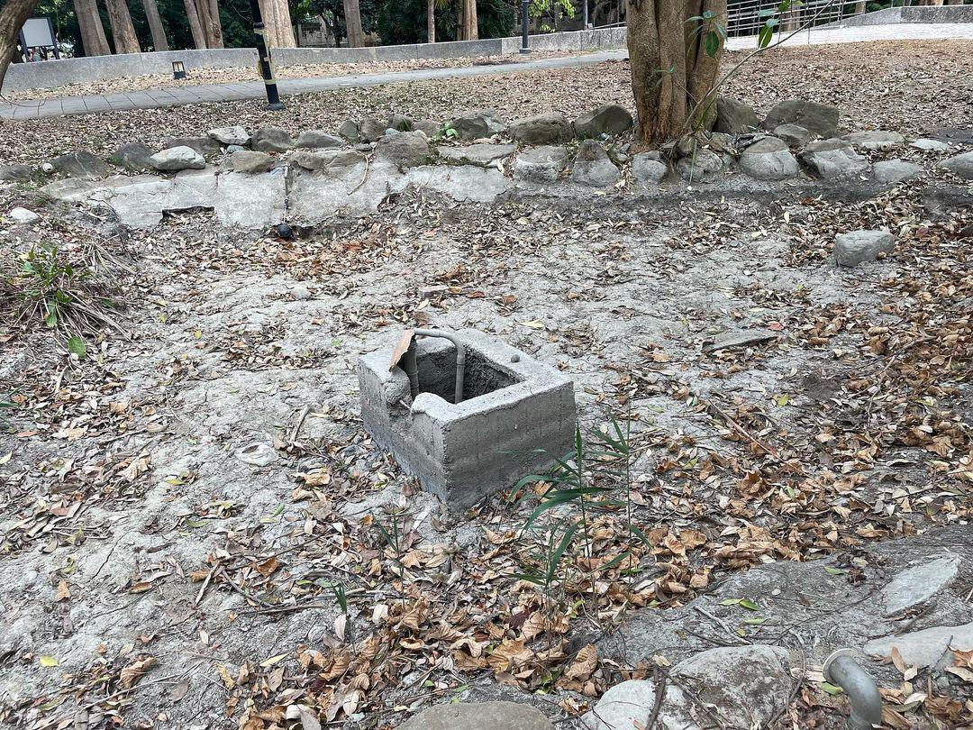
Drought
The teacher said that there is no rain in Kaohsiung
So the well has dried up...

Slide 4
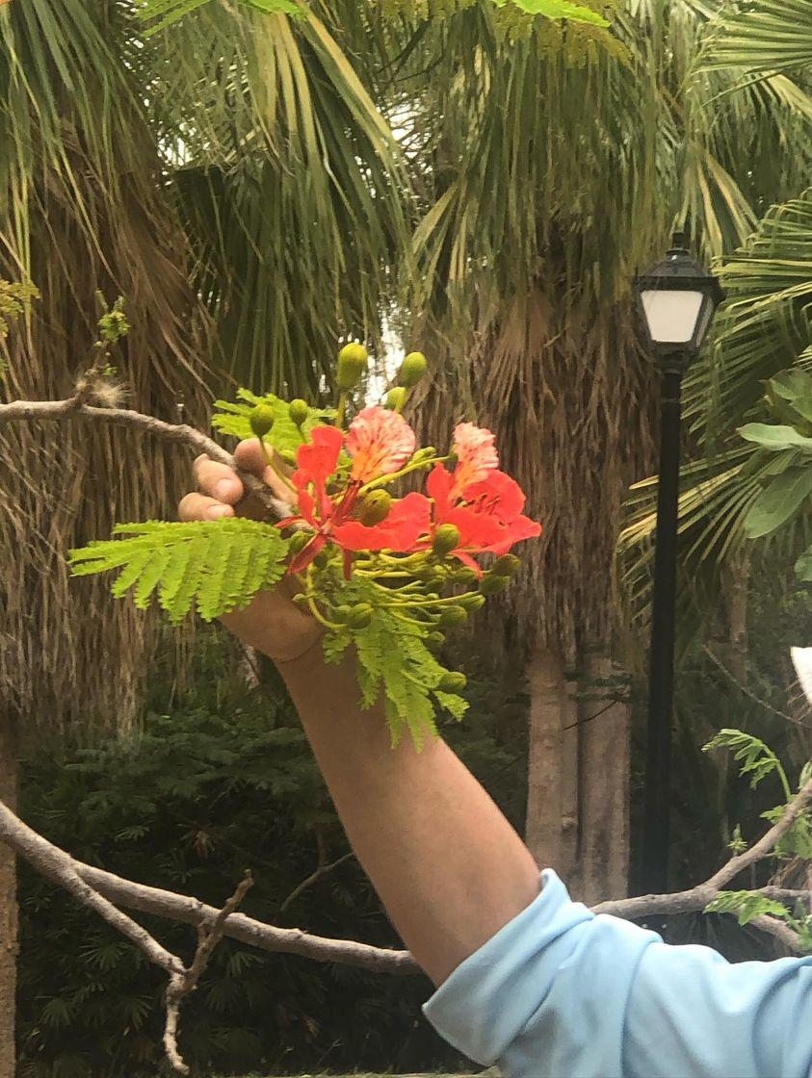
Poinciana鳳凰木
bright red or orange flowers with bright green pinnate leaves it very beautiful.
Poninciana paints are tall and can reach more than 20 meters.
It like hiah temperature and multi – day environment ,and it must be able to grow luxuriantly in a sunny place.
They have large red flowers.
Amanda

Slide 5
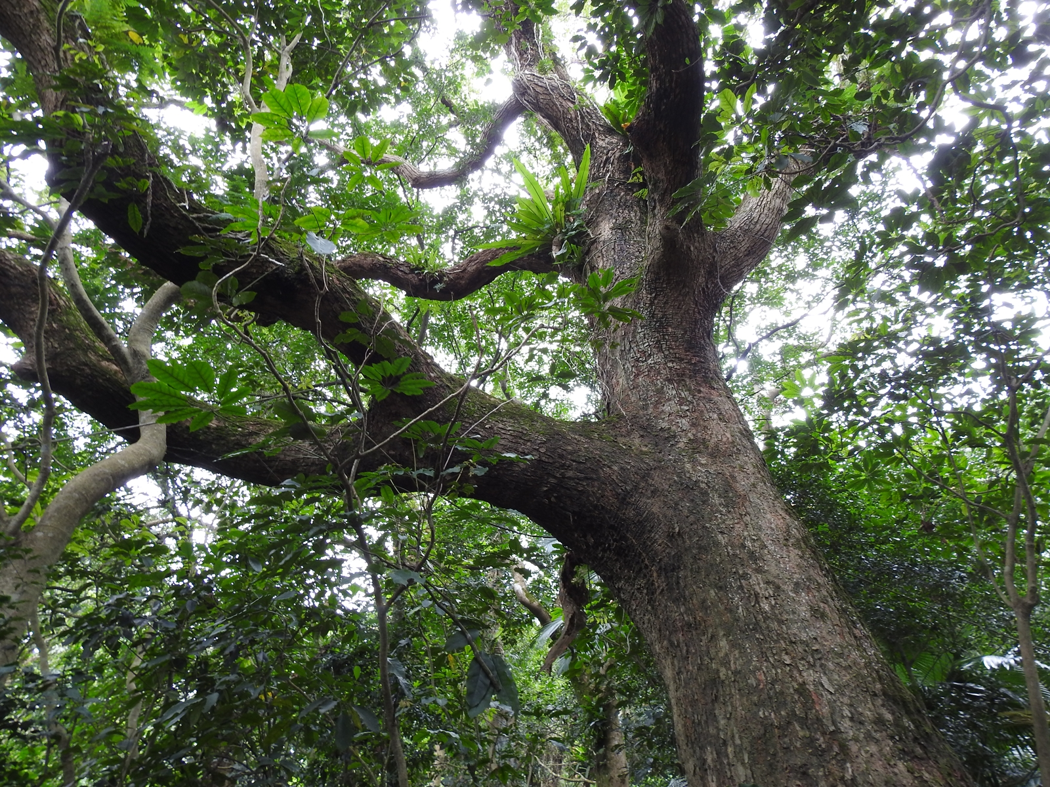
Camphor tree 樟樹
Large canopy, dense branches and leaves all year round
The essential oil that exudes a unique fragrance,
the flowering period is from February to April, and the
fruiting period is from April to July.
Kevin

Slide 6
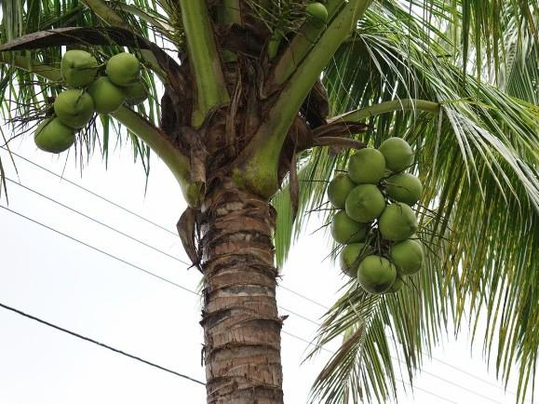
Coconut 椰子
Coconuts are the fruit of the coconut tree, commonly found in tropical regions.
Coconut tree body up to 30 meters; round or oval drupe with triangular top,20 to 30cm in diameter, brown when mature.

Slide 7
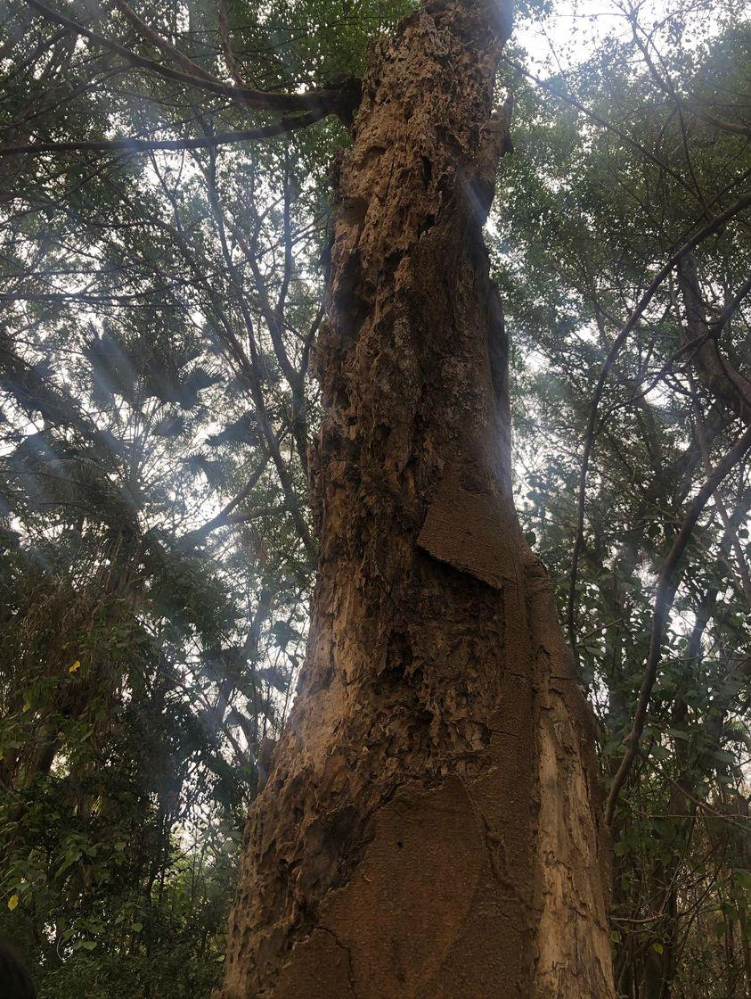
Dead tree
That tree is the home of insects.
Insects will burrow into it and live in it.

Slide 8
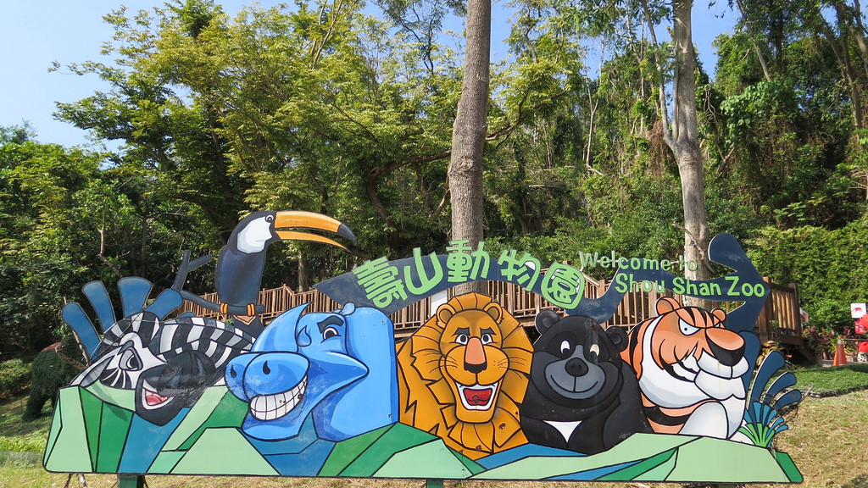
Animals
by:Zoe Evan Wilson James

Slide 9
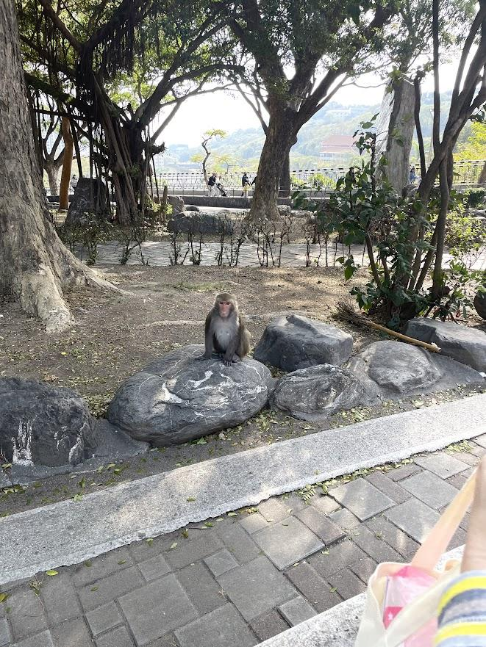
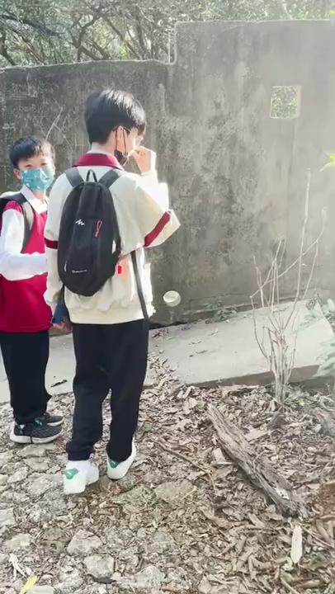
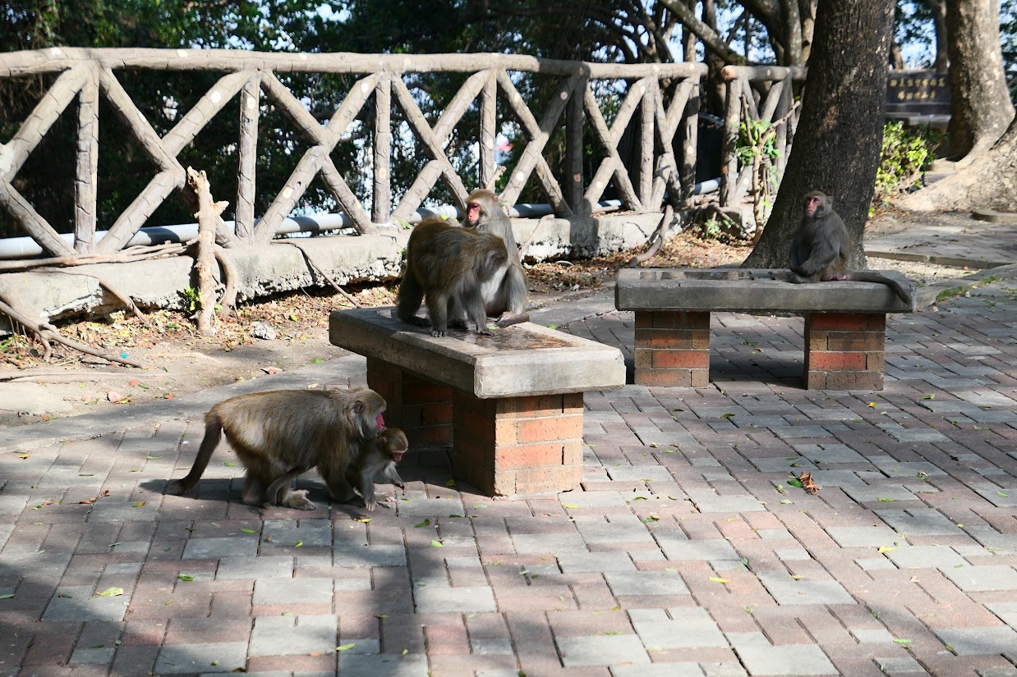
Our filp trip
by:Zoe
This is our field trip. We went to Shoushan Mountain, there are a lot of monkeys. The guides there introduced the monkeys to us. They also asked us to observe the monkeys and draw them. Here are some photos and videos of us
They are Macaca cyclopis

Slide 10
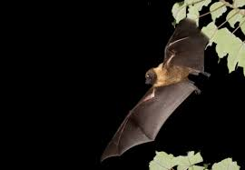
Formosan flying fox
The Taiwanese flying fox, which is a unique subspecies of Taiwan, is the largest bat in Taiwan. They feed on plant fruits. They have been found in Green Island, Orchid Island, Hualien, Taitung and Kaohsiung. They inhabited Green Island in the 1960s The number can reach thousands, and the population lives in the primeval broad-leaved forest.
by:Evan

Slide 11
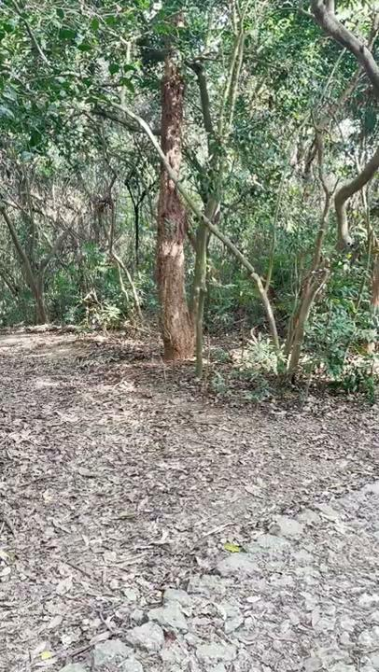
Shoushan experience by:Wilson
Once I went to Shoushan for outdoor teaching and walked along the road. On the side of the road, I could see many monkeys crawling around. That day we saw monkeys fighting. The teacher over there also took us to play some small games and chat about monkeys. expression behavior

Slide 12
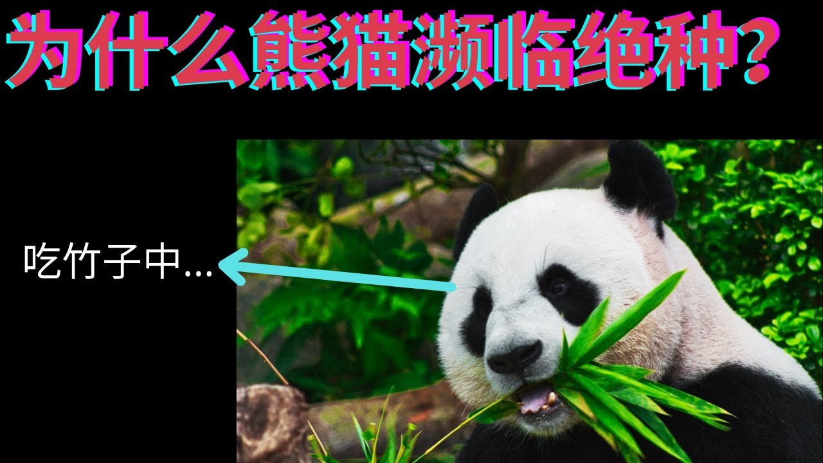
Rare animals
The reasons for their extinction are 1. Animals became extinct because they could not adapt to changes in climate or environment, such as dinosaurs. 2. At present, the rapid decline of wild animals and the increasing number of endangered animals are mainly due to the destruction and deterioration of habitats and the wanton capture and killing by humans, taking their meat or horns, skins, hairs,. for food, profit or as animals.
1.giant panda...
2.green sea turtle...
3.Chinese white dolphin...
4.Black-faced Spoonbill...
5.shark ...
6.bluefin tuna
by:Zoe

Slide 13
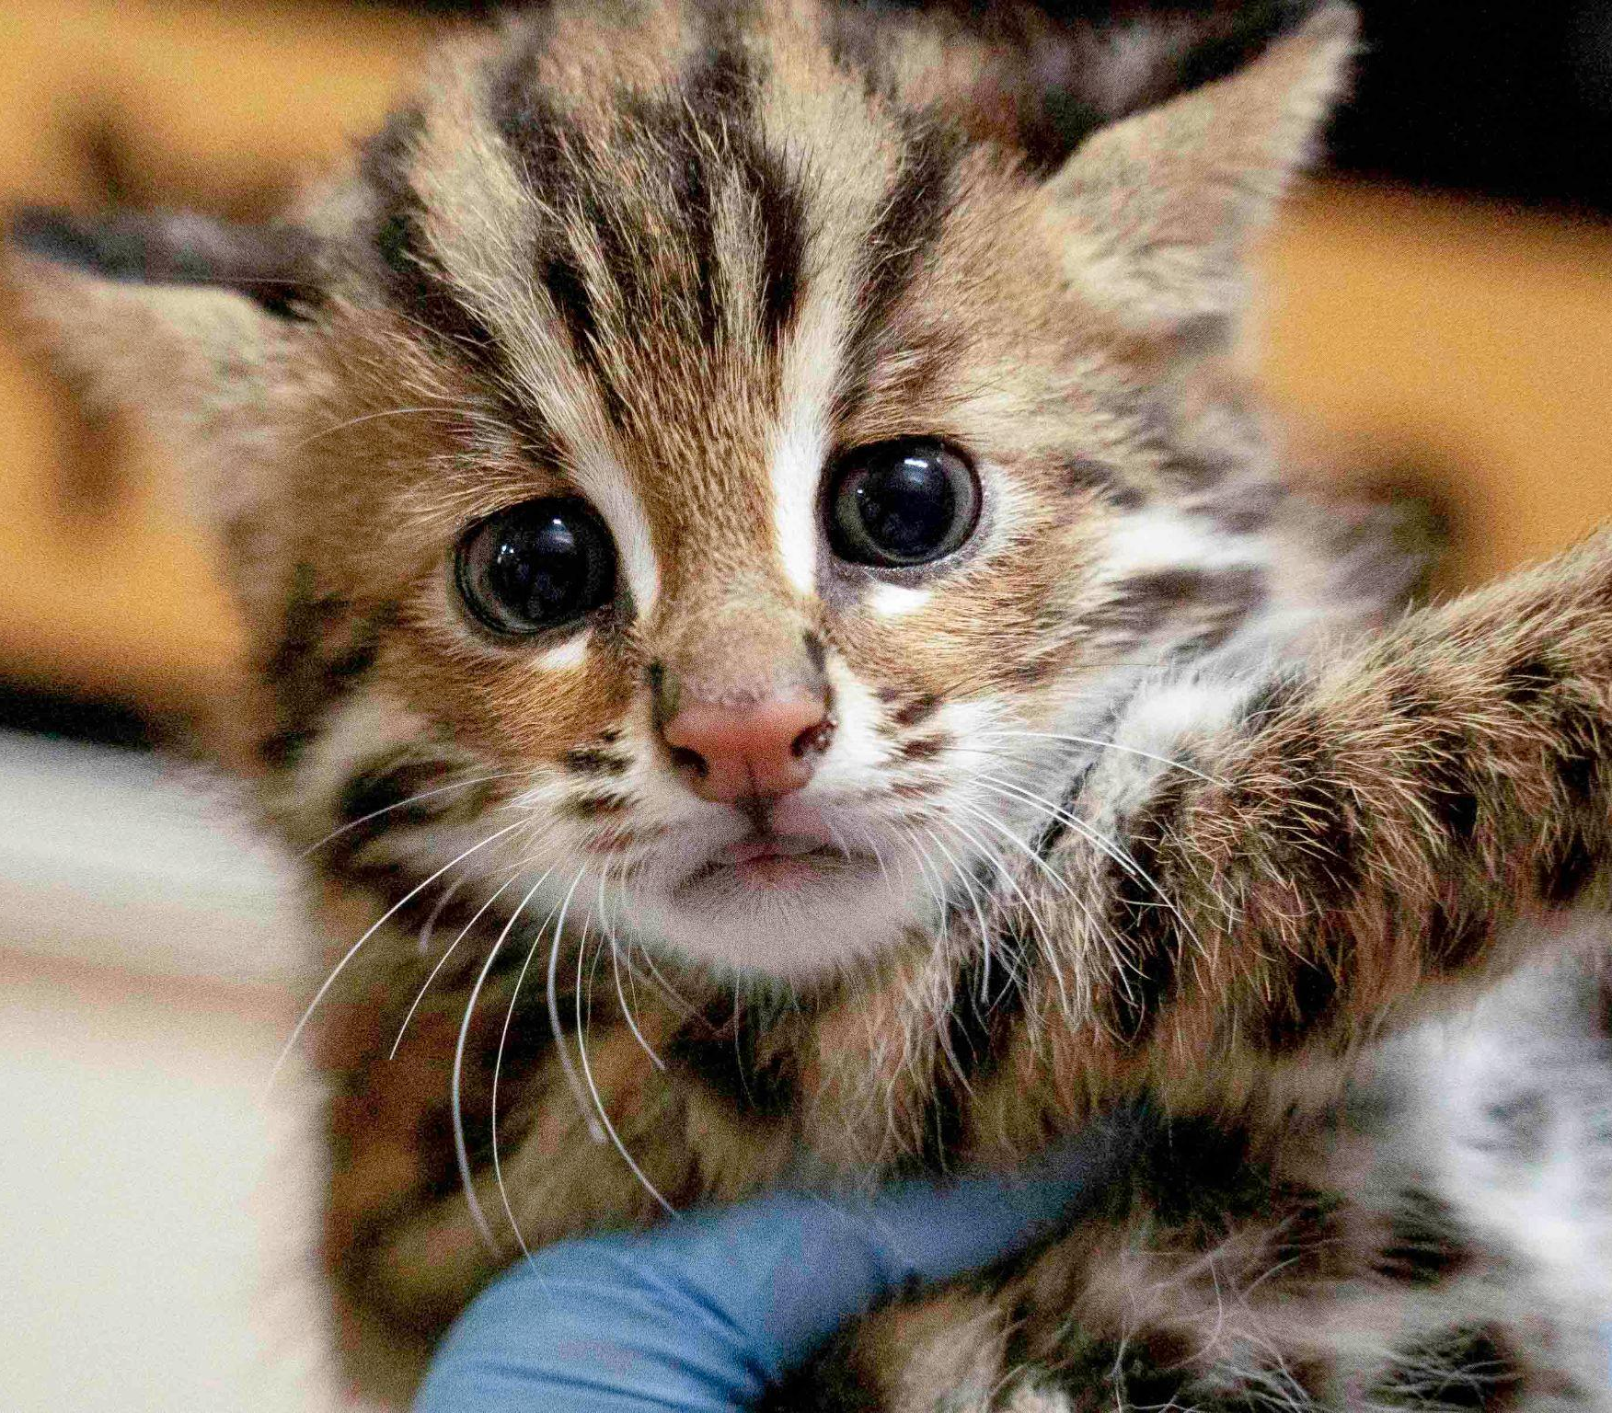
Stone Tiger
At present, the number is scarce, and there are only a few records in the north and south. The current situation of the wild population is unclear, and it seems to be distributed in small populations. Nantou and Taichung Miaoli. they are small They tail only 15 to 18 semi-circular markings.
by:James

Slide 14
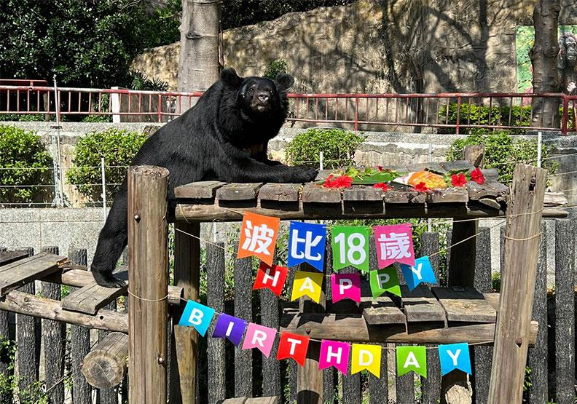
Formosan black bear
by:Zoe
The only bear species native to Taiwan, the Taiwan black bear is an endangered species of wild animal. At present, there are only about 200~600 left in Taiwan. The body is stout, the head is round and the neck is short, the eyes are small and the snout is long, the hips are round and the tail is short. The weight is about 60-150 kg, and the body length is 130-180 cm.

Slide 15
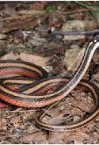
Golden silk snake
Gold snakes are small in size and move slowly. They are particularly easy to be killed by roads on the way across the road. As a result, as many as 80% of the records of gold snakes are killed by road kills. There are only 110 official records of Taiwan's endemic species of golden snake
by:Wilson

Slide 16
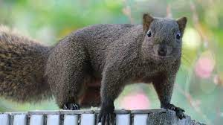
squirrel
The red-bellied squirrel in Taiwan is a unique subspecies called thaiwanensis. It is the most adaptable mammal to the human environment except rats. It is alert but not afraid of humans. They live and build nests in trees, and use leafy twigs to weave spherical nests hanging high on the treetops. The nests are larger than footballs, and the inner core is made of soft bark, fibers and other more comfortable materials. Both male and female red-bellied squirrels have their own tree nests, sometimes more than one.
by:Evan

Slide 17
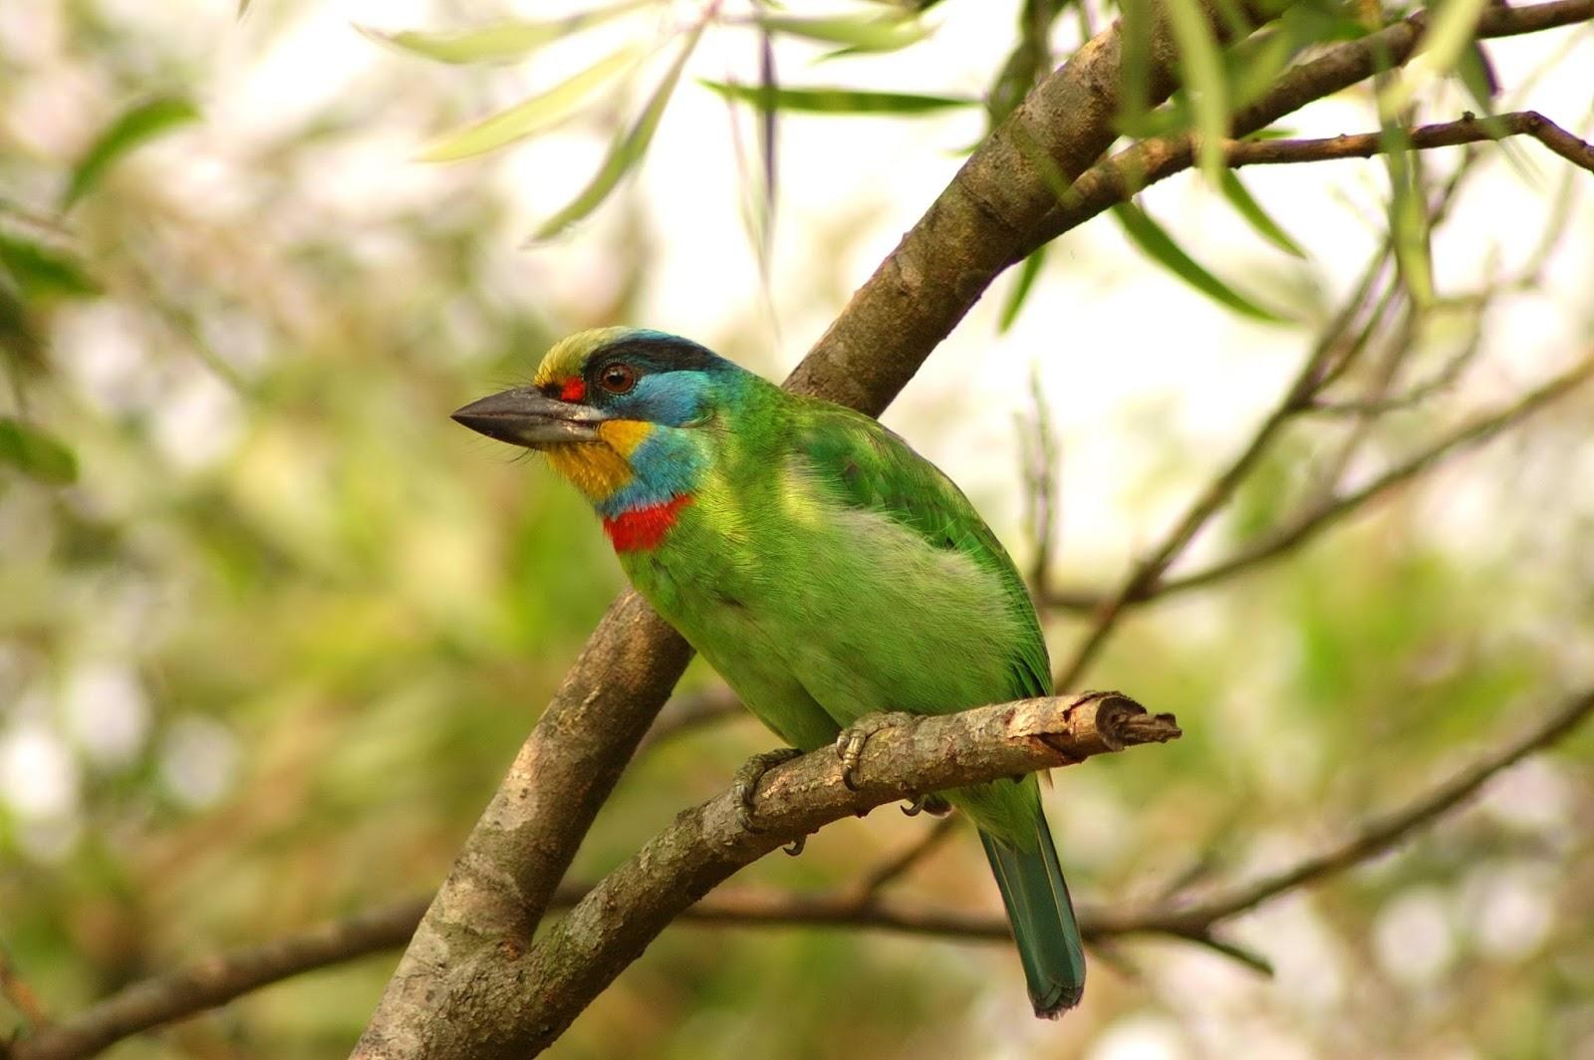
The birds of Kaohsiung
by:Kiki,Elsa,lucas,Allen

Slide 18
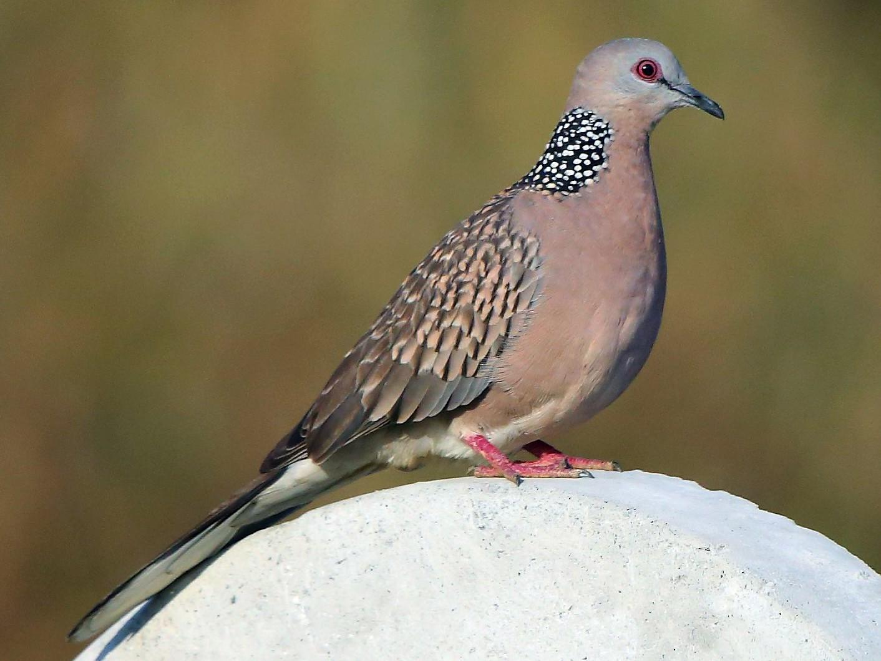
Spotted Dove
Spotted Dove are the most common birds in Taiwan. You can usually see them on the road. Unless the air pollution in that area is too serious,or you can definitely see them․ They outside look like have black and white markings on their necks
by:Lucas

Slide 19
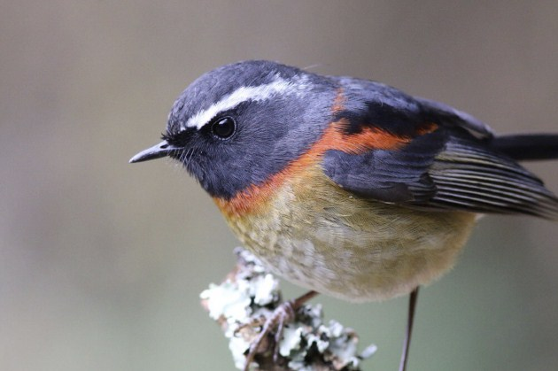
Collared Bush Robin is only appears in Taiwan, usually only seen on the mountains, and it will not live in places with pollution. At present, they are about to disappear, so we must protect them so that the only birds in Taiwan can thrive on the mountains
Collared Bush Robin
by:Lucas

Slide 20
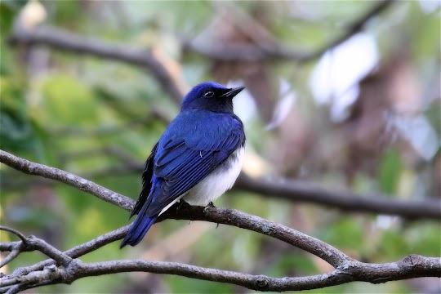
white-bellied blue flycatcher
In winter and spring every year, birds come from afar, and some of them are rare and precious, one of which is the white-bellied blue flycatcher.
The white-bellied blue flycatcher breeds in Japan, South Korea, China, and Russia, and migrates to Southeast Asia for the winter. Vietnam, Cambodia, and Thailand are the countries they visit most often. They are rare in Taiwan, and they are rare transit birds. In recent years, almost every year in the late winter and early spring, the male bird has metallic blue feathers, shining like glass in the sunlight.
by:Kiki

Slide 21
One of the birds of predators in the forests of Taiwan. likes to eat reptiles,
They are birds of predators that often make chirping sounds when they fly. Its majestic flying attitude hovers over the emerald green mountains of Baodao, just like mountain rangers sheltering the mountains.
Crested Serpent Eagle
by:Kiki

Slide 22
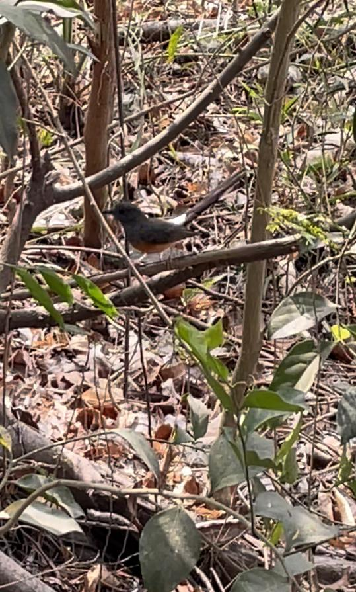
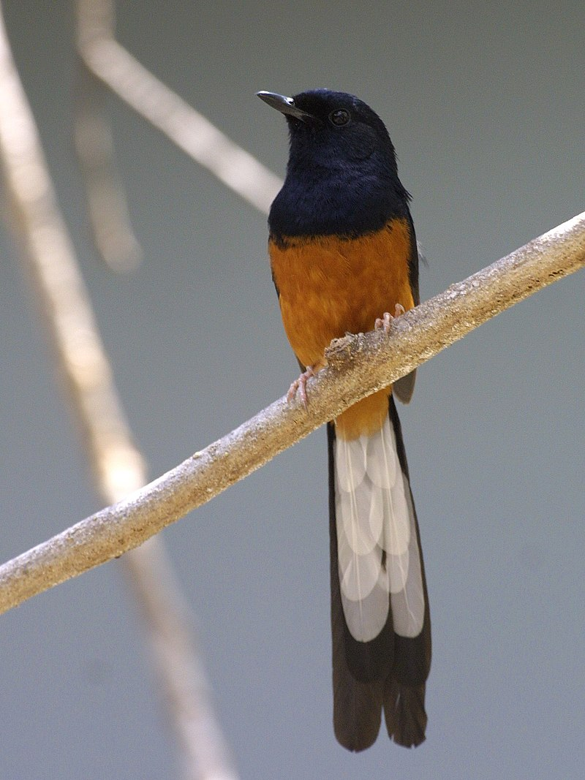
White-rumped Shama
The White-rumped Shama is an exotic species from South East Asia and China, and Yunnan and Hainan in mainland China.It is an alien species in Taiwan.Common in valley woods and ridges south of Kaohsiung.We saw a lot of these birds in the mountains
by:Elsa

Slide 23
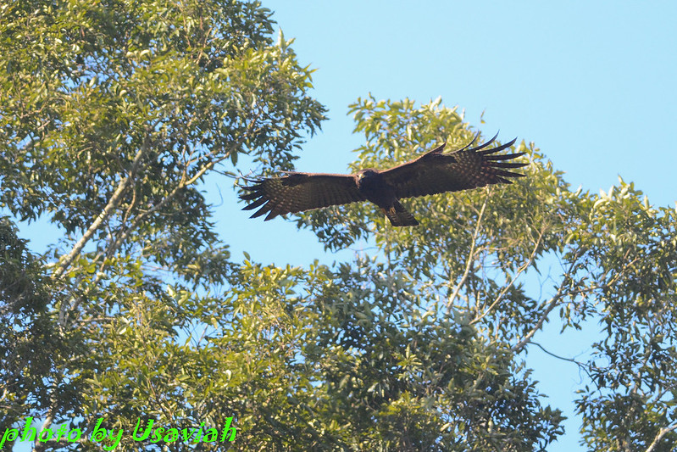
Forest carving
The forest eagle is a large raptor with a body length of about 67 to 81 centimeters and a wingspan of about 180 centimeters
by:Allen

Slide 24
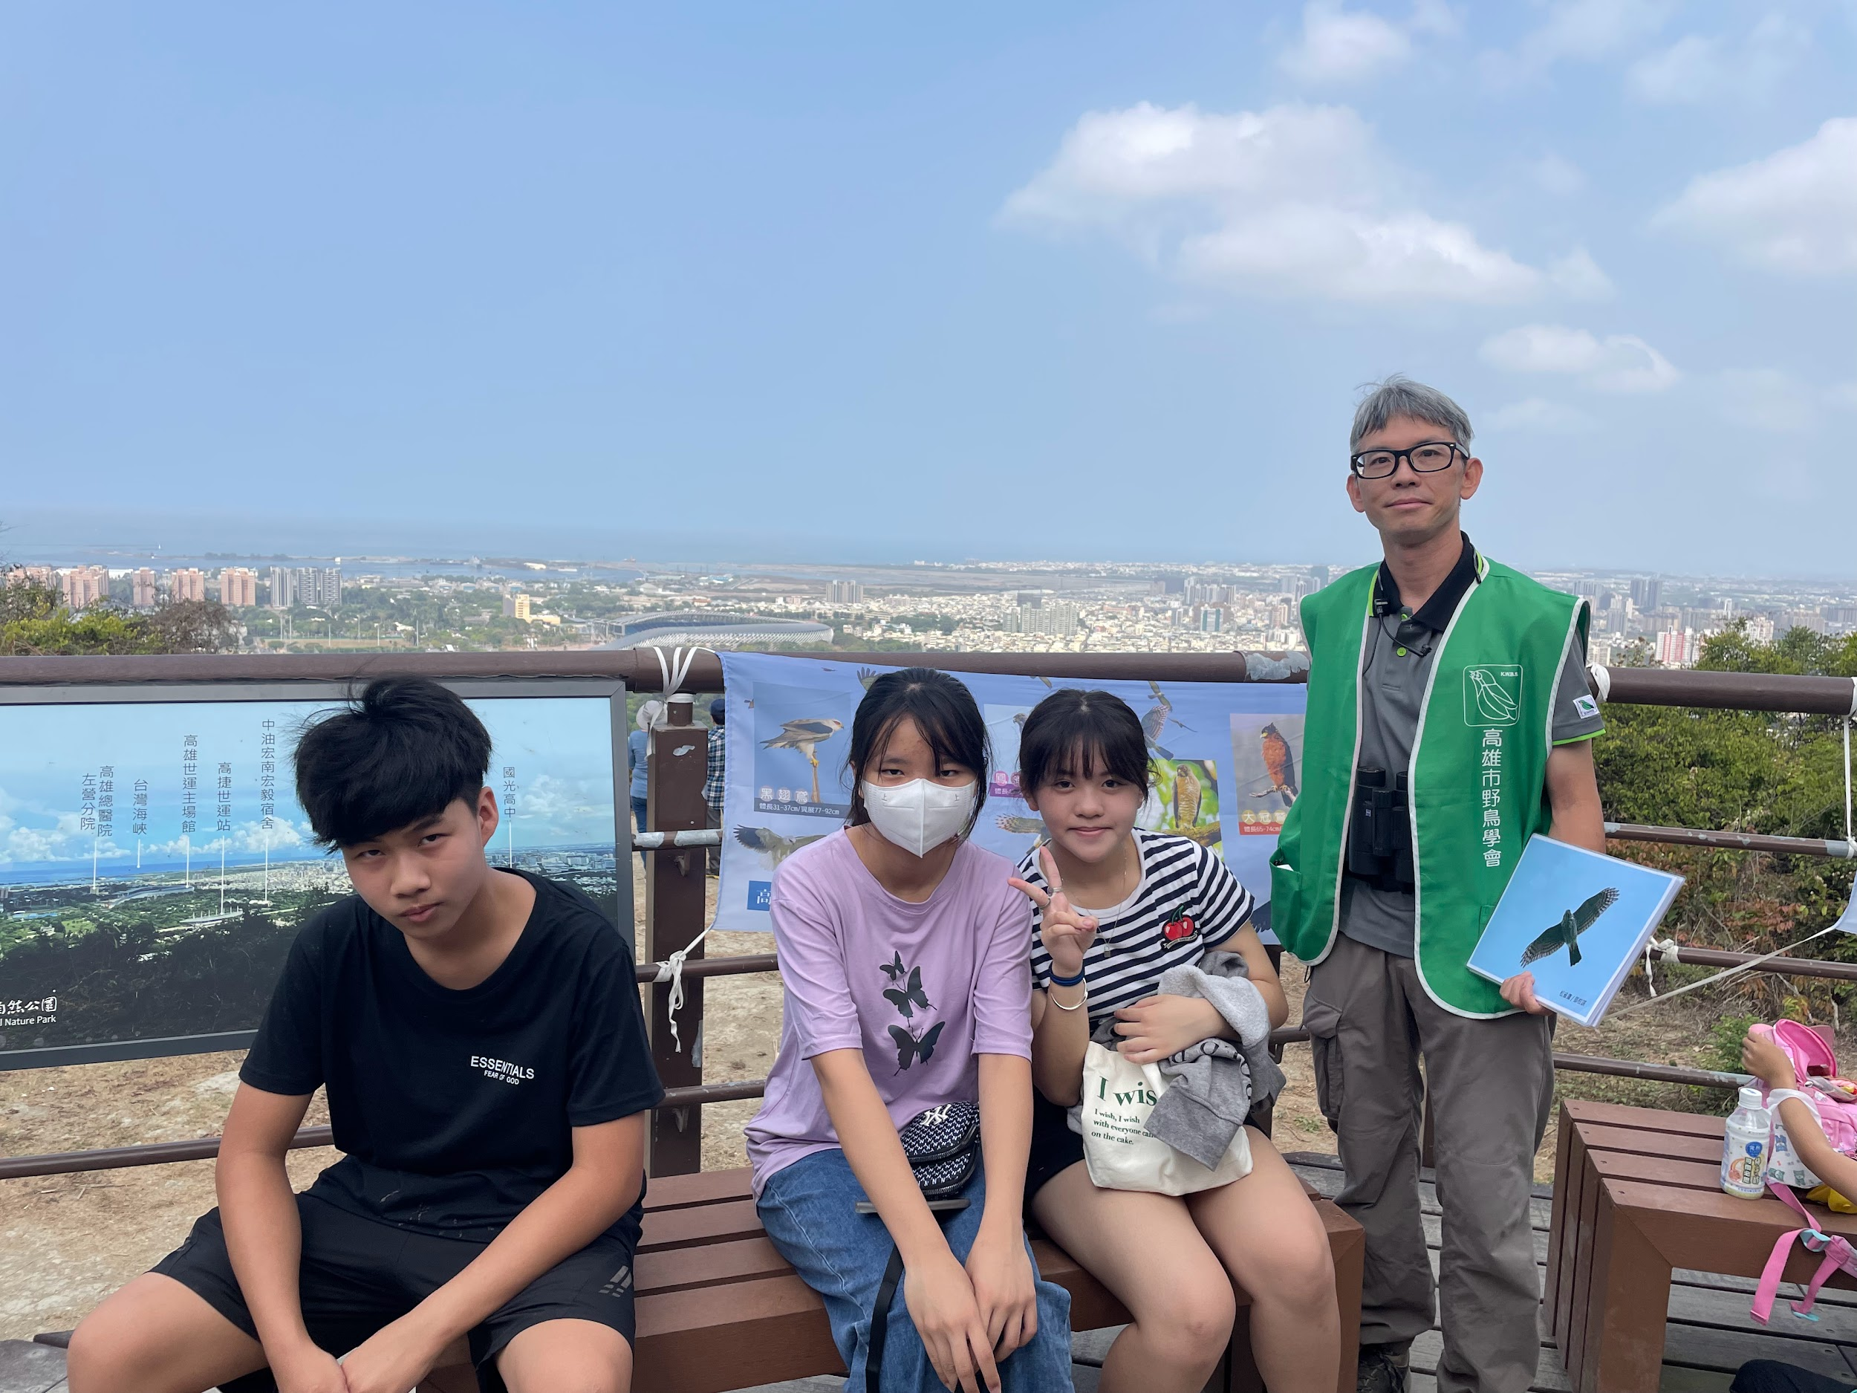
our field trip
Doing this report let me know about the birds in Shoushan,and is tiring but also very interesting Allen
For this activity, climbing the mountain was really tired, but we saw different kinds of birds in the middle of mountain, that was very interesting.by:Elsa
Although this field trip was tired, it was very interesting. It made me know many birds and let me appreciate the beautiful places of those birds. We went climbing this time not only to see these birds, but also to know many plants. Kiki
This outdoor teaching is very interesing I have see a lot of bird i haven seen before and let me know have so many kind of bird are live in Taiwan. Lucas

Slide 25
Plants
Team leader: Steven
Team members: Lenith, Mike, Daniel

Slide 26
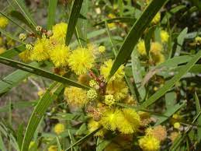
Natural Park Shoushan National have about 400plants.
Acacia confusa is a perennial tree native to South-East Asia. Some common names for it Formosan koa. It grows to a height of 15 m.
Steven

Slide 27
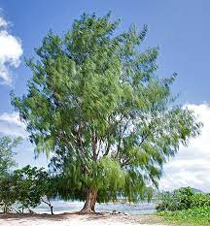
Casuarina equisetifolia,
Casuarina equisetifolia, common names Coastal She-oak or Horsetail, is a she-oak species of the genus Casuarina.
steven

Slide 28
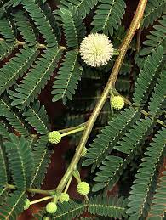
Leucaena leucocephala
Leucaena leucocephala is a small fast-growing mimosoid tree native to southern Mexico and northern Central America and is now naturalized throughout the tropics including parts of Asia.
Steven

Slide 29
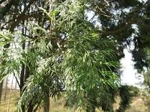
Calocedrus formosana
It is a medium-size tree to 20–25 m tall, with a trunk up to 3 meters in diameter. The bark is orange-brown weathering greyish, smooth at first, becoming fissured and exfoliating in long strips on the lower trunk on old trees.
Steven

Slide 30
Rare plants

Slide 31
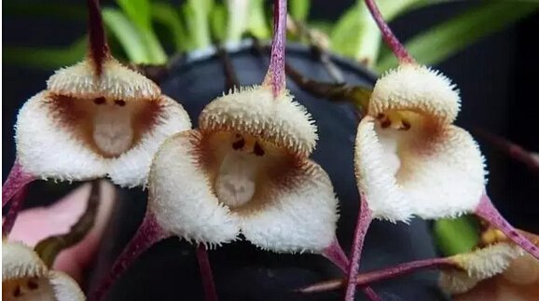
The year of the monkey sees the monkey face orchid
The "monkey face" of the monkey-faced dragon orchid is formed by different parts of its flower: for example, the "monkey face" and "monkey mouth" are the innermost lip of the flower, and the color can be dark or light.
By: Daniel

Slide 32
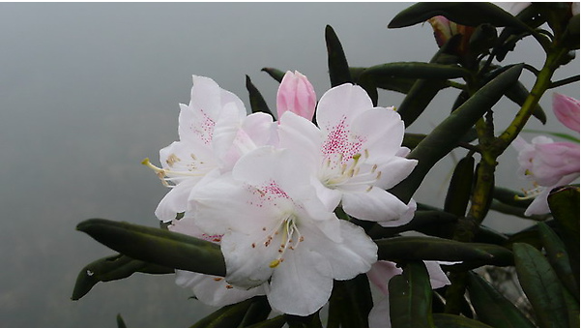
紅星杜鵑 Rhododendron hyperythrum
The underside of the leaves is densely covered with reddish-brown star-shaped hairs, and the corolla is purple-red at the beginning, and fades after blooming. The flowering period is from the end of March to the beginning of May every year.Rare plants once classified as conservation.
By: Lenith

Slide 33
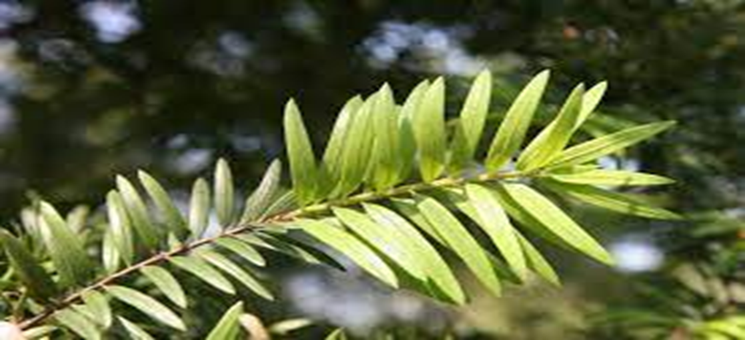
Taiwanese cow-tail fir
Yale fir is only produced in Taiwan and China. Taiwan oil fir is a unique species in Taiwan and belongs to the hereditary plant of Binghe County. Only in Pinglin area in the north and Dawu Mountain in the south
By: Mike

Slide 34
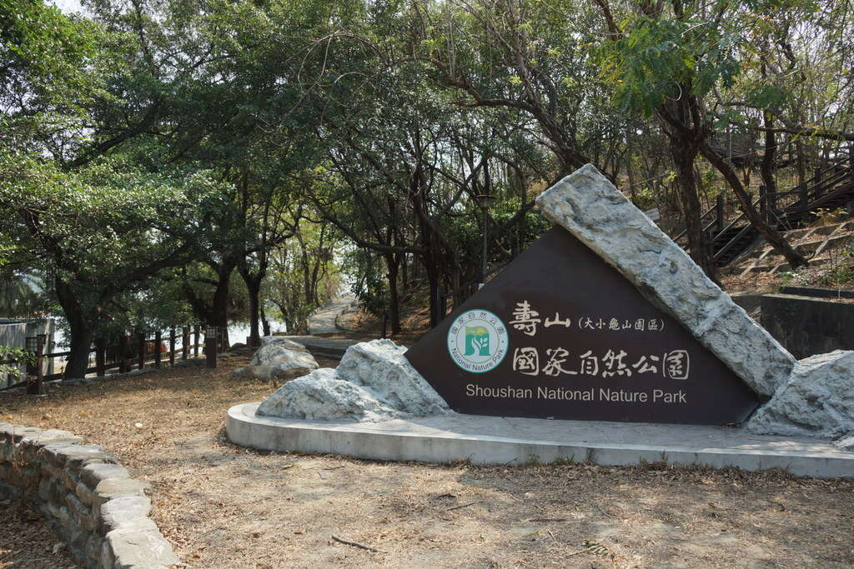
Insects
昆蟲
組員:13號 馮泰格
/6
By:Tiger Jasper Liu Tiffany
https://khh.travel/zh-tw/attractions/detail/102

Slide 35
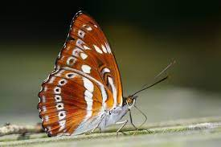
Lepidoptera
Lepidoptera also known as Butterflies is the second largest order in Insecta, including various butterflies and moths. Lepidoptera are complete metamorphosis have (egg, larva, pupa, adult). Adults have two pairs of wings covered with scales and mouthparts that are straw-shaped.
16 Liu

Slide 36
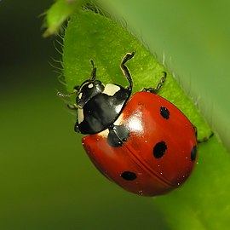
This is ladybug and is a very common family of small beetles with a wide distribution. They can be seen in all tropical to temperate areas where crops are grown - including the Lingnan area
14 Tiffany

Slide 37
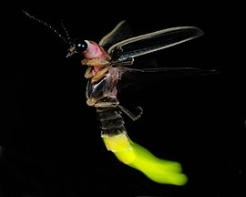
Firefly, hotaru;
it is also known as "light-emitting insects". It is a family under the suborder of beetles, including more than 2,000 species, mainly distributed in temperate and tropical regions. area. There are also many species of fireflies in Taiwan
13Tiger

Slide 38
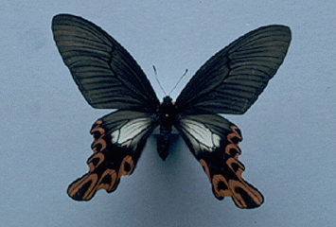
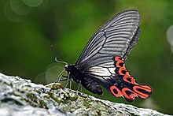
Conserved insects or extinct insects in Taiwan
Taiwan's conservation insects include broad-tailed swallowtail butterfly, yellow-clothed swallowtail butterfly, pearl swallowtail butterfly, Taiwan cicada, Taiwan long-arm beetle, long-horned beetle, Wushe blood-spotted katydid, Lanyu big leaf katydid, Taiwan snail-eating beetle, Tsuda big head Stick insects etc. Most of these conservation insects are large and beautiful, and some are endangered, such as the broad-tailed swallowtail butterfly.
15 Jasper

Slide 39
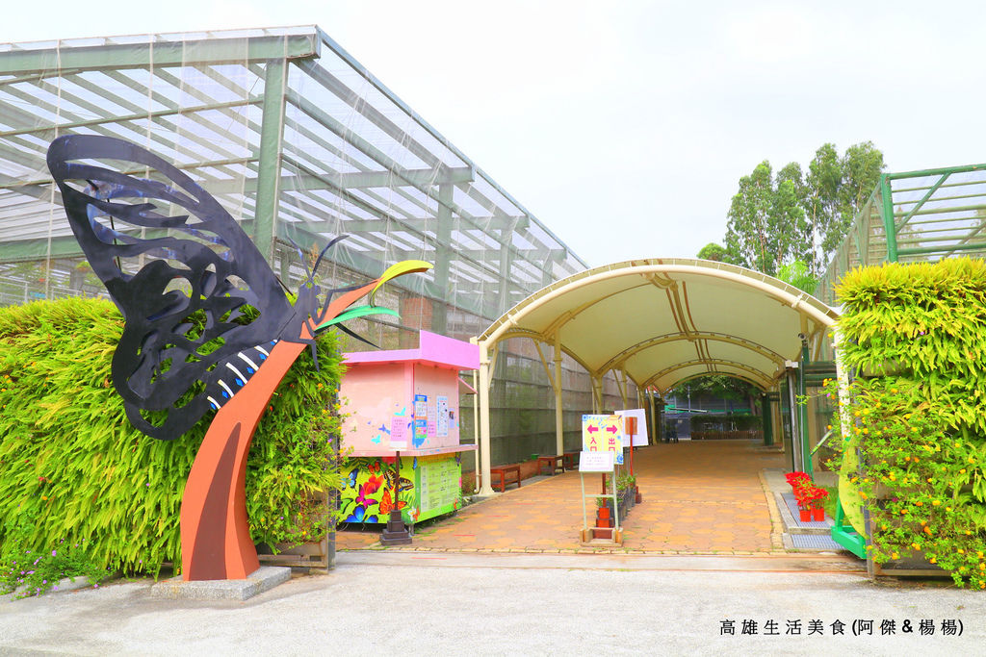
Kaohsiung Butterfly Garden
The Butterfly Garden is located on the east side of the Golden Lion Lake Scenic Area. It is the largest net room butterfly garden in the country. There are many kinds of butterflies. From the bridge, you can overlook the flying posture of butterflies. There is an indoor commentary room on the second floor.
13 Tiger

Slide 40
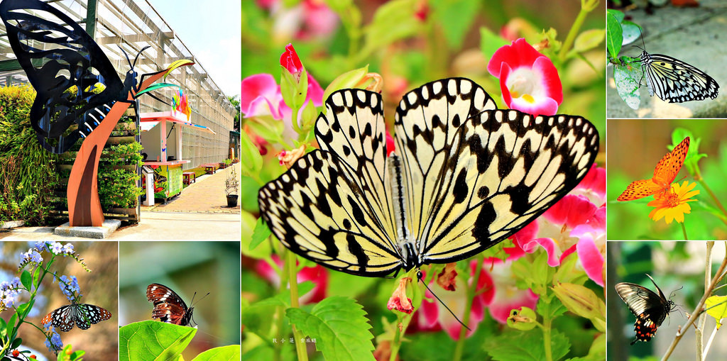
The Butterfly Garden is located on the east side of the Golden Lion Lake Scenic Area. It is the largest net room butterfly garden in the country. There are rich butterfly species, including more than 30 kinds of butterflies, including big swallowtail, black-spotted white butterfly, end-red butterfly, and yellow-sleeved swallowtail. The number of adult butterflies is the highest. There were as many as 350.
16 Liu

