Slide 1
Fashion in Slonim
by Nina Revenko
9C
Slonim gymnasia 1
Belarus

Slide 2
What is Fashion?
Fashion exemplifies the appearances of clothing, but fashion can also include beautiful accessories.
The terms "fashionable" and "unfashionable" are employed to describe whether someone or something fits in with the current or even not so current, popular mode of expression.
The term "fashion" is frequently used in a positive sense, as a synonym for glamour, beauty and style.

Slide 3
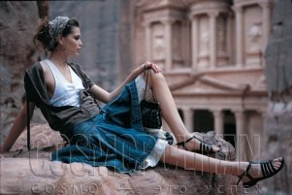
Slonim. Fashion
There are many types of fashion in my town. For example, casual, glamour, sport, street, school, etc.
People choose different clothes. It depends on everybody’s choice.

Slide 4
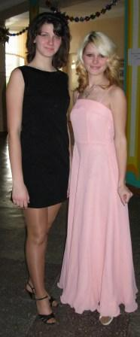
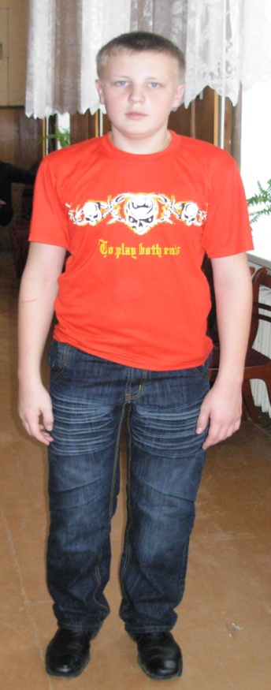
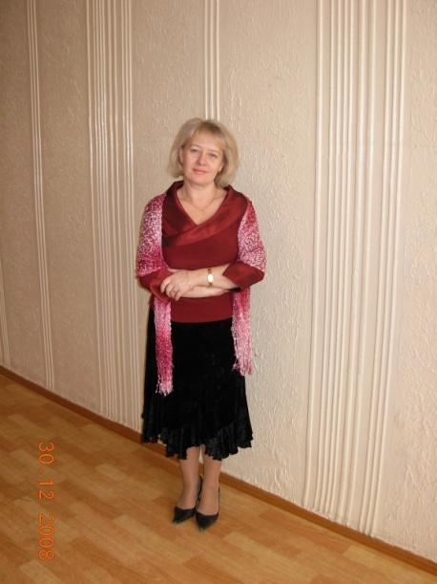
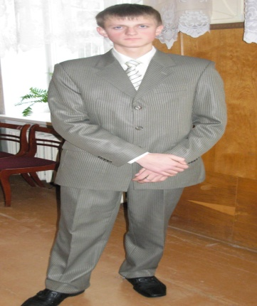
Women’s & Men’s Fashion
Women in Slonim wear casual clothes, such as jeans, trousers, jackets, pullovers, dresses, coats.
Men in Slonim prefer clothes of different styles, from casual to hard rock style. Most of them wear jeans, pullovers, etc.

Slide 5
Most of clothes in Slonim are produced in Belarus & China. But there are a few clothes, which are made by famous clothes makers, such as D&G, Armani, Chanel, Gucci, Zara, Mango, Dior, etc.
Cotton, flax, silk, acryl are the main fabrics from which clothes are made.

Slide 6
Problem of Fashion
To my mind, there is fashion crisis in Slonim. Some people can’t buy whatever they want, because in Slonim there are too few fashion shops and boutiques for women & men. What our Slonim’s market & shops can offer is not always in fashion. And their quality do not correspond to their prices.

Slide 7
