Slide 1
street games
NASTYA BABEI
9B
SLONIM GYMNASIA 1
BELARUS

Slide 2
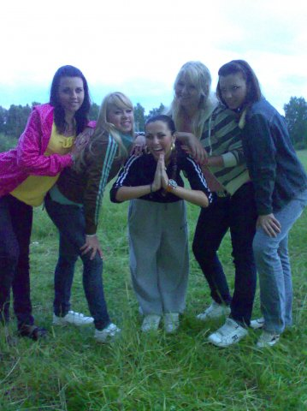
I AM
It’s a game for joyful and happy people.These are its rules:
about 6 -9 can take part in the game;
- the first person says “I am”, the second says “I am” and so on;
- those who will smile, next time will say not only “I am” but also a piece of his or her biography or something secret;
-so if creative and cheerful people play this game, at the end of the game each person will say all his life and biography.

Slide 3
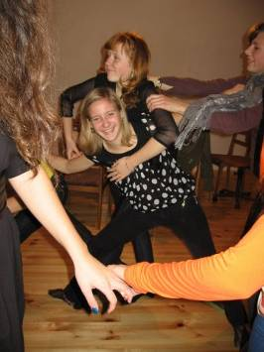
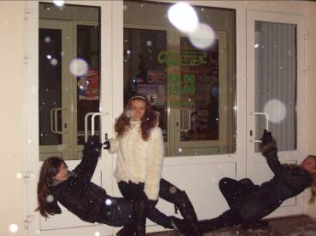
It’s a game for a big crowd of people. It’s a very popular party game which people play when they would like to have more fun.
The players stand near each other making the circle. A player touches a foot of the person who is next to him by his foot and puts his leg on that place. Then the person who is touched by the first person touches the foot of another person who stands nearby and so on. The players must be careful because they can fall down. The winner will be a person who won’t fall down.
FEET

Slide 4
FACE
There are a lot of games which we can play not only at the party. There are games which we can play on the beach. For example, the game which is called “Face”. It ‘s a very funny game for a great number of people.
These are its rules:
-one person tells everyone who plays this game a name of a person who is well-known for the rest of the players. Nobody except these two people can hear it. It can be a famous actor , actress or even a friend of the players;
-then each player mimes a person whose name he heard to the rest of the players. He can show his manners or something else but he mustn’t say a word;
-the rest of the players guess who he or she can be. If they know the person they tell the name to the person who
mimes it. If it’s right they continue the game. If it’s wrong they continue guessing the name. The winners will be those people who will give more right answers.

Slide 5
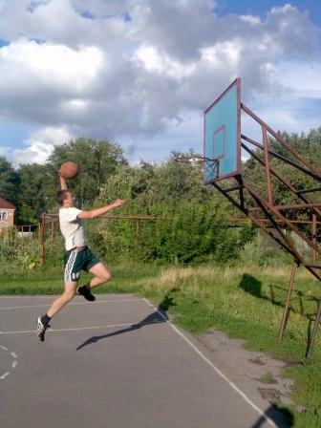
STREETBALL
Usually only one side of the court is used, but otherwise the rules of the game are very similar to those of professional basketball. The number of participants in a game, or a run, may range from one defender and one attacker (known as one on one ) to two full teams of five players each.
The rules of street ball are the same as the rules of basketball.

Slide 6
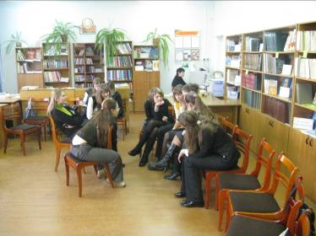
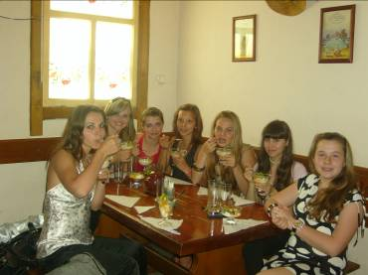
“Who? Where? When?”
A great number of people can take part in the game. These are its rules:
-one person always answers the question “who?”. Another person answers the question “when?”. The next person answers the question “with whom?” and so on. These are the questions: who, where, when, with whom, why, for what purpose. There can be more questions if you want;
-then each player gives the answer to his question to the rest of the players. Everyone says it one after another;
-then their answers become a story, sometimes a very funny story;
-this is the game without any winners and losers. It only can help your friends and you to have a good rest and relax.

