Slide 1
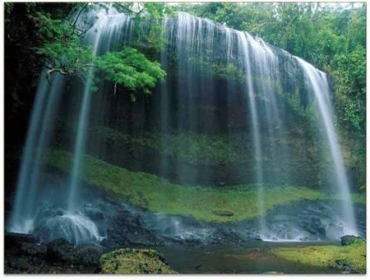
Summer holidays

Slide 2
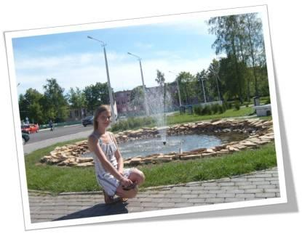
My last summer holiday!!!!!!!!!!!!!!!!!!

Slide 3
Summer holidays are the best time in the life of every pupil and student. Everybody can do what they want to do. Many of us travel round the country and while travelling we see many sights, meet different people and admire our picturesque nature. This gives us new friends and acquaintances, we find out more and more, that’s why we like summer holidays most of all..

Slide 4
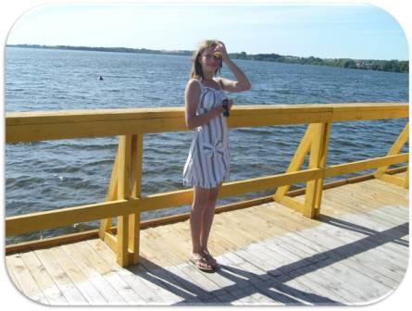

Slide 5
Why do we like this season so much?
We can do everything of nothing
We spend much time with our friends swimming and getting sunburnt on the beach, visiting bars, cafes, dance-clubs.
We can devote ourselves to the most favorite hobby.
We can sleep all day, listen to music.
And the main thing is: it’s not necessary to go to school or to worry about your home work.

Slide 6
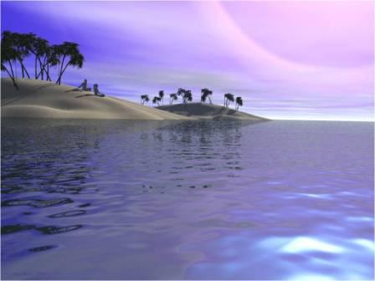
Summer is the best time to relax.

Slide 7
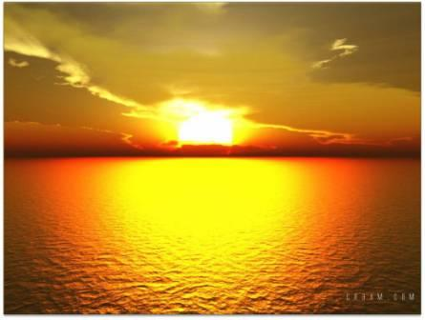
Thank you very much Kate Shyndrik

