Slide 1
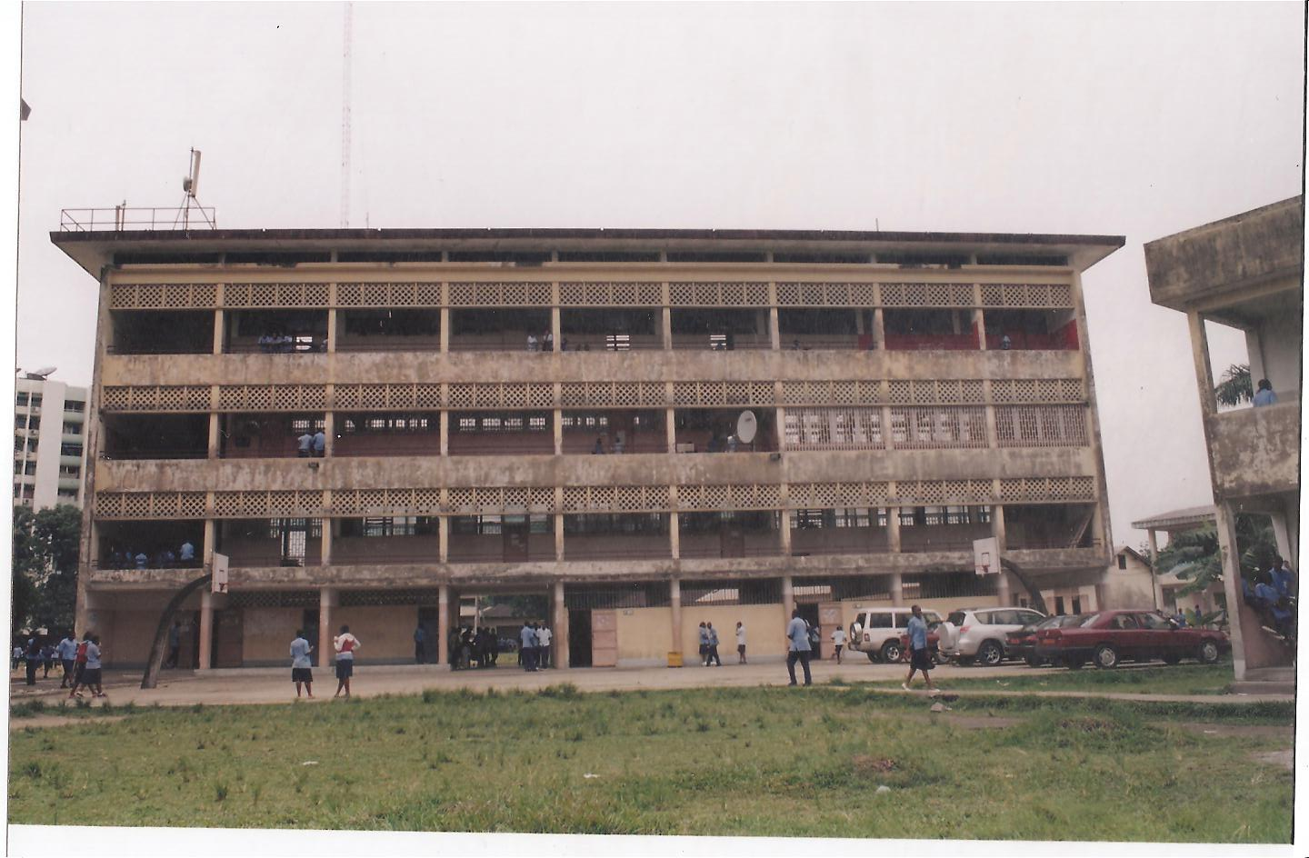
OUR MODES OF TRANSPORTATION
BY 6eme A1 STUDENTS
LYCEE JOSS DOUALA, CAMEROON
SUPERVISED BY BATE BESSEM BEATRICE ENGLISH LANGUAGE TEACHER
2009/2010 Academic Year

Slide 2
DIFFERENT MODES OF TRANSPORTATION IN CAMEROON
Train
Car
Taxi
Bus
Plane
Helicopter
Canoe
Boat
Ship
Motor Bike
Bicycle
Foot.

Slide 3
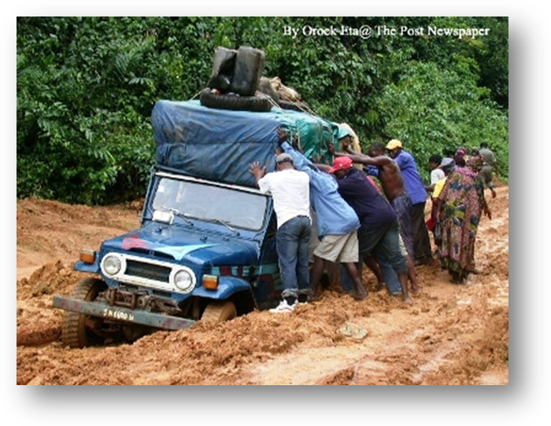
PROBLEMS FACING THE TRANSPORTATION SECTOR
1- BAD ROADS
2-HIGH PRICES OF FUEL.
3-TOO MANY CHECK POINTS ON THE HIGHWAY

Slide 4
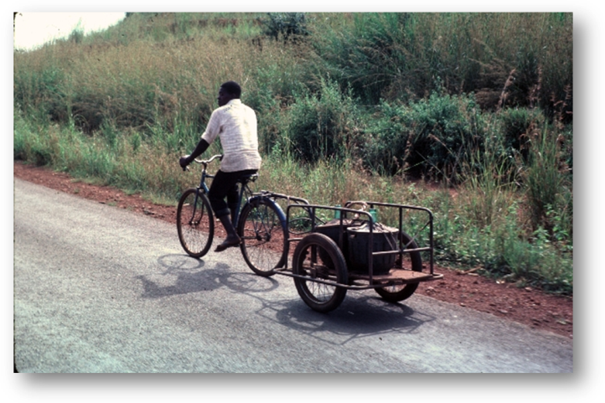
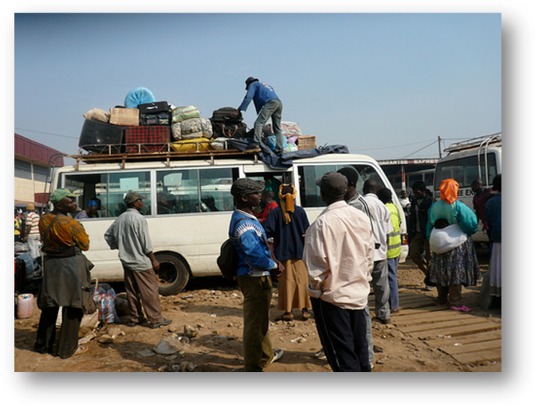
SOME OF OUR CULTURAL ASPECTS CONNECTED TO TRANSPORTATION
-Drivers put lumps of grass in a line on the road to indicate that there is an accident ahead or that a car has a problem.
-To call a taxi, you stick your arm out towards the road when one is approaching.
-There is no respect for time. At the agencies and motor parks, the workers will tell you the time of departure, but this time is never respected-Our attitude of togetherness portrayed in overloading passengers and things. It is difficult to see a taxi or bus that is not overloaded. Sometimes the passengers ask the driver to carry passengers on the way, especially in an area where it is difficult to see a vehicle. -In Cameroon drivers do not put on their seatbelts especially when driving within the town. When some drivers put on their seatbelts, others look at them as if they want to show off or they are the civilized.
-Roadside markets. Along the highway, there are many roadside markets. There are also markets at the transport agencies and motor parks. As soon as a driver stops at a check point or the toll gate, these sellers rush to the passengers to sell. Along the Bamenda-Douala highway for example, all the buses travelling at night stop at kekem so that passengers can buy food and drinks. The village is awake all night. Kids, men and women are involved in this late night business.

Slide 5
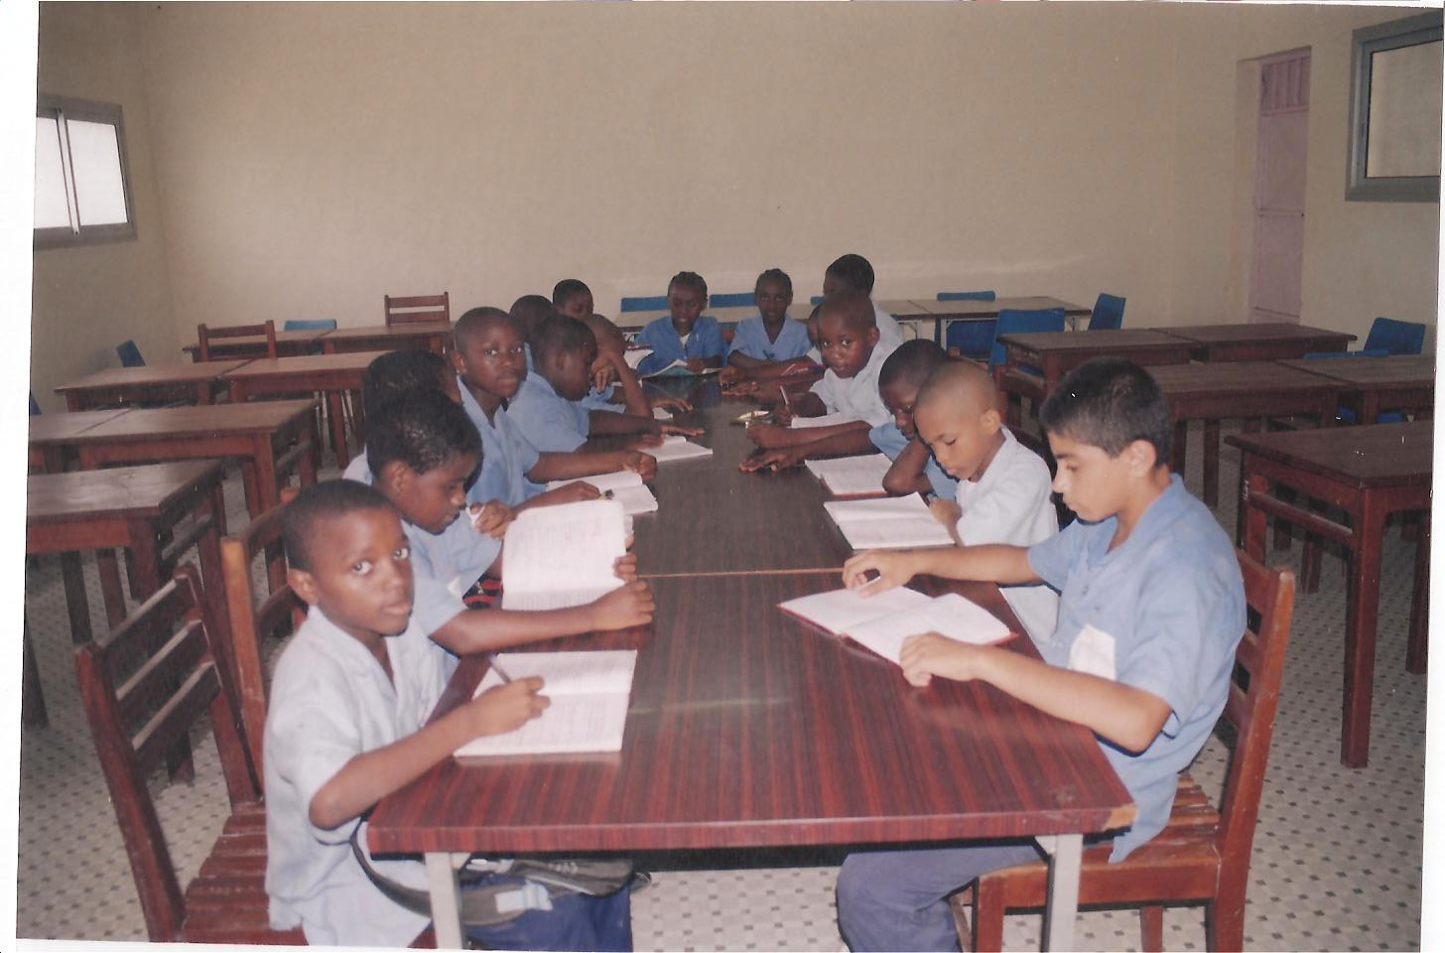
CAN OUR VOICES BE HEARD?
If given the chance, we would like to make the following suggestions that can ameliorate the transportation sector in Cameroon:
-Money collected from toll gates and airport taxes should be used to repair and construct roads and also make our airports comfortable.
-Every motor-bike taxi rider should attend a driving school.
-Drivers and passengers should always put on their driving belts.
-The government should put surveillance cameras on our highways to check speed and other faults.
-The number of check points on the highway should be one for a long stretch. The Ministry of Transport can device a means to control car documents and insurance from their offices. These numerous check points are frustrating to both the citizens and tourists.

Slide 6
THANK YOU FOR YOUR
KIND ATTENTION.
HOPE YOU ENJOYED READING OUR ARTICLE.

