Slide 1
Teen celebrities in the U.S.A
From Burr Ridge Middle School

Slide 2
Female celebrities
Taylor Swift is very famous in America. She is a pop/country singer. She has won many awards. She is 20 years old
Miley Cyrus is a actress and singer. She has many albums most of them are for her show Hannah Montana.
Miranda Cosgrove is a TV star and has started a singing career. She was on the show Drake and Josh as a co-star. Now she is the title character in her show ICarly.
Selena Gomez is another TV star on the show Wizards of Waverly place.
Lea Michelle is on the show Glee.

Slide 3
Male Celebrities
Zac Efron is a famous actor who has been in a wide variety of movies like Charlie St. Cloud.
Taylor Lautner is famous for his role in The Twilight Saga as Jacob.
Nick Jonas is a pop star in the band the Jonas Brothers. He has done a lot of Charity work.
Cory Montieth is a TV actor on the awarding winning show Glee.

Slide 4
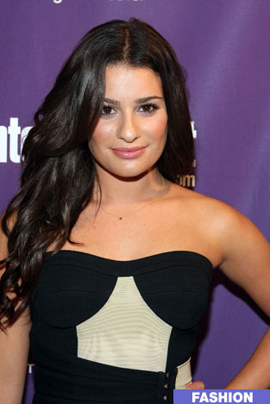
Pics of Female celebrities
Miley Cyrus &
Lea Michelle

Slide 5
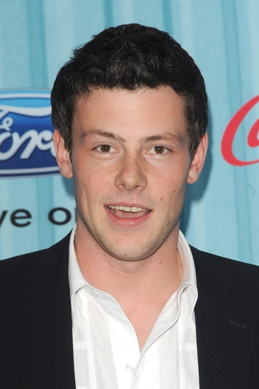
Pics of male celebrities

