Slide 1
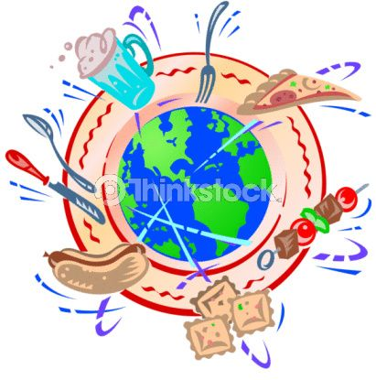
Food From Around the World!
By Burr Ridge Middle School

Slide 2
Introduction
Food is a big part of everybody’s life, regardless of where they live, what they believe in, or what they just plain like. Here we’ll take you around the world at a look into the foods people eat around the world.

Slide 3
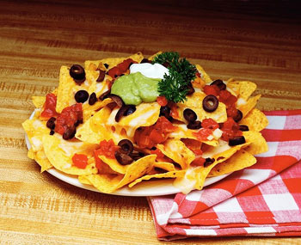
America
Starting in America, food is just a big blend of recipes from all over the world originating from generations back. It is a big blend of the world, but there are also American made foods and restaurants. For example:
Mexican Food:
Nachos are corn chips topped with melted cheese, tomatoes, guacamole (avocado spread) and additional toppings.

Slide 4
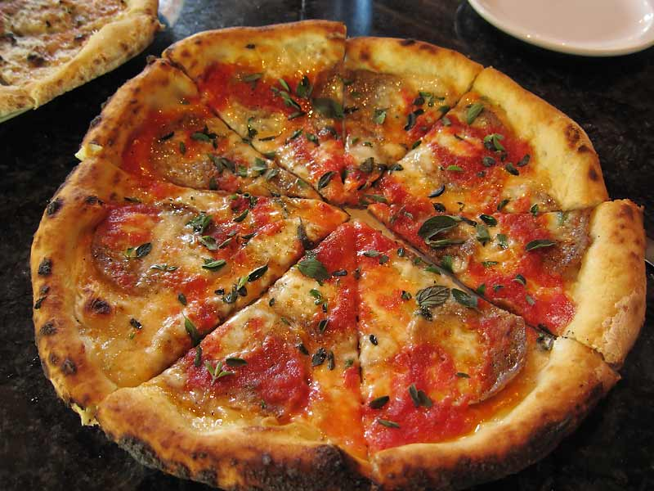
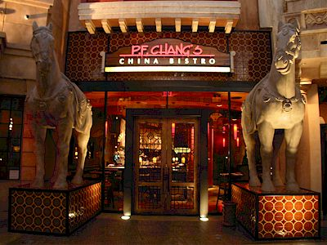
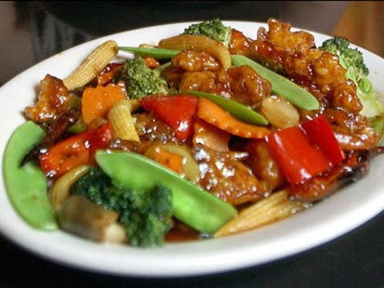
America Cont’d
There is also pizza. It is dough rolled out and topped with tomato sauce, cheese and other meats and vegetables depending on what you like. It is very popular in America.
One more type of food we love is Chinese food. Below is a picture of P.F Changs, a popular Chinese restaurant along with a picture of stir fry, vegetables and meat cooked together and topped with a thick sauce.

Slide 5
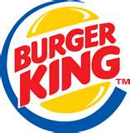
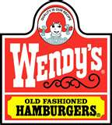
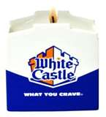
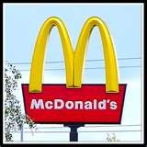
Cont’d
There are also very well liked fast foods too. McDonalds and Burger King are some of the 2 most famous fast food restaurants in America. 1 in 4 Americans turn to Wendy’s drive through on a daily basis. Because of public appeal, many people also like to have White Castle in the North Western US and Jack in the Box in Western US. Sonic has a chain of restaurants all over the US. Portillos and Panera Bread
It is our tradition for most families to go out for dinner on a special occasion such as a birthday or anniversary. Many families go to Buffalo Wild Wings (a popular restaurants that serve chicken wings and burgers) for a celebration and anniversaries. They like to go to those places because the style of the building is on the bigger side and it’s a great place to hang out with lot of people and friends and family.

Slide 6
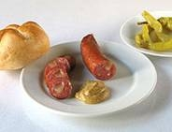
Slovenia
Slovenia is a small country but has a lot of tradition. Here are some traditional Slovenian dishes.
Main Dishes: Kras ham
Black pudding with sour cabbage
Kisla župa – Styrian sour soup
Bograč (Meat dish with onions, three kinds of meat with spices and herbs)
Štruklji (flour "rolls" with variable stuffing, which usually includes meat, vegetables and cheese and has about seventy different ways of being made.)
Dumplings (Traditional Slovenian dish of dough with various fillings. Dumplings may be baked or cooked, sweet or salty.)
Kranjska sausage-is a Slovenian sausage most similar to what is known as klobasa or Polish sausage in North America.

Slide 7
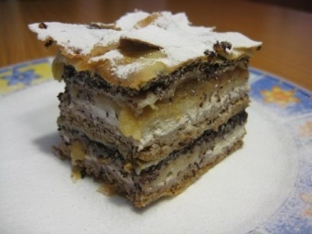
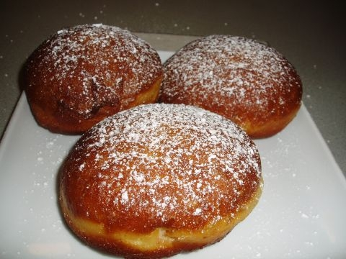
Slovenia
Desserts and Drinks:
Slovenian national donut-Donut is a pastry dough stuffed with a filling (usually with jam, chocolate or vanilla cream ...). Baking donuts is particularly significant for Carnival
Prekmurska gibanica (prekmurian layer cake)is a layered cake, originating in the region of Prekmurje,Slovenia.It contains poppy seads, walnuts, apples, raisins, and cottage cheese fillings.
Slovenian national pie-Pies are an old Slovenian dish. First pies were made only from the dough. They worked by white flour, buckwheat later. Today, they draw from leavened dough of buckwheat and potato.
Teran (Specialty Slovene wine)
Malvasia (wine)
Cviček (wine)
Cviček (wine)
Kislo mleko – Sour milk

