Slide 1
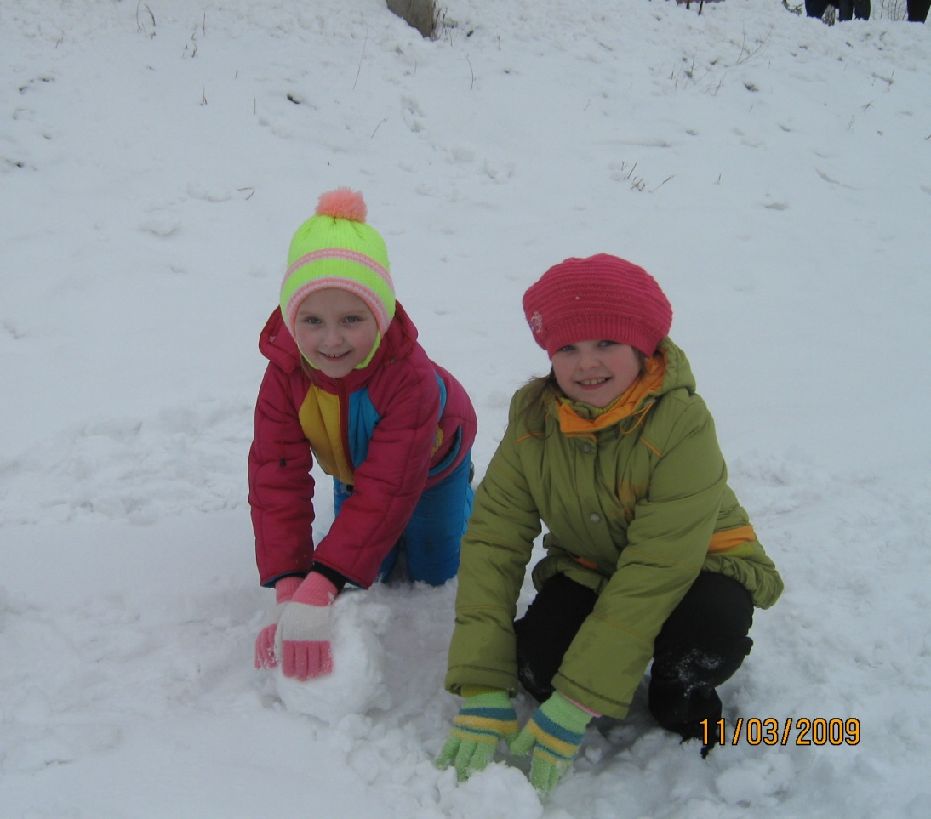
From Russia with Love
The more we are together, together, together,
The more we are together, the happier we are.
For my friend is your friend and your friend is my friend.
The more we are together, the happier we are!

Slide 2
Hi! We are from Kurgan City Russia. We are the students of the fifth grade

Slide 3
We usually have six classes six days a week. Every morning except Sunday we get up at seven a.m. and go to school.

Slide 4
At school we do different subjects. Our favorite subjects are English, science, mathematics, PT.

Slide 5
Classes finish at half past one. We are always at home at two p.m. After dinner and a short rest we prepare for the next school day.

Slide 6
Then we often do sports.

Slide 7
Kate, Olga, Lera, Ksyusha, Roma attend the club where they learn to make toys.

Slide 8
All of us like going out with our friends.

Slide 9
We read books, listen to music, play computer games, do some voluntary job.

Slide 10
We help our parents about the house: wash dishes, clean the rooms. Katya looks after her younger brother.

Slide 11
Olga takes care of her pet.

Slide 12
On Sunday we visit our relations, go to the swimming bath, and walk in the park

Slide 13
It is winter now. We can skate, ski, make a snowman, play hockey, go sledding down the hill.

