Slide 1
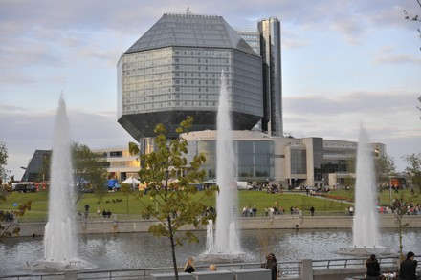

Students of the 5-th form gymnasium #30
Minsk
Belarus
PRESENTS
MINSK CITY TOUR
http://www.iearn.org

Slide 2

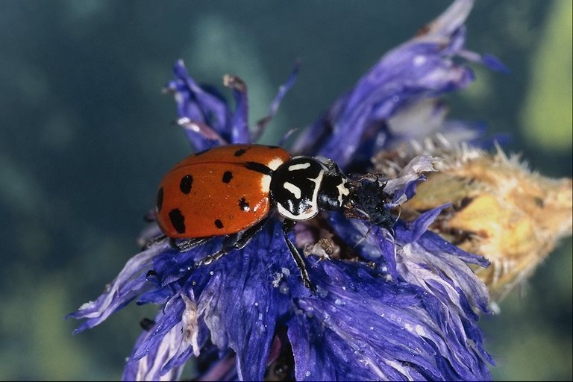
Practically all newcomers note that Minsk is a very green city. According to the estimates, there are over 2 million trees in the city. There are about 34 square meters of greenery per every Minsk resident.

Slide 3
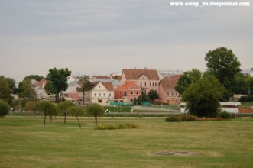
During the city tour you will see:
Troitskoye Predmestye (Trinity Suburb) – restored buildings of the 19th century . One of the oldest parts of Minsk. It was built in the 19th century.

Slide 4
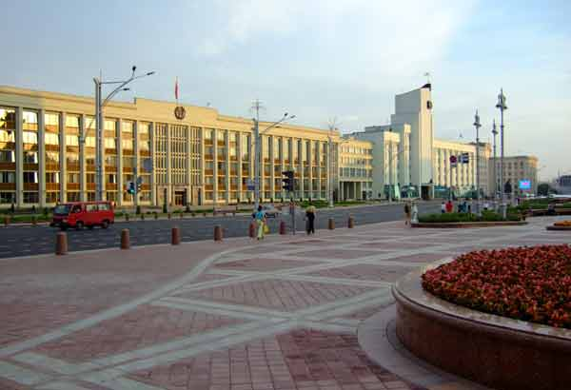
Independence Square with the House of Government

Slide 5
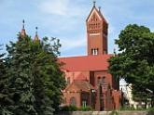
Church of St. Simon and Helena ("Red Church") named after the son and daughter of a local landowner, both of whom died young. They are represented by the two towers at the rear. In the grounds of the church you will find a bell, which was presented to the church by the Catholic diocese of Nagasaki. The people of Belarus and Nagasaki have each suffered their own nuclear tragedies and the bell is a symbol of friendship.

Slide 6
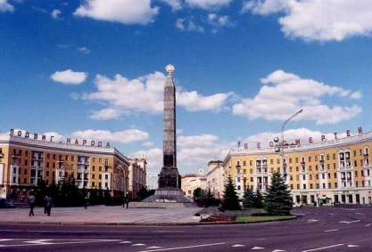
Victory Square with its 38 metres grey obelisk and eternal flame honouring the heroes of World War II

Slide 7
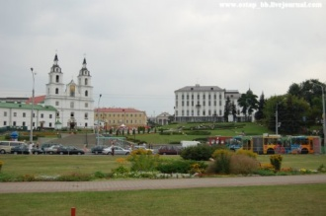
Holy Trinity Cathedral – architectural monument of the 17th century. The oldest church in Minsk. It’s on Nemiga street.

Slide 8
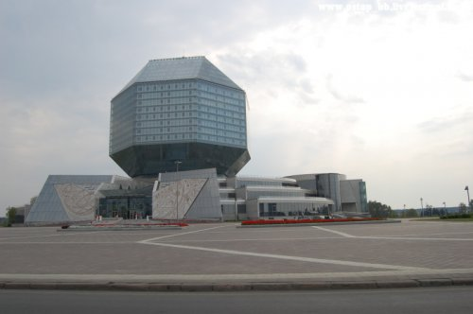
The unique building hosting the National Library of the Republic of Belarus is also located in Prospekt Nezavisimosty.

Slide 9
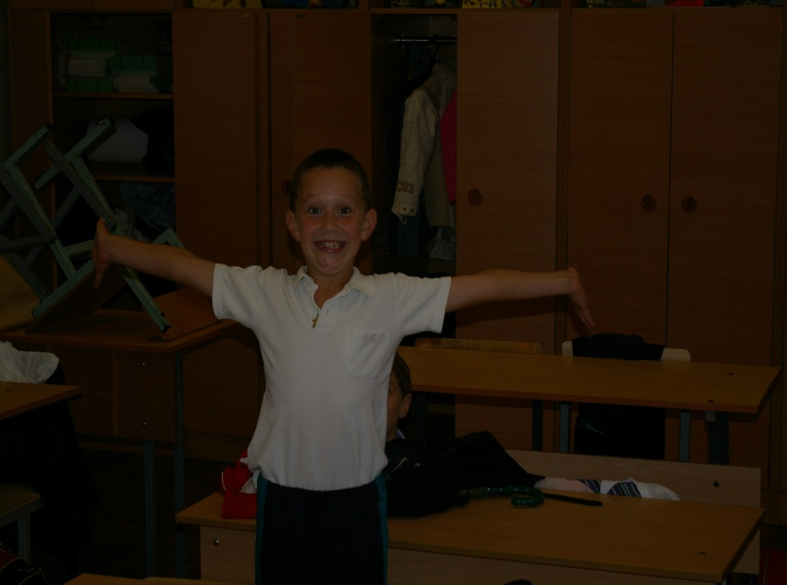
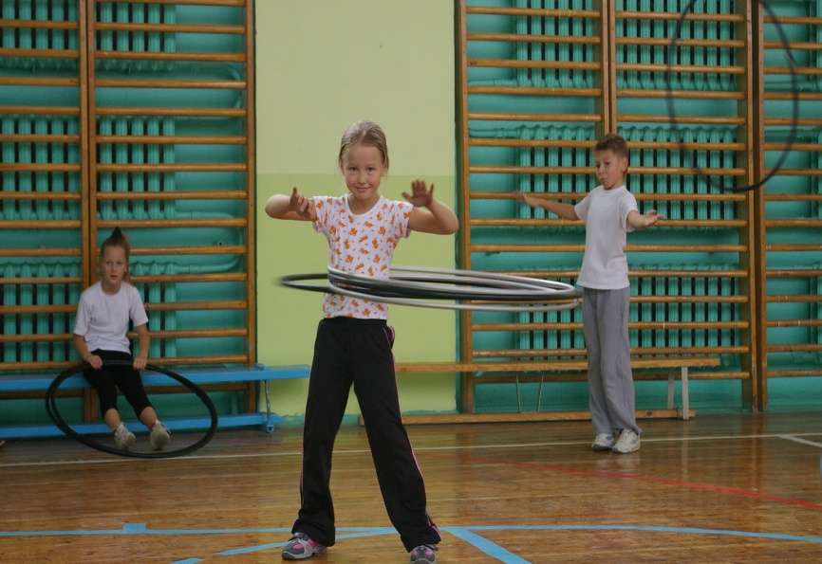
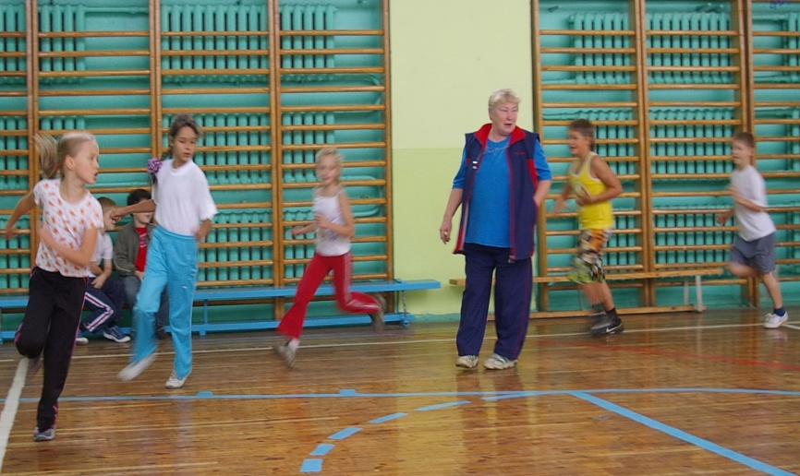
Our students love sport

Slide 10
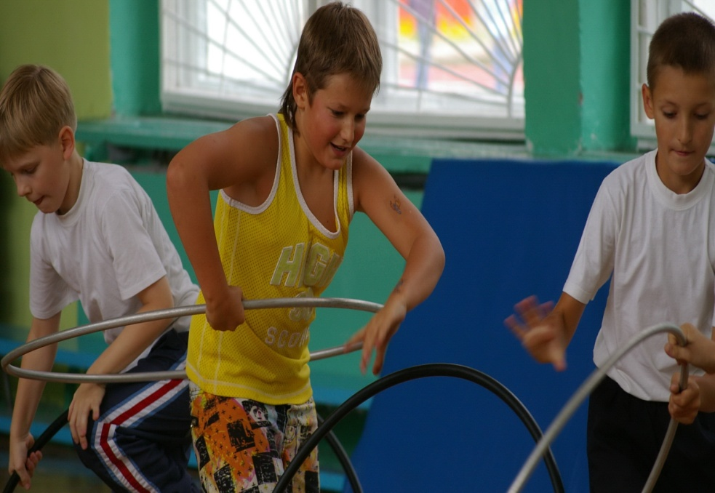
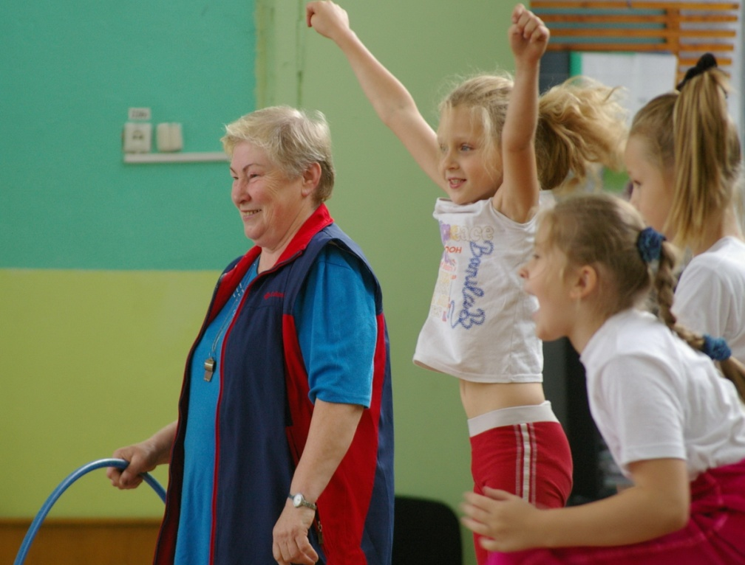
Twice a week they have their
PE lessons

Slide 11
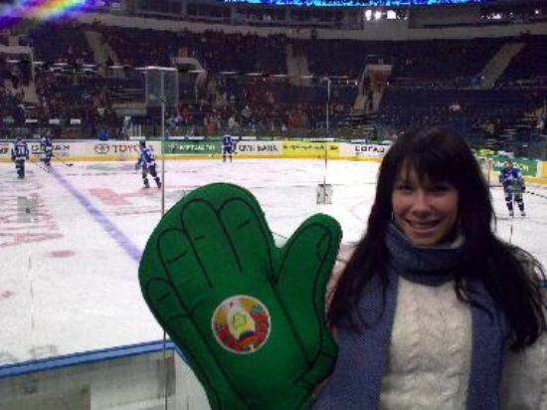
The year 2008 was declared the Year of Health in Belarus, serving logical continuation of the Year of Mother (2006) and the Year of Child (2007). In Belarus 1.481 million people do sport, which is 15.3% of the country’s population; more than 26,000 specialists work in the sport industry.

Slide 12
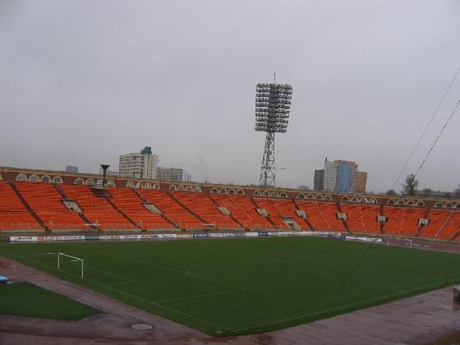
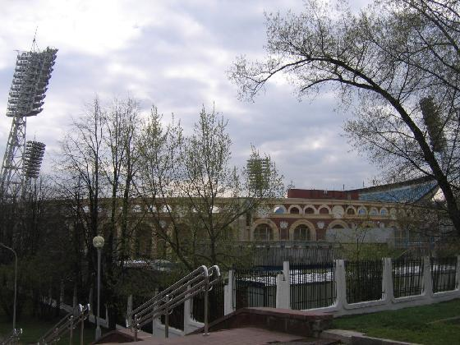
The Dinamo Stadium is part of Minsk's landscape and it's really an interesting piece of architecture. It lies along the river and very close to the main centre of the city. It has the shape of a colisseum, very classic roman style.
Inside it's the typical olympic stadium, very big, with no coverage and brand new UEFA-Cup approved orange seats.

Slide 13
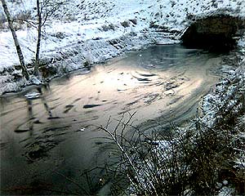
Belarus's main environmental problems are chemical and nuclear pollution. Belarus was the republic most affected by the accident at the Chernobyl nuclear power plant in April 1986. Belarus has 88 UNESCO World Heritage Sites.
In addition, Belarus has significant air and water pollution from industrial sources.

Slide 14
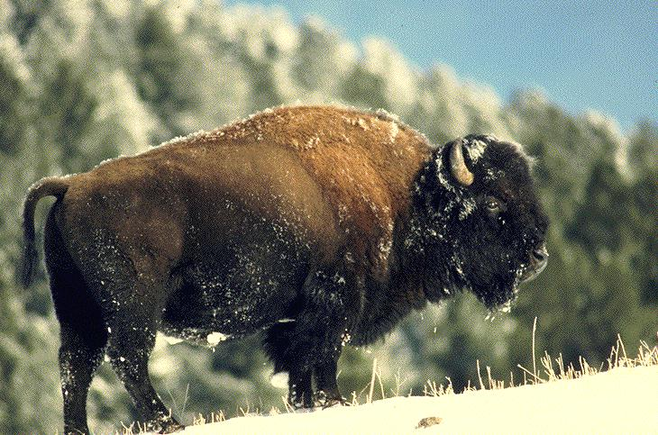
As of 2001, Belarus had over 2,000 species of plants, 74 mammal species, and 221 breeding bird species. Four mammal species and four bird species were listed as threatened that year. Endangered species include the European bison and the European mink.

Slide 15

Thank you for your attention!

Slide 16

HAVE A
NICE
DAY!!!

