Slide 1
My Special Place
By First Grade Students of Room 3
Lynnwood Elementary

Slide 2
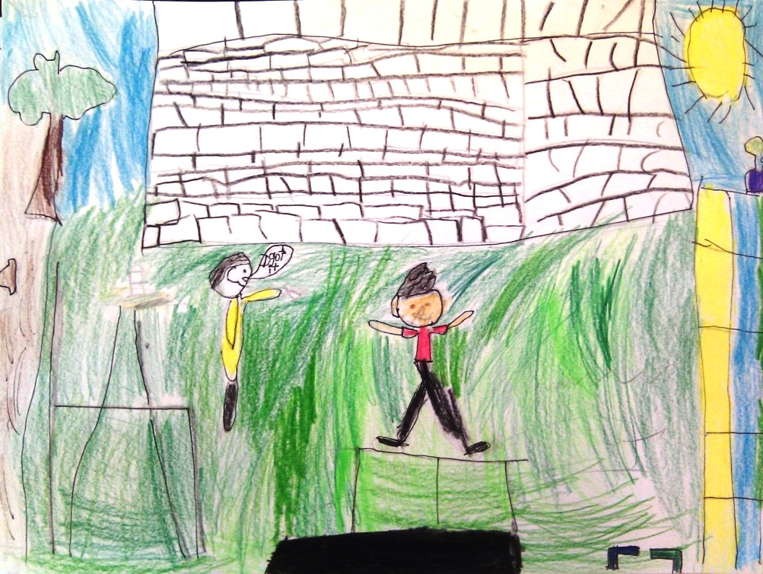
My special place is outside. I like to throw paper planes. And Andy and me play tag. And I like to play with squirt guns and in water. I like to jump and jump on my trampoline and look at the stars.
By Aidan

Slide 3
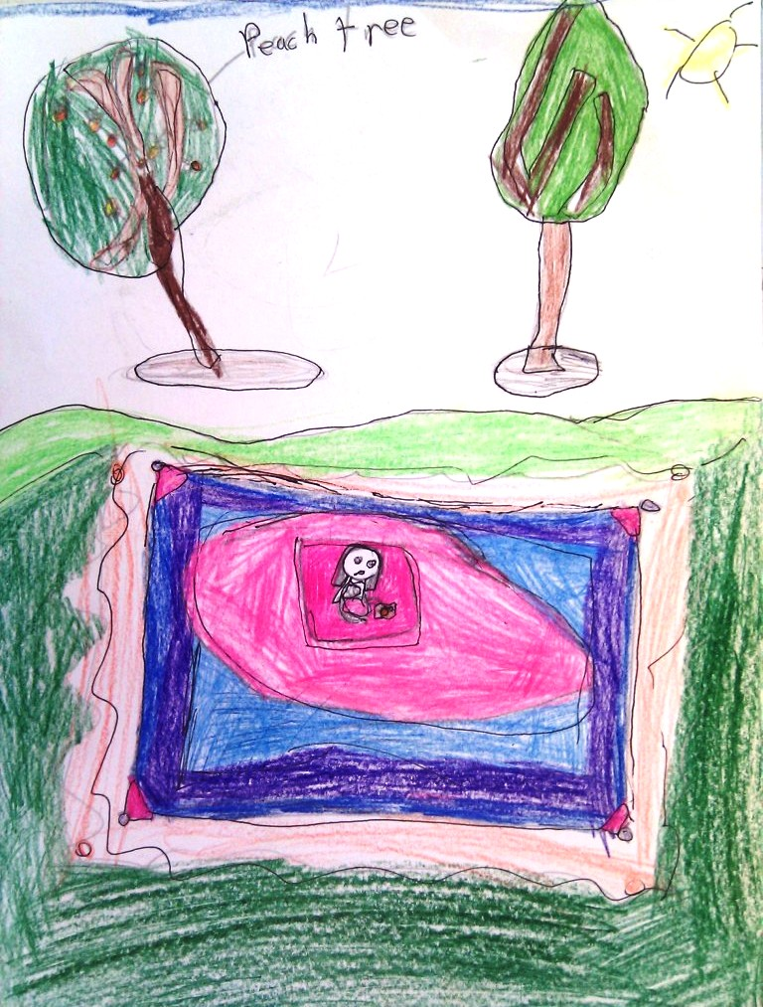
I like my special place because I have a big blanket and my neighbor grows fresh peaches from a tree. I pick a peach from the tree every day in my friend Mrs. Shell’s yard. I sit and read while I eat.
By Ayanna

Slide 4
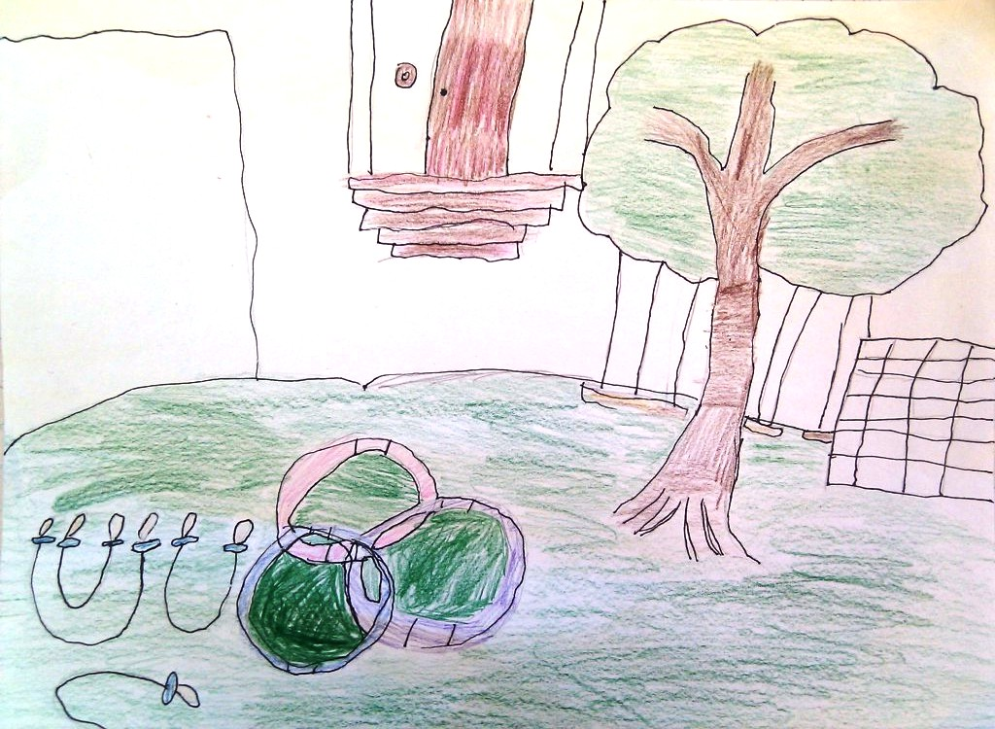
My special place is my friend’s house. I like it because they have a tree swing and four jump ropes and three hula hoops. When I played there I felt like I was in paradise. We had fun.
By Vi

Slide 5
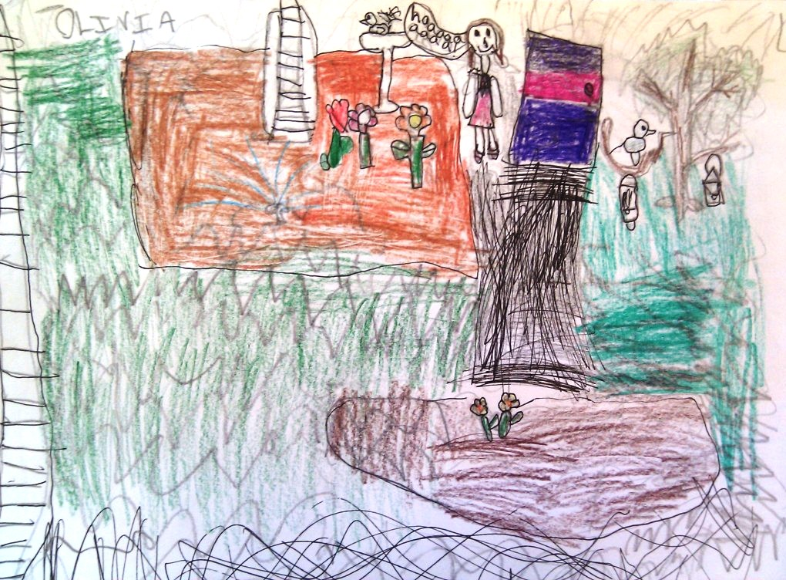
My special place is my Grandma’s garden. I love the flowers. They are so beautiful. And the food…I love the delicious food. I love to smell the roses because they smell so good. Every time I see the flowers I go like this, “Whew these smell good.” Then I water the flowers. Grandma comes out then makes me macaroni and cheese. I said, “I love you.”
By Olivia

Slide 6
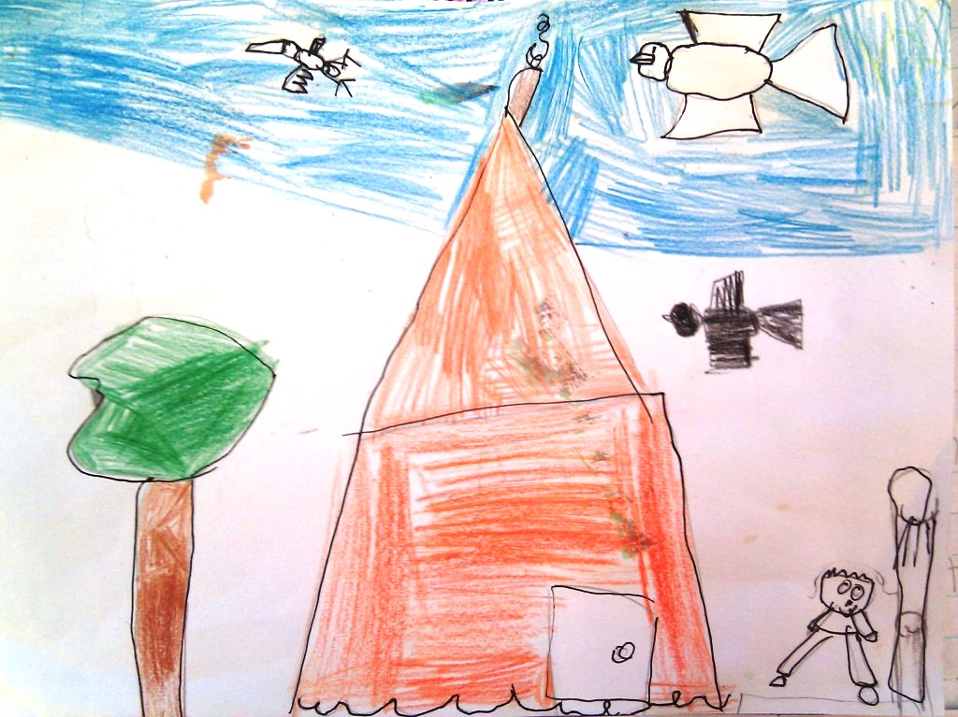
I like my house because I have fun with my brothers at home. My brothers play with me. We play outside and we play basketball.
By Giovanni

Slide 7
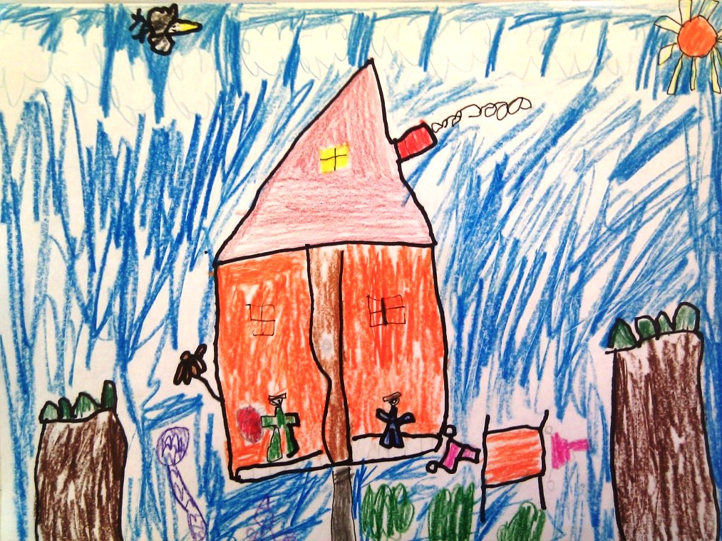
My special place is my Grandma’s House because my Dad goes and visits. Dad gets a prize for us. There is a Wii at my Grandma’s house. And she even has a computer. My Grandma’s house is special because she makes macaroni and cheese and fish sticks.
By Eldon

Slide 8
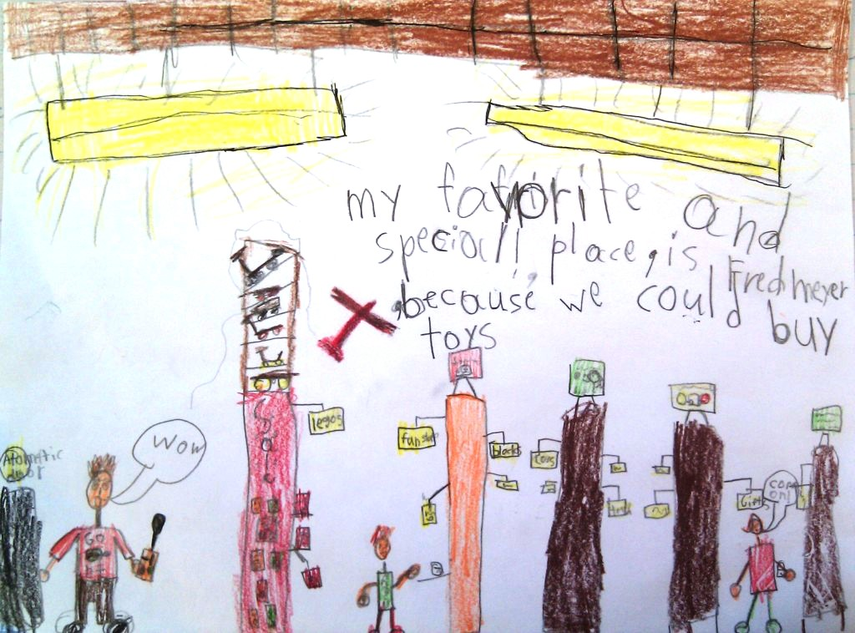
My special place is Fred Meyer. Because we could buy toys and fun stuff--Ninjago Legos and all sorts of stuff. I like to buy cookies like snicker doodles or chocolate chip. Those are my favorite. I go with my Mom or Dad. They give free cookies samples at the bakery. And if you like them you could buy them but not for free.
By Ian

Slide 9
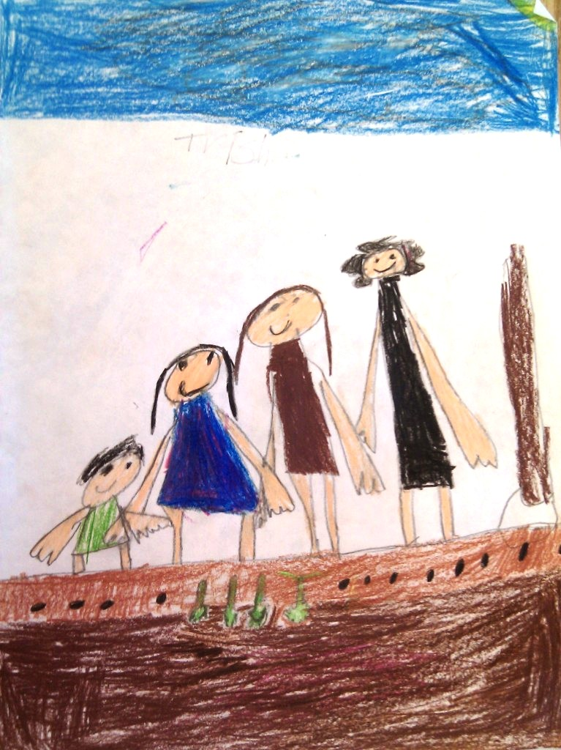
My special place is my garden because it grows food for us so we don’t have to get food at the store. Getting food from the store is wasting money. My garden is in my backyard. My Grandma likes to grow salad because salad is good. When I see my Grandma standing outside doing the garden I get out of the house and help her.
By Trisha

Slide 10
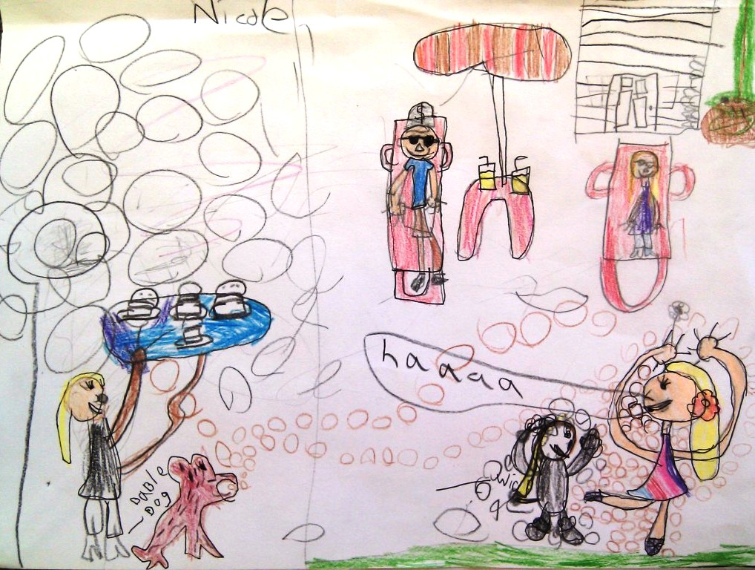
My special place is my front yard. One summer I did a ballet dance for my Mom and Dad. My sister made hamburgers. I did my dance with my puppy. When the dance was over we ate the hamburgers. It was fun. I hope we get to do that again.
By Nicole

Slide 11
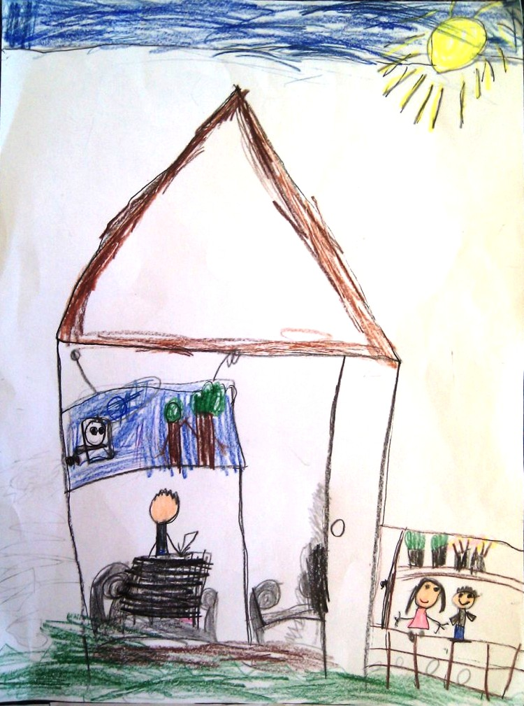
I go to my cousin’s house to play in the backyard. We can play all day. I spent the night a few times. There are balls under the deck in the backyard. My Grandma plants at Syris’ house. Because she lives there too! She cooks all the time, but I want her to take a break.
By Lyric

Slide 12
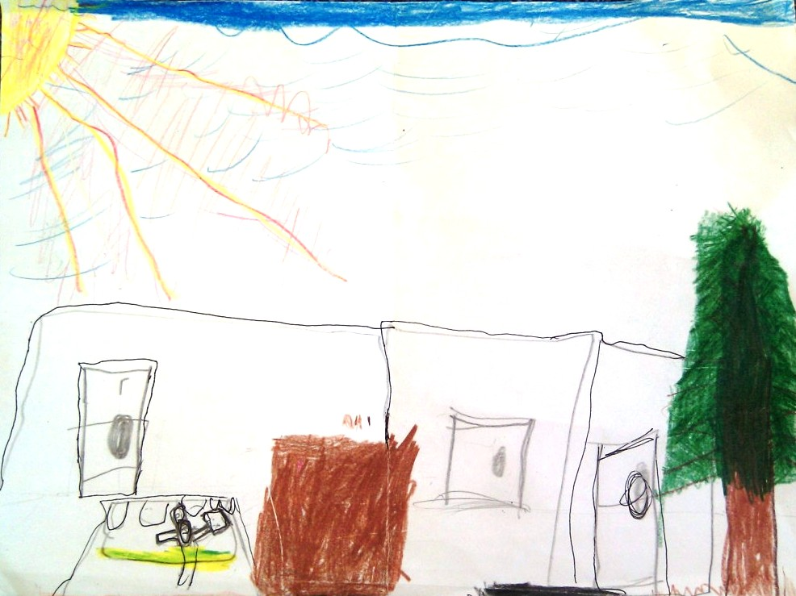
My favorite place is my backyard because I can read and play my DSI. I love it.
By Jason

Slide 13
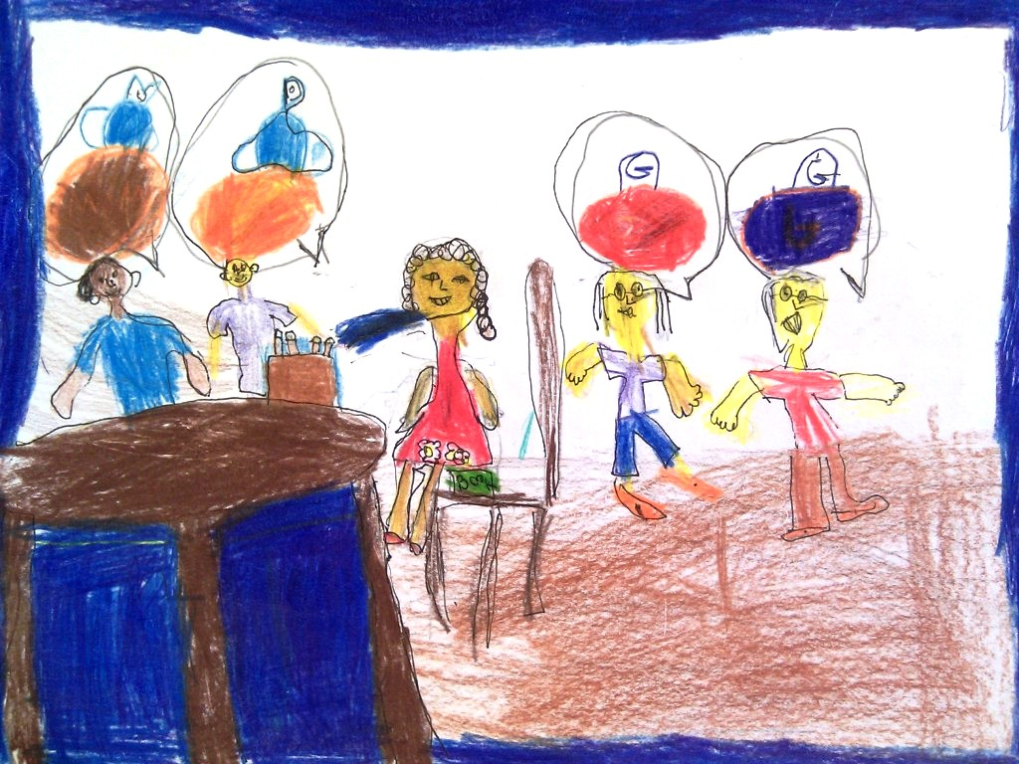
It was my birthday! I was turning 4. I was wearing a pretty red dress but it was cold so I wore a coat. It was a pretty coat. We were in the kitchen. I was happy.
By Lua

Slide 14
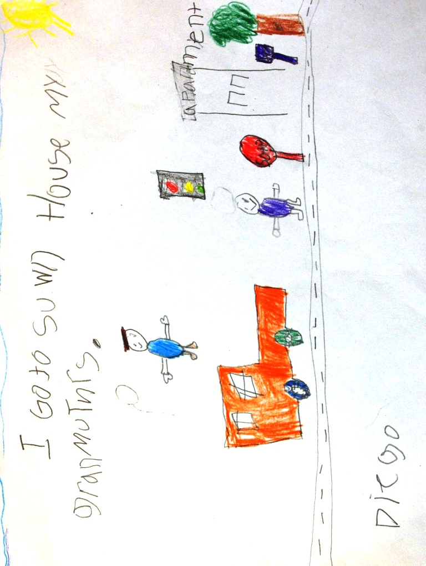
My grandmother’s apartment is in Lynnwood. We talk and we eat pizza. We watch TV. I like Sponge Bob.
By Diego

Slide 15
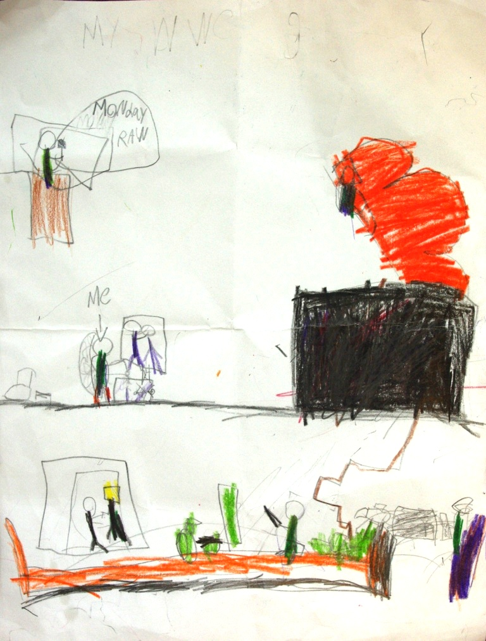
My house is my special place because it’s fun. I have a lot of toys. And my favorite toy is my WWE guys. I play with them and wrestle with them.
By Keegan

Slide 16
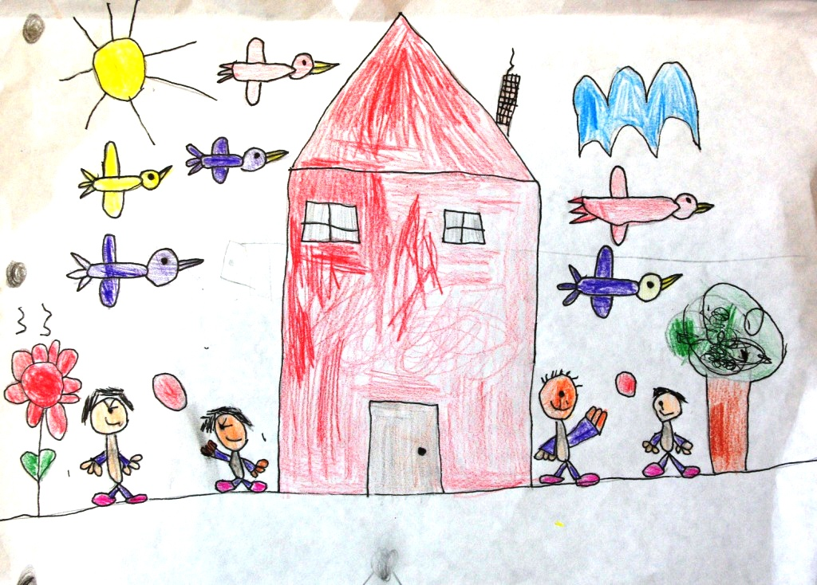
My special place is my house. Tyler and Dad and Mom and me are play ball back and forth. The birds are flying and the flowers grow big in the sunshine and the clouds are not raining. The sky is blue. Mom and Tyler and Dad are happy.
By Liana

Slide 17
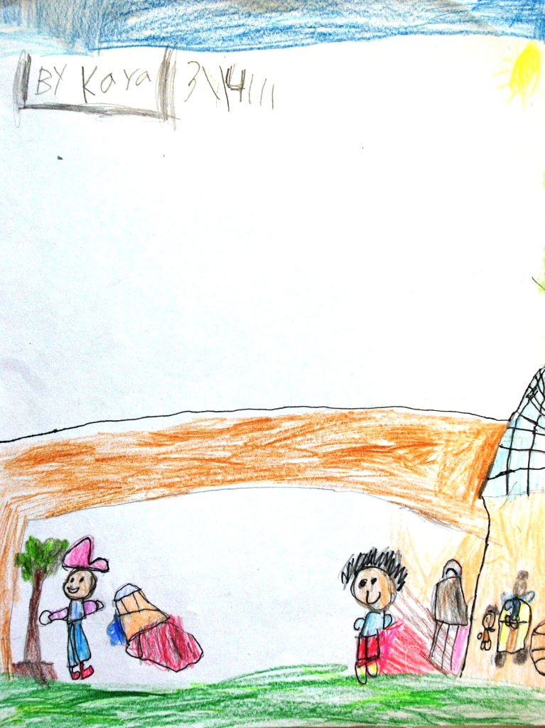
My special place is my backyard. I like to play in my backyard with my cousin. We also like my grandma’s back yard and we all play. Me and my sister ride bikes and we are happy. When my cousin goes home we say goodbye.
By Kayanalin

Slide 18
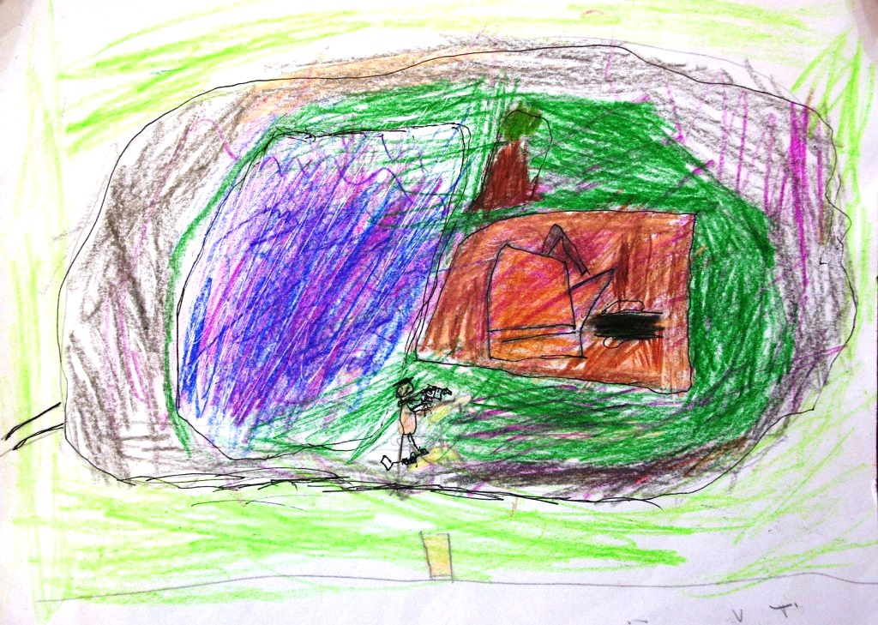
I went to the park and rode my bike around the park. I had fun. I went to the play ground and played a little bit. And I had fun. And I went by myself. I felt like a big boy. I was happy.
By Caellon

Slide 19
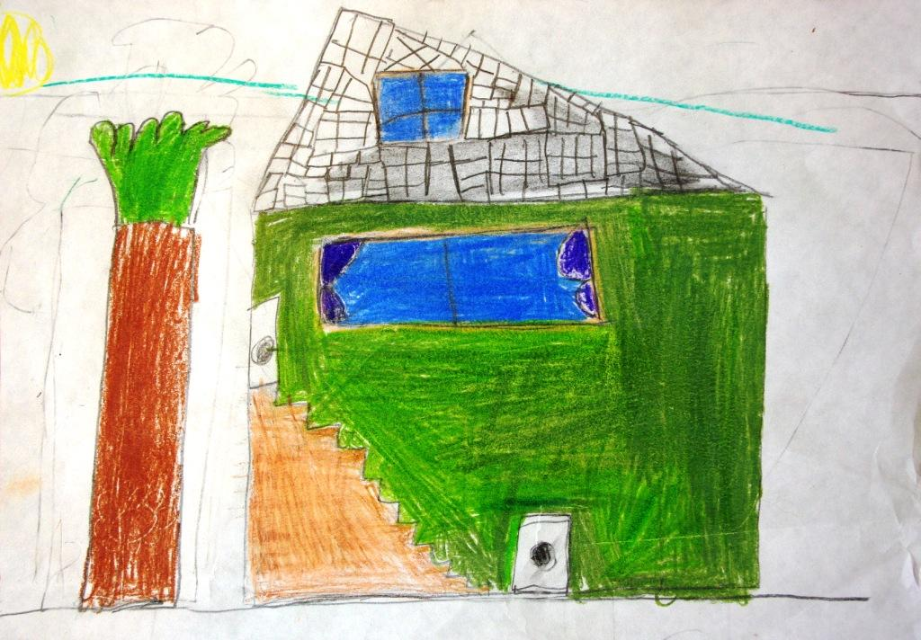
My special place is my downstairs. I play with my big monster truck and I play with my little monster truck. When my friend Max comes we play guard dog. The dog throws a ball. If it hits you you’re dead. You have to be guard dog.
By Jinay

Slide 20
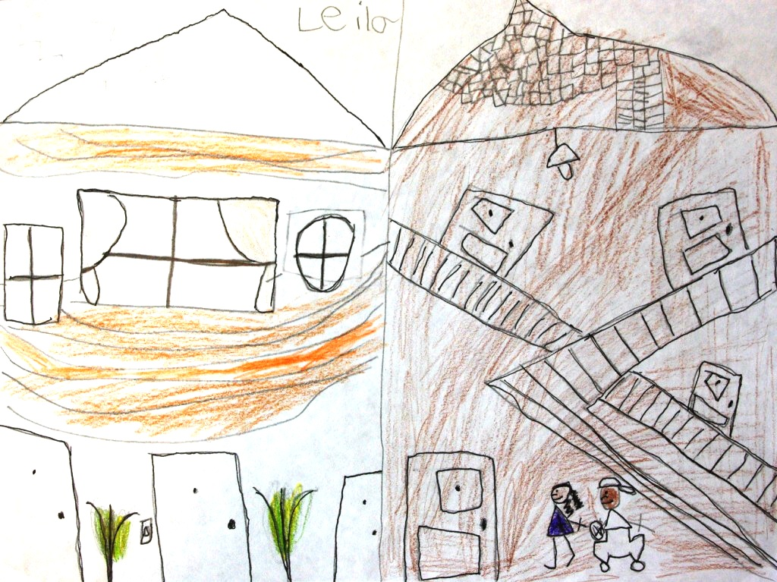
I have two favorite houses. One is my Dad’s house and two is my Mom’s house. My Mom’s and my Dad’s houses. Both houses are really swell. My Dad gets candy sours and my Mom has a Wii. I love to play Wii Sport Resort.
By Leila

Slide 21
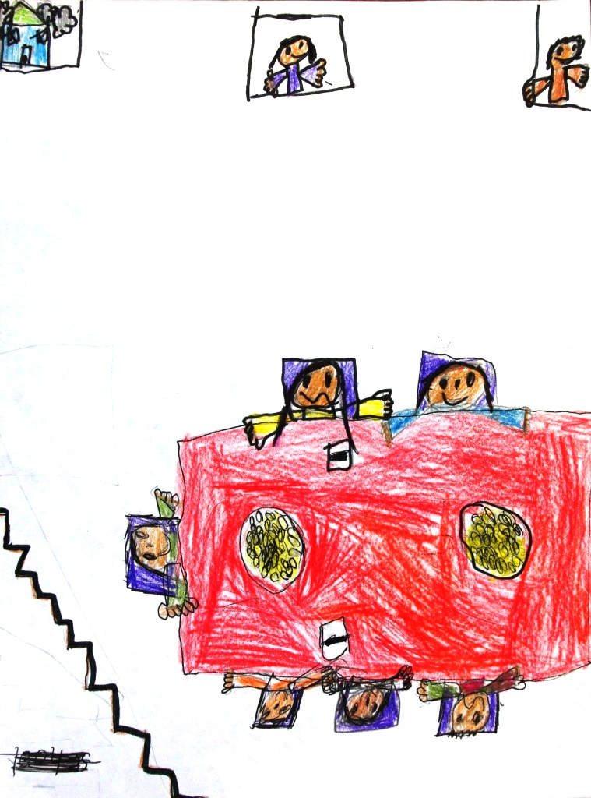
When I ate dinner I went down stairs and I saw rice and white sauce and it was very good. I kept on eating and eating and it was special for me because we got together and the food tasted good. I like it when we talk at the table. I like it when my Mom and my Grandma cook food for us.
By Lina

Slide 22
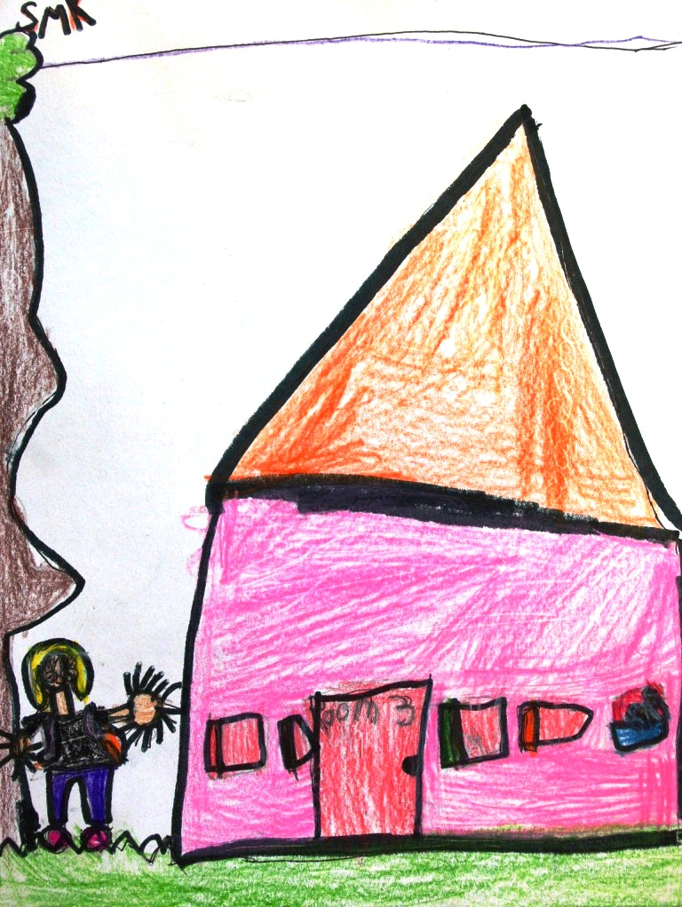
“I go to school. School is fun”, I said. “What will I do today?” I said. “I will read,” I said. I ate lunch at school. I love school. I love school because we read. That’s why I love school.
By Shayla

Slide 23
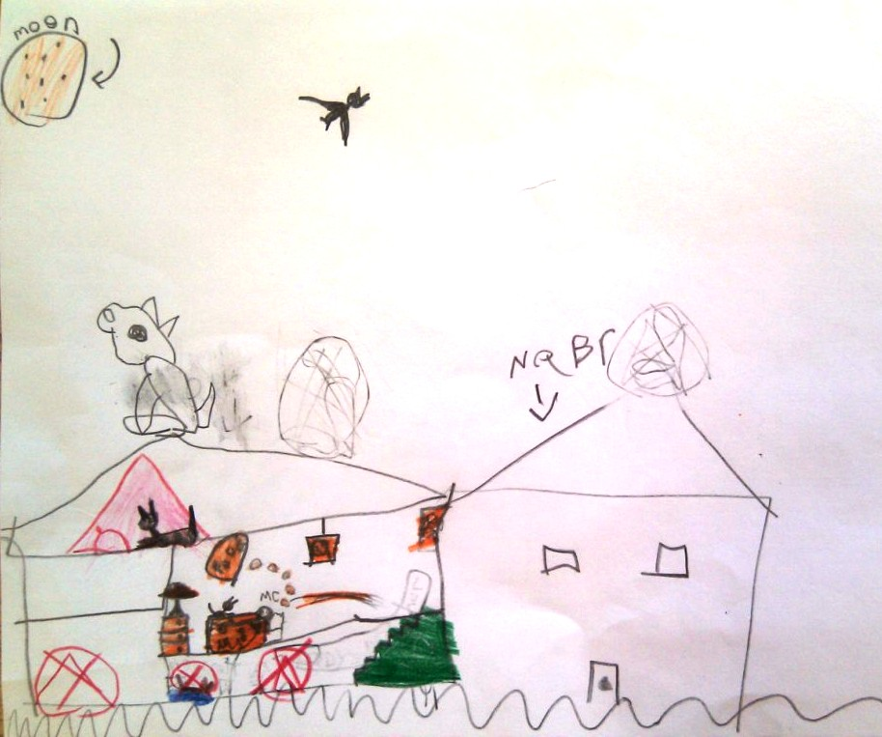
It was a crazy day at my real special place—my bedroom. I love to sleep in there with my cat Jorgin. I love her. She can open kitchen drawers. It makes my room more special since Jorgin loves to be there.
By Jessica

Slide 24
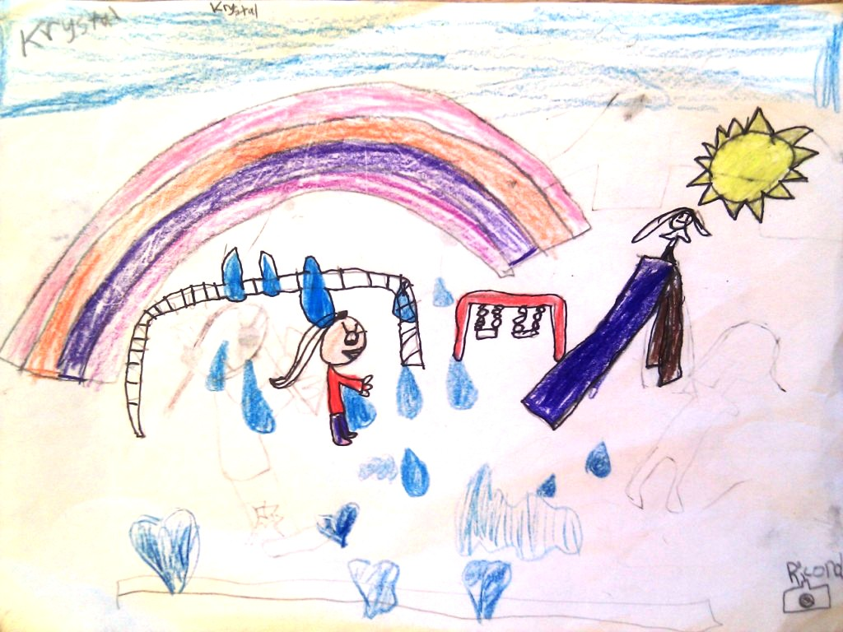
My special place is Dragon Park. One day we stayed until my dad called my mom. We had to go home. We played at home. Then we went inside. We didn’t know what to do. When it got sunny we went outside and played in the backyard. Dragon Park was special, though, because it had big swings and big monkey bars.
By Krystal

Slide 25
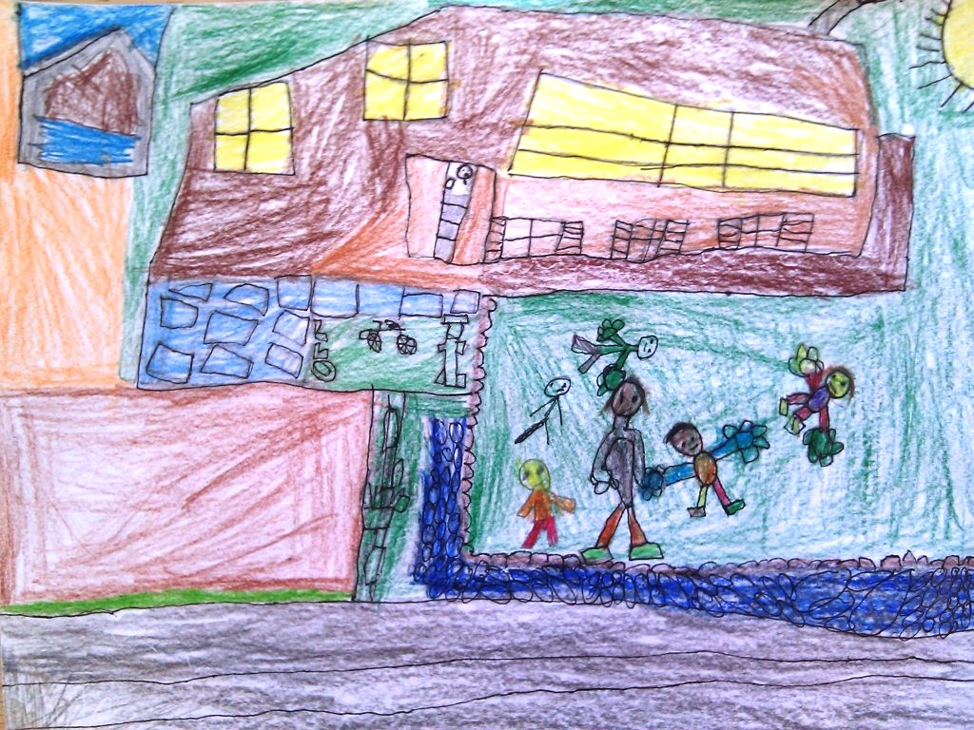
One day I was at home. When I was playing outside on the grass, my sisters were playing too. On the grass, we were having fun. I thought and thought and then I got an idea. “Let’s play in the backyard,” I said. I went to get the ball, and we played fliers up. The girls had to catch the ball, and the girls were a team. I wasn’t a team. I was alone. My special place is at home in my yard.
By Harris

Slide 26
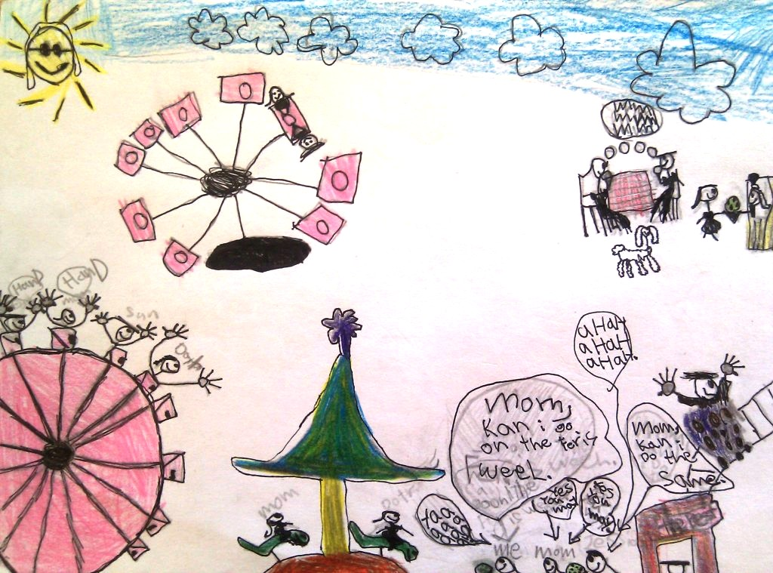
I love this carnival in the summer. It is the most fun play place. I love that place. I can’t wait to go back. The first time I went there I asked my mom where we were going. My mom said, “It is a surprise.” I was getting even happier. Finally, we got there. I said, “It is a carnival!” My mom said, “Yes it is, sweetie.” I was so happy that I never wanted to leave. I saw my friend Duncan and said hi. I had a good time. The first thing I went on was the Ferris Wheel. When I went on the Ferris Wheel, I said, “Yoww!”
By Alex

